Slide 1
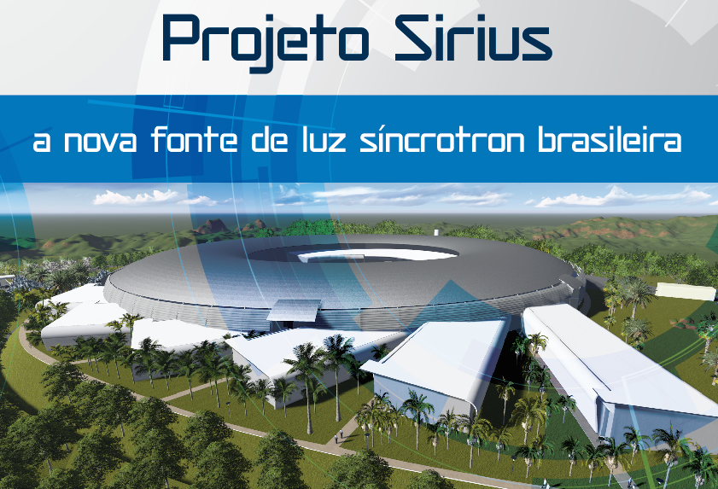
Brazilian Synchrotron Light Laboratory – LNLS: from scratch to a state-of-the-art machine in 30 years
Antonio José Roque da Silva – jose.roque@lnls.br

Slide 2
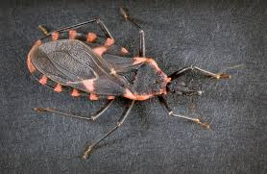
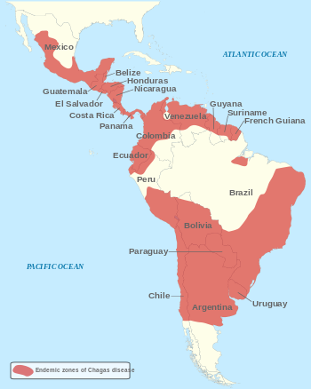
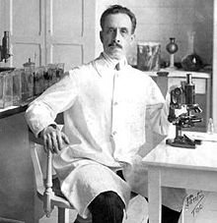
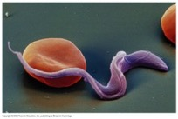
Example: Chagas’ Disease
Barbeiro
Carlos Chagas
1909
Current treatments include drugs with low efficiency in the chronic phase and with severe, harmful side effects
Trypanosoma cruzi
Affects from 8 to 10 million people in Latin America.
High social and economical cost

Slide 3
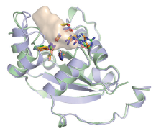
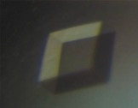
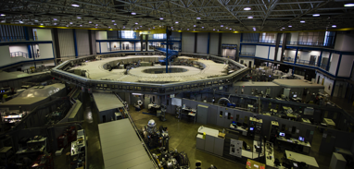
Researchers at LNBio-CNPEM and other centers in Brazil are seeking drugs that work about 10 times better than what is commercially available
Goal – discover and elucidate the molecular mechanism of novel and more selective and efficient drugs (inhibitors)
Target – Trypanosomatid Kinases
In order to efficiently find the inhibitors, one needs to know the atomic structure of the kinase
Kinase
Crystal of kinase proteins
M. Murakami (LNBio) et al.

Slide 4
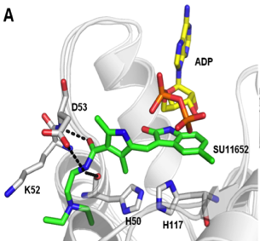
Researchers at LNBio-CNPEM and other centers in Brazil are seeking drugs that work about 10 times better than what is commercially available
Goal – discover and elucidate the molecular mechanism of novel and more selective and efficient drugs (inhibitors)
Target – Trypanosomatid Kinases
In order to efficiently find the inhibitors, one needs to know the atomic structure of the kinase
Kinase
Search for inhibitors
Atomic Structure
M. Murakami (LNBio) et al.
M. Murakami (LNBio) et al.

Slide 5
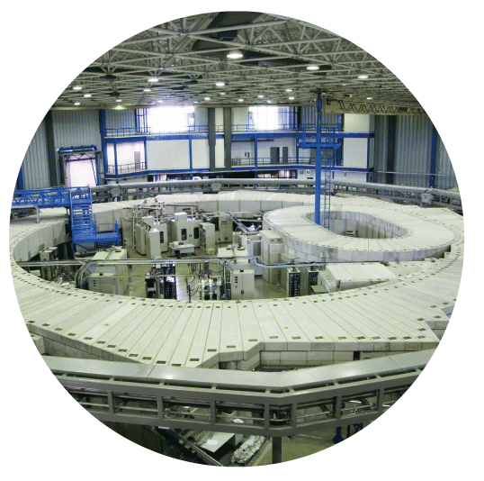
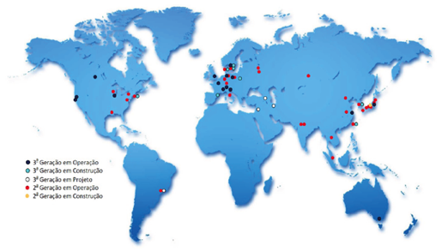
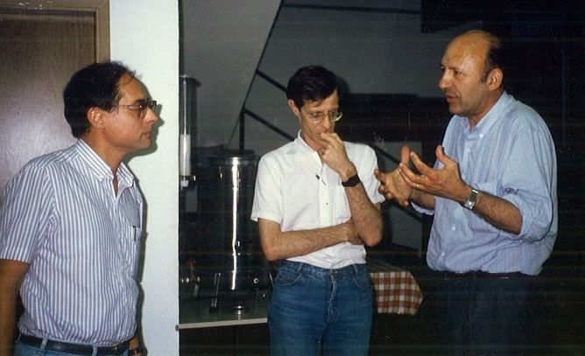
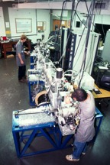
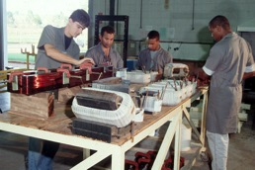
LNLS – A pioneer lab in Brazil
First synchrotron light source in the southern hemisphere
Still the only one in Latin America
Built between 1987-1997
Around 85% built in house

Slide 6
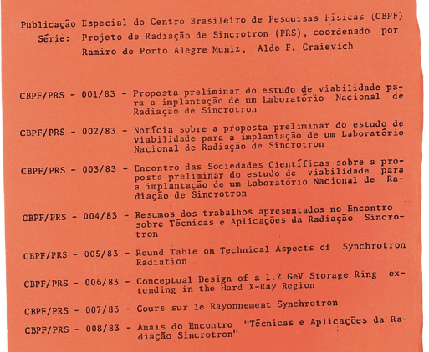
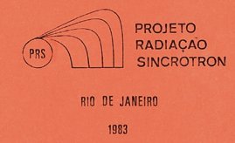
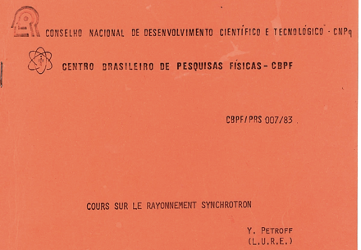
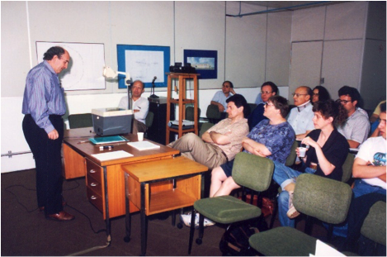

Slide 7
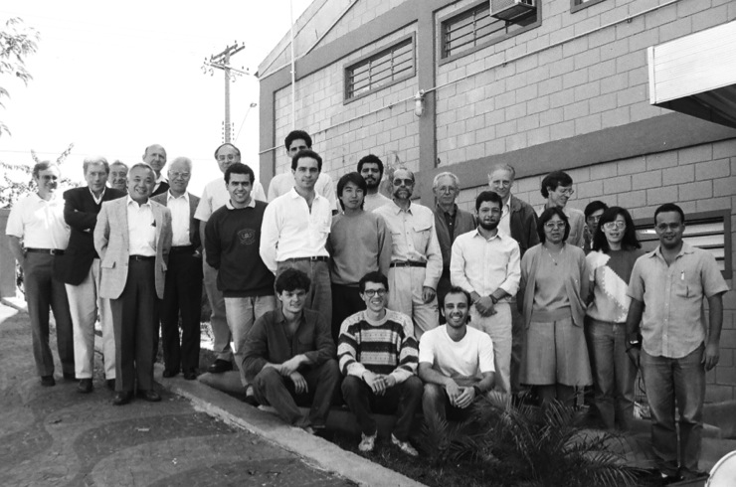
Human Resources
- Lack of personnel with knowledge in accelerator engineering and scientific instrumentation
- The solution was to hire young people, most seeking for their first job, and train them in a “hands on” approach
Roberto Medeiros
26/July/1991
Some of the young people that built LNLS - 2º meeting of the International Advisory Committee

Slide 8
Training also the users
In the early 80’s, there were around 10 people in Brazil who new/used synchrotron radiation
LNLS has been doing a continuous effort, since the very beginning, to form and train users through schools, workshops, sending people abroad, etc.

Slide 9
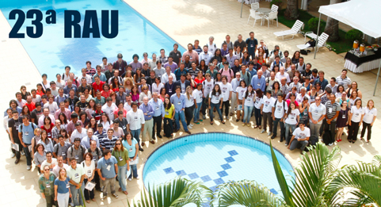

Slide 10
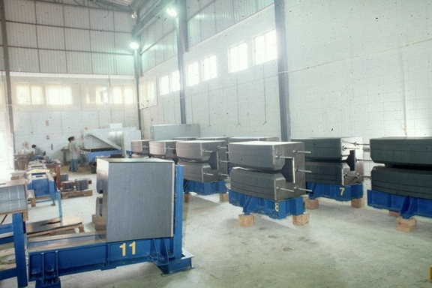
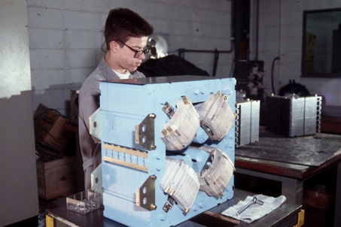
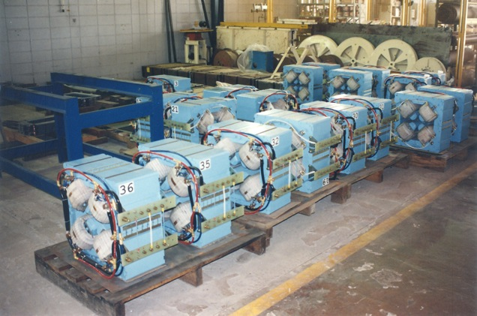
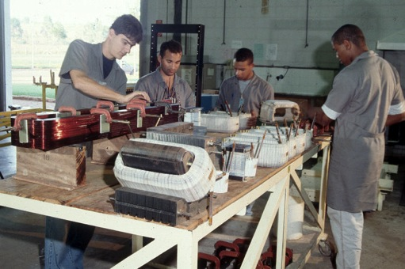
1993-1995
Magnets production
Luis Câmara
Luis Câmara
Nelson Chinaglia
Luis Câmara

Slide 11
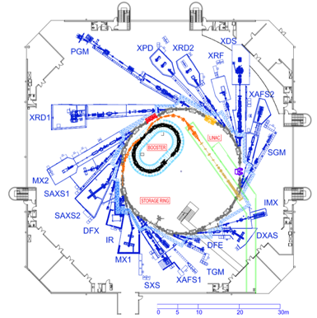
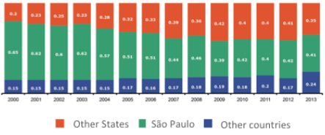
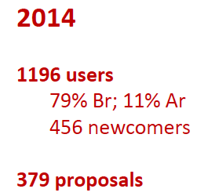
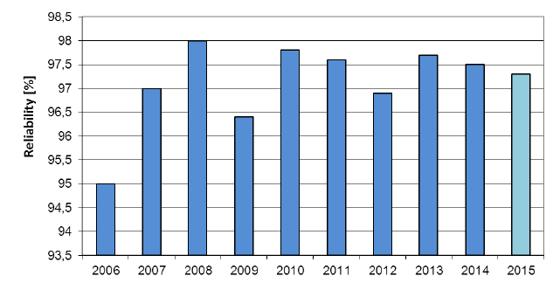
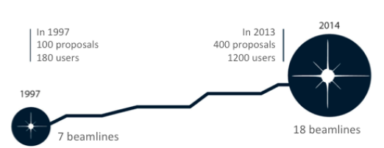
UVX
~40% SP
~40% OTHER STATES
~20% OTHER COUNTRIES
18 experimental stations

Slide 12
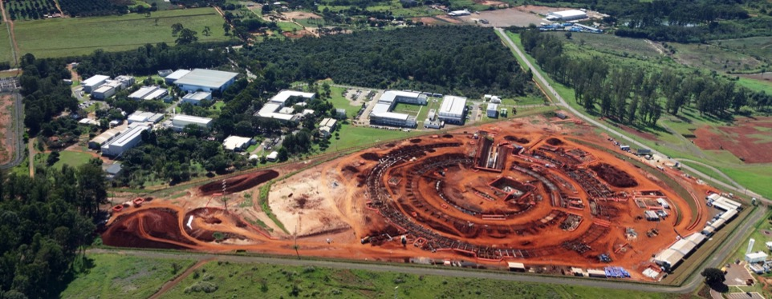
CNPEM is a private nonprofit organization working under contract with the Brazilian Ministry of Science, Technology, and Innovation
LNNano
LNLS
CTBE
LNBio

Slide 13
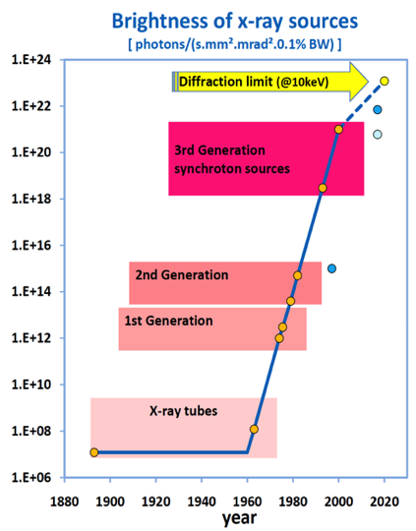
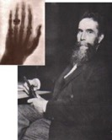
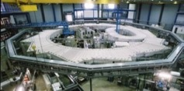
Brightness evolution of X-ray sources
2ª Generation Machine
High emittance – Low brightness
Low energy (1.37 GeV)
UVX

Slide 14
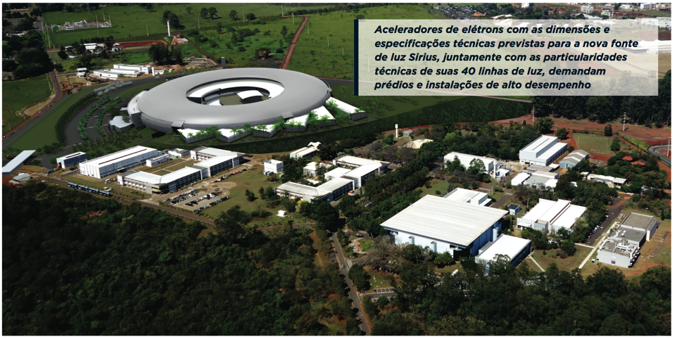
Sirius
Sirius The new Brazilian Synchrotron Light Source

Slide 15
Timeline
2008 – Proposal to prepare a conceptual design of a new light source in presented to MCTI
2006 – Recommendation, in the 2006-2009 Strategic Plan of ABTLuS, that a task force should be created in LNLS to study a new, low emittance light source
2003 – In the 13th User Meeting, the users discussed the need to start studying the possibility of a new, more competitive, light source

Slide 16
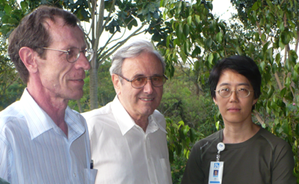
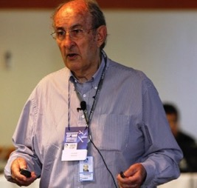
2009
1st Workshop LNLS-2: Scientific Cases
10 and 11 of February
2nd Workshop New Source: Scientific Case
27 and 28 of August
Many internal meetings to define the conceptual project

Slide 17
Timeline
2008-2012 – Developed the CDR, prototypes, scientific case, etc.
2012 - Project was mature enough to be presented to an International Committee – MAC (Machine Advisory Committee) – 18 to 20 of June
2008 – Proposal to prepare a conceptual design of a new light source in presented to MCTI
2006 – Recommendation, in the 2006-2009 Strategic Plan of ABTLuS, that a task force should be created in LNLS to study a new, low emittance light source
2003 – In the 13th User Meeting, the users discussed the need to start studying the possibility of a new, more competitive, light source

Slide 18
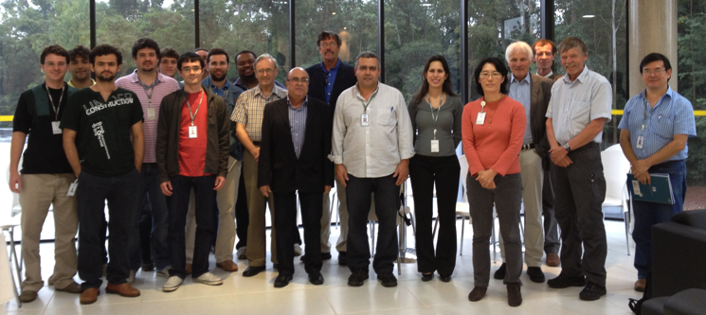
Most important MAC recommendation
The present lattice design is excellent by today’s standards, but the committee urges LNLS to push for tomorrow’s brightness standard (e.g. <1 nm emittance).

Slide 19
Most important MAC recommendation
The present lattice design is excellent by today’s standards, but the committee urges LNLS to push for tomorrow’s brightness standard (e.g. <1 nm emittance).
Increase number of dipoles!
One way would be to increase the size of the machine
Expensive solution!

Slide 20
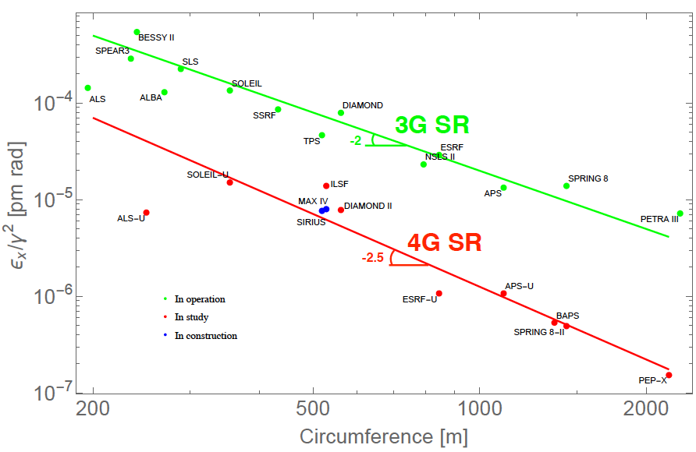
Natural emittance of some Light Sources

Slide 21
A radical turn
Sirius presented to the Machine Advisory Committee meeting in June 2012:
Emittance: 1.7 nm.rad
3-Bend Achromat, 480m circumference
MAC recommendation:
Go for a sub-nanometer.radian emittance
Sirius four months after 2012 MAC recommendation
MBA Design
Emittance: 0.28 nm.rad
7-m SS
5-Bend Achromat, 518m circumference
6-m SS
Emittance of UVX = 100 nm.rad
Ricardo Rodrigues

Slide 22
20 5BA-cells
Low field electromagnetic dipoles (B1, B2) – 0.58 T
Permanent magnet (NdFeB) combined central dipole (BC) with a high field superbend – 3.2 T -> hard x-ray (ε_{c}=19.2 keV) dipole source
Achromatic cells and low field dipoles -> IDs help to reduce the emittance
Liu Lin

Slide 23
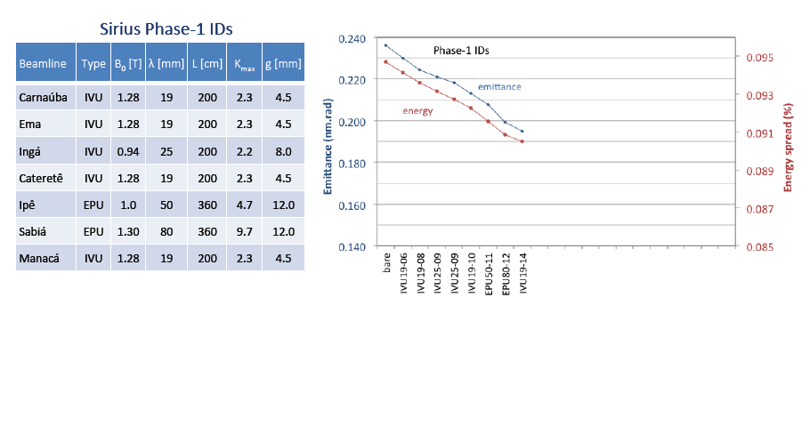
Liu Lin

Slide 24
Liu Lin

Slide 25
Natural emittance of some Light Sources
4th Generation Storage Rings
Harry Westfahl

Slide 26
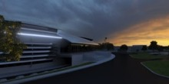
Brightness evolution of X-ray sources
Sirius
UVX

Slide 27
Multiple Bend Achromat chain reaction diagram
Many technical challenges
Much more difficult machine to build
Beamlines also extremely challenging
But a lot of fun!
Special pumping
High vacuum impedance
High resistive wall impedance
Small bore radius
Narrow vacuum chambers
Minimize RF induced instabilities
High magnetic field gradients
High amplification factors
Special injection hardware
Small clearance for injection
low lifetime
Low dynamic aperture
Tight orbit correction with fast feedback
Stable magnets, girders and floor
Stable power supplies
MBA
High orbit stability
Courtesy Ricardo Rodrigues

Slide 28
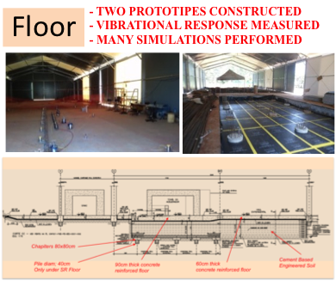
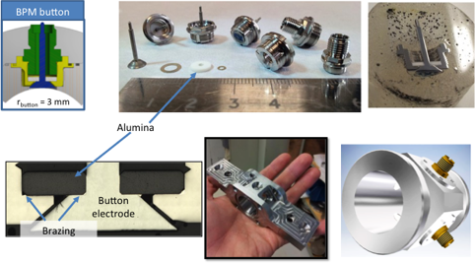
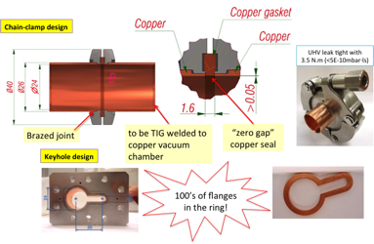
Beam position monitors
Low RF-impedance vacuum flange development

Slide 29
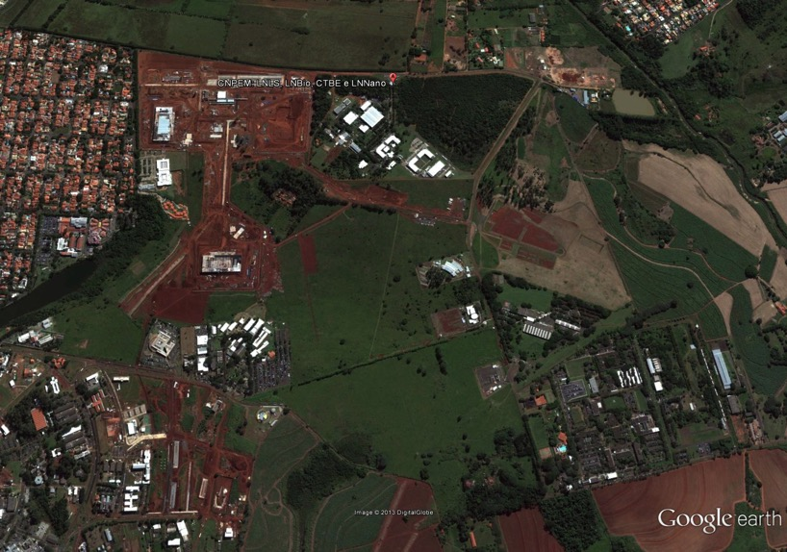
SIRIUS
@ CNPEM
CAMPUS ATUAL 380.000m²
IMPLANTAÇÃO
SÍRIUS
150.014m²

Slide 30
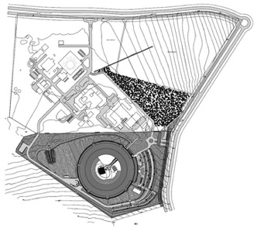
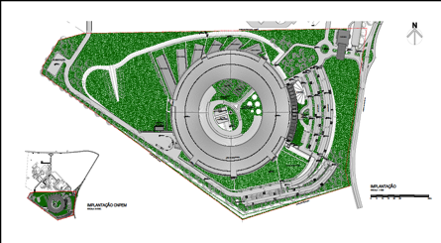
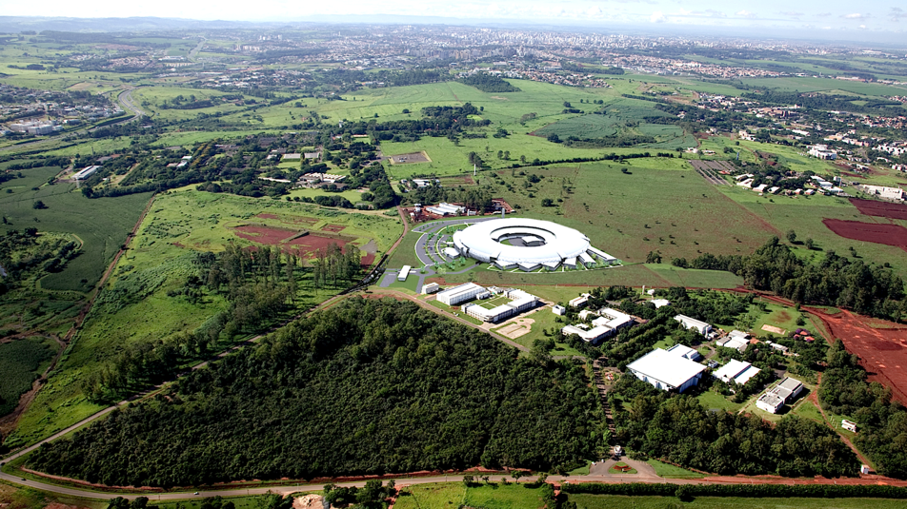

Slide 31
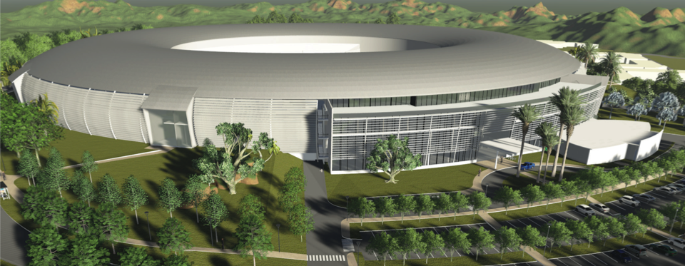
Building design and construction
Executive project concluded – 2012-2014
Total area - 68.000 m²
Special floor to minimize effects of vibration on the accelerator and beamlines

Slide 32
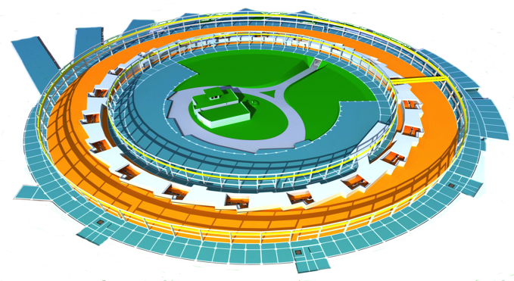
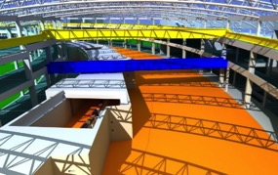
Building
Long beamlines (150 to 100 m)
LINAC (150MeV)
165 m
Aux. labs. and offices
Experimental hall
Booster (Inner wall; 0.15 to 3 GeV)
Technical area
Electrical energy
Cooling water plant
Compressed air
Air conditioning
LHe plant
RF amplifiers
Power supplies
Control room
Storage ring (3 GeV)

Slide 33
Construction started in December 2014
40 months construction – conclusion in April 2018
Important milestone: September 2017 – tunnel ready to start assembling the accelerators

Slide 34
~14%

Slide 36
Beamlines
Sirius will be able to have ~ 40 beamlines
First phase – 13 beamlines

Slide 38
Penetration of x-rays
High energy beamlines on Sirius
Maximum energy at the XDS beamline on UVX

Slide 39
Sirius - High Degree of Coherence Mammals Cells
Sirius – Very Small Beam
Nanofocus
2010
10 μm at UVX 50 nm at Sirius
2NA
δ

Slide 40
Brazilian Suppliers
Continuous interaction with many Brazilian companies in order to find developers as well as suppliers for production
WEG – magnets (Jaraguá do Sul, SC);
EXA-M – vacuum baking tapes (Salvador, BA);
Termomecânica – Cu/Ag alloy for vacuum (São Bernardo do Campo, SP) ;
Engecer – special ceramics chambers (São Carlos, SP)
FCA Brasil – vacuum chambers (Campinas, SP)

Slide 41
Brazilian Suppliers
Continuous interaction with many Brazilian companies in order to find developers as well as suppliers for production
We put together with funding agencies (FAPESP and FINEP) a specific program designed to find these partners in a more structure way
Workshop organized in June 2013 where many developments were presented to companies
~ 50 companies participated
FAPESP/FINEP have launched (5 September 2014) a call for companies from State of São Paulo to make developments for 20 sub-projects for Sirius
e.g.: ultra high vacuum chambers, fluorescence monitors, girders, Photon Beam Position Monitors electronics, micro-focalization devices, KB focusing systems, detectors, gamma and photon shutters, etc.
In July 8th 2015 the approved proposals were announced at the FAPESP
A total of eight companies were selected to develop 13 products.
In August 27th 2015 a new similar second call was launched for 13 new developments.

Slide 42
Machine Installation
Beamline Installation
Building Construction Start
Building Complete
2012
2013
2014
2015
2016
2017
2018
2019
2020
Timeline
100 mA
20 mA
350 mA

Slide 43
Conclusion
Synchrotron Science in Brazil (Latin America) has been built from ground up and reached a mature level to jump into a more competitive scenario
Sirius is planned to be one of the best machines in the world

Slide 44
A system is as good as its weakest link
Beamline optics
Accelerators
HUMAN RESOURCES!
USERS
Detectors
Experimental Stations

Slide 45
Conclusion
Synchrotron Science in Brazil (Latin America) has been built from ground up and reached a mature level to jump into a more competitive scenario
Sirius is planned to be one of the best machines in the world
The science done by the users will determine that

Slide 46
Thank you

