Slide 1
Outline of “Policy” Session and the AfLS Vision
AfLS
How did we get here ?
What are we doing ?
Where are we going ?

Slide 2
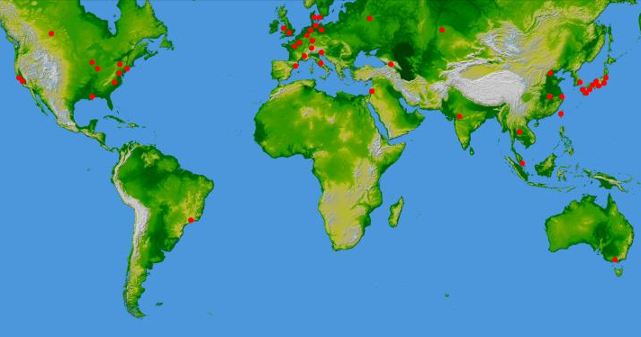
The conversation about a light source for Africa is actually well advanced and some decades old.
Africa stands out as the only habitable continent without a light source.
This is significant considering the massive proven benefit of a light source to human and infrastructure capacity building, competitive industry and the cultural enlightenment that accompanies a strong integrated science system.

Slide 3
AfLS meeting : several tasks with very concrete outcomes.
Part I
Showcase the contribution of light sources as premier tools for research, across many disciplines, and including for industry, in tackling problems that are often very pertinent to Africa.
The role of light sources in studying disease and then in drug design, including for malaria, HIV, tuberculosis and ebola.
The role of light sources in heritage studies.
Africa is the cradle of hominid evolution
Africa as the cradle of culture
Preservation
Not to mention geology, materials, industry, energy, environment ……

Slide 4
AfLS meeting : several tasks with very concrete outcomes.
Part I
Showcase the African participation in the research done at synchrotrons.
The role of light sources in studying disease and then in drug design, including for malaria, HIV, tuberculosis and ebola.
The role of light sources in heritage studies.
Africa is the cradle of hominid evolution
Africa as the cradle of culture
Preservation
Not to mention geology, materials, industry, energy, environment ……
Technology (software)
Learning to track and audit this.

Slide 5
AfLS meeting : several tasks with very concrete outcomes.
Part II
Grenoble Resolutions.
See https://docs.google.com/document/d/1gnbb_7YypwChZpiC3NkoUnkp7InL4R4lwR_bYcJbK3Y/edit?usp=sharing
Terms of Reference.
Link coming ……
Roadmap summary.
See https://docs.google.com/document/d/1gnbb_7YypwChZpiC3NkoUnkp7InL4R4lwR_bYcJbK3Y/edit?usp=sharing
Steering Committee to drive this roadmap forward.
fully mandated
globally elected
See https://docs.google.com/spreadsheets/d/1NlULgrE7Bu9t2aeiKIYd3zgFALoLbksfEFTqNC8p0q0/edit#gid=0

Slide 6
Details ? ….. Not yet.
Although we do look at costs, light source technologies, we even peek in the crystal ball to see where these may evolve, we are not yet talking about when, where and what.
Focus on what we can easily agree on now.
We are concerned with building networks, identifying partners, training, mobility, future workshops, schools and conferences and optimising the use of existing funding instruments. By degrees we will be building, on strong foundations, a massive campaign for a strong researcher user base with an aware policy-maker cohort, across Africa, and globally linked.

Slide 7
AfLS SC + ToR + Resolutions + Roadmap + (Pan Africa, Gobal) networks = ……..
Build consensus, establish pedigree, start affordably, governance, representation, transparency, inclusivity.
Details of growth can to some extent be left to future annual AfLS meetings

Slide 8
ToR : ambit of our mandate.
Full range of tasks to progress the Roadmap.
Continue to develop the Roadmap.
Organising future annual AfLS meetings
Limited Executive capacity
Some decisions to be ratified at AGM’s at the AfLS meetings
The Voice of Africa on Light Source Matters
Raising Funds
Disbursing these funds.
Accountability via AfLS AGM.
Fixed terms, Re-elections
Can co-opt members,
Spin-off sub-committees
Further develop the ToR

Slide 9
AfLS meeting : outcomes so far.
Part I – Showcase African participation and potential
User base is bigger and stronger than originally perceived.
Industry already engaged (SASOL)
Paleo- with a huge African footprint
Bio- already onto African diseases
Materials …. Experienced Users
Beginnings of a local infrastructure in some countries.
Synergies with SKA in IT support
Potential for growth based on the Userbase of feeder instrumentation

Slide 10
AfLS meeting : outcomes so far.
Associated outcomes
Starting to survey existing Funding Instruments to support Access and Training.
LS Facilities / partners identified which welcome the AfLS programme
Stakeholder Organisations / partners partners identified which welcome the AfLS programme
MOOCs

