Slide 1



Light Sources for Materials and the AfLS context
S.J.L. Billinge
CMPMS, Brookhaven National Laboratory
Department of Applied Physics and Applied Mathematics
Columbia University,

Slide 2
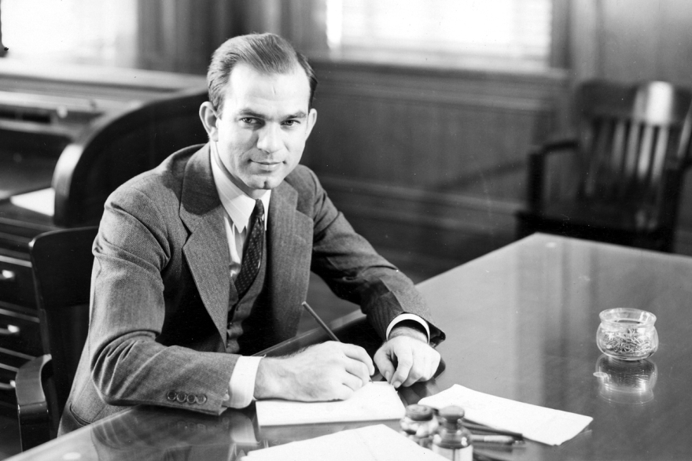
"International educational exchange is the most significant current project designed to continue the process of humanizing mankind to the point, we would hope, that men can learn to live in peace--eventually even to cooperate in constructive activities rather than compete in a mindless contest of mutual destruction....We must try to expand the boundaries of human wisdom, empathy and perception, and there is no way of doing that except through education.“
[Senator J. William Fulbright, from remarks on the occasion of the thirtieth anniversary of the Fulbright Program, 1976]

Slide 3
A synchrotron light source for Africa
Why is it important?
How would it be used?
What would it deliver?
What would it be used for?
Who would use it?
How can we get there?

Slide 4
Why is it important?
Macro and micro challenges facing mankind:
  Energy security
  Food security
  Water security
  Environmental security
  Economic security
  Political and judicial security
  Basic freedoms to pursue happiness
Some have technological solutions, all require education, cooperation and the victory of rationality over irrationality
A facility like a synchrotron promotes cooperation, education, technology, and science
The impacts of a synchrotron go way beyond the x-rays it produces

Slide 5
Why do I say that?
How is a synchrotron used?:
  It is a large-scale centralized scientific facility. It requires international cooperation to build and run it
  But it is used by individual scientists bringing small-scale samples from their labs.
    The synchrotron supports thousands of users in any given year
    Typical experiments last a few days and take place 1-2 times per year
It is a focal point for a scientific community
  A diaspora of scientific users meet each other and overlap at the synchrotron when they do experiments, forming a geographically diverse community
It is inclusive, not exclusive
  Materials scientists, earth scientists, biologists, chemists, physicists, conservation scientists, paleontologists, pharmaceutical scientists, polymer scientists, and so on and so forth
All Materials are made of atoms, synchrotrons allow us to study atoms

Slide 6
What would it deliver?
Science (we have heard about this already this week)
Technology (we have heard about this too)
A focal point for a LARGE and diverse community of scientists across Africa
  Education for that community
  Inspiration & a sense of pride for that community
  World class facilities for that community
  A high profile international stage for the science coming from that community
The synchrotron will be built in one place, but it will be used by people from across Africa to solve problems all across Africa

Slide 7

What would it deliver?
Computer science => The Internet of Things (IoT)
Synchrotron Science => The science of things (SoT)

Slide 8
Nanoscience
How can we characterize material structure when they are nano-structured?

Slide 9
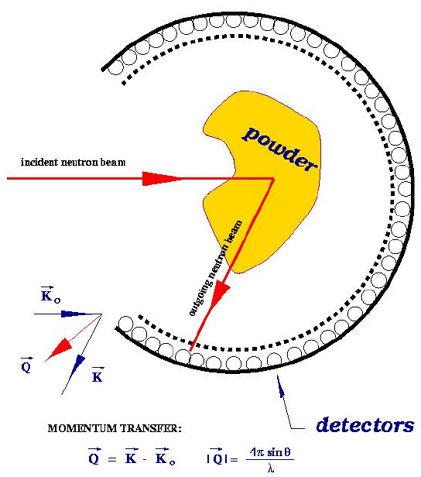
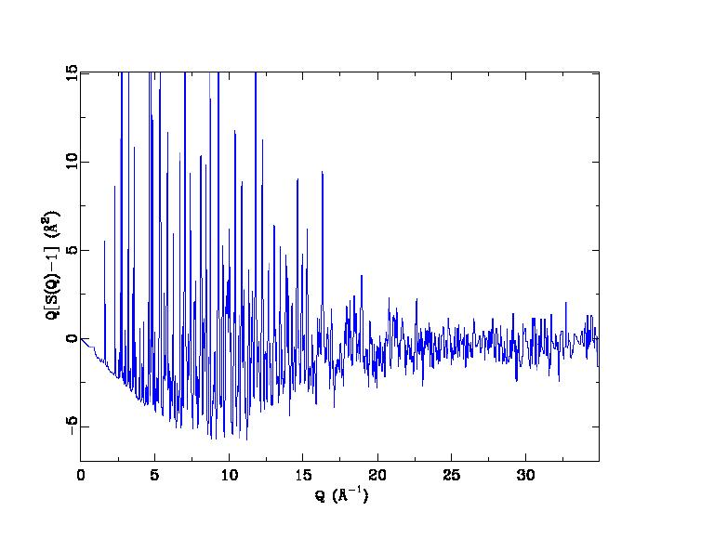
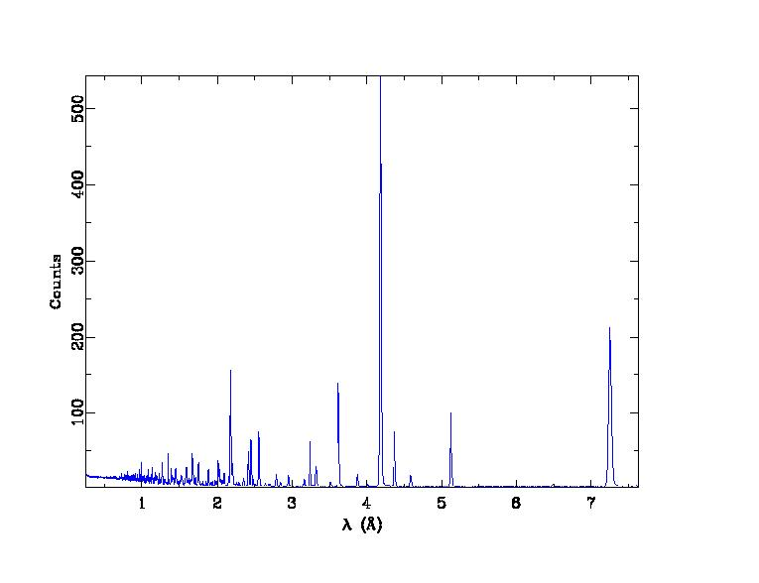
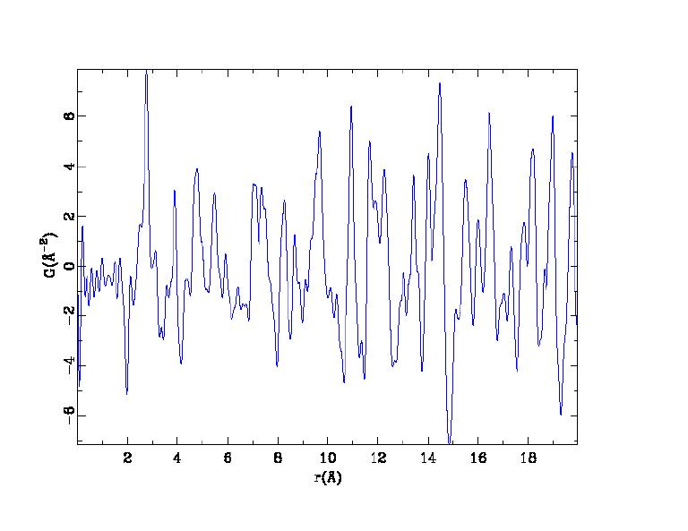
The atomic Pair Distribution Function
Structure function
Raw data
PDF

Slide 10
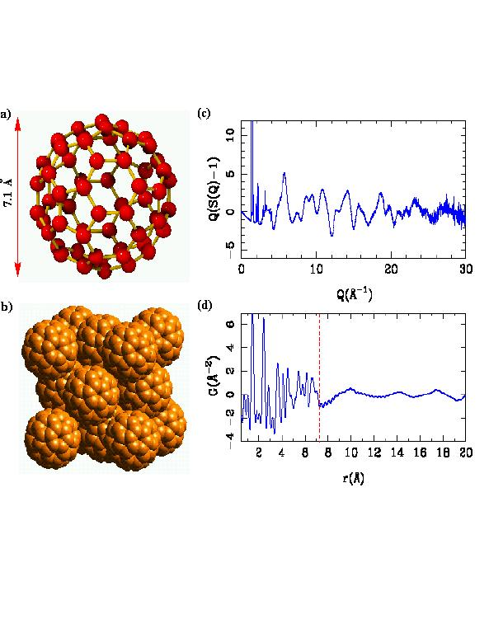
What is the PDF?
Sit on an atom and look at your neighborhood
G(r) gives the probability of finding a neighbor at a distance r
PDF is experimentally accessible
PDF gives the local structure

Slide 11
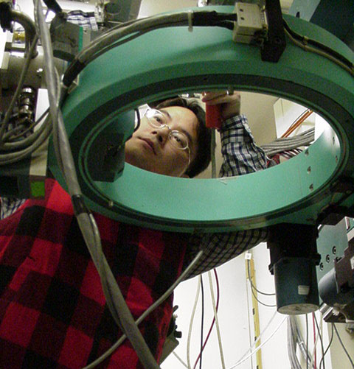
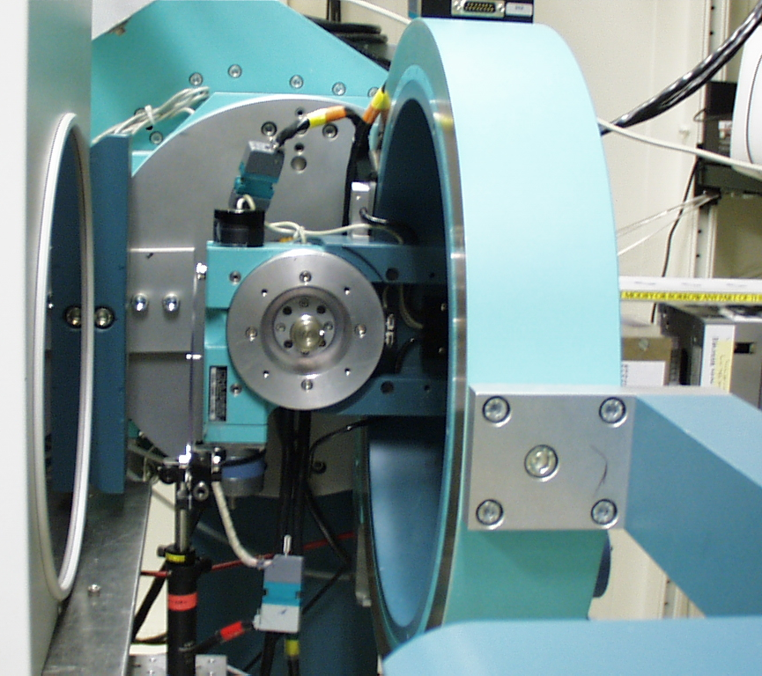
The Atomic Pair Distribution Function (PDF) Method
Use modern high intensity x-ray and neutron sources to collect unprecedentedly precise data
Utilize all the information: Bragg and diffuse scattering
Use modern computing capabilities to analyze, model and visualize the data
Chupas et al., J. Appl. Crystallogr. (2003)
Billinge-group, BNL, SUNY-SB, APS collaboration
Main developments thanks to Pete Chupas and Xiangyun Qiu

Slide 12
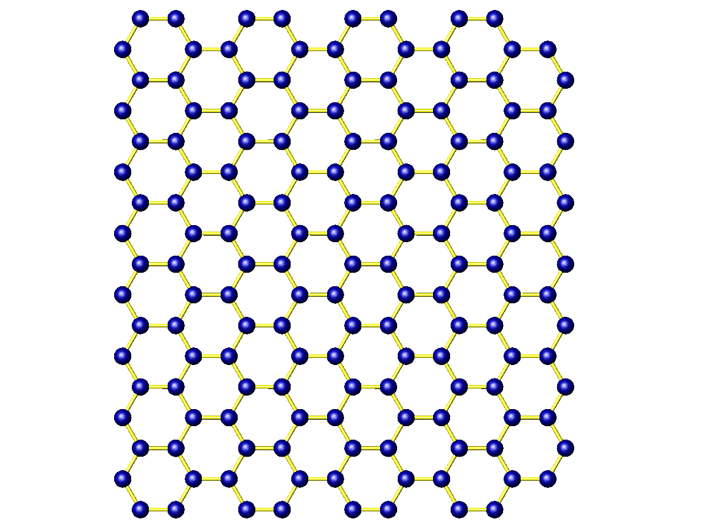
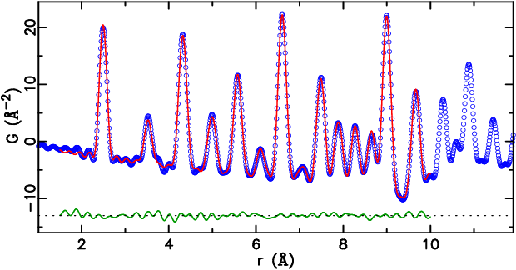
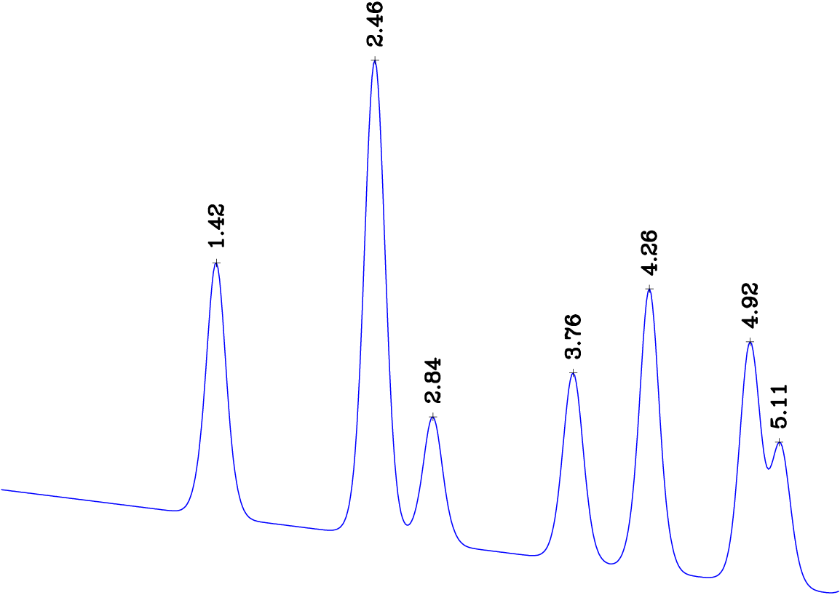
Nanostructure refinement
4.26Å
Pair distribution function (PDF) gives the probability of finding an atom at a distance “r” from a given atom.
2.84Å
1.42Å
2.46Å
3.76Å
4.92Å
5.11Å
5

Slide 13
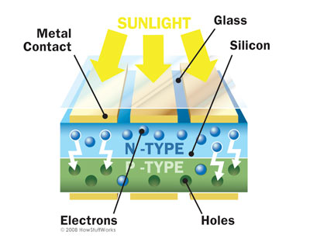
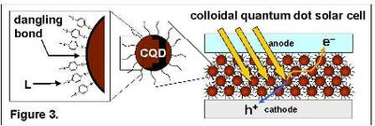
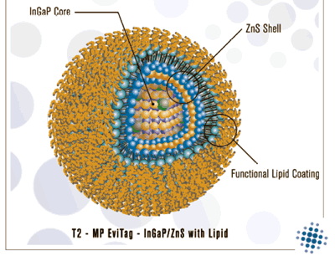
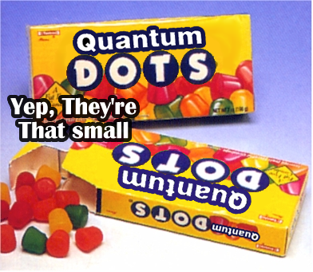
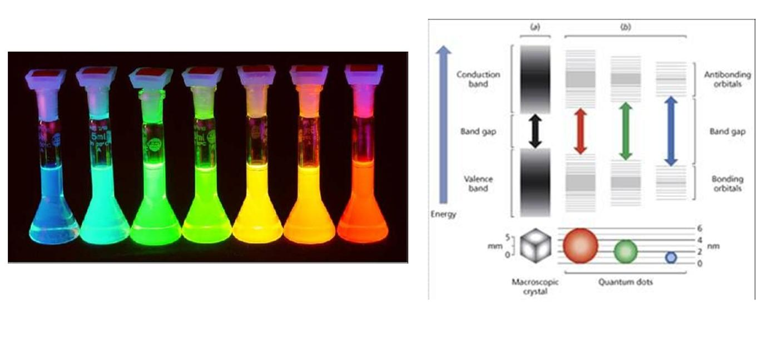
Quantum Dot solar cells

Slide 14
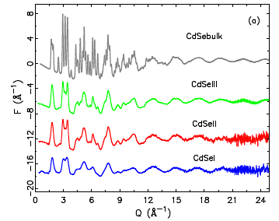
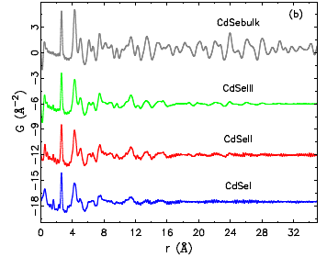
CdSe quantum dots
RAPDF experiments at APS, Sector 6
Work of grad student Ahmad Masadeh
Masadeh, SJB et al. PRB 76, 115413 (2007)

Slide 15
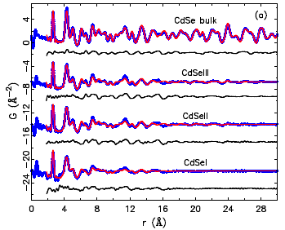
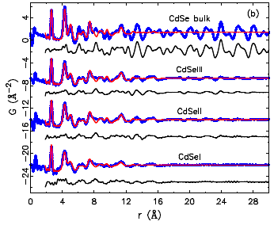
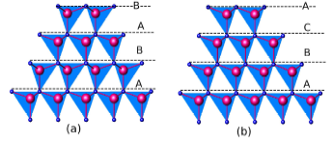
Structure of the CdSe core
Wurtzite structure
Zinc blende structure

Slide 16
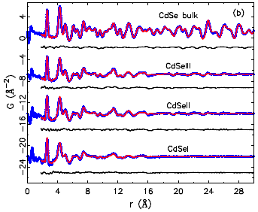
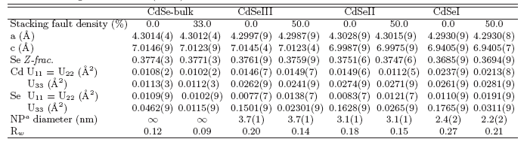
Masadeh, SJB et al. PRB 76, 115413 (2007)
Thanks to Reinhard Neder for help with stacking fault models

Slide 17
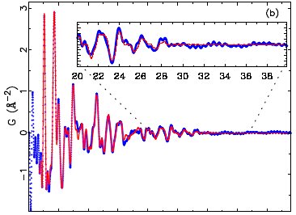

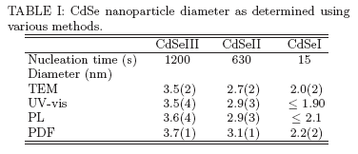
Size of the structural core
Masadeh, SJB et al. PRB 76, 115413 (2007)
Also see Shamoto paper, JAC 2007

Slide 18
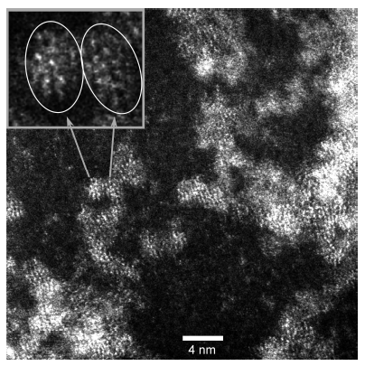
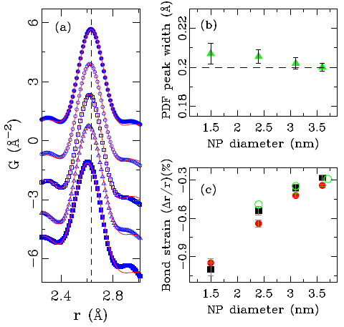
White Light Nanoparticles
Samples are from Sandy Rosenthal (Vanderbilt)

Slide 19
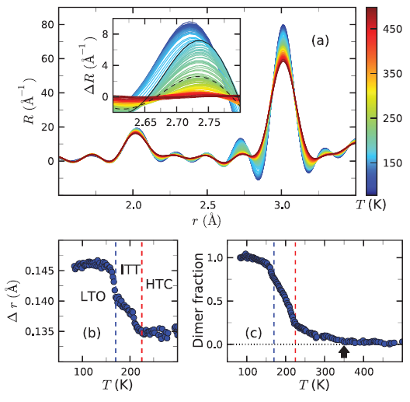
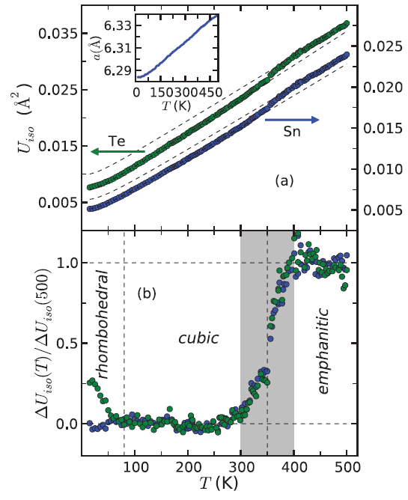
Thermoelectric materials
Evolution of Ir dimers vs T in Li₂RhO₄
Knox, Bozin, sjlb et al, PRB 13
Evolution of anharmonicity/off centering in SnTe
Knox, Bozin, SJLB et al PRB 14

Slide 20
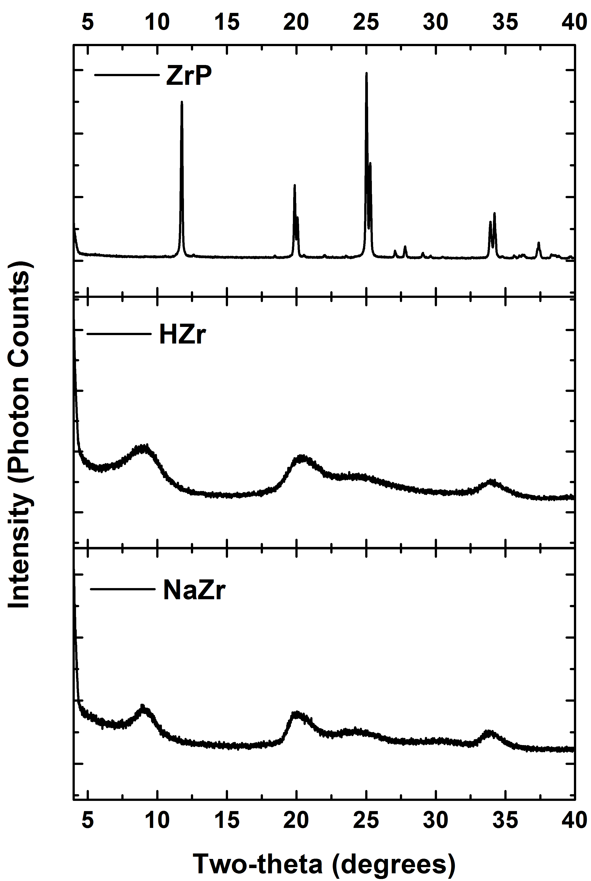
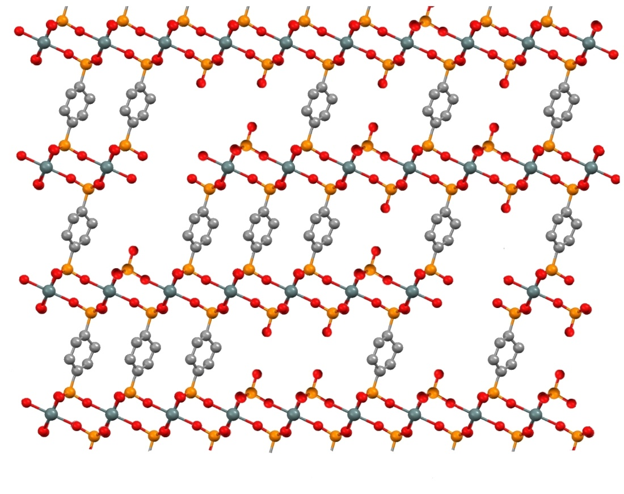
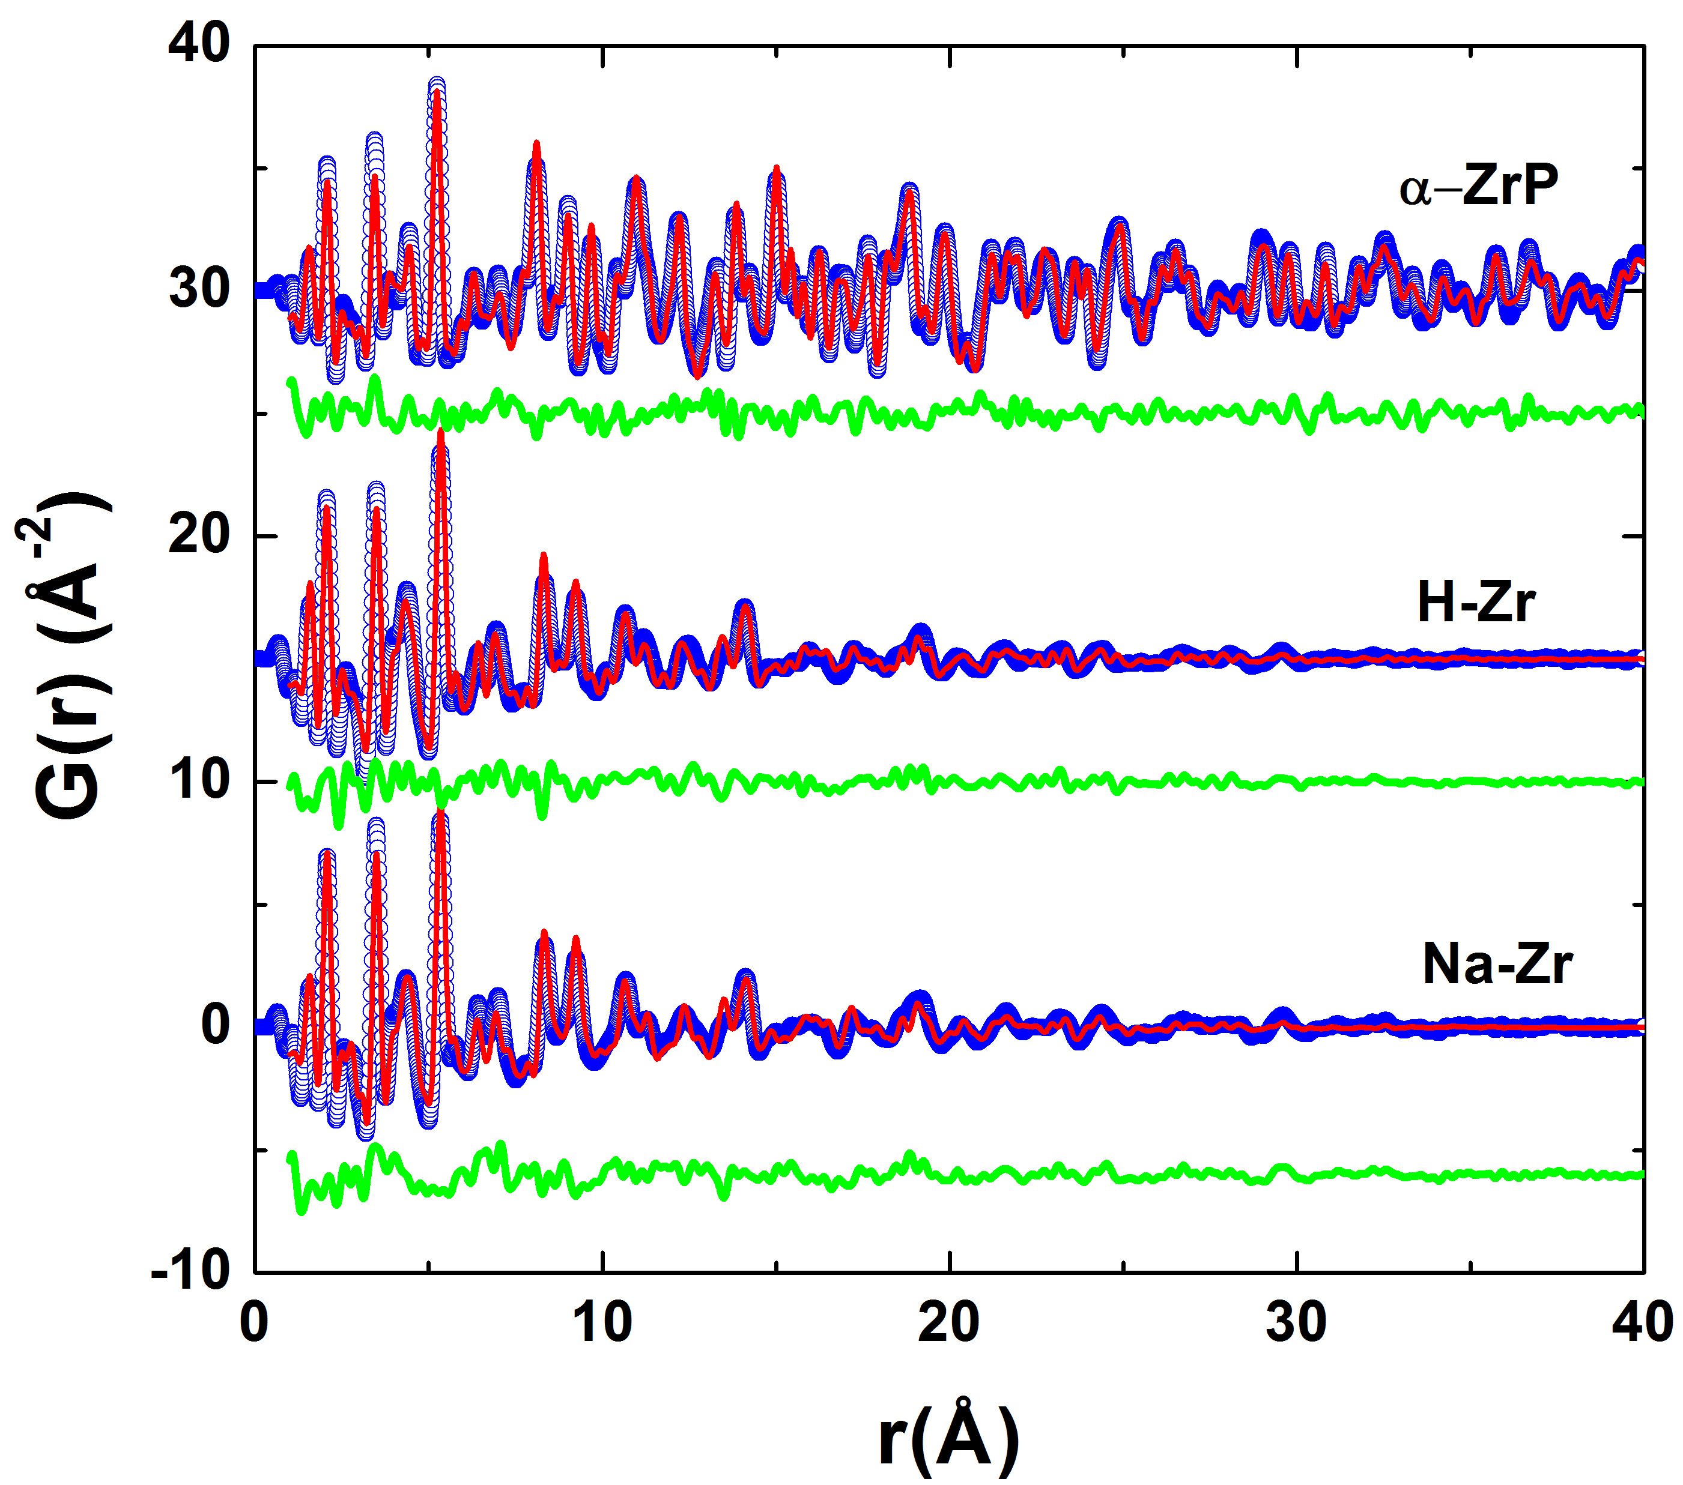
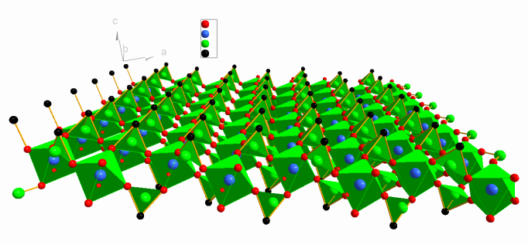
Materials for chemical separations

Slide 21
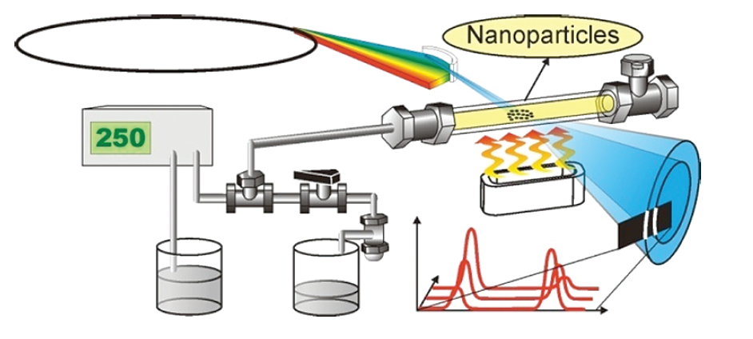
High throughput allows studies of in-situ synthesis
We can see precursor species in solution
We can measure Nanoparticle structural parameters
High energy x-rays can penetrate relatively thick walled vessels
=> Let’s do in-situ studies of synthesis
Rich collaboration with the group of Bo Iversen (Aarhus)
Image credit Christoffer Tyrsted

Slide 22

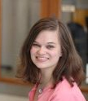

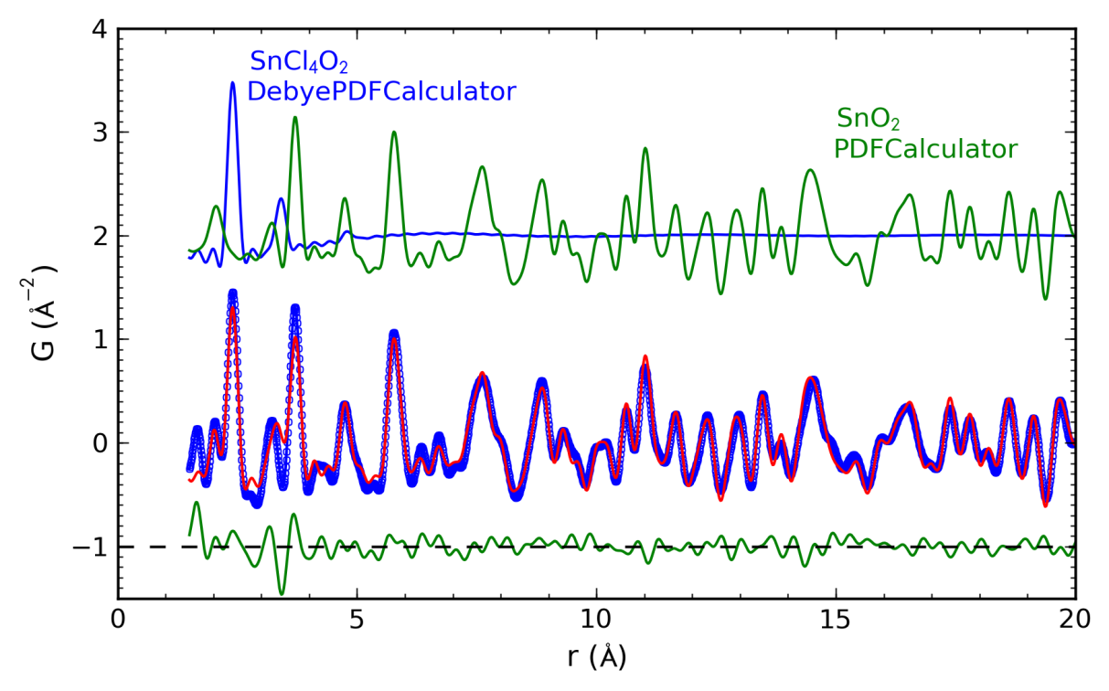
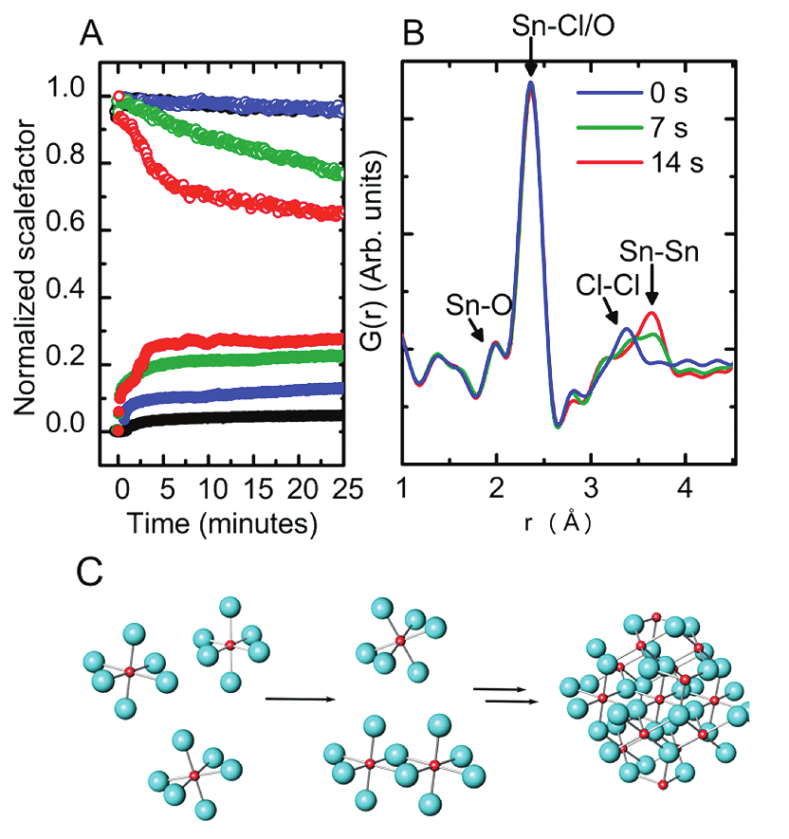
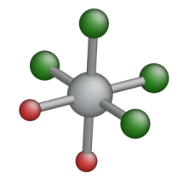
PDF analysis of in situ SnO₂ formation
in-situ studies of SnO₂ formation during hydrothermal synthesis,
PDF measured every 7 seconds at an synchrotron x-ray source
measured PDFs were fitted as a two-phase mixture of SnCl₄.2H₂O molecules and SnO₂ crystallites
time dependence of the precursor-target ratios and the crystallite size
SnCl₄O₂
SnO₂
K. M. Jensen, et al., J. Am. Chem. Soc., 134, 6785 (2012)

Slide 23
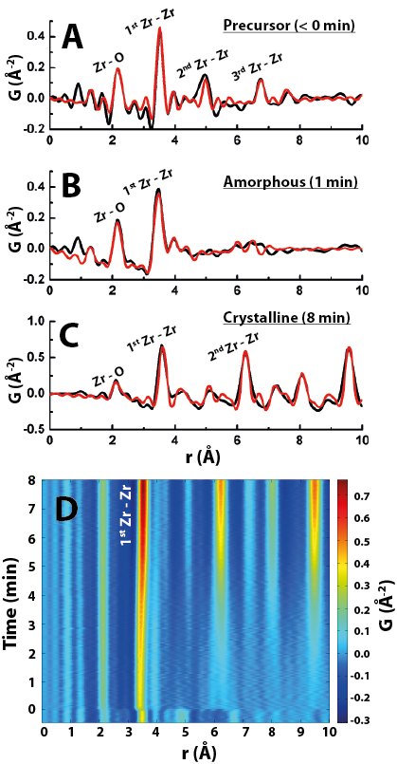
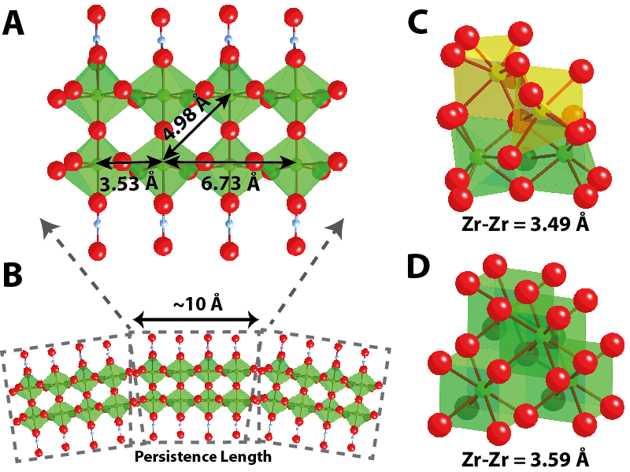
In-situ study of hydrothermal synthesis of yttria-stabilized zirconia nanoparticles
Christoffer Tyrsted¹, Nina Lock^{1,2}, Kirsten M. Ø. Jensen¹, Mogens Christensen¹, Espen D. Bøjesen¹, Hermann Emerich³, Gavin Vaughan⁴, Simon J. L. Billinge^{5,6*}, Bo B. Iversen, under review
Precursor

Slide 24
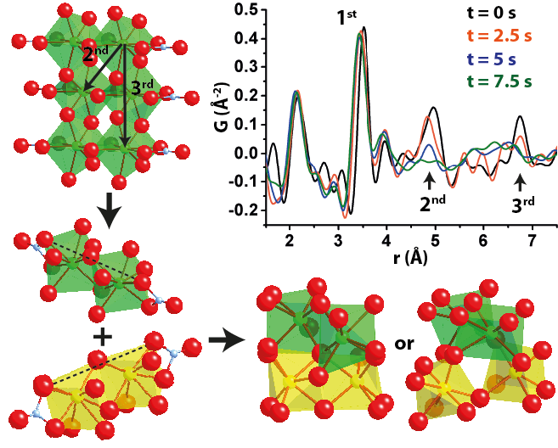
In-situ study of hydrothermal synthesis of yttria-stabilized zirconia nanoparticles
Christoffer Tyrsted¹, Nina Lock^{1,2}, Kirsten M. Ø. Jensen¹, Mogens Christensen¹, Espen D. Bøjesen¹, Hermann Emerich³, Gavin Vaughan⁴, Simon J. L. Billinge^{5,6*}, Bo B. Iversen, under review
Amorphous
intermdiate

Slide 25
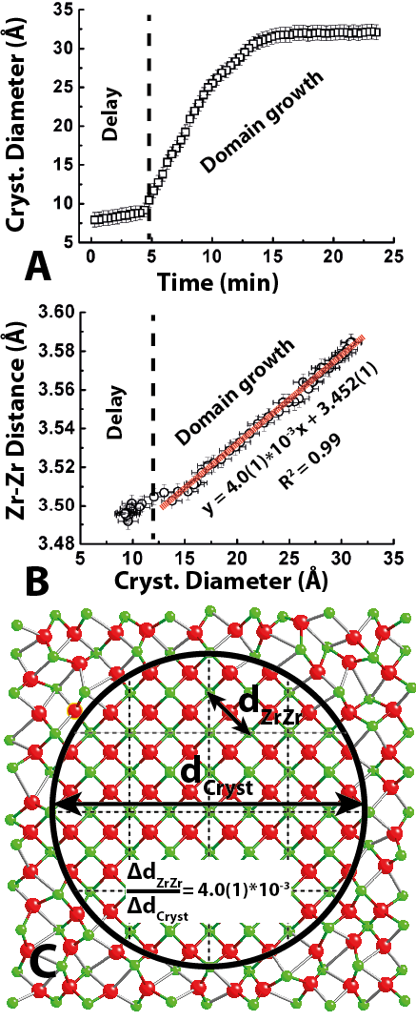
In-situ study of hydrothermal synthesis of yttria-stabilized zirconia nanoparticles
Christoffer Tyrsted¹, Nina Lock^{1,2}, Kirsten M. Ø. Jensen¹, Mogens Christensen¹, Espen D. Bøjesen¹, Hermann Emerich³, Gavin Vaughan⁴, Simon J. L. Billinge^{5,6*}, Bo B. Iversen, under review
Nanocrystalline
final product

Slide 26
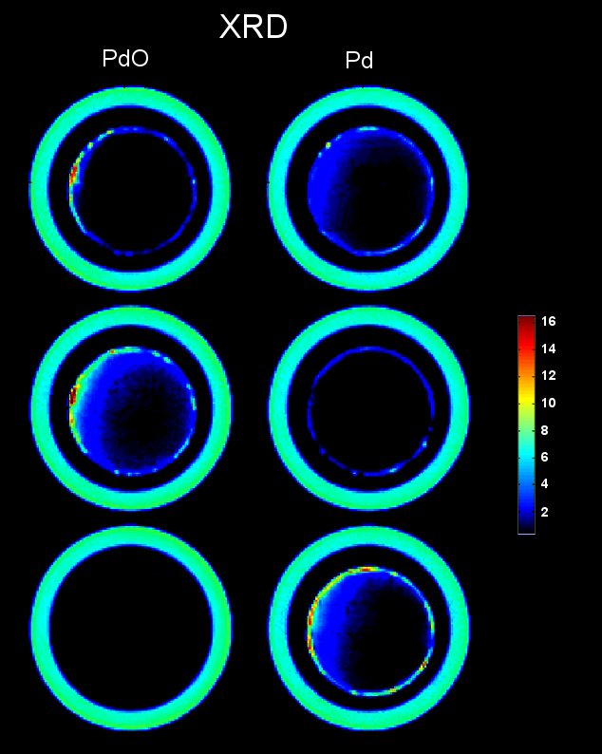
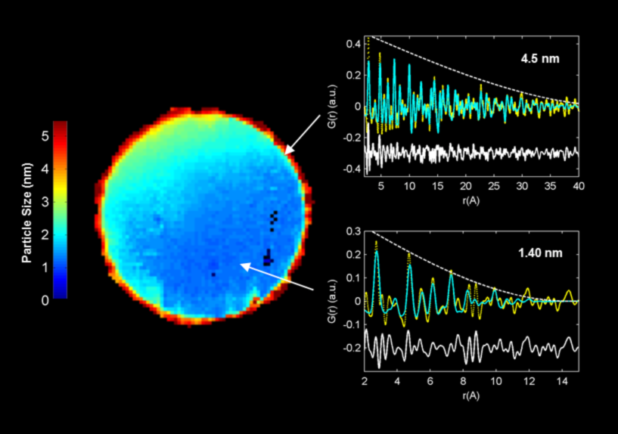
ctDPF of Catalysts
Experiments on ID15 at ESRF
Pt/PtO nanoparticle catalyst on a g-alumina support in a flow rig
Have a fully refinable PDF in every pixel of the image
Large particle size in a shell around the rim, small particle size and much lower density in the middle
=> Spatially resolved, time resolved nanostructure studies
S. D. M. Jacques, Di Michiel, SJLB et al. Nat. Commun. 4, 2536 (2013)

Slide 27
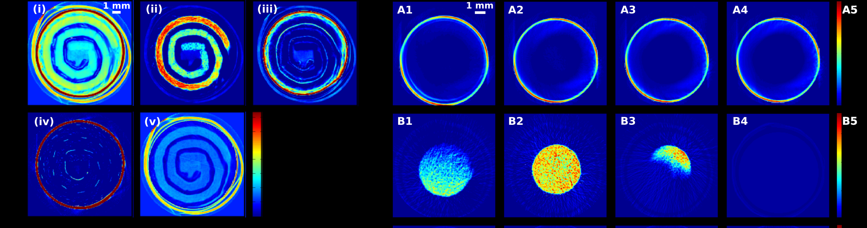
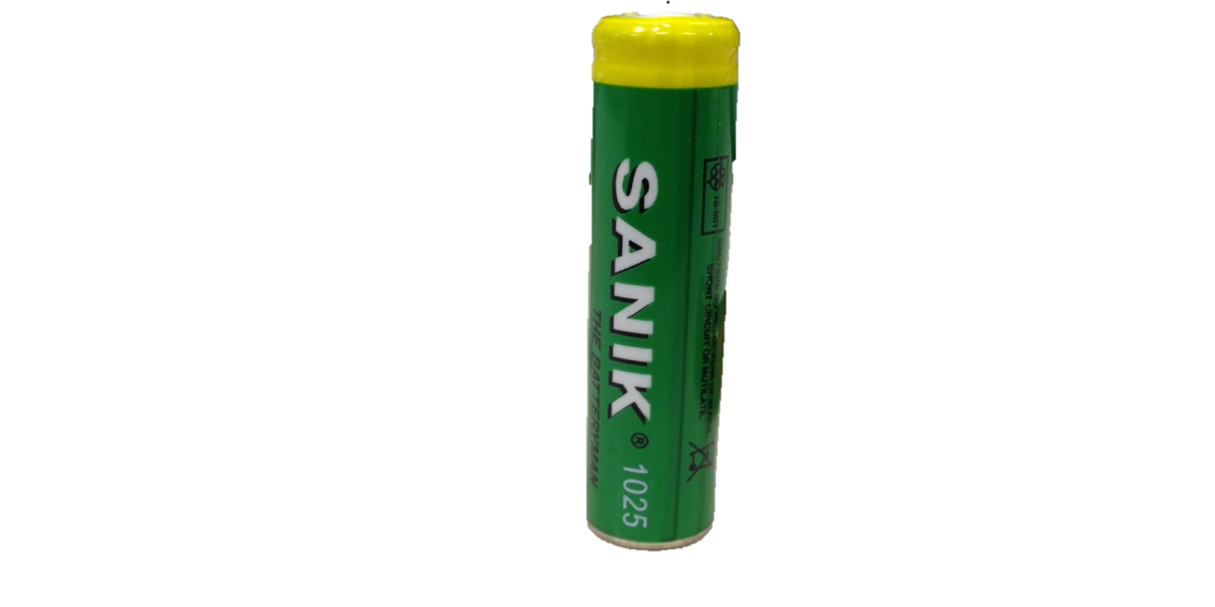
ctPDF of Battery materials
10,000 2D datasets per image, 30 mins per image
~10Tb/day
Jensen, Corr, Di Michiel, SJLB et al., J. Electrochem. Soc. (2015)

Slide 28
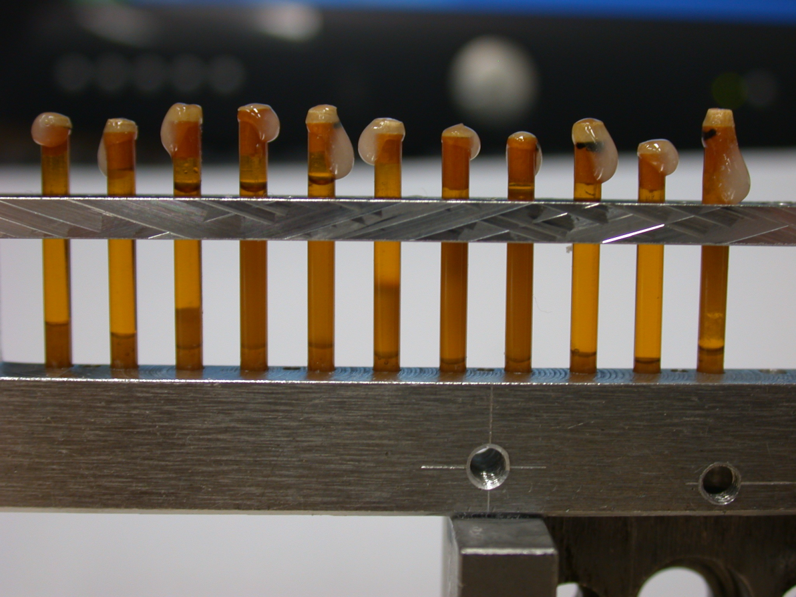
Characterizing nanoparticles of APIs in suspension
Samples were API particles of various sizes and in various concentrations in aqueous suspension
These are drugs for nebulizer applications
The goal was to characterize the structure and nanoparticle size in the different suspensions.

Slide 29
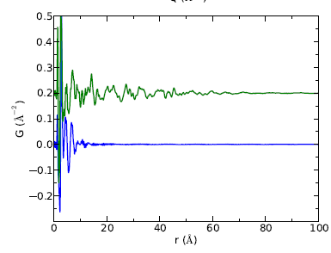
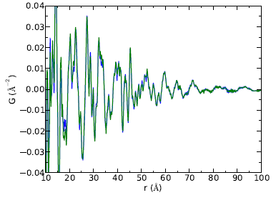
Characterizing nanoparticles of APIs in suspension
Green: PDF of the crystalline control sample
Blue: PDF of the aqueous solvent
Reproducibility!
High-r region from the crystalline control and sediment from a high concentration suspension

Slide 30
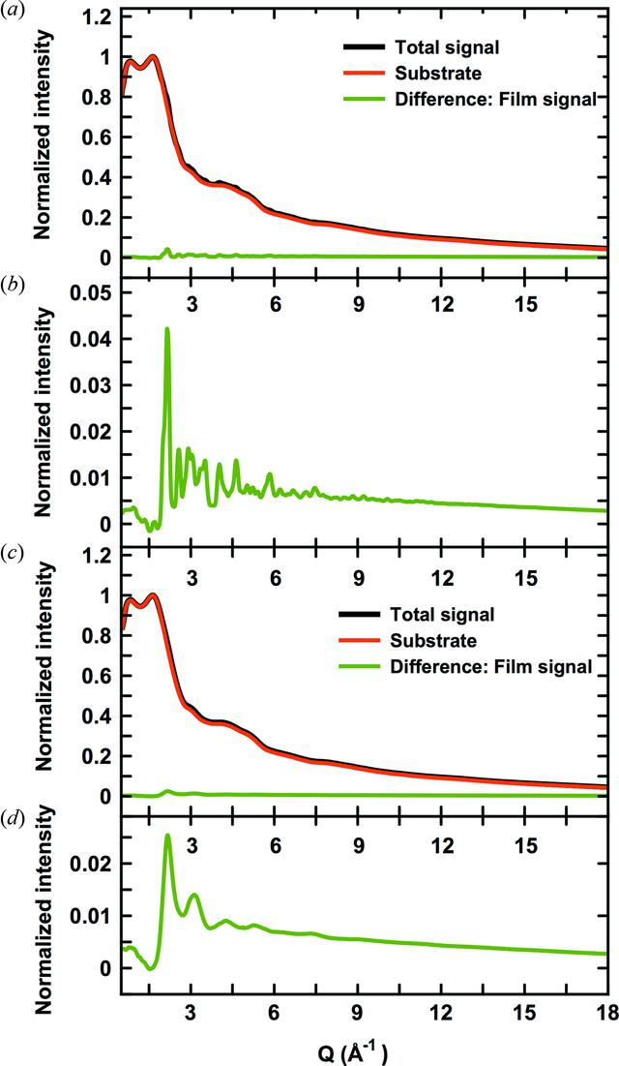


Thin film PDF at normal incidence
Jensen, Iversen, Johnson, Dooryhee SJLB et al. IUCrJ 2015

Slide 31



Recrystallization from the amorphous state: Lactose
Lactose is a common excipient for pharmaceutical tableting
Commercially available in crystalline or amorphous forms
A-form can be prepared from α-Monohydrate crystals by spray-drying, melt quenching, and lyophilization
Collaboration with Eugene Cheung,
Paul Krolikowski, and Steve Hollis (Amgen Inc.)

Slide 32









Time dependent studies
Various A-form samples aged at, 40°C/75% RH

Slide 33





Time dependent studies
How does the crystallinity grow in?

Slide 34
The science of things
Computer science => Internet of Things (IoT)
Synchrotron science => Science of Things (SoT)

Slide 35
How do we get there?
Work on the politics/economics (top down)
Build the community (bottom up)
Educate the community
Build the community

Slide 36

Building and educating the Materials Science Research community in Africa

Slide 37


Slide 38


Slide 39


Slide 40


Students working in groups

Slide 41
Group research proposal activity
Using dyes from local plants as photoactive material in dye-sensitized solar cells
Making activated carbon for supercapacitor applications from waste streams of coffee production (were in Addis Ababa)
Developing an online research portal for the JUAMI community: the JUAMI research exchange
A collaboration to share hands-on learning materials and learning modules between US and African Universities

Slide 42


Slide 43


Slide 44



Slide 45


Juami facebook page
Juami Research Exchange

Slide 46




Joint Undertaking for an African Materials Institute
Arusha, Tanzania; May 29 – June 10, 2016
Theme: Materials for Sustainable Energy
Local Host Institution: Nelson Mandela African Inst. Sci. & Tech.
To receive announcements: join the JUAMI group on facebook
Morning tutorials
Afternoon learning activities
Evening research lectures
~ 20 instructors
~ 60 students: 25 US + 35 African
By application, participation fully funded
http://www.columbia.edu/cu/juami/
US Organizing committee:
Simon Billinge, Peter Green, Sossina Haile
Columbia Univ., Univ. of Mich., Northwestern
At the base of Mt. Kilimanjaro
Intense learning in a multi-cultural environment

Slide 47
Bottom up: ways to get started?
Educate and advertise capabilities.
  Workshops (like this one!)
  Schools (like JUAMI but with a heavy synchrotron component)
  MOOCs
Clearing house of mentors.
  Engage young researchers (e.g., JUAMI fellows)
  Online community of synchrotron researchers
  Collaborate to make beamtime requests
  Collaborate on data analysis
Program of embedding African scientists in experienced Mentor groups (needs funding)
Mail in access to existing synchrotrons
Collaborative beamtimes
Autonomous beamtimes
Involvement in building and running beamlines (partner User agreements)

Slide 48

Massively Open Online Courses
and the African Lightsource
MOOCs are changing everything about education
Access, distribution, metrics and learning science
A collaboration with Lawrence Norris

Slide 49
Training Opportunities for African Lightsource and synchrotron users everywhere
Using a MOOC platform (like OpenEdX) it is possible to have a web portal branded as an africanlightsource.org site that taps into an entire worldwide library of courses and training modules.
Online training institute hosted on OpenEdX
http://training.africanlightsource.org
Couple this with an online community of practice on wordpress/Google groups etc.
http://community.africanlightsource.org

Slide 50

Summary
African Light Source will happen. The questions are more when? And how? Than whether?
Top down activities by high level people
Bottom up activities by African scientists (with a bit of help from their friends around the world)

Slide 51


Platform Deployment & Course Design
#1 Open edX Provider for Higher Ed

Slide 52

WHY
1 - Innovation with full autonomy
2 - Ability to launch an unlimited number of branded instances
3 - Full control of analytics - no shared data
4 - Pedagogical research.
Discover new interactive activities
5 - No licensing or royalty fees
6 - No revenue sharing with third-party orgs
7 - New entrepreneurial, e-commerce initiatives
8 - Implementation of new content marketing strategies
9 - Prospect generation and new enrollments
10 - A new path towards alumni engagement
11 - New learning features and integrations

