Slide 1
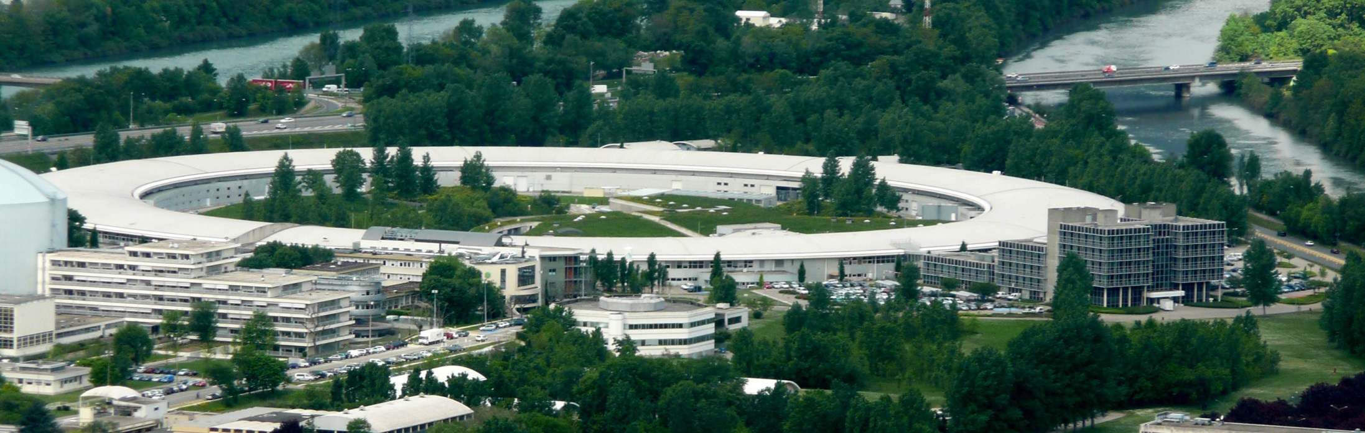
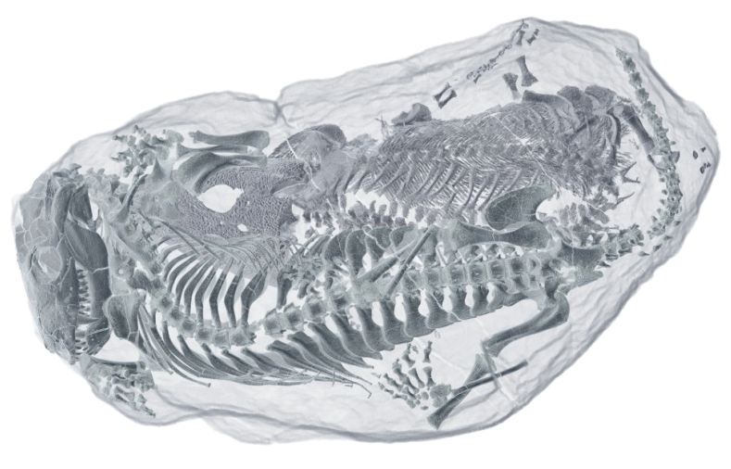
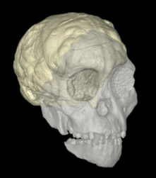






Integrating synchrotron technology
into the palaeosciences in South Africa
Dr. Kristian J. Carlson
Evolutionary Studies Institute
University of the Witwatersrand
First African Light Source Conference and Workshop, Grenoble, France

Slide 2
Outline of presentation
Self-organizing partnerships between paleoscience institutions on the continent
Paleosciences in South Africa
Paleoscientific research applications of light source technology:
  Palaeobiology of organisms around the Permo-Triassic extinction event
  Endocast form of Australopithecus sediba (brain evolution)
  Evolution of developmental schedules (Taung Child absolute age at death)
First African Light Source Conference and Workshop, Grenoble, France

Slide 3
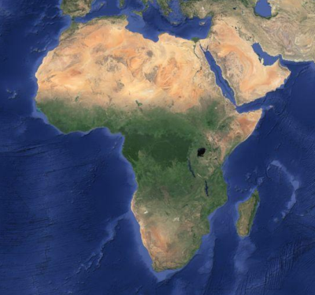
Pan-African partnerships in the Palaeosciences
East African Association for Paleoanthropology and Paleontology (EAAPP)
  Eritrea
  Ethiopia
  Kenya
  Tanzania
  Uganda
Centre of Excellence in Palaeosciences (South Africa)
  University of the Witwatersrand
  University of Cape Town
  Rhodes University
  Museums (e.g., Iziko, National, Ditsong)
https://maps.google.com/
https://maps.google.com/
First African Light Source Conference and Workshop, Grenoble, France

Slide 4
South African government support heritage studies
2008: issuing of a ten-year innovation plan by the
SA Department of Science and Technology (DST)
  5 Grand challenges
  One being related to the science and technology for global change
  Key emphasis on understanding climate change and biodiversity
  Includes present and past biodiversity
First African Light Source Conference and Workshop, Grenoble, France

Slide 5
Major fossil bearing regions in South Africa
Great Karoo region
  (260-100 my)
Cradle of Humankind
  (4-1 my)
  (UNESCO World Heritage Site since 1999)
https://maps.google.com/
https://maps.google.com/
First African Light Source Conference and Workshop, Grenoble, France

Slide 6
SAHRA: South African Heritage Resources Agency
Regulation of SA heritage objects
  http://www.sahra.org.za/
  established in 1999 under the National Heritage Resources Act
  mandate to identify, protect, and promote South African cultural
  heritage resources
  includes archaeological and palaeontological materials
  issues site excavation/collection permits
  authorizes loans of materials (fossils)
First African Light Source Conference and Workshop, Grenoble, France

Slide 7
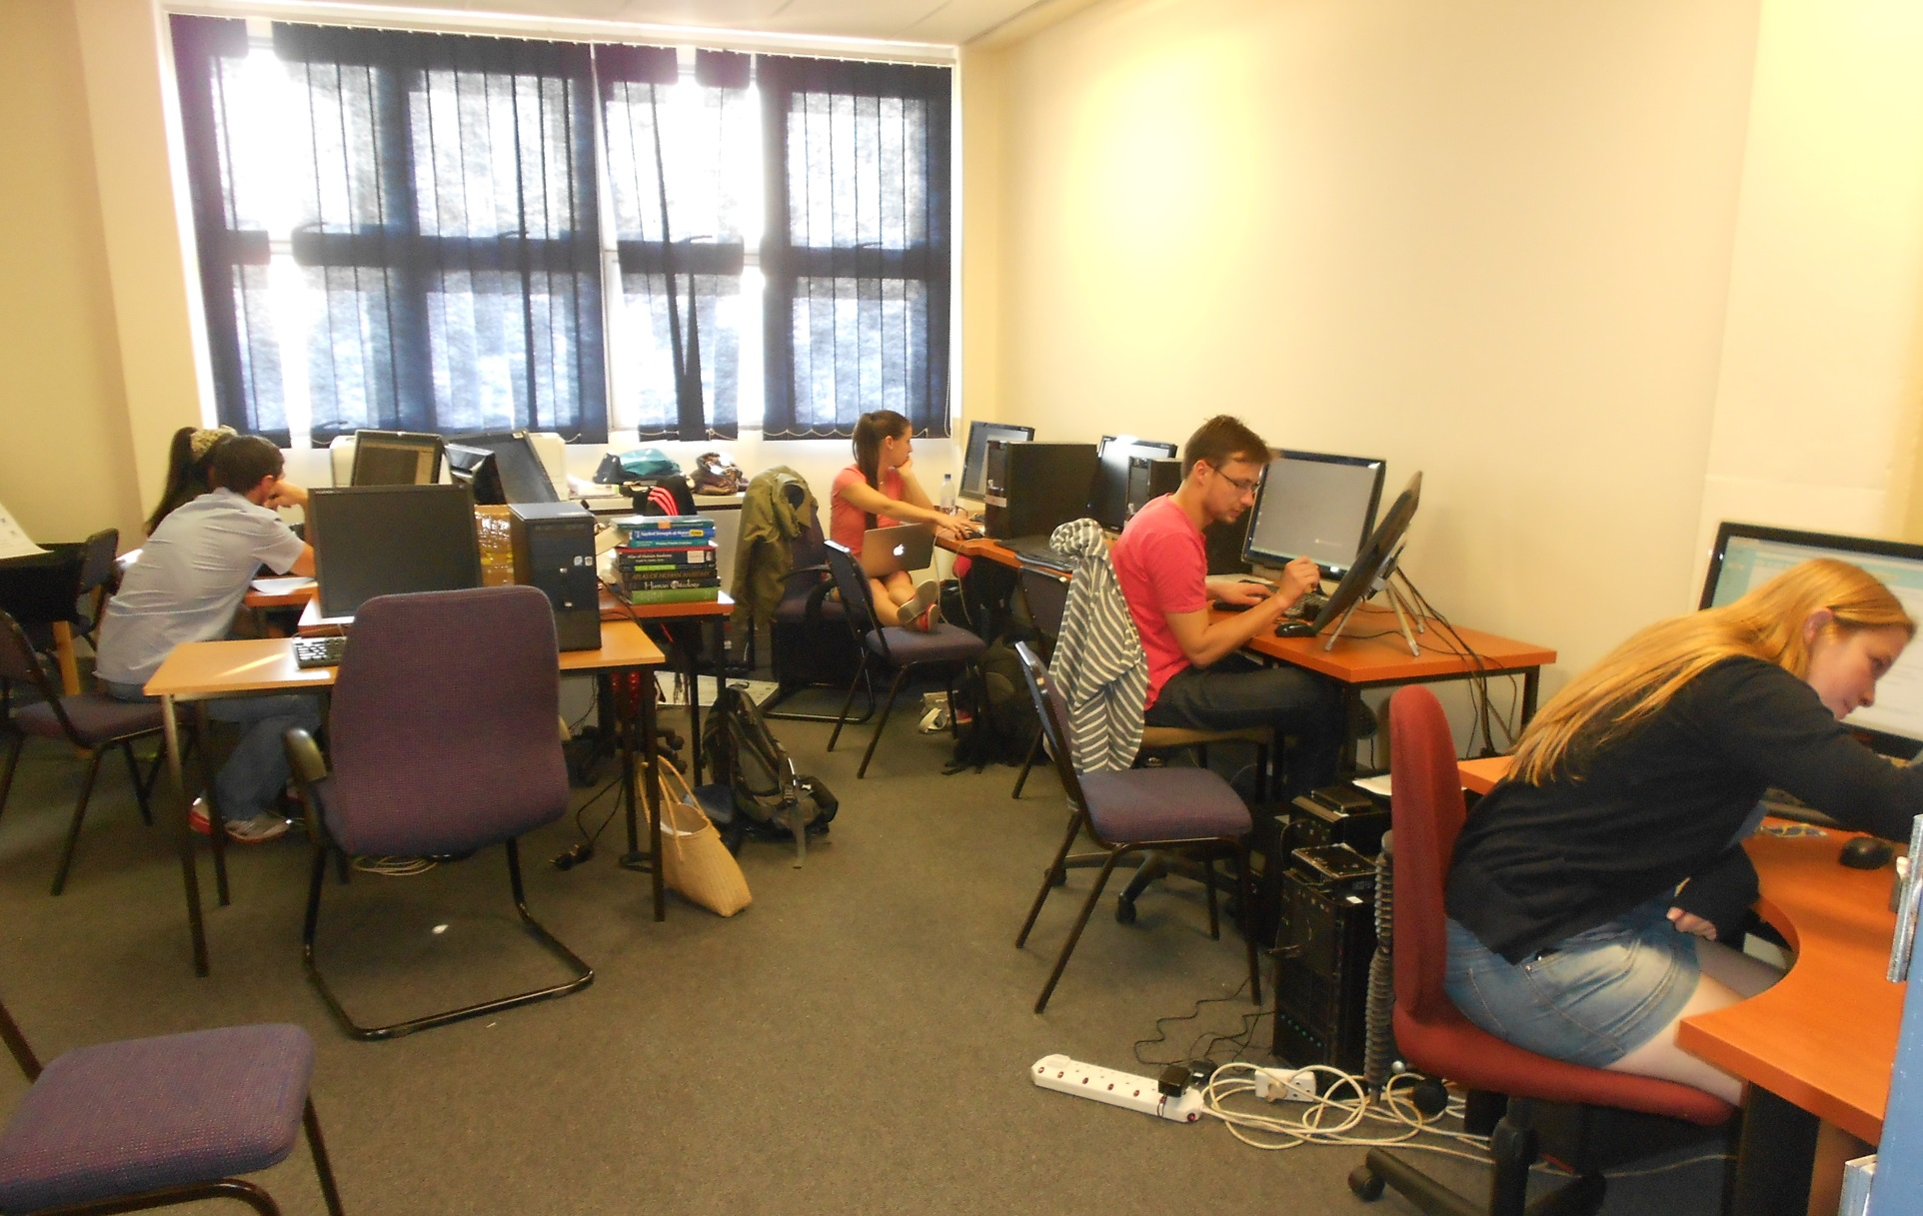
Virtual Imaging in Palaeontology (VIP) laboratory
First African Light Source Conference and Workshop, Grenoble, France

Slide 8

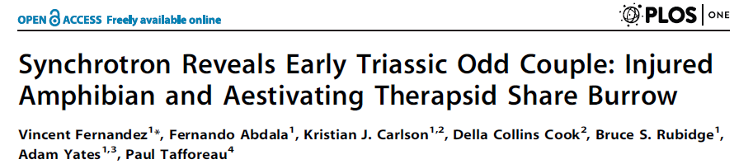
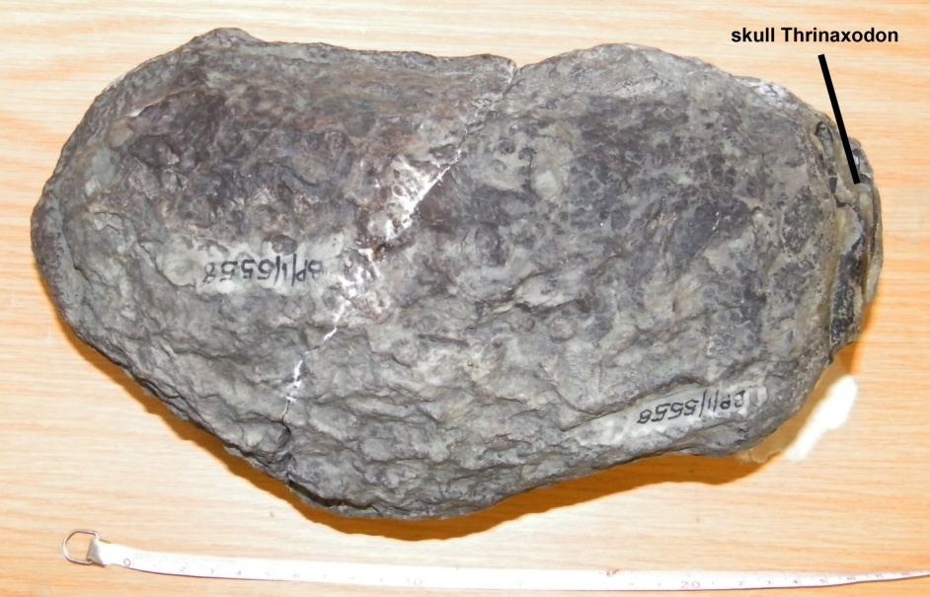
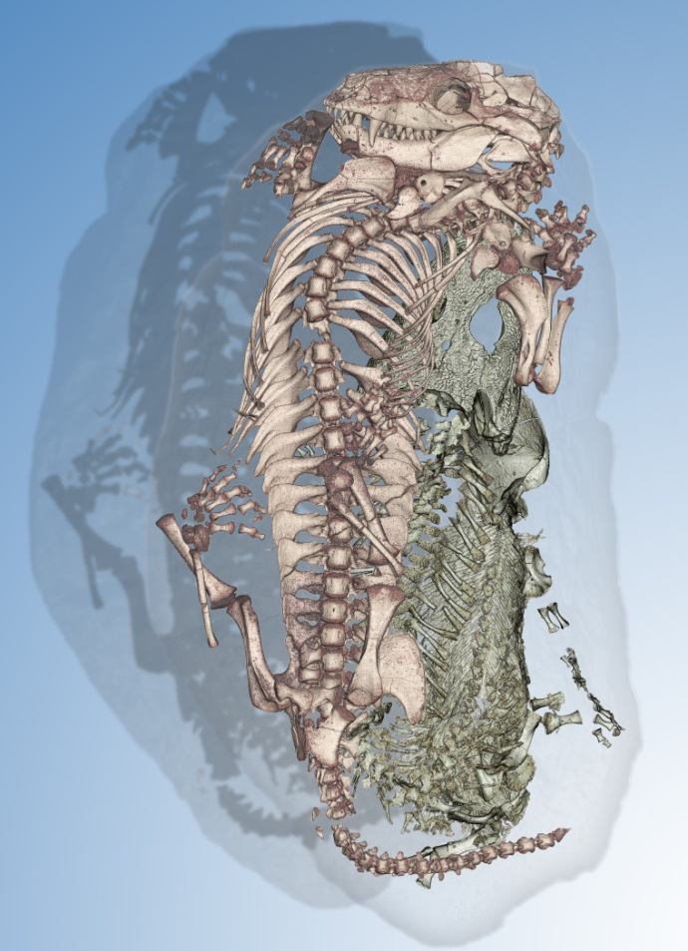
Fossilized burrow: 251 million years old
Fernandez et al. (2013) PLoS ONE
Broomistega putterilli
Thrinaxodon liorhinus
First African Light Source Conference and Workshop, Grenoble, France

Slide 9
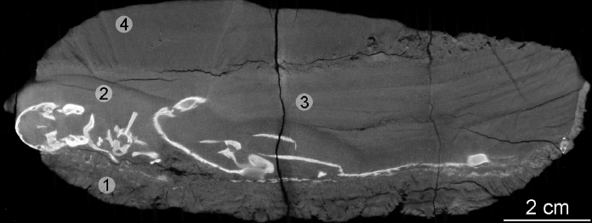
Fossilized burrow: 251 million years old
Fernandez et al. (2013) PLoS ONE
Broomistega putterilli
Thrinaxodon liorhinus
First African Light Source Conference and Workshop, Grenoble, France

Slide 10
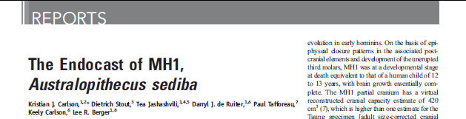
Human brain evolution
Carlson et al. (2011) Science 333: 1402-1407
The same slice of the MH 1 cranium obtained with medical CT (upper and lower left) versus with synchrotron scanning at the ESRF (upper and lower right).
Voxel sizes are approximately 450 μm and 45.71 μm, respectively.
First African Light Source Conference and Workshop, Grenoble, France

Slide 11
Human brain evolution
A. sediba
Modified from Holloway et al. (2004)
Carlson et al. (2011)
First African Light Source Conference and Workshop, Grenoble, France

Slide 12

Endocast shape comparisons
All endocasts scaled to 420 cc
Homo sapiens
Pan troglodytes
Carlson et al. (2011)
First African Light Source Conference and Workshop, Grenoble, France
Notes:
C

Slide 13
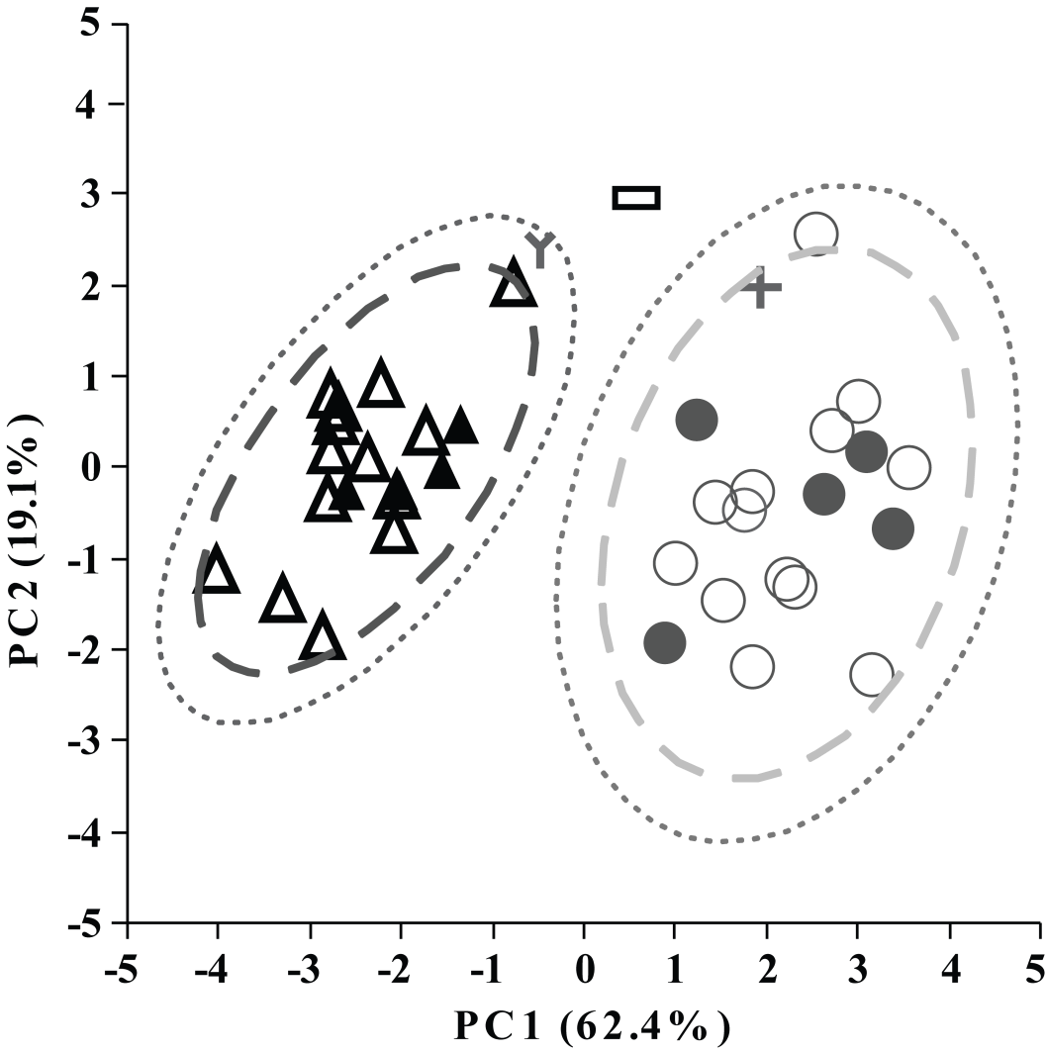
Endocast shape
analysis
Summary
Cranial capacity – at the lower end of Australopith range
Orbitofrontal organization – more Homo-like than other relatively complete australopiths
Frontal lobe reorganization and overall brain size increase in Genus Homo may not have transpired simultaneously.
Carlson et al. (2011)
MH 1 (A. sediba) = cross
Sts 5 (A. africanus) = rectangle
KNM-WT 17000 (Paranthropus aethiopicus) = Y symbol
Modern humans = circles
Chimpanzees = triangles
First African Light Source Conference and Workshop, Grenoble, France
Notes:
C

Slide 14
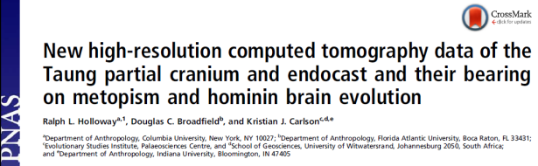
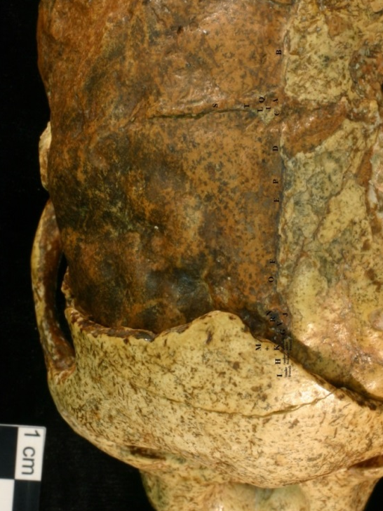
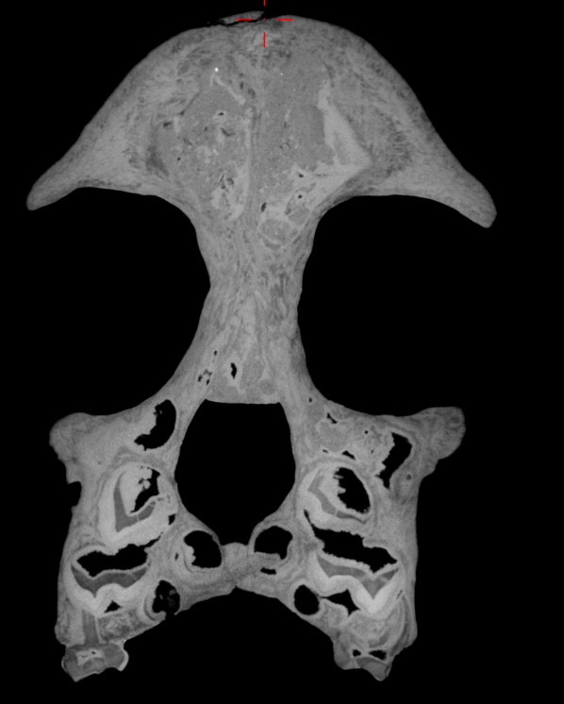
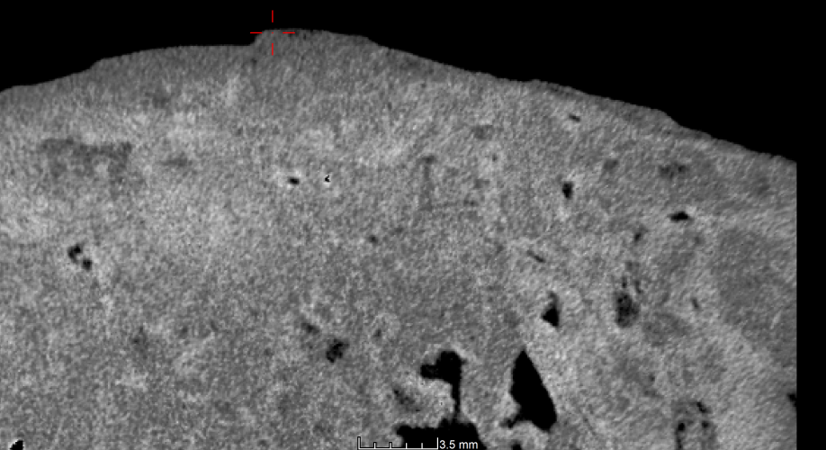
Taung Child
Type specimen
Australopithecus africanus
Refined endocast form (left hemisphere)
Absolute age-at-death (# of days)
Holloway et al. (2014) PNAS 111: 13022-13027
Note thin layer of bone covering the left
parietal region of the endocast
First African Light Source Conference and Workshop, Grenoble, France

Slide 15
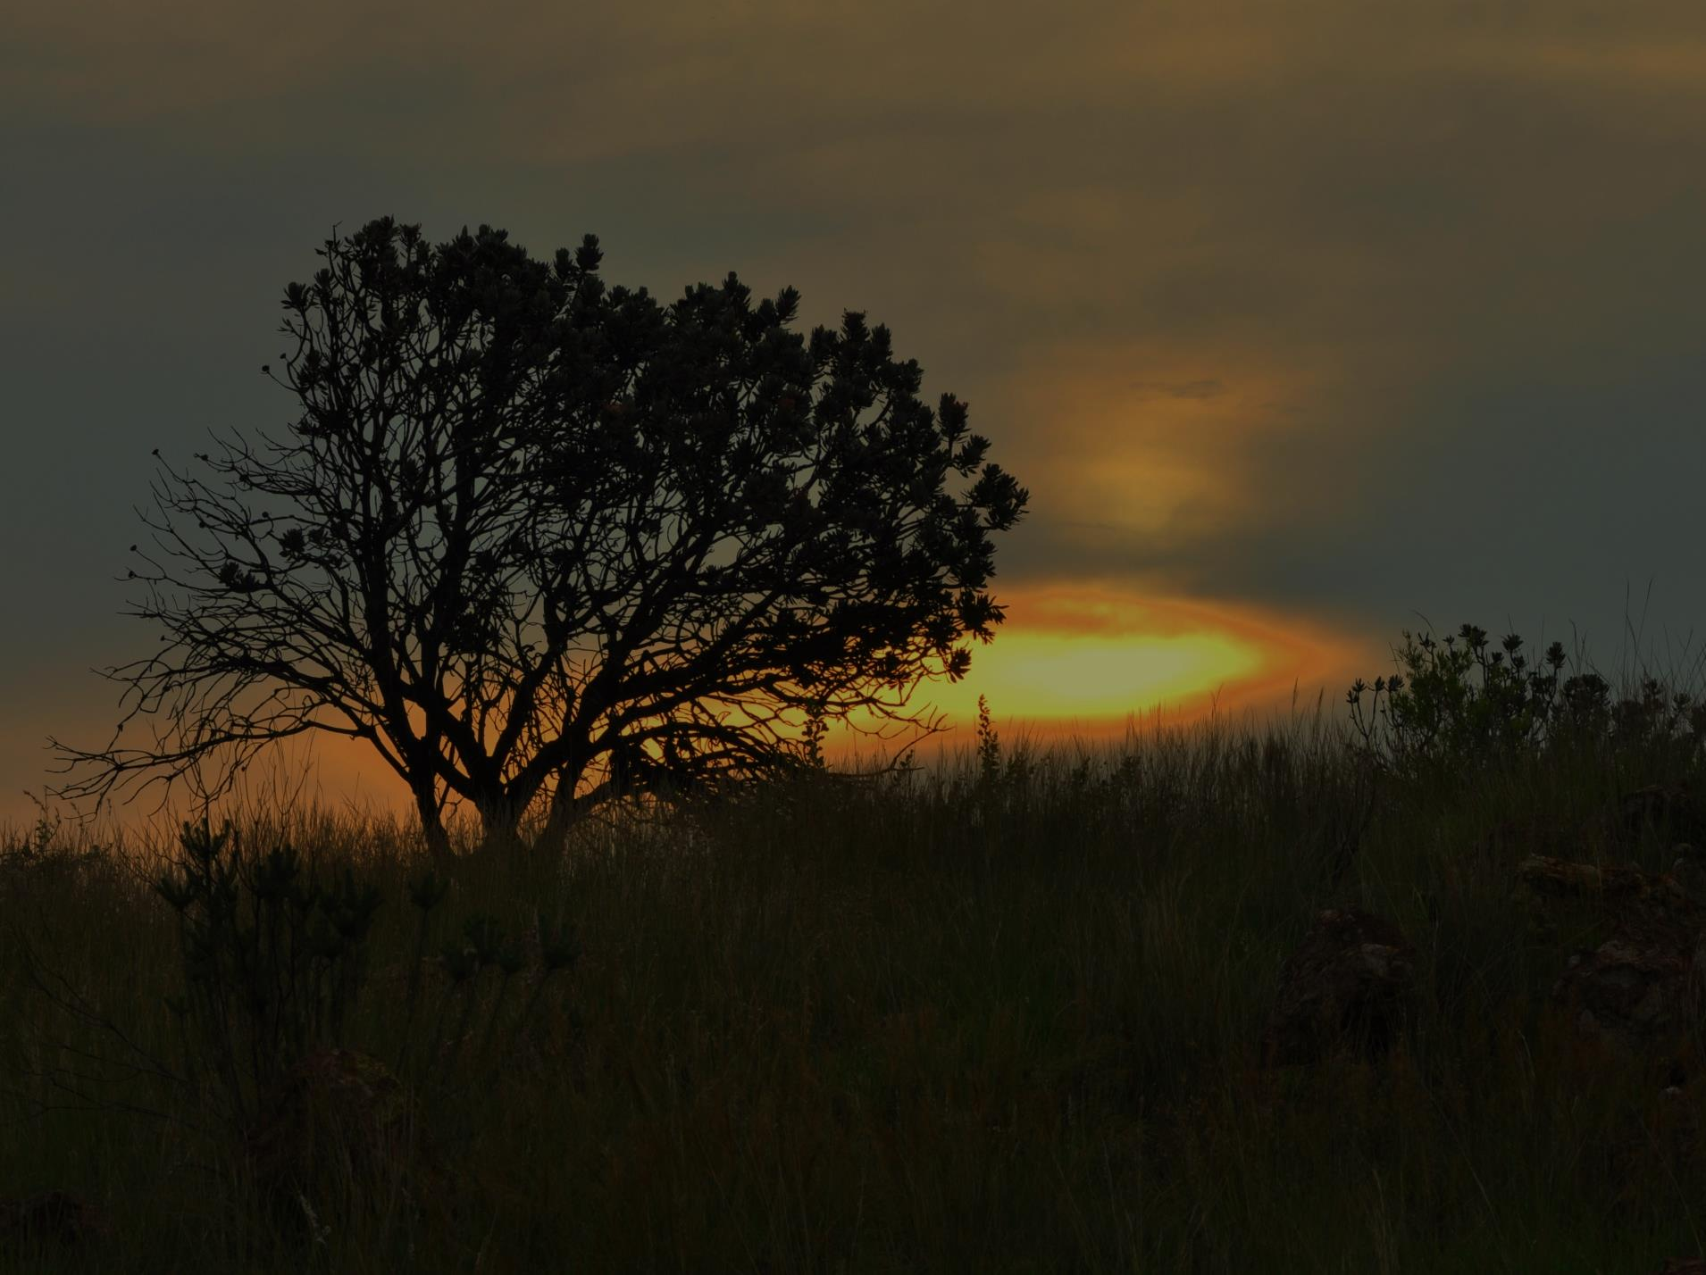
Thank you to the:
The organizers of AfLS 2015 for the invitation to speak
Collaborators in the various projects referenced here
The Department of Science and Technology (South Africa)
The National Research Foundation (South Africa)
The CoE – Palaeosciences (South Africa)
And you for your attention!

