Slide 1


Our plan of schools and practical trainings to contribute to the African Light Source project
Thu. 19 Nov. 2015
AfLS Conf & Workshop at ESRF
Hitoshi Abe
Photon Factory, IMSS, KEK
Dept. Materials Structure Science,
Sch. High Energy Acc. Sci.,
SOKENDAI (GUAS)

Slide 2
Five important things for New
A
B
C
D
E
Administration
Budget
Curiosity
Design of Machine and BLs
Experts: professors, scientists, engineers, technicians, students,...

Slide 3
Five important things for New
Administration
Budget
Curiosity
Design of Machine and BLs
Experts: professors, scientists, engineers, technicians, students,...
Our plan: Schools
to offer opportunities to them
to learn expertise in synchrotron radiation

Slide 4
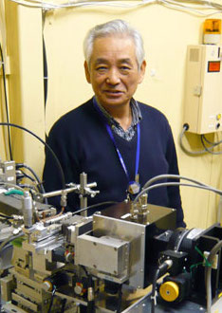
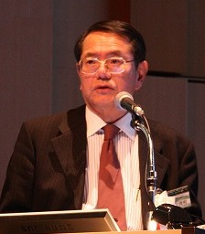

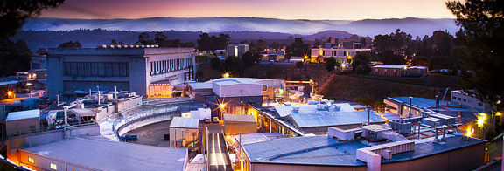
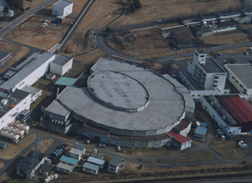
Japan ~1980: SSRL as mother of PF
Prof. T. Matsushita, Prof. T. Ohta, and colleagues had been to Stanford to learn synchrotron radiation.
They came back to build the first Japanese dedicated SR facility, Photon Factory, which is still operated.
SSRL
PF
We learned a lot from SSRL and other advanced facilities.

Slide 5
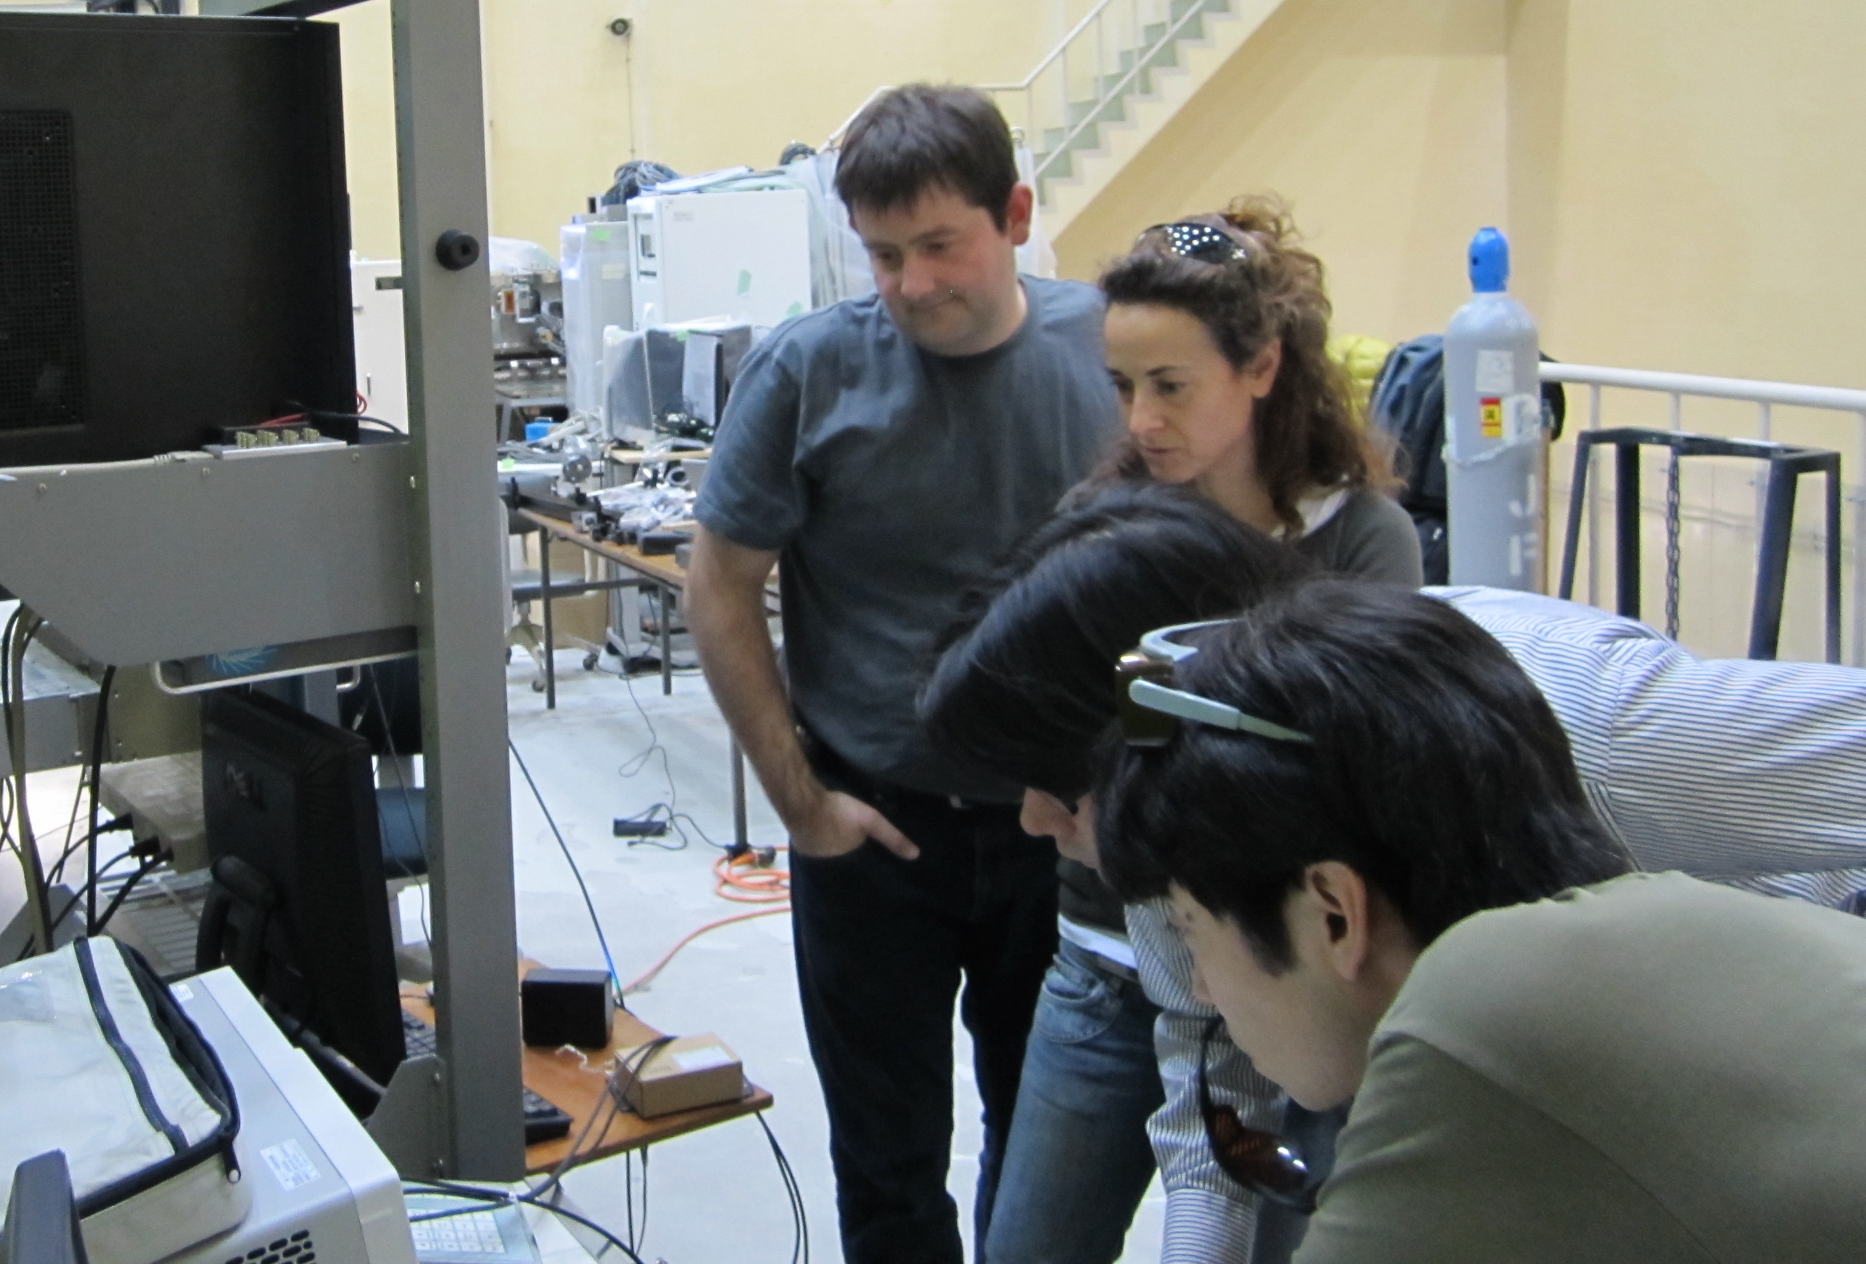
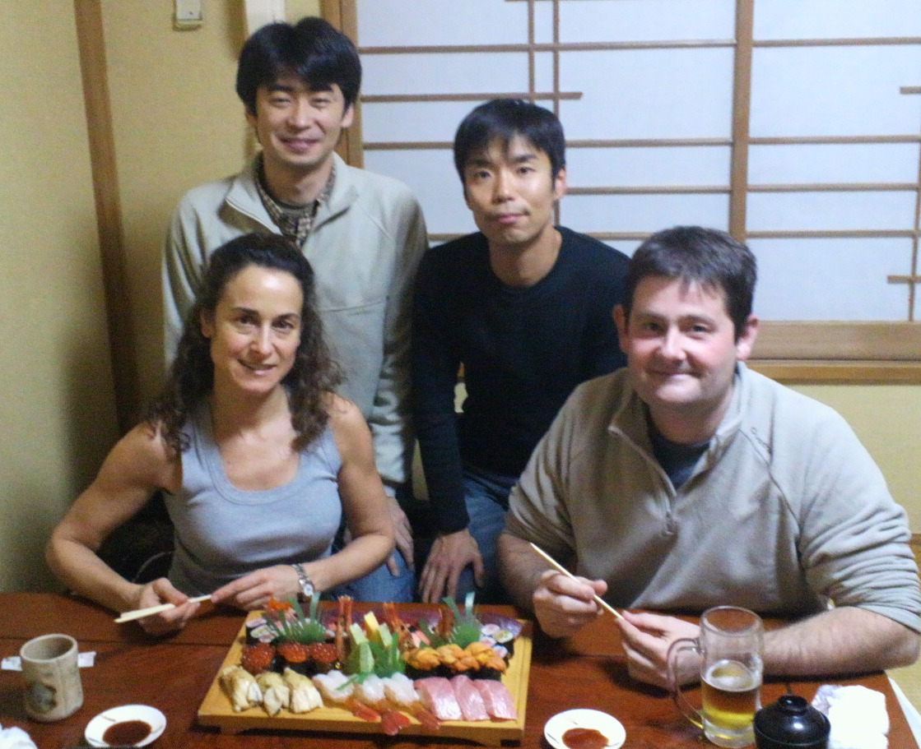
2010s, we...
We’ve learned a time-resolved experimental method from Dr. S. Pascarelli and Dr. O. Mathon since 2011. They are so kind to teach us.
We’ve learned a lot from them, and continued to learn.

Slide 6
Let us share a knowledge of SR
We learned a lot from professors and scientists at advanced facilities to build SR facilities in Japan in 1980s, and are still learning.
Now for African Light Source!!
We are glad to contribute to the project by operating schools to share a knowledge of SR with scientists and students related to AfLS.
You may remember the SESAME project.

Slide 7

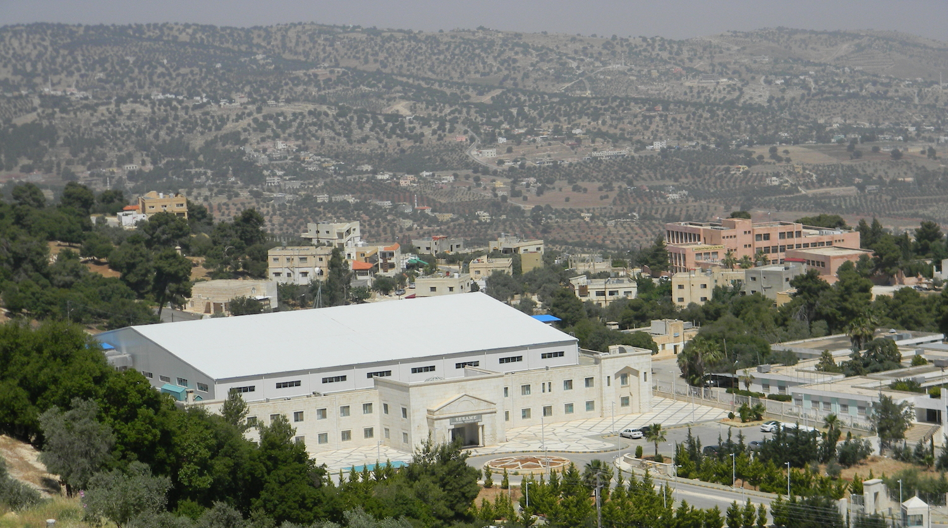

SESAME project
(Synchrotron-light for Experimental Science and Applications in the Middle East)
1999, International Interim Council
2002, UNESCO approved the project.
2003, International Council
2014, SESAME, fully in operation
SESAME-JSPS schools had been held
in Egypt, Turkey, Jordan, ...

Slide 8
SESAME-JSPS schools
Lectures
  Machines, Beamlines, End stations, ...
  XRD, XPS, XRF, XAFS, PX, SAXS, Imaging, ...
Tutorials
  Practical lectures and data processing tutorials
  XRD, XPS, XRF, XAFS, PX, ...
Students’ presentations
  presentations by students
  what they’ve learned

Slide 9
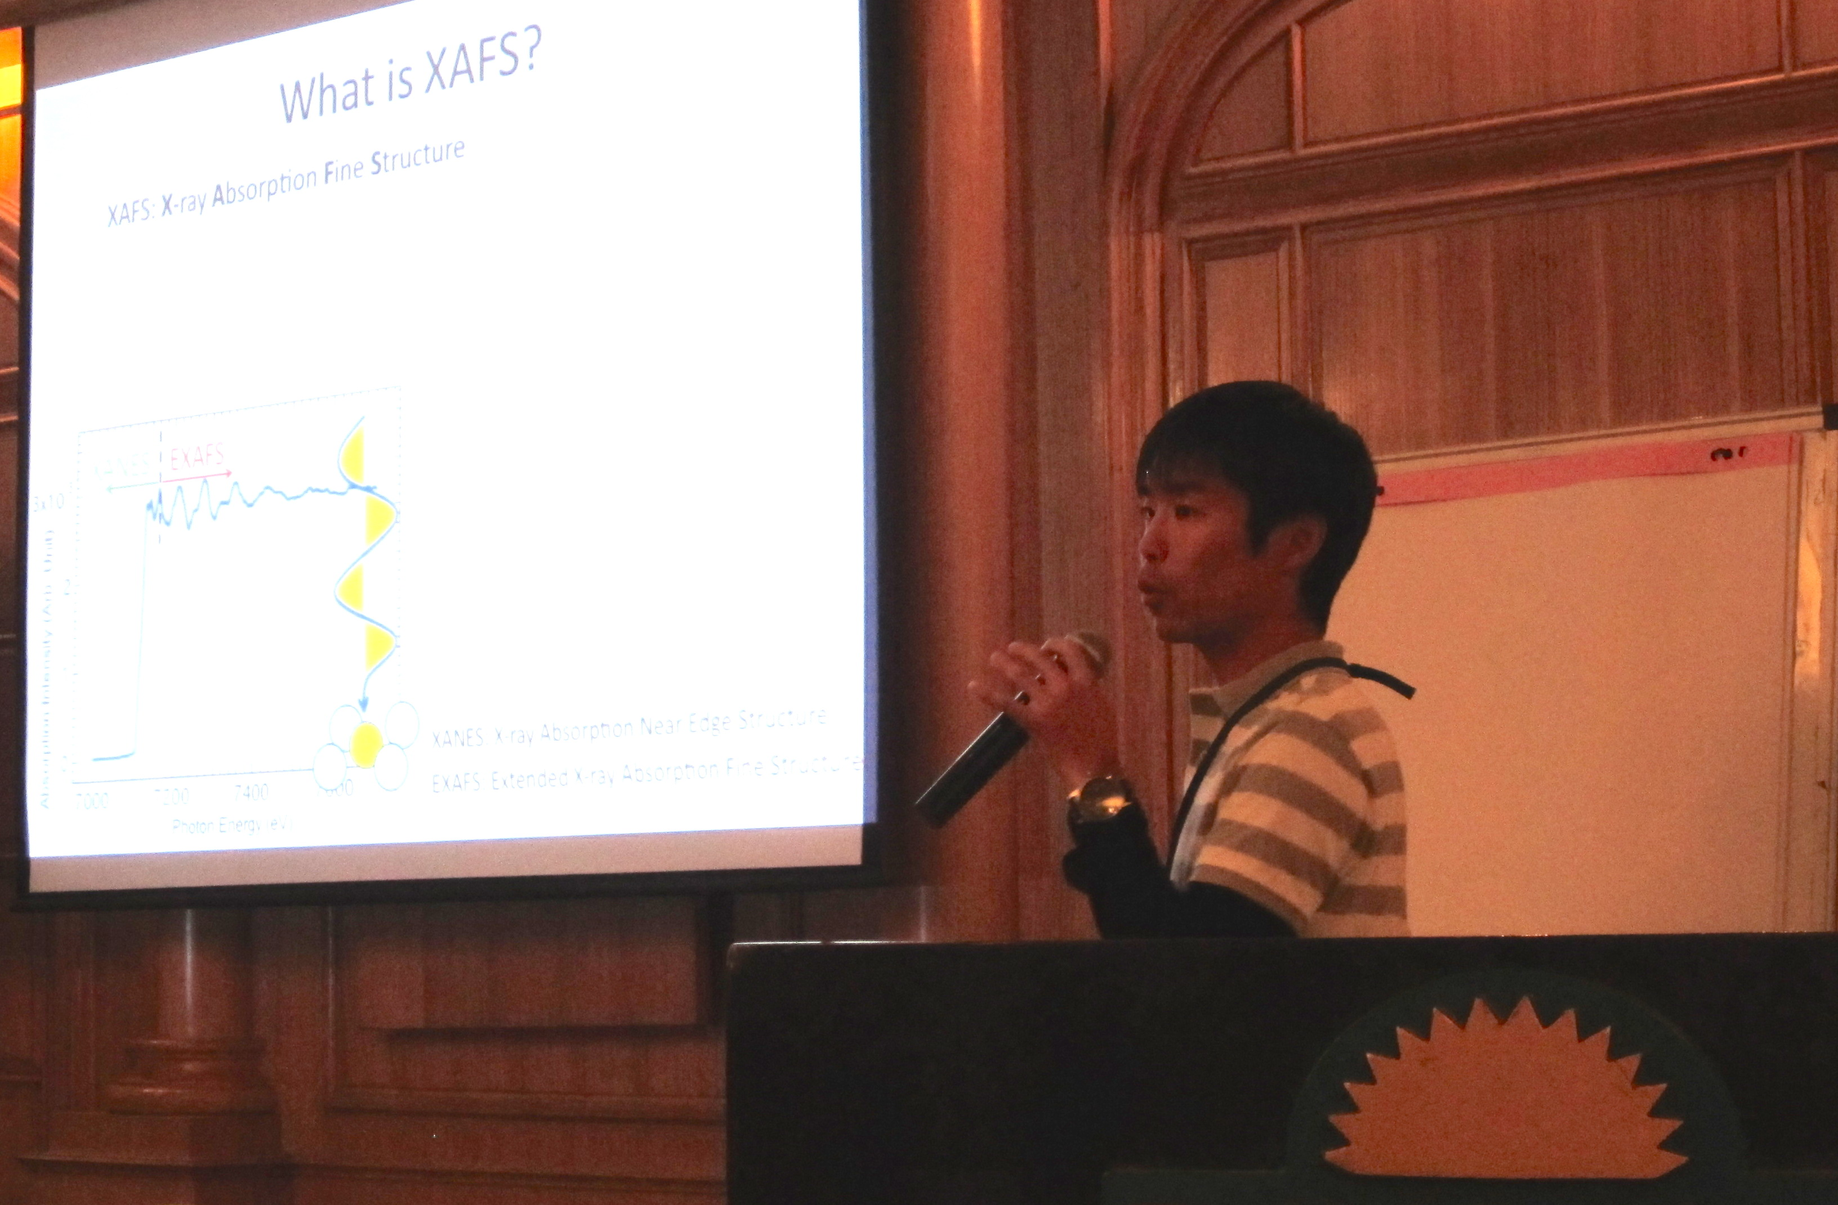
Lectures: SESAME schools
Machines, Beamlines, End stations, ...
XRD, XPS, XRF, XAFS, PX, SAXS, Imaging, ...

Slide 10
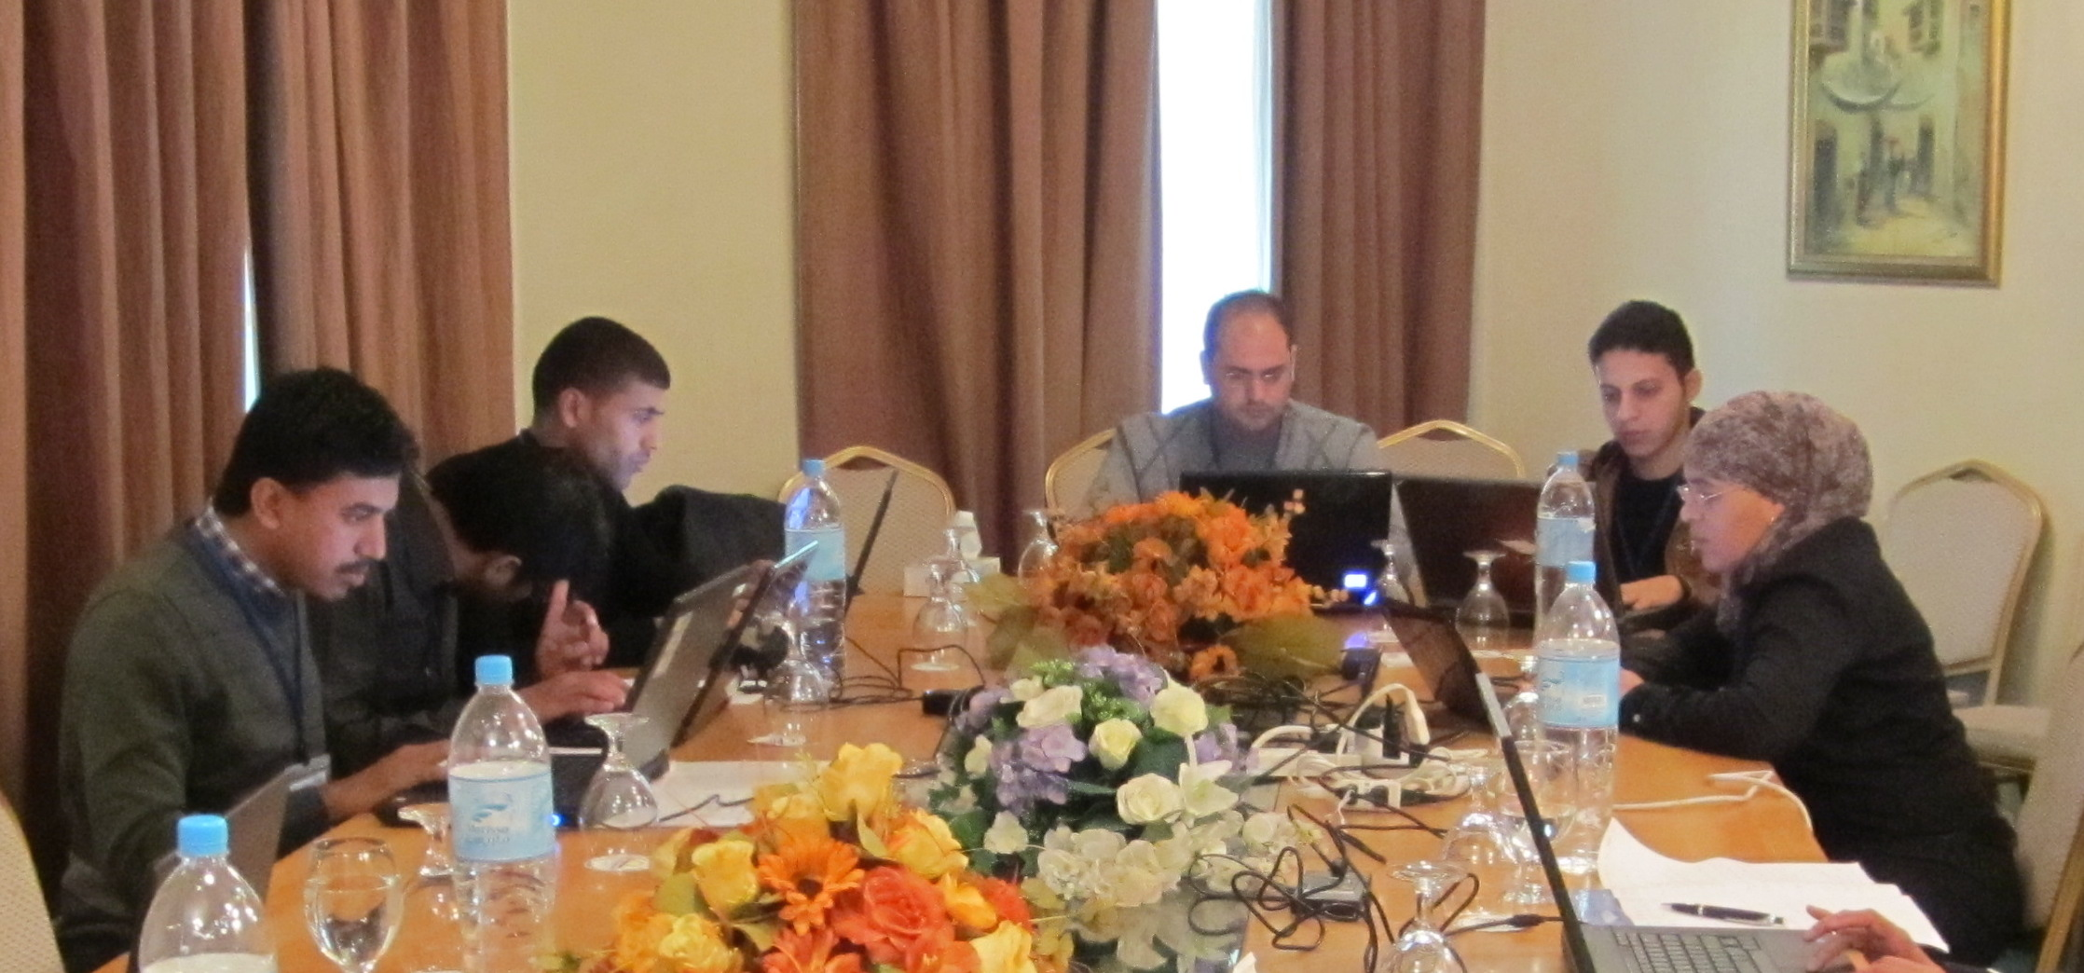
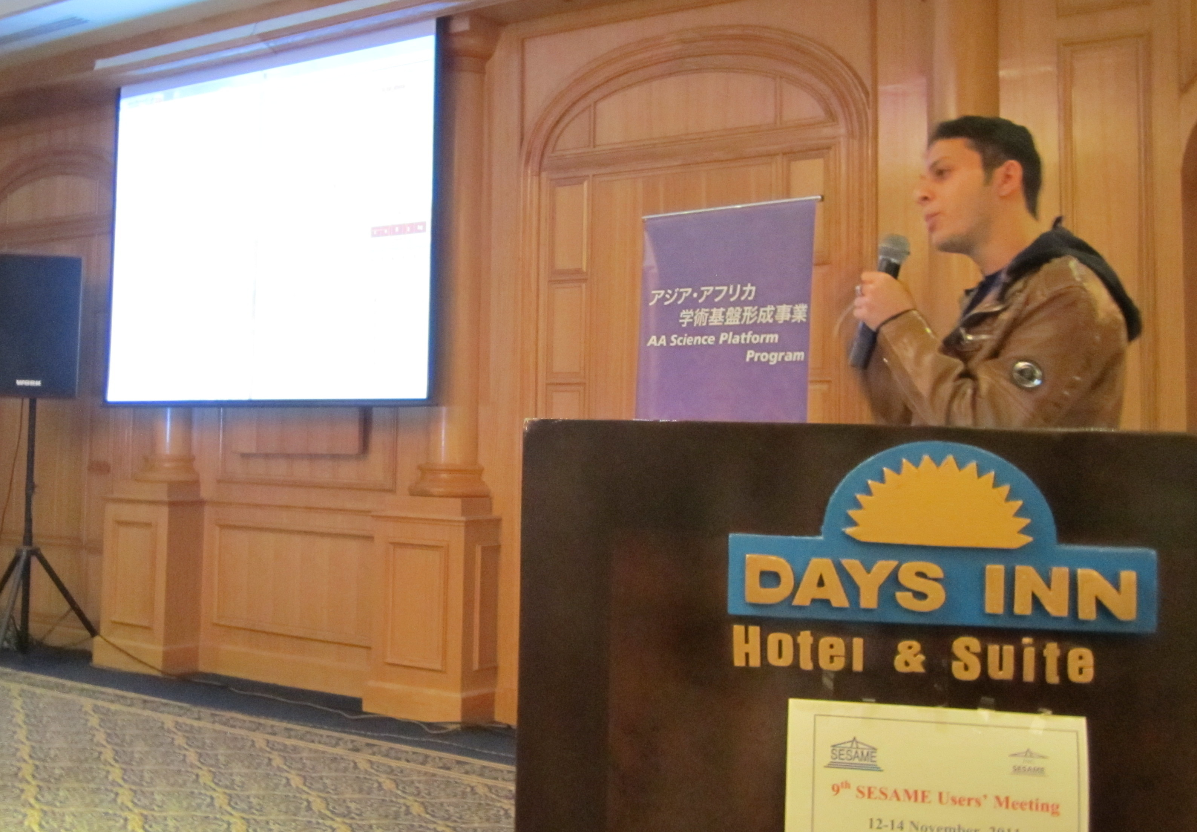
Tutorials: SESAME schools
Practical lectures and data processing tutorial
XRD, XPS, XRF, XAFS, PX, ...
Students’ presentations

Slide 11
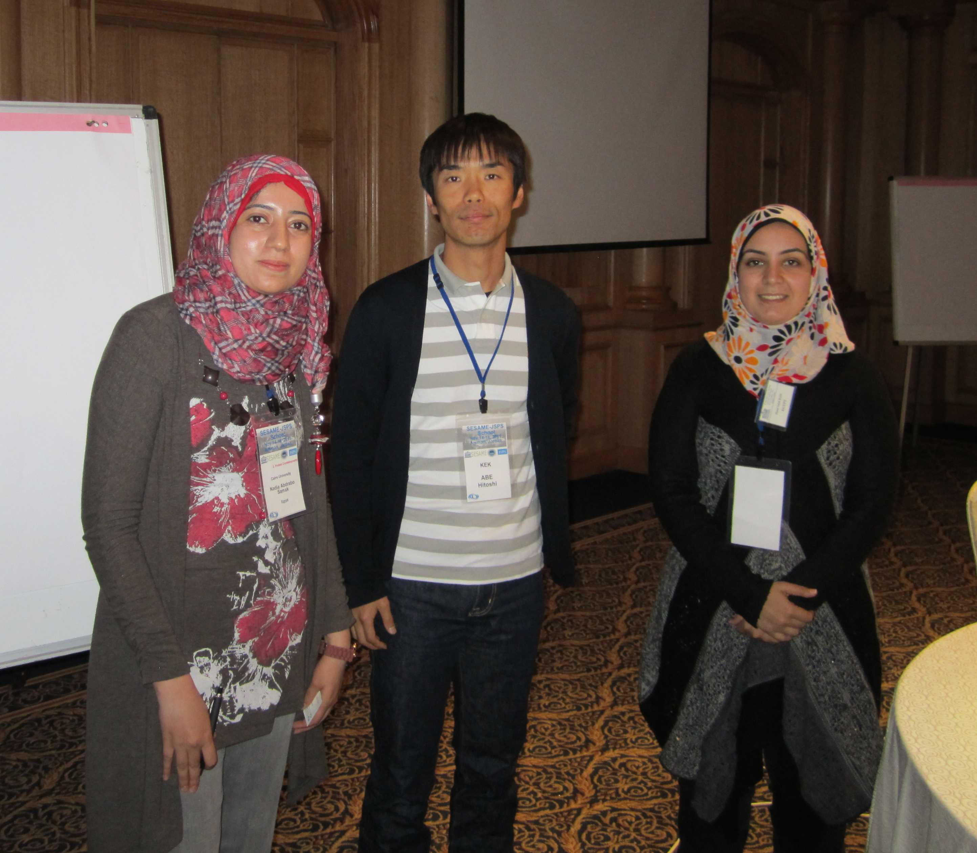
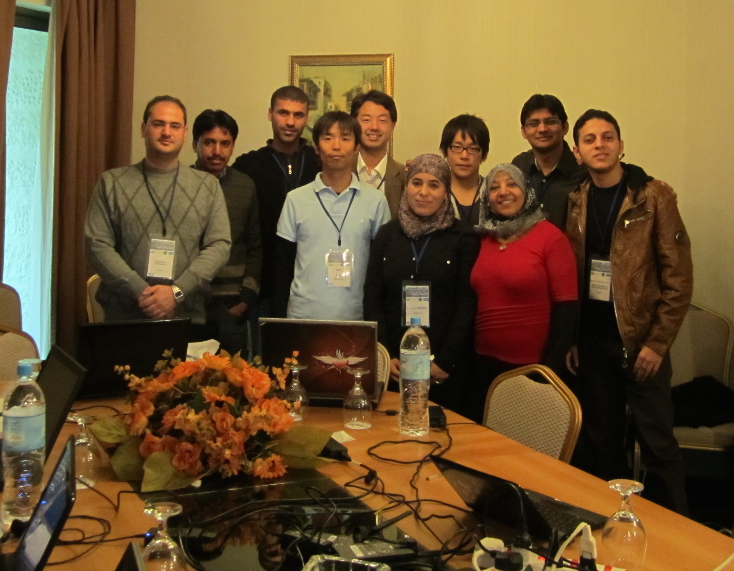
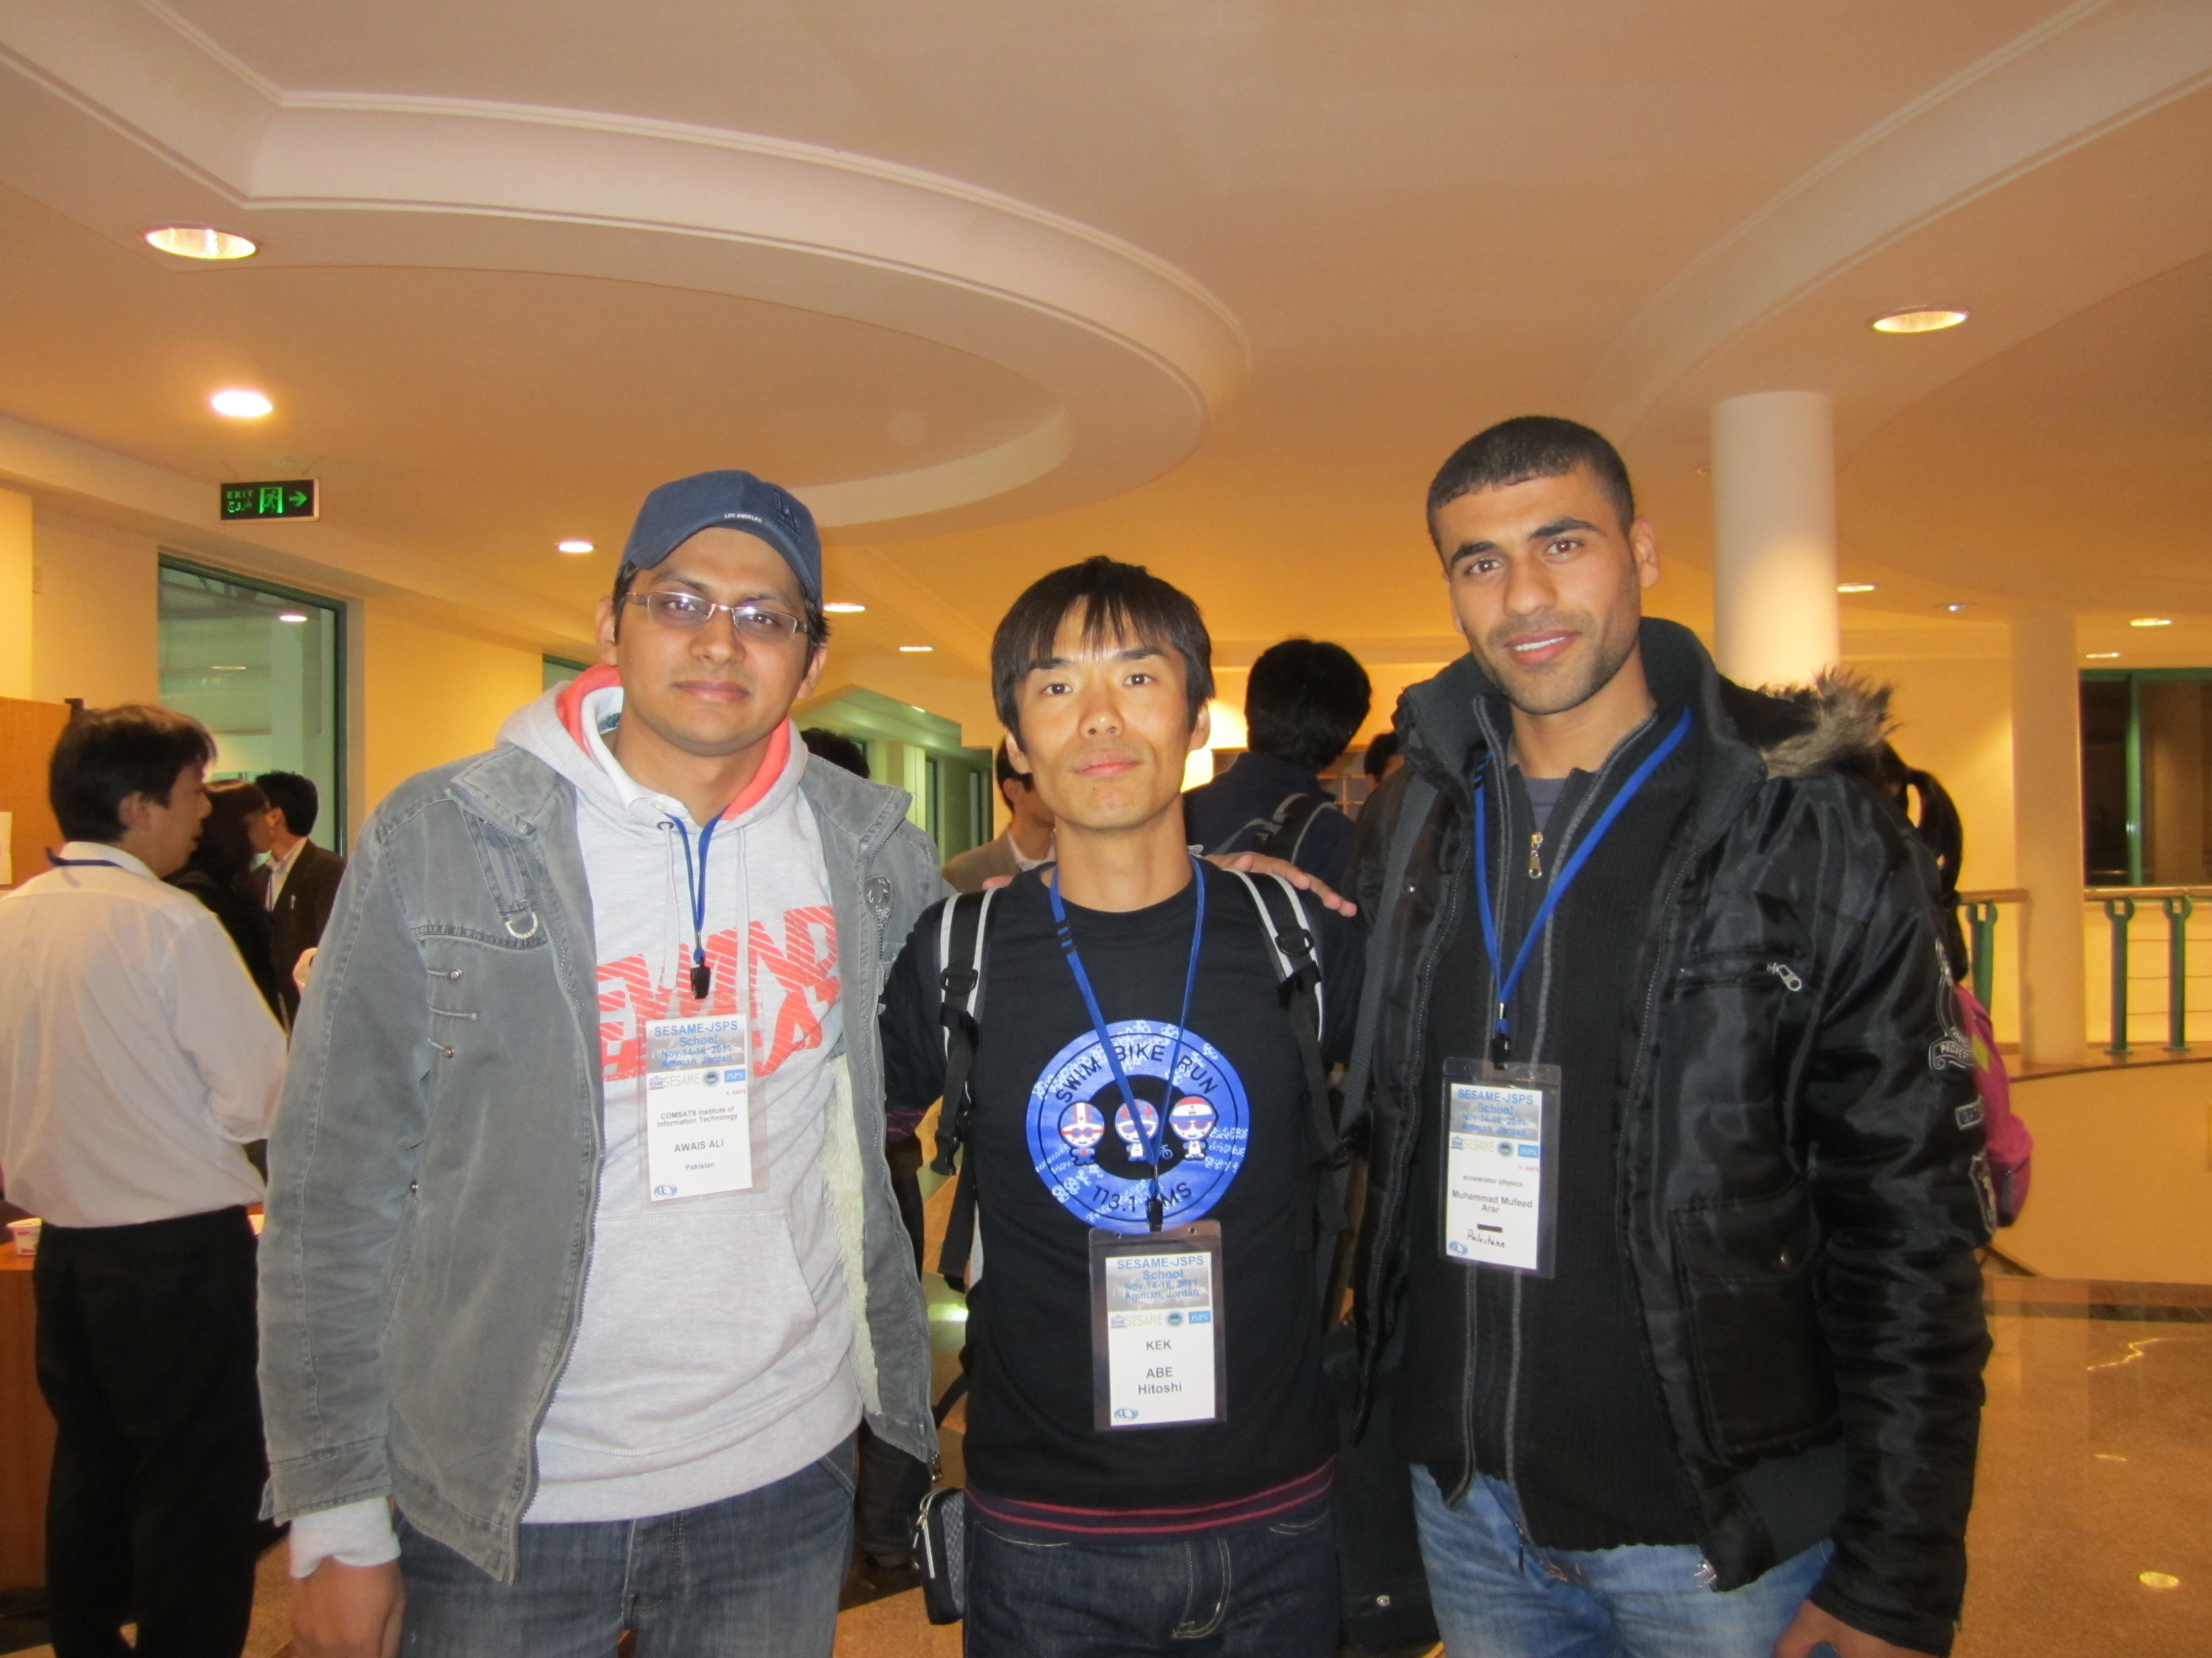
SESAME friends & network
One of my SESAME friends said, the most effective things of SESAME school were:
  Tutorials (hands on training)
  Networking of scientists and students.

Slide 12
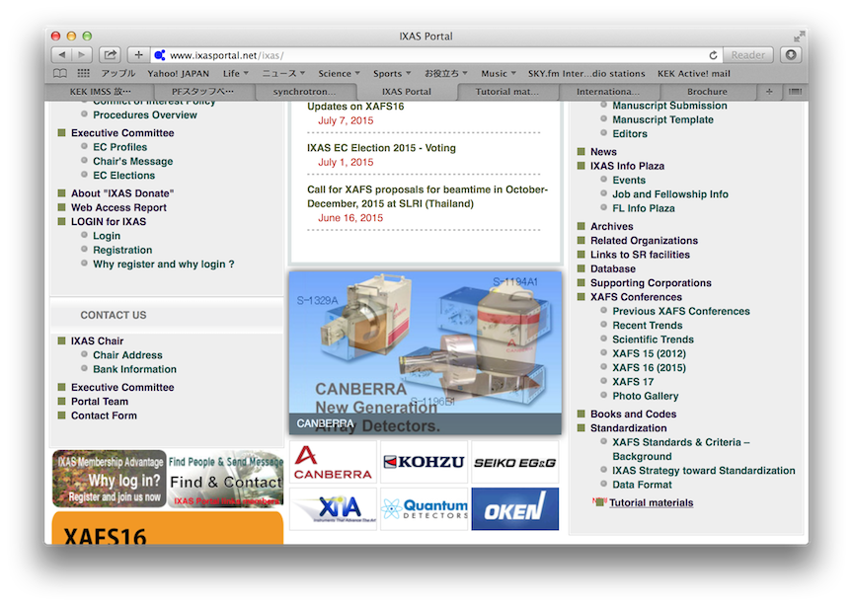
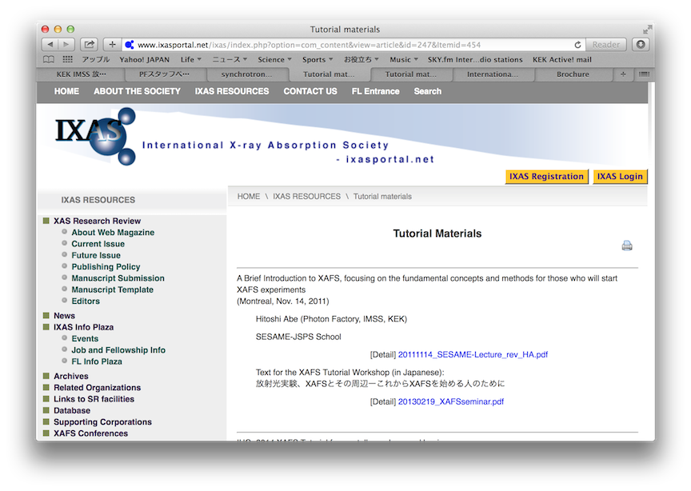
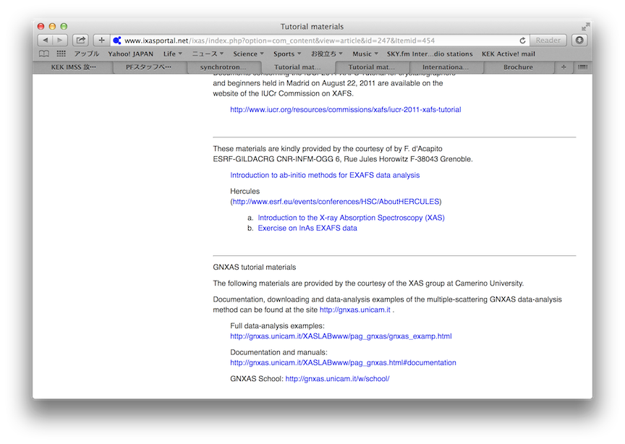
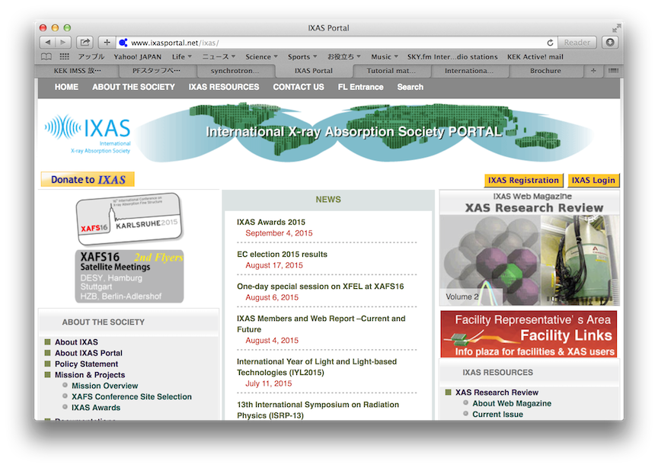
Our plan: AfLS schools
to offer opportunities to learn
Schools: Lectures & Tutorials
Practical trainings
Joint researches
MOOCs (massive open online course)
Tutorial materials
http://www.ixasportal.net/ixas/
complementary to schools

Slide 13
Schools: Lectures & Tutorials
would be held (once a year) at an African institute or an institute near African countries.
Lectures
  on the fundamentals of synchrotron radiation, BL diagnostics, and synchrotron experiments.
  about 100 participants for the class.
Tutorials
  to learn how to process data of synchrotron experiments
  given in relatively small groups, about 50 participants in total

Slide 14
Practical training
at (Japanese) synchrotron facilities
African scientists and students would be invited to learn synchrotron radiation and to have practical trainings of measurements on site.
They could be stay one or a few months.

Slide 15
Joint research
Joint researches will be certainly welcome.
African scientists and students could find some Japanese scientists to perform joint researches at SR facilities in Japan or somewhere in the world.
To have AfLS schools, we need funds...

Slide 16
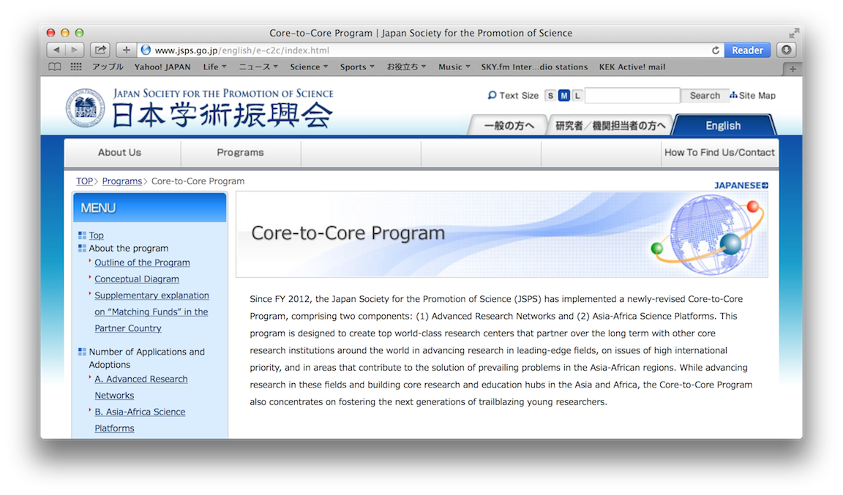
JSPS Core-to-Core Program: Asia-Africa Science Platforms.
to create high-potential research hubs in fields of special importance or significance to Asia and/or Africa and of high priority in Japan.
Core institutions in Japan and in counterpart countries conduct collaborations.
They take the form of joint research projects, seminars, and researcher exchanges, which are to be organized and carried out effectively under the program.
Core institutions are expected to continue operation as a research hub after funding under this program has ended.
  http://www.jsps.go.jp/english/e-c2c/index.html

Slide 17
JSPS Core-to-Core Program: Asia-Africa Science Platforms.
to create high-potential research hubs in fields of special importance or significance to Asia and/or Africa and of high priority in Japan.
Core institutions in Japan and in counterpart countries conduct collaborations.
They take the form of joint research projects, seminars, and researcher exchanges, which are to be organized and carried out effectively under the program.
Core institutions are expected to continue operation as a research hub after funding under this program has ended.
  http://www.jsps.go.jp/english/e-c2c/index.html

Slide 18
JSPS Core-to-Core Program: Asia-Africa Science Platforms.
to create high-potential research hubs in fields of special importance or significance to Asia and/or Africa and of high priority in Japan.
Core institutions in Japan and in counterpart countries conduct collaborations.
They take the form of joint research projects, seminars, and researcher exchanges, which are to be organized and carried out effectively under the program.
Core institutions are expected to continue operation as a research hub after funding under this program has ended.
  http://www.jsps.go.jp/english/e-c2c/index.html

Slide 19
JSPS Core-to-Core Program: Asia-Africa Science Platforms.
to create high-potential research hubs in fields of special importance or significance to Asia and/or Africa and of high priority in Japan.
Core institutions in Japan and in counterpart countries conduct collaborations.
They take the form of joint research projects, seminars, and researcher exchanges, which are to be organized and carried out effectively under the program.
Core institutions are expected to continue operation as a research hub after funding under this program has ended.
  http://www.jsps.go.jp/english/e-c2c/index.html

Slide 20
AfLS school EC to be organized
Steering committee of AfLS
AfLS school EC
AfLS project
Japan
ESRF
SSRL
Staff candidates,
Scientists, Engineers,
Students, ...
Schools
KEK-PF
facilities
Trainings
facilities
Universities
Universities
Universities
Joint researches
Institutes
Institutes
Institutes
development of scientists & students for AfLS

Slide 21
Summary
We’d like to share a knowledge of SR.
AfLS schools are suggested as our contribution.
  Lectures & Tutorials
  Practical trainings
  Joint researches
Collaborators are welcome to operate AfLS schools.

Slide 22
Summary
We’d like to share a knowledge of SR.
AfLS schools are suggested as our contribution.
  Lectures & Tutorials
  Practical trainings
  Joint researches
Collaborators are welcome to operate AfLS schools.

Slide 23
Summary
We’d like to share a knowledge of SR.
AfLS schools are suggested as our contribution.
  Lectures & Tutorials
  Practical trainings
  Joint researches
Collaborators are welcome to operate AfLS schools.

Slide 24
Summary
We’d like to share a knowledge of SR.
AfLS schools are suggested as our contribution.
  Lectures & Tutorials
  Practical trainings
  Joint researches
Collaborators are welcome to operate AfLS schools.

Slide 25
Acknowledgements
SESAME school members and friends
Ms. Diana Salah RAIE, for the valuable comments

Slide 26
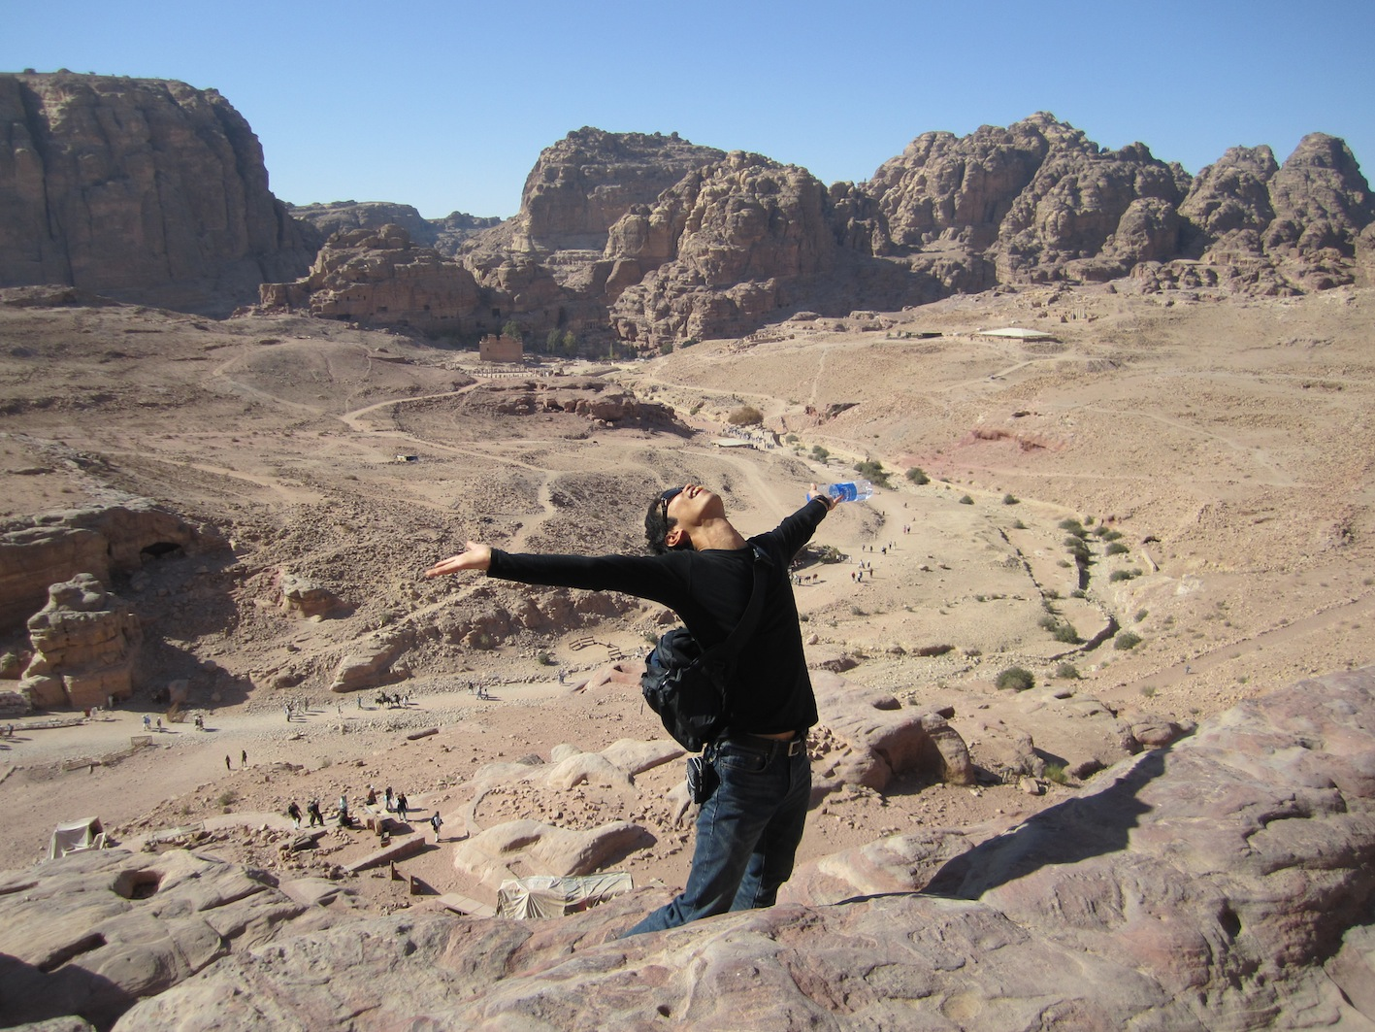
Thank you for your attention

