Slide 1






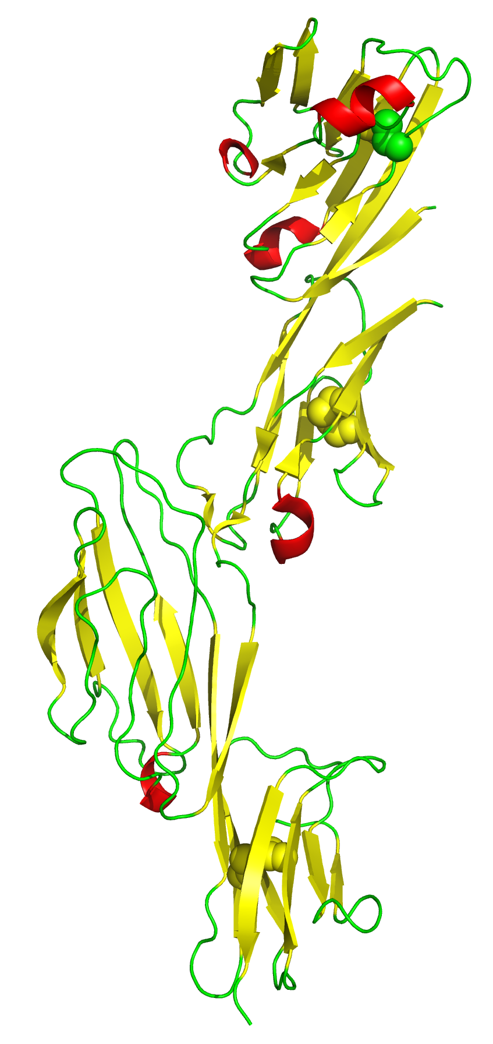
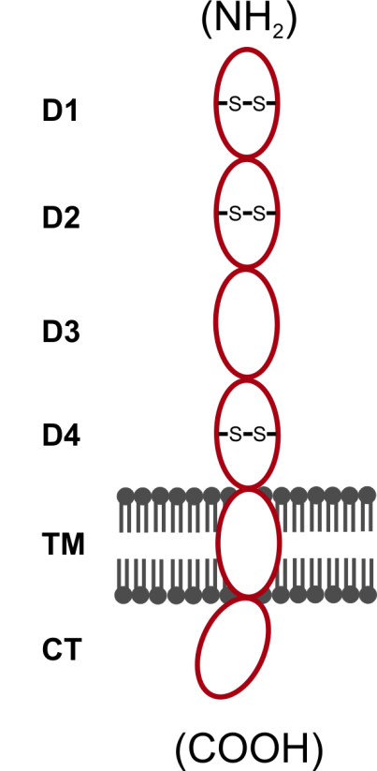
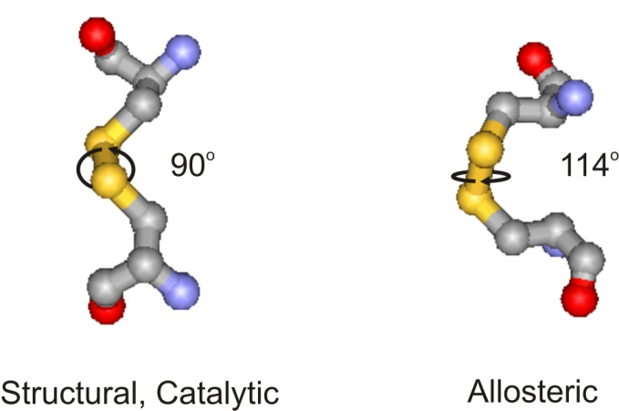
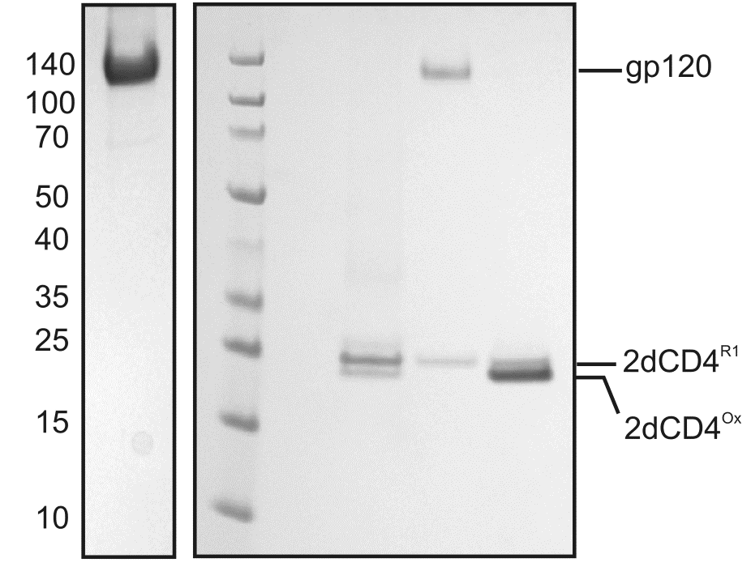
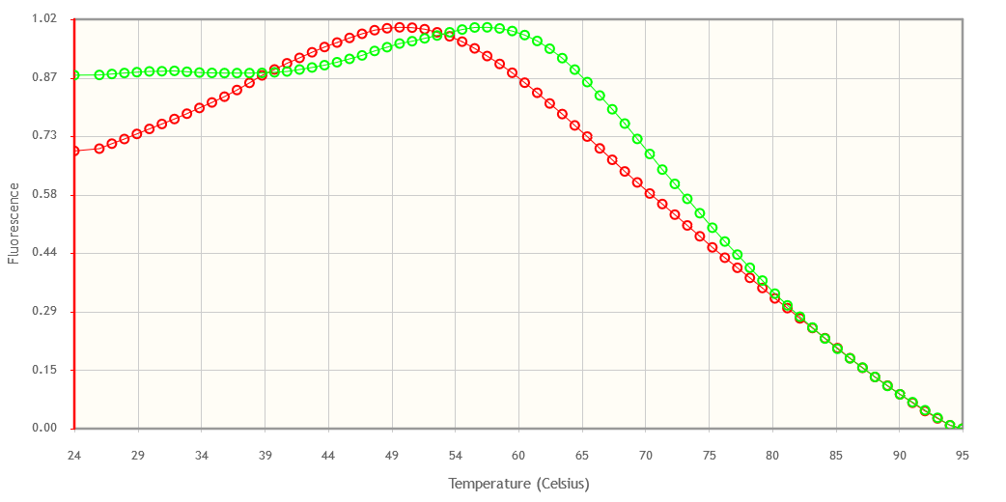
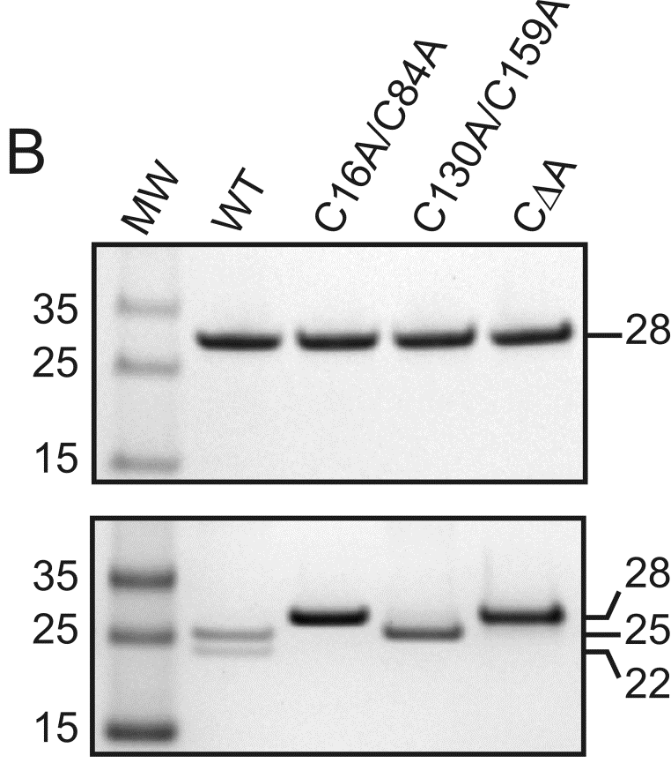
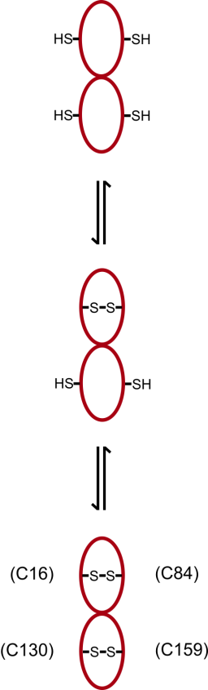
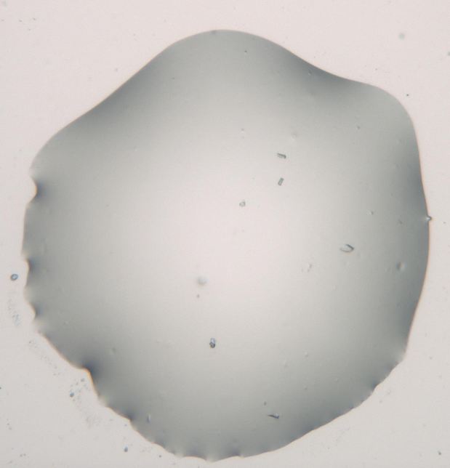
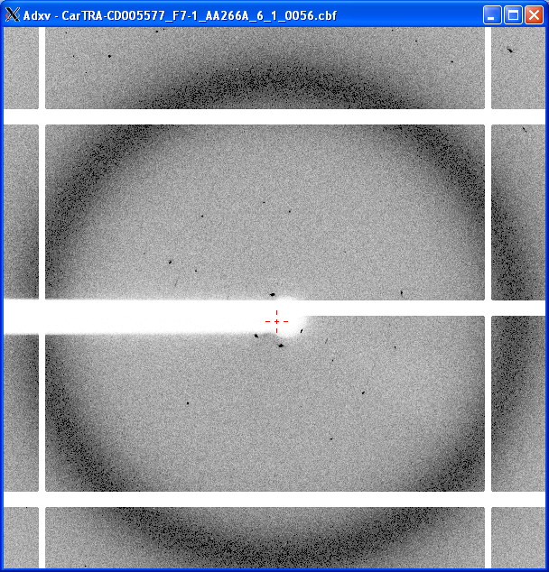
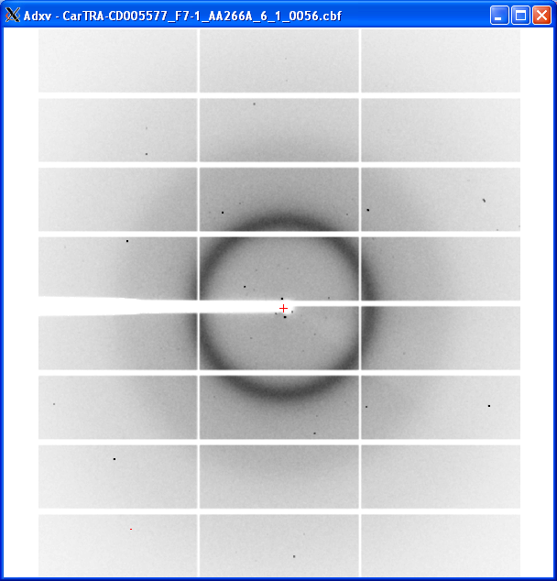
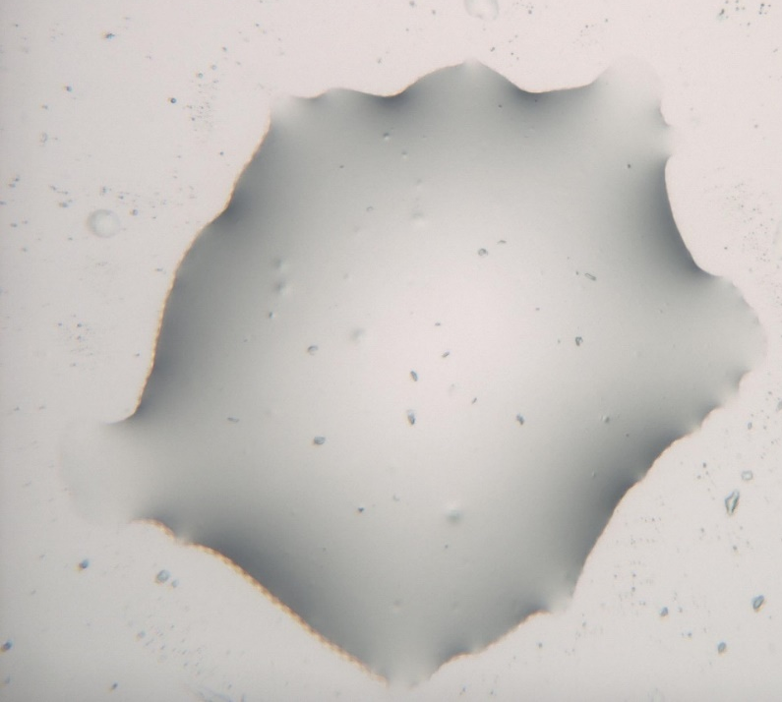
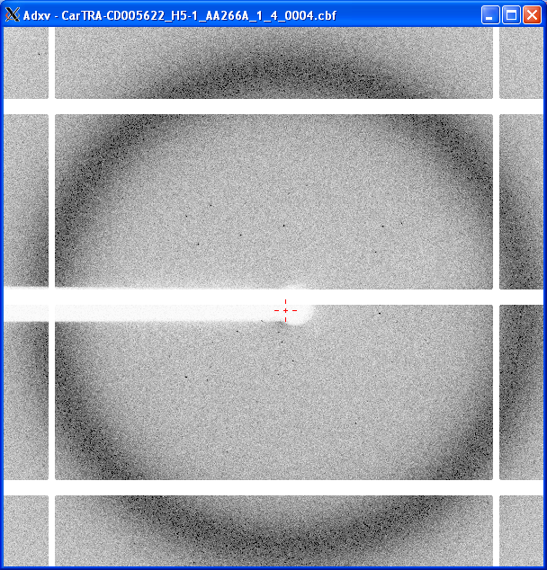
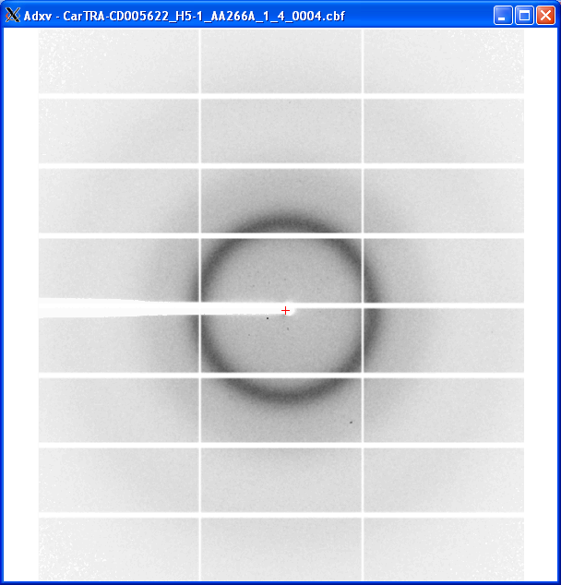

Structural studies of dynamic CD4 changes relevant to HIV infection
J.A. Channell^{1,2,4,5}, N. Cerutti³, M. Moulin¹, T. Forsyth^{1,4}, M. Haertlein¹, E. Mitchell^{2,4}, A. Capovilla³, M. Papathanasopoulos³
From the ILL Life Sciences Group¹ and the ESRF Business Development Office², Grenoble, France, the HIV Pathogenesis Research Unit in the Department of Molecular Medicine and Haematology at the University of the Witwatersrand, Johannesburg, South Africa³,EPSAM, Keele University, UK⁴ and the South African Medical Research Council⁵.
CD4 is the primary receptor for HIV-1 surface glycoprotein, gp120. Preliminary data suggests that gp120 binds a specific redox isomer of CD4 in which its second domain, metastable allosteric disulphide bond is reduced. A collaboration exists between the ILL, ESRF and HPRU to use high and low-resolution X-ray and neutron scattering techniques to determine the structural implications of CD4 redox biology on gp120 binding and will thus aid in rational design of HIV-1 entry inhibitors.
A)
Scientific Background
HIV is the causative agent of AIDS infecting CD4+ and CCR5/CXCR4+ cells of the innate and adaptive immune systems of more than 35million people, worldwide. CD4 is the primary receptor of trimeric HIV-1 surface antigen (env) and specifically binds gp120. CD4 has a transmembrane (TM), a cytosolic tail (CT) and 4 ecto-domains (D1-4) of which D1,2 & 4 contain disulphide bonds(fig. 1A,B)². D2 contains a non canonical configuration of disulphide bond (-RHStaple) which is metastable and associated with an unusual class of disulphide bonds called the allosteric disulphides. Biochemical analyses show that CD4 can only bind gp120 when its D2 disulphide bond is reduced³ (fig.1C). Physiologically, CD4’s function is involved in the adaptive immune response and can be found on resting T-cells in fully oxidised monomers and on active T-cells in D2 swapped disulphide dimers. Therefore, the partially reduced CD4 redox isomer (2dCD4^{R1}) is a functionally and therefore a potentially structurally unique CD4 species able to bind gp120.
C16-84C
D1
C130-159C
D2
D3
B)
(NH₂)
C)
1 2 3 4 5
Figure 1: A) Ecto-domains of CD4 1-4. The disulphide bonds in D1, 2 and 4 are shown in space filling mode. (generated using PyMOL from PDB ID 1WIQ)^{1.} B) Schematic depicting full-length, oxidised, monomeric CD4 as found on the resting T-cell. The D1 and 4 disulphides are structural whereas the D2 disulphide bond belongs to the allosteric family of disulphide bonds. C) 1=gp120 control, 2=molecular weight marker, 3=pre-bound CD4 redox isomers, 4=gp120-CD4 bound fraction, 5=unbound CD4 fraction. SDS-PAGE showing that only the partially reduced 2dCD4^{R1} species is capable of binding CD4³.
16C-C84
D1
130C-C159
D2
D4
C303-345C
303C-C345
D3
D4
TM
CT
(CO₂H)
Hypothesis
Gp120 is capable of binding a CD4 species in which its 1st domain, structural disulphide bond is oxidised and its 2nd domain, allosteric disulphide is reduced.
Aim
To characterise the structural implications of CD4 redox biology on gp120 binding to aid design of anti-CD4 directed immunogens for HIV-1 development.
Escherichia coli expressed 2dCD4-WT
Deuteration of 2dCD4
CΔA
(R2)
TSA carried out at the EMBL on E.coli expressed 2dCD4-WT suggests incomplete re-folding due to high fluorescence at low temperature. Conversely TSA of B.choshinensis expressed 2dCD4-WT suggests correct folding due to initially low fluorescence at low temperature and is therefore the expression system which has been selected for deuteration of CD4.
Hydrogenated gp120 will be complexed with deuterated mutant (blue) and WT (red) 2dCD4 and dialysed against increasing percentage of D₂O solvent for SANS contrast match studies. At 0% D₂O the entire complex will be visible. At ~40% D₂O the hydrogenated gp120 will be matched out and the structure of deuterated 2dCD4 will be observed. At 100% D₂O the deuterated 2dCD4 will be matched out and the structure of the hydrogenated gp120 will be visible.
C16A-C84A (R2) &
C130A-C159A (R1)
Brevibacillus choshinensis expressed 2dCD4-WT
WT
(Ox)
0% D₂O
40% D₂O
100% D₂O
gp120
gp120
gp120
-S-S-
-S-S-
-S-S-
Figure 2 (left): Thermal shift assay denaturation profile of 2dCD4-WT expressed in E.coli (top) and B.choshinensis (bottom) measuring SYPRO orange fluorophore fluorescence versus temperature.
A-
-A
A-
-A
A-
-A
0% D₂O
40% D₂O
100% D₂O
gp120
gp120
gp120
Fluorescence vs temperature (°C)
H₂O
100mM Bicine pH 8.0
Figure 3 (right): A) Reducing (top) and non-reducing (bottom) SDS-PAGE of CΔA 2dCD4 mutations used to knock out the disulphide bonds in D1 (C16A/C84A), D2 (C130A/C159A) and D1 and D2 (CΔA) and schematic to show how this is depicted. B) SANS experiment strategy.
-S-S-
-S-S-
-S-S-
HS-
-SH
HS-
-SH
HS-
-SH
1dCD4-D1 X-ray Crystallography
After a successful diffraction test of CD4-domain 1 micro-crystals, carried out by the EMBL HTX lab at MASSIF-1, a crystallogenesis condition optimisation will be performed for MX studies of domain 1 of CD4.
Figure 5: Micro-crystals of 1dCD4-D1 grown and harvested by EMBL HTX lab Grenoble, France and tested using MASSIF-1 at ESRF, Grenoble France. (Left) Crystal diffraction to 8$Å,$ crystal conditions: sitting drop, precipitant = Sodium di-Hydrogen phosphate 1.6M, buffer = Sodium phosphate citrate 0.1M pH 4.2, precipitant = di-potassium hydrogen phosphate 0.4M. (Right) Crystal diffraction to 9$Å$, crystal conditions: sitting drop, salt = potassium di-hydrogen phosphate 0.2M, precipitant = PEG3350 20% w/v.
References and Acknowledgements:
1. RCSB Protein Data Bank[online] 1WIQ Available at: http://www.rcsb.org/pdb/explore.do?structureId=1wiq
[Accessed: January 2015]
2. Kwong, P.D., Wyatt, R., Robinson, J., Sweet., Sodroski, J. and Hendrickson, W.A. Structure of an HIV gp120 envelope
glycoprotein in complex with the CD4 receptor and a neutralizing human antibody. Nature (1998) 393 pp648-59)
3. Cerruti, N., Killick, M., Jugnarain, V., Papathanasopoulos, M. and Capovilla, A. Disulfide reduction in CD4 domain 1 or
2 is essential for interaction with HIV glycoprotein 120 (gp120), which impairs thioredoxin-driven CD4 dimerisation.
Journal of Biological Chemistry (2014) 289(15) pp10455-65
4. Cerutti, N. On the redox biology of the immuno-virological receptor CD4: biological function and applications in
HIV-1 drug and vaccine development. 2014.
5. Adapted from Alexio Capovilla. Redox biology of HIV-1 entry: Science and Applications. 2013
Thank you to everyone at the HPRL at Wits for all your hospitality
and help during my sojourn in South Africa! Thank you to the South African Medical
Research Council for partial funding of the project.
I also thank the HTX lab and MASSIF-1 team for the TSA and 1dCD4-D1 results.

