Slide 1
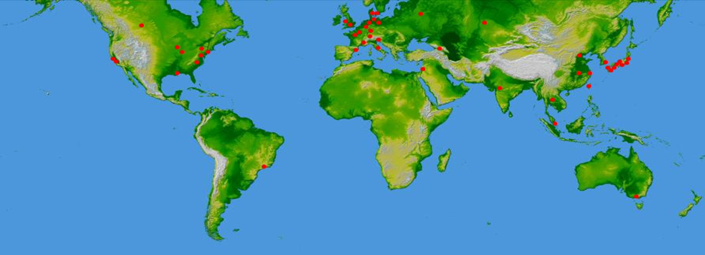
A Synchrotron Light Source for Africa
Africa is presently the only habitable continent without a synchrotron light source. Dozens of scientists from African countries now perform experiments at facilities in Europe and elsewhere. Their numbers are limited mostly by distance and travel cost. A light source in Africa would enable thousands of African scientists and engineers to gain access to this superb scientific and technological tool. Indeed, in order to be competitive socially, politically and economically in the years to come, access to a nearby synchrotron light source will be an absolute necessity.
A major workshop/conference on the African Light Source was held at the European Synchrotron Radiation Facility (ESRF) in Grenoble, France on Nov. 16-20, 2015. This included:
A Science Part during which African work performed at Light Sources around the world were presented, along with global highlights of research and facilities.
A Strategy / Policy Part which included discussions on the Roadmap for Africa and the Election and Founding of the new, fully mandated Steering Committee for the African Light Source to replace the Interim Steering Committee.
Grenoble Resolutions; see http://www.lightsources.org/press-release/2015/11/20/grenoble-resolutions-mark-historical-step-towards-african-light-source?qt-sitewide_events=0
Also see: www.africanlightsource.org

