Slide 1



Synchrotron Radiation and Structural Biology
Sine Larsen, Department of Chemistry
University of Copenhagen

Slide 2
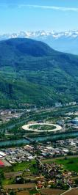
Outline:
Synchrotron radiation and Structural Biology from 2003 to 2013
Malaria proteins
Future developments
Ways to develop a case for an ALS

Slide 3
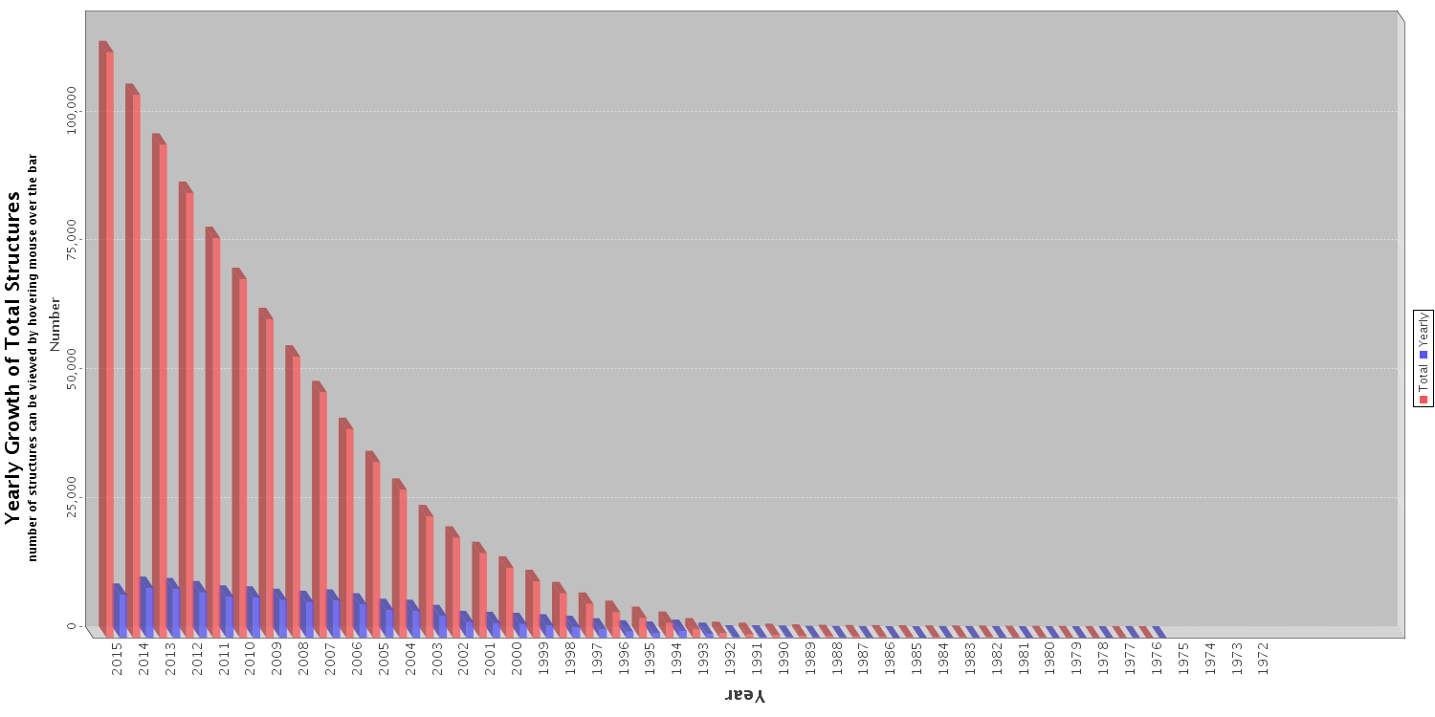
Deposited structures in the Protein Data Bank
Total : 113672
X-rays: 101330

Slide 4
DepositionYear | Total X-Ray Structures | Total Synch Structures | Total Synch Structures(%)
1995 | 971 | 167 | 17.2
1996 | 1149 | 275 | 23.9
1997 | 1502 | 490 | 32.6
1998 | 1793 | 673 | 37.5
1999 | 2149 | 1106 | 51.5
2000 | 2457 | 1500 | 61.1
2001 | 2660 | 1722 | 64.7
2002 | 2783 | 1919 | 69.0
2003 | 3921 | 2874 | 73.3
2004 | 4459 | 3351 | 75.2
2005 | 5136 | 3851 | 75.0
2006 | 5670 | 4425 | 78.0
2007 | 6708 | 5374 | 80.1
2008 | 6120 | 5098 | 83.3
2009 | 7377 | 6147 | 83.3
2010 | 7817 | 6805 | 87.1
2011 | 8117 | 6993 | 86.2
2012 | 8775 | 7799 | 88.9
2013 | 9212 | 8451 | 91.7
2014 | 9112 | 8244 | 90.5
2015 | 8344 | 4320 | 51.8
Total | 106232 | 81584 | 76.8
Nov. 3 2015

Slide 5
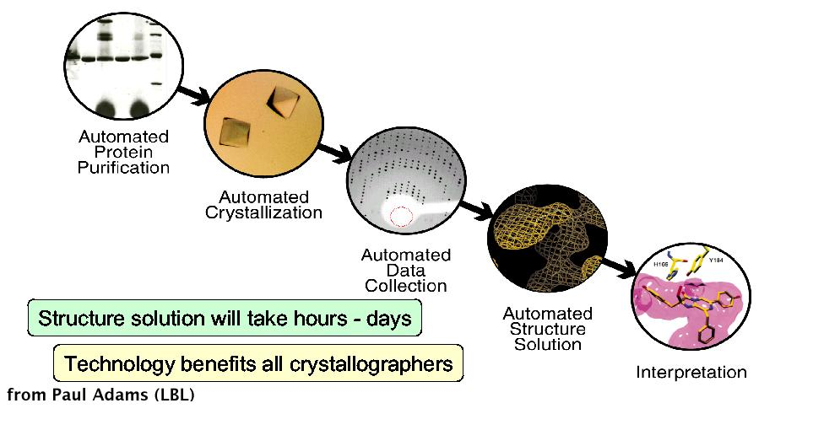
High throughput methods for X-ray crystallography

Slide 6
Automation of the Typical MX Experiment
Crystallisation
Information
Preparation
Beamline configuration,
alignment, validation.
Sample transport via courier
Mount Samples
Robotic sample changer.
Align Samples
Computer assisted alignment.
Initial Measurements
Indexing (strategy), XANES scan.
Collect Diffraction Data
Experiment
Database
Information feedback during data collection (solid line) and further back for sample screening (dashed line).
Integrate/Reduce
Data
Deposition
Phase/Model Build

Slide 7
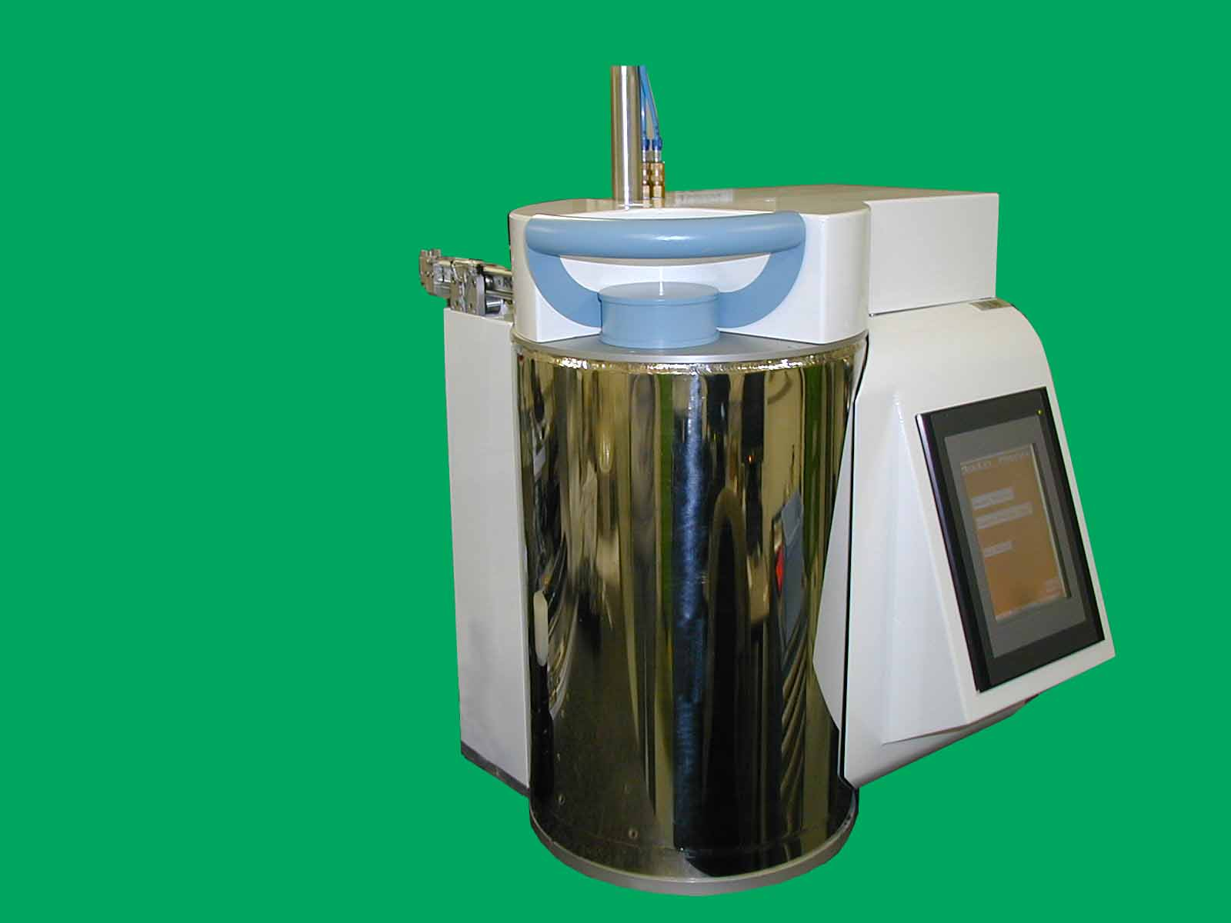
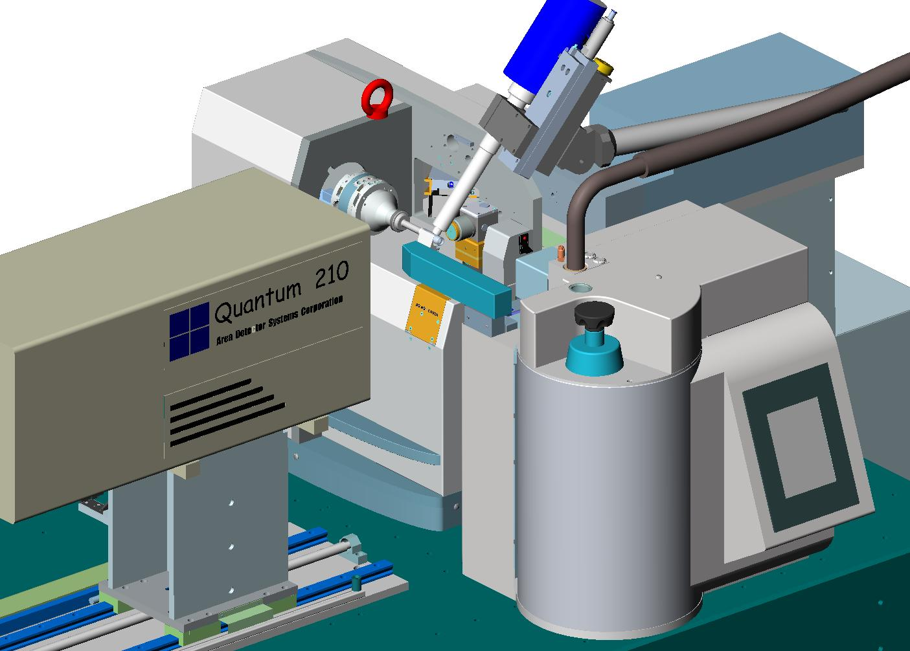
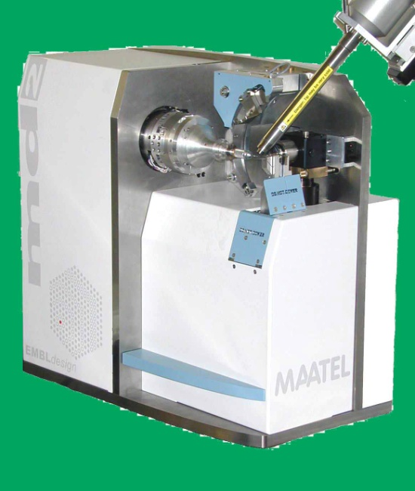
Mount and align samples
Sample changer
EMBL-Microdiffractometer
+
sample changer
Micro- or mini-diffractometer
A joint EMBL-ESRF-MRC-France project

Slide 8

Complementary methods
Analytical ultracentrifugation Size Exclusion Chromatography
Cryobench (spectroscopy) Protein Sequence analysis
Deuteration Lab SAXS/SANS
Electron Microscopy Surface Plasmon Resonance
High throughput crystallization also Circular Dichroism
of membrane proteins
High Field NMR Fluorescence spectroscopy
Mass spectrometry Light Scattering

Slide 9

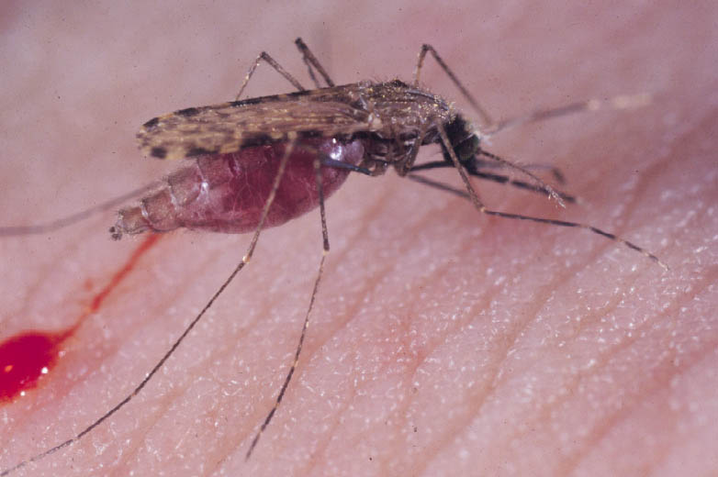
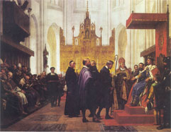
Plasmodium falciparum erythrocyte membrane protein 1 (PfEMP1) Antigens
Department of Chemistry
Stig Christoffersen,
Vladyslav Soroka
Annette Langkilde
Center for Medical Parasitology (CMP)
Ali Salanti, Louise Turner, Anja T.R. Jensen
Thor G. Theander and Lars Hviid
ESRF
Gordon Leonard
Funded by the “Program of Excellence” established by University of Copenhagen

Slide 10
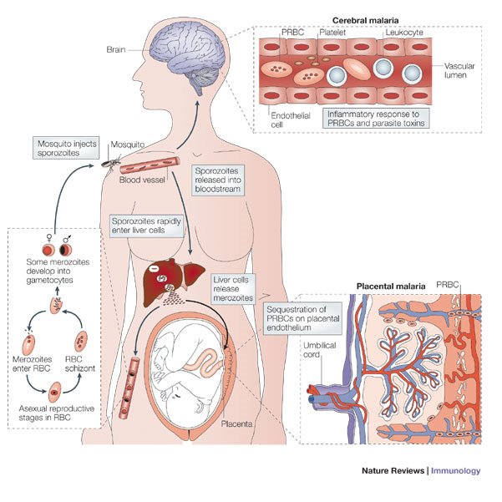

Slide 11
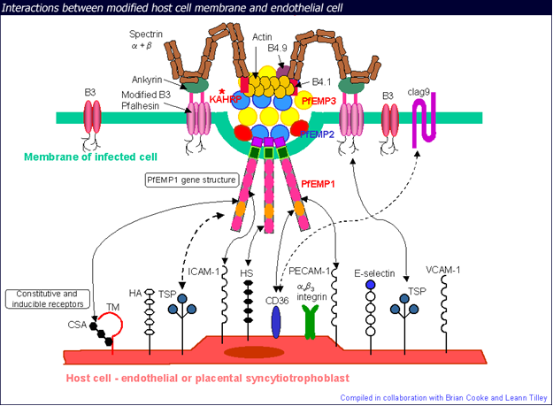
Cooke, Coppel & Wahlgren Parasitol Today 2000 16 416

Slide 12
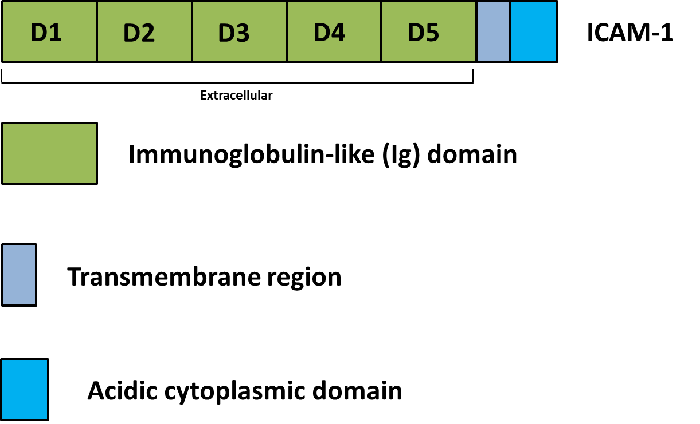
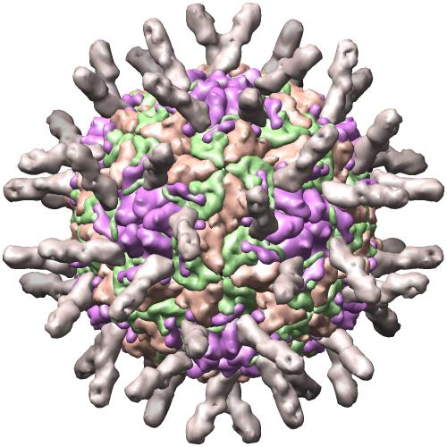
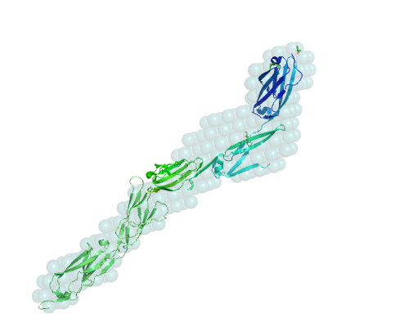
Intercellular Adhesion molecule 1-ICAM 1
ICAM 1 glycoprotein
Involved in Cerebral Malaria

Slide 13
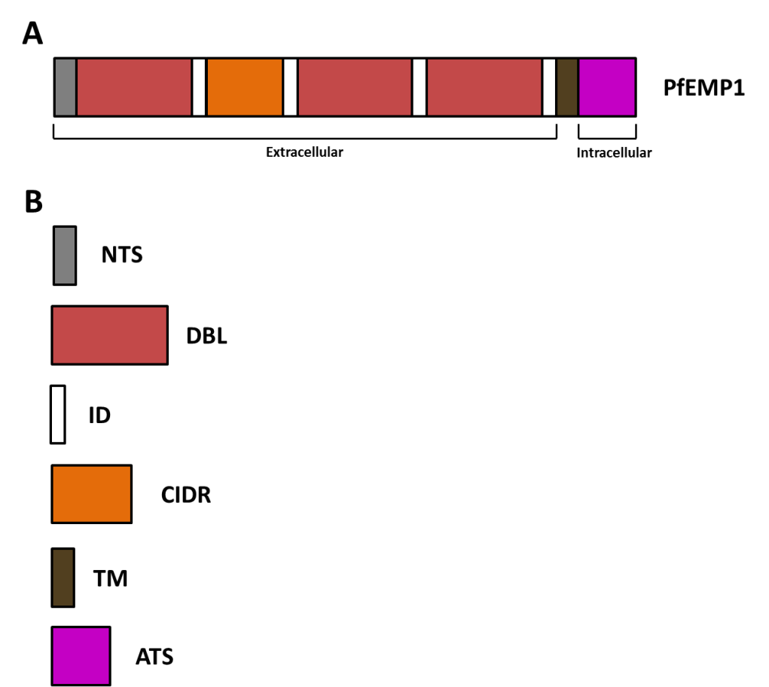
PfEMP1 proteins

Slide 14
ICAM-1 receptor binding PfEMP1’s involved in cerebral malaria.
VAR3 125 kDa
DBLa
CIDRa
DBLb
VAR20 280 kDa
DBLa
CIDRa
DBLb
DBL3
DBL4
CIDRb
VAR13 315 kDa
DBLa
CIDRa
DBLb
DBL3
CIDRb
DBL4
DBL5
Binds to the proteoglycan receptor ICAM-1

Slide 15
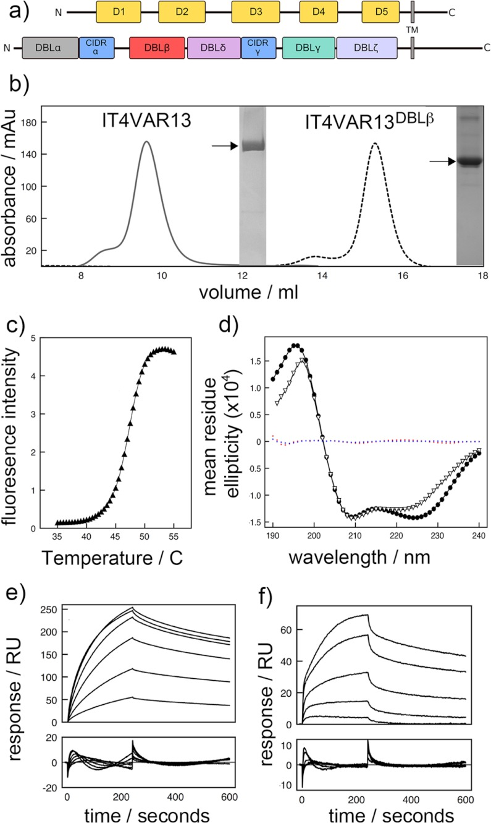
SEC and AUC shows that DBLβ interacts with ICAM-1

Slide 16
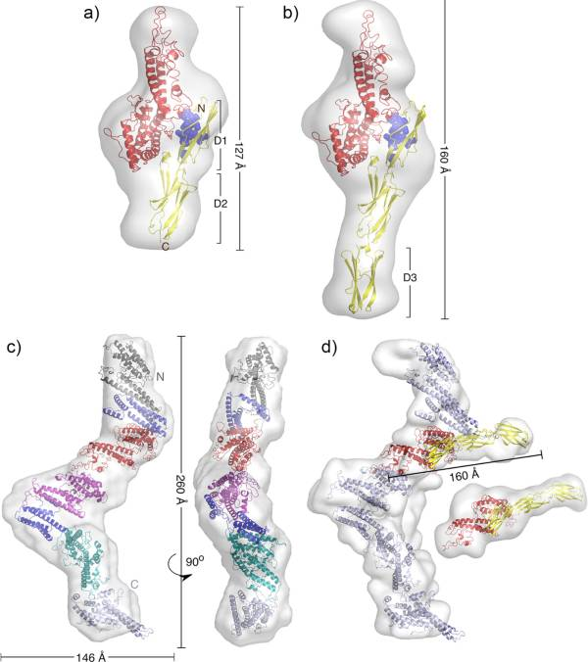
IT4VAR13(DBLβ)
ICAM-1 (D1-D5)
IT4VAR13 SAXS structure
IT4VAR3ICAM(D1-D5)
Brown, Turner, Christoffersen et al J. Biol.Chem. 288 (2013) 5992-6003

Slide 17
Crystallography can give a more details
The DLBγ domain of VAR 4

Slide 18
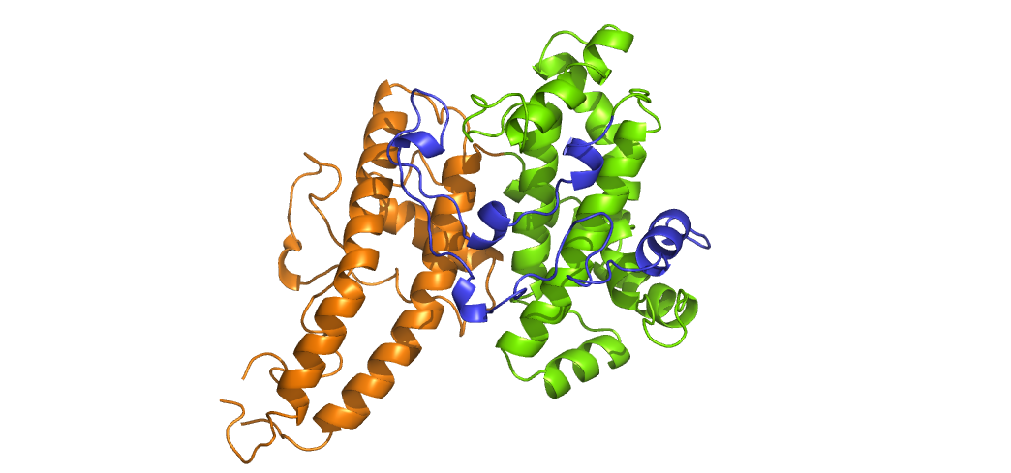
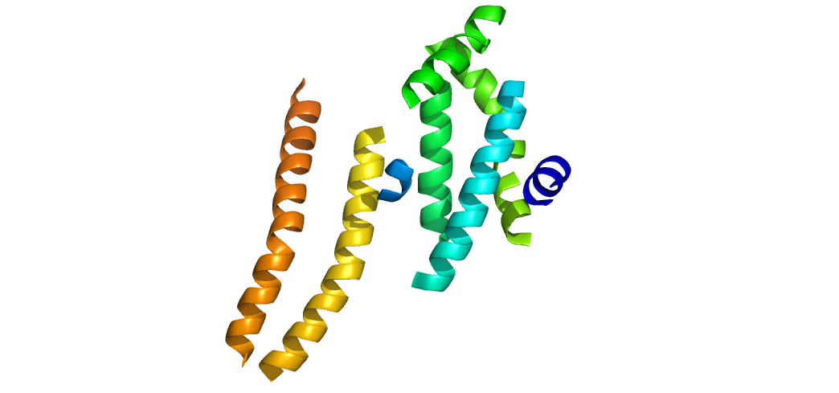
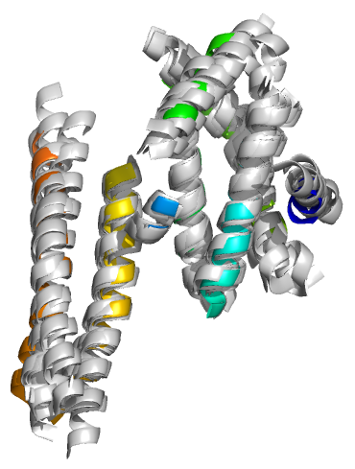
PfEMP1 protein – VAR4
D1
D2
D3
D4
D5
D6
D7
D8
D9
A
NTSA2
DBLα1.4
CIDRα1.6
ID
DBLβ3
ID
DBLβ3
ID
DBLγ13
ID
DBLδ1
CIDRβ5
ID
ATSA2
H3
H4
H2
H1a
H6
PPRRQ
H1
H5
B
C
D

Slide 19
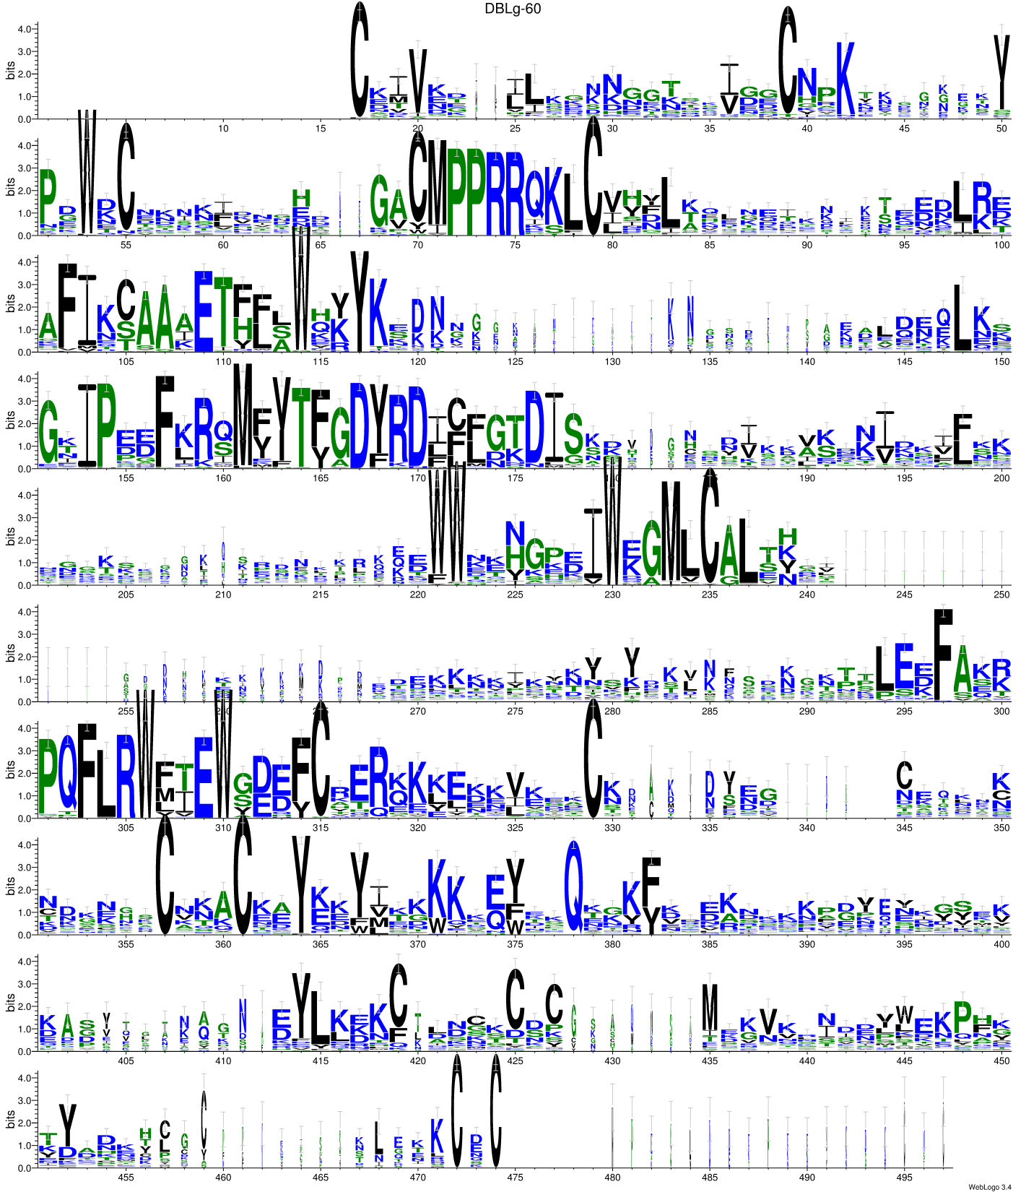
Sequence alignments of
DBLγ domains

Slide 20
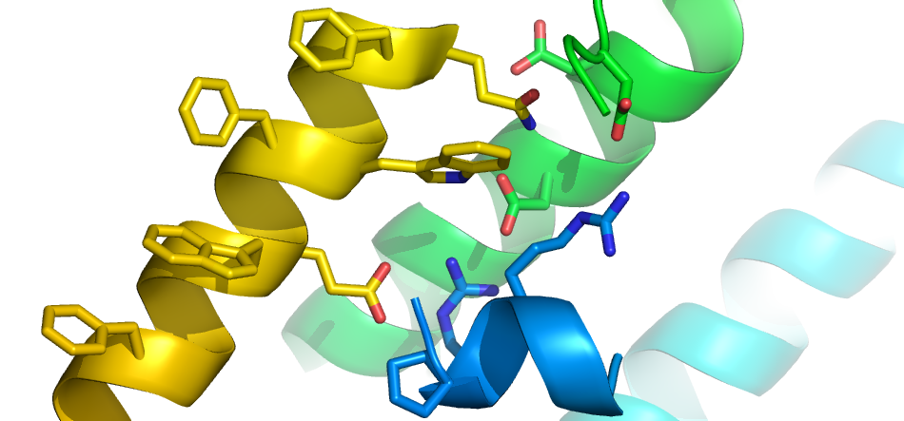
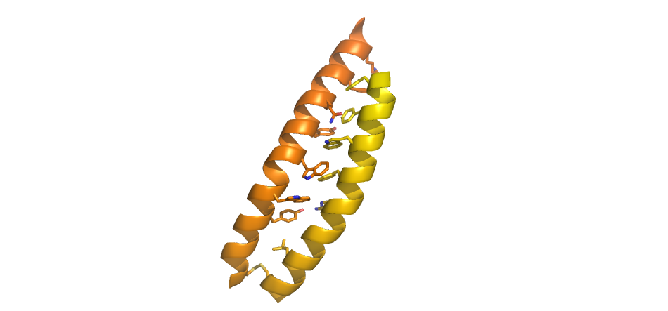
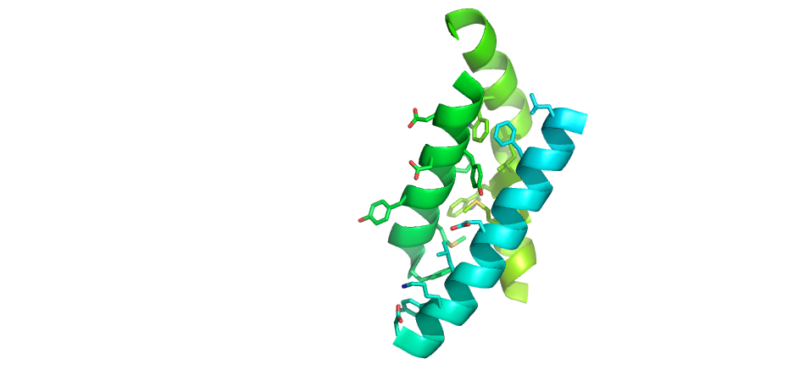
A
C
F2179
D2082
F2183
N2178
D2088
W2182
H2
K2018
H5
D2079
F1935
W2186
R2007
R2008
Y2258
F2190
E2185
H1
F2183
N2254
H6
Y2251
W2186
PPRRQ
W2247
B
F2190
H4
W2243
R2194
H5
D2082
L2028
W2125
Y2240
F2032
L2201
D2079
Y2080
H2
H1
C2233
W2133
C2205
M2136
M2073
E2039
F2069
L2043
Conserved residues are found in the core domain
Y2047
K2046
D2050

Slide 21
AB01 binds to the DBLγ domain
H/D X MS used to identify the binding sites

Slide 22
-5% 0% 5% 10% 15% 20% 25% 30% 35% 40%
persentage protection
1
MGHHHHHENLYFQGGSCKIVEEVLSKPRDKTTGGIDHCNPKYYPRKENYPGWNCTPGQF
H1a
61
KSGHAGACMPPRRIKLCVINLQYLNEKKSPEELRKAFIQCAAIETYWLWQKYKKDKNGGV
H1b
H1
121
AQAKLNSGTIPDDFKRQMFYTFGDYRDLCLDTDISSKADTSTGVGKVKINIDSVFQKIDI
H2a
H2
H3
181
TNVEQRKPWWGKNAEAIWDGMLCALSYNTTNKNMDYNAHTKLNPTYGYNAIKSELEDFVN
H4
H5a
241
RPQFLRWFTEWSDEFCTERSIKIKELETKCNDCTVSESGTSDATGNKTCDDKDKCDECKR
H5
301
ACTTYKTWLKNWKTQYKTQSKKYFDDKRKELYKSIDDVASSTQAYQYLHAQLKKLCGNAD
H6
H7a
361
CKCMDGESKETTGQPDNSHDSHMPASLDDEPEEVNGKCNC

Slide 23
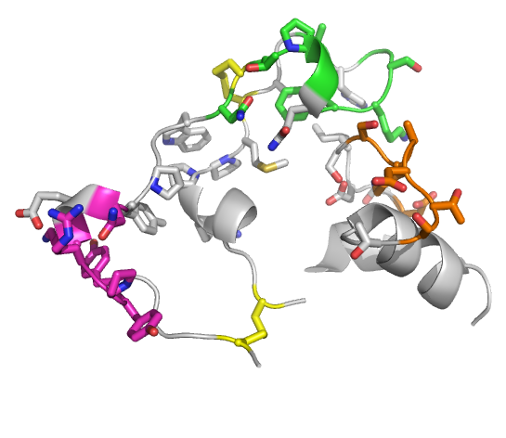
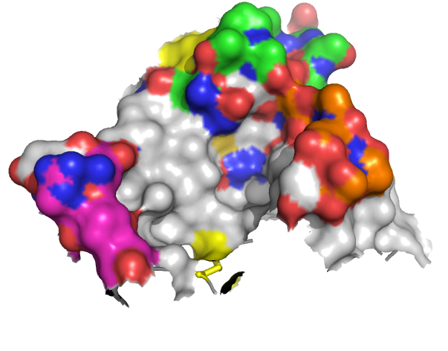
P1747
P2
T1747
S1753
P3
C1746
N1745
K1752
N1740
D1850
Y1735
PPRRQ
R1737
C1768
H3
Y1734
C1730
P1
P1 and P3 from H/DX MS P2 from mimitope

Slide 24
DBL domain | Ligand | Location respectively to the DBL core
DBL4g-Var4 | Mab AB01 | 1734-YYPRKENYPGW-1745 H1a – PPRRQ loop in S1 subdomain. 1842-DTDISSKADTST-1853 H2-H3 loop in the S2.
DBL1a-Var0 (2xuo) | Heparin | K20, K32, K40 H1a helix; K226, K227, K230 H3 helix; K423, K424 H6-H7a loop; K451, K456 (H7a-H8a loop).
DBL3x-Var2-CSA (3cml) | Sulphate/CSA | K1324, G1329, and R1467 from H1-H2 loop in S2 subdomain
EBA-175 (1zro) | Sialic acid | 27-KKNDRSN-33 H1a – PPRRQ loop (S1)
PvDBP (2C6J) | DARC | 91-NYQYNKEFC-98 from H1-H2 loop (S2) and 169-KEKFVWIC-176 from H4-H5 loop (S2)

Slide 25
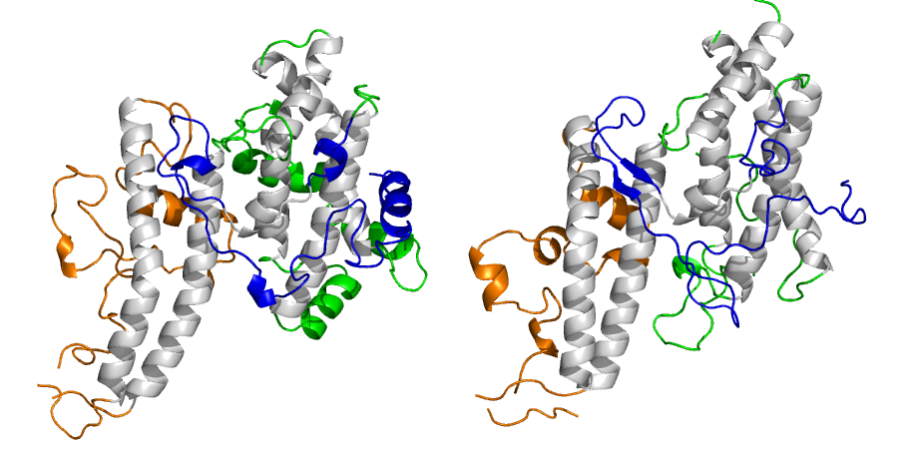
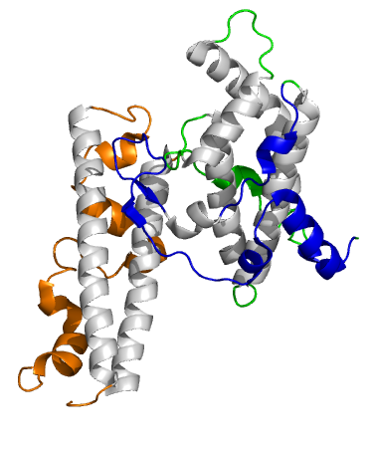
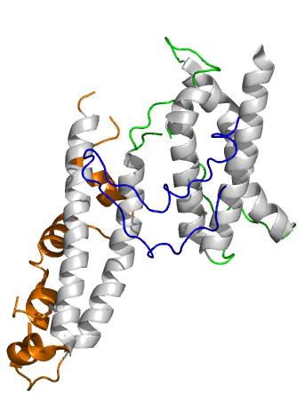
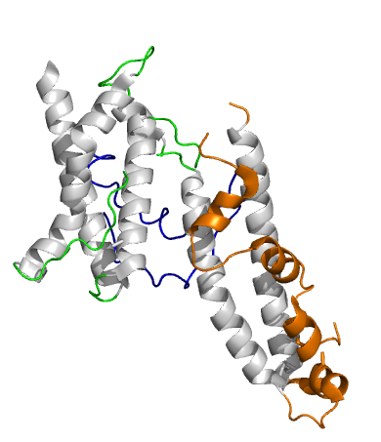
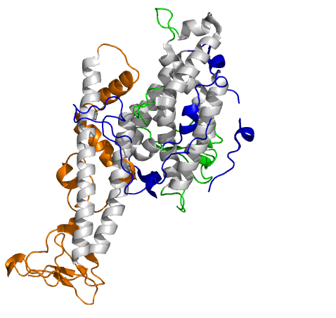
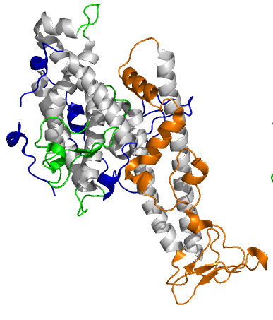
DBLγ
DBL3X
3cml
EBA-175
1zro
AB01
CSA
Sialic acid
DBP P. vivax 2cbj
DBL1a 2xuo
DARC
Heparin

Slide 26
SAXS studies of VARCSA a PfEMP1 protein involved in placenta malaria

Slide 27
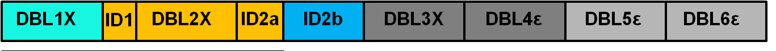
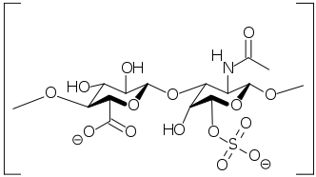
VAR2CSA- placenta malaria
Identified as ”the most promising” vaccine candidate against pregnancy associated malaria. Binds specifically to Chondroitin Sulfate A (CSA).

Slide 28
Truncated Protein Constructs of VAR2CSA
CSA affinity
DBL1
ID1
310 kDa
DBL2
ID2
CIDR
DBL3*
DBL4
DBL5
DBL6*
(TM)
100%
DBL1
ID1
230 kDa
DBL2
ID2
CIDR
DBL3*
DBL4
100%
ID1
190 kDa
DBL2
ID2
CIDR
DBL3*
DBL4
100%
DBL1
ID1
DBL2
ID2
60%
120 kDa
DBL1
ID1
DBL2
ID2
CIDR
DBL3*
100%
(Multiple bands on SDS-page)
- reveal CSA binding domains, and propose a model for the overall structure of VAR2CSA using SAXS

Slide 29
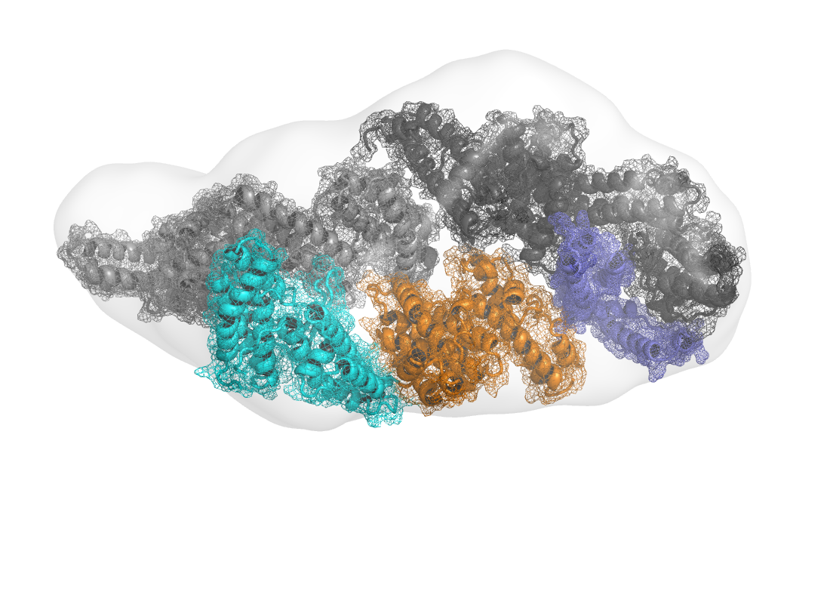
DBL4
DBL5
DBL6
DBL3
CIDR (ID2b)
DBL2
DBL1
CSA-blocking antibody epitopes have been found on DBL3, DBL4 and DBL5 single domains.
The CSA binding was mapped to the DBL2 domain.
Clausen, Christophersen et al J.Biol. Chem. 287, 23332 (2012)

Slide 30
VAR2CSA interacts with cancer cells
Salanti, Clausen et al Cancer Cell 28 (2015) 500-514

Slide 31
PfEMP1 proteins
The modular PfEMP1 proteins vary in shape from compact to elongated
The DBL domains are comprised of a helical core structure with additional loops and helices
The interactions in the core structure involve residues that are conserved among rhe different types of DBL domains
The interaction partners interact primarily with the additional helices and loops
Combining results from SAXS and diffraction is important

Slide 32
The future for structural biology
is bright!!!
Better automation and better detectors
Impact of free electron lasers
Serial Synchrotron Crystallography
Room temperature studies
Oxidation states of metal ions in proteins
Ultimate storage rings EBS
Cryo EM

Slide 33
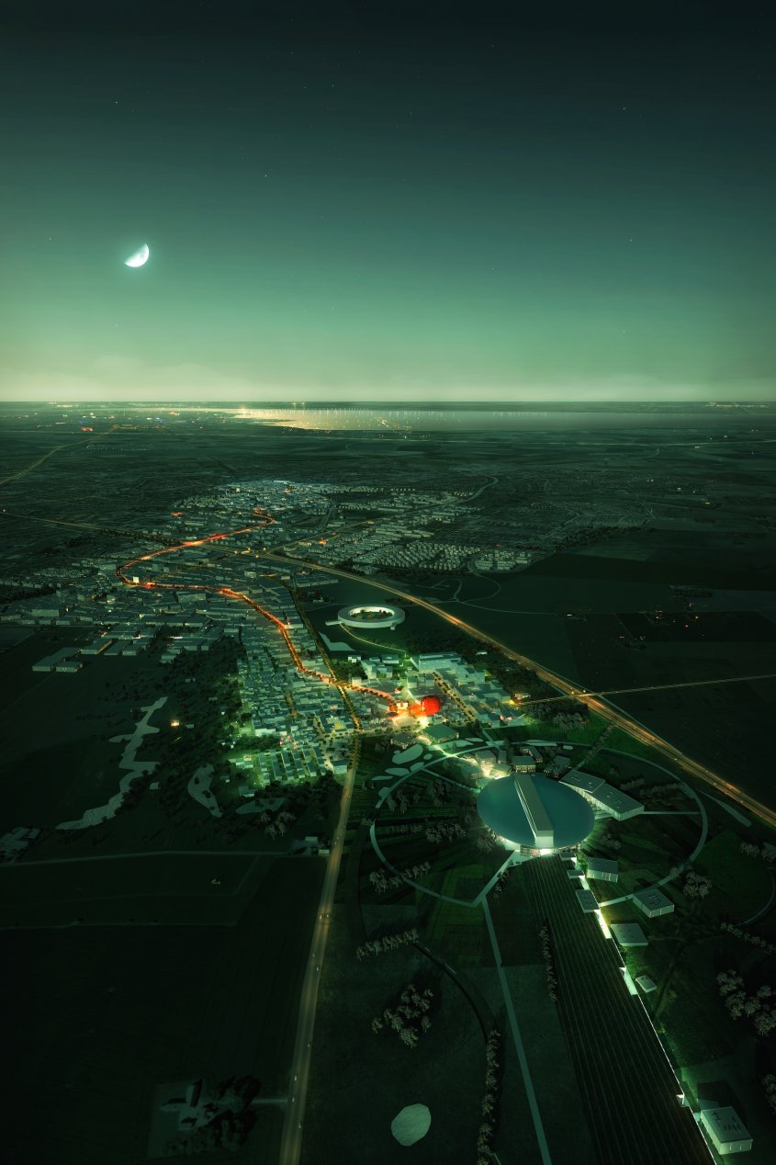
Brunnshög North of Lund, Sweden 2020
Home of the European Spallation Source (ESS)
and
MAX IV the first ultimate storage ring

Slide 34
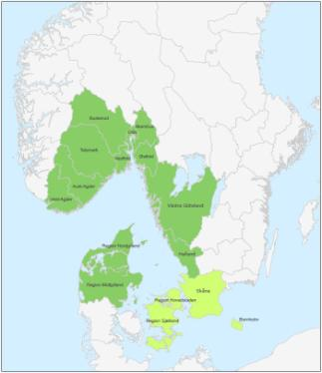



Interreg Öresund-Kattegat-Skagerrak
15 regions SE, DK, NO
136 MEUR for cross border cooperation
Co-financing 50%

Slide 35
ESS & MAX IV: Cross Border Science and Society
International Attractiveness
Cross Border Barriers
Cross Border Network and Research Programme
Strategic Platform
Regional Supply Base
Welcoming International Talents

Slide 36












Slide 37
World of synchrotrons
Thank you for your attention
There is room for one in Africa

