Slide 1
THE IMPACT OF SYNCHROTRON RADIATION ON SCIENCE & SOCIETY IN THE DEVELOPING WORLD
Herman Winick
SLAC National Accelerator Laboratory
Winick@slac.stanford.edu
AfLS Workshop/Conference
ESRF, Grenoble
Nov. 16-20, 2015
Nov. 18, 2015; 5:30 am

Slide 2
Why a Synchrotron Radiation Facility in the Developing World?
World-class basic & applied research
Train graduate students who will no longer have to go abroad
Attract scientists working abroad to return (reverse the brain drain)
Address local/regional issues/concerns
biomedical, environmental, human heritage
Promote development of high-tech industry (capacity building)
Use scientific cooperation to promote peace & understanding between people from different traditions, religions, races, & political systems.
Light sources operate in a democratic mode, open to all (women, minorities…)

Slide 3
Projects in the Developing? World
Light Sources in Construction or recently Started Operation
SESAME in the Middle East (starts research in 2016)
SOLARIS in Poland
Light Sources in Planning
African Light Source (AfLS), Iranian Light Source Facility (ILSF), Mexican Light Source (MLS), Turkish Light Source, Others?? (Cuba)
Light Sources begun in developing countries decades ago, now in operation, with upgrades & new facilities in progress or planning
China, Brazil, India, Korea, Taiwan, Thailand…

Slide 4

LIGHT SOURCES AROUND THE WORLD

Slide 5

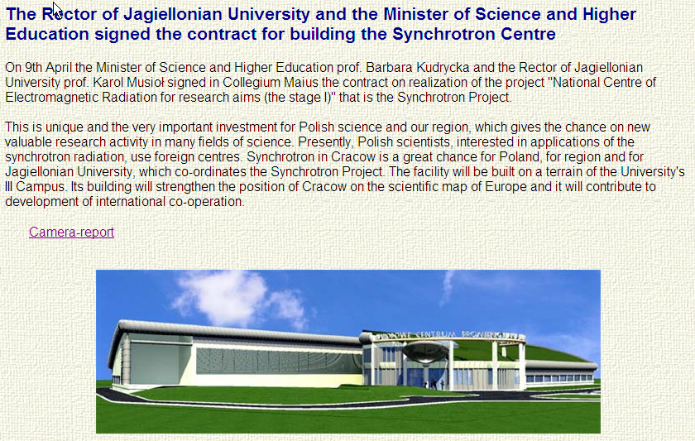
SOLARIS storage ring circumference: 95 m, electron energy: 0.7 - 1.5 GeV.
Copy of MAX IV 1.5 GeV ring; First light achieved June, 2015

Slide 6
Witamy na stronie synchrotronu SOLARIS!
Narodowe Centrum Promieniowania Synchrotronowego SOLARIS buduje w Krakowie pierwszy w Polsce synchrotron. Synchrotron to nowoczesne multidyscyplinarne urządzenie badawcze, które otworzy nowe możliwości w wielu dziedzinach nauki takich jak: biologia, chemia, fizyka, inżynieria materiałowa, medycyna, farmakologia, geologia czy krystalografia.
Centrum SOLARIS będzie otwarte dla wszystkich grup badawczych z Polski, a także z zagranicy. Badania będą mogły się rozpocząć w 2016 roku.
----------------------------------------------------------------------
Welcome to the website of synchrotron SOLARIS!
National Centre for Synchrotron Radiation SOLARIS builds in Krakow, Poland's first synchrotron. Synchrotron is a modern multidisciplinary research unit, which will open up new opportunities in many fields of science such as biology, chemistry, physics, materials engineering, medicine, pharmacology, geology or x-ray crystallography.
SOLARIS Centre will be open to all Polish research groups, as well as from abroad. The study will be able to start in 2016.

Slide 7
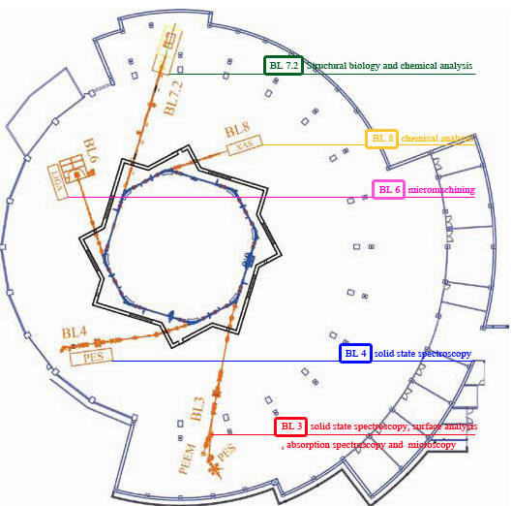
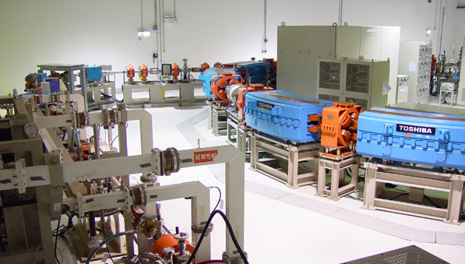
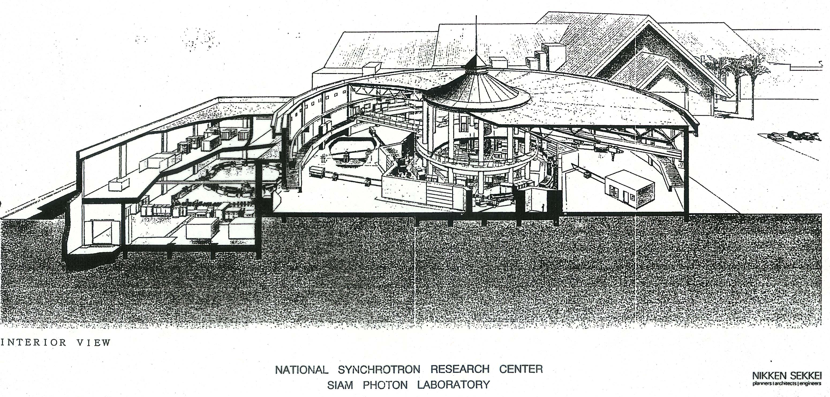
Synchrotron light in Thailand
SIAM facility; gift by Japan of 1 GeV SOR-Tech facility
An initiative by Takehiko Ishii

Slide 8
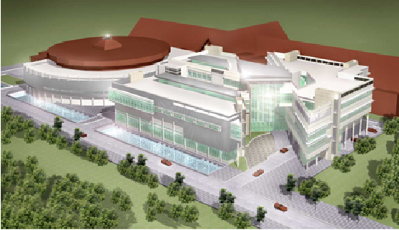
National Synchrotron Research Center (NSRC); Thailand

Slide 9
SESAME
Synchrotron-light for Experimental Science and
Applications in the Middle East
A Third Generation Light Source for the Middle East
Modeled on CERN, Under the Auspices of UNESCO
A Collaboration of 9 Middle East countries
On Track for startup in 2015/16
An example for other regions, e.g.
      Sub-Saharan Africa
      Central Asia
      ...

Slide 10
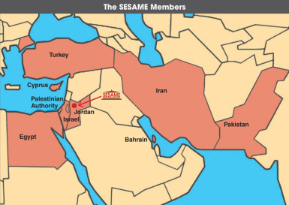
SESAME (Synchrotron light for Experimental Science and Applications in the Middle East) is a third generation light-source
under construction near Amman
Members: Bahrain, Cyprus, Egypt, Iran, Israel, Jordan, Pakistan, Palestinian Authority, Turkey
Observers: EU, France, Germany, Greece, Italy, Japan, Kuwait, Portugal, Russian Federation, Sweden, Switzerland, UK, USA
Purpose: to foster
- science* and technology in the Middle East and neighbouring countries
* from biology and medical sciences through materials science and physics to archaeology; endorsed by IUPAP, IUPAC, IUBMB, 45 Nobel Laureates,..
- cooperation across political divides
UNESCO Executive Board (2002) described SESAME as “a quintessential UNESCO project combining capacity building with vital peace-building through science” and “a model project for other regions”

Slide 11
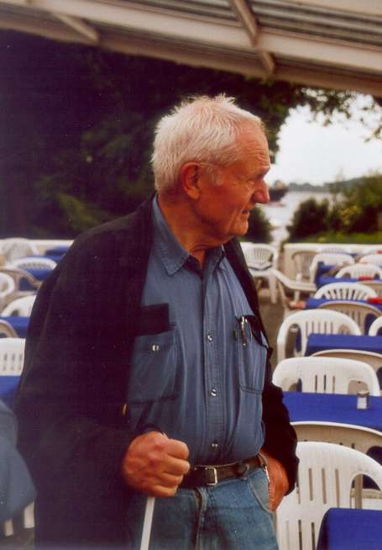
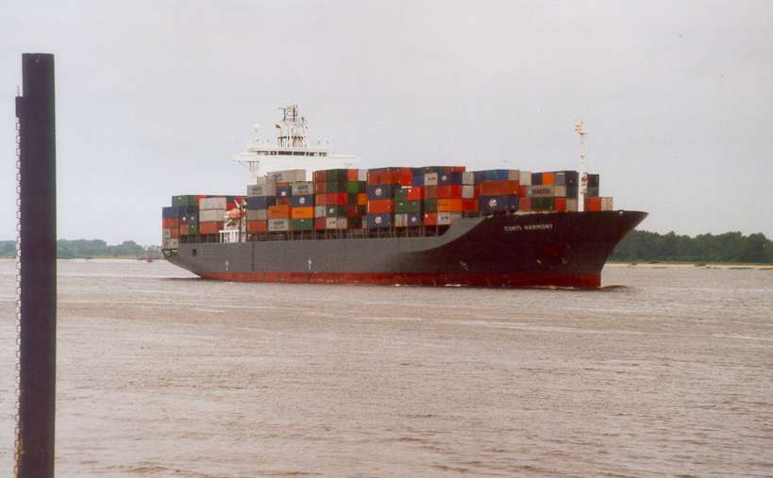
Gus Voss (1929-2013) watching the boat leave Hamburg harbor on its way to Aqaba, Jordan with BESSY I on board; June 7, 2002

Slide 12
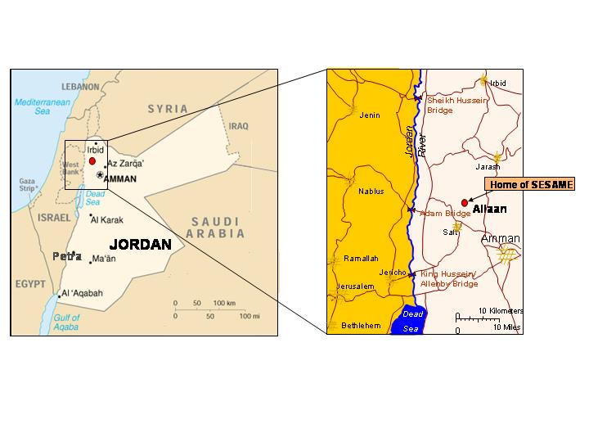
SESAME location in Allaan, Jordan

Slide 13
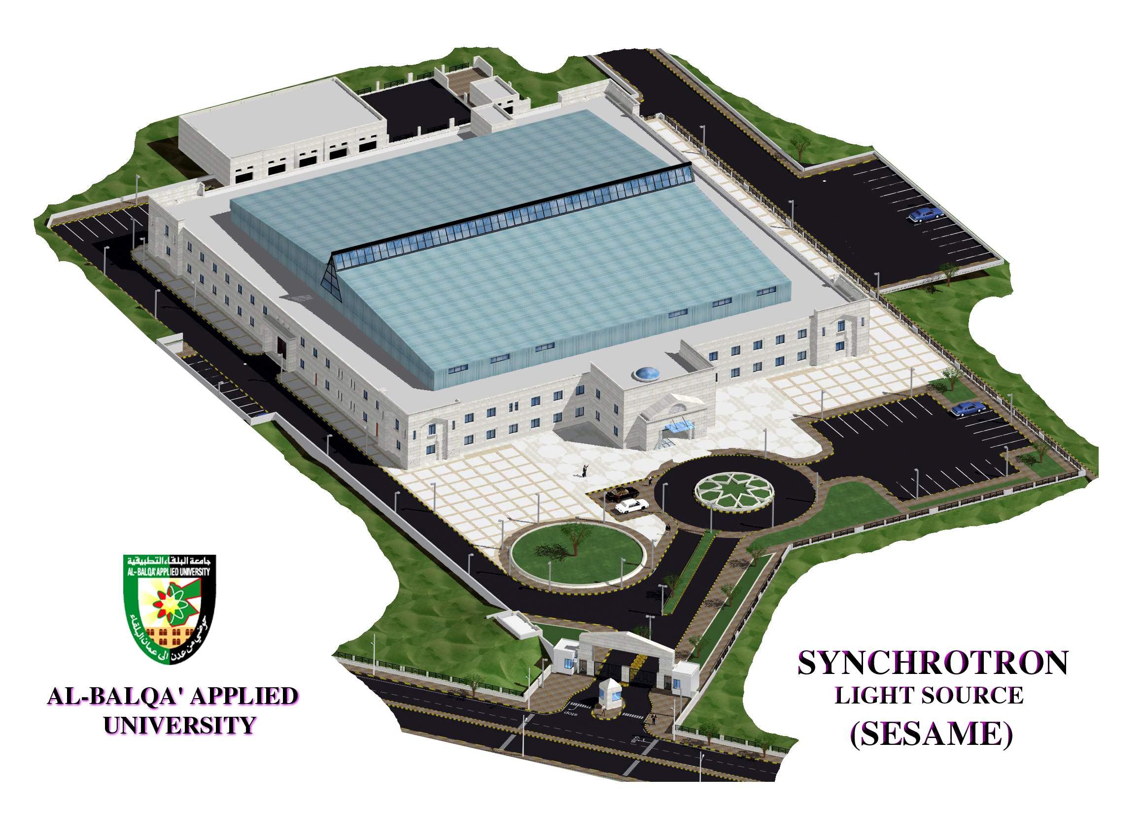
Synchrotron-Light for Experimental Science
and
Applications in the Middle East
Bahrain, Cyprus, Egypt, Iran, Israel, Jordan, Pakistan, Palestinian Authority, Turkey
www.sesame.org.jo

Slide 14
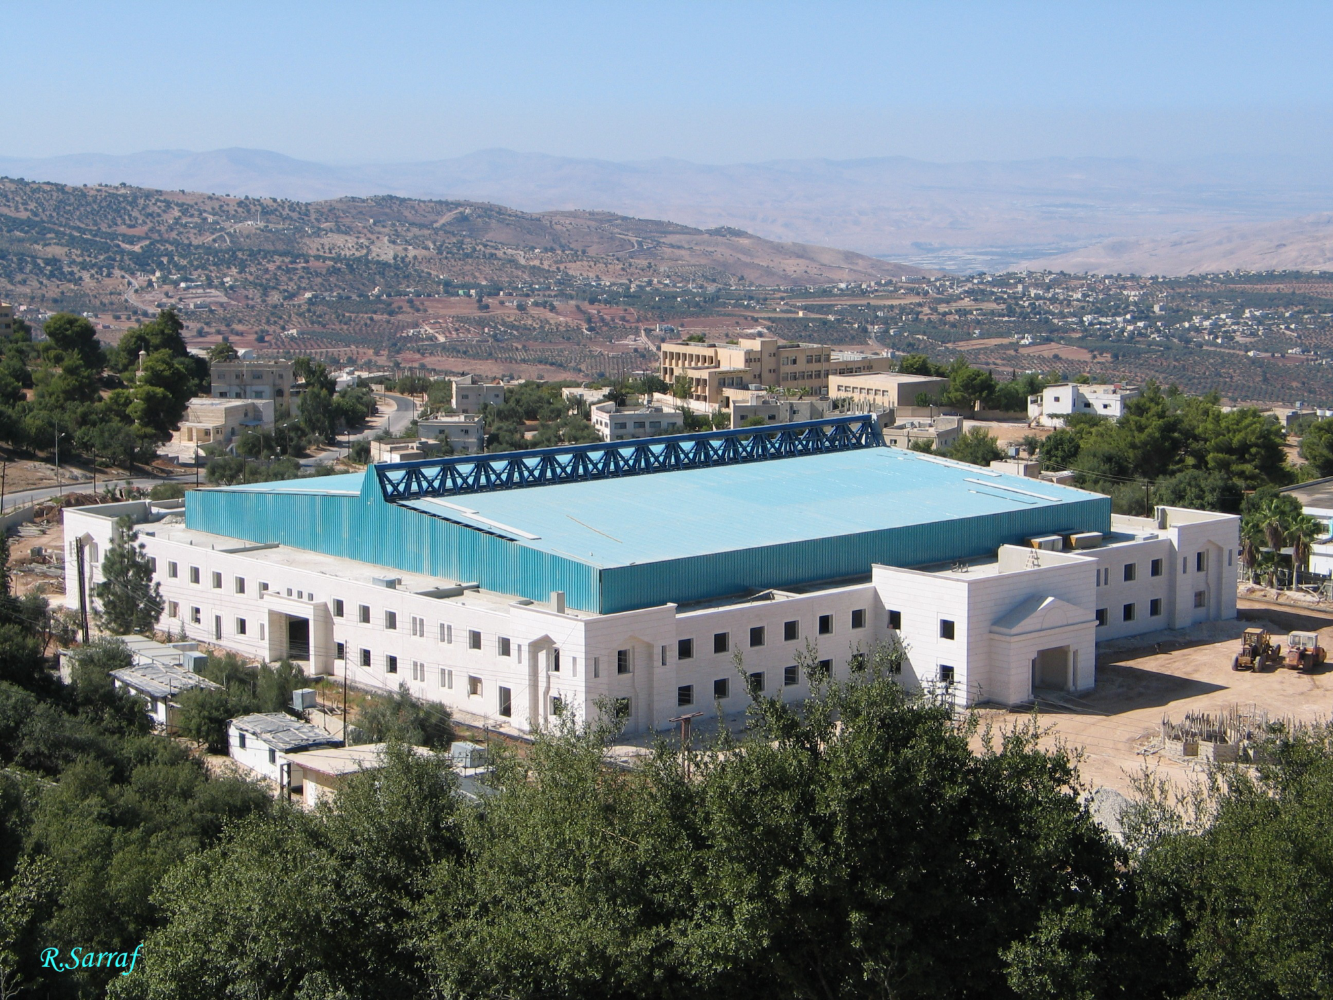

Slide 15
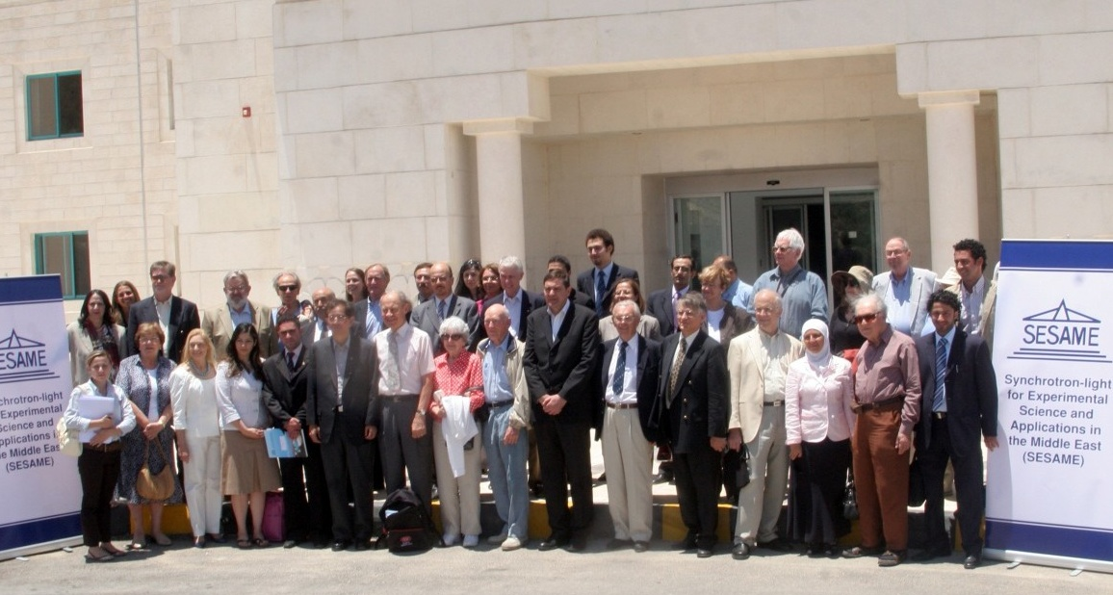
Nobel Laureates visit SESAME site in June, 2008
45 Laureates endorse SESAME “as a beacon, demonstrating how shared scientific initiatives can help light the way towards peace”.

Slide 16
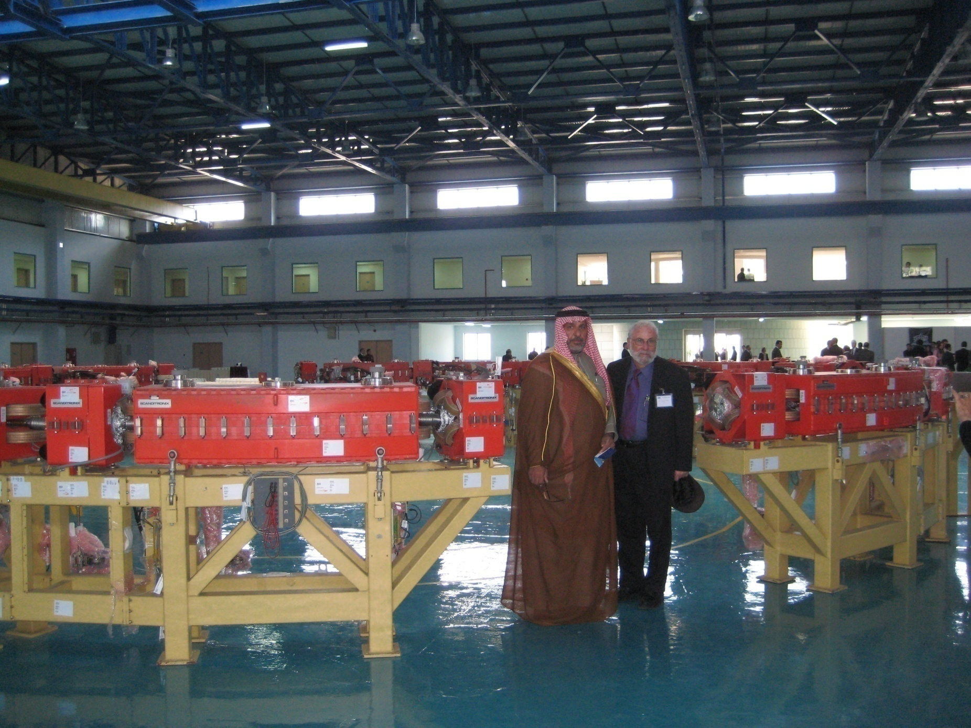
BESSY I 0.8 GeV Booster Synchrotron set up in SESAME building for “soft” inauguration on November 3, 2008
Mayor of Salt City in Jordan, Mr. Salameh, and Herman Winick

Slide 17
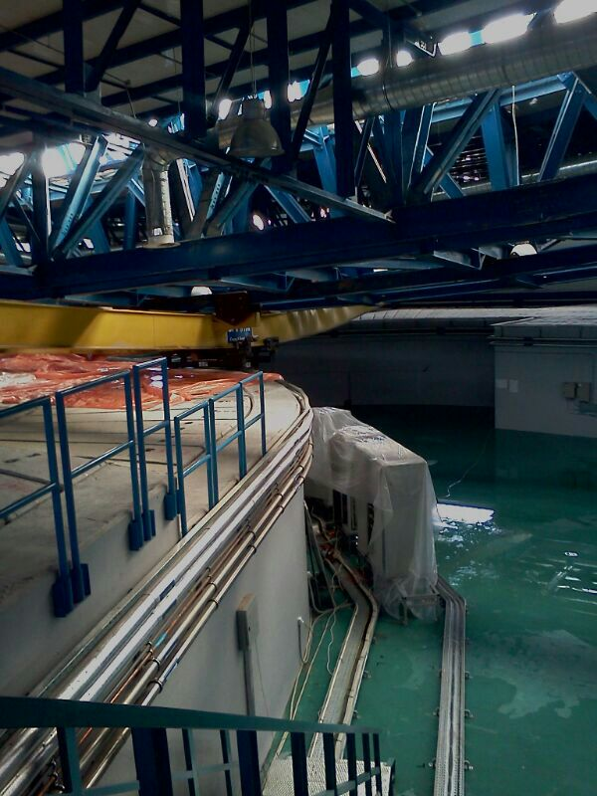
ROOF COLLAPSE IN SNOWSTORM
Jordan was hit by an unusual severe snow storm Dec 11 – 14, 2013. The SESAME experimental hall roof caved in due to heavy wind, rainfall and dense snow. Allan is located 680 m above sea level and typically snow falls occur for altitudes above 800 m in Jordan. Allan is characterized by rain fall. The last light snow seen in Allan was in winter 1992. The Jordanian code for buildings requires accounting for snow load of 75 Kg/square meter in such a location. The steel structure designer considered a load of 175 kg/square meter of snow. Due to the strong westerly winds, a heavy accumulation of snow and hail accumulated on the corrugated metal sandwich panel roof. This resulted in exceptionally heavy load and weak points in the middle of the structure that yielded under pressure. As a result the main truss bent in the middle and rested on the shielding wall, that acted as a support for the truss and metal frame structure. Fortunately, no one was hurt and no equipment was damaged.

Slide 18
Members
Observers
Governing Body
Council is Modelled on CERN Council
Each Member one vote
Two delegates
BAHRAIN
Cyprus
EGYPT
Iran
ISRAEL
JORDAN
PAKISTAN
PALESTINIAN AUTHORITY
TURKEY
France
EU
Germany
Greece
Italy
Japan
Kuwait
Portugal
Russia
Sweden
Switzerland
UK
USA

Slide 19
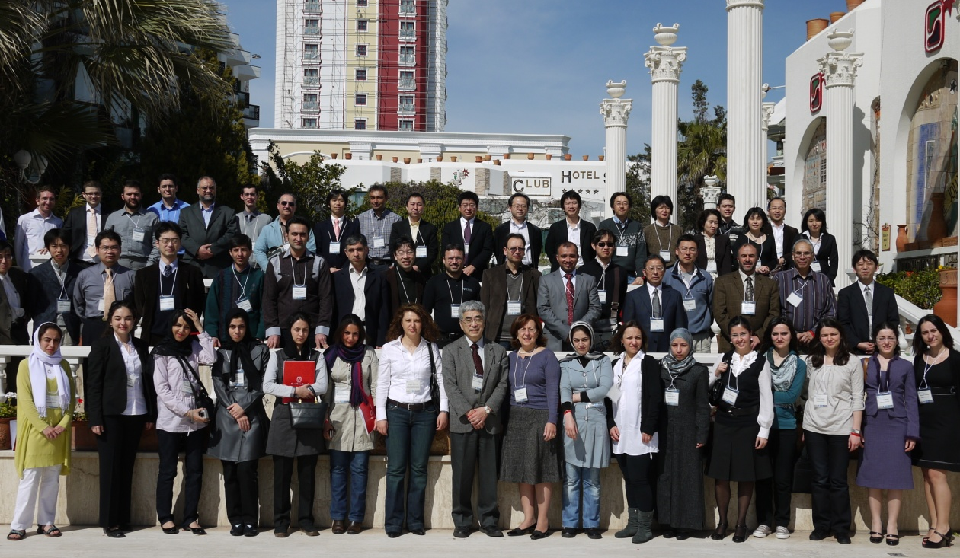
Japan Society for the Promotion of Science (JSPS)
JSPS-SESAME-Sabanci Univ. School; Turkey, March 1-5, 2010

Slide 20
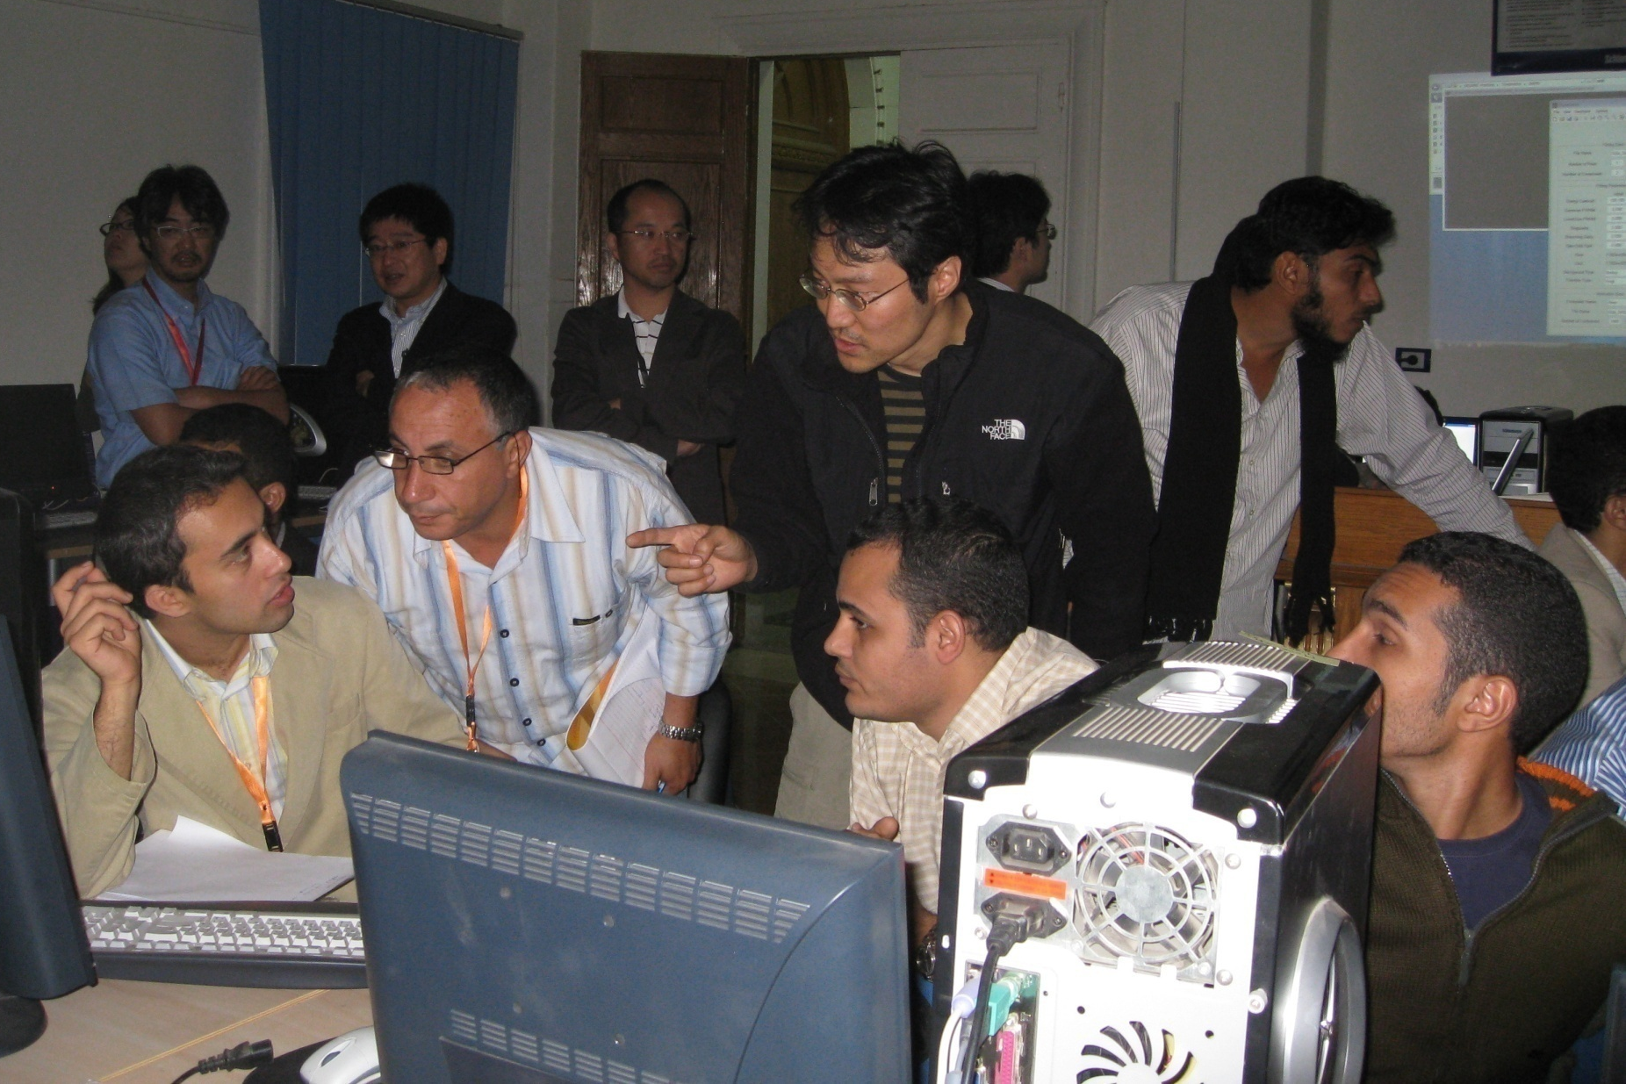
Hands-on Session at SESAME-JSPS School for Synchrotron Sciences; Cairo, Egypt; Nov. 17-23, 2008

Slide 21
SESAME; in construction in Jordan www.sesame.org.jo
2.5 Gev
400 mA
C = 133 m
Emitt; 26 nm
12 spaces for wigglers or undulators
16 bend magnet lines
Beam lines up to 36 m long
Operational in 2016

Slide 22
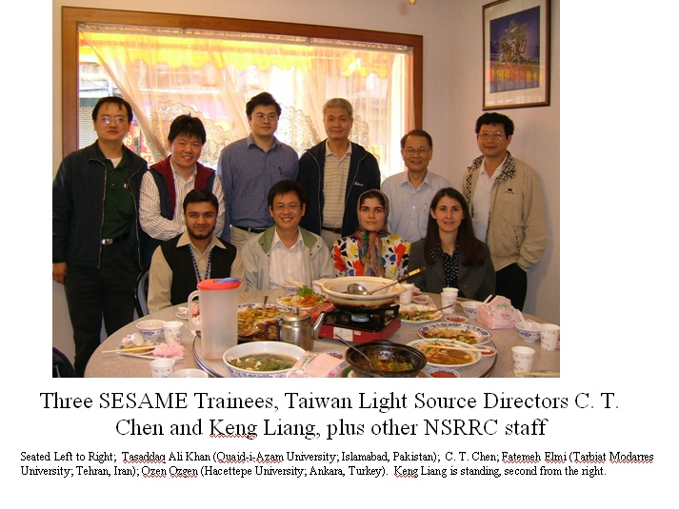

Slide 23
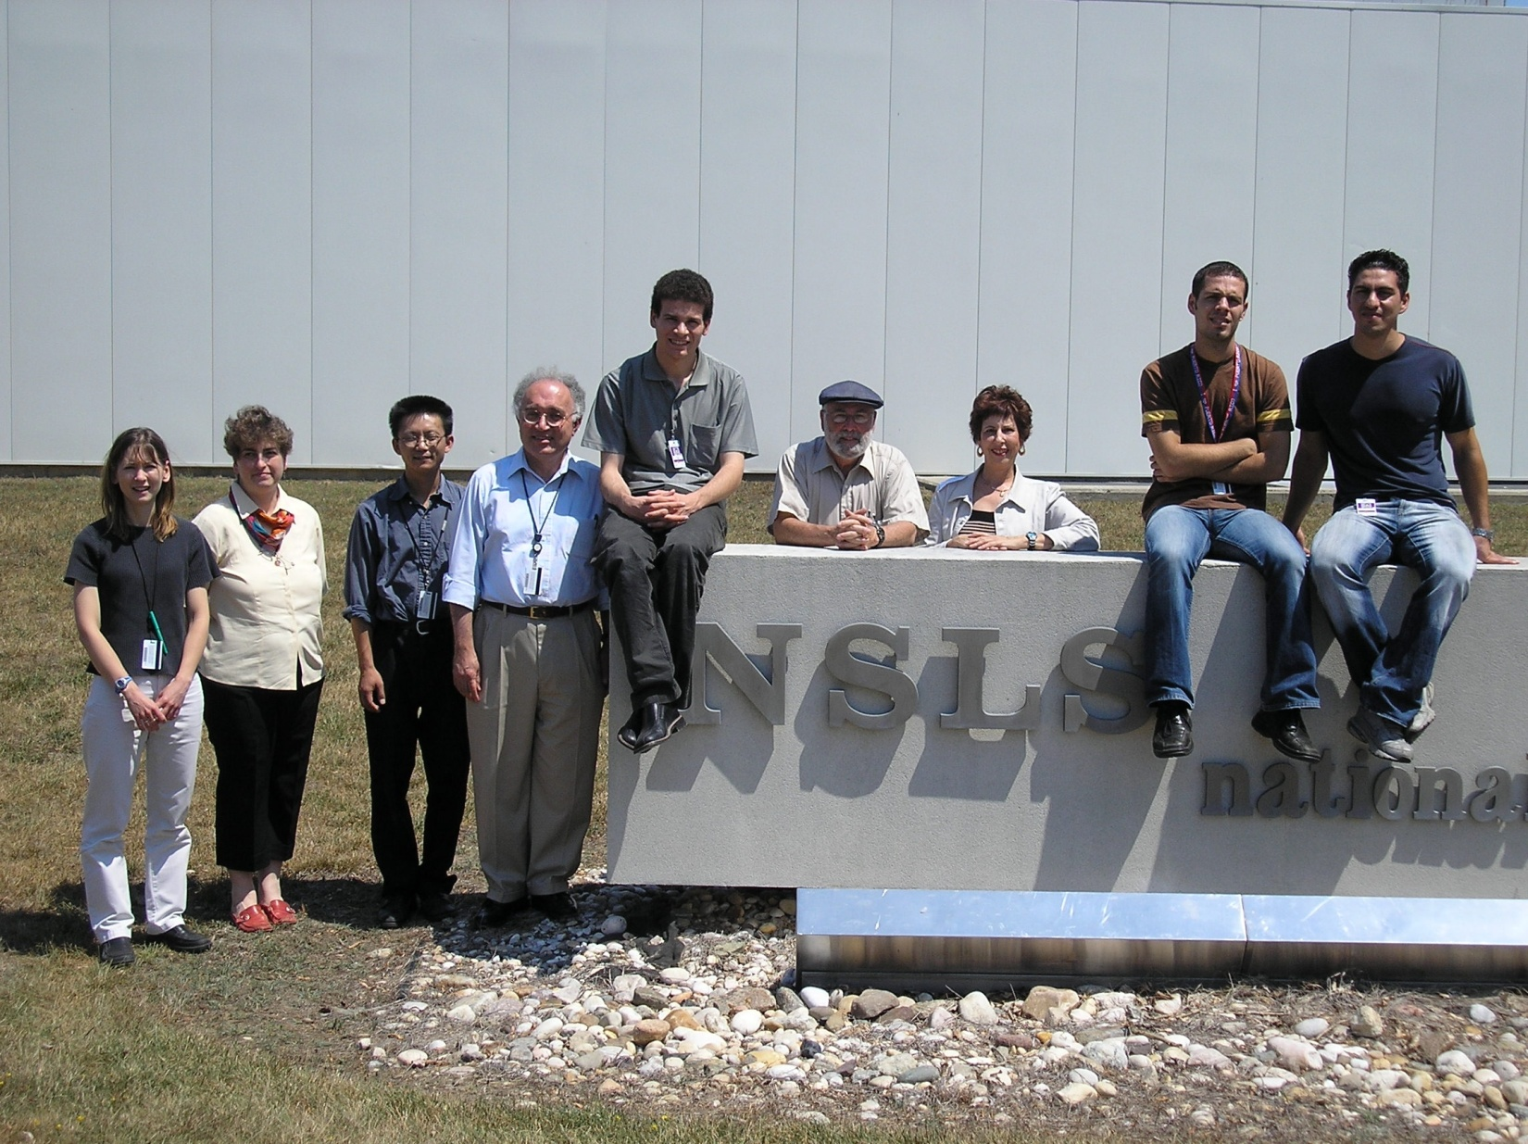
Israeli-Arab students from Ben-Gurion University at NSLS (Brookhaven Lab) for one month, summer 2005. Funded by the US Department of Energy
Lisa Miller, Vivian Stojanoff, Zhong Zhong, Avraham Dilmanian, Mahmoud Simri, Herman Winick, Brenda Laster, Ebrahim Mahajna, Sami Khoury-Salameh

Slide 24
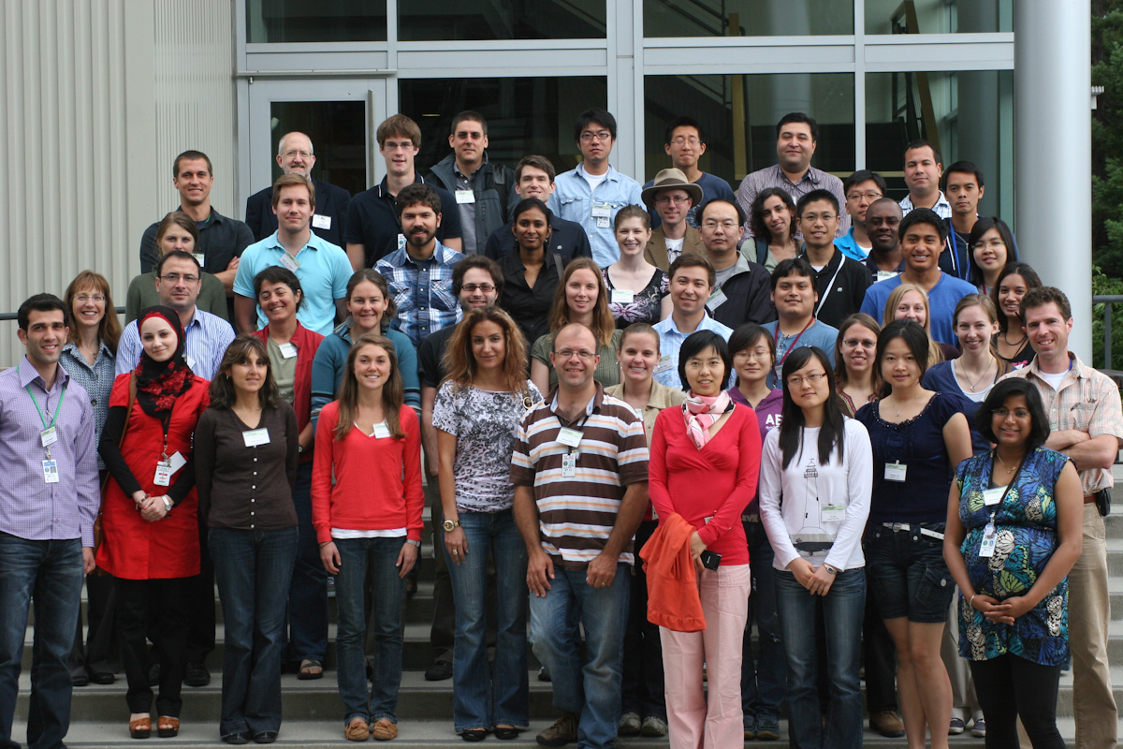
2011 SSRL-XAS Summer School Class Photo by Natalie Cramar

Slide 25
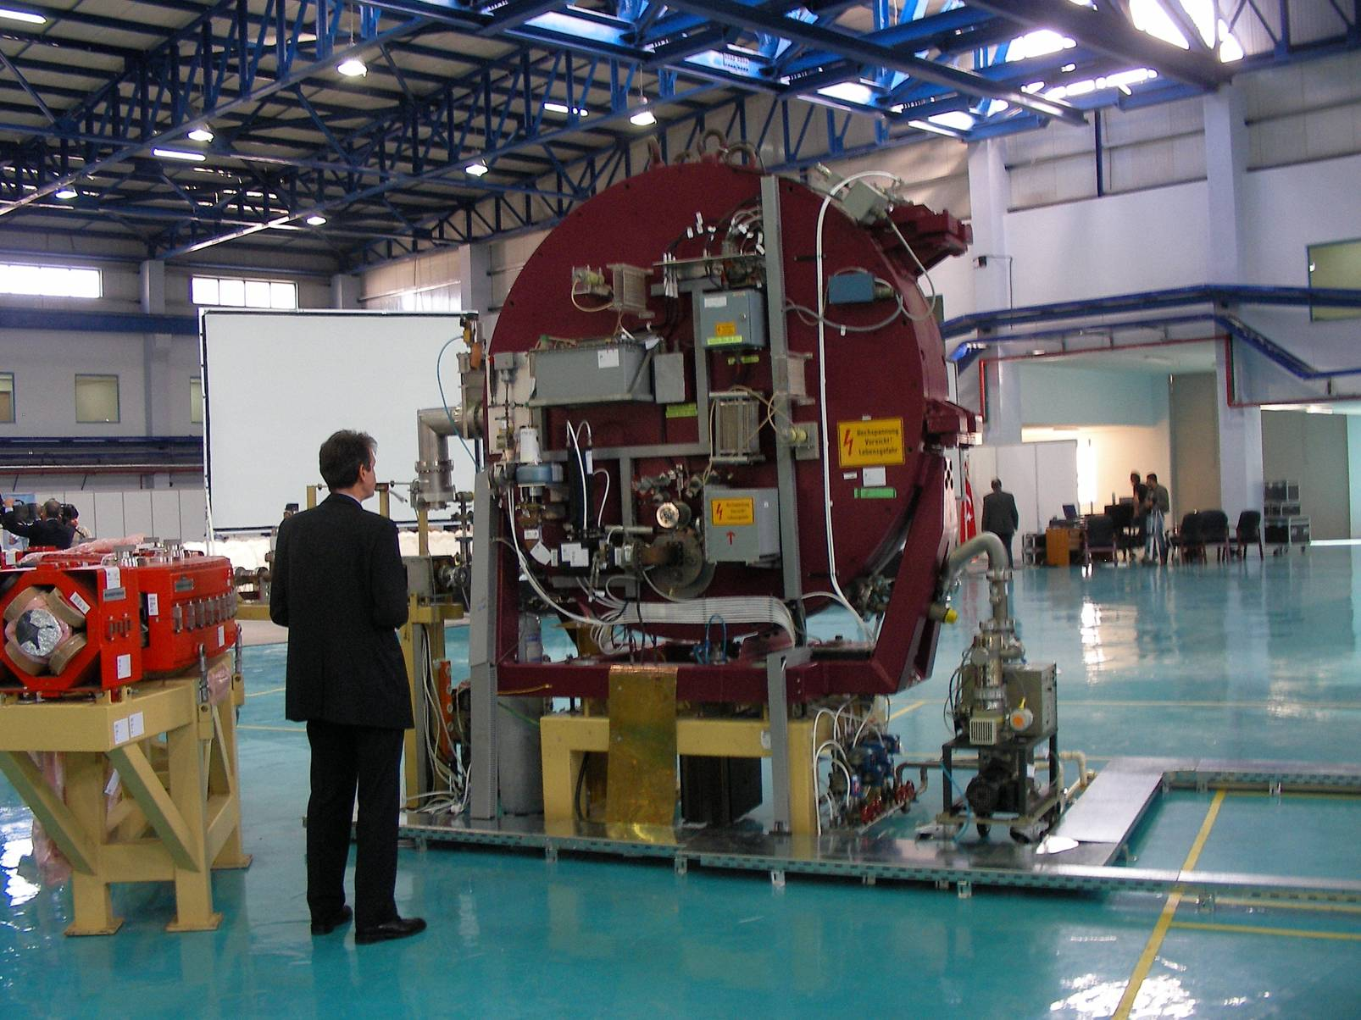
Microtron PreInjector at SESAME
Accelerated beam, April 2009

Slide 26
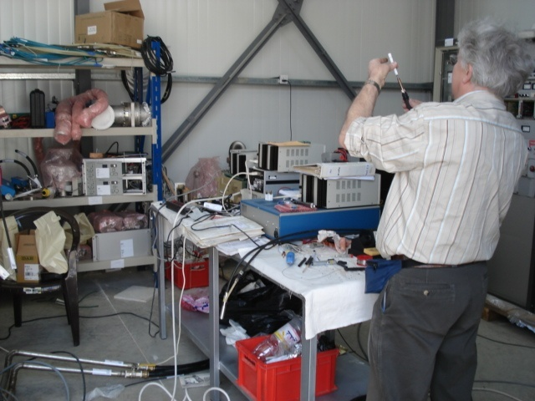
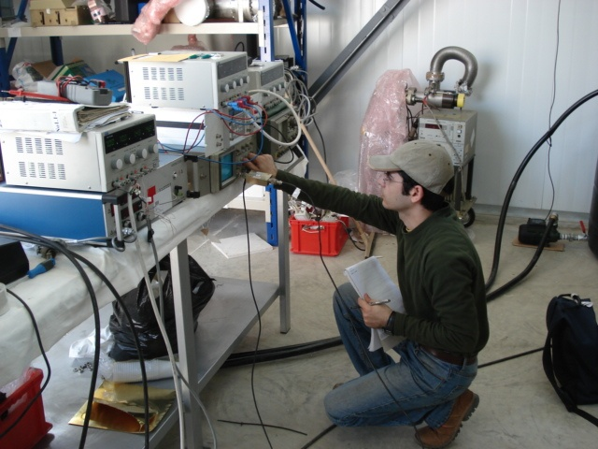
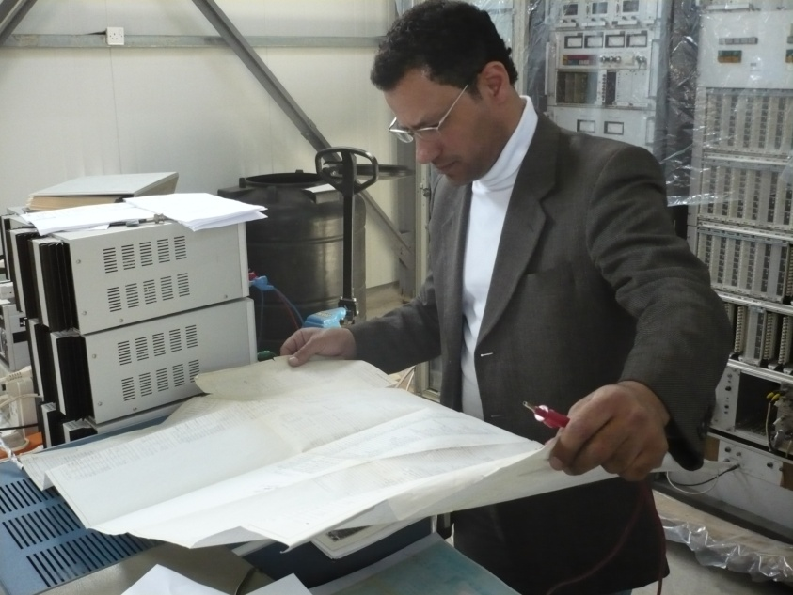
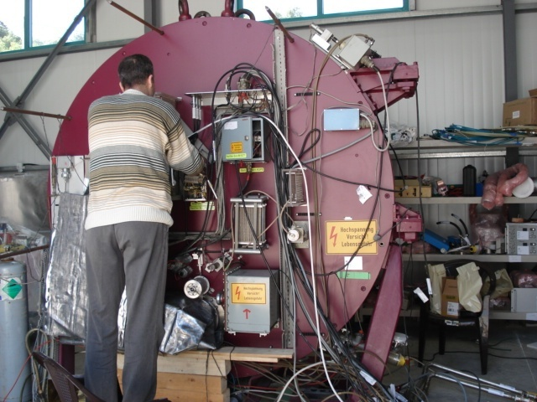
SESAME
Tests of the MICROTRON Subsystems
26
K. Toukan The Royal Swedish Academy of Sciences, Stockholm, Sweden, June 10° ,2008

Slide 27
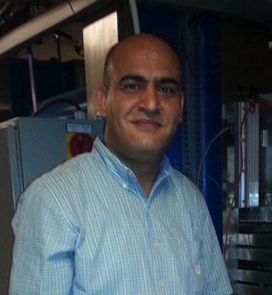
Dr. Hamed Tarawneh
Student at SESAME Accelerator School in 2000
Sent by SESAME to Lund for additional training
PhD in Accelerator Physics at Lund Univ; Advisor is Prof. Mikael Eriksson
Thesis Topic is Multi Bend Achromat (MBA)
Back to SESAME
Then to Berkeley
Now at MAX IV

Slide 28
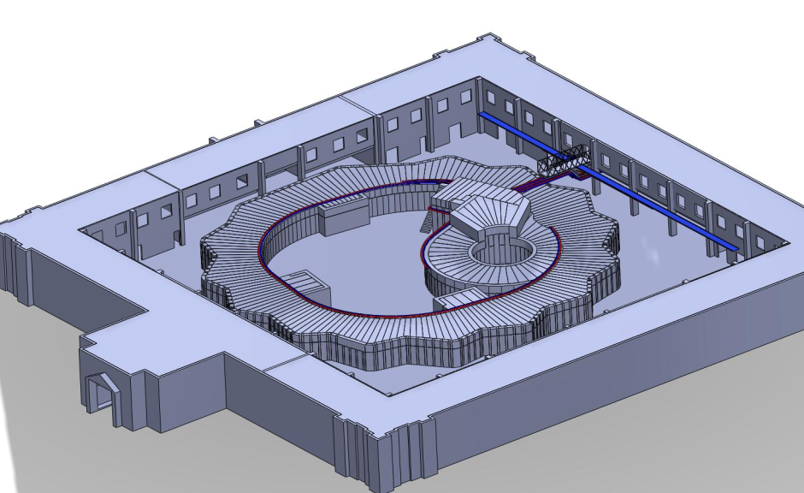
3D View of the New Shielding
SESAME
28
K. Toukan The Royal Swedish Academy of Sciences, Stockholm, Sweden, June 10° ,2008

Slide 29
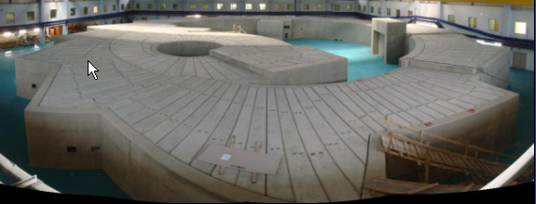
Shielding complete for SESAME injector and storage ring; May 2011

Slide 30
SESAME Scientific Collaborations
Human Histone Deacetylases are flexible enzymes: insights from solution structural analysis of human apo-histone deacetylase 8 (HDAC8 )
Authors:
Tzvia Selzer¹, Brian Vash², Said Ali³, Rotem Sertchook¹, Guenter Grossmann⁴, Peter Atadja², Travis Stams², Dalia Cohen², and Irit Sagi¹*
1. Dept of Structural Biology, the Weizmann Inst. of Science, Rehovot, Israel.
2. Novartis Institutes for Biomedical Research, Cambridge, MA USA.
3. Department of Biophysics, Cairo University, Giza, Egypt.
4. Molecular Biophysics Group, CCLRC Daresbury Lab, Warrington, UK
*Corresponding author
Ph: 972 8 9342130 Fax: 972 8 9344154 irit.sagi@weizmann.ac.il

Slide 31
First of 16 cells of the SESAME storage ring, assembled for testing at CERN in March, 2015 in a collaboration between CERN and SESAME Members/Observers.

Slide 32
SESAME Summary
Delay due to roof collapse in heavy snowstorm (December, 2013)
Now on track for start of operation in 2016 with 2 Beam Lines
EU has joined as an Observer; 5M Euro contribution to CERN for Magnets
2M Euro from Italy
Next President of the SESAME Council is Rolf Heuer, outgoing Director of CERN
Heuer succeeds previous Council Presidents who were also Directors of CERN (Herwig Schopper and Sir Chris Llewellyn-Smith)
Capital funding from SESAME Member countries to complete new 2.5 GeV storage ring, first beam lines (Egypt, Iran, Israel, Jordan, Turkey)

Slide 33
Conclusions
SESAME
There are challenges
Stable financial support; attracting new members from the Gulf and the Mahgreb (new members very welcome); compensating differences in the human and financial resources of the members; solving problems involving travel restrictions; remaining funding for provision of full energy and current, hostel, adaptation/upgrading of full suite of Phase 1 beamlines,….
But an enormous amount has been achieved *
* thanks especially to HM King Abdullah II, Director Toukan, UNESCO, IAEA, JSPS, those who have donated equipment,…
SESAME is working politically and technically, and the training program is building capacity in the region
The voluntary contributions (agreed March 2012) constitute a major step forward and make it possible for SESAME to come into operation in 2016

Slide 34
ANOTHER WORLD?
“As a string theorist, I work on parallel universes. I was always curious about what a parallel universe was like, and now I know. I’m living in one when I go to SESAME meetings”
Eliezer Rabinovici; Hebrew University and Israeli representative to the SESAME Council
SESAME is Happening!!
www.sesame.org.jo

Slide 35
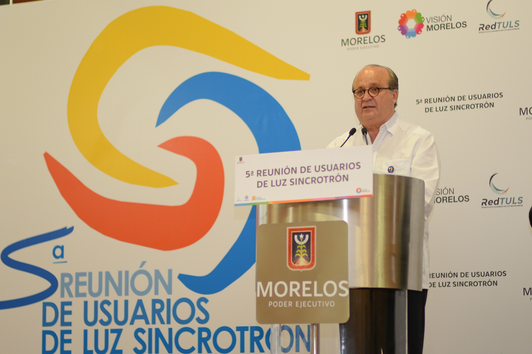
5th Users’ Meeting of the Mexican Light Source;
104 participants, August, 2015

Slide 36
Short History of Mexican Light Source
• 2006-2007 Conacyt Megaprojects
- 1st Mexican Workshop on accelerator Physics
- Fund limited proposal —> 2nd Generation Light Source
• 2010-2011 Conacyt Committee on Accelerator Projects —> Tematic Networks (Red FAE)
- Synchrotron LS & Hadrotherapy Facility
- Visit to ALBA —> 2nd MWAP —> 3rd Gen LS
- 1st Mexican Users Meeting
- 1st Mexican Particle Accelerator School
• Morelos Government—>Fomix Project (Conacyt & Sicyt Morelos)
-Strategic Project & Business Plan to Build a Synchrotron in Morelos
Instituto de Física - UNAM coordinates the project: UNAM, UAM, Univ. of Guanajuato.

Slide 37
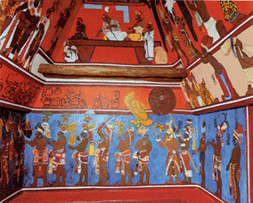
Mayan Pigments
Pigments produced by the Mayas, show colors of various hues, ranging from a purple to a greenish blue
Mayan Pigments are extremely stable: it can resist the attack of boiling, concentrated nitric acid, alkali and organic solvents.

Slide 38
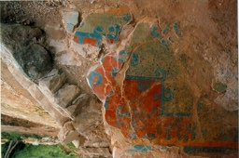

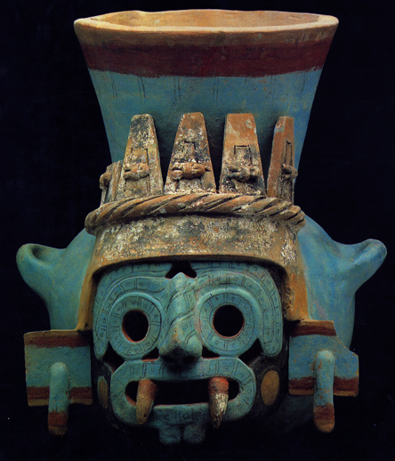
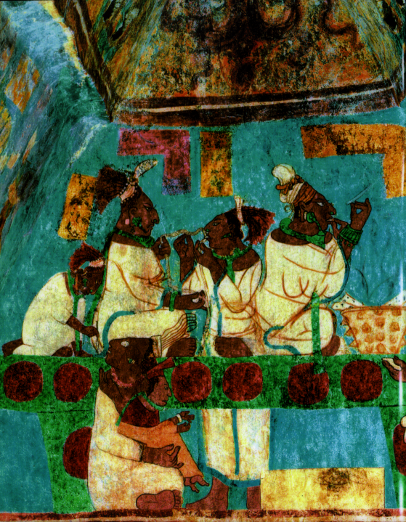
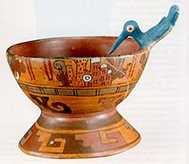
AZUL MAYA
An Ancient Hybrid Organic/Inorganic Material
Russell R. Chianelli
Materials Research and Technology Institute -UTEP
“Art Institute of Chicago/Northwestern University Seminar series in Conservation Science:
“Nanotechnology for research and art conservation ”
October 28, 2010

Slide 39
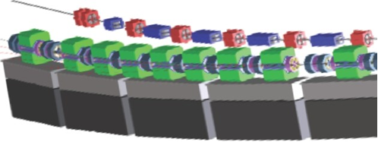
Mexican Light Source: Lattice Conceptual Design
• The Multiple bend achromat cells (MBA, D. Einfeld 1993) and Diffraction Limited Light Sources are being considered in a scheme suggested by R. Hettel, R. Bartolini & F. Pérez (II MWAP, 2014, Huatulco)
3x3x3= 300 m circumference, 300 pm emitance, 3 GeV
• DBA - ALBA, Spain
• 5BA - Sirius, Brazil
• 7BA - MAX IV, Sweden
• 9BA - ALS II, USA

Slide 40
Launch of the
Interim Steering Committee for the
African Light Source
Launched electronically on the
16th August 2014
Coinciding with the ASP2014 Forum Day

Slide 41
Interim Steering Committee for the African Light Source
African Light Source Workshop to be held on
November 16-20, at European Synchrotron Radiation Facility (ESRF) Grenoble, France.
  Participants will be African scientists, students who have worked at Light Sources, Policy Makers, and friends of Africa who support the vision for an African Light Source.
  Discussions on the Roadmap for Africa
  Election and Founding of the new, fully mandated Steering Committee for the African Light Source

Slide 42
These members nominated following communications sent to all available mailing lists and records of interested parties.
Initial members of the Interim Steering Committee of the African Light Source
Sekazi Mtingwa | MIT, USA
Simon Connell | UJ, SA
Tshepo Ntsoana | Necsa, SA
Jonathan Dorfan | OIST, Japan
Mohammad S. Yousef | Cairo University, Egypt
Tarek Hussein | Cairo University, Egypt
Kennedy Reed | LLNL, USA
Brian Masara | SAIP, SA (Zimbabwean)
Ken Evans-Lutterodt | BNL, USA
Sverker Werin | MAX IV, Sweden
Francesco Sette / ESRF representative | ESRF, Europe
Ahamadou Wague | Universite Cheikh AntaDiop Senegal
Krystle J. McLaughlin | Lehigh University, USA
Herman Winick , | SSRL/SLAC

Slide 43
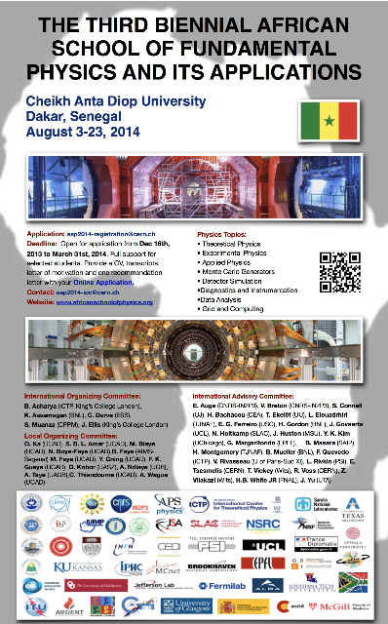

Slide 44
At the African School on Fundamental Physics; Ghana, 2012

Slide 45
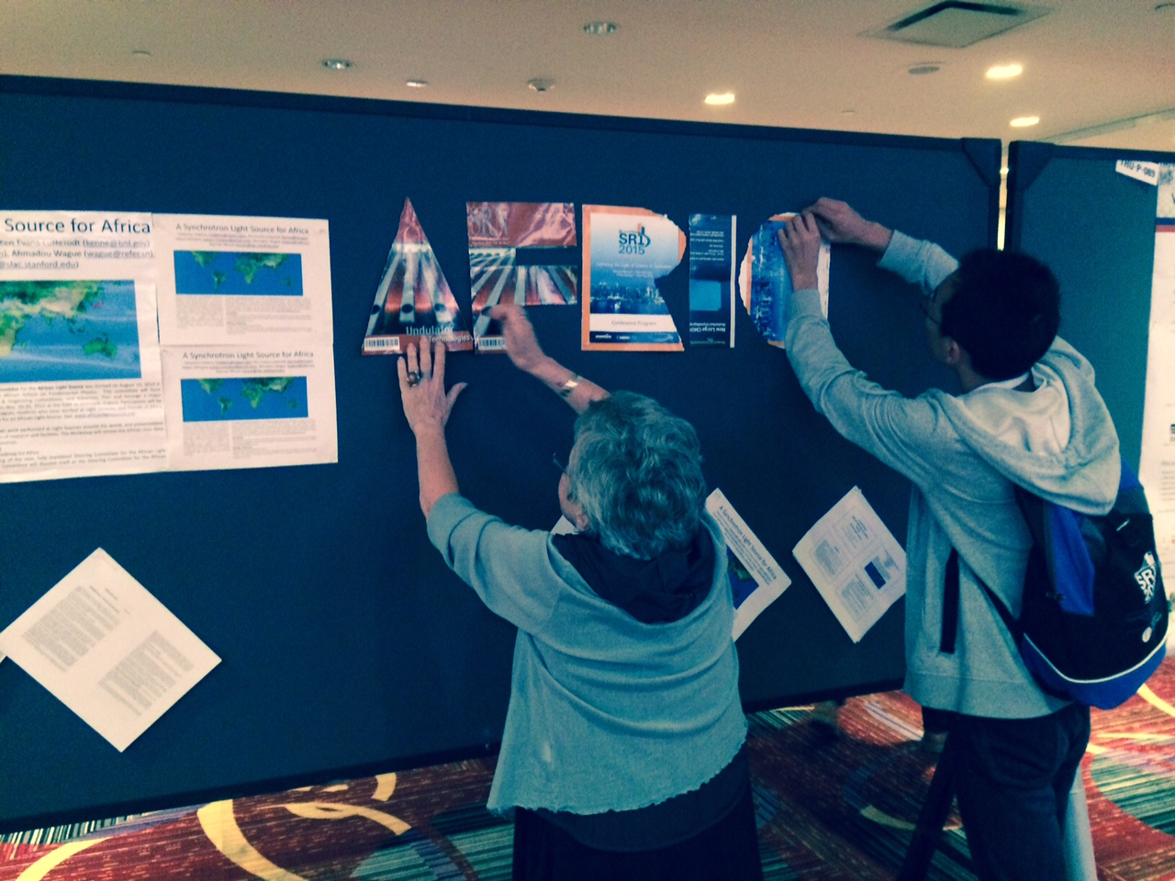
Putting up African Light Source Poster at SRI 2015 in New York

Slide 46
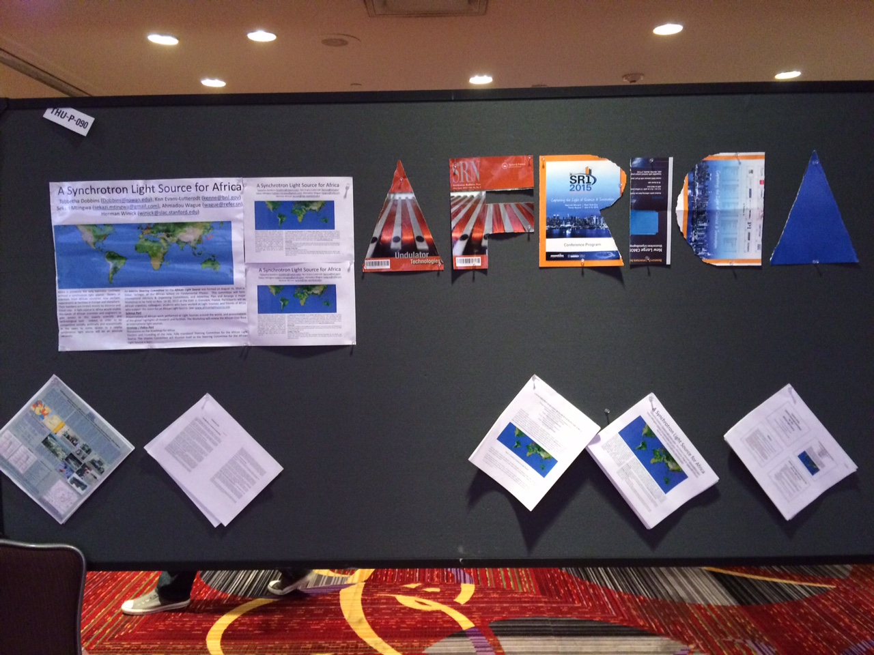
Final Poster

Slide 47
Particularly relevant to consideration of new light sources in developing regions is the successful experience with Light Sources in Brazil, Korea, Taiwan
Began consideration of national light source in 1980s
Began operation in 1990s
Since then each has trained hundreds of PhDs locally
Attracted dozens of mid-career diaspora scientists to return
World class research on a broad range of science & technology
Including local biomedical, environmental, human heritage issues/concerns
Attracted other scientific institutes to locate at light source site
Growth of User community
Demand for higher performance light sources
Governments approve funding (>$300M) for advanced facilities

Slide 48
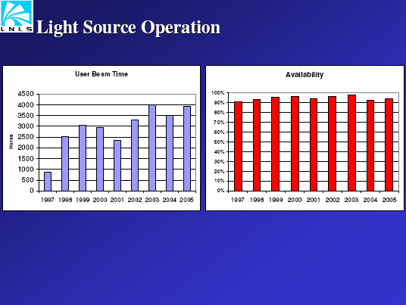

Slide 51
Attendance at Annual Users Meeting for Taiwan Light Source

Slide 52
SOME FACTS ABOUT THE TAIWAN LIGHT SOURCE (2007)
NSRRC has produced more than 140 PhDs. More than 25 Taiwanese scientists returned to Taiwan due to the light source.
Taiwan companies have developed capabilities to design, fabricate, and measure many technical components of a light source. (from Keng Liang)
The previous Director of NSRRC, Chien-Te Chen, was born in Taiwan. He was the leader of a major Bell Labs research group which used synchrotron radiation to study the electronic properties of materials by the photoemission technique. Under his leadership, Bell Labs built a beam line for these studies at the National Synchrotron Light Source (NSLS) at Brookhaven National Laboratory. In the 1990’s he returned to Taiwan as Director of the NSRRC. As part of the deal to bring him back to Taiwan, the government paid to have his beam line at NSLS sent to Taiwan where it was installed at the NSRRC.
The second Director (Jan. 1, 06) of NSRRC, Keng Liang, was born in Taiwan, received a PhD at Stanford University in the 1960’s after which he worked for the EXXON corporation for about 30 years. His main research activity was the use of synchrotron radiation for studies relevant to the interests of EXXON (materials, catalysis, etc.). In the 1990’s he returned to Taiwan to become Deputy Director of the NSRRC.

Slide 53
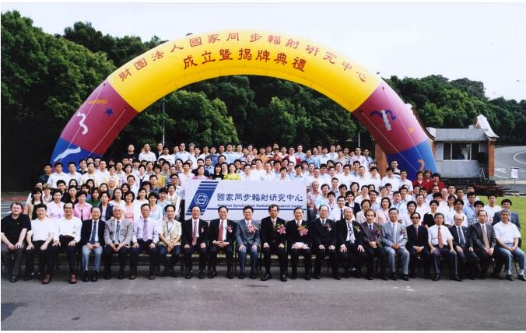
Taiwan Light Source Users’ Meeting

Slide 54
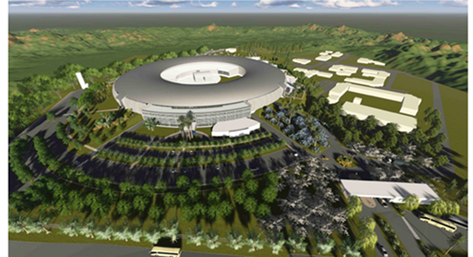
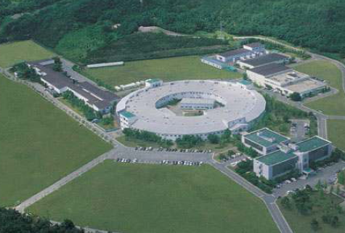
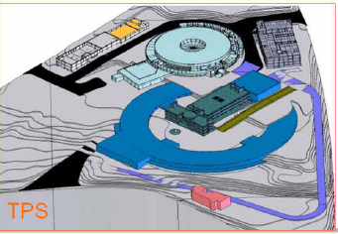
New Light Sources in Brazil, Korea, Taiwan
PAL-II
SIRIUS, Brazil
Pohang Light Source, Korea
All are Upgrades or replacements of 1980s light sources. All are 3 GeV, and very low emittance
Taiwan Photon Source

Slide 55
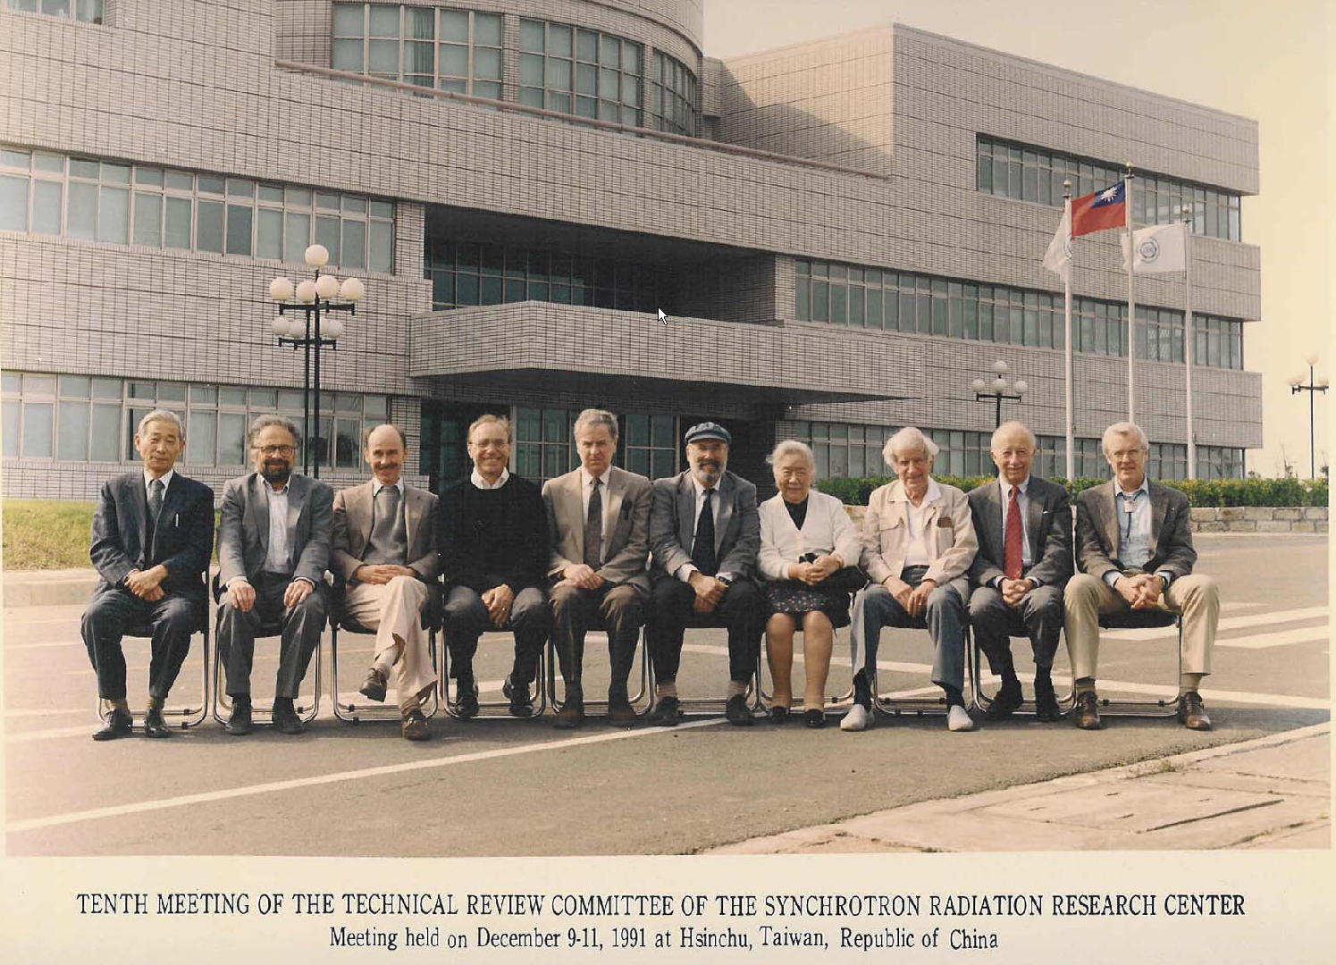

Slide 56
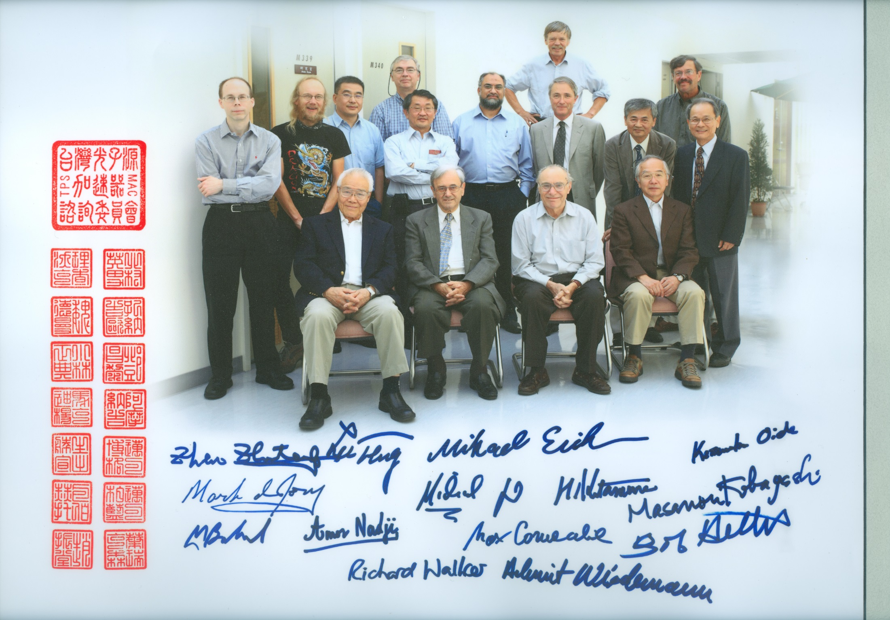

Slide 57
Anton Chekov
"There is no national science, just as there is no national multiplication table. Science that is national is not science."

Slide 58
End of Presentation
Thank you

