Slide 1

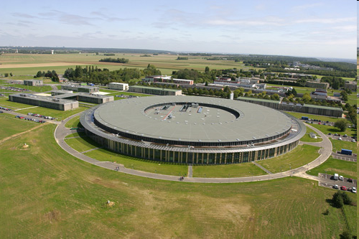
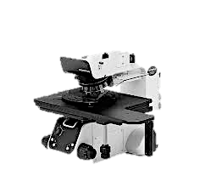
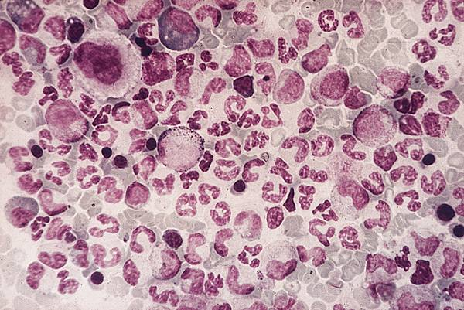
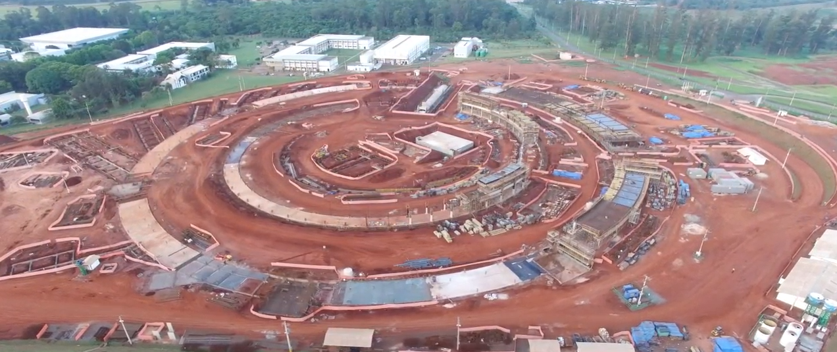
BIOSCIENCES WITH INFRARED SYNCHROTRON RADIATION
SOLEIL
SIRIUS
P. Dumas
SOLEIL Synchrotron ( France)
dumas@synchrotron-soleil.fr

Slide 2

Synchrotron infrared beamlines?
30 facilities with IR beamlines
Two recently closed
One suspended

Slide 3
@ ALBA (Spain) x1.
@ ASTRID ( Denmark)
@ Metrology Light Source (x2)-Berlin
@BESSY II (x1)
@SSRF ( China-Shangai) x1
@POHANG (x1)
@INDUS 2
@SESAME (x1)
@ Synchrotron Light Research Institute ( Thailand) ( x1)
@LNLS ( Brazil) (x1)
@ SSLS ISMI (Singapore) (x1)
@ NSRL U4 (China) (x1)
@ JLab THz lab (x1).
@ CAMD IR beamline (x1)
@ SPring-8 BL43IR (x1)
@UVSOR BL6A1 (x1)
@ ESRF ID21 (x1)
@MAX-Lab Beamline 73 (x1)
@ ANKA Germany ( x1)
@ NSRRC Taiwan ( x1)
@ Canadian Light Source ( x2)
@ ELETTRA SISSI beamline (x1)
@ DAFNE SINBAD beamline (x1)
@Australian Synchrotron (x2)
@ SLS IR beamline ( suspended)
@ SOLEIL ( x2) BESSY (x1)
@ Diamond (x1)
@ SRC Madison ( x2) ( Closed October 2013)
@ NSLS Infrared Programs ( x6)- closed on September 20, 2014
@ ALS Synchrotron Infrared Program ( x2)
Location

Slide 4
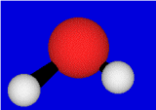

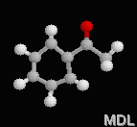
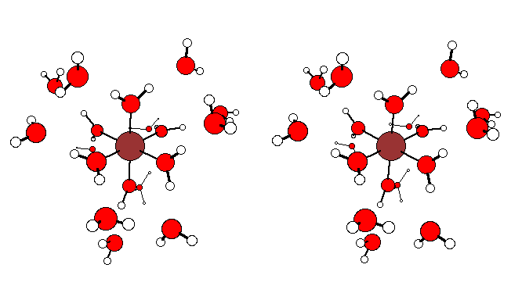
INFRARED SPECTROSCOPY IN BIOSCIENCES?
1- MOLECULAR ANALYSIS; FINGERPRINTING
10 μm
3 μm
6 μm
Protein
Absorbance units
Carbohydrate
30 μm
Phospholipid
Nucleic acid( DNA)
Wavenumbers ( cm-1)

Slide 5
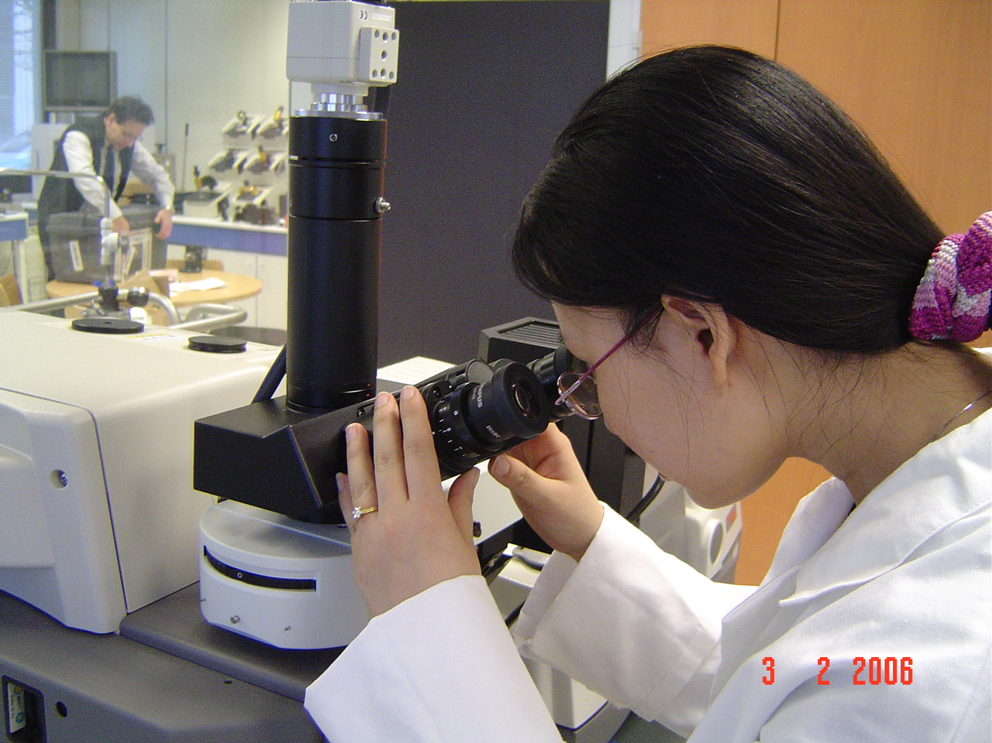
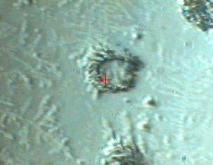
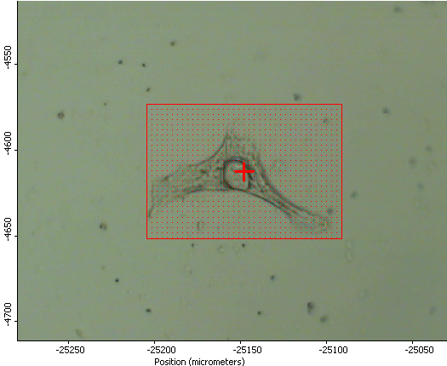
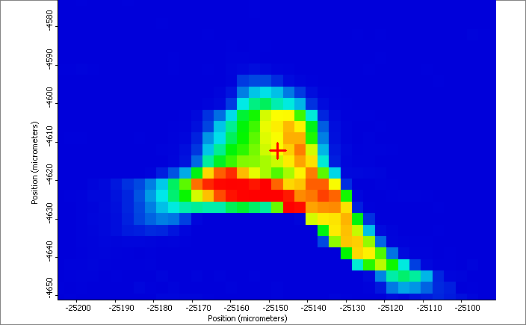
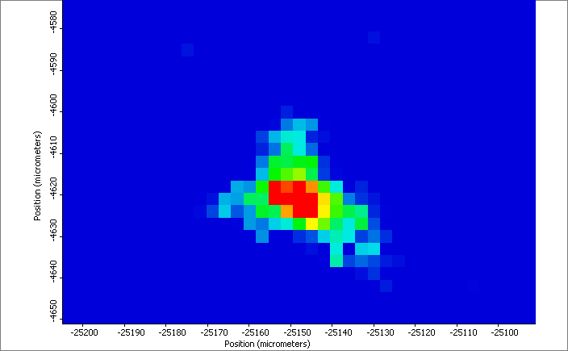
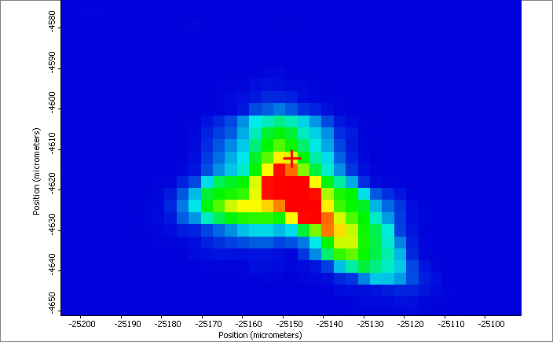
FROM SPECTROSCOPY TO MICROSCOPY: IMAGING
2- SPATIAL RESOLUTION= Microscope AND SOURCE BRIGHTNESS
Synchrotron source
HeLa Cell ~60x70µm
Spot Size 5x5µm²
step 1µm
Chemical image with sub-cellular resolution
LIPIDS
NUCLEIC ACIDS
PROTEINS
Min

Slide 6
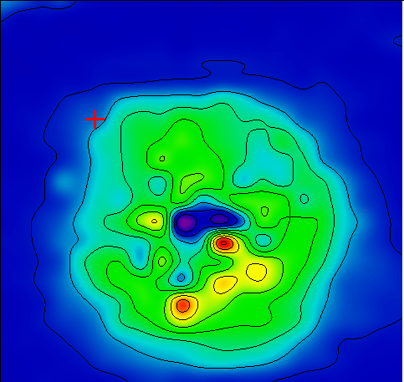
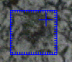
STRUCTURAL INFORMATIONS
10 μm
3- SECONDARY STRUCTURE OF PROTEINS
Lysozyme (white egg chicken) α+ β
Concanavalin A allβ
Myoglobin (Horse heart ) all α

Slide 7

* Main studies using Synchrotron IR in Biosciences?
Main activity, actually, is in single cell analysis ( beside imaging):
Cell cycle
Disease , cancer, alzeihmer, leukemia, many other diseases
Drug treatment
Diagnostic
Prognosis
Plant Biology:
Cell walls
Samples genetically modified
Food ….
* The newest trends in biosciences with synchrotron IR

Slide 8
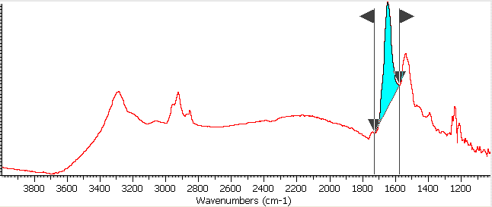
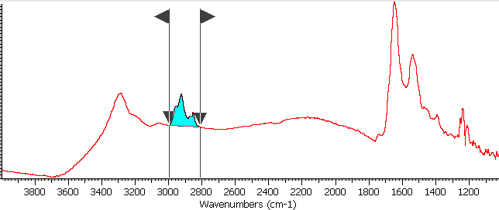
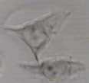
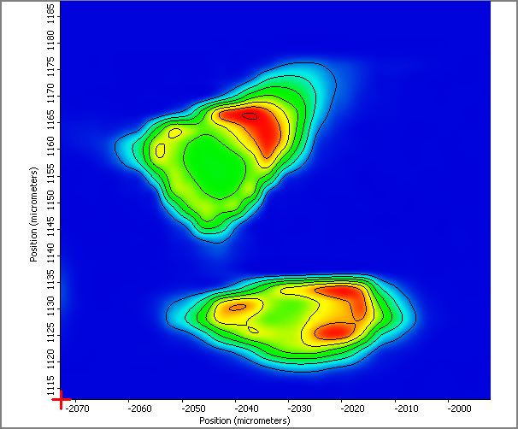
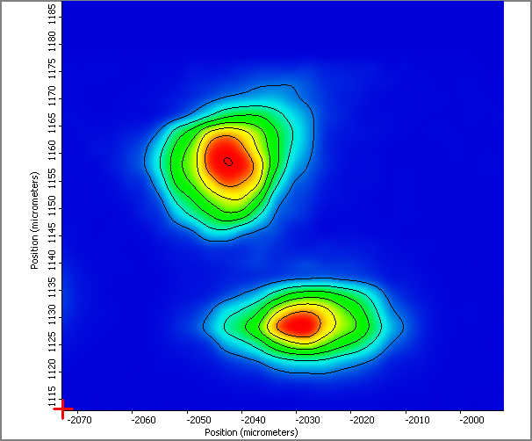
Single cell studies and imaging
Proteins
Lipids

Slide 9
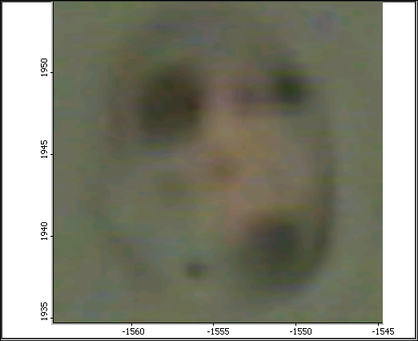
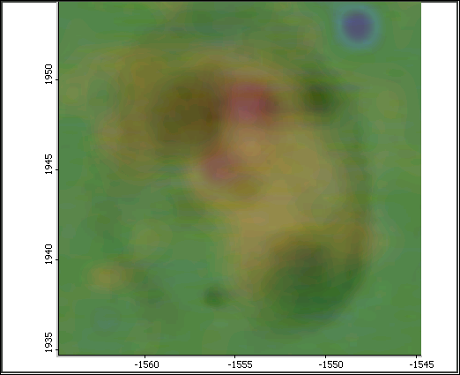
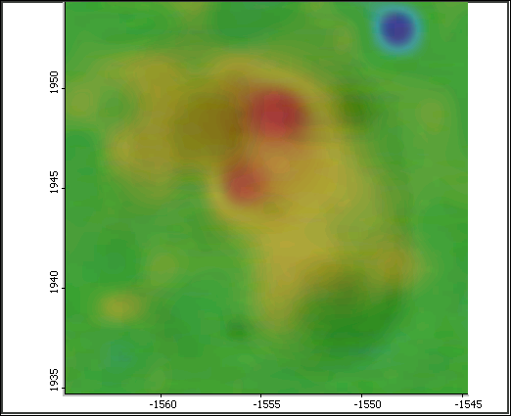
Imaging at Sub-cellular resolution
DNA imaging inside one isolated nucleus
Nucleotides
Imaging an isolated nucleus at sub-cellular resolution
5 μm
5 μm
Biochemical markers of isolated cancer cell nuclei : a new look using a bright infrared source
J. Sulé-Suso, J. Pijanka, A. Kohler, Y. Yang, P. Dumas, S. Chio-Srichan, and G. D. Sockalingum.

Slide 10
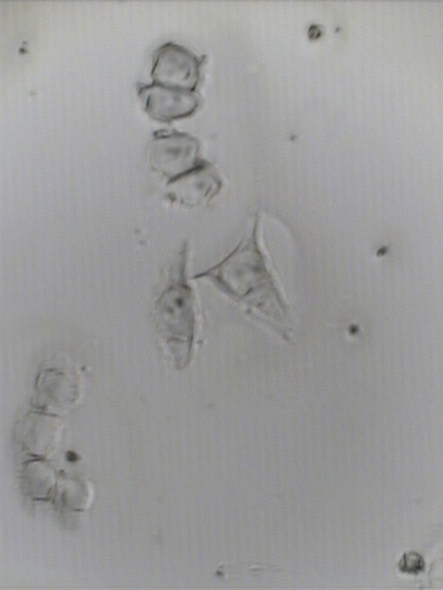
Probing Nucleus specifically
Statistical analysis: PCA, HCA, LDA-PLS ANN etc….

Slide 11
Use of statistical analysis: scores
1520 cm-1
1640 cm-1

Slide 12
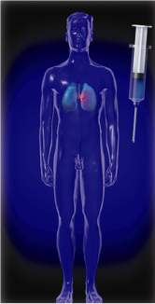
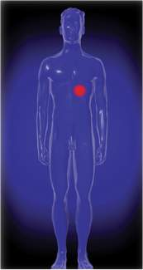
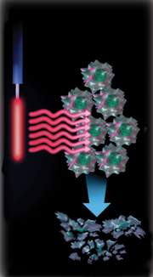
PHOTODYNAMIC THERAPY: a case study
Nonthermal
laser light
Tissue
uptake
and clearance
Resident
oxygen
Photosensitizer
Relatively selective retention in tumor
Tumor tissue destruction
S₁
Type II
ISC
singlet oxygen
T₁
O₂
superoxide
hydroxyl radicals
fluorescence
absorption
phosphorescence
Type I
http://www.photofrin.com
S₀
Notes:
Notes:
Photodynamic therapy uses a standard endoscopic technique to deliver a nonthermal laser light to activate an IV-administered photosensitizing drug¹
The components of photodynamic therapy include:
a photosensitizing chemical
nonthermal laser light¹
resident molecular oxygen (personal communication, TS Mang, PhD)
Photodynamic therapy entails:
administering a photosensitive agent
allowing time for selective retention in the tumor and clearance from a variety of
other tissues¹
exposing tumor to nonthermal laser light (personal communication, TS Mang, PhD)
1. PHOTOFRIN® Advisory Board Meeting, March 18, 1997. Transcript on file, Axcan PharmaTM.

Slide 13
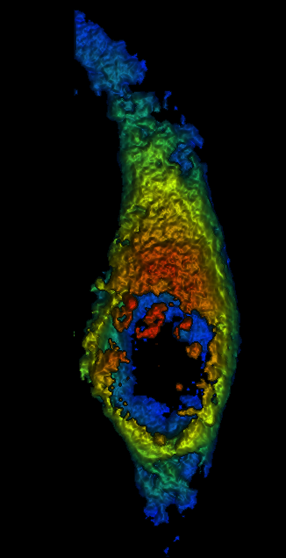
HA location inside cells by fluorescence microscopy
30’
Hypocrellin A : HA
1 h
2 h
3 h
24 h
5 h
Chio-Srichan, S., Refregiers, M., Jamme, F., Kascakova, S., Rouam, V., & Dumas, P.
Biochimica et Biophysica Acta (BBA) - General Subjects, 2008, 1780(5): 854-860

Slide 14
Statistical analysis reveal a marked effect upon light irradiation
Cells incubated with HA 6hours but with light
Cells incubated with HA in dark: control, 30mn, 6 hours, 24 hours
Chio-Srichan, S., Refregiers, M., Jamme, F., Kascakova, S., Rouam, V., & Dumas, P.
Biochimica et Biophysica Acta (BBA) - General Subjects, 2008, 1780(5): 854-860

Slide 15
α
?
?
β
β
0.75
0.75
1640
16
1630
16
0.70
0.70
0.65
0.65
0.60
0.60
0.55
0.55
0.50
0.50
0.45
0.45
0.40
0.40
Log(1/R)
Log(1/R)
0.35
0.35
1060
1060
-
-
DNA
0.30
DNA
0.30
0.25
0.25
0.20
0.20
0.15
0.15
Biochemical effect
0.10
0.10
0.05
0.05
1700
1700
1600
1600
1500
1500
1400
1400
1300
1300
1200
1200
1100
1100
1000
1000
Wavenumbers
Wavenumbers
(cm
(cm
-
-
1)
1)
PCA analysis of 2μM HA treated HeLa cells after 6h incubation with/without 10Jcm⁻²irradiation.
Chio-Srichan, S., Refregiers, M., Jamme, F., Kascakova, S., Rouam, V., & Dumas, P.
Biochimica et Biophysica Acta (BBA) - General Subjects, 2008, 1780(5): 854-860

Slide 16
Towards biomedical-related studies
DEFICIENCY, OVERACCUMULATION:
Starvation
Alcoholism
Obesity
stress
genetics
MODULATING FACTORS
(GENETICS, ENVIRONMENT…)
DISEASE
CHEMICAL MODIFICATIONS
POLLUTANTS
RADIATIONS
SHOCKS, FRICTION
COLD
HEAT
ALLERGENES
BACTERIA
VIRUS
FUNGI
YEASTS
PARASITES
PRIONS
ENVIRONMENT
PATHOGENS
Notes:
THIS IS A PARADIGM OF MODERN MEDICINE THAT DISEASES ARE CAUSED BY UNDERLYING MODIFICATIONS OF THE CELLS AND TISSUES CHEMISTRY OR CHEMICAL COMPOSITION. FOR CASES WHERE DIAGNOSTIC IS A PROBLEM, FINDING THE CHEMICAL COMPOSITION MAY HELP IN DIAGNOSIS BUT ALSO IN PROGNOSIS

Slide 17
Probing molecular motions by INFRARED SPECTROSCOPY
λ ( 2-200 μm)
IR
absorption
CHEMICAL MODIFICATIONS
As tissues, cells are very heterogeneous, one need cellular, sub-cellular probe
MICROSCOPY at that scale
SYNCHROTRON IR BRIGHT SOURCE
DIAGNOSIS ?
PROGNOSIS ?
Notes:
IR spectrum
Tissue heterogeneity => spatial resolution

Slide 18
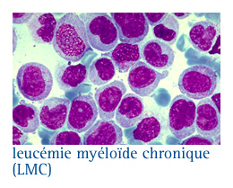
chronic myeloid leukemia
* Cancer of white blood cells
* Clonal bone marrow stem cell disorder
* Caused by reciprocal translocation of a piece of chromosome 22 on chromosome 9 =>
    - Phildaelphia chromosome (Ph+)
    - bcr-abl fusion gene
Notes:
Chronic Myeloid Leukemia is the cancer of white blood cells. This has been identified as a translocation of a piece of chromosome 22 on chromosome 9. It’s namled bc robilson fusion. It is associated with Philadelphia chromosome.. It’s a tyrosqine kinase that activates a cascade of protiens with unregulated phophorylations. The diseas eevolves in various steps from little symptols to blast crisis
T315I MUTATION RENDERS LEUKEMIC CELLS RESISTANT TO GLEEVEC
T315I CELLS BECOME SELECTIVELY ADVANTAGED UPON TREATMENT
T315I SUBCLONES ARE PRESENT IN SOME PATIENTS
IT IS NECESSARY TO STOP TREATMENT IF T315I IS PRESENT
CAN WE DETECT THE T315I MUTATION? CAN WE DETECT THE T315I SUBCLONE AMONG A WT POPULATION?

Slide 19
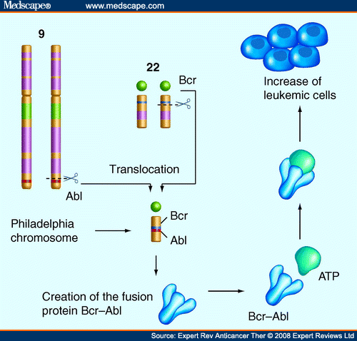
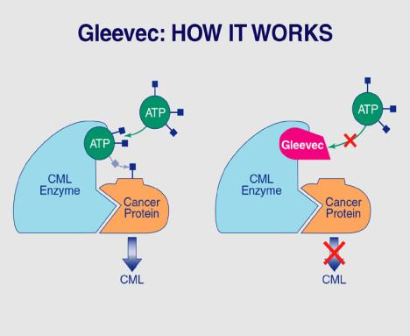
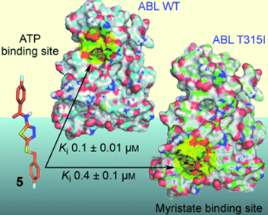
Chronic myeloid Leukemia
Treatment: inhibitors of tyrosine kinase (imatinib, dastinib, nilotinib)
Resistance: the T315I mutation (in the imatinib fixation site) renders bcr-abl resistant to all first generation TK inhibitors
  The frequency of the mutation can be as low as 1 cell in 100,000 and as high as 40%
Notes:
The treatment is known and has been considered as revolutionary. It is issued from the study of the protein structure and the findings of the active site
However, unfortunately, resistance appears which is identified by a T315I mutation at residue 315 (T315I) .
T315I doesn’t seem to have enhanced TK activity (conflicting litterature)
T315I cells don’t have a competitive advantage versus native bcr-abl cells unless treated by imatinib
Chronic Myeloid Leukemia is the cancer of white blood cells. This has been identified as a translocation of a piece of chromosome 22 on chromosome 9. It’s namled bc robilson fusion. It is associated with Philadelphia chromosome.. It’s a tyrosqine kinase that activates a cascade of protiens with unregulated phophorylations. The disease evolves in various steps from little symptols to blast crisis

Slide 20
From model studies to patient
Characterization of a drug resistance phenotype
3 CELL MODELS :
  MURINE EMBRYONIC STEM CELLS (PROGENITOR CONTEXT)
  GENETICALLY ENGINEERED UT7 CELLS;
    STABLE BCR-ABL EXPRESSION
  GENETICALLY ENGINEERED UT7 CELLS:
  REPRESSIBLE BCR-ABL EXPRESSION
Féraud O., Turhan A.,Bennaceur A. ( Brousse Hospital Paris) Sandt C., Dumas P.
(SOLEIL)
Notes:
T315I MUTATION RENDERS LEUKEMIC CELLS RESISTANT TO GLEEVEC
T315I CELLS BECOME SELECTIVELY ADVANTAGED UPON TREATMENT
T315I SUBCLONES ARE PRESENT IN SOME PATIENTS
IT IS NECESSARY TO STOP TREATMENT IF T315I IS PRESENT
CAN WE DETECT THE T315I MUTATION? CAN WE DETECT THE T315I SUBCLONE AMONG A WT POPULATION?

Slide 21
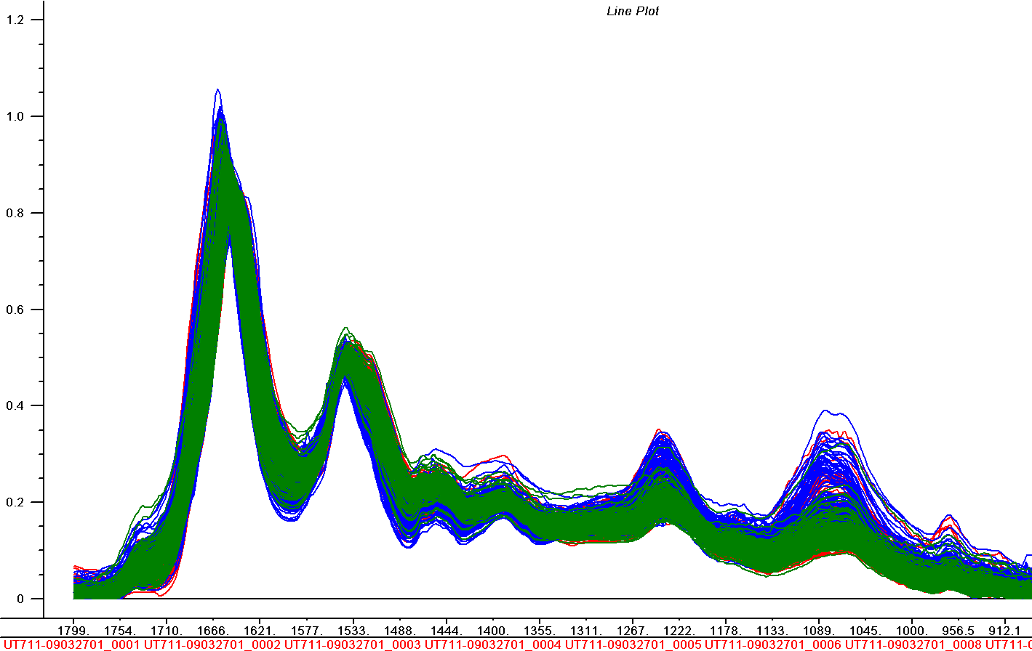
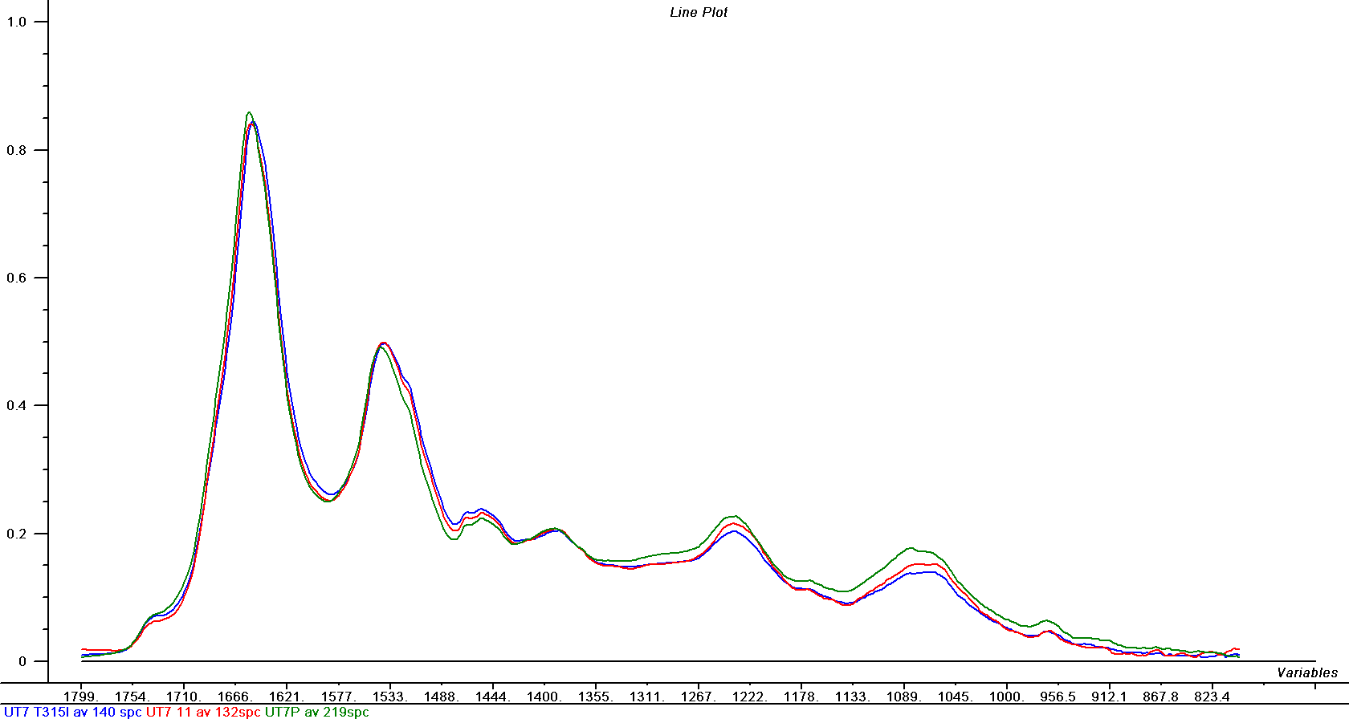
With Haematological Cell line UT7
UT7P: NO bcr-abl EXPRESSION
UT7-11: STABLY TRANSFECTED WITH WILD TYPE bcr-abl
UT7T315I: STABLY TRANSFECTED WITH T315I bcr-abl MUTANT
Ensemble of IR spectra

Slide 22
UT7 stable transfected
UT7P: NO bcr-abl EXPRESSION
UT7-11: STABLY TRANSFECTED WITH WILD TYPE bcr-abl
UT7T315I: STABLY TRANSFECTED WITH T315I bcr-abl MUTANT
PC2
0.0
-0.5
-1.0
Score plot
-1
0
1
PC1

Slide 23
Murine embryonic stem cells GS2
GS2
GS2 transfected by the wild-type bcr-abl p210
GS2 transfected by the mutant bcr-abl T315I
Sugar, DNA?
Phosphate
Secondary structure

Slide 24
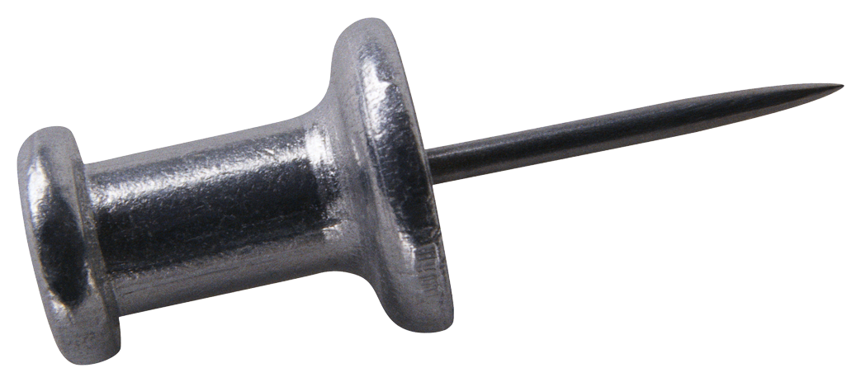
SUMMARY OF CHRONIC MYELOID LEUKEMIA CELLS
IT IS POSSIBLE TO DETECT A SPECIFIC SIGNATURE OF bcr-abl EXPRESSION IN DIFFERENT CELL CONTEXTS (MURINE, EMBRYONIC STEM CELLS, HUMAN, HAEMATOPOIETIC CELLS)
SPECIFIC SIGNATURES OF THE T315I MUTANT IS DETECTABLE
THIS SUGGESTS HIGHER PHOSPHORYLATION RATE OR DIFFERENT TARGETS FOR T315I
IT IS POSSIBLE TO DETECT THAT SPECIFIC MUTATION IN HAEMATOPOIETIC PROGENITORS FROM CML PATIENTS IN SINGLE CELLS => DIAGNOSTIC TOOL ? ( FIRST RESULTS PROMISING)
( patented)

Slide 25

TOWARDS DIAGNOSTIC TOOL?
Signatures are in three spectral domain: Sugar ( around 10 microns wavelength),Phosphate ( around 8 microns) and amide I ( around 6 microns)
Probably one could use only one probe ( the strongest = amide I) @ 6 microns
Tunable IR laser around 6 μm, linear array detectors seem one way to bring the diagnostic to Hospital. Laser and spectral quality ? Cell sorter and fast data recording? Quick diagnostic on circulating blood cells from patients?
Work in progress Jens Bergert ( ICFO-Barcelona)- P. Dumas( SOLEIL) with a broadband attosecond IR laser
Notes:
What do we need? Cell by cell analysis, fast for cell sorting possibility. Would need this tool close to operating room or in hospital. What is requested? Three spectral domain can be targeted: sugar, phosphate and amide I at 10,8 and 6 microns respectively with fast tunability and quite narrow spectral tunability. Issue remains: are laser sufficently stable to record high quality spectra? Cells damage? At present, I believe that stability is improving, there are various announcements of progress along that line, it is essential.

Slide 26
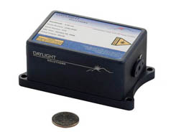
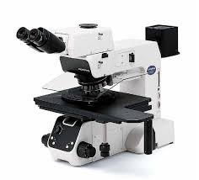

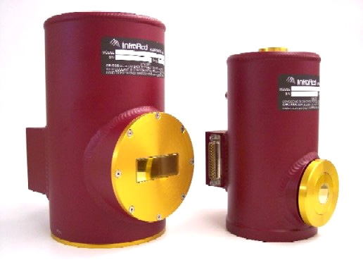
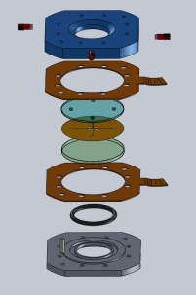
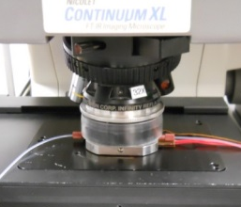
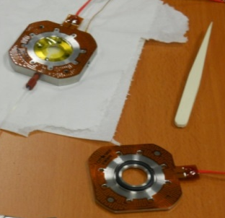
HOW BRIGHT IR SOURCE, SUCH AS LASERS, CAN BE IMPLEMENTED ?
Infrared laser
Microscope
Linear array detector
Circulating microfluidic cells

Slide 27
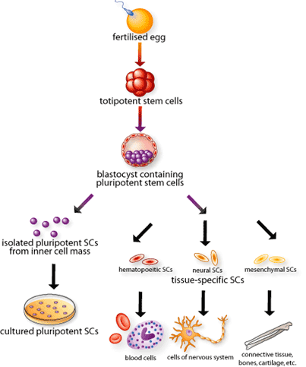
STEM CELLS RESEARCH WITH IR synchrotron
EMBRYONIC STEM CELLS
    UNDIFFERENTIATED CELLS
    TOTIPOTENT: CAN GIVE ANY CELL TYPE
    IMMORTAL: SELF-RENEWAL CAPACITY
Notes:
An another exemple on going at SMIS: identification of the status of stem cells stemness and reprogrammation.

Slide 28
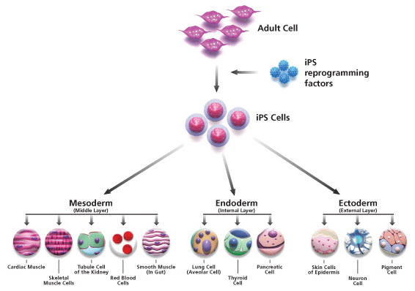
INDUCED PLURIPOTENT STEM CELLS
INDUCED PLURIPOTENT STEM CELLS
*REPROGRAMMED FROM ADULT CELLS BY TRANSFECTION OF 4 GENES (EMBRYONIC TRANSFECTION FACTORS among Oct-4, c-Myc Sox-2, Klf-4, Nanog, Lin-28…)
*PLURIPOTENT: POSSIBLY TOTIPOTENT
*IMMORTAL: COULD BE MALIGNANT

Slide 29
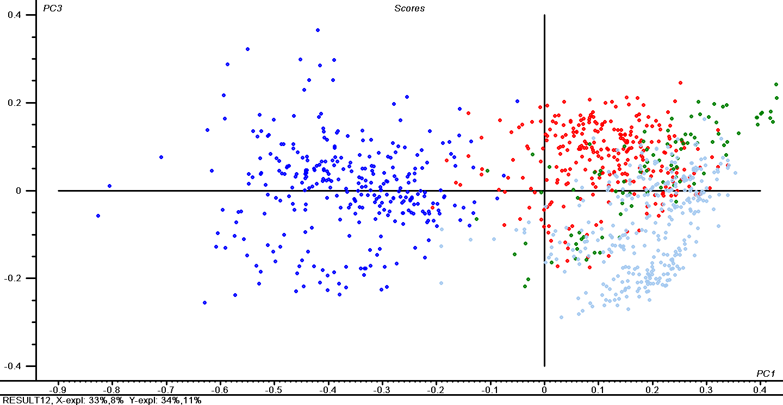
STEM CELLS lines: identity REVEALED BY IR
Signatures of stemness !
H1
H9
CL01
HUES3
H1 & H9 ARE VERY SIMILAR (THEY WERE ISOLATED IN THE SAME LAB)
CL01 IS DIFFERENT (IT CARRIES GENETIC ABNORMALITIES: TRISOMY 1)
Sandt, C., Féraud, O., Oudrhiri, N., Bonnet, M. L., Meunier, M. C., Valogne, Y., Bertrand, A., Raphaël, M., Griscelli, F., Turhan, A. G., Dumas, P., & Bennaceur-Griscelli, A.
Identification of spectral Modifications Occuring During Reprogramming of Sommatic Cells.
PLoS One, 2012, 7(4): art.n° e30743
Sandt, C., Frederick, J., & Dumas, P.
Profiling pluripotent stem cells and organelles using synchrotron radiation infrared microspectroscopy.
Journal of Biophotonics, 2013, 6(1): 60–72
Notes:
IT SEEMS POSSIBLE TO IDENTIFY A SMALL NUMBER OF STEM CELL LINES BY THEIR SPECTRAL SIGNATURE

Slide 30
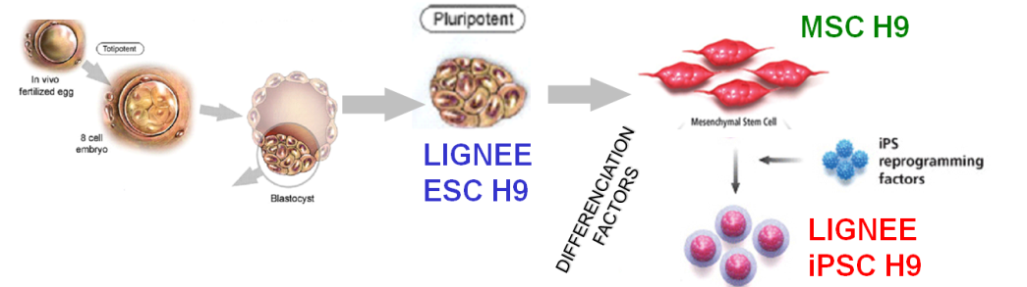
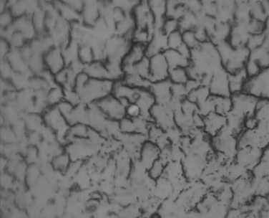
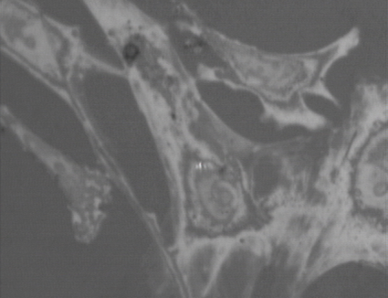
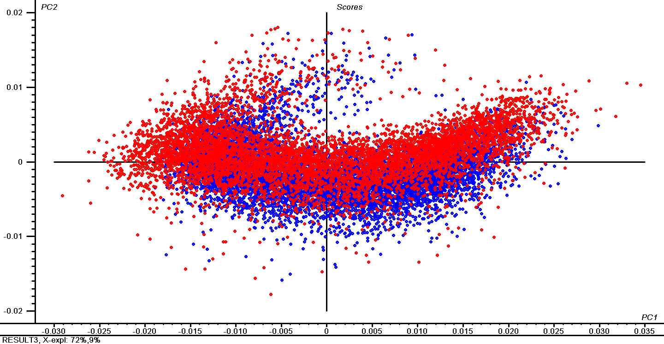
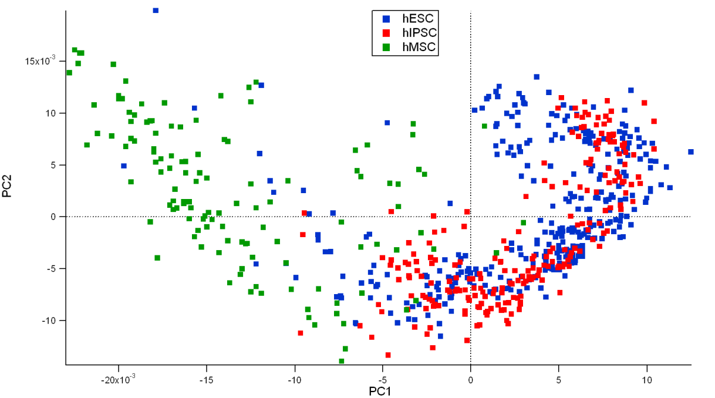
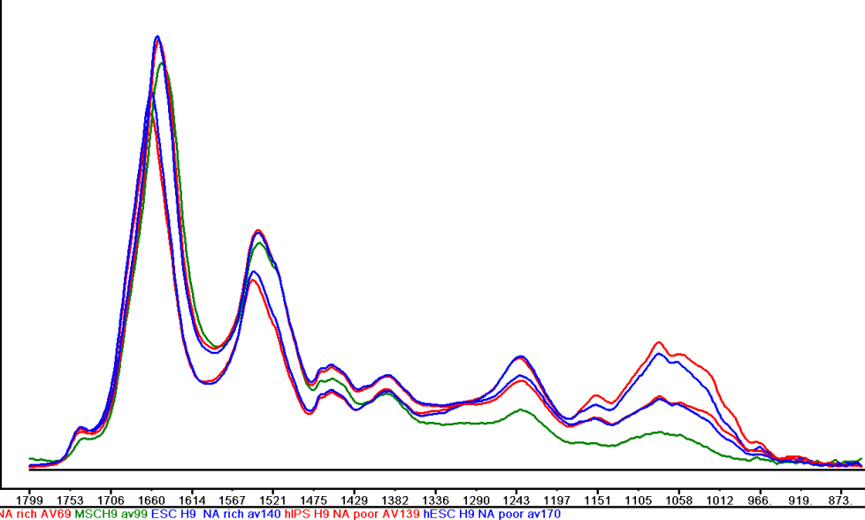

INDUCED STEM CELLS PROCESS checkeD
ESC H9
MSC H9
iPSC H9
iPSC H9
ESC H9
MSCH9
iPSC H9
ESC H9
Notes:
IT SEEMS POSSIBLE TO IDENTIFY A SMALL NUMBER OF STEM CELL LINES BY THEIR SPECTRAL SIGNATURE

Slide 31

REAL CASES TESTED
Unsuccessful reprogrammation
AMNIOTIC FLUID CELLS (AFC): 2 cell lines
iPSC DERIVED FROM AFC: 2 cell lines
Diagnostic Tool?

Slide 32

In-situ cells studies: effect of drug studied

Slide 33


PENETRATION KINETIC OF RHENIUM CARBONYL TAGGED LIPIDS IN LIVING CELLS
FOW CONTROL
C. Policar, S. Clede, C. Sandt et al.. To be published
Notes:
CPT = CAMPTHOTECIN

Slide 34


THERE ARE CASES WHERE THE DIAGNOSTIC HAS BEEN DEVELOPED AT SYNCHROTRON FACILITY
P. Dumas, F. Le Naour et C. Guettier
Patent N°: 12766107.2-1553

Slide 35


LINEAR RELATIONSHIP BETWEEN IR BAnDs ratio and TG content provided by lipidomic analysis
IR signals intensity versus TG values
R²= 0.9
40%
R²= 0.5

Slide 36

FROM MICROSCOPE AT HOSPITAL

Slide 37
Validations after transplantation
IR analysis: 3 mn
Lipidomic analysis= 2 weeks

Slide 38


TO AN IMPROVED METHOLOGY: in operation and being commercialized
ATR ( Attenuated Total Reflection)
~ 50 cm
Sample deposited on glass slide, detector used : room temperature DTGS

Slide 39



The newest trends in Biosciences
0.5 x 0.5 μm² pixel
Fast and higher spatial resolution imaging and spectroscopy
IR tomography
Nano-IR spectroscopy and imaging

Slide 40

Fast imaging and higher spatial resolution
Synchrotron IR does not have a superior flux compared to internal source. Expanding the beam for covering a 2D detector is useless unless :
1-one increases the intensity with larger horizontal collection
2- We avoid the horizontal aberration of such large horizontal angle
Horizontal opening angle= 320 mrad !
Set up at SRC ( Madison)
Beamline IRENI

Slide 41


Sample Illumination: Optical Paths
M. J Nasse, M.J Walsh, E.C Mattson, R.Reininger, A. Kajdacsy-Balla, V. Macias, R. Bhargava, & C. J Hirschmugl, Nature Methods, 8, 413-416 (2011)
valve
photon
shutter
e- beam
Notes:
ir windows: AR coated KRS-5

Slide 42
Why use multiple synchrotron beams?
Synchrotron
Multiple beams
Synchrotron
Single beam
Spectromicroscopy
Several Small
sources
Larger total
solid angle
= High brightness
Wide field
illumination
Small source
Small solid angle
= High brightness
Small field
(Aperture Defined)
illumination
Medium pixels
5 x 5 µm²
High S/N ratio
Slow
(Raster scanning)
Medium resolution
Small pixels
0.54 x 0.54 µm²
High S/N ratio
Fast
(IR Camera)
High resolution

Slide 43

Faster and higher image quality
IRENI
0.54 x 0.54 μm²/pixel

Slide 44






LNLS IR beamline
Classical optical set up
IR-LNLS @ 80 mrad
Machine parameters | E₀ = 1.37 GeV, I₀ = 0.1 A
Bending magnet | B= 1.67 T, R = 2.71 m
Electron beam size | 400×80 µm² RMS (H×V)
Photon divergence | 90×40 mrad² tot (H×V)
Focal plane : (H×V)
2.2×0.7 μm FWHM
4.5×3.4 μm @ 99%
N = 2.0×10¹³ ph/s/0.1%BW
@ λ = 10 µm
0 m
1 m
2 m
0.5 m
1 m
Outgoing divergence : (H×V)
2.2×1.4 mrad FWHM
4.6×7.0 mrad @ 99%
2 m

Slide 45






LNLS IR beamline
M₂ cone- shape, M₃ cylinder (COMA removal)
Machine parameters | E₀ = 1.37 GeV, I₀ = 0.1 A
Bending magnet | B= 1.67 T, R = 2.71 m
Electron beam size | 400×80 µm² RMS (H×V)
Photon divergence | 90×40 mrad² tot (H×V)
N = 2.0×10¹³ ph/s/0.1%BW @ λ = 10 µm
0 m
Focal plane : (H×V)
0.3×1.2 mm FWHM
0.8×2.6 mm @ 99%
2 m
1 m
Outgoing divergence : (H×V)
0.4×2.5 mrad FWHM
0.9×5.2 mrad @ 99%
(5.6, 103.7) μm.mrad
2 m
1 m
(5.6, 103.7) μm.mrad
Th. Moreno and P. Dumas to be published
and
J. Synchrotron Radiation (2015) 22,1163-1169
0.5 m

Slide 46


IR Tomography
Piezo driven
rotation
Tip-tilt stage
Sample
H.Bretchel, R.L. Olmon, M.C. Martin and M.R. Raschke Natl Acad Sci U S A. 2014 May 20; 111(20): 7191–7196
Typical FTIR microtomography acquisition:
Spectral images acquired for 100 images over 180 degrees = 1.8 degree steps. Semi-manual rotation.
15x condenser and 36x objective yields projected pixel resolution of 1.1 x 1.1 microns per pixel at the sample. Diffraction-limit still applies.

Slide 47




IR Tomography
1524 – 1628 cm⁻¹
region (blue):Shows channels made of hemicellulose
2800 – 3000 cm⁻¹
C-H region (brown)
Poplar wood fibers
M.C. Martin et al. Nature Methods 10, 861–864 (2013)
1524 – 1628 cm⁻¹ region (blue)
Hemicellulose
1689 – 1782 cm⁻¹ region (red)
Lignocellulose
Courtesy: M.C. Martin

Slide 48

ALS Experimental Setup
IR nano-spectroscopy and nano-imaging
AFM
Commercial tapping-mode AFM (Veeco/Bruker) with 250-300 kHz cantilever frequency
MCT detector covering 1.7-13 µm (Kolmar)
Lock-in detection ,200 µs typical, (Zurich Instruments)
Commercial FTIR spectrometer (Thermo Scientific)

Slide 49

LNLS Experimental Setup
IR nano-spectroscopy and nano-imaging
Synchrotron infrared nanospectroscopy using low-aberration beamline optics
Raul O. Freitas, C. Deneke, F. C. B. Maia, Th. Moreno, Paul Dumas
To be published

Slide 50



Broadband nano-spectroscopy: interferograms
IR nano-spectroscopy and nano-imaging
FFT
SiO₂
1 μm
Si

Slide 51


Peptoids nanosheets
γ-globulin
2 μm
Peptoid Nanosheets
H.A. Bretchel, E A. Muller, R.L. Olmon, M.A. Martin, M. B. Raschke
Proceedings of the National Academy of Sciences, 111(20), 7191–7196 ( 2014)

Slide 52
SUMMARY
Synchrotron IR microspectroscopy is an important experimental station for biosciences activity.
Biomedical applications are emerging and diagnostic tools can be developed at hospital thanks to the knowledge and experience gained at synchrotron.
Exciting new directions: fast imaging and high spatial resolution with adapted optics , tomography
One exciting new field is the nano IR: several beamlines are starting to initiate such work, and the demand is already very high.

Slide 53
ACKNOWLEDGMENTS
G.P. Williams ( Jefferson Labs)
Lisa Miller ( NSLS)
Larry Carr ( NSLS)
Christophe Sandt ( SOLEIL)
Raul Freitas ( LNLS)
and many others…

Slide 54


Tribute to the innocents victims in Paris on November 13.

Slide 55
THANK YOU FOR YOUR ATTENTION

Slide 56

SPECTRAL FEATURES
proteins
lipids
sugar
iPSC H9
ESC H9
MSCH9
This is consistent with the metabolic activity

