Slide 1
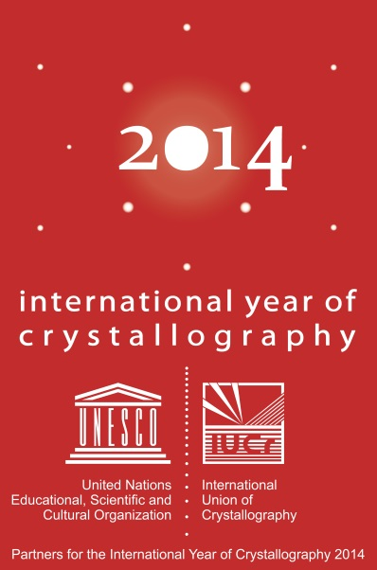

“
It is structure that we look for whenever we try to understand anything. All science is built upon this search; we investigate […] how crystals aggregate; how atoms are fastened together; how electrons constitute a chemical bond between atoms.
Linus Pauling, Main Currents in Modern Thought (1950)
”
The contribution of the IUCr to the development of scientific education, research and infrastructure in Africa
Michele Zema
International Union of Crystallography
5 Abbey Square, Chester, UK
and
University of Pavia, Italy
mz@iucr.org
Michele Zema
Project Manager for IYCr2014
IUCr outreach officer
IUCr, UK and U. Pavia, Italy

Slide 2
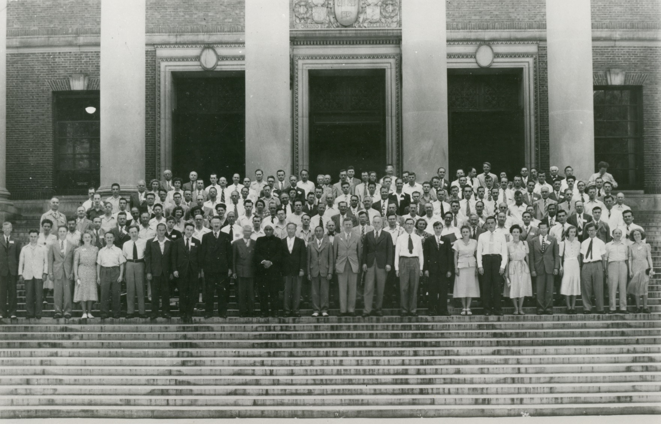
1948_ First Congress and General Assembly of the IUCr, Harvard, USA
Michele Zema
Project Manager for IYCr2014
IUCr outreach officer
IUCr, UK and U. Pavia, Italy
1947 the IUCr, founded after an idea of P.P. Ewald, is accepted into ICSU
1948 the first elected President by the General Assembly is W.L. Bragg
1948 the first issue of Acta Crystallographica is released

Slide 3

IUCr
Facts
58 member countries
43 adhering Bodies (including 4 regional Associates)
23 commissions
9 journals (IUCrJ launched in 2014)
Awards the Ewald Prize every three years
IUCr Congress every 3 years:
23rd IUCr Congress, Montréal, August 2014
24th IUCr Congress, Hyderabad, India, 2017
25th IUCr Congress, Praha, Czech Rep., 2020
since 1947
Michele Zema
Project Manager for IYCr2014
IUCr outreach officer
IUCr, UK and U. Pavia, Italy
The IUCr is a member of

Slide 4
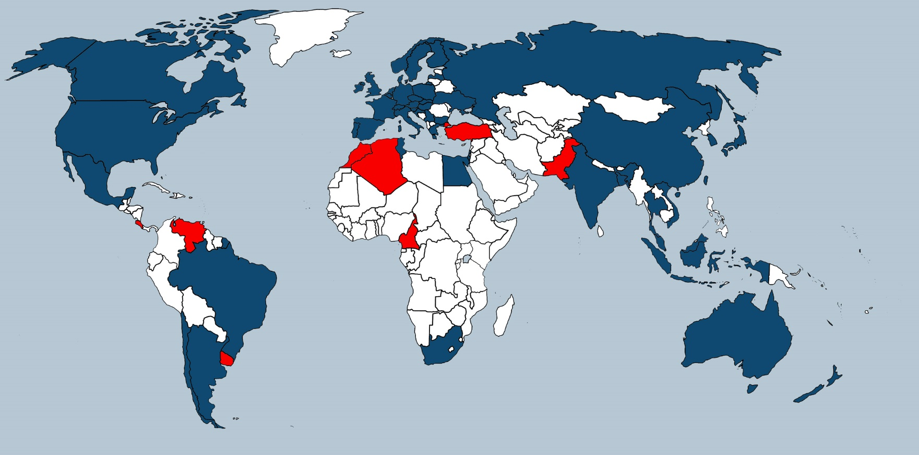
IUCr
Facts
Michele Zema
Project Manager for IYCr2014
IUCr outreach officer
IUCr, UK and U. Pavia, Italy
Countries that adhered to the IUCr before 2014 are shown in blue,
those countries that joined in 2014 during IYCr are shown in red.

Slide 5
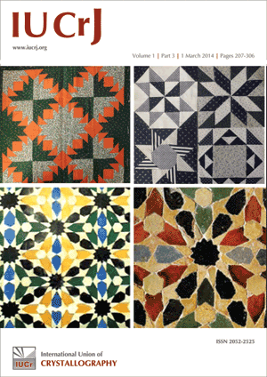
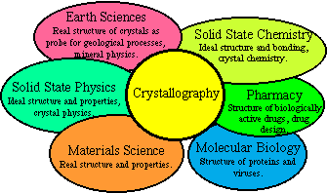

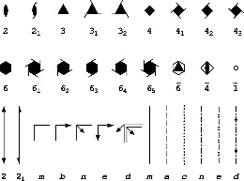
IUCr
Aims
promote international cooperation in crystallography
promote international publication of crystallographic research
form a focus for the relations of crystallography to other sciences.
contribute to the advancement of crystallography in all its aspects, including related topics concerning the non-crystalline state
facilitate standardization of methods, units, nomenclatures and symbols
Michele Zema
Project Manager for IYCr2014
IUCr outreach officer
IUCr, UK and U. Pavia, Italy

Slide 6
IUCr Commissions
Commission on Aperiodic Crystals
Commission on Biological Macromolecules
Commission on Charge, Spin and Momentum Densities
Commission on Crystal Growth and Characterization of Materials
Commission on Crystallographic Computing
Commission on Crystallographic Nomenclature
Commission on Crystallographic Teaching
Commission on Crystallography in Art and Cultural Heritage
Commission on Crystallography of Materials (ad interim)
Commission on Electron Crystallography
Commission on High Pressure
Commission on Inorganic and Mineral Structures
Commission on International Tables
Commission on Journals
Commission on Magnetic Structures
Commission on Mathematical and Theoretical Crystallography
Commission on Neutron Scattering
Commission on NMR Crystallography and Related Methods
Commission on Powder Diffraction
Commission on Small-Angle Scattering
Commission on Structural Chemistry
Commission on Synchrotron and XFEL Radiation
Commission on XAFS
Michele Zema
Project Manager for IYCr2014
IUCr outreach officer
IUCr, UK and U. Pavia, Italy

Slide 7
IUCr Commission on Synchrotron and XFEL Radiation
The Commission on Synchrotron Radiation was formally established at the Bordeaux General Assembly in 1990, with the following terms of reference:
Crystallography of small molecules and large molecules in the areas of very high resolution, large unit cells, microcrystals, reduced radiation damage, kinetic crystallography and multi-wavelength anomalous-dispersion phasing.
Fibre diffraction and small-angle scattering including time-resolved studies.
X-ray topography.
EXAFS (Extended X-ray absorption fine structure).
Diffuse scattering.
X-ray optics and detectors of particular relevance to the utilization of the unique properties of synchrotron radiation.
Magnetic scattering.
High pressure diffraction.
The Commission will serve several functions as follows:
To assist in the organization of relevant sessions at IUCr Congresses and other meetings that will catalyze developments and innovations in the subject.
To catalogue information on the available synchrotron-radiation sources and the instrumentation relevant to the above topics. This information will be made freely available and so improve the future planning, use and effectiveness of the global resources available for the community of crystallographers and diffractionists represented by the IUCr.
To provide a forum for comparing and contrasting the policies of the various centralized synchrotron facilities.
To facilitate scientific and technical studies amied at improving standards of sources, equipment and procedures.
To try to provide a mechanism whereby potential users of synchrotron radiation from anywhere in the world can be directed to the appropriate facility and helped with gaining access there.
Michele Zema
Project Manager for IYCr2014
IUCr outreach officer
IUCr, UK and U. Pavia, Italy

Slide 8
IUCr Commission on Synchrotron and XFEL Radiation
Members
R.F. Garrett (Chair, Australia)
S.-L. Chang (Taipei)
M.A. Garcia-Aranda (Spain)
E. Granado (Brazil)
P. Grochulski (Canada)
J.-L. Hodeau (France)
Y. Murakami (Japan)
S. Pascarelli (France)
J.L. Smith (USA)
T. Tschentcher (Germany)
Consultants
D.M. Fritz (USA)
T. Hatsui (Japan)
M. Kozak (Poland)
G. Paolucci (Jordan)
M.K. Sanyal (India)
M. Suchomel (USA)
S. Wakatsuki (Japan)
Michele Zema
Project Manager for IYCr2014
IUCr outreach officer
IUCr, UK and U. Pavia, Italy

Slide 9
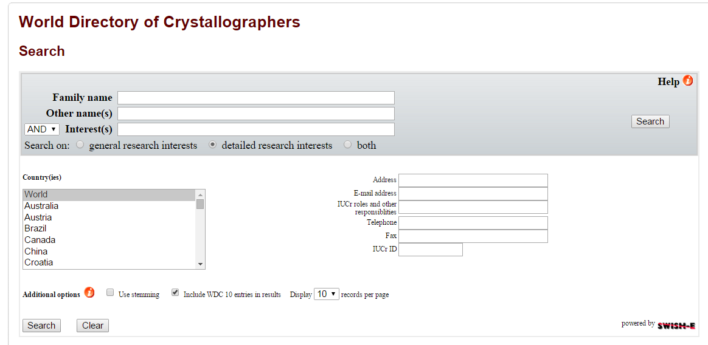
World Directory of Crystallographers
Facilitating communication within the crystallographic community
http://www.iucr.org/people/wdc
Launched in 1957, the database currently has 20,000 entries.
Subscription is free.
The database allows you to create your own unique profile, research interests and papers published.
Manage subscriptions to journal e-alerts and the IUCr Newsletter from your profile, as well as enjoying the special offers on publications and services from time to time.
Michele Zema
Project Manager for IYCr2014
IUCr outreach officer
IUCr, UK and U. Pavia, Italy

Slide 10
IUCr publications

Slide 11
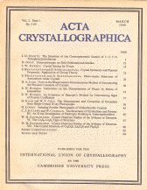
`Acta is intended to offer a central place for publication and discussion of all research in this vast and ever-expanding field. It borders, naturally, on pure physics, chemistry, biology, mineralogy, technology and also on mathematics, but is distinguished by being concerned with the methods and results of investigating the arrangement of atoms in matter, particularly when that arrangement has regular features.‘
Paul P. Ewald, Acta Crystallographica (1948), 1, 2
Michele Zema
Project Manager for IYCr2014
IUCr outreach officer
IUCr, UK and U. Pavia, Italy

Slide 12
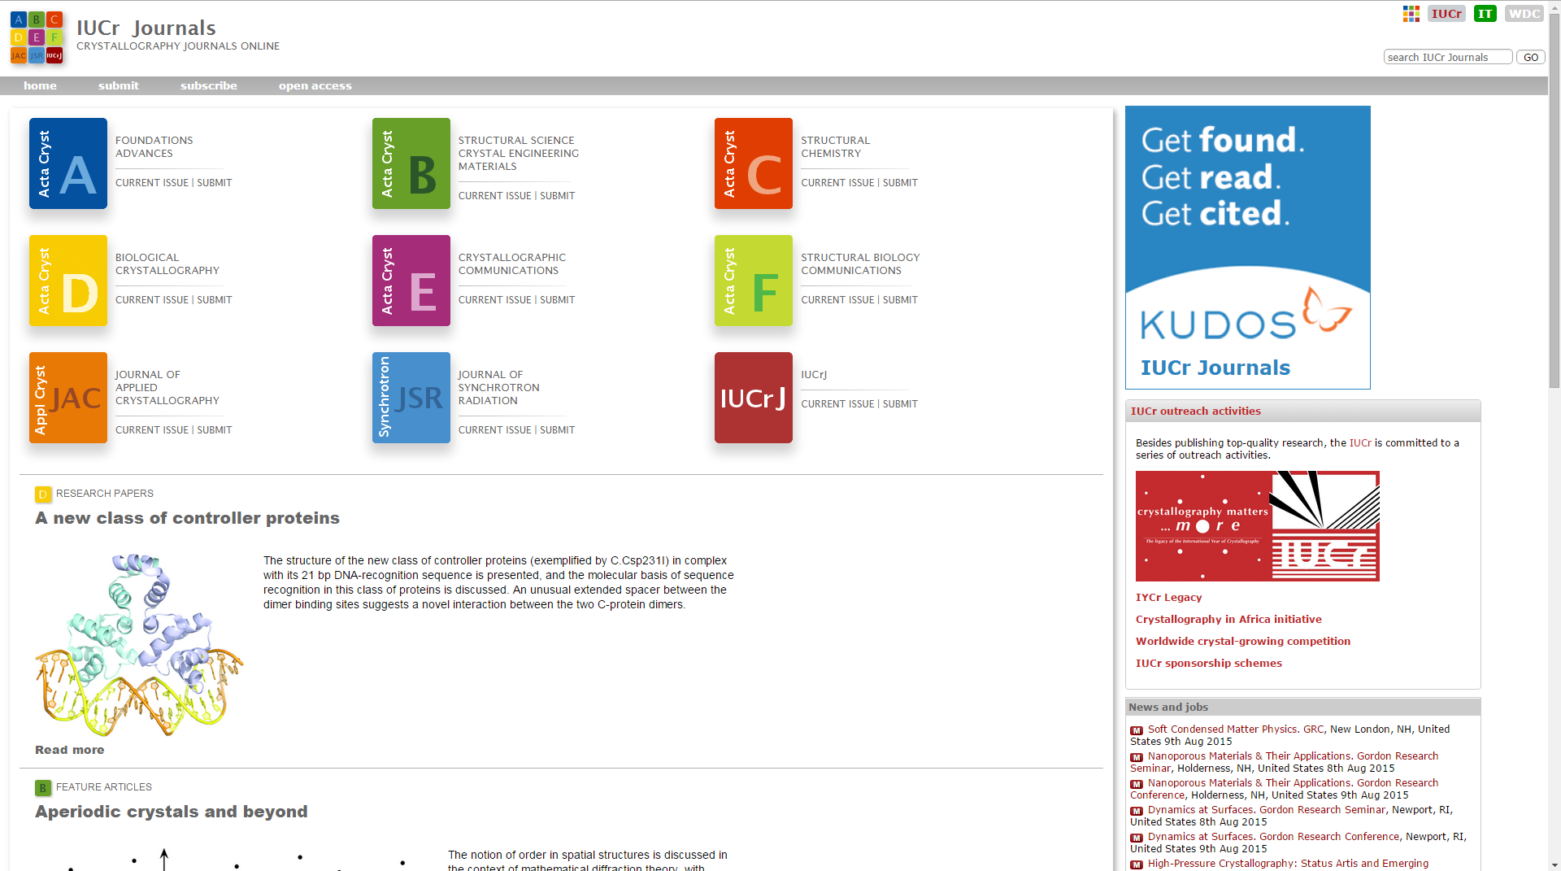
IUCr journals: new style

Slide 13
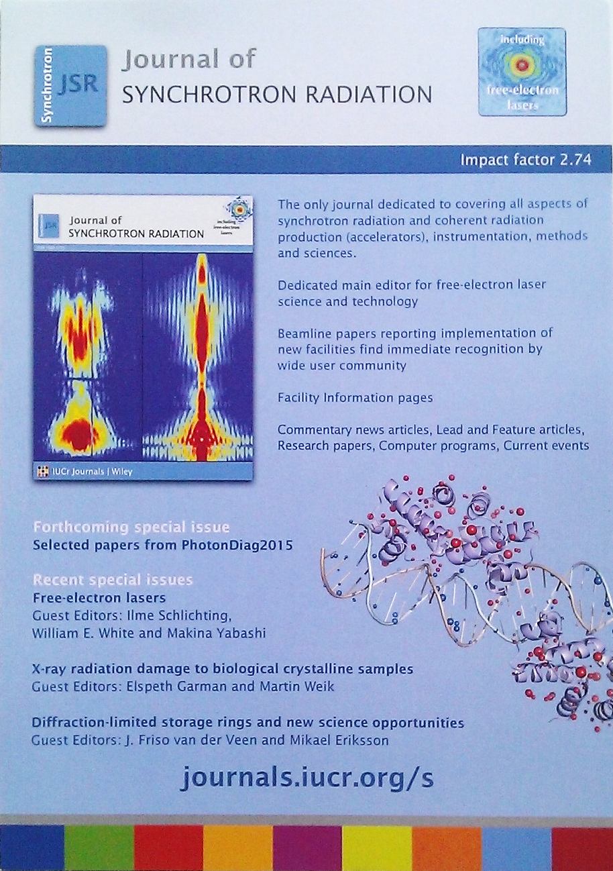
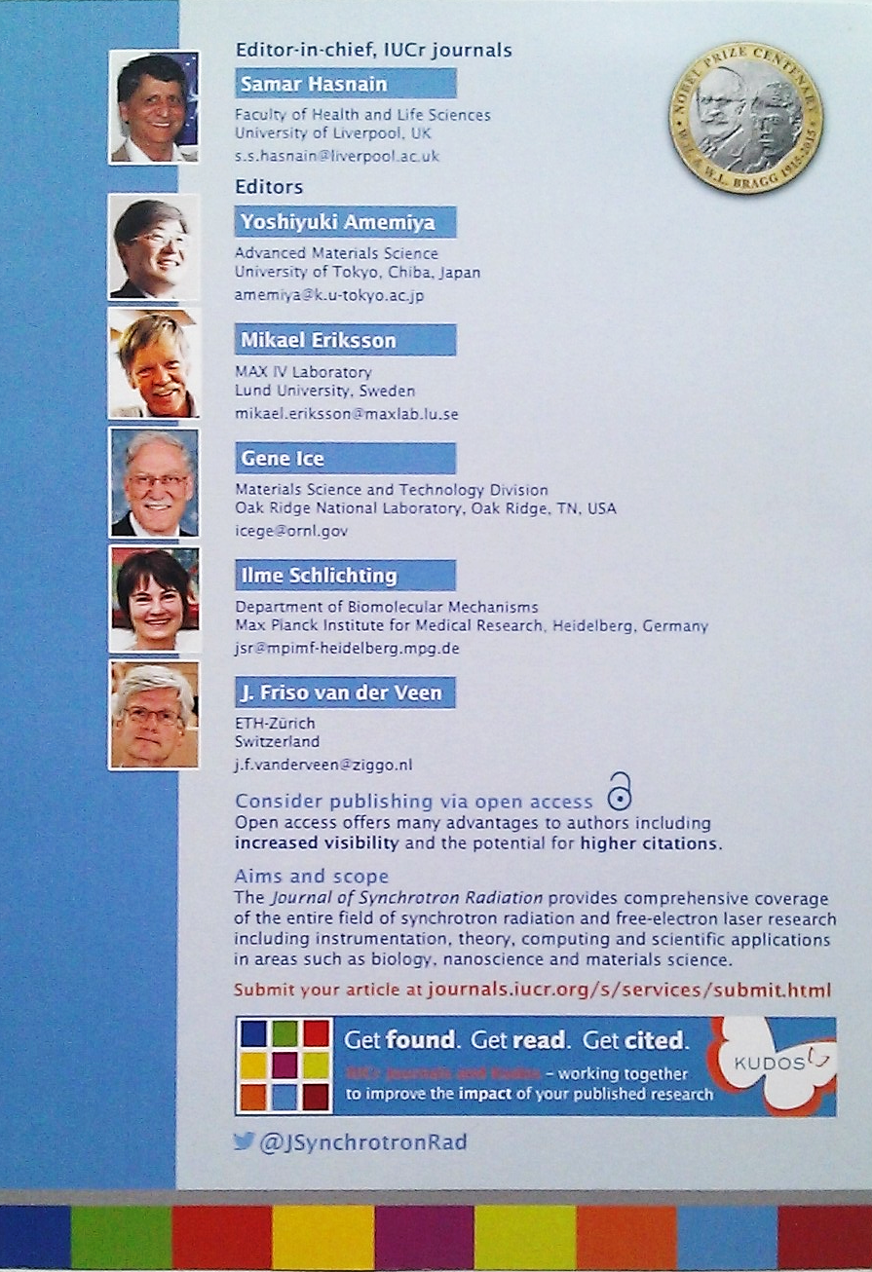
Journals of synchrotron radiation

Slide 14
Facility information page

Slide 15

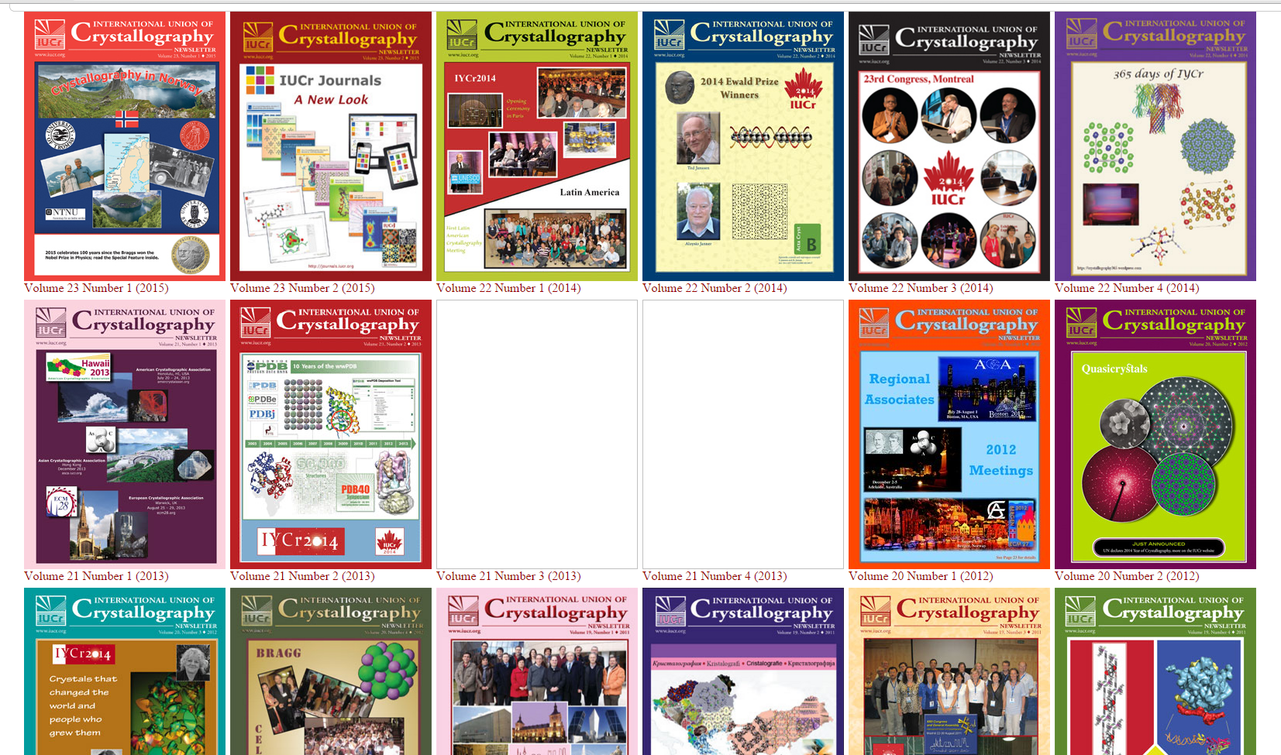
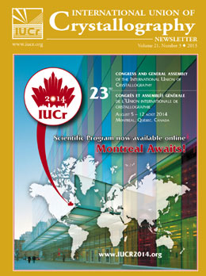
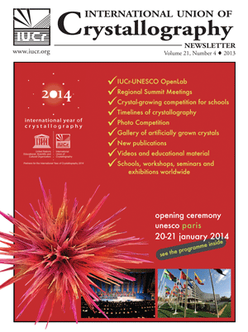
IUCr Newsletter
distributed electronically to 12,000 crystallographers and other interested individuals in 102 countries.
http://www.iucr.org/news/newsletter

Slide 16
IUCr
educational and outreach initiatives
and IYCr2014

Slide 17
IUCr sponsorships
The IUCr currently sponsors scientific activities and meetings in a number of ways:
Visiting Professorships
    The IUCr Visiting Professorship scheme aims to support some of the costs of having internationally recognized scientists as lecturers for short courses at workshops or schools organized in developing countries.
Scientific conferences and workshops
Journal subscriptions
Crystallography in Africa
www.iucr.org/iucr/sponsorship
Michele Zema
Project Manager for IYCr2014
IUCr outreach officer
IUCr, UK and U. Pavia, Italy

Slide 18
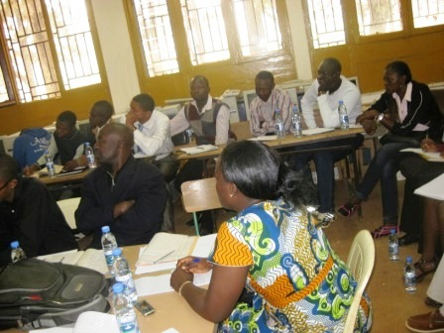
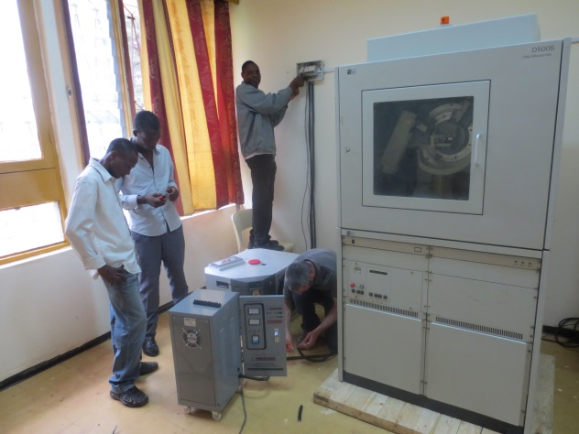
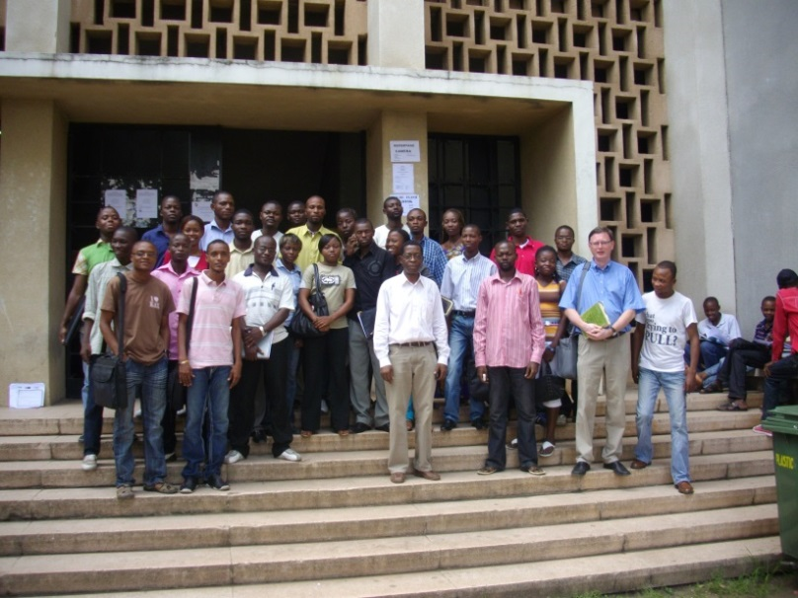
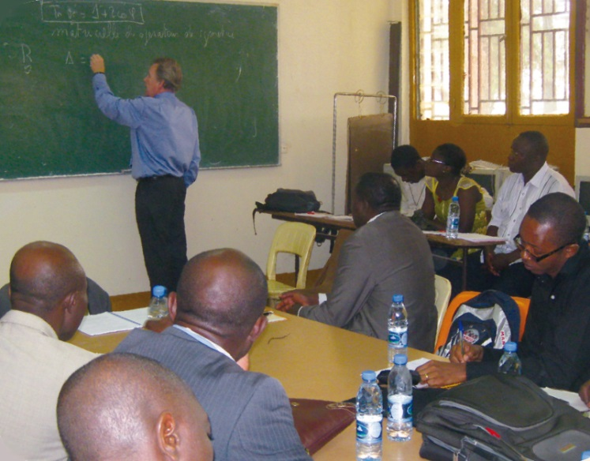
IUCr initiative
Crystallography in Africa
since 1999
Approved by the IUCr Executive Committee following a proposal of Jan Boeyens from South Africa
crystallography lecture series and schools
bursaries awarded to African students to attend meetings of the IUCr Regional Associates
bursaries for young professors (up to the age of 40), post-doctoral students and PhD students from Africa to attend an IUCr Congress
instrumentation supplied free of charge by partner companies (namely, Bruker AXS)
Steering Committee
Claude Lecomte, Chair
Patrice Kenfack
Luc Van Meervelt
Hocine Merazig
Romain Murenzi (TWAS)
Jean Paul Ngome (UNESCO)
Andreas Roodt
Abdelmalek Thalal
Michele Zema

Slide 19

UN General Assembly, GA/11262, 3 July 2012
Resolution 66/284
submitted by Morocco, approved unanimously
2014 is proclaimed International Year of Crystallography
Recognizing that humankind’s understanding of the material nature of our world is grounded, in particular, in our knowledge of crystallography;
Stressing that education about and the application of crystallography are critical in addressing challenges such as diseases and environmental problems, as well as solutions for plant and soil contamination;
Considering that the impact of crystallography is present everywhere in our daily lives;
Considering also the significance of the scientific achievements of crystallography, as illustrated by twenty-three Nobel Prizes awarded in the area, and that crystallography is still fertile ground for new and promising fundamental research;
Considering further that 2014 marks the centenary of the beginning of modern crystallography and its identification as the most powerful tool for structure determination of matter,
Being aware that 2014 provides an opportunity to promote international collaboration as part of the sixty-fifth anniversary of the founding of the International Union of Crystallography;
Noting the broader welcome by the crystallographic community worldwide of the idea of 2014 being designated as the International Year of Crystallography
Michele Zema
Project Manager for IYCr2014
IUCr outreach officer
IUCr, UK and U. Pavia, Italy

Slide 20







Crystallography for the next generation
– RESOLUTION –
issued on the occasion of the IYCr Legacy Conference, Rabat, Morocco, 22-24 April 2015
[…] At a time when scientific endeavour is critical for societal benefit and the importance of crystallography is greater than ever, crystallography remains a science that still has lower visibility than it should,
the IUCr and all partner institutions commit:
  to enhance the stature of crystallography […]
  to build capacity in developing regions of the world […]
  to extend further the public understanding of science in general and crystallography in particular […]
Private endorsement at http://www.iycr2014.org/declarations
Notes:
IYCr final document issued on the occasion of the Closing Ceremony/IYCr Legacy Conference

Slide 21
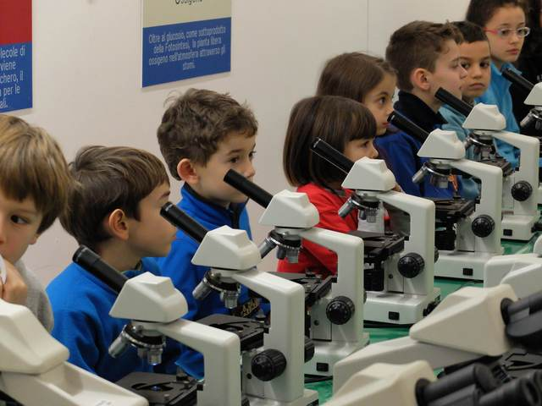
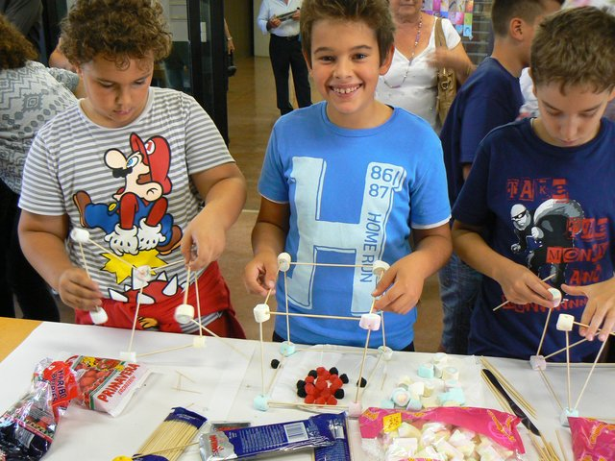
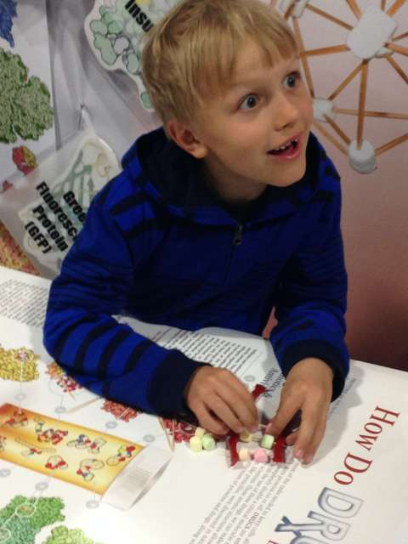
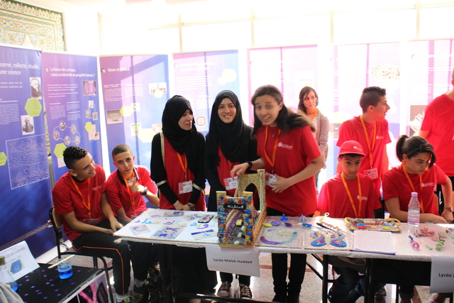
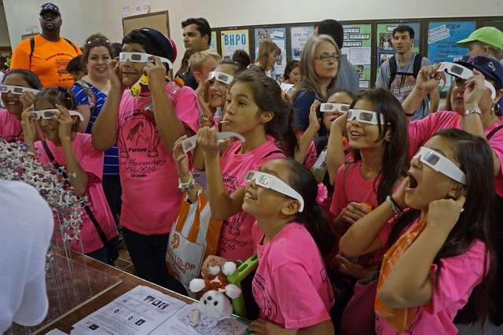
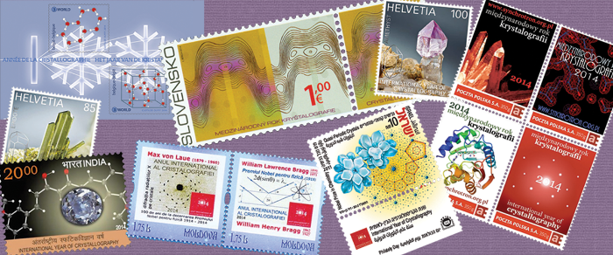
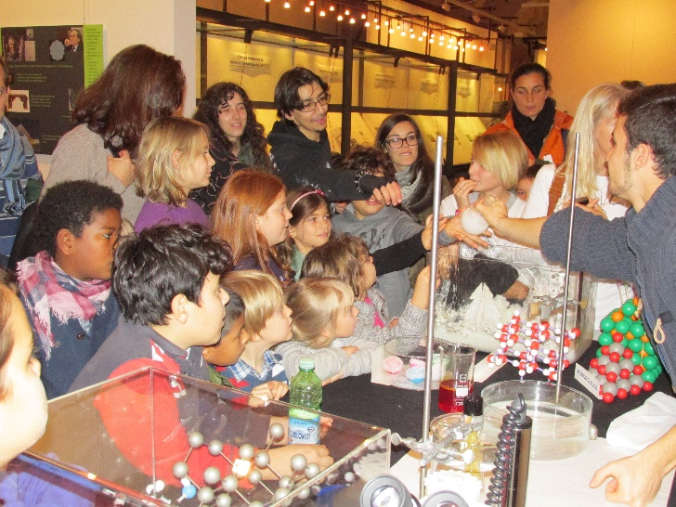
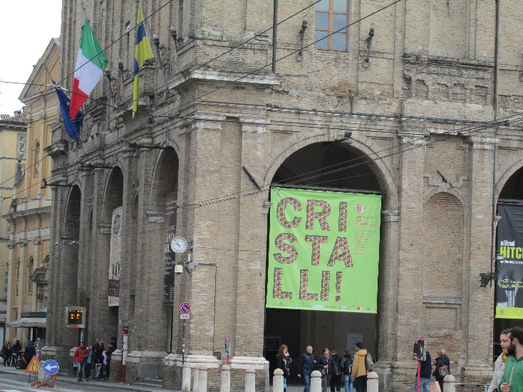
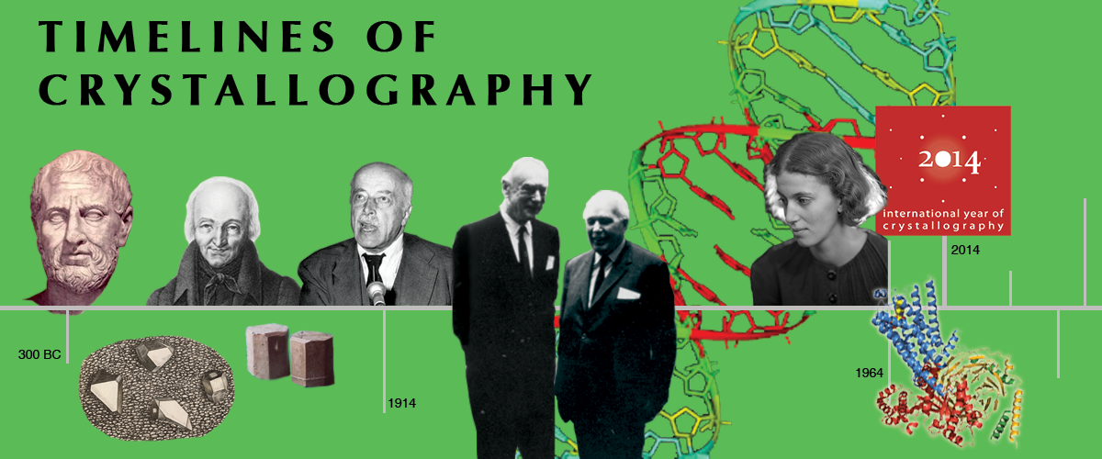
EXHIBITIONS
SCIENCE FAIRS
FREE STREAMING MOVIE
POSTAGE STAMPS RELEASES
BROCHURES AND PUBLICATIONS
TIMELINES OF CRYSTALLOGRAPHY

Slide 22
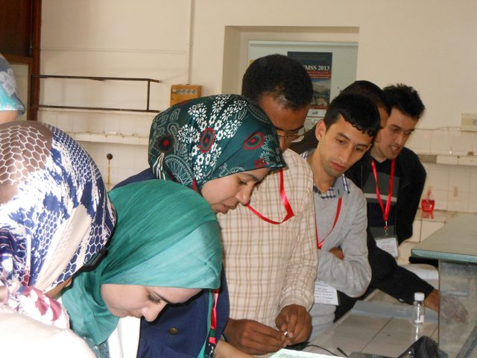

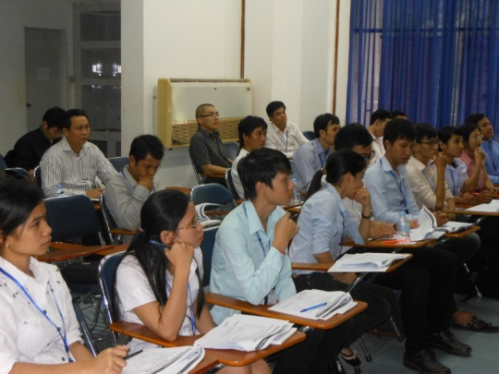
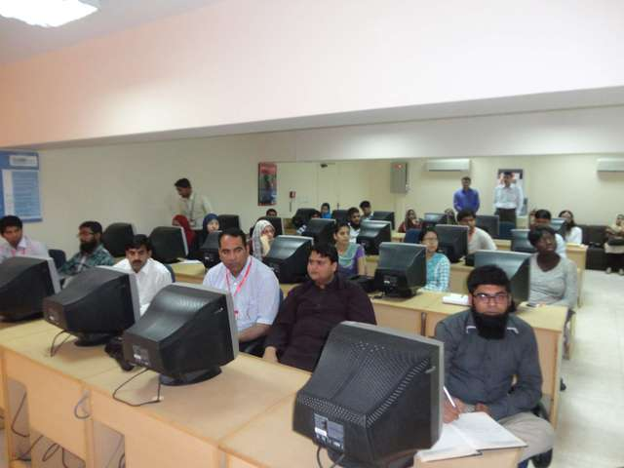
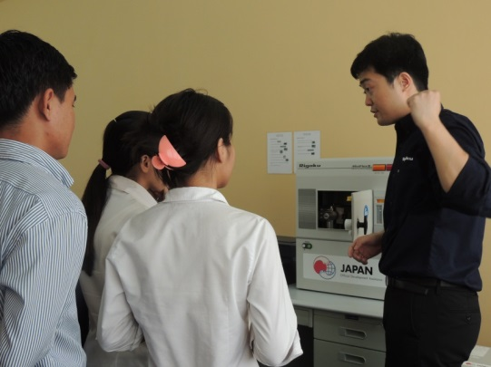
The IUCr-UNESCO OpenLab is a network of operational crystallographic laboratories based in different countries worldwide, mainly in less endowed regions of Africa, South and Central America and South Asia. They are aimed at allowing access to crystallographic knowledge and technology in all parts of the world, key for the fruitful development of science, and to open possibilities for conducting high-level research.

Slide 23
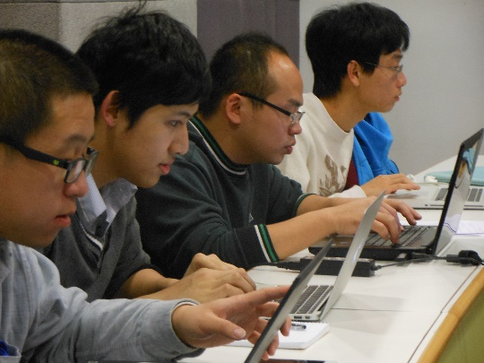
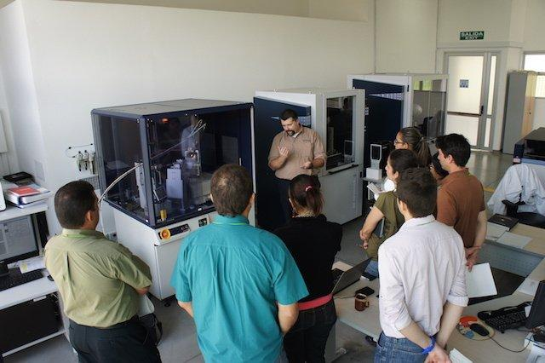
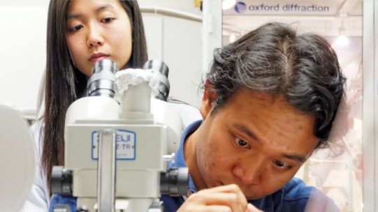
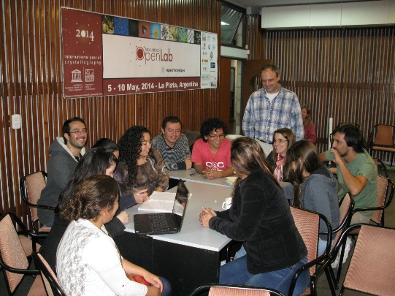
Co-organized by IUCr, UNESCO, industry and local institutions
New instruments installed or existing machines used
Students from the hosting country and from neighbouring region to foster cooperation
Lecturers from the IUCr and from the partner company, together with local teachers and tutors

Slide 24
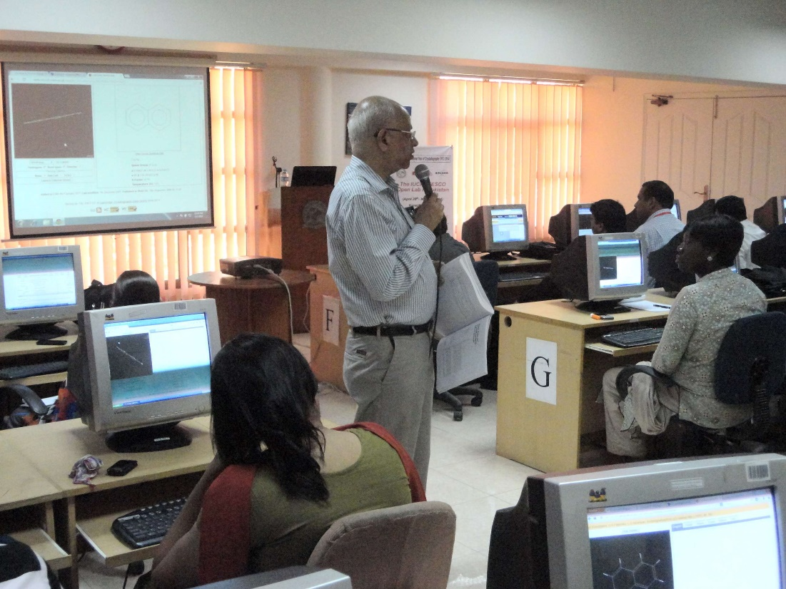
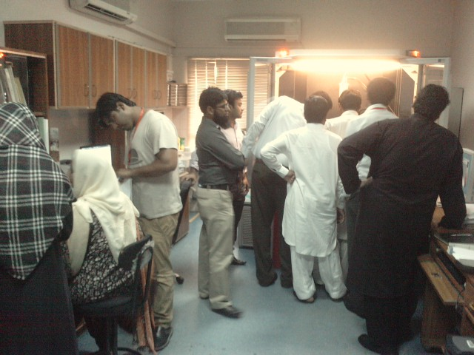
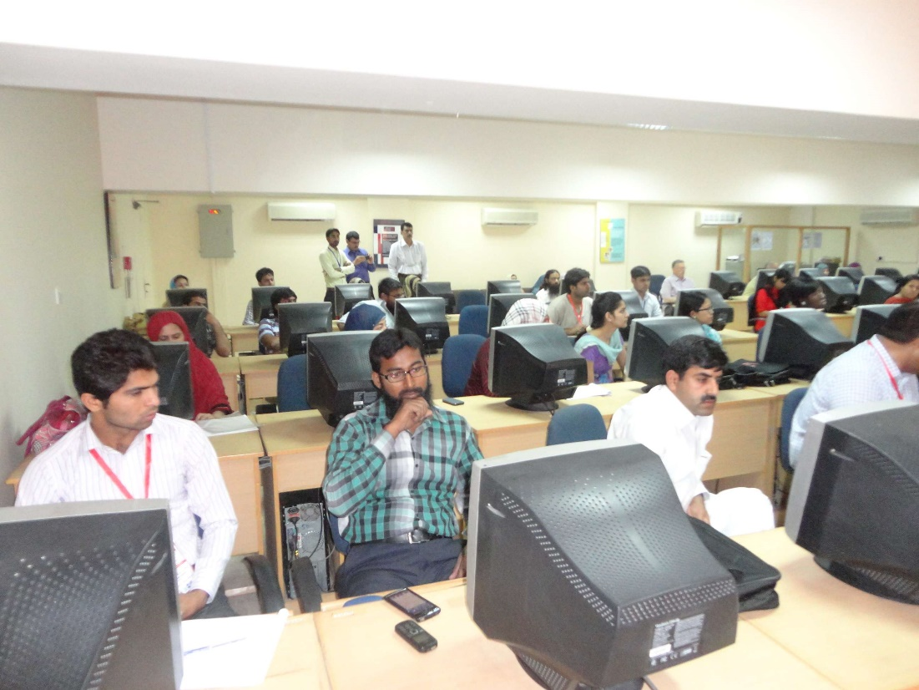
Lectures
The 1st IUCr-UNESCO OpenLab
was held in Karachi (Pakistan)
on 30 April to 8 Maj 2014
in conjunction with the
IYCr South-East Asia Summit Meeting
Hands-on experiments
Software fayres

Slide 25
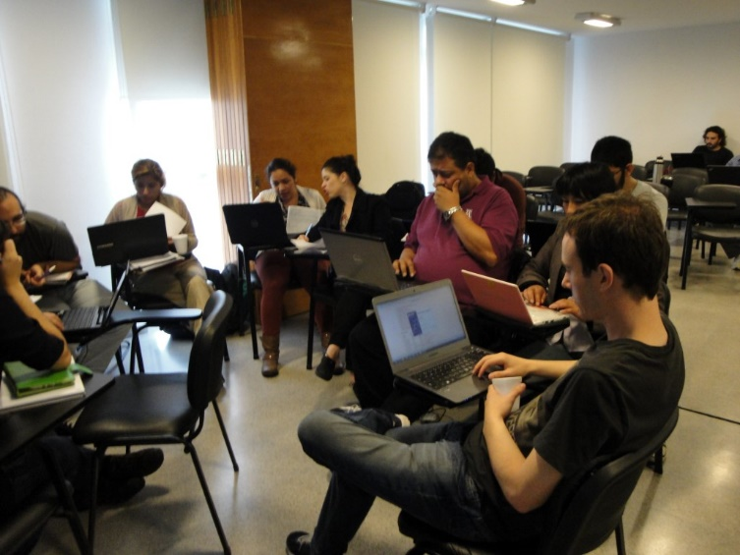
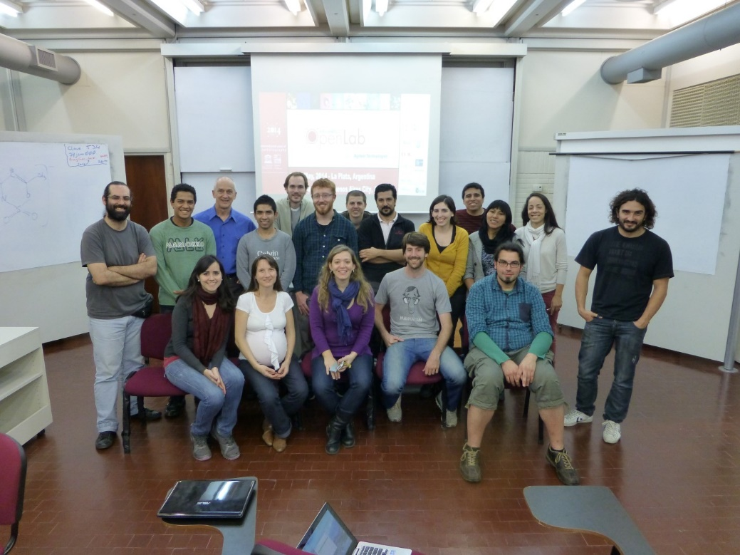
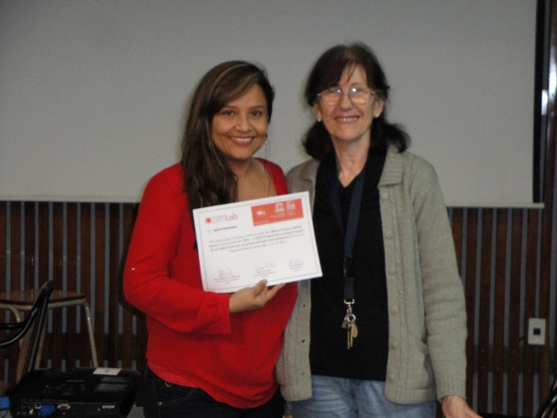
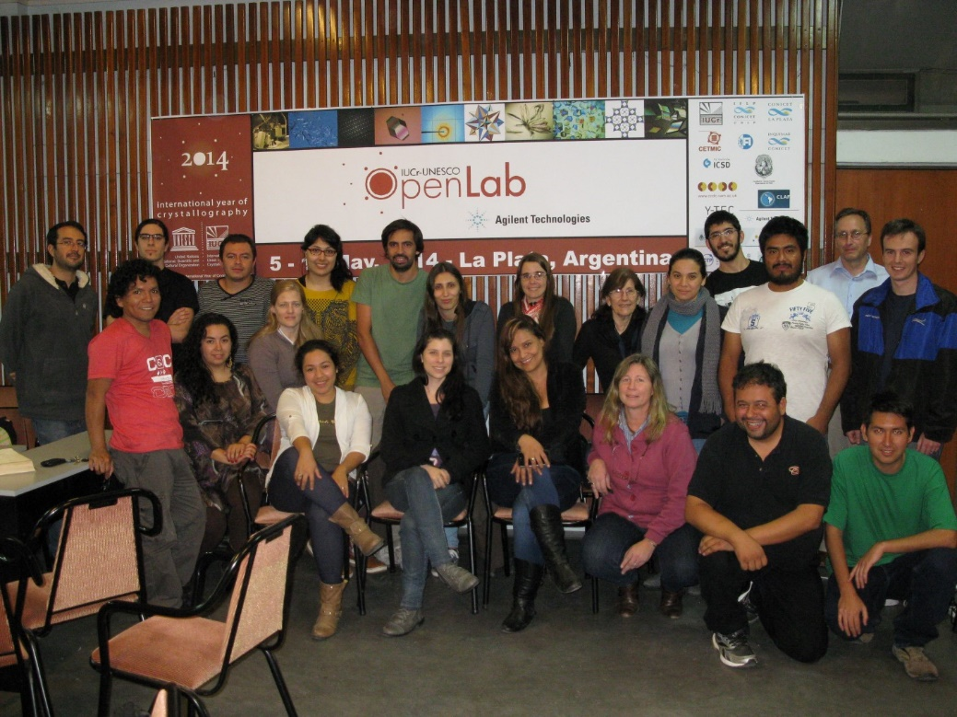

OpenLab Argentina
Buenos Aires
La Plata

Slide 26
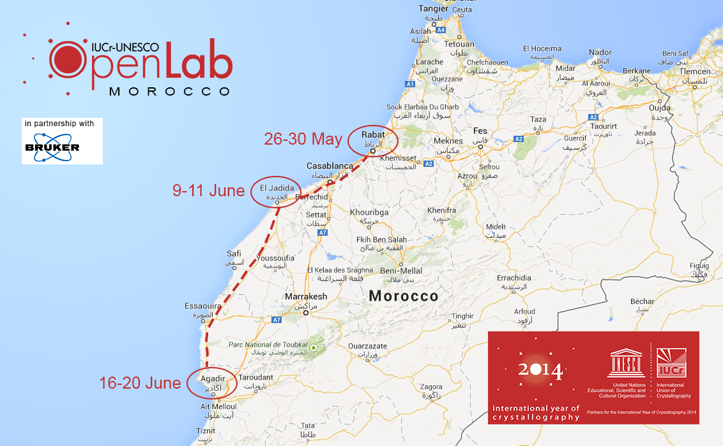
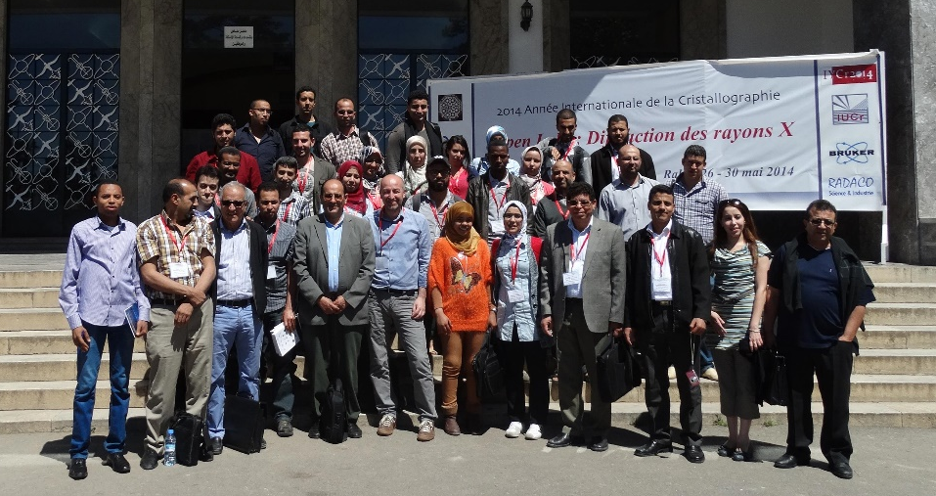
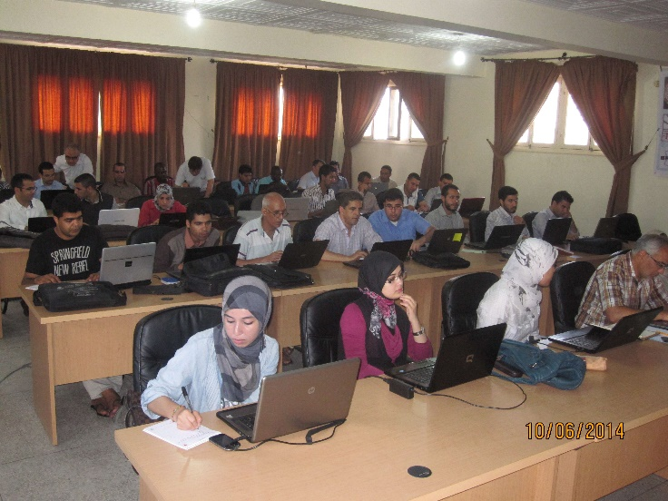
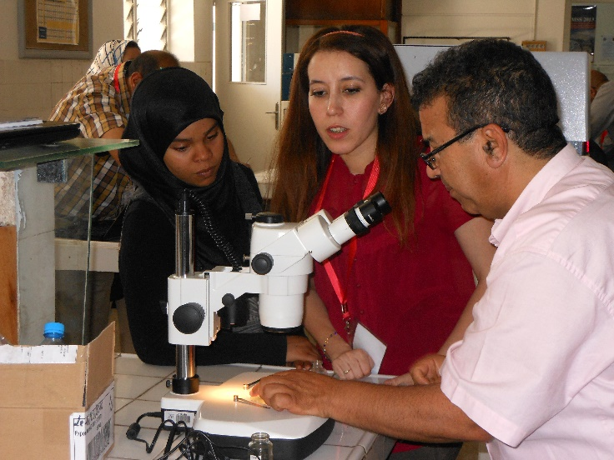
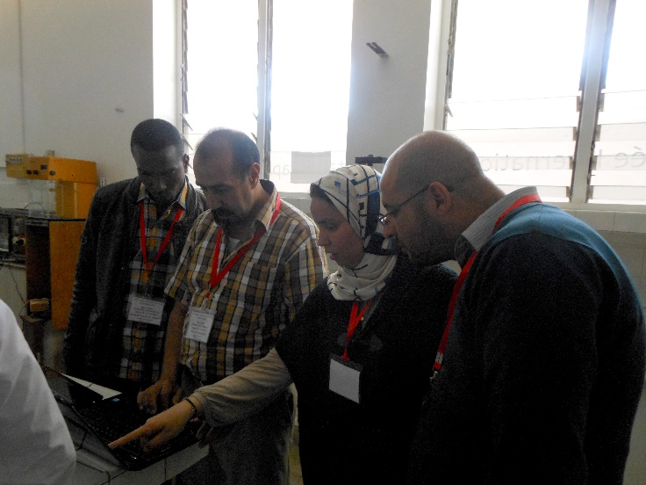

Slide 27
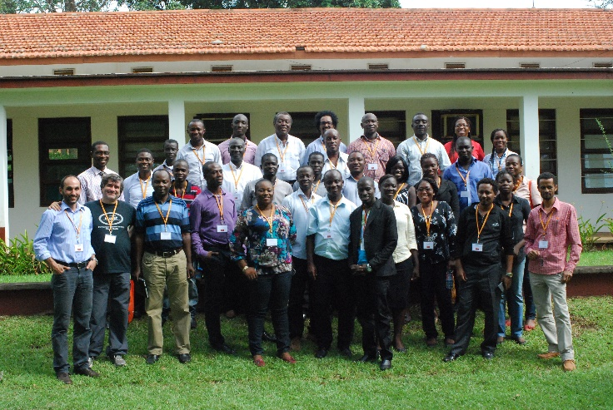
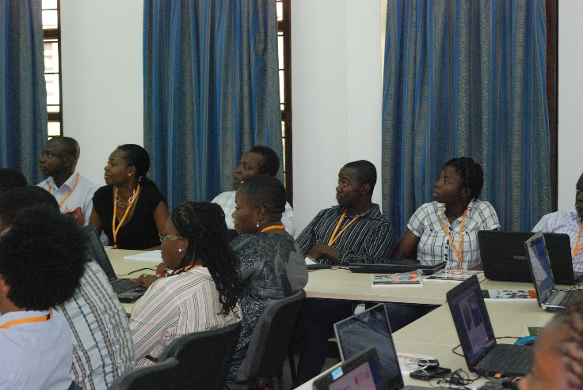
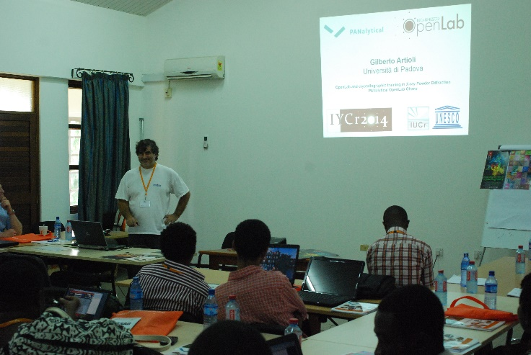






G H A N A
CAMBODIA
URUGUAY

Slide 28




A unique opportunity for young scientists
from 19 different nations
to MEET other crystallographers
to SHARE experiences
and be TRAINED

Slide 29


 |  | Dates | Type | Country | Location
1 | Bruker OpenLab Pakistan | 30 Apr 2014 - 8 May 2014 | OpenLab Type 2 | Pakistan | Karachi
2 | Agilent OpenLab Argentina | 5 May 2014 - 10 May 2014 | OpenLab Type 2 | Argentina | La Plata and Buenos Aires
3 | Bruker OpenLab Morocco | 20 May 2014 - 20 Jun 2014 | Travelling Lab | Morocco | Rabat and Agadir
4 | PANalytical OpenLab Ghana | 9 Jun 2014 - 12 Jun 2014 | OpenLab Type 2 | Ghana | Accra
5 | Rigaku OpenLab Cambodia | 7 Jul 2014 - 11 Jul 2014 | OpenLab Type 2 | Cambodia | Phnom Penh
6 | Bruker OpenLab Uruguay | 23 Jul 2014 - 31 Jul 2014 | OpenLab Type 1 | Uruguay | Montevideo
7 | Bruker OpenLab Indonesia | 18 Aug 2014 - 22 Aug 2014 | Travelling Lab | Indonesia | Bandung
8 | Agilent OlexSys OpenLab Turkey | 1 Sep 2014 - 5 Sep 2014 | OpenLab Type 2 | Turkey | Izmir
9 | STOE DECTRIS Xenocs OpenFactory | 10 Sep 2014 - 19 Sep 2014 | OpenFactory | France and Germany | Grenoble and Darmstadt
10 | Rigaku OpenLab Colombia | 27 Oct 2014 - 31 Oct 2014 | OpenLab Type 2 | Colombia | Bucaramanga
11 | PANalytical OpenLab Mexico | 18 Nov 2014 - 21 Nov 2014 | OpenLab Type 2 | Mexico | Mexico City
12 | Agilent OlexSys OpenLab Hong Kong | 3 Dec 2014 - 7 Dec 2014 | OpenLab Type 2 | Hong Kong | Hong Kong
13 | Bruker OpenLab Vietnam | 8 Dec 2014 - 12 Dec 2014 | OpenLab Type 2 | Vietnam | Ho Chi Minh City
14 | PANalytical OpenLab Turkey | 19 Jan 2015 - 22 Jan 2015 | OpenLab Type 2 | Turkey | Ankara
15 | Bruker OpenLab Algeria | 9 May 2015 - 14 May 2015 | OpenLab Type 1 | Algeria | Constantine
16 | Bruker OpenLab Tunisia | 14 May 2015 - 23 May 2015 | Travelling Lab | Tunisia | Monastir and Nabeul
17 | CCDC OpenLab Kenya | 6 Sep 2014 - 10 Sep 2015 | OpenLab Type 2 | Kenya | Nairobi
18 | PANalytical OpenLab Mexico | 28 Sept 2015 - 2 Oct 2015 | OpenLab Type 2 | Mexico | Puebla
19 | Bruker OpenLab Senegal | 5 Oct 2014 - 10 Oct 2015 | Travelling Lab | Senegal | Ziguinchor
20 | Bruker OpenLab Vietnam | 14-18 Dec 2015 | OpenLab Type 2 | Vietnam | Ho Chi Minh City
21 | Rigaku OpenLab Cambodia | 11-15 Jan 2016 | OpenLab Type 2 | Cambodia | Phnom Penh
22 | Bruker OpenLab Uruguay | 26 Feb – 3 Mar 2016 | OpenLab Type 2 | Uruguay | Montevideo
2014
2015
2016

Slide 30

Asia: Karachi (Pakistan), 28-30 April 2014
Vistas in Chemical crystallography
Latin America: Campinas (Brazil), 22-24 September 2014
Biological Crystallography and complementary techniques
Africa: Bloemfontein (South Africa), 15-17 October 2014 Crystallography as vehicle to promote Science in Africa and beyond

Slide 31



Aims and outcomes of the IYCr2014 Summit meetings
The IUCr-UNESCO Summit meetings have been intended to bring together scientists from countries in three widely separated parts of the world, using a common crystallographic theme. There is a real necessity for scientists to think beyond political borders and other distinctions. These meetings, focussed on high level science, also highlighted the difficulties and problems of conducting competitive scientific research in different parts of the developing world.
South-East Asia
Karachi, Pakistan
28-30 April 2014
Latin America
Campinas, Brazil
22-24 September 2014
Africa
Bloemfontein, South Africa
15-17 October 2014
Summit Declaration
Establishment of the
China-Pakistan-India fund
Foundation and 1st meeting of the Pakistani Crystallographic Association Lahore, 9 Oct 2014
1st India-Bangladesh bilateral meeting, Kolkata, 18-19 Sept 2015
New edition of OpenLab planned in Cambodia
Summit Declaration
Foundation and 1st meeting of LACA, Sao Paulo, 9-11 Sept 2015
New editions of OpenLabs planned in Mexico and Uruguay
Summit Declaration
AfCA Steering Committee formed
ICSU proposal approved
2nd North African Crystallographic Conference, Algeria or Tunisia, mid-2016
1st Crystallographic workshop for Central Africa, Cameroon, October 2016
New OpenLabs planned in Senegal, Kenya, Cote d’Ivoire, Gabon

Slide 32


summit meetings
Bloemfontein (South Africa), 15-17 October 2014
Appeal
legacy of the International Year of Crystallography
provide basic diffraction equipment
establishment of National Committees of Crystallography
scientific visa
training workshops, education programmes, mobility of researchers, joint research projects, regional conferences
Formation of the African Crystallographic Association (AfCA)
Michele Zema
Project Manager for IYCr2014
IUCr outreach officer
IUCr, UK and U. Pavia, Italy

Slide 33

IUCr Project title: Building Science Capacity in Africa via Crystallography
Funded under the ICSU Grants Programme 2015
Lead Applicant: International Union of Crystallography
Co-Applicant: European Crystallographic Association
Supporting organizations: UNESCO, ICSU Regional Office for Africa, INDABA, SAASTA
Project plan (2015/2016):
Follow-up meeting to the Bloemfontein Summit (to be held in North Africa)
Crystallography workshop in Central Africa (Dschang, 6-11 October 2016)
Support to African scientists to attend the INDABA series of conferences in South Africa
+ many additional actions
http://www.iycr2014.org/capacity-building/icsu2015

Slide 35





A proposal for an ICTP Workshop 2017
to be held at Université Assane SECK de Ziguinchor, Senegal
Venue for an IUCr-UNESCO OpenLab, held in collaboration with Bruker and CCDC, October 2015

Slide 36
National Organising Committee
G.R. Desiraju (Chair)
P. Chakrabarti
T.N. Guru Row
R.K.R. Jetti
D. Pandey
D.M. Salunke
M.K. Sanyal
Local Organising Committee
G.R. Desiraju (Chair)
R.K.R. Jetti (Vice Chair)
R. Banerjee
K. Biradha
U. Ramamurty
C.M. Reddy
J.A.R.P. Sarma
M. Zema
www.iucr2017.org

Slide 37

Could this be a good opportunity for the next AfLS meeting?

