Slide 2
Remote data collection at the ESRF
Gordon Leonard
ESRF Structural Biology Group

Slide 3
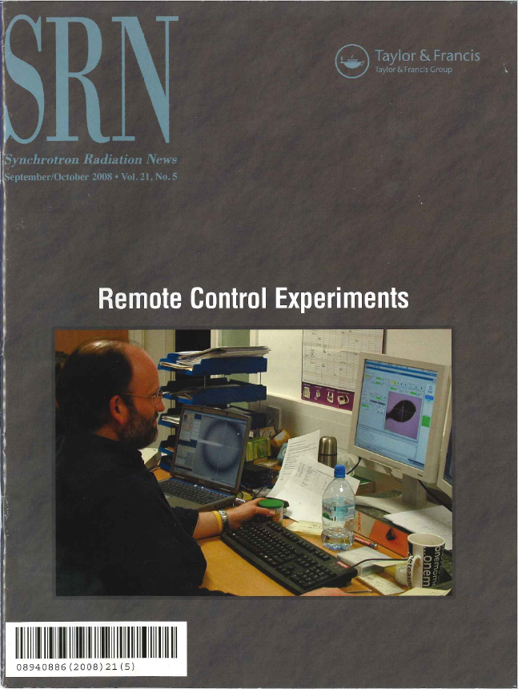
Remote Access for users of SR MX beam-lines
Remote access is a way of providing a better service to both academic & industrial users of end-stations at synchrotrons.
Allows access the best SR MX beam-lines in Europe/World without the need to travel
Optimised use of beam time
Reflects the continuing globalization of Science

Slide 4
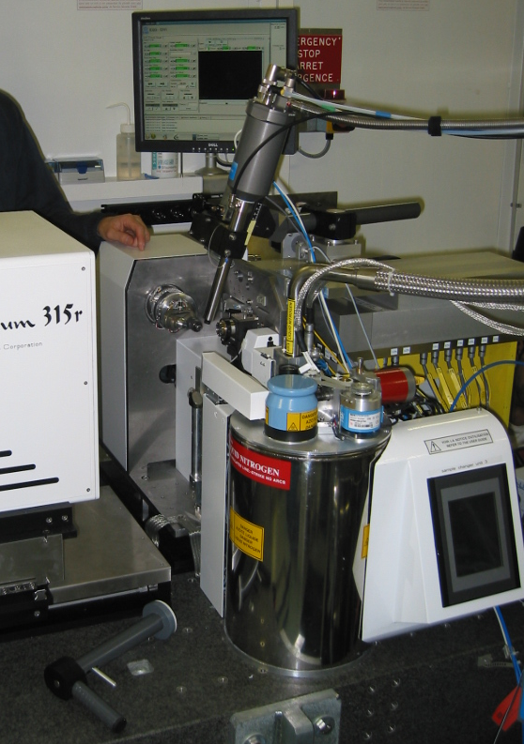
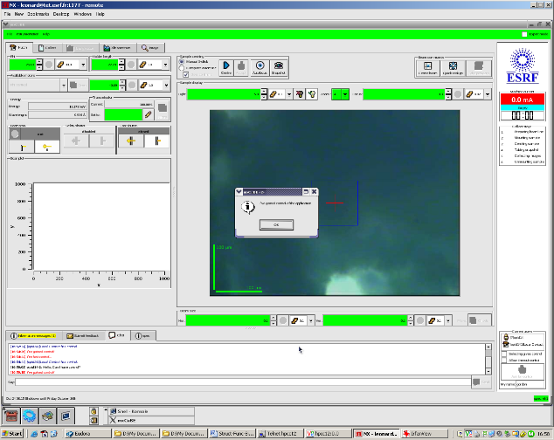
What’s needed To Provide remote access?
In principle, its fairly straightforward
Laboratory Information Management System (LIMS) (tracking of experiments, download of results & data)
Control GUI (running on computer accessible from anywhere)
Sample Changer
And staff to deal with samples, load/unload SCs, solve BL problems, etc.

Slide 5
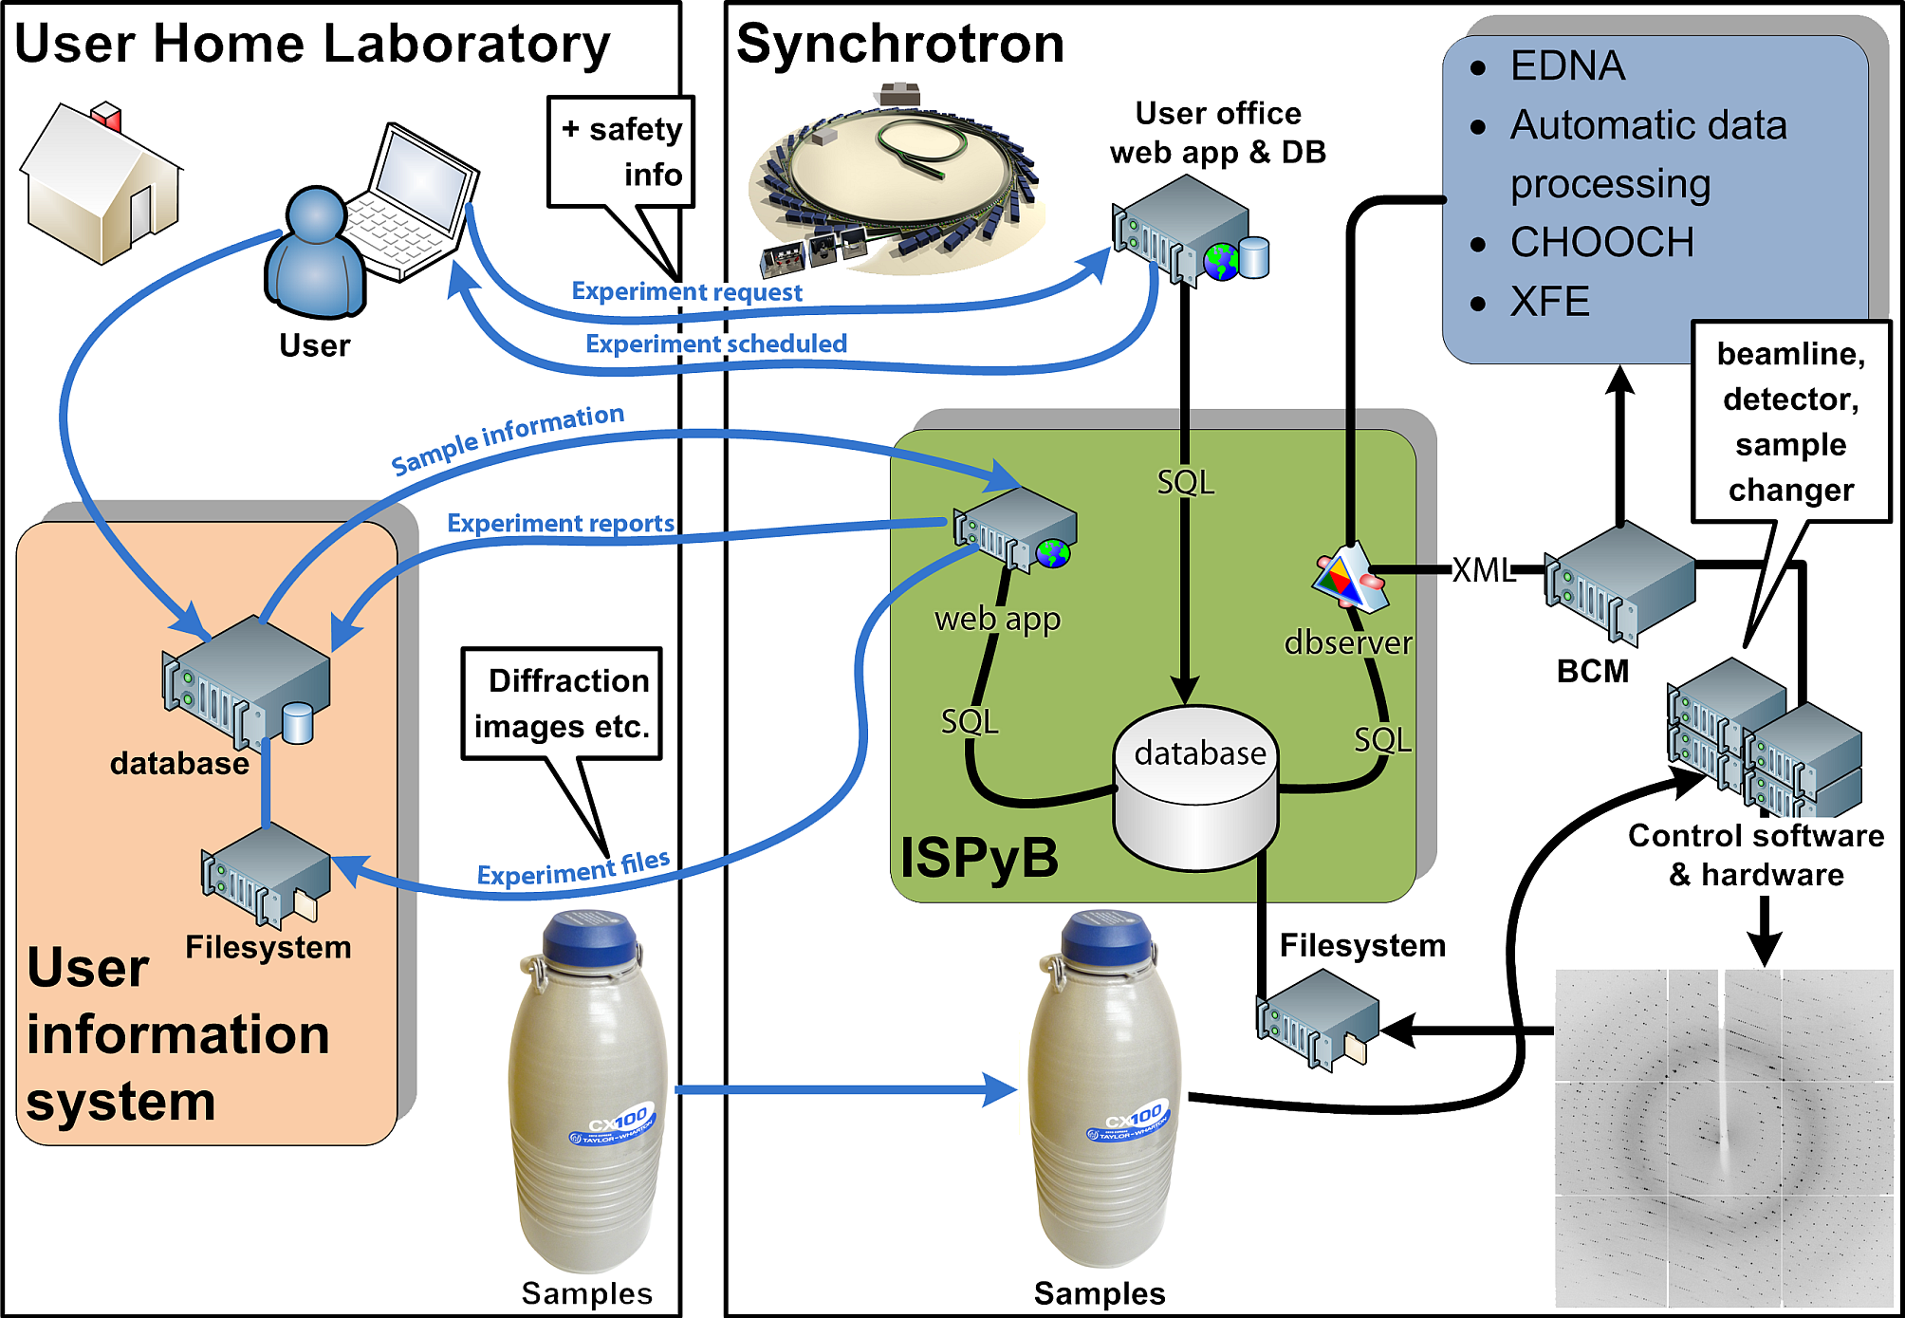
Actually, it’s a bit more complicated….

Slide 6
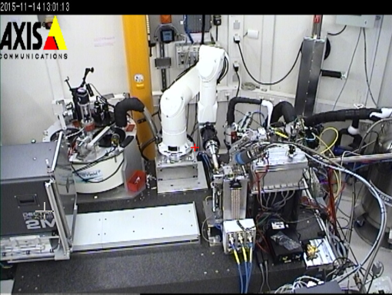
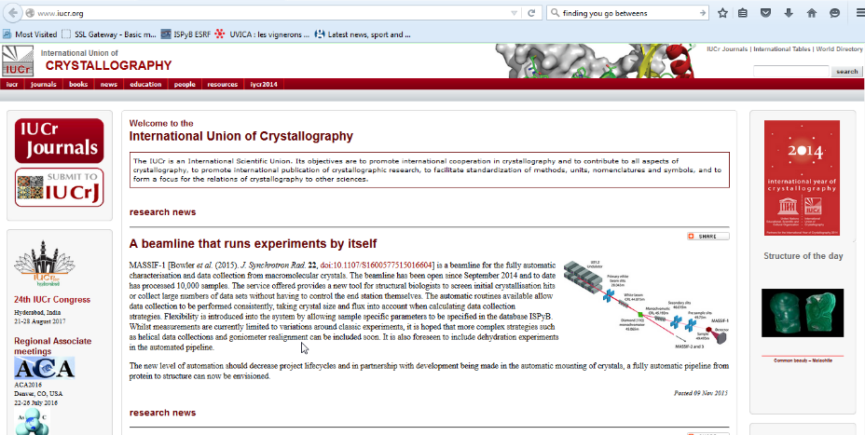
What sort of remote access?
Data Collection ‘Service’
Based on ‘diffraction plan’ submitted via LIMS
ESRF staff control beam-line and take decisions about data collection
or
Beam-line automatically takes all decisions about data collection
Full remote control
BL staff optimise beam-line & load samples in Sample Changer
External Users log in to beam-line control PC from home lab
External users control BL remotely as if they were actually at ESRF.
BL staff on-call in case of problems
‘Hybrid’ control
As full remote control but some users come to ESRF to collect, some stay at home and collect from there.
Users at the ESRF responsible for loading/unloading sample changer, solving minor beam-line problems

Slide 7
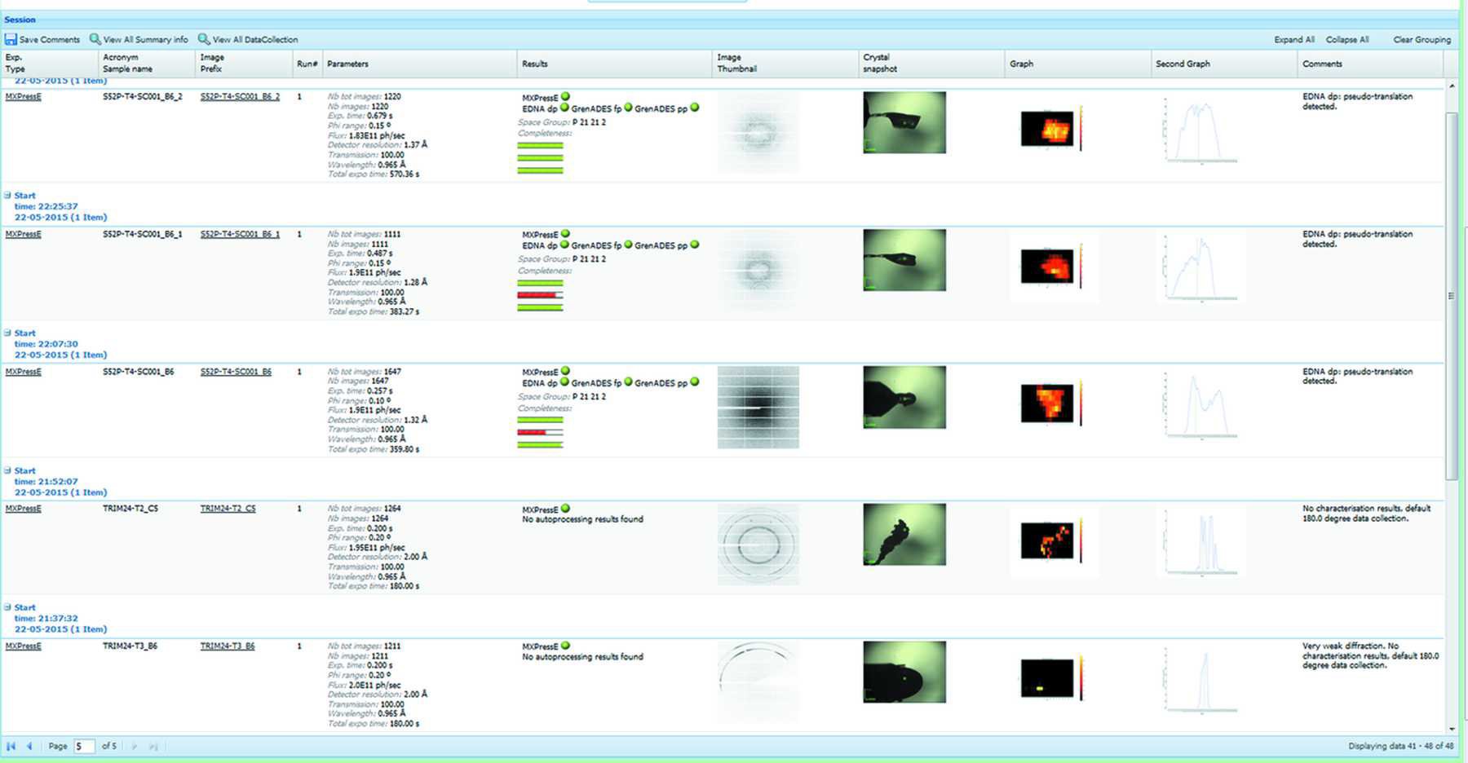
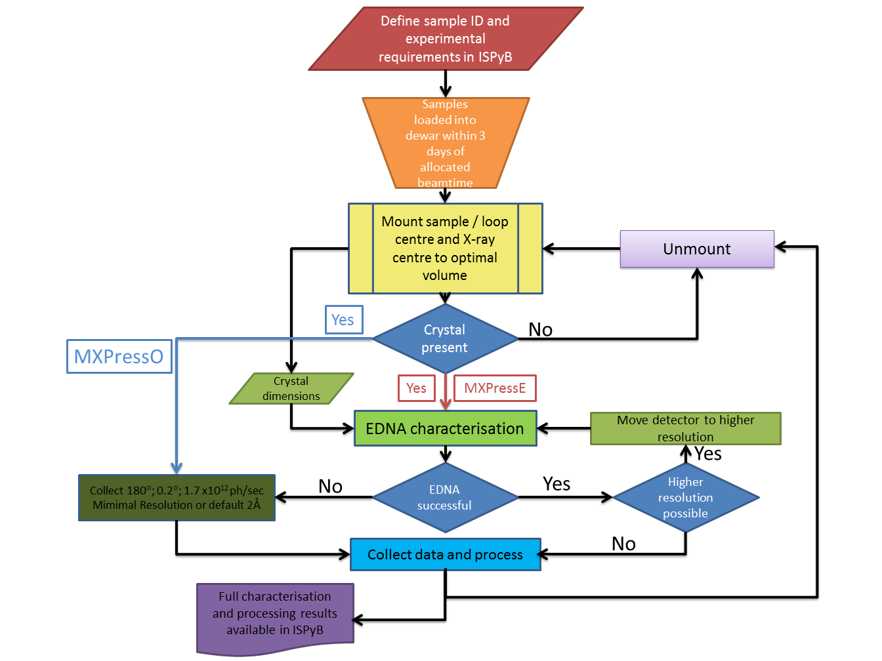
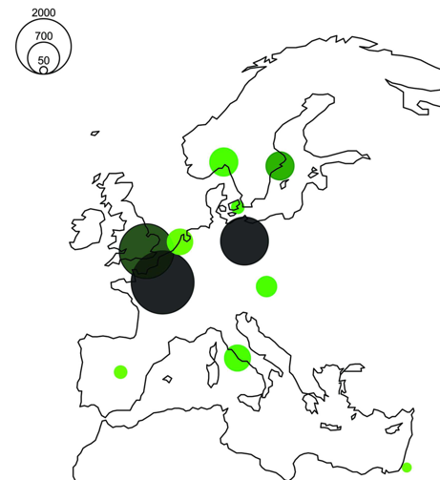
Automatic data collection

Slide 8
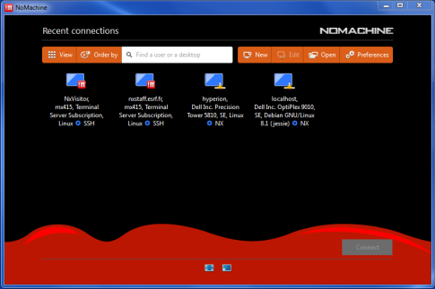
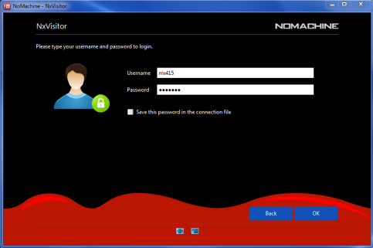
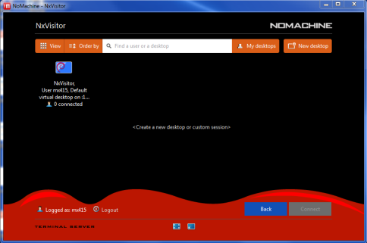
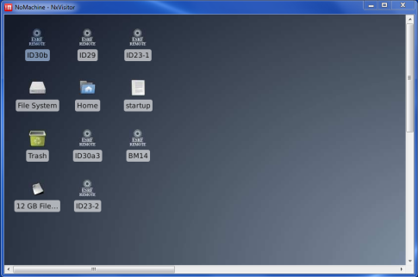
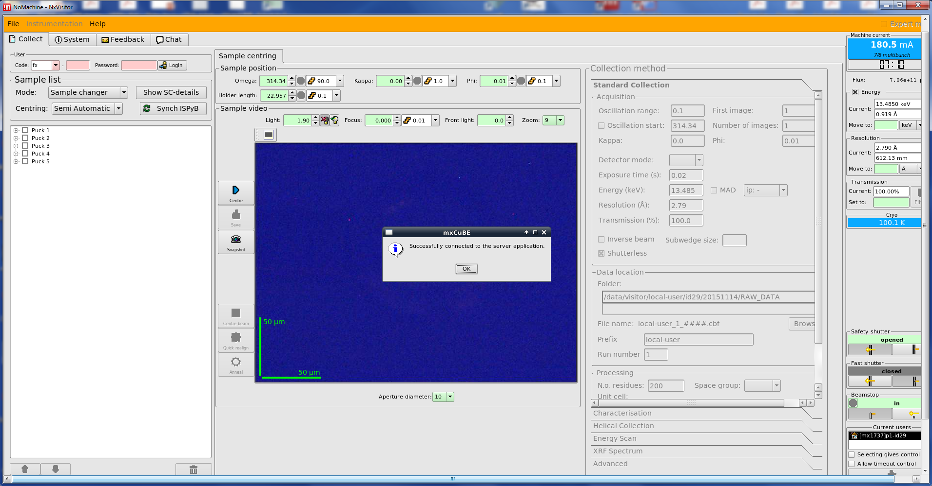
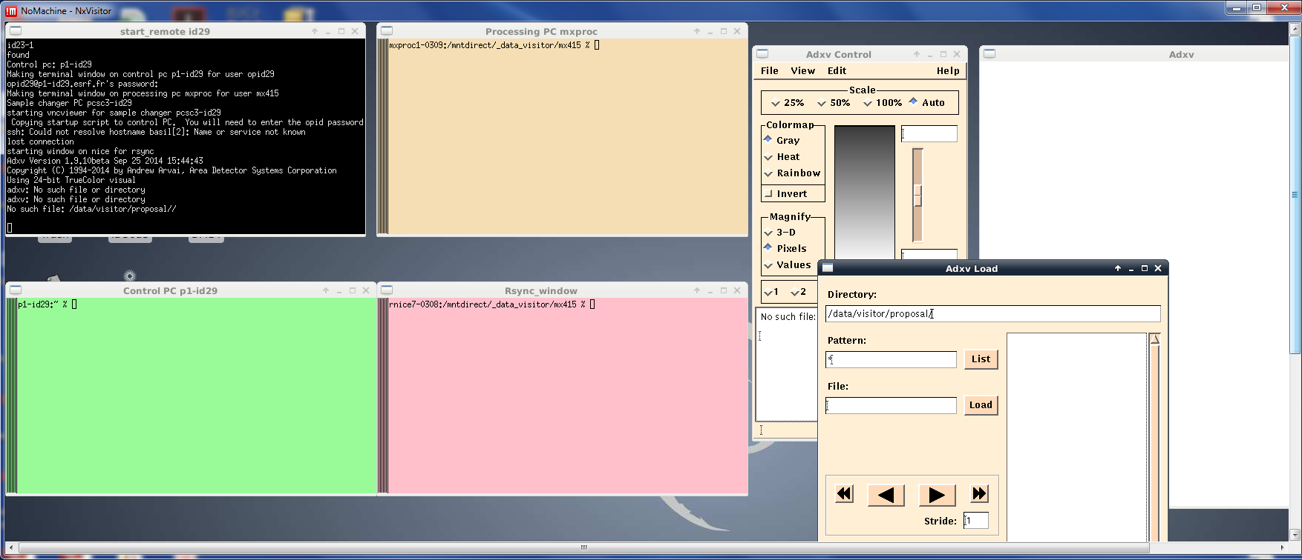
‘Normal’ Remote ACCESS

Slide 9
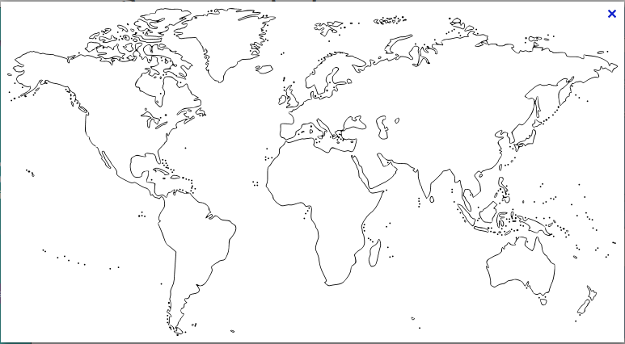
‘Normal’ Remote ACCESS (DEMO)

Slide 10
MORE ABOUT REMOTE ACCESS
Beteva, A., et al., High-throughput sample handling and data collection at synchrotrons: embedding the ESRF into the high-throughput gene-to-structure pipeline. Acta Crystallographica Section D-Biological Crystallography, 2006. 62: p. 1162-1169.
Cipriani, F., et al., Automation of sample mounting for macromolecular crystallography. Acta Crystallographica Section D-Biological Crystallography, 2006. 62: p. 1251-1259.
Gabadinho, J., et al., Remote Access Experiments at the Macromolecular Crystallography Beamlines of the ESRF. Synchrotron Radiation News, 2008. 21(24-29).
Gabadinho, J., et al., MxCuBE: a synchrotron beamline control environment customized for rnacromolecular crystallography experiments. Journal of Synchrotron Radiation, 2010. 17: p. 700-707.
Delageniere, S., et al., ISPyB: an information management system for synchrotron macromolecular crystallography. Bioinformatics, 2011. 27(22): p. 3186-3192.
Malbet-Monaco, S., et al., How the ESRF helps industry and how they help the ESRF. Acta Crystallographica Section D-Biological Crystallography, 2013. 69: p. 1289-1296.
Monaco, S., et al., Automatic processing of macromolecular crystallography X-ray diffraction data at the ESRF. Journal of Applied Crystallography, 2013. 46: p. 804-810.
Bowler, M.W., et al., MASSIF-1: a beamline dedicated to the fully automatic characterization and data collection from crystals of biological macromolecules. Journal of Synchrotron Radiation, 2015. 22(Pt 6): p. 1540-1547.
Mueller-Dieckmann, C., et al., The status of the macromolecular crystallography beamlines at the European Synchrotron Radiation Facility. European Physical Journal Plus, 2015. 130(4).

Slide 11
Thanks for your attention

