Slide 1
RUTHERFORD BACKSCATTERING ANALYSIS USING LITHIUM IONS
Trevor Derry, Morgan Madhuku and Tony Miller.
WITS, iThemba LABS (G) & the DST-NRF CoE-SM

Slide 2
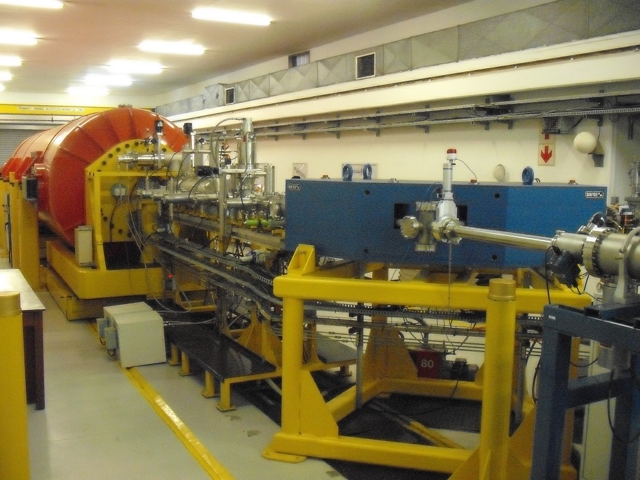

Slide 3
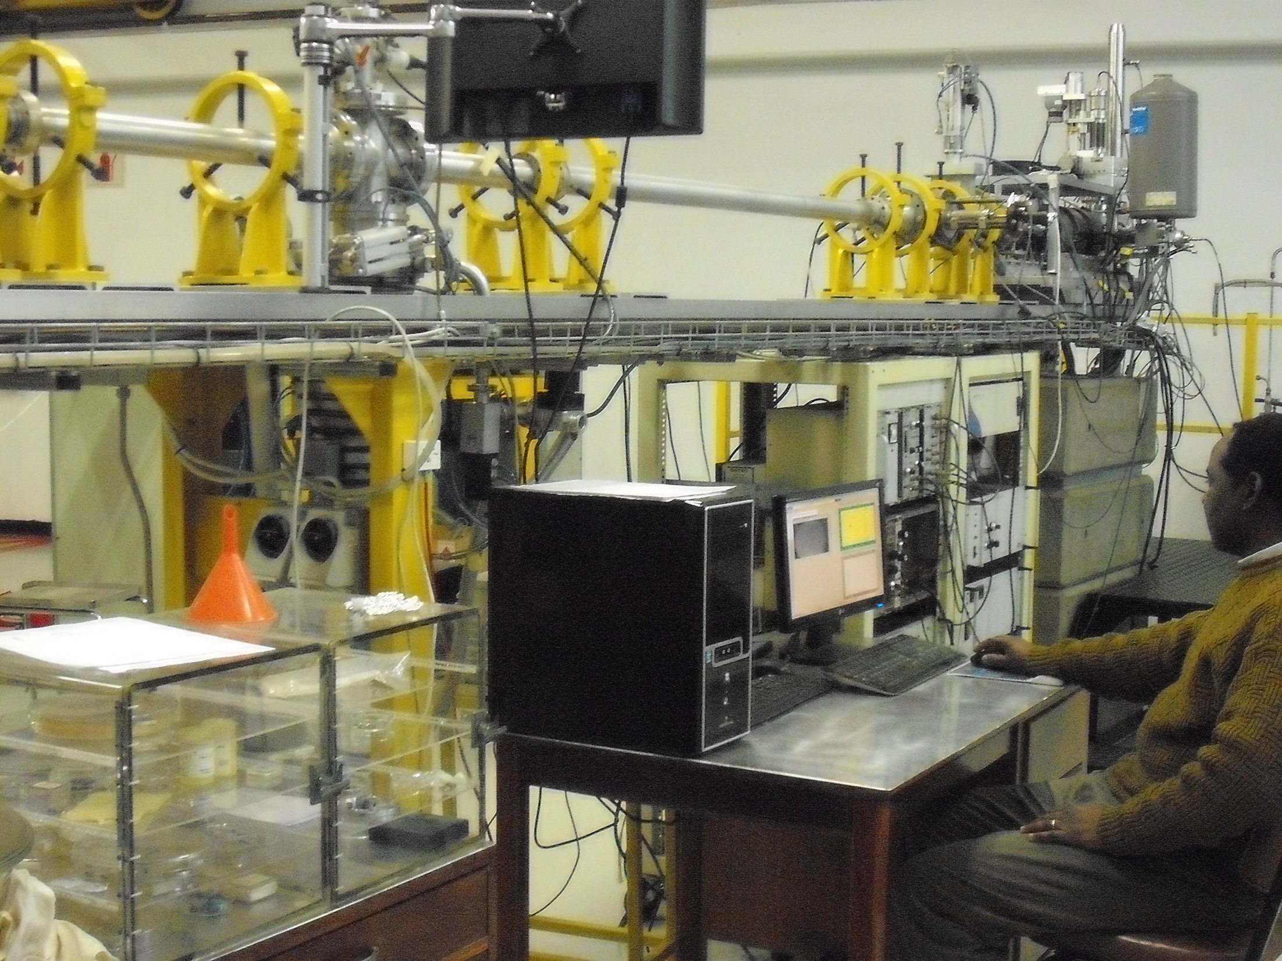

Slide 4
Lithium-7 RBS questions
Does it work / can we do it?
Are the Li⁺ beam currents large enough?
Are the spectra linear in backscattered energy? How good is the resolution?
Can we accumulate enough counts in a reasonable time for practical experiments?

Slide 5
Previous work: J.A. Leavitt et al, Nucl. Instrum. & Meth. B35 (1988) 333-338

Slide 6
Previous work: J.A. Leavitt et al, Nucl. Instrum. & Meth. B35 (1988) 333-338

Slide 7
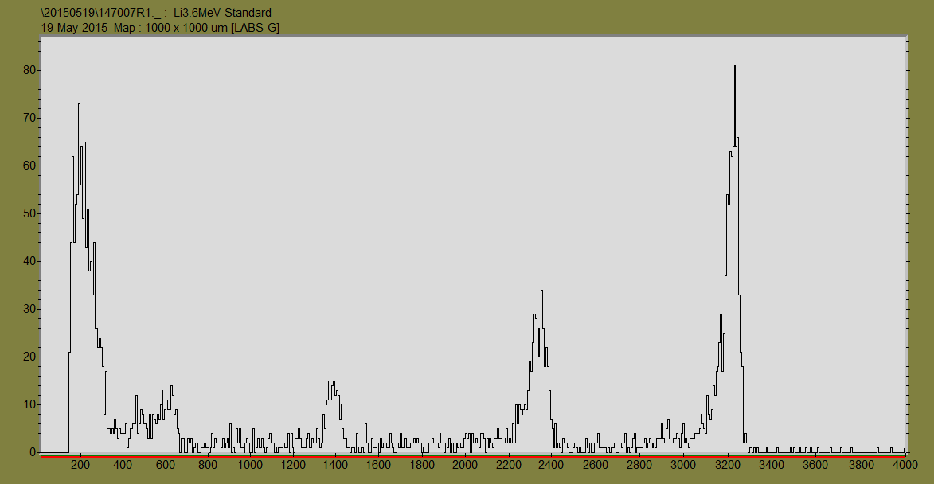
RBS spectrum of 3,6 MeV ⁷Li⁺ ions scattered from thin Au, Ni, Al and O films on carbon

Slide 8
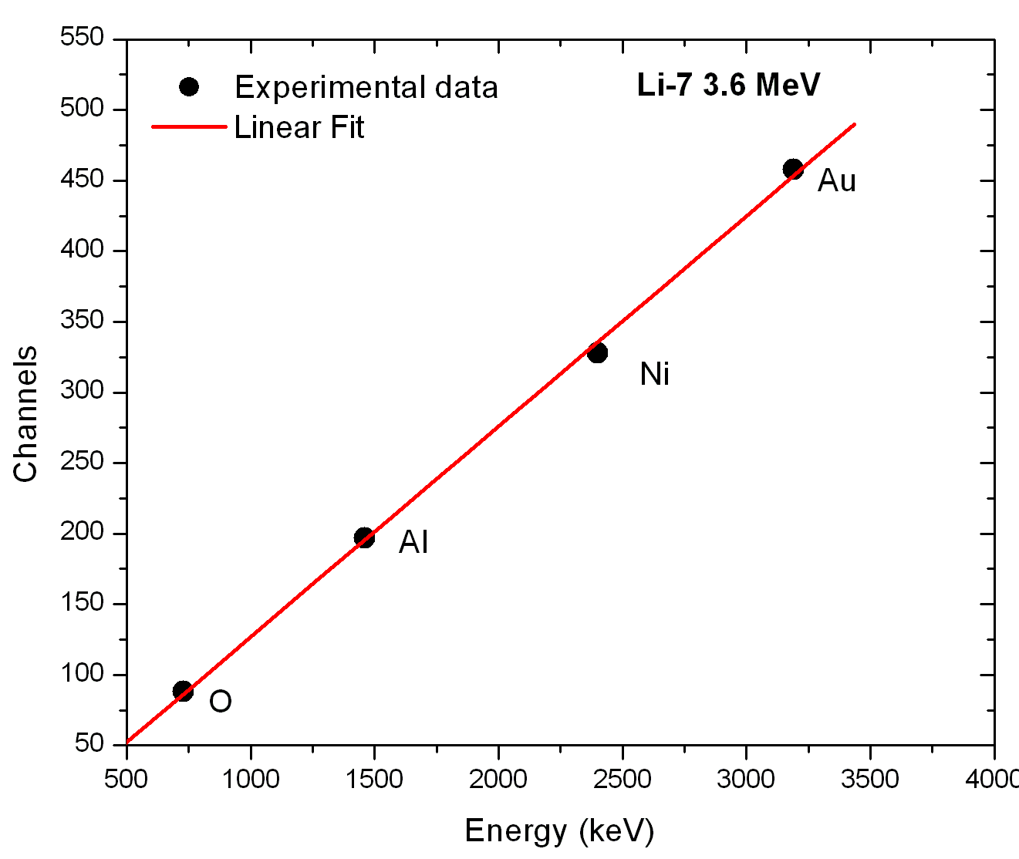

Slide 9
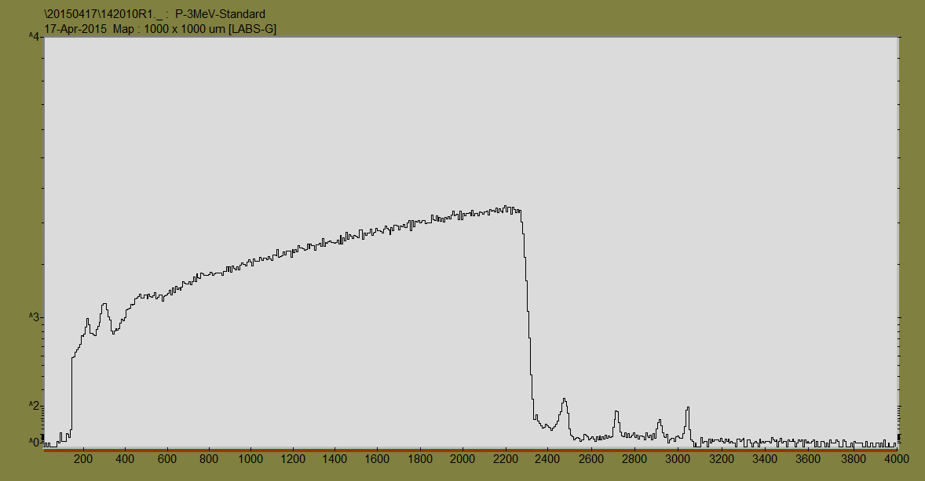
RBS spectrum of 3,0 MeV protons scattered from thin Au, Ni, Al and O films on carbon

Slide 10
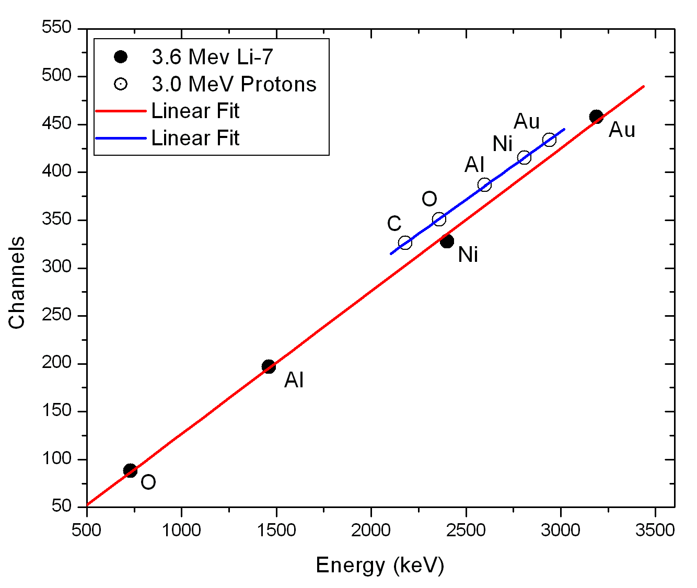

Slide 11
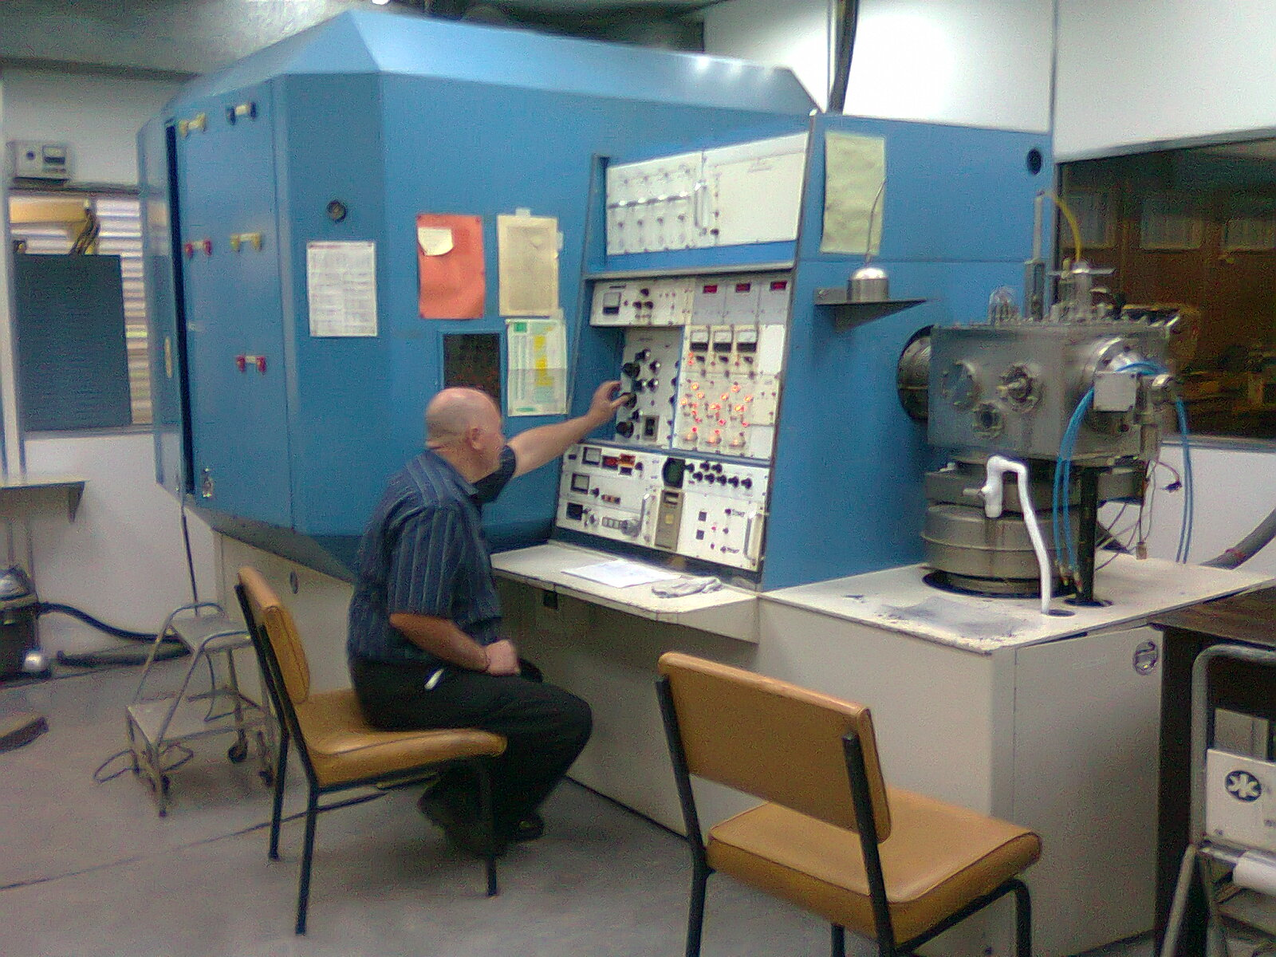

Slide 12
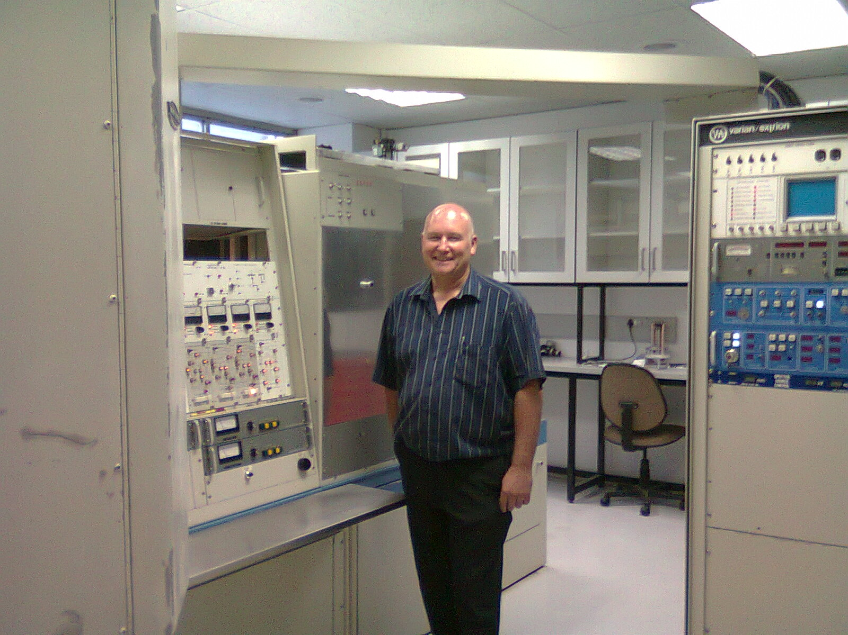

Slide 13
RBS formulae
Kinematic factor $K=\frac{E_{1}}{E_{0}}$
$\frac{ΔE_{1}}{Δx}=K{\left(\frac{dE}{dx}\right)}_{in}−\frac{1}{cosθ_{L}}{\left(\frac{dE}{dx}\right)}_{out}$
$N_{A}=\frac{P_{i}}{ΔS}ΔE_{1}\left[\frac{dx}{dE_{1}}\right]{\left[\frac{Z_{sub}}{Z_{i}}\right]}^{2}\frac{ρ_{sub}N^{∗}}{M_{sub}}cosθ$

Slide 14
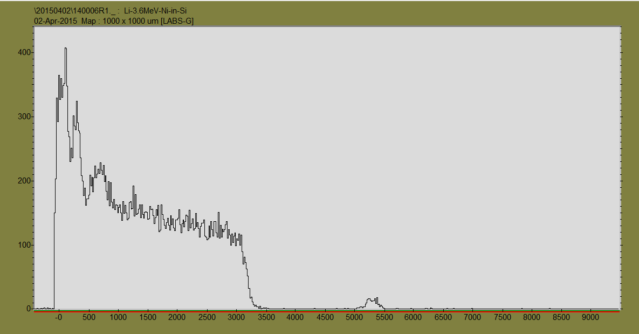
Ni in Si – 1,9x10¹⁶ ions/cm² (Li⁺~80pA, 40 mins)

Slide 15
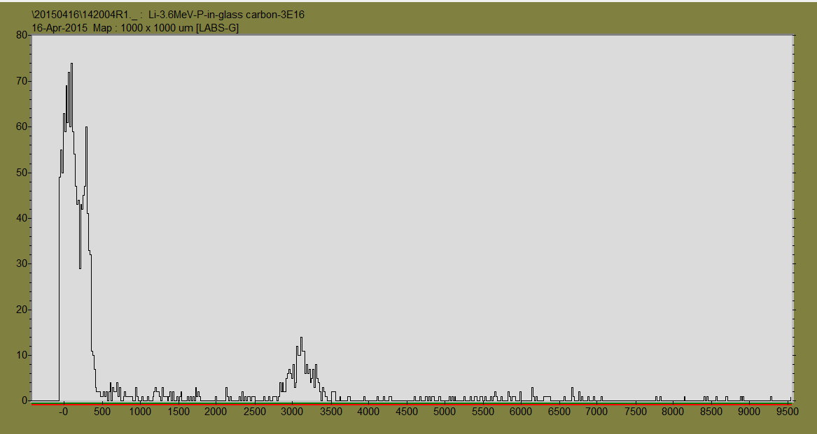
P in glassy C – 6x10¹⁶ ions/cm² (Li⁺~80pA, 40 mins)

Slide 16
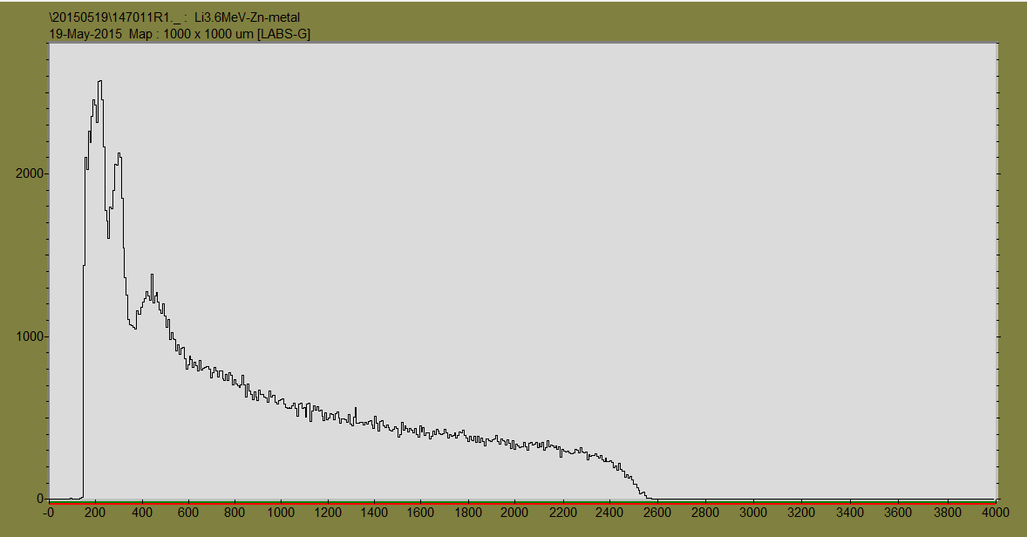
Zinc sheet (same conditions)

Slide 17
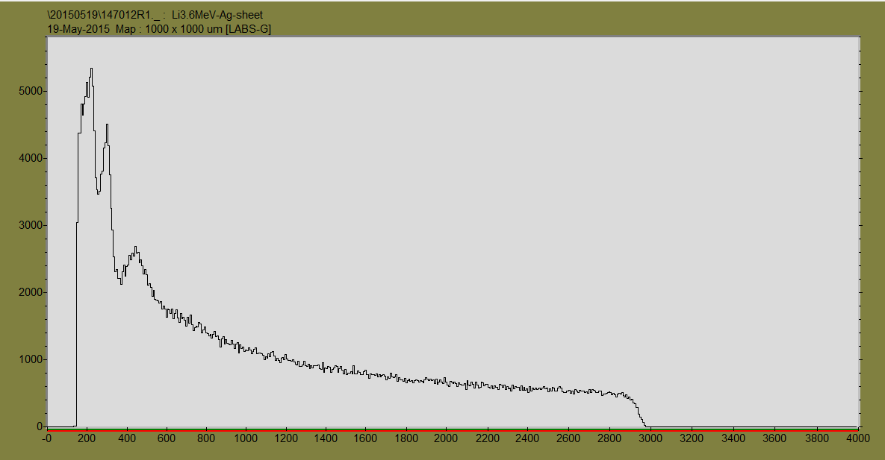
Silver sheet (same conditions)

Slide 18
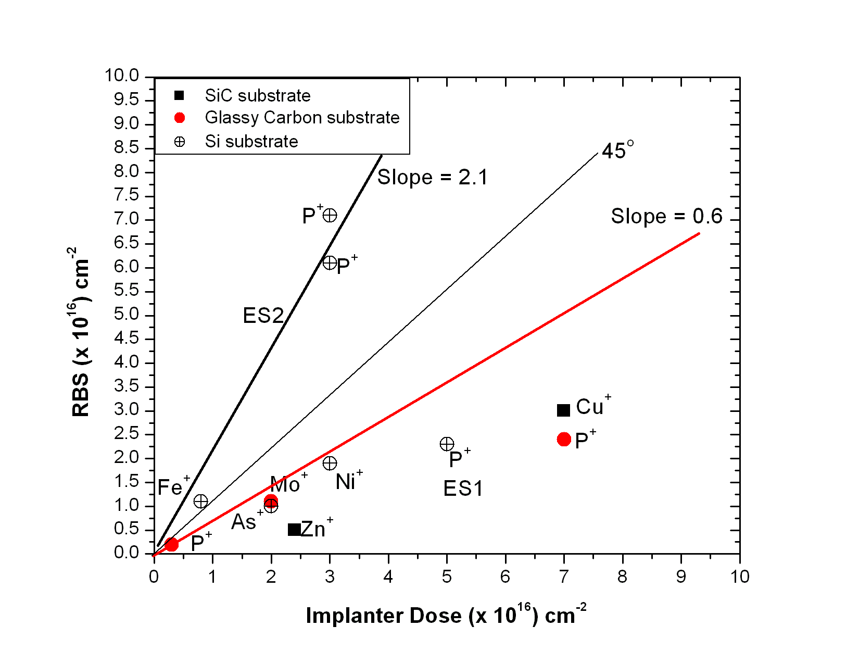
Implanter calibration curves

