Slide 1
Geophysical Survey Methods in the Southern Karoo Basin
Martin Bentley
Lucian Bezuidenhout
Part of SHALE GAS WORKSHOP
1st OCTOBER 2014

Slide 2
Scope
Overview – Airborne – Seismic – Magneto-Telluric - Conclusion

Slide 3
Defining Geophysics
Measure the physical response of rocks
Can be linked to specific rock properties
Overview – Airborne – Seismic – Magneto-Telluric - Conclusion

Slide 4
Advantages of geophysical surveys
Not limited to areas with outcrop
Regional scale
Well-established techniques
Exploration
Civil engineering
Overview – Airborne – Seismic – Magneto-Telluric - Conclusion

Slide 5
Geophysics in the Karoo
Some work has been done
Limited scale
Raw data is often not freely available
Importance of the Karoo is growing
Need more subsurface data
Overview – Airborne – Seismic – Magneto-Telluric - Conclusion

Slide 6
Overview of proposed methods
Airborne Survey
Magnetic
Gravity
Radiometric
Passive seismic tomography
Magneto-Telluric Survey
Overview – Airborne – Seismic – Magneto-Telluric - Conclusion

Slide 7
The Airborne Survey
Martin Bentley

Slide 8
Background
Currently a lack of high-resolution data
Magnetic
Data is not freely available
Radiometric
Gravity
Overview – Airborne – Seismic – Magneto-Telluric - Conclusion

Slide 9
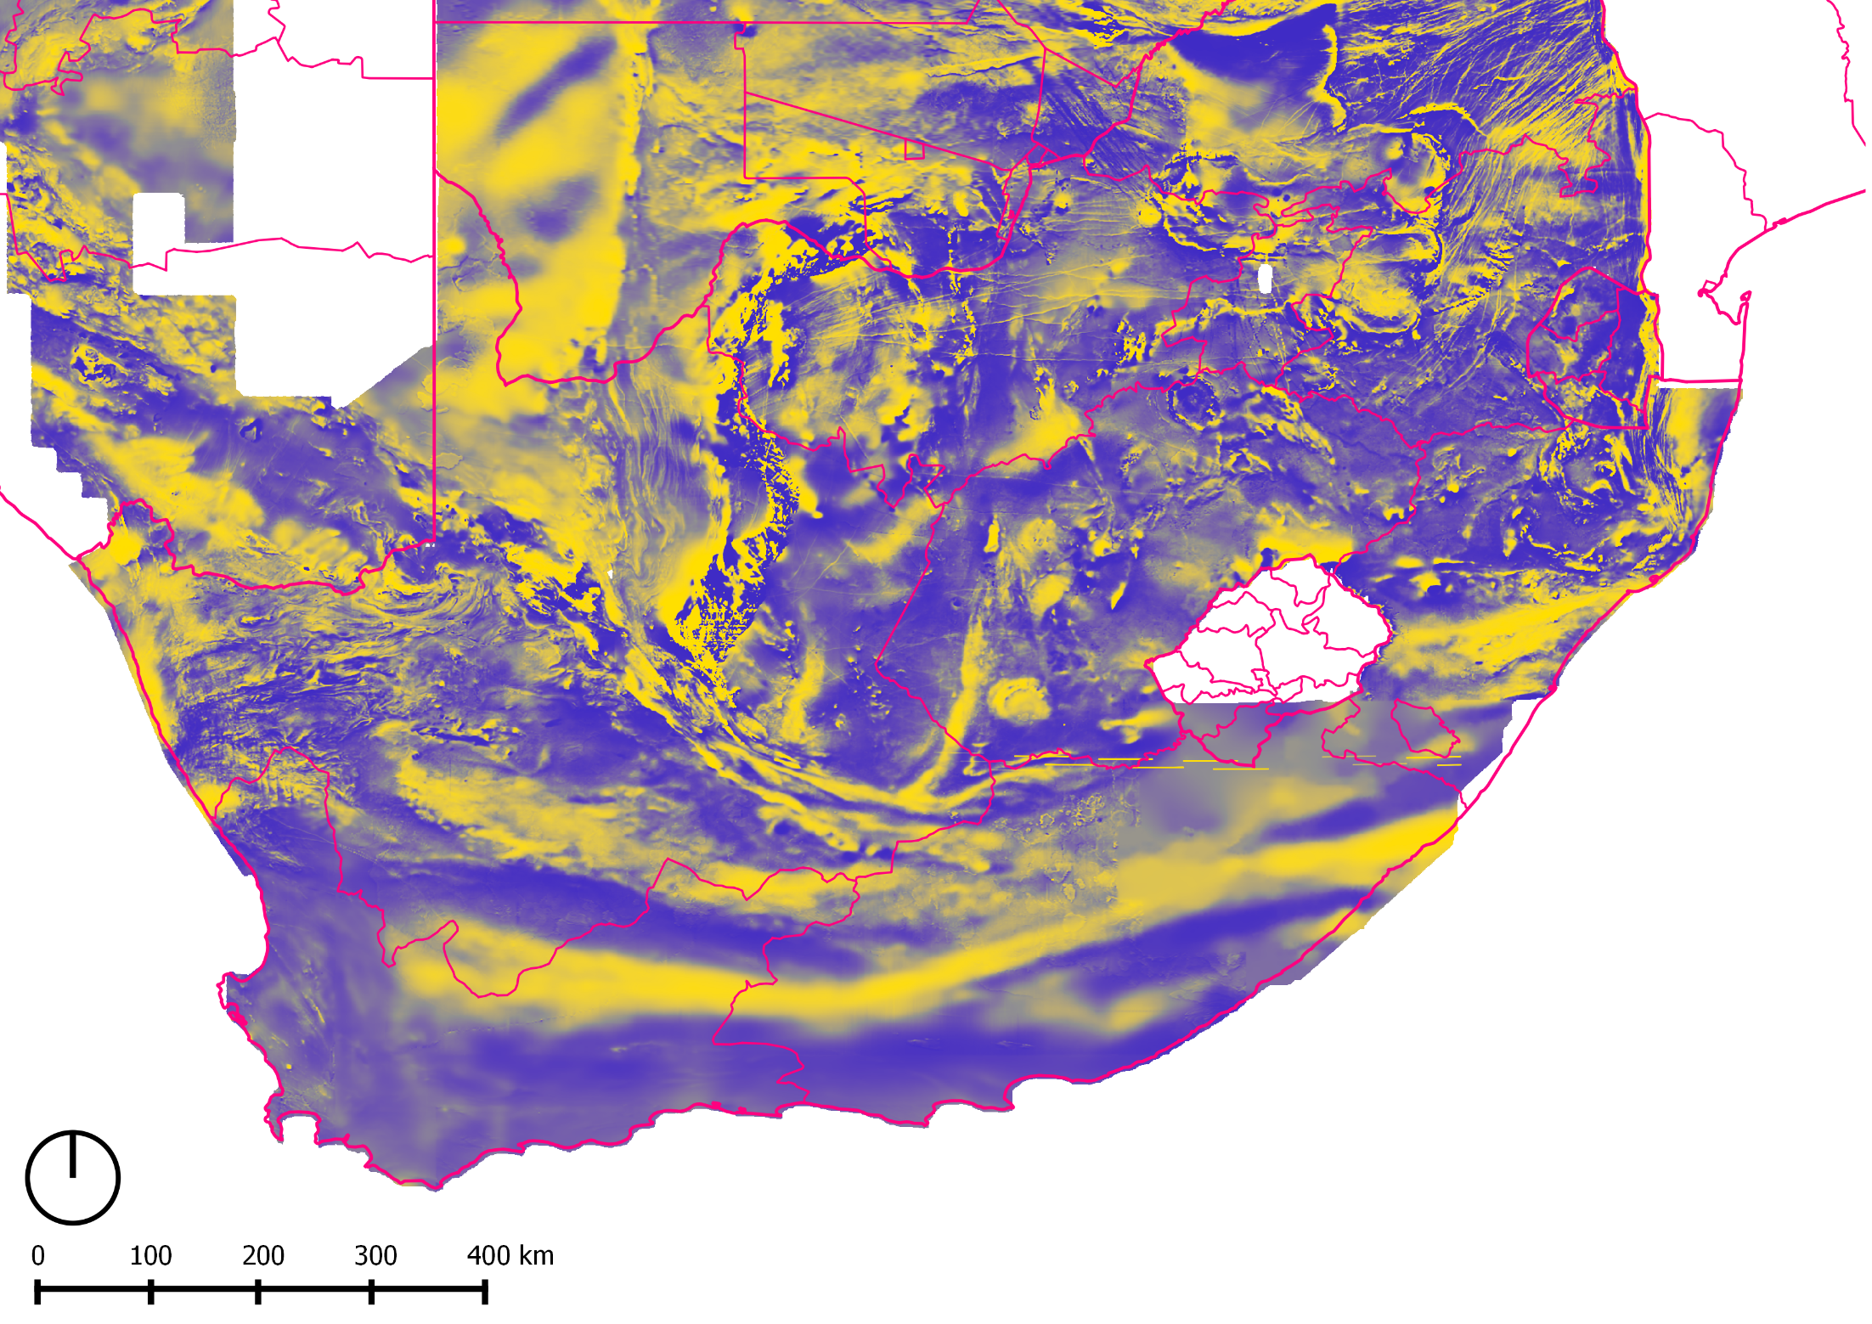
Overview – Airborne – Seismic – Magneto-Telluric - Conclusion

Slide 10
Overview – Airborne – Seismic – Magneto-Telluric - Conclusion

Slide 11
Proposed Plan
Use gyrocopter as payload carrier
Gather multi-parameter data
Magnetic
Gravity
Radiometric
Data for accurate digital terrain model
Overview – Airborne – Seismic – Magneto-Telluric - Conclusion

Slide 12
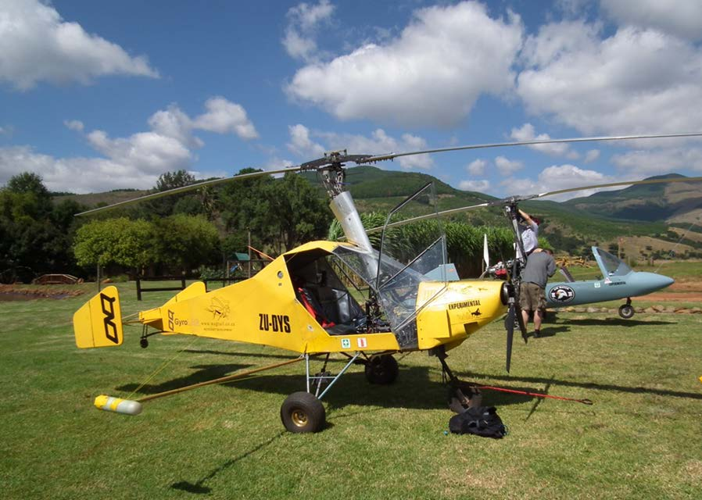
The Payload Carrier
Gyrocopters in Barberton, courtesy M. Doucouré.
Overview – Airborne – Seismic – Magneto-Telluric - Conclusion

Slide 13
Data processing
Existing software is:
Expensive
Will create software for:
Processing
Analysis
Visualisation
Overview – Airborne – Seismic – Magneto-Telluric - Conclusion

Slide 14
The Passive Seismic Survey
Lucian Bezuidenhout

Slide 15
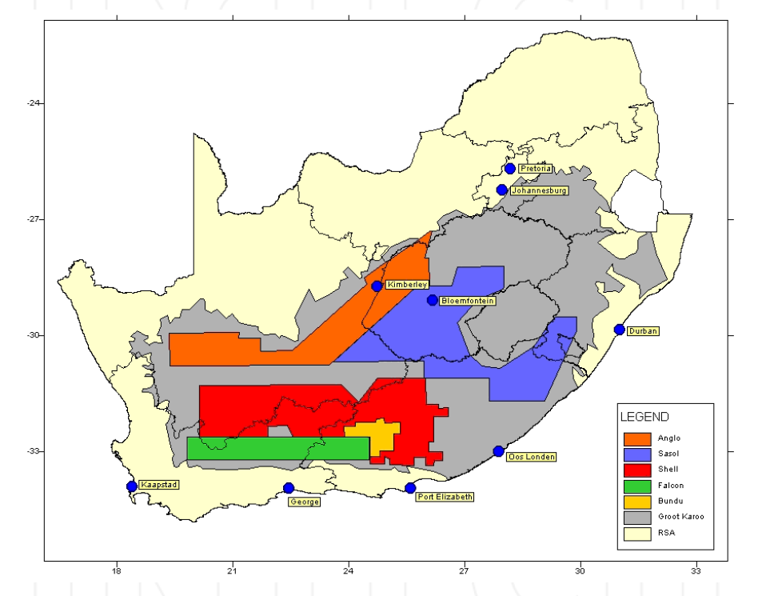
Potential Karoo areas for exploration for SHALE GAS
Map of South Africa showing possible areas of future exploration and associated companies with pending exploration rights
GREAT KAROO
ANGLO
SASOL
SHELL
FALCON
BUNDU
G. Steyl and G. J. van Tonder [http://dx.doi.org/10.5772/56310]

Slide 16
Objectives
Explore the concept of passive seismic tomography using three-component sensors on a seismic grid.
Create a 3-D imagery of the Karoo sub-surface using passive seismic measurements.
Gain an improved understanding of the subsurface of the Karoo basin.
Construct a seismic (earthquake) survey of the Karoo prior to hydraulic fracking.
To complement and support other investigated geophysical aspects (e.g. hydrology, geology, etc…) with microseismic activity monitoring.
Go into areas with limited accessibility.
Overview – Airborne – Seismic – Magneto-Telluric – Conclusion

Slide 17
Where in the Karoo?
Overview – Airborne – Seismic – Magneto-Telluric – Conclusion

Slide 18
Seismic Tomography vs Passive Microseismic Monitoring
Microseismic monitoring – passive observation of very small earthquakes which are naturally occurring underground or are present as a result of human activities (i.e. imaging subsurface using subsurface source ⁺).
Passive imaging techniques are based on ability to extract coherent contribution to seismic field from continuous ambient noise signal (based on reconstruction of Green’s function cross-correlation of data acquired at two different locations *).
AREAS of APPLICATION :
Probing of Earth’s interior with noise – information from upper and middle crust can be retrieved with increased spatial resolution.
Detection and characterization of changes within active structures.
(e.g. volcanoes, faults, earthquake zones, glaciers)
Mining, Oil and Gas, Shale Gas, Geothermal Reservoirs, Stability of Nuclear Waste and CO₂ Repositories# [exploration, risk management and mitigation, environmental concerns, gain knowledge of existing fault and fracture networks, continuous monitoring, etc.]
⁺ Claerbout, Geophysics, 33 (1968) 264. * Shapiro and Campillo, Science, 307 (2005) 1615.
# Case studies: Sabra et al., Geophysi. Res. Lett., 32 (2005) L14311; Stehley et al., Geophys. J. Int., 178 (2009) 338; Lin et al., Geophys. J. Int., 170 (2007) 649.
Overview – Airborne – Seismic – Magneto-Telluric – Conclusion

Slide 19
Advantages
OPERATIONAL
- can concentrate in regions of interest as well as large areas
- can obtain data from difficult terrain
- no day-to-day operational costs
- can create community involvement
ENVIRONMENTAL
- uses underlying perturbations as a “source” signal
- no explosives, no drilling, no cables….
- suitable for environmentally sensitive regions
Can conceivably be used in frontier geopolitical and sensitive exploration areas and to establish regional baselines.
Overview – Airborne – Seismic – Magneto-Telluric – Conclusion

Slide 20
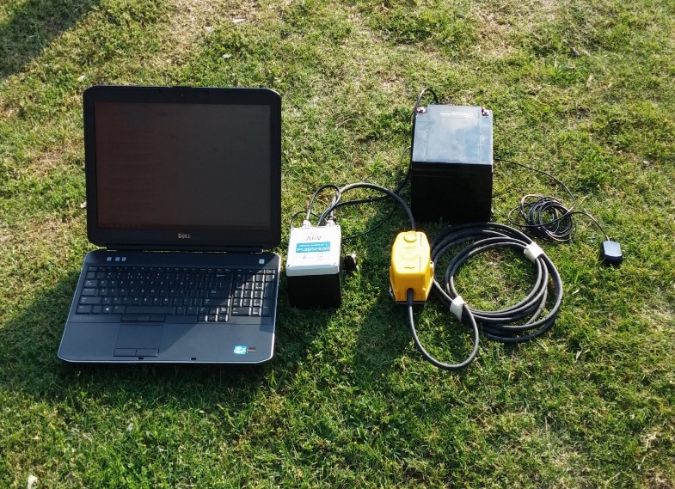
Technique Basics
Areas lacking sampling
Battery
Surface
Data Cube
Data
monitoring
GPS
Sampling depth
up to 30 km
Geophone
local seismic events
(magnitudes from -1 to 2 on RS)
Passive microseismic measurements can be carried out without synthetic sources or waiting for earthquakes
Resolution can be improved by increasing number of recording stations or periodic redeployment of stations
Accuracy and resolution of the subsurface image relies strongly on the ability to resolve the velocity model and upon density of sampling.
Overview – Airborne – Seismic – Magneto-Telluric – Conclusion

Slide 21
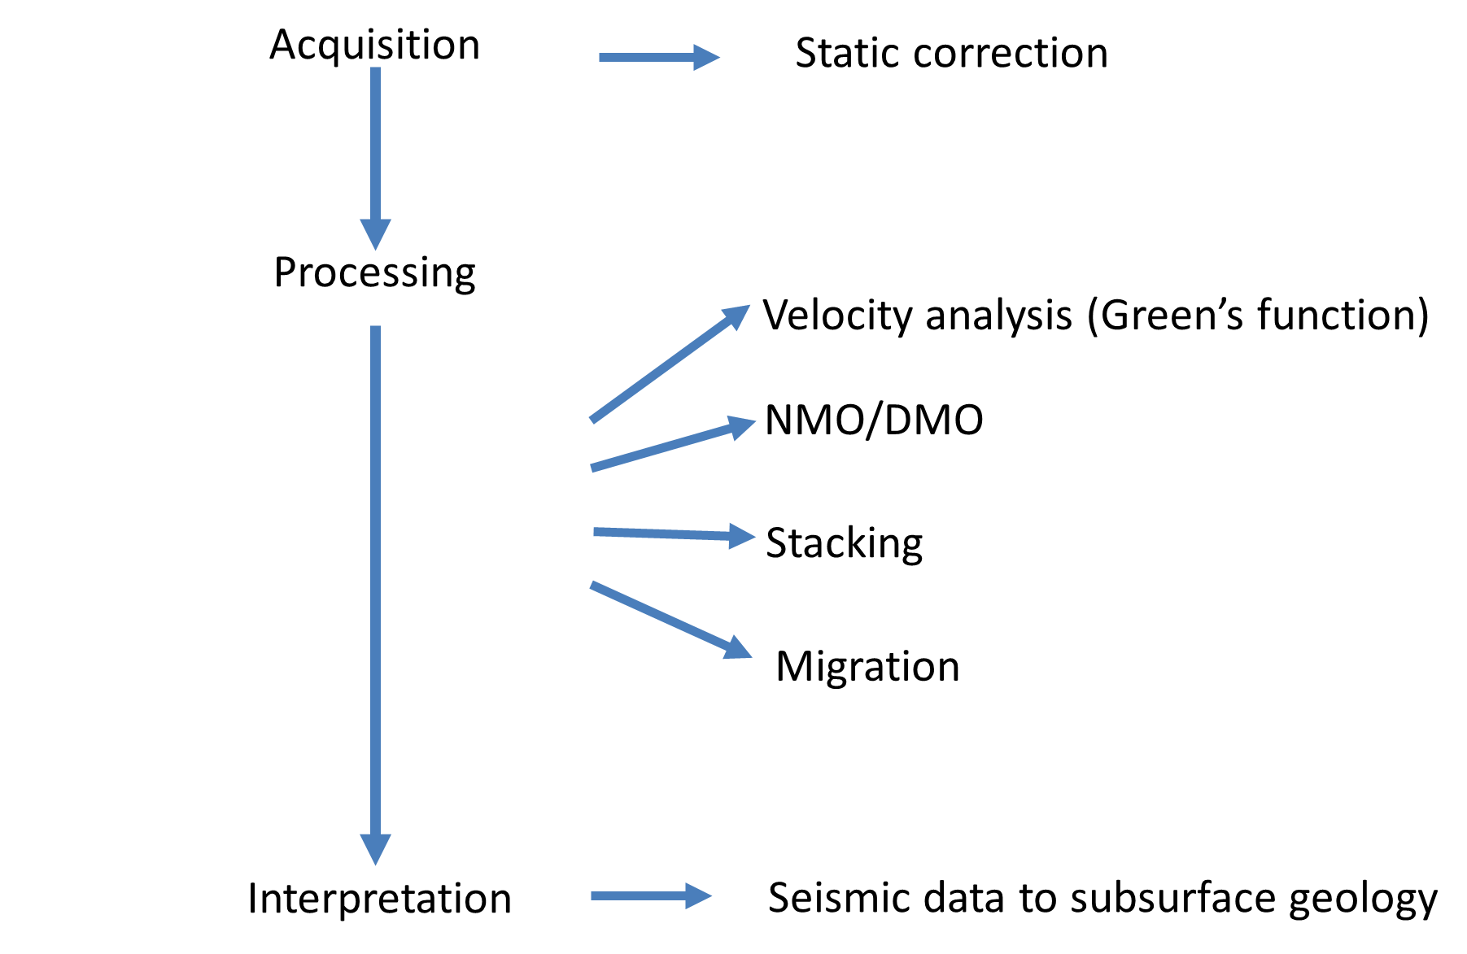
Data Interpretation
Overview – Airborne – Seismic – Magneto-Telluric – Conclusion

Slide 22
Previous model of Karoo
Overview – Airborne – Seismic – Magneto-Telluric – Conclusion
(Lindeque et al. (2007/8))

Slide 23
The Magneto-Telluric Survey
Geophysical method used for imaging of subsurface by measuring natural variations of electric and magnetic fields at the Earth’s surface.
Energy source: solar energy and lighting cause variations in the earth’s magnetic field thus inducing electric currents (telluric currents) below the surface.
Different rocks, sediments and geological structures have different conductivities
Depths from 300 m to hundreds of km can be investigated; frequency range 0.0001 up to 10000 Hz.
Overview – Airborne – Seismic – Magneto-Telluric – Conclusion

Slide 24
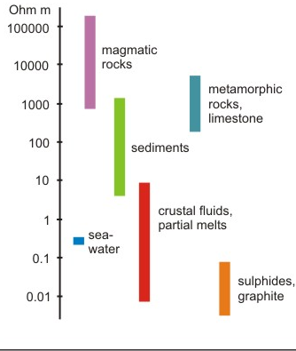
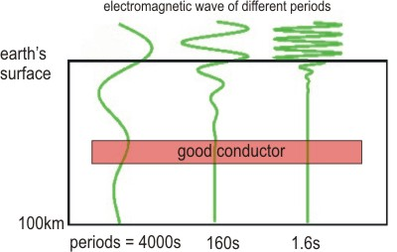
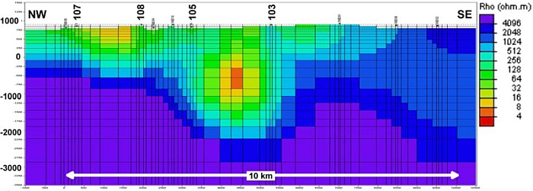
Resistivity of Rocks
EM wave propagation
Resistivity model
Overview – Airborne – Seismic – Magneto-Telluric – Conclusion

Slide 25
Conclusion
This geophysical survey will aim for an increased understanding of the subsurface conditions in the Karoo by:
Gathering new, high resolution data for critical areas
Correlation of multiple geophysical methods
Hope to get better understanding of:
Geological structures (folds/faults/intrusions)
Thank you
Overview – Airborne – Seismic – Magneto-Telluric – Conclusion

