Slide 1


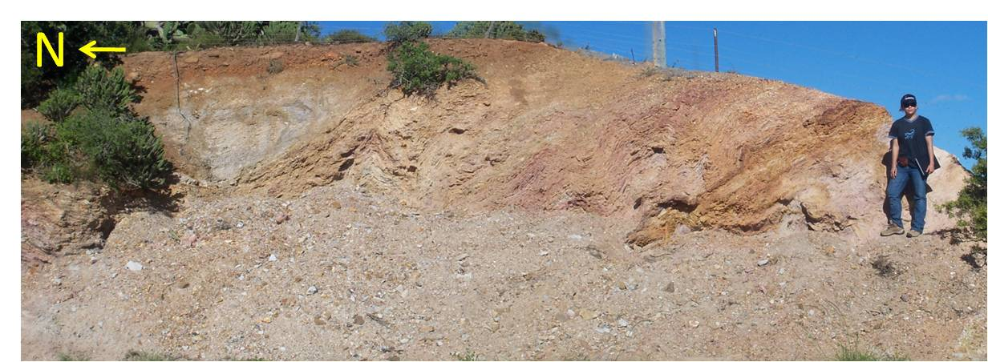
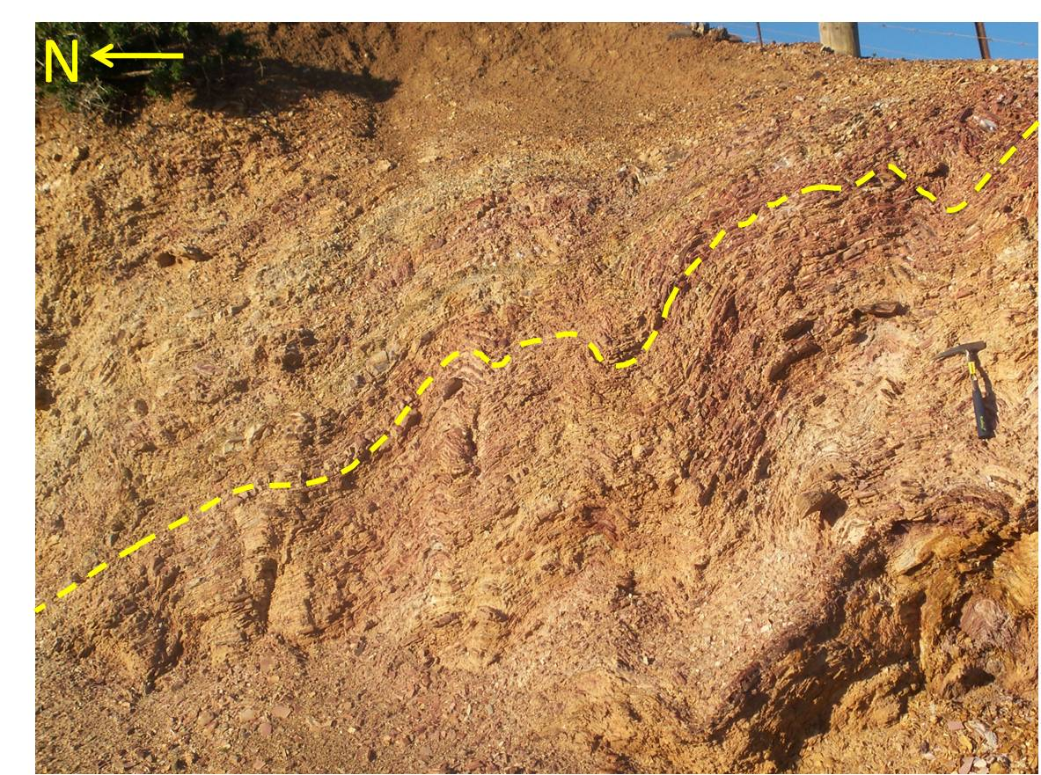
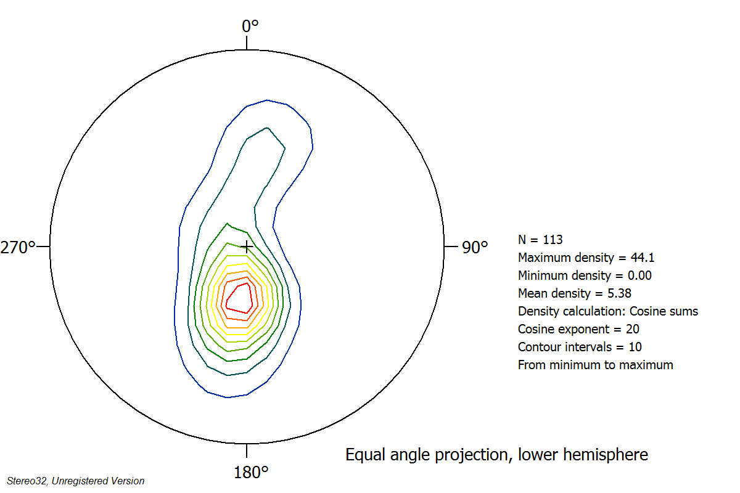
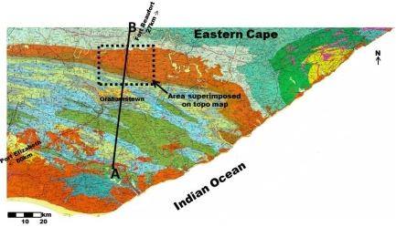
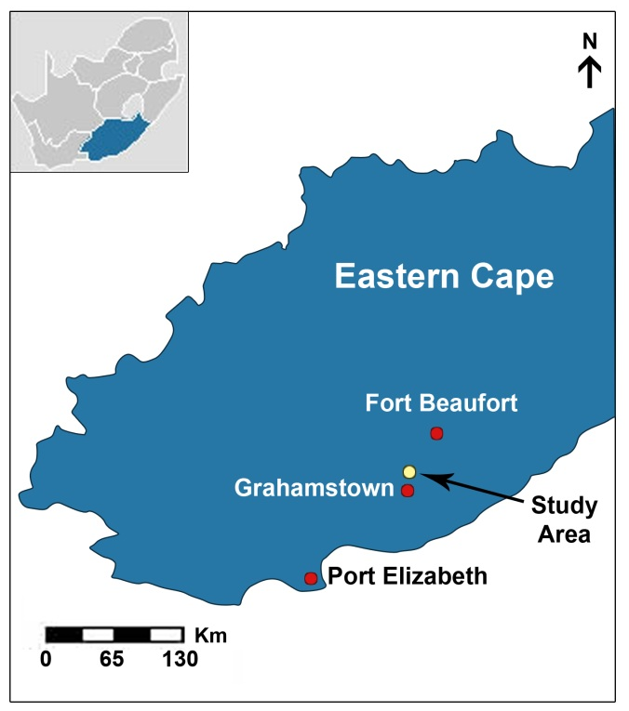
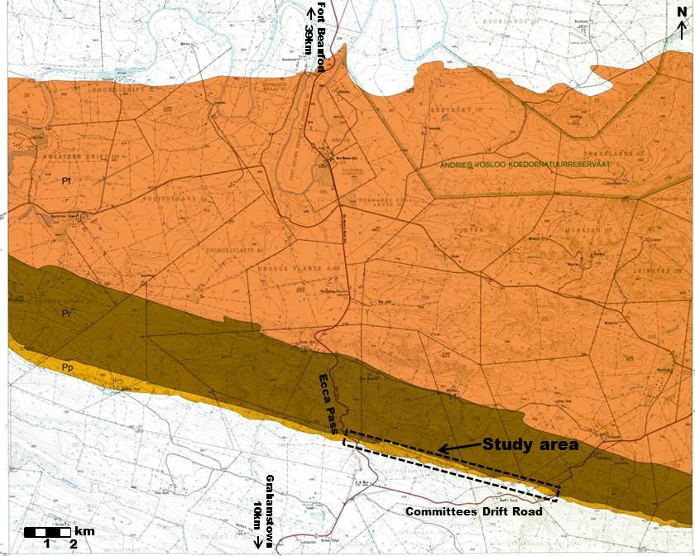
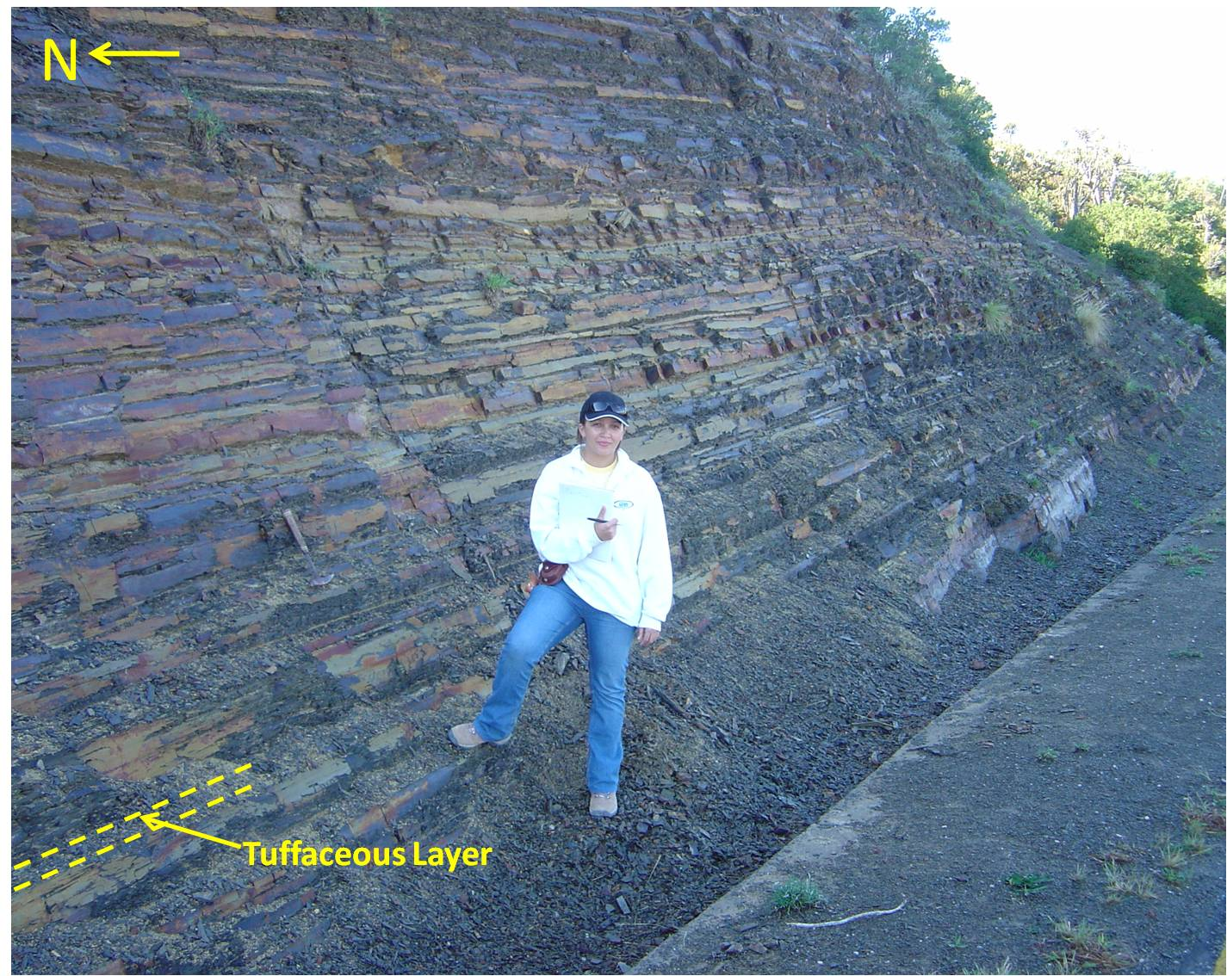
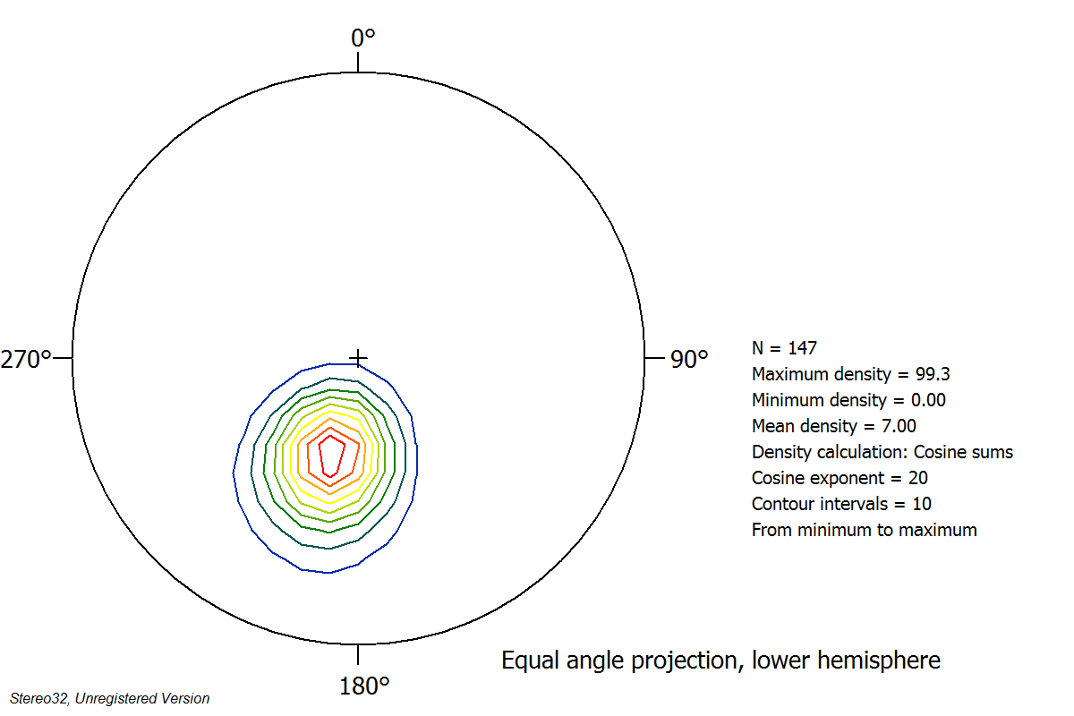

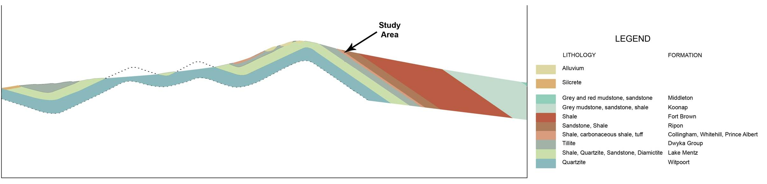
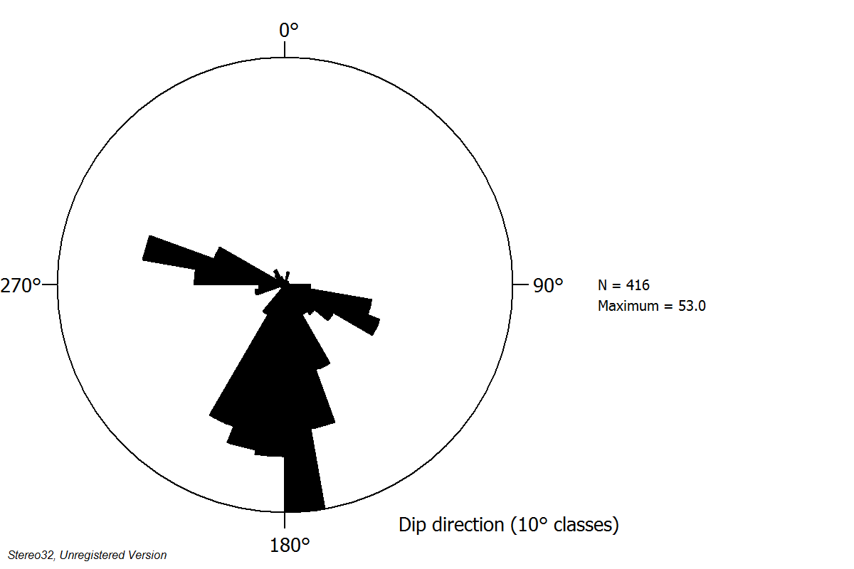
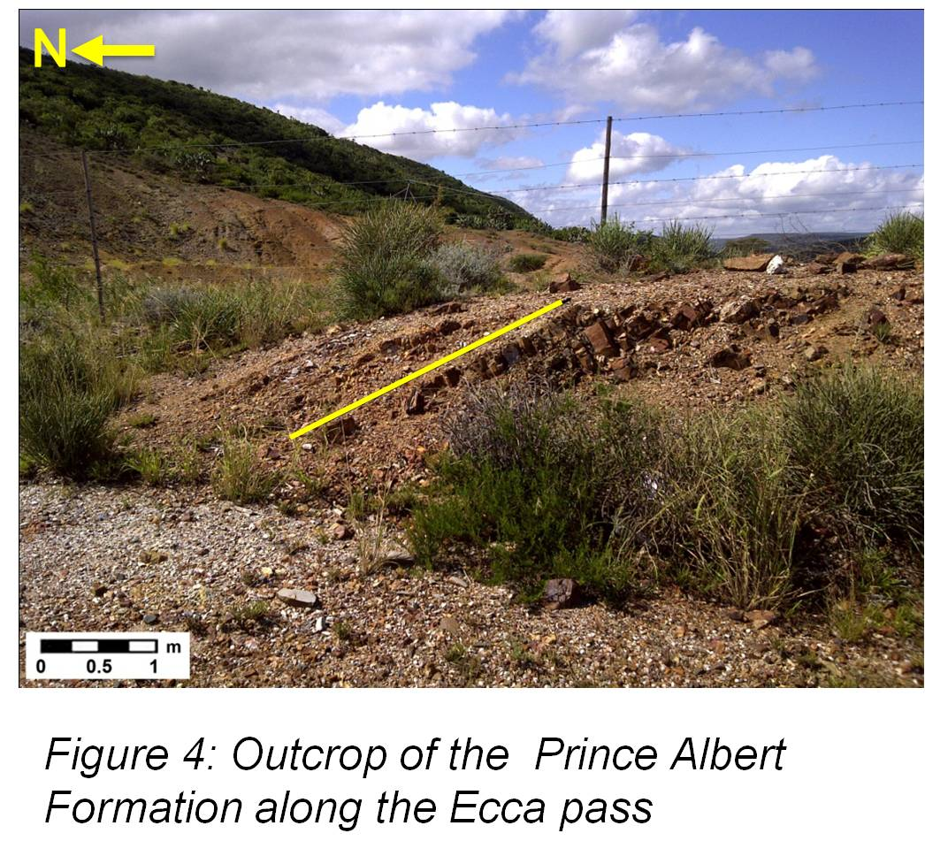
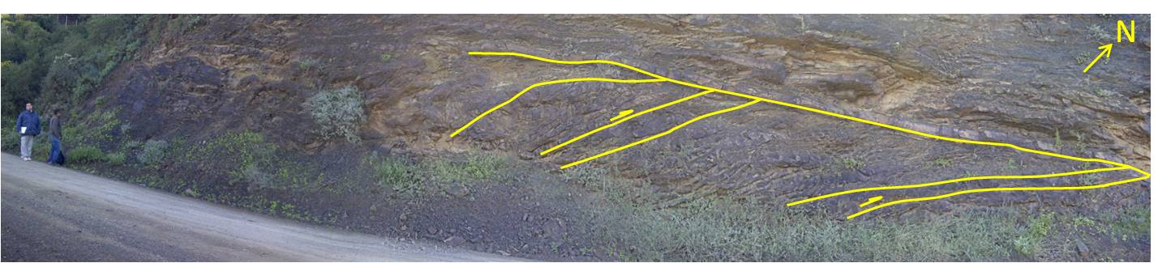



A geological study of the lower Ecca Group, north of Grahamstown, South-East Karoo Basin, South Africa
Earth Stewardship Science
Research Institute
S Slamang¹, P.W.K Booth², D Mikeš³, M.J de Wit⁴
1-4. Department of Geoscience, Nelson Mandela Metropolitan University, Port Elizabeth, South Africa
ABSTRACT
The study incorporates the structural and sedimentologic characteristics of outcrops of the lower Ecca Group. The largest outcrop of the study area occurs along the Ecca Pass (situated approximately 25km North Of Grahamstown, en route to Fort Brown), and smaller outcrops are visible to the east. Attention is placed on facies characterization and petrographic analyses, in order to reconstruct the sedimentary environment of the lower Ecca Group. The Ecca Group is thought by some to have been deposited in a retro-arc foreland basin, with deposition occurring mostly during the Permian. It comprises mostly sedimentary rocks with minor dolerite intrusions to the north. Approximately 2000m of sediment was deposited in a large body of water and is composed predominantly of rhythmites, mudstones, sandstones, and shales. The combined thickness of the Prince Albert, Whitehill, and Collingham Formations is approximately 130m, and therefore accounts for ~6.5% of the total thickness of the Ecca Group.
The shales of the Whitehill Formation are of particular interest to exploration companies as a potential reservoir of natural gas, as they are rich in organic content. Fracking in the U.S. has grown over the past decade, as has the wealth of information around the industry. Because of the large scale success in the U.S., many countries including South Africa that have potential shale gas reserves have started exploring for shale gas. There is currently a great deal of speculation as to the amount of shale gas reserves, and exploration is necessary to determine the gas potential.
INTRODUCTION
The area of study lies in the Eastern Cape, between Grahamstown and Fort Beaufort, more specifically along the Ecca Pass (located approximately 20km north of Grahamstown en route to Fort Brown/Fort Beaufort) (see Figure 1.1 and 1.2). It includes outcrops visible along the Ecca Pass, and outcrops to the east of the Pass. The layers of the lower Ecca Group are all visible in succession along the Ecca Pass. This therefore aids in supplying a more accurate interpretation of the geology of the lower Ecca Group in this area as all the layers can be analysed in succession.
The geological map of 3326 Grahamstown (see Figure 1.3) was used to draw a geological cross section (see Figure 1.4) of the study area. This was done in order to gain a better understanding of the underlying geological features of the Grahamstown-Fort Brown area. The geological cross section (figure 1.4) shows that the bedding of the Ecca Group dips in a general north-easterly direction, and this is confirmed by readings taken in the field.
  AIM AND PURPOSE OF THE STUDY
The research is aimed at documenting, analysing, and interpreting, the structural features and sedimentary petrology of the lower Ecca Group, with an emphasis placed on the individual layers of the Collingham Formation.
This will be achieved by:
Describing and interpreting the structural characteristics observed in the field. The structural characteristics include that of folds (particularly of the Whitehill Formation), joints, and duplex faults (particularly of the Prince Albert Formation).
Drawing numerous sections in an easterly direction starting with a section along the Ecca Pass and ending with a section along the Committees Drift Road, in order to ascertain general thickness of the formations in the area.
Examining the sedimentary characteristics (e.g. grain size and mineral content) of the rocks, in order to determine the depositional environment of each of the members.
The area was chosen as it incorporates an exceptionally well exposed outcrop along the Ecca Pass, portraying all the formations of the lower Ecca Group of the SE Karoo Basin in succession. The Ecca Pass will therefore serve as a reference area, which will allow for easier identification of these formations at other areas, based on the characteristics of the rocks observed along the Pass.
METHODOLGY
A preliminary study of the site was conducted making use of various maps and google earth aerial photographs. The maps used were the 1:250 000 geological map of 3326 Grahamstown (1995, Council for Geoscience), and the 1:50 000 topographic map of 3326BA Fort Brown (1877, Chief Director of Surveys and Mapping). The geologic map was then enlarged and superimposed on the topographical map in order to identify where the Ecca Group outcrops in the study area. In order to better understand the underlying geologic features of the Grahamstown-Fort Brown area, a geologic cross section was then drawn, making use of the geologic map of Grahamstown.
The structural and sedimentary characteristics have been documented, and will be analysed, and interpreted. The structural characteristics include that of folds (particularly of the Whitehill Formation), joints, and duplex faults (particularly of the Prince Albert Formation). The sedimentary characteristics include that of grain size and mineralogy in order to determine the depositional environment of each of the units. Several sections through the Lower Karoo strata will be drawn, in order to determine formation thicknesses and the structural configuration in depth.
The orientation, frequency and continuity of joints in each of the formations has been documented as this is an important aspect related to the possible escape of gas through the strata overlying the Whitehill Formation. Fresh samples, especially of organic rich shales, has been obtained for petrographic and geochemical analysis. Scanning Electron Microscope (SEM) work will be done in order to analyse some of the detailed mineralogy of the samples obtained from the study site. The degree of metamorphism of the sediments will also be determined.
PALEO-DEPOSITIONAL ENVIRONMENT OF THE KAROO BASIN
There are different theories put forward by authors regarding the geological history of the Karoo Basin. Most of these theories have been summed up by Lindeque (2011) in figure 5.
DISCUSSION
The lowermost member of the Ecca Group, namely the Prince Albert Formation has an average thickness of ~58m, and is composed predominantly of greenish-grey, fairly arenaceous mudrock. The Prince Albert Formation along the Ecca Pass (see Figure 6) is quite weathered, but readings is still ascertainable and from figure 6 the general north easterly dip can be seen. Immediately east of the Ecca Pass along the Committees Drift road, there is evidence of duplexing within the shales of the Prince Albert Formation, due to thrust stacking (see Figure 7). This structural phenomenon is in all probability related to tectonism which took place during the northward compressional phases associated with the Cape Fold Belt, during the Permian/Triassic Periods.
The Whitehill Formation has an average thickness of ~20-30m and is composed predominantly of shales and minor amounts of chert. The shales have been weathered to a distinct white colour, with minor shades of red and yellow visible (see Figure 8a and b). Extensive folding of this formation is evident along the Ecca Pass (see figure 8b), with the trend and plunge of the fold axis at ~100/15° (see figure 9).
a
The Collingham Formation has a total thickness of approximately 30m and is comprised predominantly of shales interlayered with a yellowish material (ashfall tuff?) (see Figure 10). Some of the shales in the area tend to whether to a brown oxidised colour.
Bedding of all strata in the area dip in a north-easterly direction with an average azimuth and dip reading of ~42/46° (see figure 11). Jointing of all formations have been collectively plotted and has a general strike of WNW-ESE and N-S (see figure 12), with a predominant southerly strike.
CONCLUSION
The interest in and subsequent debate on shale gas in the Karoo (South Africa) has grown exponentially over the past few years. This study together with many others conducted will ultimately add to a better understanding of the Formations forming part of the extraction process. This investigation aims to document the main characteristics of lithologies of the Ecca Group, as well as their thicknesses, sedimentary structures, mineralogy, and structural aspects (fold style, orientation of the main folds, fault patterns, and duplexing). From the information obtained, an interpretation of the sedimentary and structural history will be presented.
REFERENCES
Lindeque, a. et al., 2011. Deep Crustal Profile Across the Southern Karoo Basin and Beattie Magnetic Anomaly, South Africa: an Integrated Interpretation With Tectonic Implications. South African Journal of Geology, 114, pp.265–292.
ACKNOWLEDGEMENTS
Ms S Slamang would like to thank Inkaba yeAfrica, NRF, NMMU, Prof M de Wit, Prof P Booth, and Prof D Mikeš for assistance throughout this project.
a
b
Figure 8 a): Outcrop of the Whitehill Formation along the Ecca Pass, b) Zoomed in image of the Whitehill Formation showing extensive folding.
Figure 9: Stereogram showing folding within the Whitehill Formation, with trend and plunge of the fold axis at ~100/15°.
Figure 5: (a) This represents the idea put forward by Johnson (2006) and others, whereby the oceanic paleo-Pacific plate subducted northerly below the Gondwanan continental plate.
(b)This model represents the idea put forward by Winter (1984), of a southward subduction and subsequent continent on continent collision, thereby explaining the absence of 300Ma granites in the CFB and that of a suture zone and paleo-oceanic crust below the Karoo Basin.
Models (c and d) are preferred by Lindeque (2007 and 2011), as it best explain the northerly dip of the mid-crust tectonic fabric, whereby subduction occurred in a northerly direction, and the continental crust eventually collided with the island arc seen at (c).
Figure 1: Map of the Eastern Cape
modified from (Swanepoel et al. 2009).
Figure 2: The Ecca Group superimposed on a topographical map of Fort Brown. Topographical map obtained from: Chief directorate of surveys and mapping; insert obtained from: Council for Geoscience.
Figure 10: Outcrop of the Collingham Formation
along the Ecca Pass. Note the thinly bedded
shales interlayered with yellow material (ashfall tuff?)
Figure 11: Stereogram showing an average bedding reading of ~42/46 °
Figure: 3: Geological map of 3326 Grahamstown (Council for Geoscience).
A
B
Figure 12: Rose diagram showing the predominant strike direction of south for jointing, with a secondary direction of WNW-ESE.
Figure 4: Geological cross section drawn from A-B of map 3326 Grahamstown.
Figure 6: Outcrop of the Prince Albert
Formation along the Ecca pass
Figure 7: Duplexing of the Prince Albert Formation along the Committees Drift Road, situated just east of the Ecca Pass

