Slide 1
Seismicity of the Eastern Cape Province from 1970-1979
Mpho Mogoswane
Department of Environmental, Water and Earth Sciences,
Faculty of Science at Tshwane University of Technology,
South Africa

Slide 2
OUTLINE
Introduction
Geology of the study area
Seismicity before re-location
Seismological stations
Catalogue for Eastern Cape
Methodology
Results
Geology and Seismicity after re-location
Conclusion
Recommendation
References

Slide 3
Introduction
Seismology is the study of earthquakes and seismic waves that move through and around the earth.
Aim of study
Re-evaluate the phase readings and re-locate the earthquake epicenters.
Determine hypocenter depth of each earthquake using ray tracing (Chapman et al., 1988) to identify additional seismic phases after relocation.
Determine fault plane solution through a grid search method (Snoke et al. 1988).
Determine moment tensor solution time domain seismic moment inversion (Dreger, 2003) for earthquakes M>4.0.

Slide 4
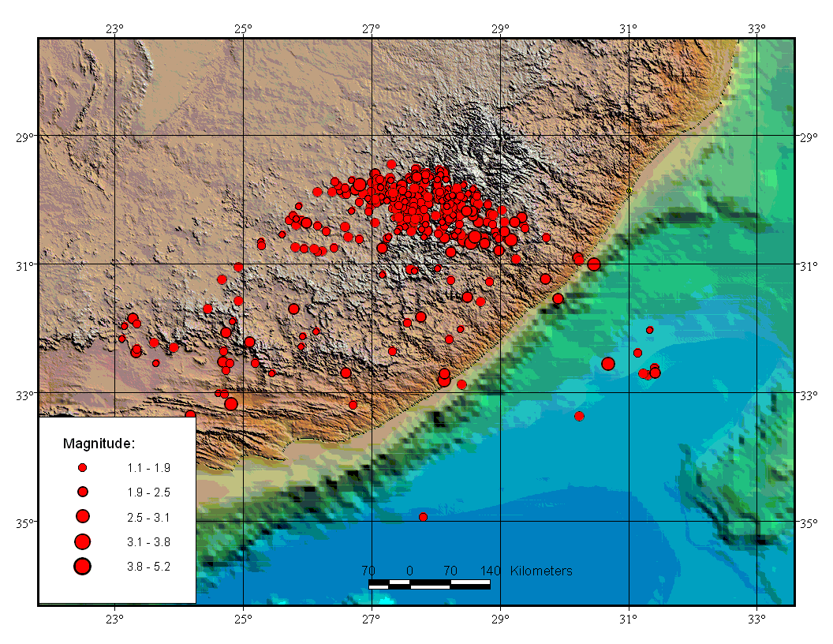
Seismicity of the study area before re-location

Slide 5
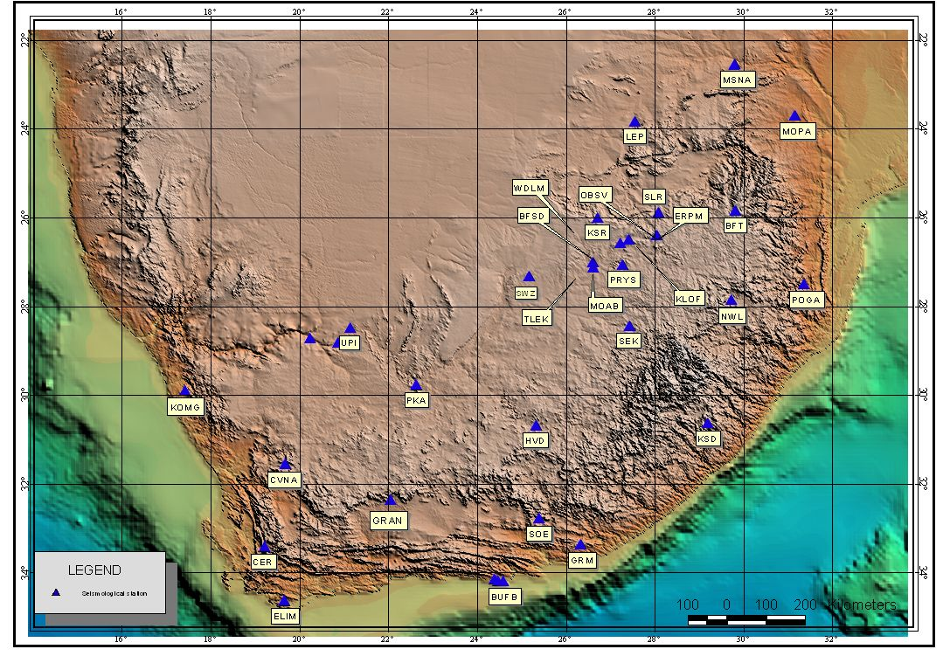
Seismological Stations

Slide 6
Catalogue
The data used for this study was obtained from Seismology Unit of Council for Geosciences which is responsible for the operation of the South African National Seismograph Network (SANSN).
The database had 63 earthquakes on a period of 19 years. On this study only a period of 9 years is covered from 1970 to1979.

Slide 7
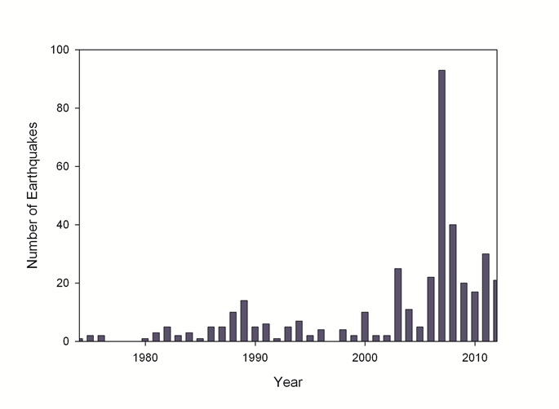
Catalogue
Yearly Distribution

Slide 8
Methodology
Searched earthquake bulletin from Council for Geoscience archive to compile the data, also used SANSD and ISC online catalogue .
Seisan earthquake analysis software was used to process the data, version 9.0 (Havskov, 2011).
Used software to plot and analysis of the earthquake data.
Refined the original phase picks by re-picking seismic phases.
Identify inaccurate phase readings (large time residuals and apply weighting – identify timing errors).
Re-locate the earthquake, find magnitude and depth determination.
Fault plane mechanism (FOCMEC, FPFIT, HASH, INVRAD and PINV).
Determined errors related to data.

Slide 9
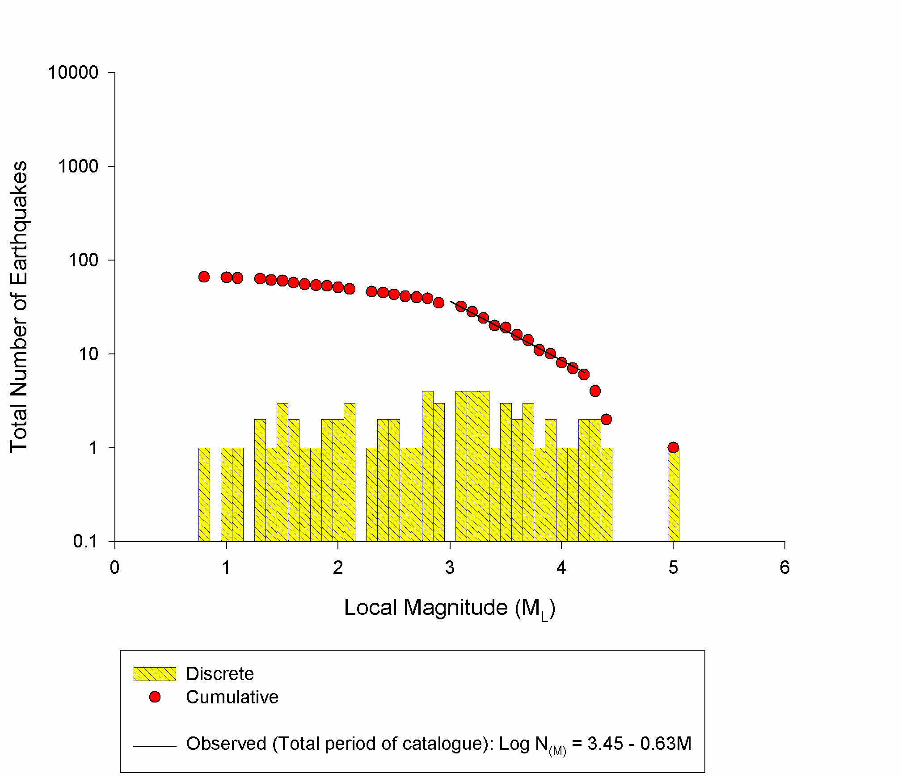
Results
B-Value
B-Value is expressed by Gutenberg-Richter law (Log N=a-bM) which shows the relationship between the magnitude and total number earthquakes.
Where;
N is the number of events having a magnitude ≥ M
a and b are constant.
a=3.45
b=0.63

Slide 10
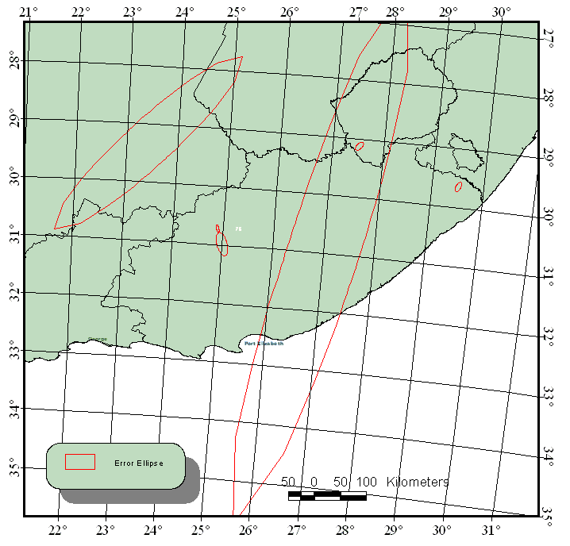
Error Ellipses
Compiled from SANSD and ISC online catalogue.
Error in location unacceptable (red big ellipses).

Slide 11
The Geology and Seismicity after re-location

Slide 12
Conclusions
The Eastern Cape Province is not well endowed with large valuable deposits meaning less mines.
Therefor most of seismic events occurring are naturally induced, which were caused by the movement of Cape Fold Belt from Cape Town extending to Eastern Cape Province.
The information I gathered from this study can be used for seismic hazard and risk determination.
Less events detected due to insensitive or absence of equipment.

Slide 13
Recommendation
There is a need to compare historical seismic data of Eastern Cape with the present. This will improve the understanding of seismicity in the area.
Better seismic station coverage is needed in the Eastern Cape to improve the quality of the data.

Slide 14
References
Havskov, J and L. Ottemӧller (2010). Processing earthquake data. Springer.
Ottemӧller, J and P. Voss and J. Havskov (2012), editors. SEISAN: The earthquake analysis software for Windows, SOLARIS, LINUX And MACKINTOSH Version 9.1. Manual, Department of Earth Science, University of Bergen, Norway.
Saunders, I. 2005. South African National Seismograph Network FDSN 2005 Report.
Chapman, C.H.C., Jen-Yi and Lyness, D.G., 1988. The WKBJ seismogram algorithm. In: Seismological Algorithms, edited by Doornbos, D.J. Academic Press, London.

Slide 15
THANK YOU

