Slide 1


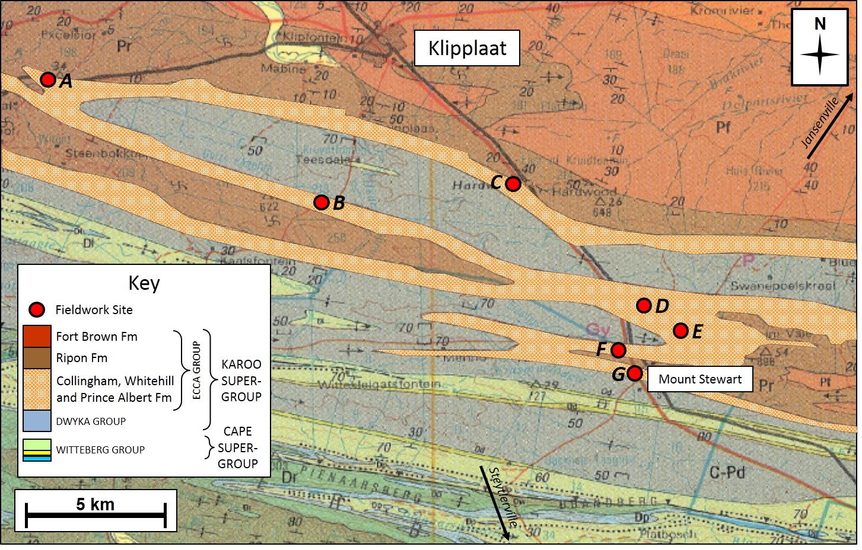
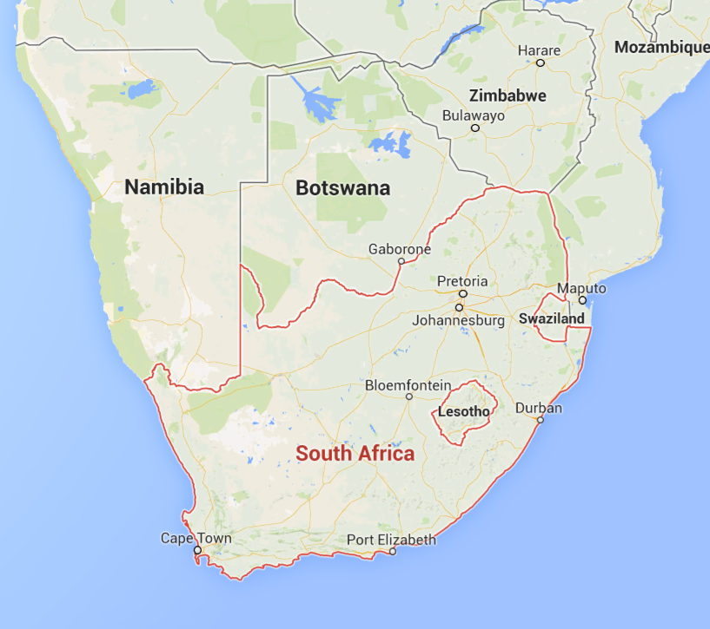
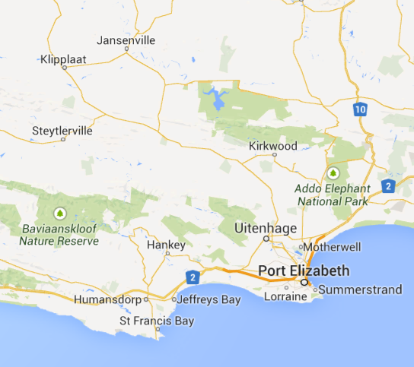
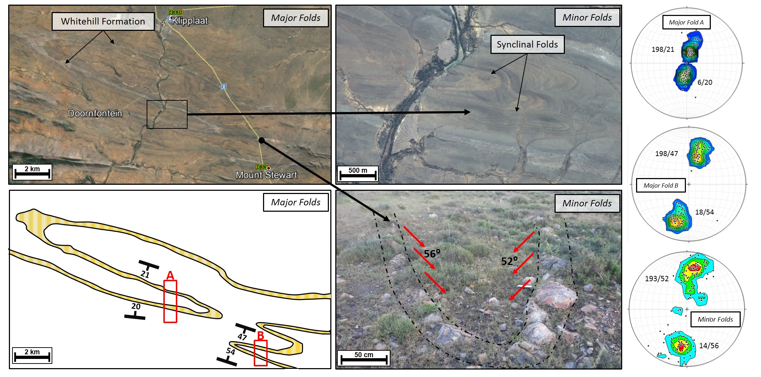
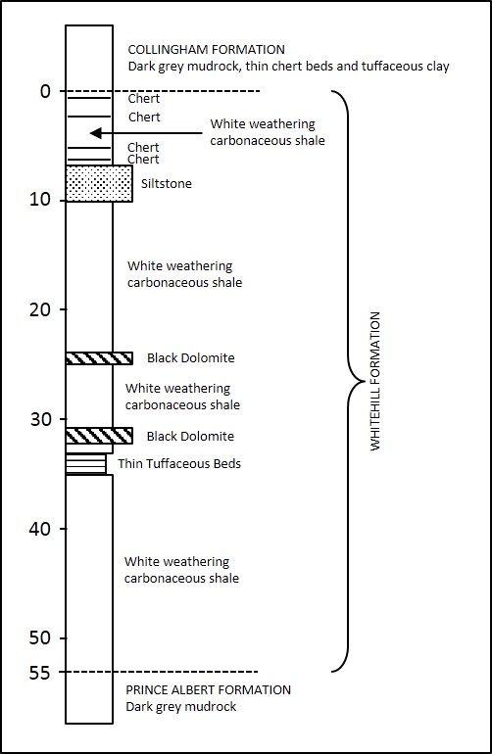
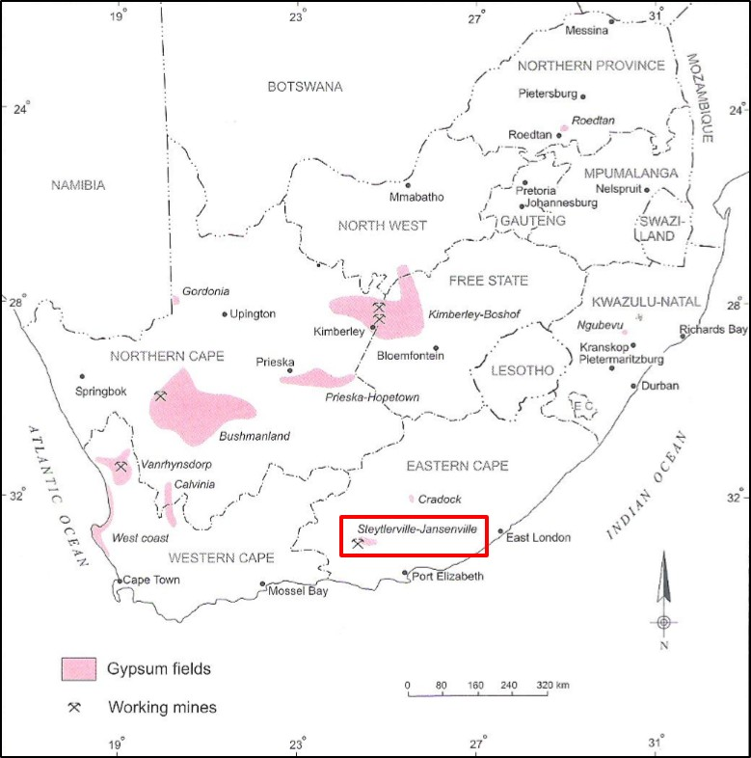
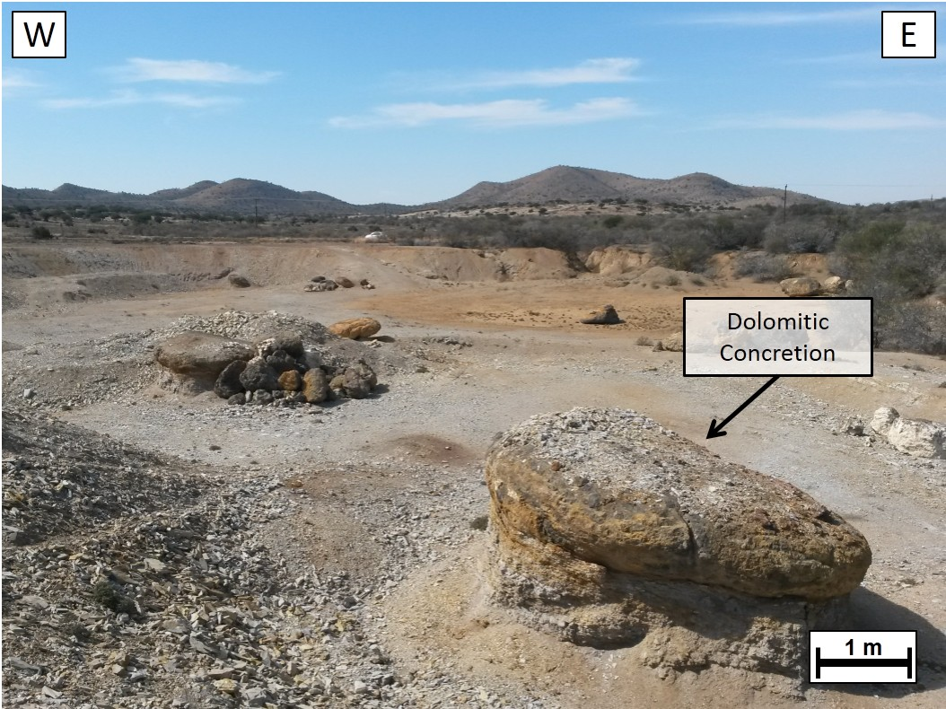
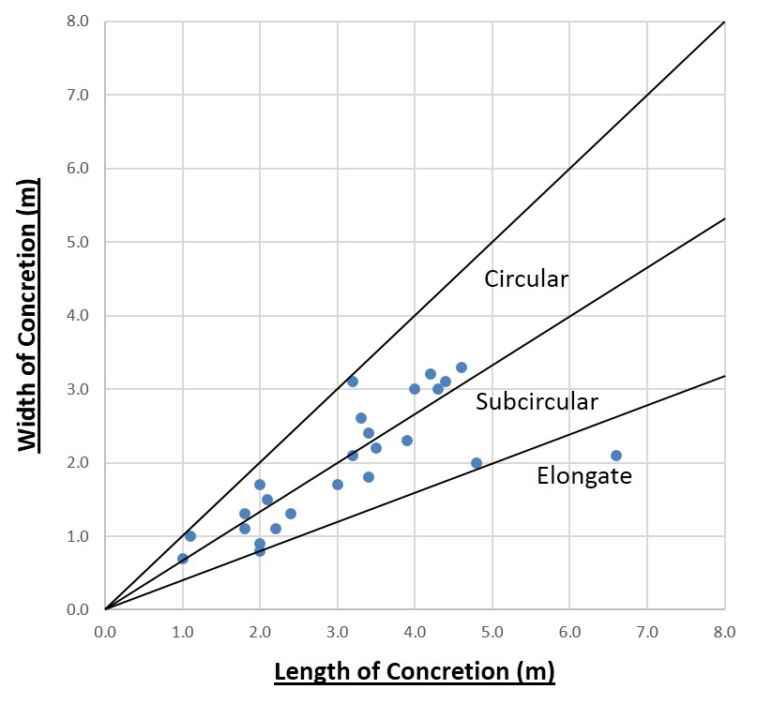
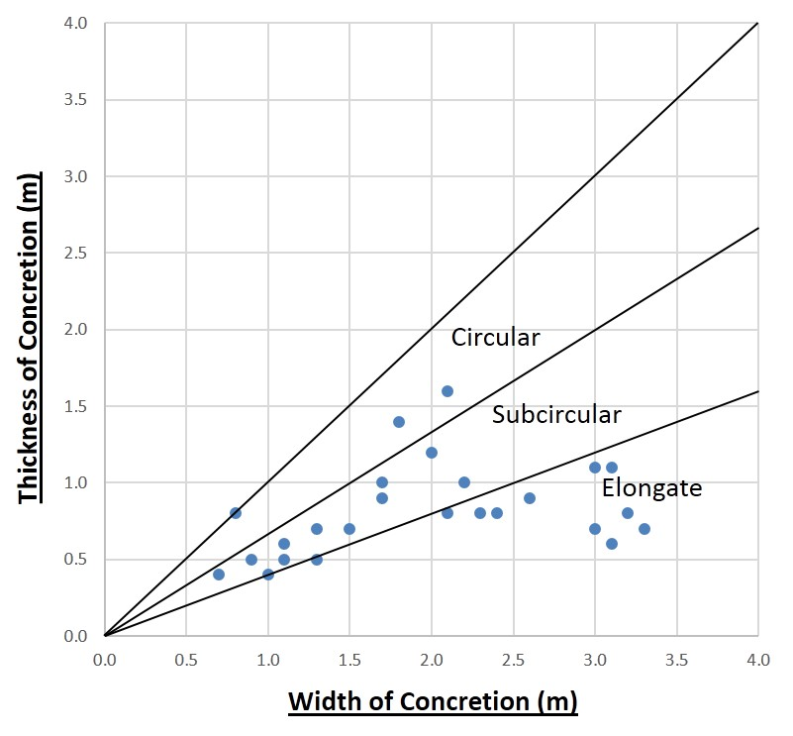



Gypsum Deposits Associated with the Whitehill Formation (Ecca Group) in the Steytlerville-Jansenville Area, Southern Karoo, South Africa
Earth Stewardship Science
Research Institute
Almanza, R.D., Booth P.W.K. and De Wit, M.J.
Nelson Mandela Metropolitan University , Department of Geosciences, Port Elizabeth, South Africa
The calcium and sulphate ions required to form the gypsum (CaSO₄·2H₂O) are supplied by the Whitehill Formation shale which is carbonate and pyrite rich. This particular shale is undergoing close study with regards to its potential to supply gas energy, but must also be recognised for its other economic benefits. Prerequisites for gypsum formation include the supply of calcium and sulphate to a zone of weathering, restricted drainage such as a pan, a clay layer in the drainage area and an arid climate where evaporation exceeds precipitation. The area of Klipplaat, Eastern Cape, in the Great Karoo meets these requirements and Pretoria Portland Cement (PPC) have mined gypsum from a weathered zone of the Whitehill Formation shale. Gypsum grades vary greatly from below 40% CaSO₄·2H₂O to well over 70% CaSO₄·2H₂O, and seem to be affected by the degree of weathering as well as their topographical position. Folding of the shale occurs as a series of large-scale and small-scale anticlines and synclines striking from East to West. Pyrite should be concentrated in the fold axes (weakest points) and this is where the larger gypsum deposits are found. Carbonate concretions are common in the study area and literature suggests that they are associated with a higher pyrite phase and this could explain the connection between the concretions and a richer gypsum zone within the Whitehill Formation. It is also possible that organic carbon is concentrated in and around these concretions and this could provide ‘pockets’ of higher carbon content within the Whitehill Formation where shale gas might be trapped at depth. A summary of the study area is given in Figure 1.
Fold Analysis
The areas with tight folding and resultant faulting are closely associated with higher gypsum deposits (provided that water is able to accumulate in these areas). For this reason, the folding of the study site has been analysed to assess whether the smaller (minor folds) are associated with the forces that caused the tectonic shortening of the ‘major fold’ system. Two major folds have been recorded thus far along with minor folds which are often found near the axes of the major folds (Figure 4 & Table 1).
Table 1: Summary of Azimuth and Dip Readings | Major Folds |  | Minor Folds
 | Fold A | Fold B
Northern Limb Ave Azimuth | 6 | 18 | 14
Northern Limb Ave Dip | 20 | 54 | 56
Southern Limb Ave Azimuth | 198 | 198 | 193
Southern Limb Ave Dip | 21 | 47 | 52
Figure 1: Geological and locality map of the study site outlining the lower Ecca Group stratigraphy.
The Whitehill Formation - Ecca Group
The Whitehill Formation is characterised by the fact that it weathers to a white colour at the surface. Deposition occurred in approximately 265 Ma. The lithology is split into ‘deep-water’ facies and ‘shallow-water’ facies. The former consisting of chert and carbonate concretions while the latter has silty horizons, carbonate beds, but no chert.
The Whitehill Formation is underlain by the Prince Albert Formation and overlain by the Collingham Formation (Figure 2). The latter contains the ‘Matjiesfontein chert’, a dark grey, white-weathering chert layer which acts as a helpful marker bed 10m above the contact with the Whitehill Formation (Visser, 1992).
Du Toit (1954) noted that the carbon content ranges between 12% and 14%, but Cole & Van Vuuren (1978) measured it to be 3.3% ± 2.1 and Geel et al. (2013) mention 4.5% total organic carbon (TOC) for the area near Wolwefontein. The Whitehill Formation also has the lowest quartz/mica ratio of the Ecca Group shales, as well as the highest sulphur weight percentage. Iron contained in the shale is in the form of pyrite, and sulphur has been oxidised to gypsum or barite (Geel et al., 2013).
Figure 4: Fold analysis of the study area and the comparison of azimuth and dip readings between major and minor folds
Carbonate (Dolomitic) Concretions
Similar to the Rhinestreet black shale of New York state, the Whitehill Formation contains concretions associated with calcium carbonate shells which grew in a shallow marine environment during a period of non-deposition (Figure 5). The size and shape of the concretions is also controlled by the enrichment of pyrite and the length of non-deposition. Shale of the Whitehill Formation contains dolomite near the base of the formation. While the shale particles are tightly packed, the dolomite shows greater porosity under a scanning electron microscope (SEM). The porosity of the dolomite units are 2.9%, while the shales are 1.57% (Geel et al., 2013). Large concretions can be formed in less than 20 million years due to large concentrations of carbonate shells, widely spread nucleation growth sites as well as a stable hydrological cycle.
25 concretions were measured and it has been pre-determined that the concretions in this study area are generally subcircular and result in oblate spheroids (Figure 6). This shape can be brought about during the depositional growth phase or during the lithifying (compaction) phase, but could also be affected by the folding which has caused lateral shortening of the lithology. Gypsum is often concentrated in shale surrounding the concretions and this is likely due to the higher pyrite content associated with the concretion surface.
Figure 2: Whitehill Formation holostratotype (Cole and Basson, 1991)
Steytlerville-Jansenville Gypsum Field
Gypsum commonly occurs within 10m of the surface in ‘gypsum crusts’ which contain between 15 – 95 % gypsum and are approximately 5m thick. There are three types of crust: horizontally bedded crusts, surface crusts and non-bedded surface crusts. The latter occurs when surface deposits become consolidated by meteoric water. The process of gypsum crystallization is affected by the salinity, temperature, pH and organic matter of the water (Oosterhuis, 1998).
The gypsum here is of medium grade in an approximately 37cm thick layer which consists of powdery CaSO₄·2H₂O at an average of 65% (Fockema et al., 1962). Many mines have been abandoned due to transportation costs and varying gypsum grades (Figure 3)
Figure 5: Dolomitic concretions exposed in the Site E quarry
Figure 6: Cross-plots of the concretion dimensions measured at Site E
Conclusions
So far it is clear that the gypsum deposits of the Steytlerville-Jansenville field are related directly to the Whitehill Formation shale due to their higher calcium carbonate and pyrite content. Small-scale folding, which is caused by the same forces as the large scale folding, contributes to the weakness of the rocks and this, along with faulting and ‘damming’ of water, supplies the depositional environment for gypsum precipitation. Carbonate concretions, which are also related to higher gypsum quality, are generally subcircular and oblate. The concretions which are carbonate rich must also be considered as significant in the assessment of black shales of the Whitehill Formation for their gas potential because of their greater porosities.
Figure 3: Gypsum fields in South Africa highlighting the Steytlerville-Jansenville gypsum field in the Eastern Cape (from Oosterhuis, 1998).
Key References
Cole, D. and Van Vuuren, C.J., 1978, Preliminary Report on the Oil Potential of the Whitehill Formation Between Strydenburg (Cape Province) and Hertzogville (Orange Free State), Report (Geological Survey (South Africa)).
Du Toit, A.L., 1954, The Geology of South Africa, 3rd Edition, Edinburgh: Oliver and Boyd.
Geel, C. Schulz, H., Booth, P., de Wit, M. and Horsfield, B., 2013, Shale gas characteristics of Permian black shales in South Africa: results from recent drilling in the Ecca Group (Eastern Cape), Energy Procedia, vol. 40, pp. 256-265.
Oosterhuis, W.R., 1998, Gypsum, In: Wilson, M.G.C. and Anhaeusser, C.R. (Eds.), The Mineral Resources of South Africa: Handbook, Silverton: Council for Geoscience, pp. 394-399.
Visser, J.N.J., 1992, Deposition of the Early to Late Permian Whitehill Formation during a sea-level highstand in a juvenile foreland basin, South African Journal of Geology, v. 95 (5/6), pp. 181-193.
Acknowledgements
Although this project is still in the early stages of data collection and analysis, I already have many people to thank for their various contributions –
Professor Booth, for undertaking the responsibility to supervise this project; Professor de Wit, for supporting the study and organising the funding through the NRF and Inkaba yeAfrica; the other NMMU staff and students for their assistance; Mount Stewart and Klipplaat farmers for allowing access to their land; Mr Jo van Heerden and Mariri Trading, for the background knowledge and advice; family and friends for their support; Debbie Taylor, for her eternal support and encouragement.
Without these people this important study would not have begun and would not be progressing, however slowly, to result in an important contribution to understanding the geology of the Karoo.

