Slide 1


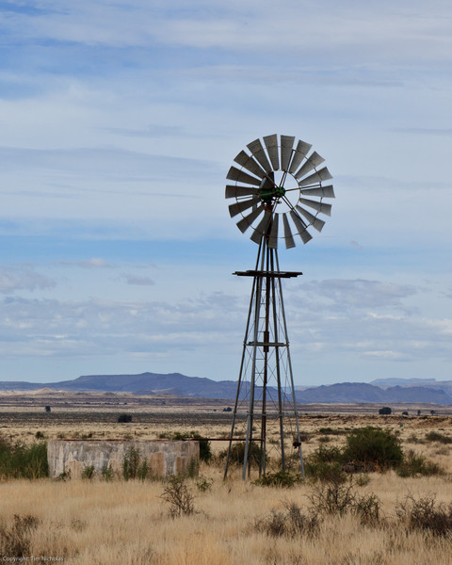
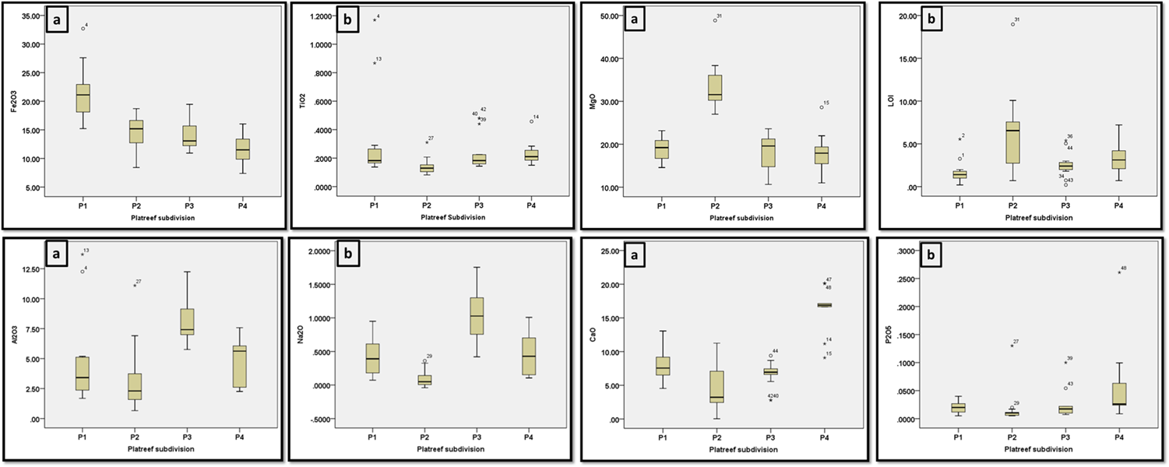
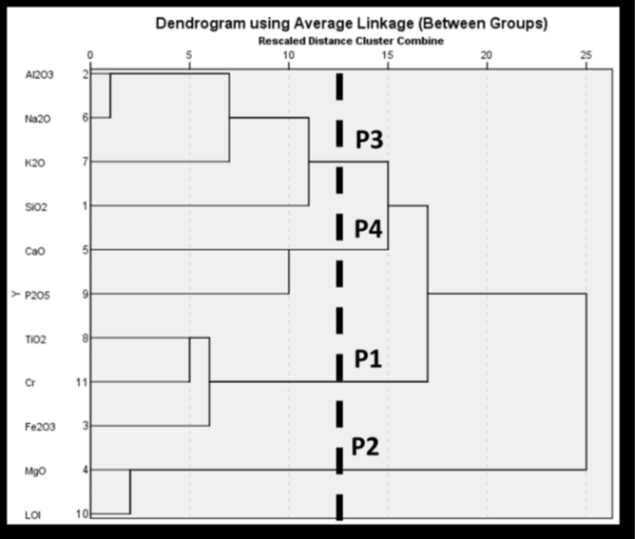
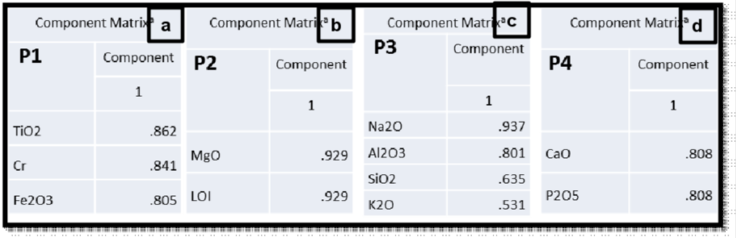



Geochemical characterization of P1, P2, P3 and
P4 units at the Akanani prospect area, Bushveld
Complex, South Africa: Combination of R-Cluster,
R-Factor and Discriminant analysis approach
University of the Western Cape
Department of Earth Sciences
Mandende¹, H., Siad², A.M., Bailie³, R., Okujeni⁴, C
Department of Earth Sciences, University of the Western Cape
Using the discriminant functions computed with the training groups, the 18 unknown samples (Table 2) were classified into one of the pre-defined four groups with a recognition rate of 100% and correctly classified the 53 samples to their pre defined groups (Table 3). In this discriminant analysis the discriminant accuracies for the four groups are 100%, indicating that the percentage of accurate analyses is high for discriminating the four Platreef units at Akanani and thus results can be used with a high level of confidence. Figure 3 shows the spatial distribution of the group membership of the Akanani prospect area resulting from the discriminant analysis. Figure 4 is a graphical representation of the concentration of some selected major elements in each of the four lithological units
Introduction
The Platreef is a 10-400m thick package of texturally heterogenous pyroxenite,
norite and gabbro-norites containing numerous xenoliths of dolomite, calc-silicate
and granofels derived from the floor rocks (Harris and Chaumba, 2001). The
varying nature of the floor rock along strike and down-dip from north to south
makes it difficult for geologists to make accurate predictions on the location of
the mineralization. Furthermore the complexity of the Platreef at various localities
makes it difficult for mining personel to come up with a definitive criteria
for classifying and characterizing Platreef lithologies. Interplay of magmatic processes,
contamination of the magma by footwall rocks and post-magmatic processes
such as hydrothermal activity are proposed to be responsible for its complexity
and heterogeneity (Nichol and Kinnaird, 2008). Because of this complexity
a definitive criteria for lithostratigraphic and lithogeochemical correlation of
the Platreef rock succession at Akanani has not been provided.
This study is focused on the Akanani prospect area, approximately 25 km northwest
of the Town of Mokopane where the Platreef is informally subdivided into
4 major lithological units (P1 to P4; from bottom to top (Van der Merwe, 2008;
McDonald and Holwell, 2011).
Figure 1: Geological map of the Platreef showing the study area
(modified after Van der Merwe et al. 2012).
Aims and Objectives
The present study was initiated to determine the distinctive geochemical characteristics that
can be used to identify each layer and in so doing determine the
geochemical elements characterizing each of the pyroxenite layers.
Materials and Method
R-Mode Cluster analysis- Create and determine the number of geochemical
element association groups.
R-Mode Factor analysis- Create training samples for P1, P2, P3 and P4 unit
based on element associations created through r-mode cluster analysis
Discriminant analysis- To characterize the four groups created through the combination of r-mode cluster
and factor analysis and classify unknown samples to their respective pre-defined groups.
Results and Interpretation
For the r-mode cluster analysis (Fig. 2) four groups were determined; group 1
was characterized by the association of Al2O3, Na2O, K2O and SiO2 identified
as P3 unit; group 2 shows high affinity for CaO and P2O5 which represents the
P4 unit; group 3 shows enrichment of TiO2, Cr, Fe2O3 which shows high affinity
with P1, while group four is characterized by the association of MgO and LOI
which coroborates with the highly serpentinized olivine-rich P2 unit.
Figure 2: Four groups representing the four lithological
Unit (P1, P2, P3, P4) atthe Akanani prospect area
Table 3: Classification results for the predicted
group membership
Table 2: Classification results for
the newly created training samples
Figure 3: Discriminant plot showing the
dominance of elements within the four lithological units.
Petrography
Figure 4: Graphical representation of the concentration of major elements in each unit.
Note that all elements were analysed in wt%.
Figure 5: Petrographic photographs of the four lithological units. All panels are taken in crossed pollars.
Cumuls chromite (Cr) associated with clinopyroxene (cpx) and orthopyroxene (opx).
(b) Clinopyroxene (Cpx), Fractured orthopyroxene (opx) oikocryst, extensively serpentinized olivine (ol),
unaltered primary Fe-Cr spinel and interstitial plagioclase. (c) Medium-coarse grained Feldspathic pyroxenite with
abundant orthopyroxene (opx) and clinopyroxene (cpx) and interstitial plagioclase. (d) Cumulus plagioclase,
abundant clinopyroxene, Ilmenite (il) and biotite (bio).
Discussion
The use of the three multivariate statistical techniques allowed for an evidence
based analysis of the geochemical character of P1, P2, P3 and P4 unit at the
Akanani prospect area. The findings of this study show the enrichment of Fe2O3,
Cr and TiO2 in group one which is described as P1 unit. This classification is in
disagreement with previous misconception that the P1 unit at Akanani is a finegrained
gabbro-norite websterite (Mitchell and Scoon, 2012). The Cr content of
the P1 unit is interpreted as resulting from the depletion of MgO and Al2O3 and
increased TiO2 and Fe2O3 resulting in the re-distribution of Cr. Consistently high
MgO and LOI associated with the P2 unit suggests that this unit is ultramafic
and highly serpentinized. The dominant alteration mineral is serpentine in the
P2 unit, which occurs as veining and unlike amphibole and sericite that maybe
late-stage magmatic indicates an influx of externally derived hydrothermal fluids
consistent with the high LOI contents. Elevated concentration of felsic elements
Al2O3, Na2O, K2O and SiO2 in P3 suggests that this unit may have underwent
feldspathization. The classification of P3 as a fine-grained feldspathic pyroxenite
containing upto 70 modal % clinopyroxene (Lee, 1996) is not consistent with
the findings of this study and should not be used to describe the texture of P3
feldspathic pyroxenites at Akanani. The P4 unit is characterized by high CaO and
P2O5 and can be interpreted as a late-stage residual melt of assimilated Platreef
that interacted with Main Zone gabbro-norite. Judging from this study, the Platreef
subdivision is complex and as such the stratigraphic subdivision presented here
should be treated with caution and is only relevant to the Platreef at Akanani.
The correct classification of rock types can thus not rely solemly on core-logging
and mineralogy, but further geochemicalanalysis should be done in conjuction
with petrography and field observations.The approach in this investigation focuses
on determining the changes in elementassociation and mineralogy that reflects
the distinctive nature of the four units ofthe Platreef at Akanani. The methodology
presented here can be useful in the reconstructionof the stratigraphic subdivision
of the Platreef thus making it easierfor exploration for and recovery of PGEs easier and cost effective.
References
Table 1 shows results from the factor analysis. The first factor shows positive loadings for Fe2O3, Cr
and TiO2; the second factor is positively loaded with MgO and LOI respresenting
an extensively serpentinized olivine-rich variety of the Platreef; Factor three is positively
loaded with Na2O, Al2O3, K2O and SiO2 representing a feldspathic variety
of the Platreef, while factor four has positive loadings for CaO and P2O5
and may represent a variety intermediate between the P3 unit and the Main Zone
gabbro-norite.
1. Lee, C.A. (1996). A review of mineralisation in the Bushveld Complex and
some other layered intrusions. In: Cawthorn RG (ed) Layered Intrusions; Elsevier
Science BV, Amsterdam, pp 103–145.
2. Harris, C. and Chaumba, J.B., 2001. Crustal contamination and fluid-rock interaction
during formation of the Platreef, northern limb of the Bushveld Complex,
South Africa. Journal of Petrology, 44, pp 1321-1347.
3. McDonald, I. and Holwell, D.A. ( 2011). Geology of the Northern Bushveld
Complex and the setting and genesis of the Platreef Ni-Cu-PGE deposit. Reviews
in Economic Geology, 107, pp713-722.
4. Mitchell, A.A and Scoon, R.N. (2012). The Platreef of the Bushveld Complex,
South Africa: A new hypothesis of multiple, non-sequential magma replenishment
based on observations at the Akanani project, North-West of Mokopane,
South Africa; South African Journal of Geology, 115.4, pp 535-550.
5. Van der Merwe, F., Viljoen, F., Knoper, M. (2012). The mineralogy and mineral
associations of platinum group elements and gold in the Platreef at Zwartfontein,
Akanani Project, Northern Bushveld Complex, South Africa. Miner Petrol 106,
pp25-38.
6. Van der Merwe, M.J. (2008). The geology and structure of the Rustenburg
layered suite in the potgietersrus/mokopane area of the Bushveld Complex, South
Africa. Miner Deposita 43, pp405–419.
Acknowledgements:
Table 1: Four factors scores for the four groups (P1-P4). (a) and (b) represent the
mafic group of P1 and P2, while (c) and (d) represent the feldspathized group
of P3 and P4 melanorites
I would like to thank Inkaba yeAfrica, DST, NRF, GFZ as well my supervisor Dr. Abdi Siad, my co-supervisors Dr. Russel Bailie, Professor Charles Okujeni and Professor Jan Van Bever Donker for the financial and academic suport they have offered me.

