Slide 1
Fibre optic humidity sensing for the ATLAS ITk and a search for H → ZdZd → 4ℓ in Run 3 data
Xola Mapekula
PhD (Mechanical Engineering) · Student no.201071570 · Registered 30/01/2023
Supervisors: Prof. S. H. Connell, Dr L. Truong, Dr K. Assamagan
In collaboration with the ATLAS Collaboration, CERN
PhD Proposal Defence 2026

Slide 2
Study field and topic
Experimental particle physics and detector instrumentation, within the ATLAS Collaboration at CERN. The detector enables the physics.
PART I · INSTRUMENTATION
Fibre optic humidity sensors for the ATLAS ITk
Develop and qualify a radiation-tolerant fibre optic sensor (FOS) package that monitors humidity and temperature inside the new Inner Tracker (ITk) for the High-Luminosity LHC.
PART II · PHYSICS ANALYSIS
Search for H → ZdZd → 4ℓ
Use ATLAS Run 3 data at √s = 13.6 TeV to search for the Higgs boson decaying to two dark vector bosons, Zd.
Notes:
My field is experimental particle physics and detector instrumentation, within the ATLAS Collaboration. The thesis has two parts. Part one is instrumentation for the new ATLAS Inner Tracker that needs humidity monitoring that survives its radiation environment. For this, the aim is to develop and qualify a fibre optic sensor package for it. Part two is a physics analysis where we will be using Run 3 data to search for the Higgs boson decaying to two dark vector bosons, Zd.

Slide 3
Problem statement
Two problems, each leading to one research question.
PART I
The ITk will operate at −20 to −40 °C, so its dew point must stay at or below −60 °C. Conventional humidity sensors are not radiation hard, add material and cables, and cannot be replaced for more than a decade.
PART II
The Higgs boson is a natural portal to a dark sector, giving H → ZdZd → 4ℓ. Event displays from the previous analysis show missing energy alongside the four leptons. Searches so far rely on mass variables; MET and the lepton angles are not yet used.
RQ1: Can a hybrid FBG/LPG fibre optic package measure humidity in the ITk to a dew-point resolution of 0.5 °C at −60 °C, and remain usable after irradiation?
RQ2: Can MET and the four-lepton angular variables, combined through simulation-based inference, improve the sensitivity to H → ZdZd in ATLAS Run 3 data?
Notes:
Each part starts from a concrete problem. The ITk will be cooled to between minus twenty and minus forty degrees, so its dew point must stay at or below minus sixty degrees. Electronic humidity sensors are not radiation hard, add material, and cannot be replaced once installed. On the physics side, the Higgs boson is a natural portal to a dark sector, giving four leptons. In the previous iteration of the analysis, we found from event displays that there is missing energy that accompanies the four lepton final state. Searches so far rely on mass variables; the missing energy and the angles between the leptons are not yet used.

Slide 4
Aim and objectives
Aim: to develop and qualify a fibre optic humidity monitoring package for the ATLAS ITk, and to search for exotic Higgs decays to dark vector bosons in Run 3 data.
PART I OBJECTIVES
Design a strain-free FOS package with FBGs and a TiO₂-coated LPG.
Build an automated environmental control system for calibration.
Derive calibration curves and a method to extract temperature, humidity and dose.
Qualify the package in an irradiation campaign.
Define sensor placement and integration in the ITk.
PART II OBJECTIVES
Port the analysis to the Run 3 framework (TopCPToolkit) and validate it.
Characterise the missing transverse energy (MET) in the four-lepton final state.
Quantify how well the angles φ, θ₁, θ₂, θ* and φ₁ separate signal topologies.
Build an SBI analysis with these variables and set limits on H → ZdZd.
Notes:
For part one, I have five objectives: design a package that holds the gratings free of strain, build an automated system to control humidity and temperature during calibration, derive calibration curves and a method to separate temperature, humidity and radiation dose, qualify the package under irradiation, and define where the sensors go in the ITk. For part two, I have four: move the analysis to the Run 3 software framework and validate it, characterise the missing transverse energy in the four lepton final state, quantify how well five angular variables separate the signal topologies, and build a simulation-based inference analysis on these variables to set limits.

Slide 5
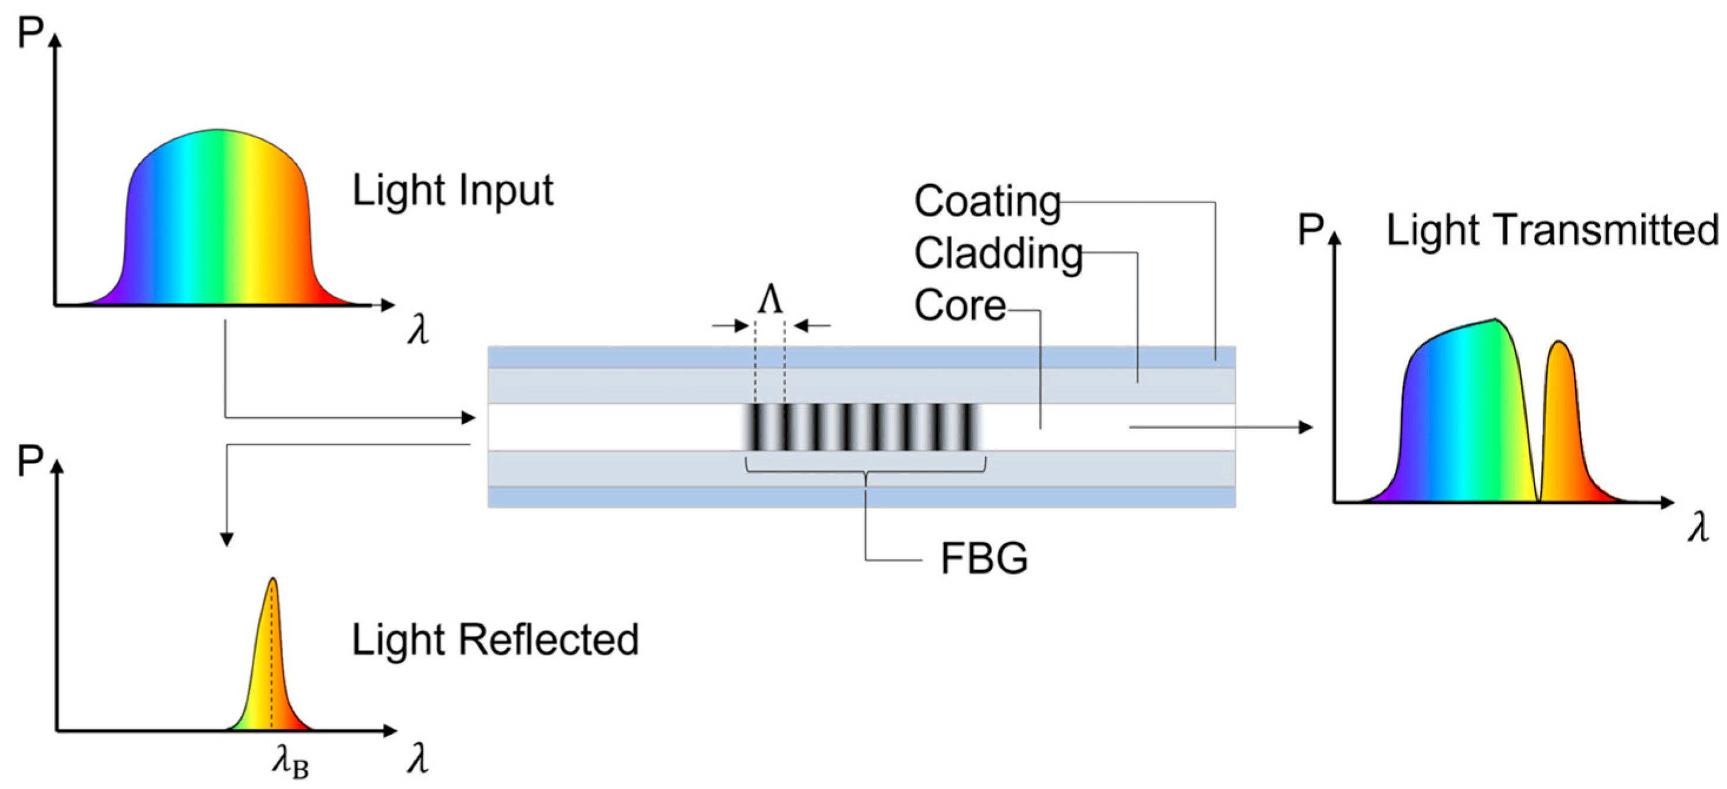
Literature review · Part I
Fibre gratings can sense humidity and survive radiation, but packaged sensors have not been qualified for the ITk.
Fibre Bragg gratings
The Bragg wavelength shifts with temperature and strain. Gratings on radiation-hard fibre drift little under dose; gratings on B/Ge co-doped fibre are radiation sensitive.
Long-period gratings
Light couples into cladding modes, so the resonance tracks the surrounding refractive index. A TiO₂ coating gives humidity sensitivity, highest near the modal transition (Cusano et al., 2005).
LPGs in particle physics
LPGs have been studied for temperature, humidity and dose monitoring, with gamma, proton and neutron irradiations and an ITk device concept (Scherino, 2024).
RESEARCH GAP
No production FOS package has yet been calibrated and qualified under ITk conditions, and the effect of coating thickness on the radiation response of packaged LPGs is not yet established.
Notes:
Three findings shape part one. Bragg gratings respond to temperature and strain, and their radiation response depends on the fibre, which can be used to measure dose. Long-period gratings respond to the refractive index around them; a titanium dioxide coating makes them humidity sensitive. Scherino's 2024 thesis at CERN established LPGs as a platform for environmental monitoring in particle physics. What is missing is the qualification of production packages under real ITk conditions, and how coating thickness affects the radiation response once the sensor is packaged.

Slide 6
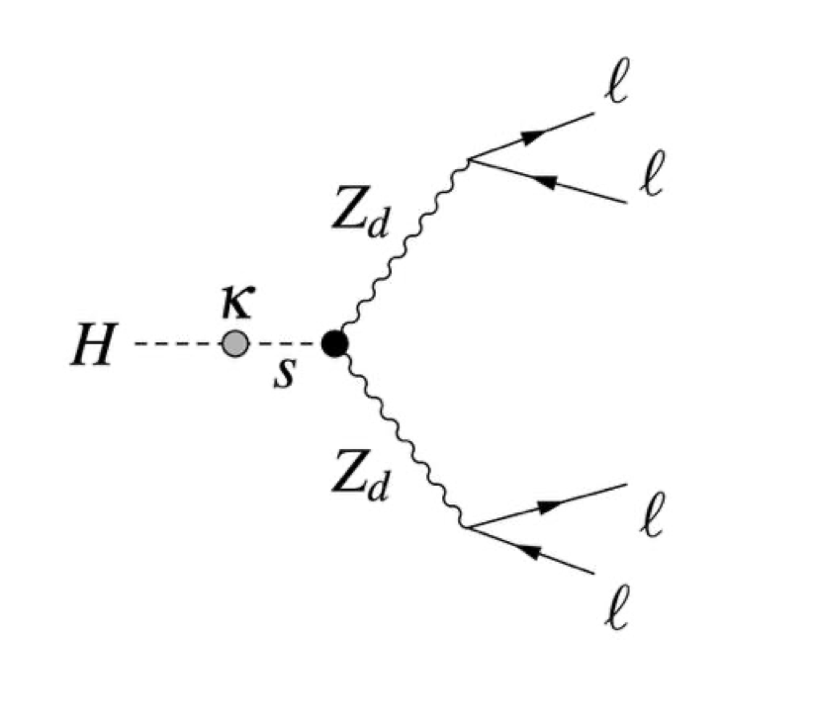
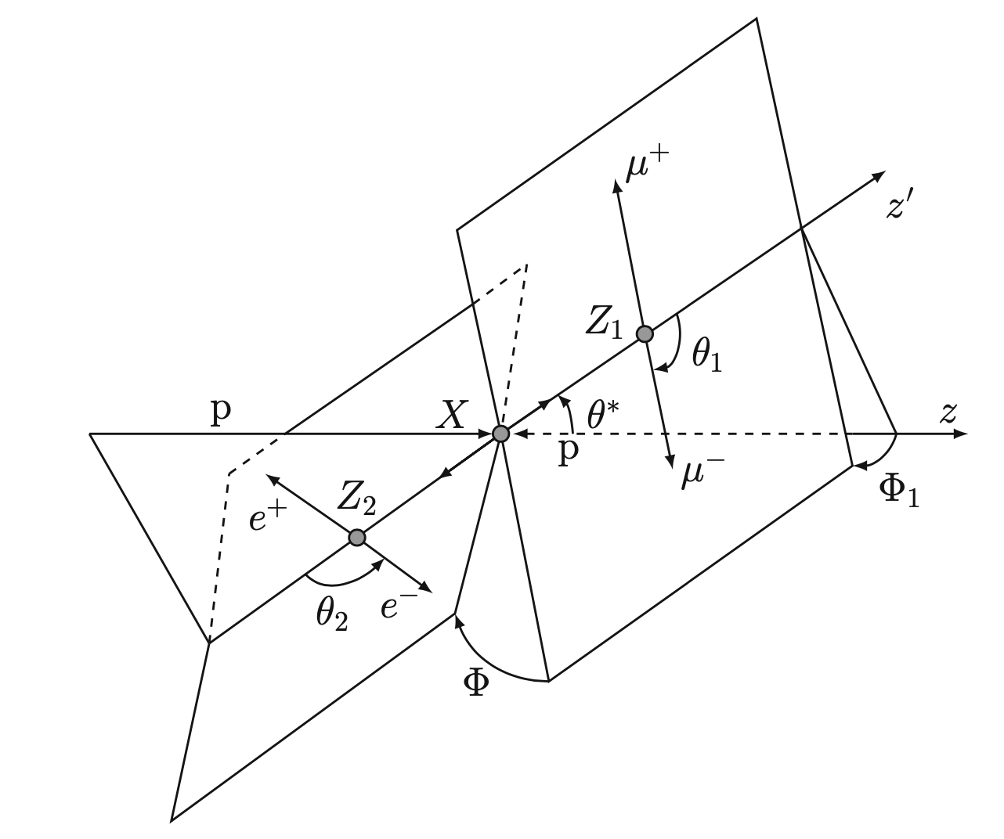
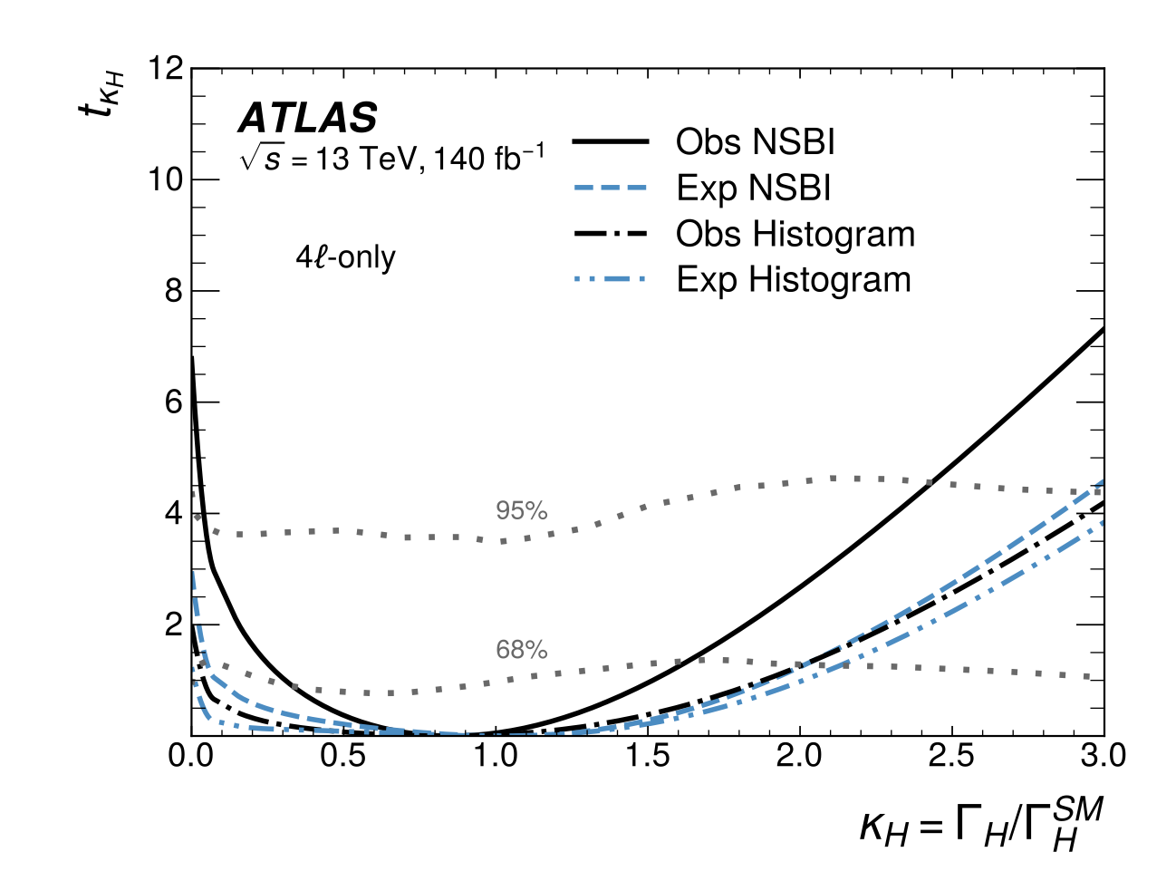
Literature review · Part II
Angles and SBI are proven in Higgs physics but unused in dark sector searches.
Model and Run 2 search
A dark boson Zd couples to the SM through kinetic mixing ε and Higgs mixing κ (Curtin et al., 2014). ATLAS Run 2, 139 fb⁻¹: no excess for 15 < mZd < 60 GeV (JHEP 03 (2022) 041).
Four-lepton angles
Five angles of the 4ℓ system, φ, θ₁, θ₂, θ* and φ₁, were used to measure the Higgs spin and parity (ATLAS, EPJC 75 (2015) 476; notation of Banerjee et al., 2021).
Simulation-based inference
Neural networks learn likelihood ratios from simulation, allowing unbinned fits in many variables; first used by ATLAS for off-shell H* → ZZ → 4ℓ (arXiv:2412.01548).
RESEARCH GAP
No Run 3 result exists for H → ZdZd, the MET and angular structure of these events have not been exploited, and SBI has not yet been applied to exotic Higgs decays to dark vector bosons.
Notes:
For part two, the model is the Hidden Abelian Higgs Model, where a dark boson Zd couples through kinetic and Higgs mixing; the Run 2 search found no excess. Two other bodies of work matter. The five angles of the four-lepton system are well understood from the ATLAS Higgs spin and parity measurement. And simulation-based inference, where neural networks learn from simulation, has now been used by ATLAS for the off-shell Higgs in four leptons. The gap: neither the angles, the missing energy nor this method have been used in the dark sector search.

Slide 7
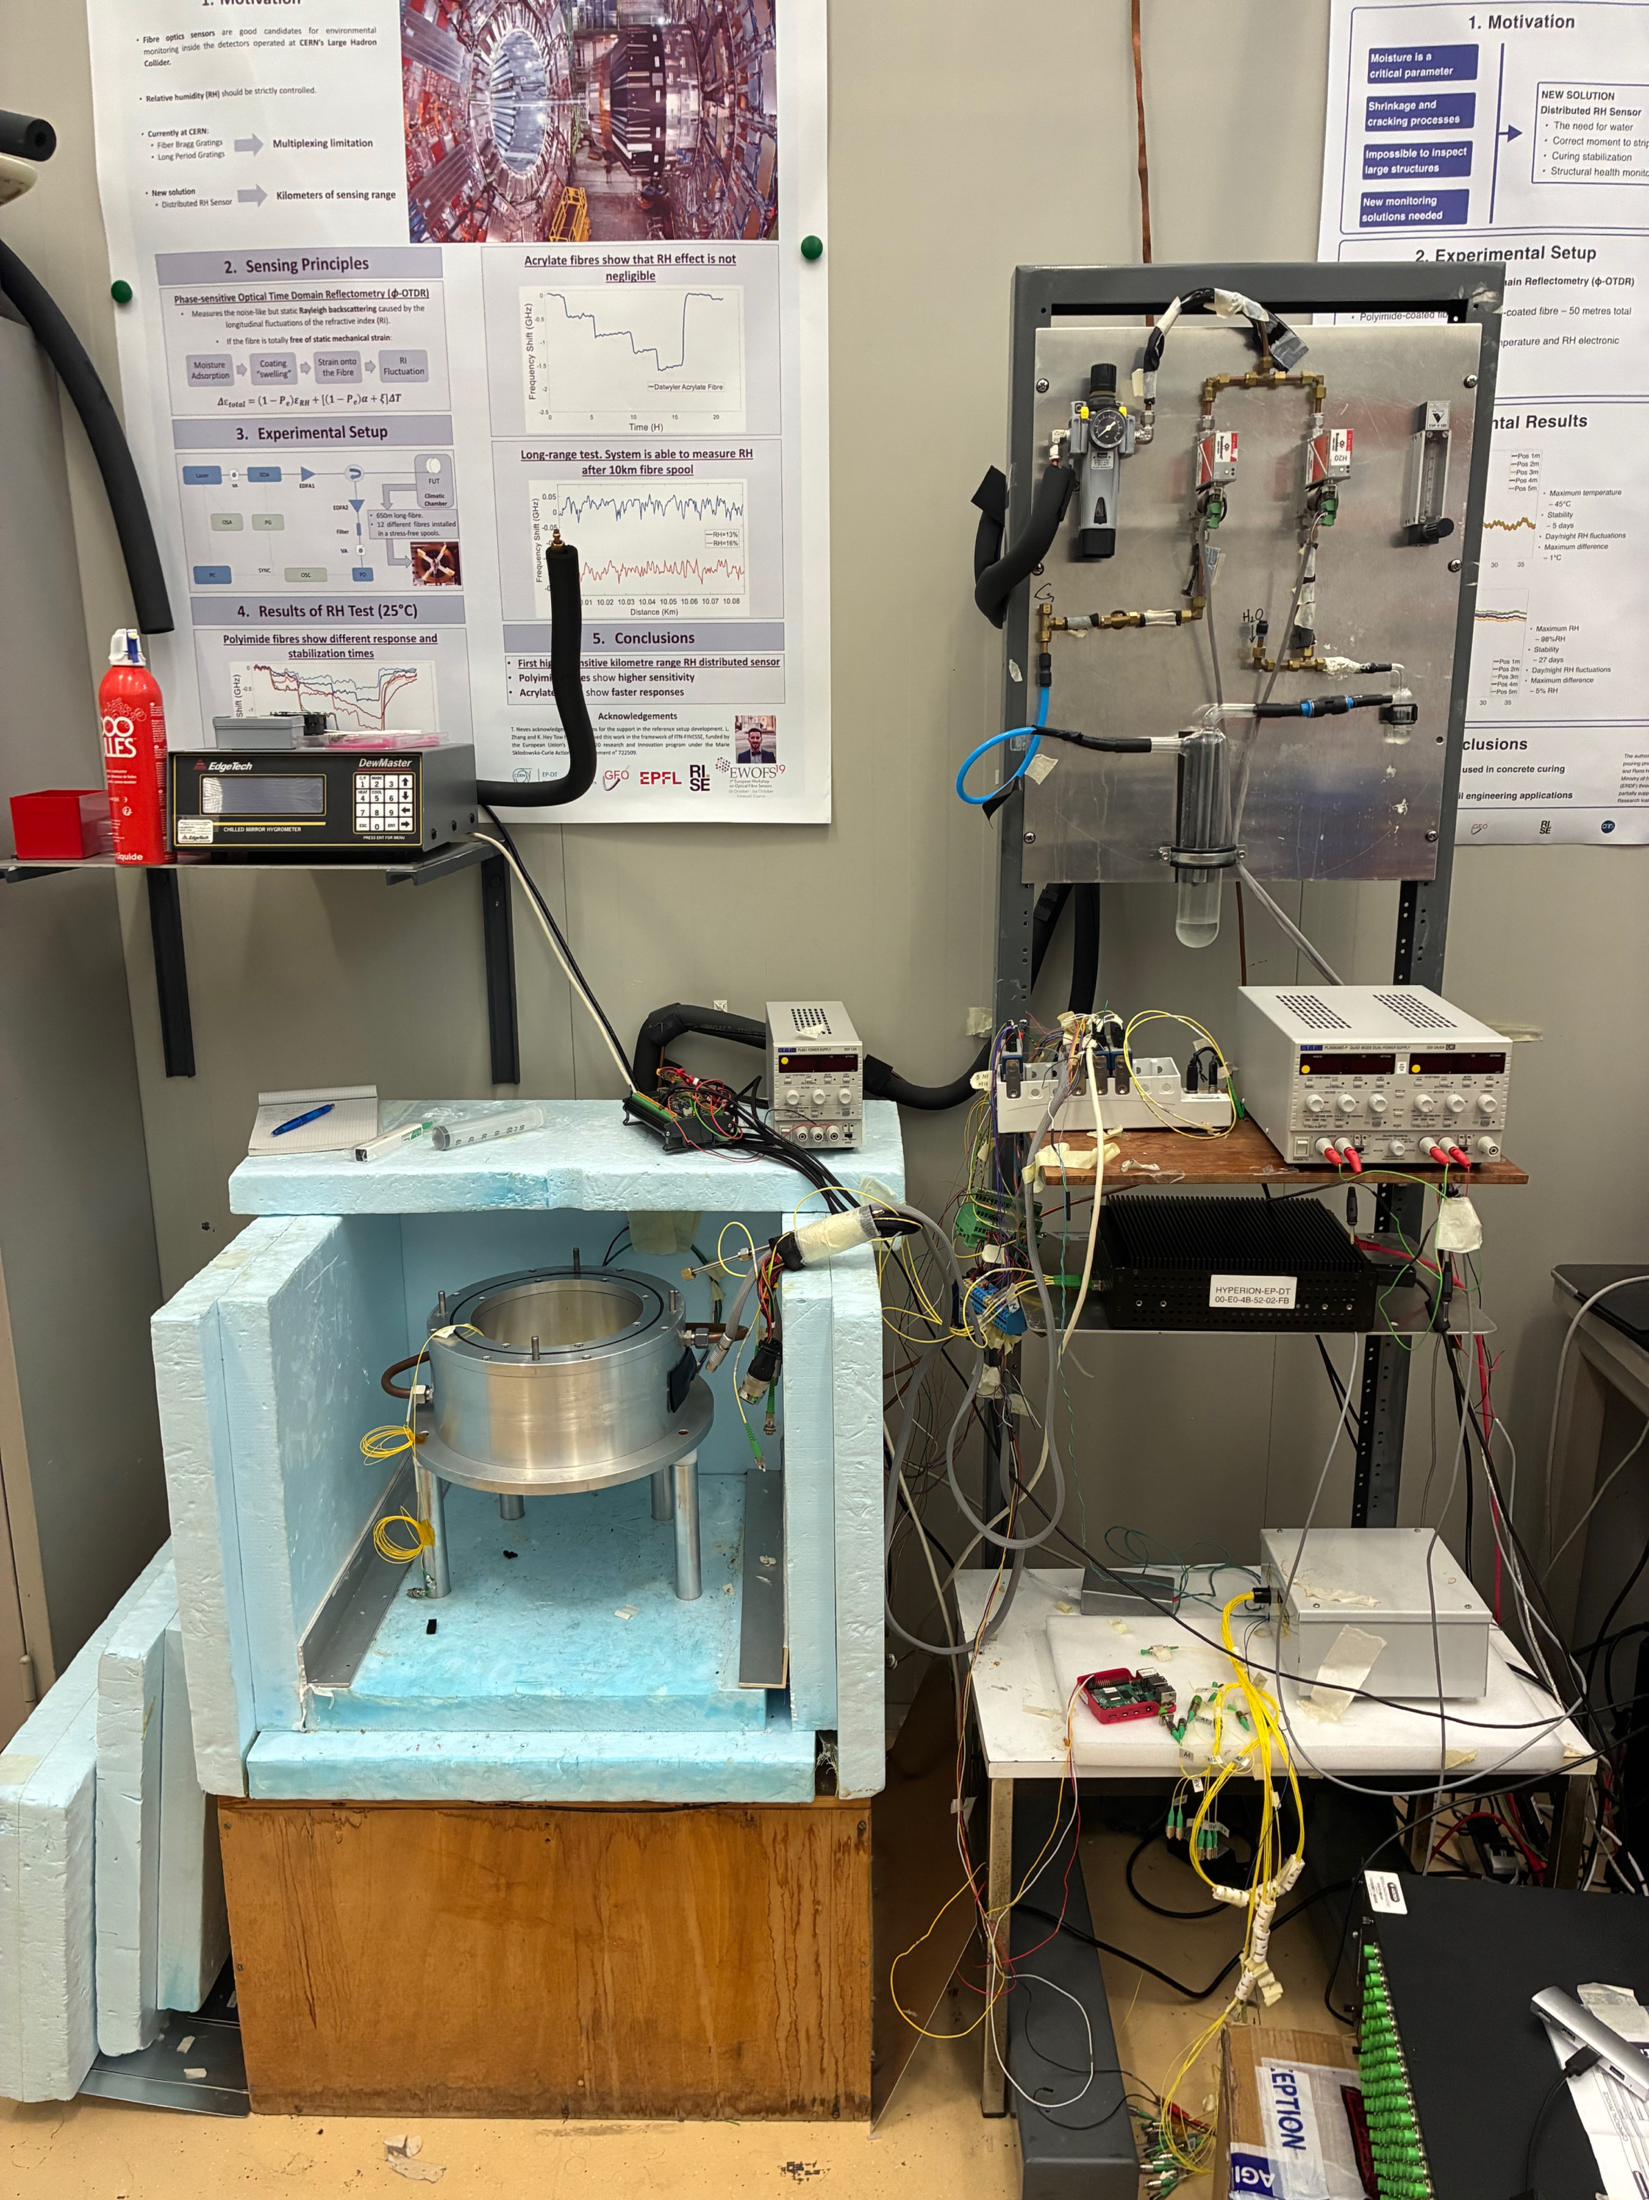
Methodology · Part I
Four steps take the sensor from calibration to installation in the ITk.
Control system: Build a control system for the climatic chamber that sets the dry and moist air flow automatically, with reference sensors and an optical interrogator.
Extract: Calibration curves and a sequential method to separate temperature, humidity and dose.
Irradiate: Irradiation at CERN IRRAD, comparing LPGs with different numbers of TiO₂ layers.
Integrate: Sensor placement in the ITk informed by CFD, with grounding and fibre routing.
Output: calibrated, radiation-qualified FOS packages and a placement plan for the ITk.
Notes:
Part one will follow four steps. First, I will build a control system for the climatic chamber that controls the dry and moist air flow automatically, with reference sensors and an optical interrogator reading the gratings. Second, from the calibration data I will derive calibration curves and a sequential method that separates temperature, humidity and dose. Third, an irradiation campaign at CERN's IRRAD facility, comparing LPGs with different coating thicknesses. Fourth, integration: choosing where the sensors go in the ITk, guided by airflow simulations, and solving grounding and fibre routing.

Slide 8
Methodology · Part II
The analysis is rebuilt for Run 3, then extended with MET and the lepton angles.
Framework: move the analysis to TopCPToolkit and check it against the existing chain.
Selection: keep events with four good leptons; ZZ* from simulation, Z+jets and tt̄ from data with the ABCD method.
MET study: measure how much MET is left after each selection cut, to test whether another particle could be in the final state.
Angles: compute the five angles between the leptons (φ, θ₁, θ₂, θ*, φ₁). Signal and ZZ* give different angle patterns.
SBI fit: neural networks trained on simulation use the angles, masses and MET of every event in one fit, as ATLAS did for the off-shell Higgs.
Result: a limit on H → ZdZd for each Zd mass.
Notes:
Part two has six steps. First, the analysis moves to TopCPToolkit, the Run 3 framework, and is checked against the existing chain. Second, the selection, with ZZ star from simulation and Z+jets and ttbar from the ABCD method. The new part follows. The MET study looks at how much MET is left after applying each event selection cut to see if there could possibly be another particle in the final state. Then I compute the five angles between the leptons, because the signal and the main background produce different angle patterns. Finally, neural networks trained on simulation use the angles, masses and MET of every event in one fit, giving a limit for each Zd mass.

Slide 9
Proposed solution and contribution
A qualified ITk sensor and an SBI search using MET and angles: five contributions.
Part I solution
A low-mass, radiation-tolerant FOS package that measures temperature, humidity and dose, calibrated with an automated procedure.
ORIGINAL CONTRIBUTION TO KNOWLEDGE
Qualification of production FOS packages under ITk temperature, humidity and radiation conditions.
Dose compensation with two FBGs of different radiation sensitivity.
An automated calibration system and multi-parameter extraction method.
A characterisation of MET in Higgs-portal topologies.
A new Run 3 search for H → ZdZd that uses four-lepton angular variables and MET in an SBI fit.
Part II solution
An SBI analysis of H → ZdZd in Run 3 that uses MET and the angular structure of each event, on a validated TopCPToolkit implementation.
Notes:
Putting this together, the proposed solution for part one is a low-mass, radiation-tolerant sensor package that measures temperature, humidity and dose, with an automated calibration procedure. For part two, it is a simulation-based inference analysis of Run 3 data that uses the missing energy and the full angular structure of each event. The original contributions are five: the qualification of production packages under real ITk conditions; dose compensation using two Bragg gratings with different radiation sensitivity; the automated calibration system and extraction method; a characterisation of missing energy in Higgs-portal topologies; and a new Run 3 search that uses the angles and missing energy in an SBI fit.

Slide 10
Resourcing plan · Time
A four-year plan with both parts running in parallel.
Year | Part I · FOS | Part II · Physics
Year 1 | Literature review, package design, calibration test stand | Literature review, Run 3 framework set-up, port of the analysis
Year 2 | Automated calibration, calibration curves, extraction method | Validation, event selection, MET study and angular variables
Year 3 | Irradiation campaign and analysis of the radiation response | SBI network training, backgrounds and systematic uncertainties
Year 4 | Placement and integration plan, thesis writing | Unbinned SBI fit and limits, thesis writing and submission
Notes:
For time, I plan four years with both parts running in parallel, which balances lab work with analysis work. Year one is the literature review, the package design, the calibration test stand, and setting up the Run 3 framework. Year two is calibration and the extraction method, alongside validation, the selection, the MET study and the angular variables. Year three is the irradiation campaign and training the SBI networks with backgrounds and systematics. Year four is the integration plan, the unbinned fit and limits, and writing the thesis.

Slide 11
Resources and ethics
The study relies on CERN facilities and ATLAS computing, with modest direct costs.
Money
Funding: SA-CERN / CERN
  CERN travel and stays
  Sensor materials
  Irradiation access through CERN IRRAD
Equipment
Climatic chamber with mass-flow controllers
Hyperion si255 optical interrogator
Reference temperature and humidity sensors
CERN IRRAD proton facility
Computing and data
CERN lxplus and the ATLAS computing grid
GPU time for training the SBI networks
ATLAS Run 3 data and mc23 simulation
AnalysisBase and TopCPToolkit software
ETHICAL CONSIDERATIONS
The study involves no human or animal participants, so ethical clearance is not required. ATLAS data are used under the ATLAS Collaboration's data access and publication policy.
Notes:
For money, the study will be funded by SA-CERN/CERN, with costs for travel and stays at CERN and for sensor fabrication; irradiation access comes through CERN's IRRAD facility. The equipment for part one is a climatic chamber with mass-flow controllers, a Hyperion optical interrogator and reference sensors. For part two, I need CERN's lxplus cluster and the ATLAS grid, GPU time to train the inference networks, the Run 3 data and mc23 simulation, and the ATLAS analysis software. On ethics: the study has no human or animal participants, so no ethical clearance is needed, and all ATLAS data are used under the collaboration's data and publication policy.

Slide 12
Progress to date
The groundwork for both parts is in place.
PART I · FOS
Done: Literature review on FBG and LPG sensing and radiation effects.
Done: Package concept and materials: Neoceram housing, Kapton flex grounding.
In progress: Commissioning the calibration test stand and interrogator readout.
PART II · PHYSICS
Done: Literature review on dark sector models, four-lepton angles and SBI.
Done: MET feasibility study on generated samples set up; angles coded.
Done: Analysis ported to TopCPToolkit; validation against the reference chain next.
Next six months: complete the calibration system and validate the ported analysis against the reference chain.
Notes:
On progress: for part one, the literature review is complete, and I have chosen the package concept and materials, a Neoceram housing with a Kapton flex circuit for grounding. I am now commissioning the calibration test stand and the interrogator readout. For part two, the literature review covers the dark sector models, the four-lepton angles and simulation-based inference. I have set up a feasibility study of the missing energy on generated samples and coded the angular variables, and I have ported the analysis to TopCPToolkit. Over the next six months I will finish the calibration system and validate the ported analysis against the reference chain.

Slide 13
Summary
A humidity sensor built to survive the HL-LHC, and a Run 3 dark sector search that uses MET and the angular structure of four-lepton events.
RQ1
Answered by calibrating and irradiating FOS packages against the ITk dew-point requirement.
RQ2
Answered by an SBI analysis of Run 3 data that uses MET and the four-lepton angles.
Thank you · Questions
Notes:
To summarise: this PhD will deliver a humidity sensor package built to survive the High-Luminosity LHC, and a Run 3 dark sector search that uses missing energy and the angular structure of four-lepton events. The first research question will be answered by calibrating and irradiating the packages against the ITk dew-point requirement; the second by a simulation-based inference analysis of Run 3 data built on those variables. Thank you, and I am happy to take questions.

