Slide 1

Radiation Effects and Hardening of Fiber Optic Sensors for Particle Detectors and Applications
Speaker: Abdool Sattar Cassim | Start Date: January 2026
Supervisors: S.H. Connell, L. Truong, E. Igumbor, and D.M. Madyira
P6M02Q - PhD in Mechanical Engineering
PhD Proposal Defense 2026

Slide 2
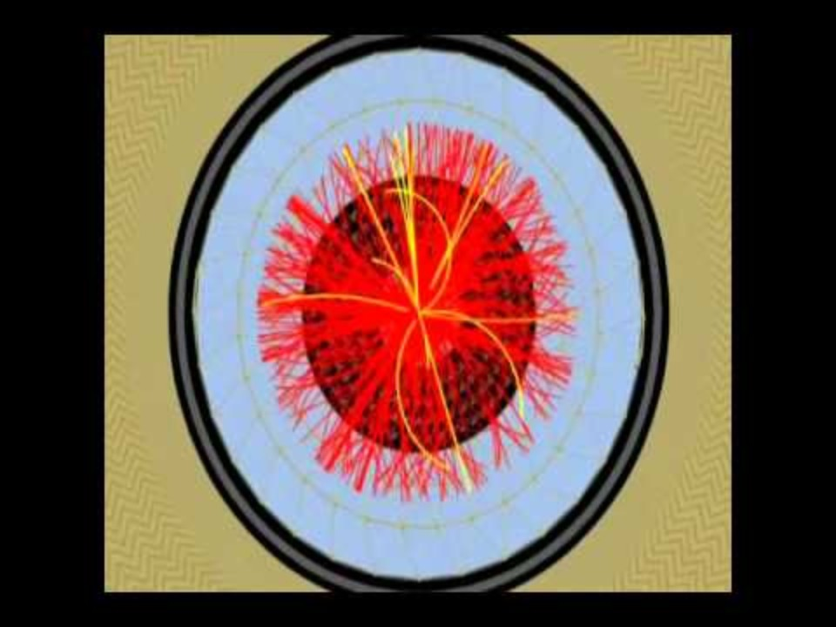
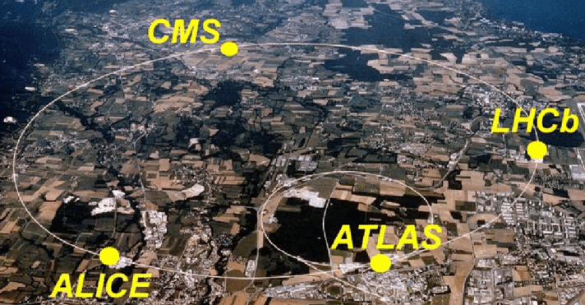
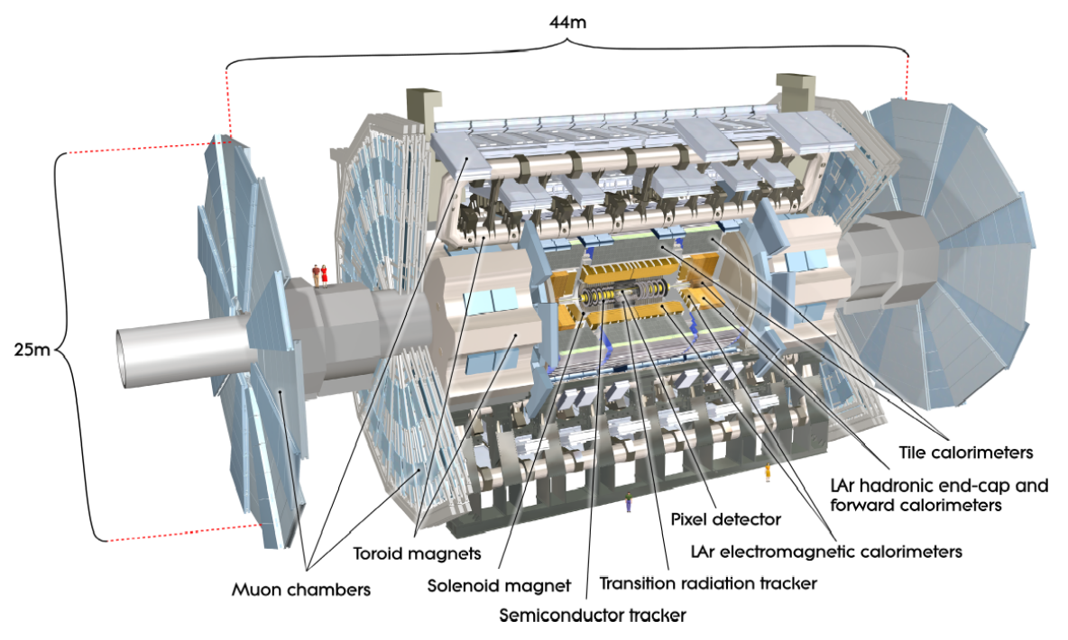
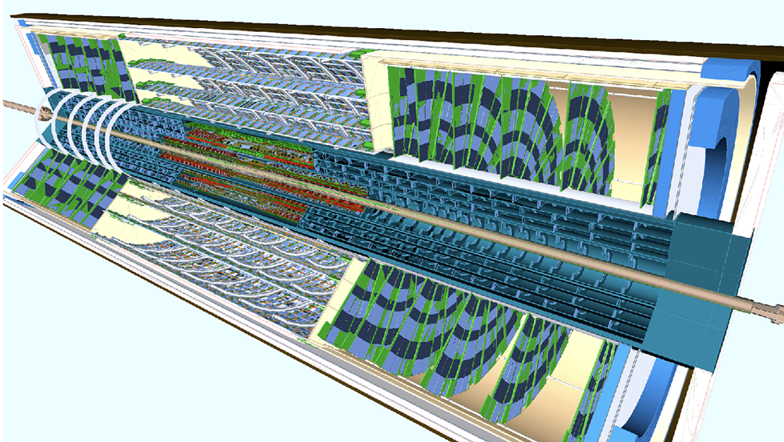
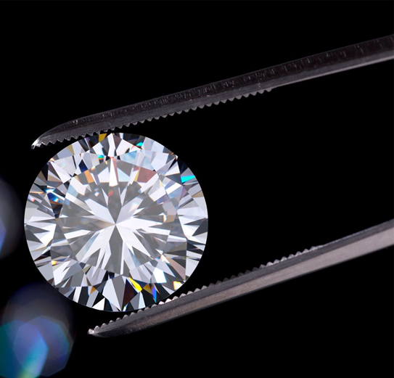
Introduction and Problem Statement
  CERN operates in extreme radiation environments.
  Silicon detectors are sensitive to humidity and condensation.
  Commercial humidity sensors fail under radiation.
  Fiber Optic Sensors (FOS) used as sensors.
  TiO₂-coated LPG sensors degrade due to coating and Ge/B co-doped fiber radiation damage.
  Proposed solution: nanocrystalline diamond-coated LPGs for radiation-hard humidity sensing.
(a)
(b)
(c)
(d)
Figure 1: (a) The Large Hadron Collider; (b) ATLAS detector; (c) Inner Tracker for ATLAS; (d) A beautifully cut diamond

Slide 3
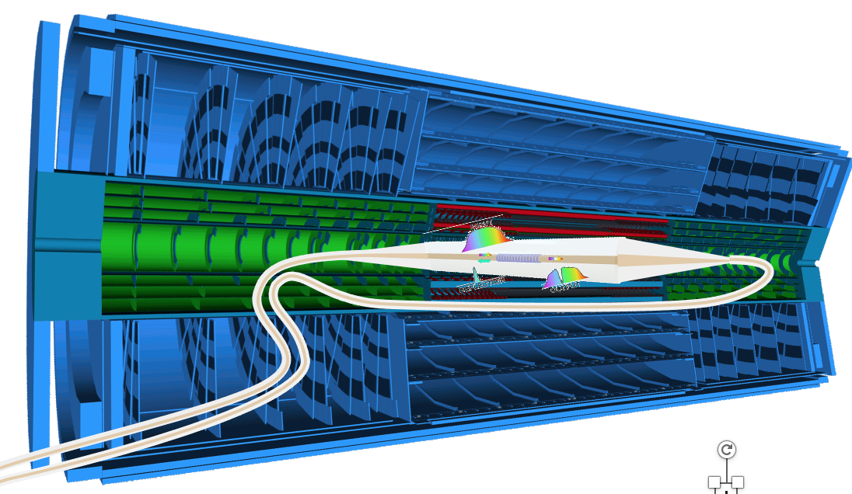
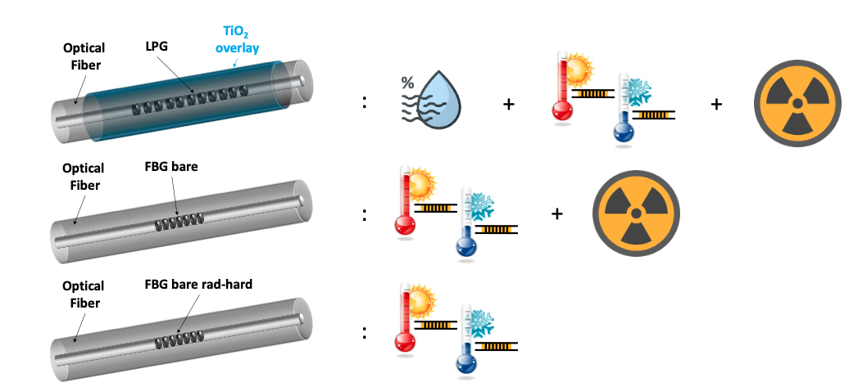
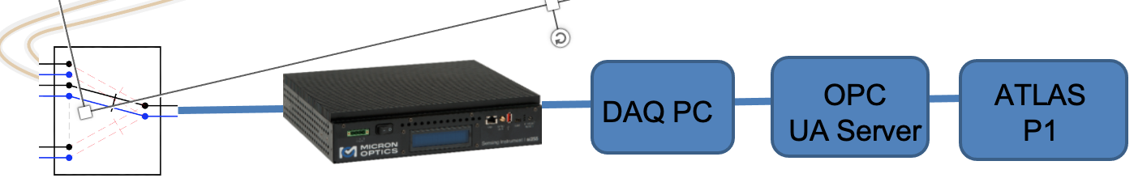
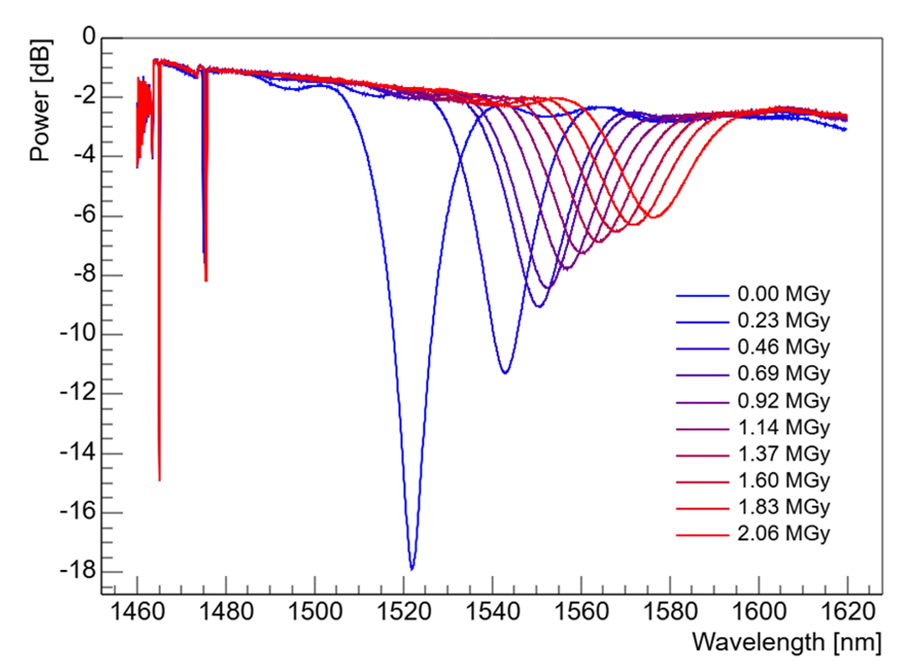
Current FOS Environmental Monitoring
(a)
(b)
(c)
  TiO₂ coated sensors.
  Results in light (signal) absorption – Radiation Induced Attenuation (RIA).
  Grating degradation – Wavelength shift.
Figure 2: (a) ATLAS ITk readout system; (b) Parameters each sensor is sensitive to; (c) Radiation effects on LPG coated with TiO2 (8-layer)

Slide 4
Research motivation and central problem
ATLAS ITk provides the extreme-environment driver; the question extends to other applications.
Environment
Observed concern
Knowledge gap
  Results in light (signal) absorption – Radiation Induced Attenuation (RIA).
  Changes in optical loss, resonance wavelength, grating strength and calibration stability.
How do fibre/grating construction and functional coatings change degradation, and can hardening be demonstrated?
Core research problem
Quantify radiation-induced changes in fibre-optic sensors, understand the material mechanisms and evaluate approaches that improve performance and reliability.

Slide 5
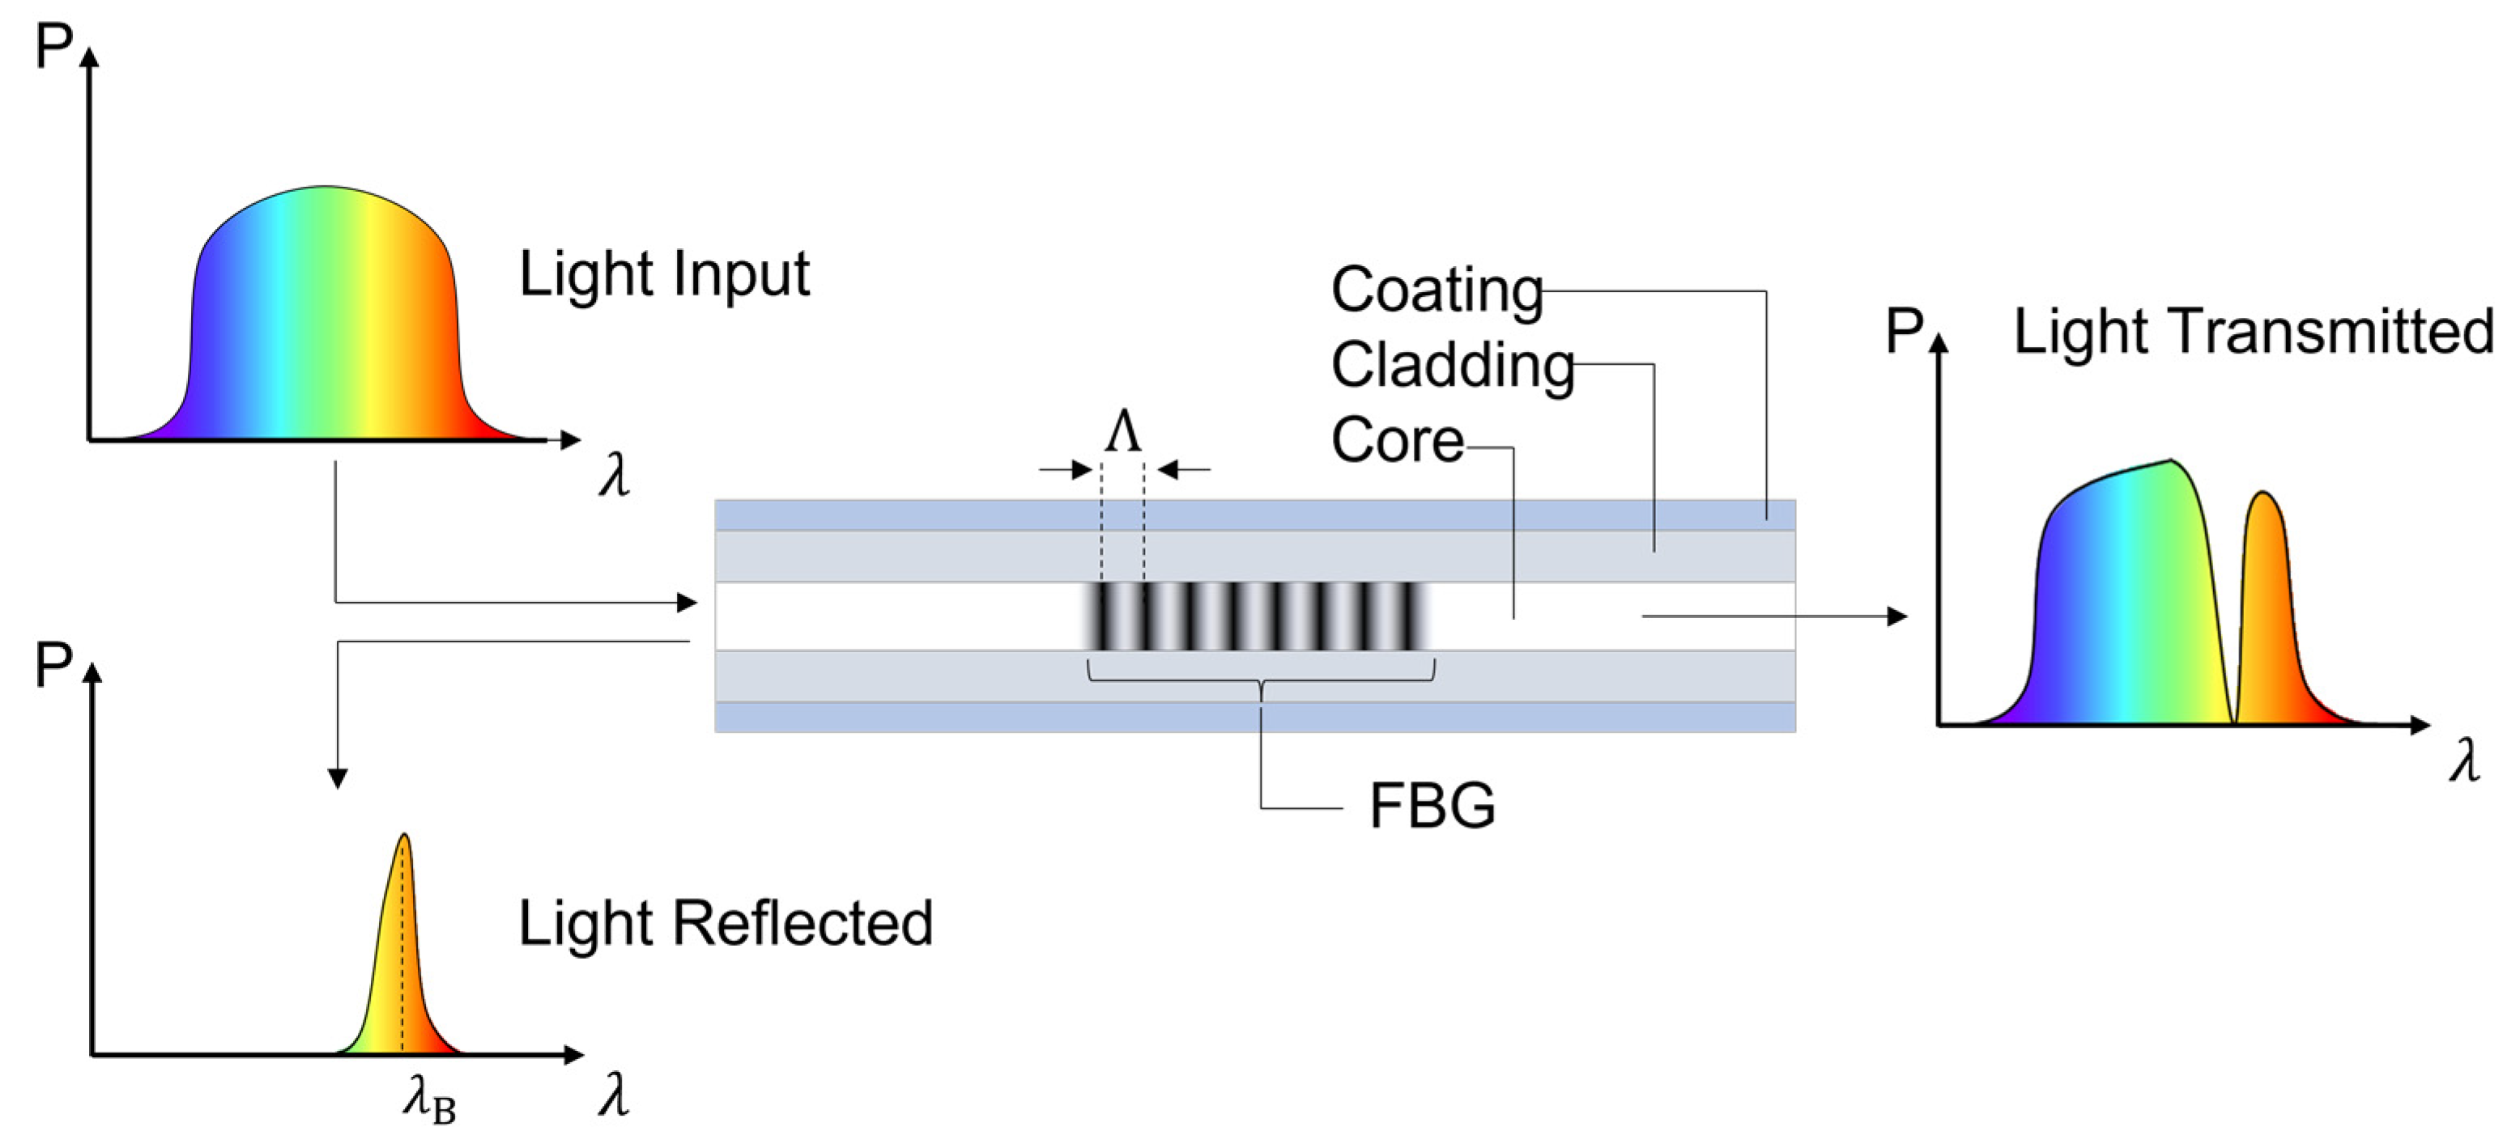
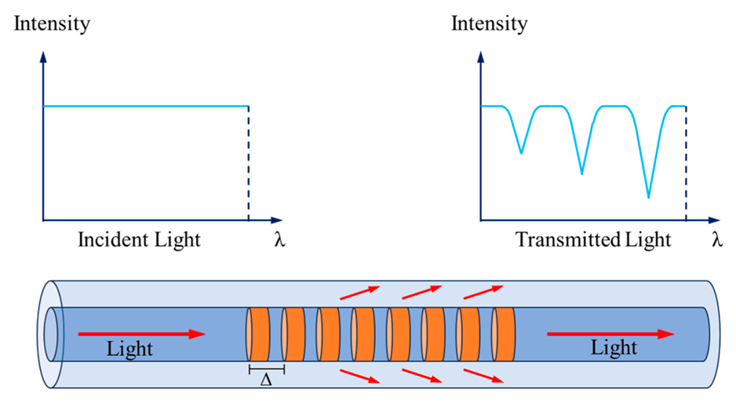
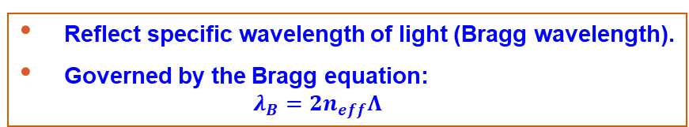
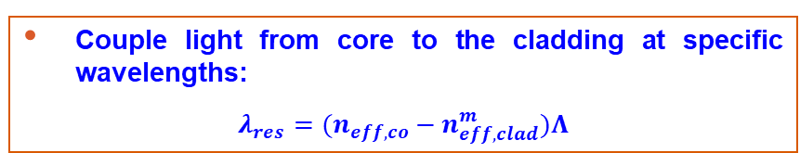
What are Fiber Optic Sensors?
  Uses change in light propagation to infer environmental parameters.
  Two types: Fiber Bragg Grating (FBG) and Long Period Grating (LPG).
FBG
LPG
  Reflect specific wavelength of light (Bragg wavelength).
  Governed by the Bragg equation:
    $$λ_{B}=2n_{eff}Λ$$
  Couple light from core to the cladding at specific wavelengths:
  $λ_{res}=(n_{eff,co}−n_{eff,clad}^{m})Λ$
Figure 3: Functioning principles of an FBG [1]
Figure 4: Functioning principles of an LPG [2]
[1] Falcetelli, A. Martini, R. Di Sante, and M. Troncossi, “Strain Modal Testing with Fiber Bragg Gratings for Automotive Applications,” Sensors, vol. 22, no. 3. 2022, doi:10.3390/s22030946.
[2] Zhuo, Y.; Ma, P.; Jiao, P.; Yuan, X. Application of Long-Period Fiber Grating Sensors in Structural Health Monitoring: A Review. CivilEng 2024, 5,559-575.https://doi.org/10.3390/civileng5030030

Slide 6
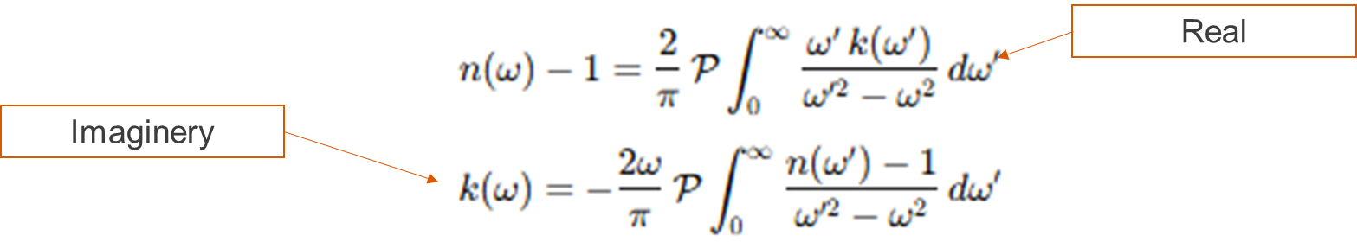
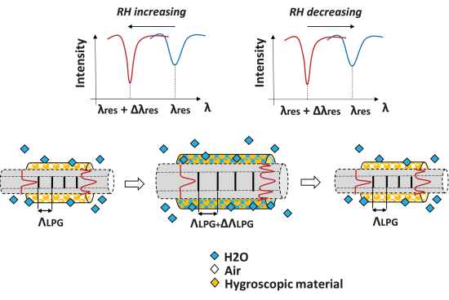
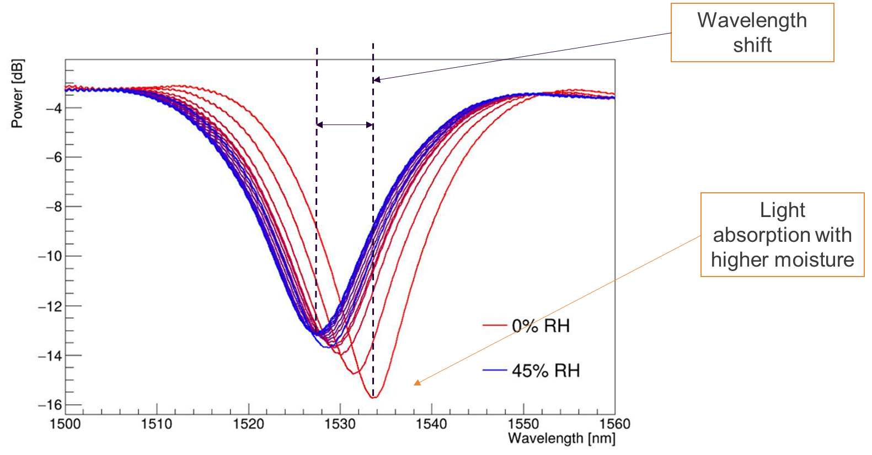
Humidity sensing in LPGs
    LPGs are not inherently sensitive to humidity – use coatings.
    Numerous coatings of various materials used:
      TiO₂-ZnO, Al2O3/GO, agarose gel, GO , PVA, Polymers [3-4] etc.
      Sensitive in relative humidity regimes above 10%.
    Kramers-Kronig formula that relates the light absorption in a fiber to its refractive index change and vice-versa.
    Moisture absorption in the coating leads to a change in refractive index (Relation implies linked change in absorption).
    Similarly, radiation-induced absorption in the fiber implies a corresponding change in refractive index.
Figure 5: Humidity sensing on an LPG with coating [4]
Figure 6: Shift in LPG spectra with humidity on a TiO2 coated sensor
[3] T. Venugopalan, T. L. Yeo, T. Sun and K. T. V. Grattan, "LPG-Based PVA Coated Sensor for Relative Humidity Measurement," in IEEE Sensors Journal, vol. 8, no. 7, pp. 1093-1098, July 2008, doi:10.1109/JSEN.2008.926524
[4] D. Lo Presti, C. Massaroni and E. Schena, "Optical Fiber Gratings for Humidity Measurements: A Review," in IEEE Sensors Journal, vol. 18, no. 22, pp. 9065-9074, 15 Nov.15, 2018, doi:10.1109/JSEN.2018.2870585

Slide 7
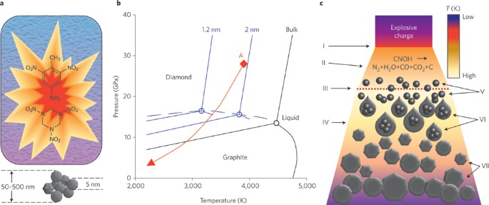
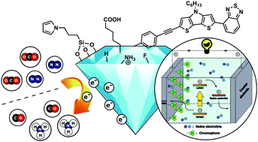
Nanocrystalline Diamonds
    Diamond particles that are as small as 2-5 nm (ultra-NCD).
    Produced by detonation or Chemical vapor deposition (CVD).
    Diamond is naturally hydrophobic – it does not absorb moisture.
    However, the surface can be tailored to different purposes.
Types of surface chemistry
    Hydrogen-Terminated Diamond (C-H)
        Dangling C bonds saturated with H atoms.
        Hydrophobic: No “hooks” for H20, low surface energy and electrically neutral molecules.
        Acts similar to oil as a results.
    Oxygen-Terminated Diamond (C-O, C=O, C-OH)
        Introduces Ethers (C-O-C), Ketones (C=O), Carboxyls (-COOH) and Hydroxyls (-OH).
        Hydrophilic: Highly electronegative oxygen that can bond to H20.
Figure 7: Production of detonated nanodiamond [5]
Figure 7: Diamond surface chemistry [6]
[5] Mochalin, V., Shenderova, O., Ho, D. et al. The properties and applications of nanodiamonds. Nature Nanotech 7, 11–23 (2012). https://doi.org/10.1038/nnano.2011.209
[6] Raymakers, J., Haenen, K., & Maes, W. (2019). Diamond surface functionalization: From gemstone to photoelectrochemical applications. Journal of Materials Chemistry C, 7(33), 10117–10141. https://doi.org/10.1039/C9TC02856A

Slide 8
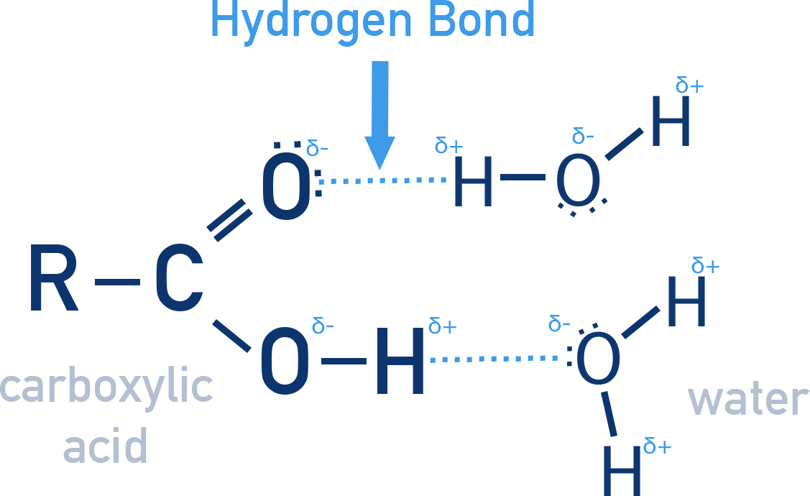
Solution: Oxygen-terminated Diamond but How?
    Hydrophilic surface.
    Water molecules interact with hydroxyl and carboxyl groups via hydrogen bonding.
    These functional groups act as primary moisture absorption sites [7].
    Hydrogen bonding mechanism for water adsorption has been demonstrated in previous studies [8–10].
    Additional uptake mechanism occurs via capillary condensation [11].
    Water vapor condenses in nanopores at grain boundaries between particles [12].
    After hydrogen-bonding sites are filled, water accumulates in these pores.
    Forms an aqueous film, replacing air (n = 1.0) with water (n = 1.33).
    Modifies the local refractive index and optical response.
Figure 8: Carboxylic acid hydrogen bonded to water [16]
Figure 9: Schematic showing capillary condensation on a LPG nanodiamond coating
[7] Butler et al., Oxygen Adsorption on the (110)-Oriented Diamond Surface
[8] Girard et al., Radiation Effects on Silica-Based Optical Fibers, IEEE TNS, 2013
[9] Piña-Salazar et al., Hygroscopic Nature of Nanodiamonds, JCIS, 2019
[10] Struck & D’Evelyn, Interaction of Hydrogen and Water with Diamond (100), JVST A, 1993
[11] Girard et al., Radiation-Induced Point Defects in Silica-Based Optical Fibers, Rev. Phys., 2019
[12] Aprà et al., Interaction of Nanodiamonds with Water, Nanomaterials, 2021
Notes:
Don’t need references so much
In detonated nanodiamond (DND), an additional moisture uptake mechanism occurs [17].
Capillary condensation leads to water vapor condensing into liquid within nanoscopic pores of aggregated structures [23].
Nanopores form at grain boundaries and between DND particles.
Once primary hydrogen-bonding sites are saturated, additional water accumulates in these pores.
This forms a thin aqueous film within the structure.The local refractive index changes from air (n = 1.0) to water (n = 1.33).
Air-filled gaps are progressively replaced by water, altering optical properties.

Slide 9
Aim, Objectives, Research Questions
Aim
    To investigate radiation effects in fibre-optic sensors and evaluate material, grating and coating strategies for radiation hardening.
1. Radiation response
2. Harsh-environment stability
Compare TiO₂ LPGs, RadSoft and RadHard FBGs before/after exposure.
Measure temperature, strain, humidity and longer-term spectral stability.
3. Functional hardening
4. Damage mechanism
Prototype diamond coatings and test against matched uncoated controls.
Correlate spectral response with Raman, SEM and synchrotron evidence.

Slide 10
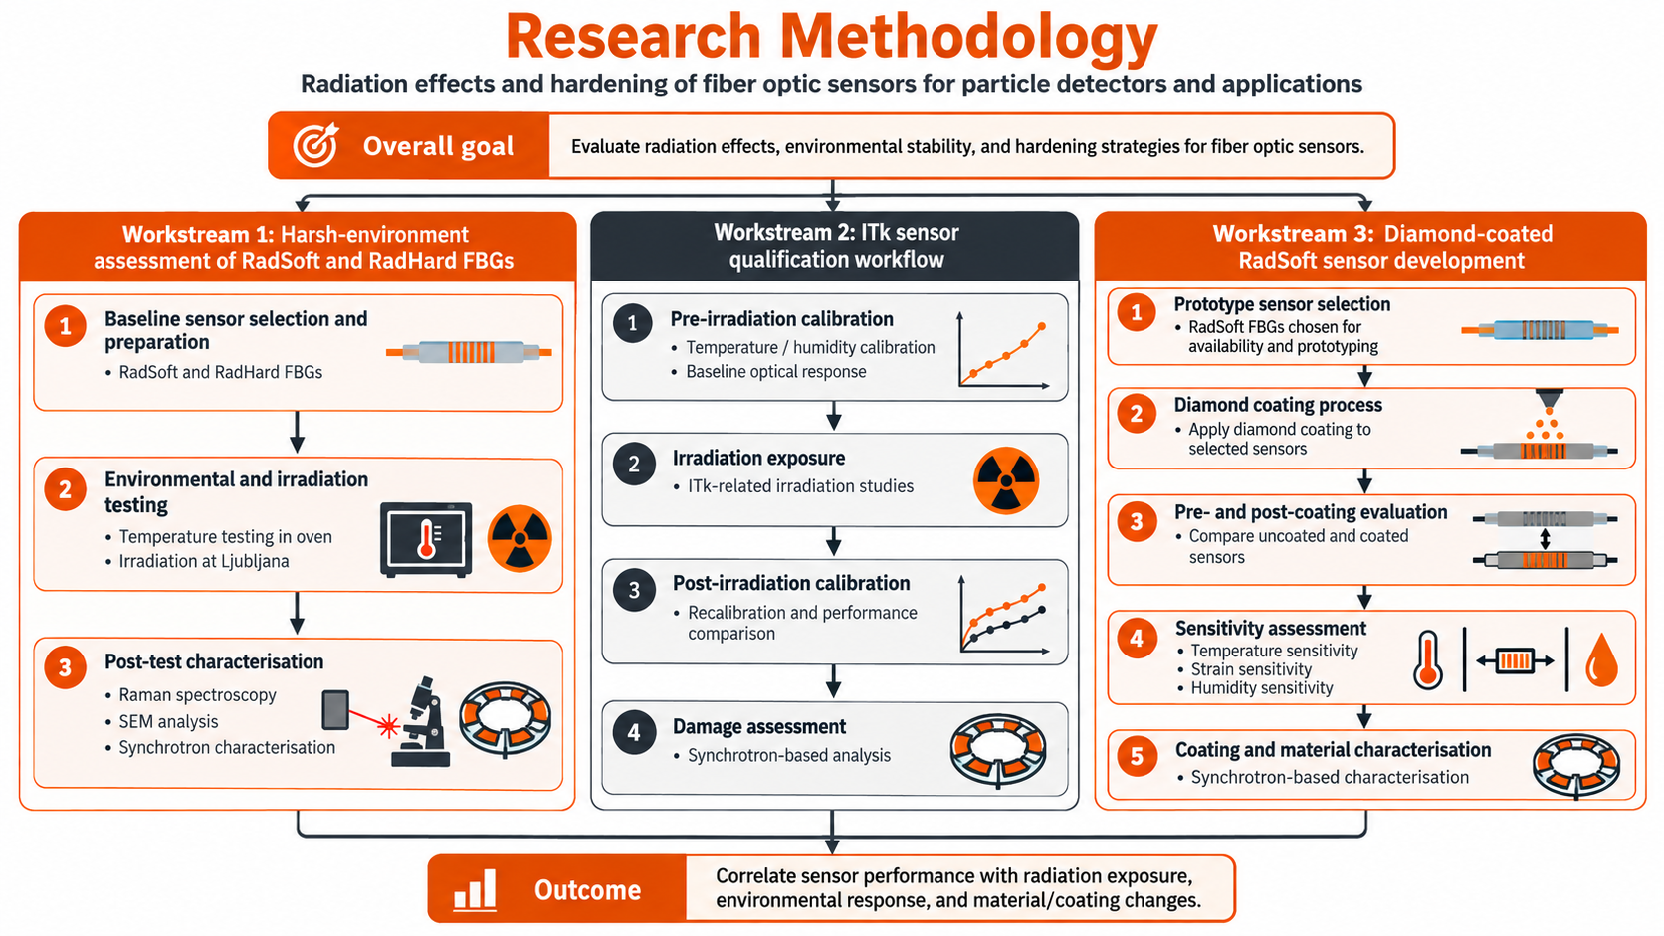
Research Methodology

Slide 11
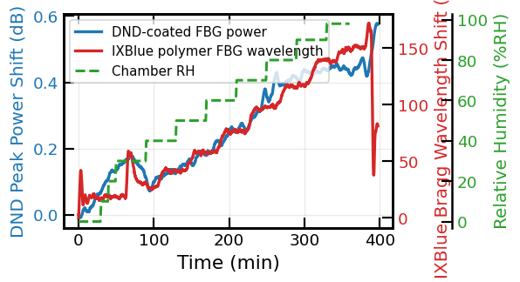
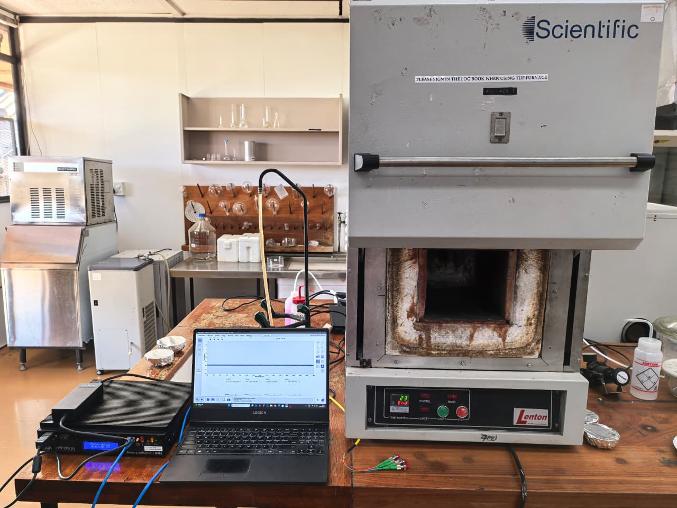
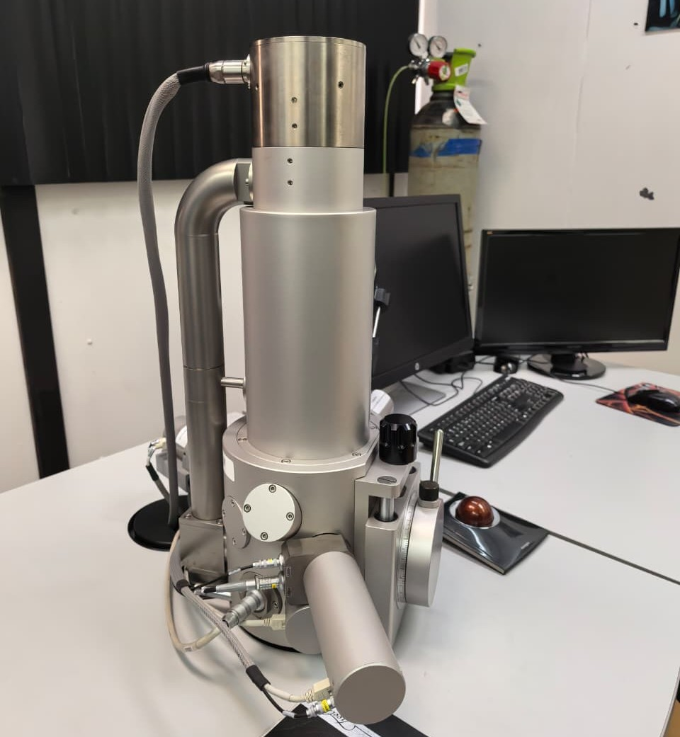
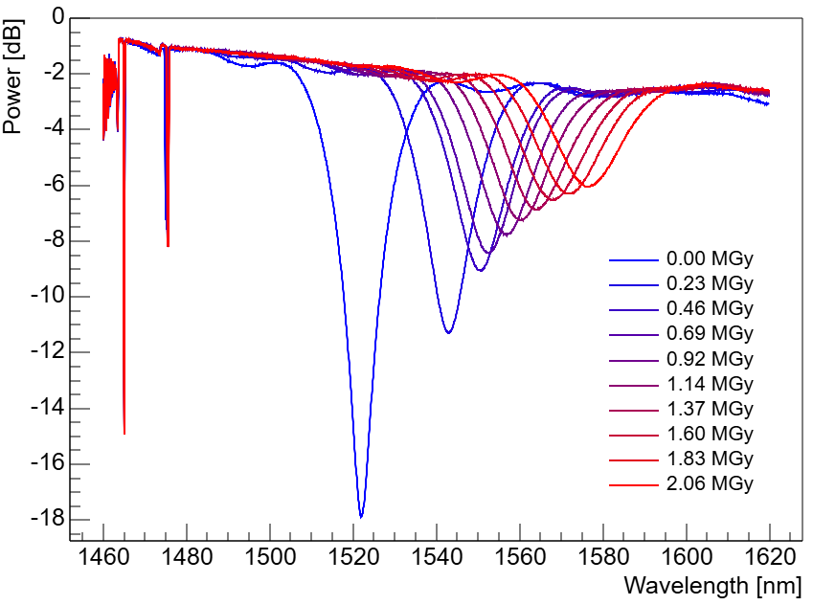
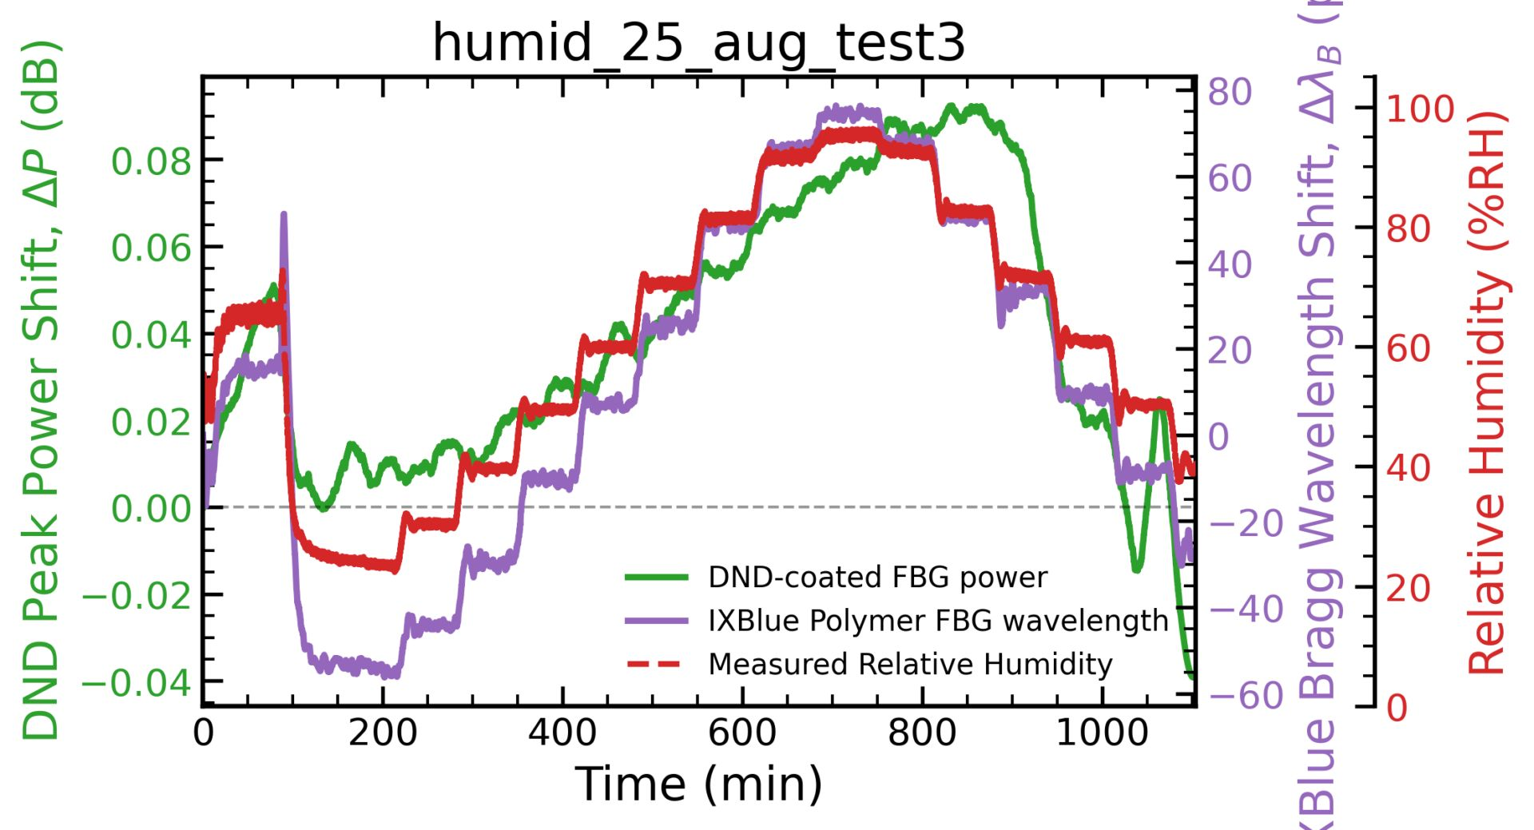
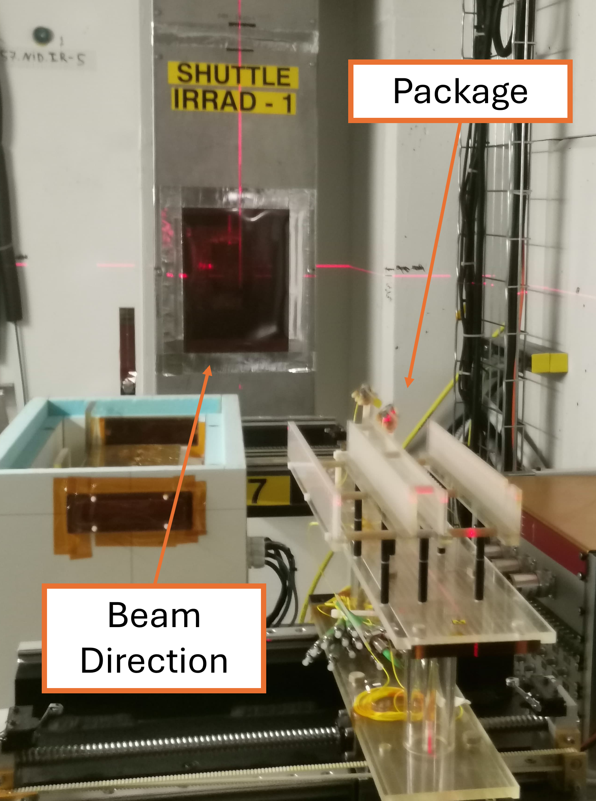
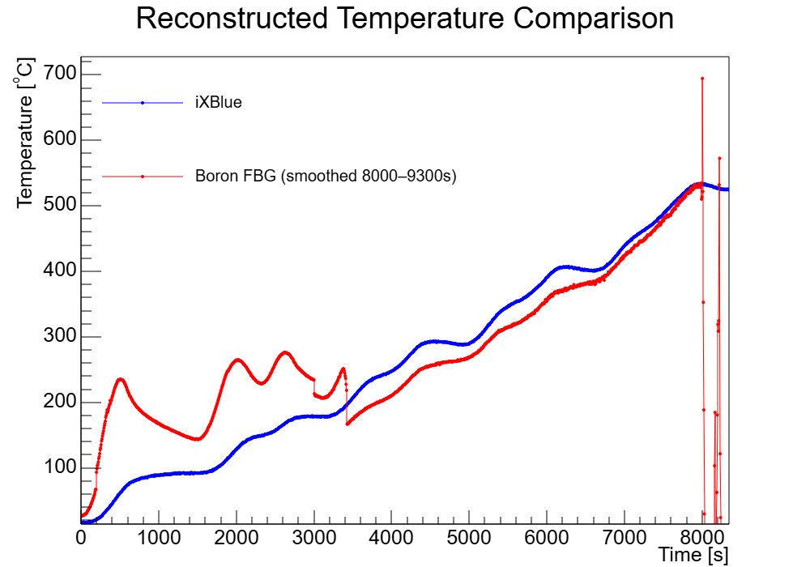
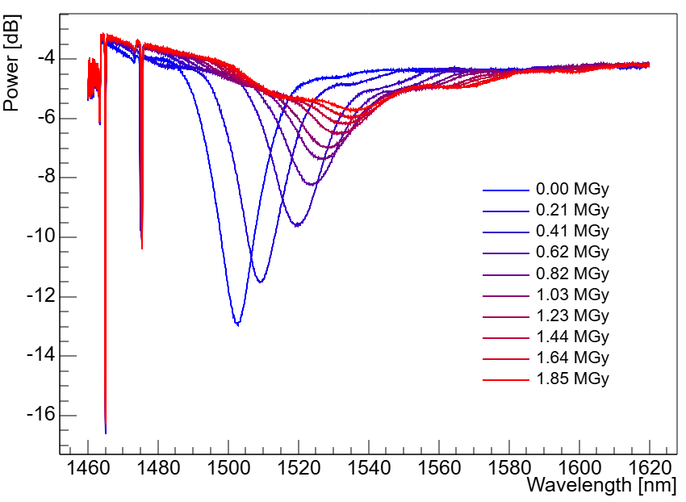
Overview of progress
Workstream 1
Workstream 2
Workstream 3
    Manufactured radsoft FBGs
    Tested temperature extrema
    Characterised using SEM and Raman
    Irradiated radhard at CERN
    Irradiated TiO2 fibre in two campaigns
    Investigated effect of TiO2 coating thickness on humidity
    Also assessed radhard and radsoft fibre sensitivity to proton radiation
    Coated radsoft fibre (proof of concept)
    Demonstrated humidity sensitivity

Slide 12
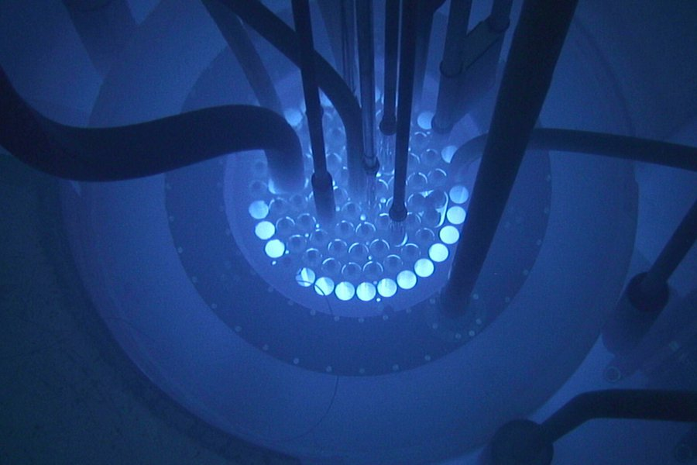
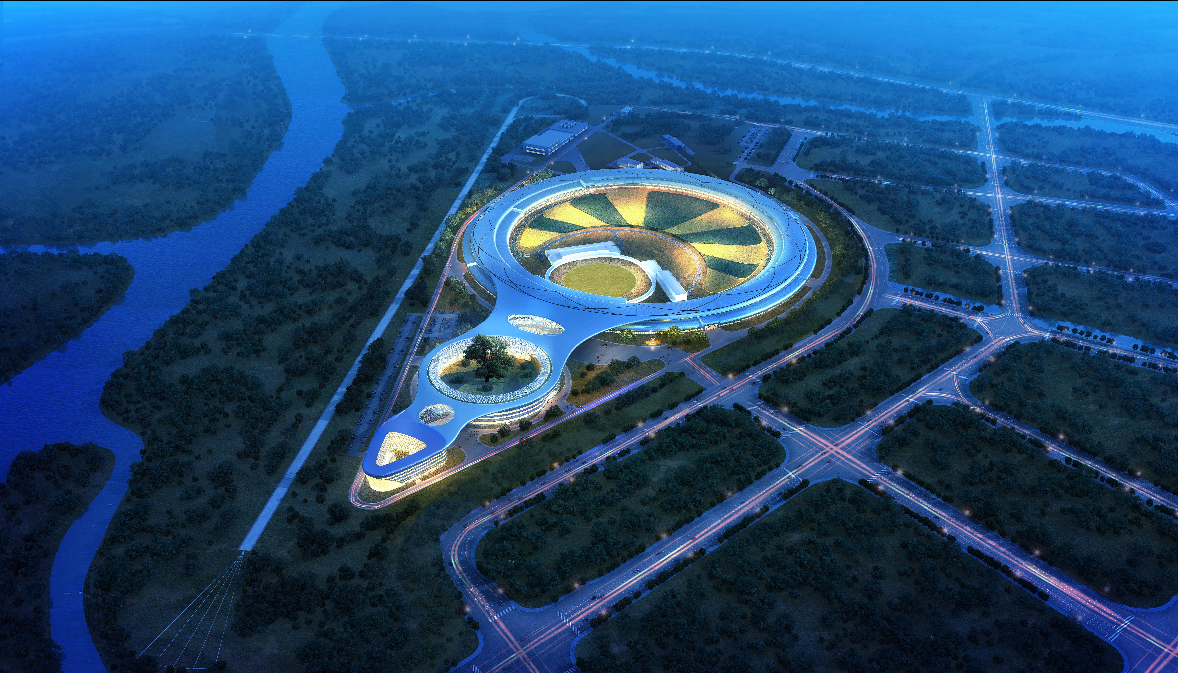
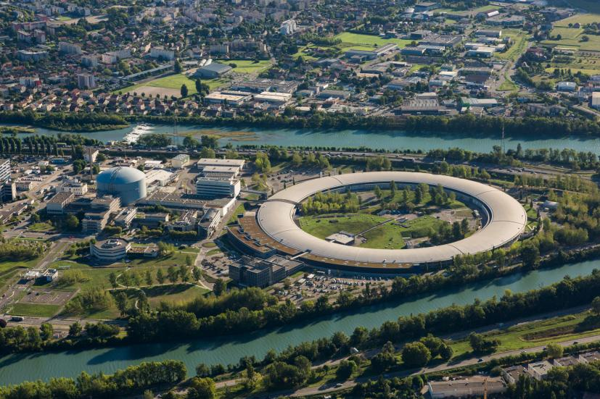
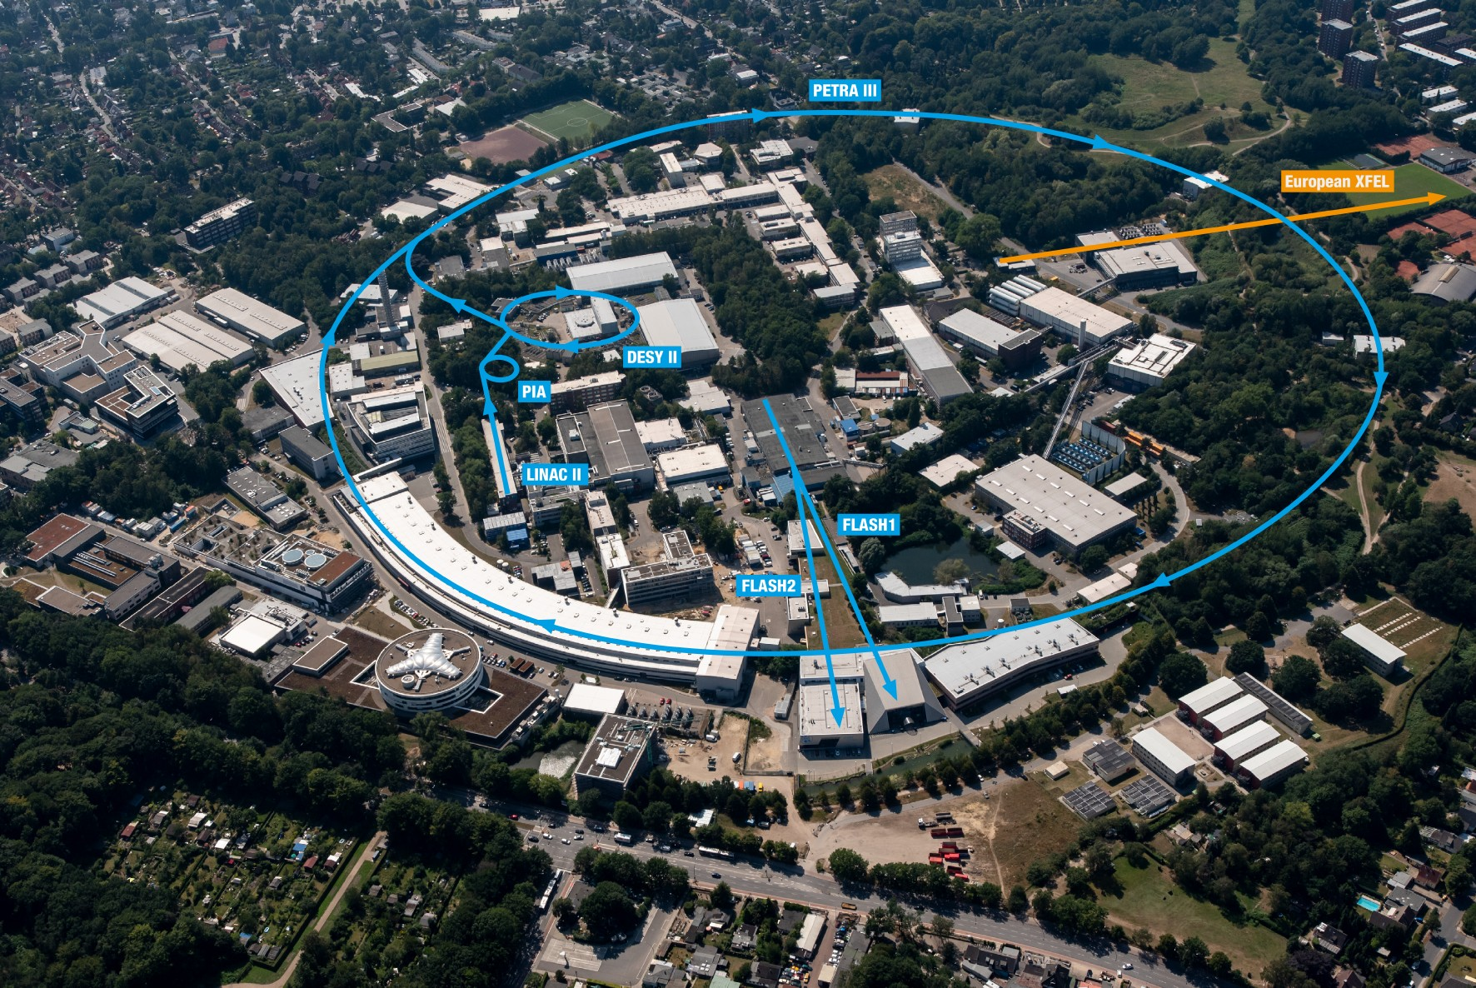
Next experiments and why they matter
Ljubljana reactor and HEPS Synchrotron
ESRF/DESY to study radiation damage
Neutron exposure at Ljubljana nuclear reactor of RadSoft/RadHard and coated/uncoated controls; quantify post-irradiation optical response.
Approved beamtime at ESRF and DESY: investigate relevant structural and chemical changes in irradiated fibre.
Redo TiO2 coating on radhard fibre
Coating R&D
Model / comparison
Surface treat fibre and redo experiments. Characterise coating and radiation effects at synchrotron. Repeat on radhard fibre and using LPG
GEANT4 radiation energy deposition may support analysis; optical predictions require additional validation. (Mostly done)

Slide 13
Conferences and Workshops attended
Conferences
    South African Institute of Physics, July 2026 (Cape Town, South Africa)
    GEANT4 Study on Suitability of Diamond-Coated LPG Sensors
    Effect of Coating Thickness on Proton Radiation Sensitivity for Titanium-Oxide Coated Novel Fiber Optic Sensors
    Radiation-Resistant Temperature Monitoring in High-Energy Physics Environments
    Characterisation of Temperature-Sensitive FBG Sensors for Extreme Environments
    5th International Conference on Information Systems and Emerging Technologies (ICISET 2026) (September)
    A Systematic Review of Machine Learning Based Wind Turbine Condition Monitoring Methods
    WindAc Africa 2026, October 2026 (Cape Town, South Africa)
    Fiber Bragg Grating Sensors for Continuous Condition Monitoring of Wind Turbine Drivetrain Components
    International Conference "Synchrotron Radiation: Science, Knowledge, Innovations, Future" (SKIF), October 2026 (Novosibirisk, Russia)
    Synchrotron-Based Characterisation of Radiation-Induced Structural Modifications in Fibre Bragg Grating Sensors for Extreme Environment
Workshops
    BRICS-STAR School, September 2026 (Beijing, China)
    Inner Tracker Week, August 2026 (Fukuoka, Japan)
    ATLAS Week, October 2026 (Geneva, Switzerland)

Slide 14

Thank You

