Slide 1

Optimising PET Detector Performance for Diamond Sorting in MinPET
By: Mwalimo Mandisa Maila
Student Number: 221088499
Supervisor: Professor S. Connell
Co-supervisors: Mr T. Mpai
Mr T. Brooks
10 October 2025

Slide 2
Contents
Introduction
Research Problem, Aim and Objectives
Literature Findings
Methodology
Results
Conclusion and Recommendations

Slide 3
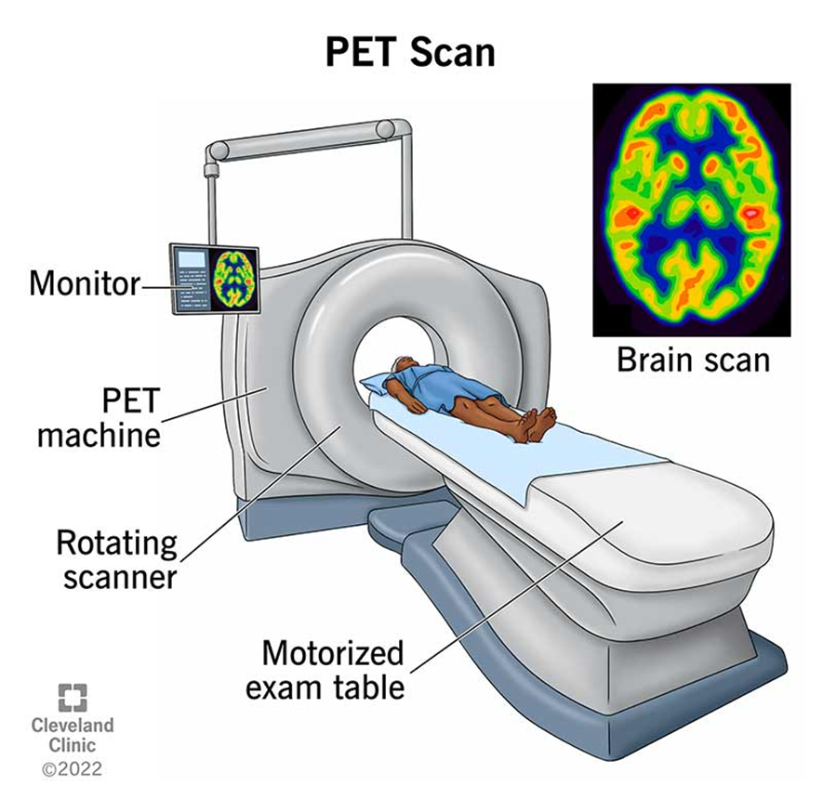
Introduction
Positron Emission Tomography (PET) is a medical imaging technique used to visualise functional processes in the body by detecting gamma photons from positron annihilation.
PET scanners are commonly used in oncology, cardiology, and neurology to trace metabolic activity.
Figure 1: Medical PET Scan [1].

Slide 4
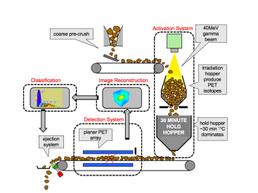
Introduction
MinPET adapts this technique for the mining industry by detecting positron-emitting isotopes formed in diamond-bearing kimberlite.
Unlike traditional methods, MinPET does not require crushing the ore, making it more energy-efficient and less destructive to diamonds.
Figure 2: MinPET Process Schematic [2].

Slide 5
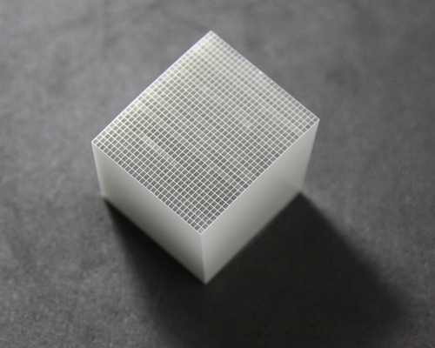
Research Problem
PET relies on accurate spatial localisation of photon interactions in detector pixels.
Signal leakage between adjacent scintillator pixels can lead to spatial mispositioning.
Leakage is influenced by photon incident angle, particularly in segmented geometries.
Figure 3: Scintillator Crystal Array [3].

Slide 6
Research Aim and Objectives
Aim: To investigate signal leakage in scintillator pixels under varying angular offset.
Objectives:
Simulate gamma photon interactions in PET-like pixel geometry using Geant4.
Vary detector pixel angles (10°, 20°, 30°) and observe energy deposition.
Visualise using ROOT and compare leakage patterns across configurations.
Recommend how the issue can be mitigated in the MinPET system.

Slide 7
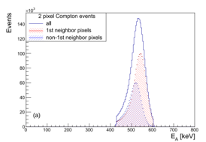
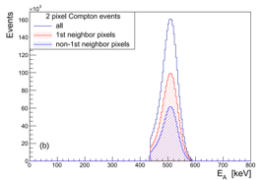
Literature Review and Findings
Signal leakage arises from Compton scattering and electronic cross-talk in segmented PET arrays.
Optical cross-talk in crystal arrays and ASIC/PCB components can also degrade signal isolation.
Prior studies emphasise the need for angular and spatial optimisation in detector design.
(a)
(b)
Figure 4: Observed Energy of 511 keV Gamma Ray [4].
Notes:
The literature identifies several sources of signal leakage in PET systems. Firstly, geometric collimation helps restrict photon entry angles, but it does not fully prevent leakage due to internal scattering. A key contributor is Compton scattering, where a photon deposits energy across multiple pixels, especially when entering at an angle. There’s also optical and electronic cross-talk, which can occur within the scintillator crystal matrix or at the electronics level — particularly in systems using SiPMs and ASICs.
uncorrected light sharing between adjacent pixels distorts energy reconstruction in Compton events — causing a shift above the 511 keV photopeak. After applying a correction algorithm, this distortion is resolved, aligning multi-pixel events back to the true energy value. This highlights the importance of correcting optical signal leakage for accurate event identification in PET detectors.

Slide 8
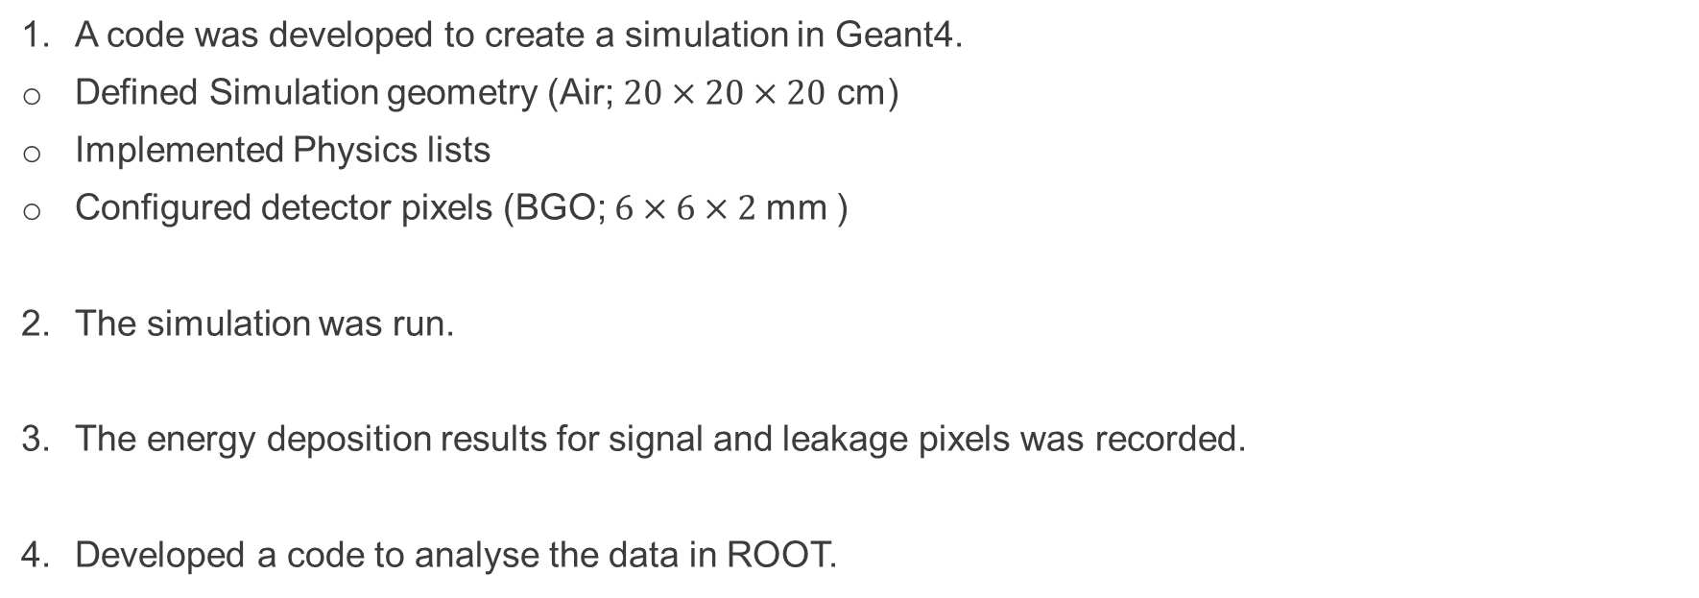
Methodology
A code was developed to create a simulation in Geant4.
Defined Simulation geometry (Air; $20×20×20$ cm)
Implemented Physics lists
Configured detector pixels (BGO; $6×6×2$mm )
The simulation was run.
The energy deposition results for signal and leakage pixels was recorded.
Developed a code to analyse the data in ROOT.

Slide 9
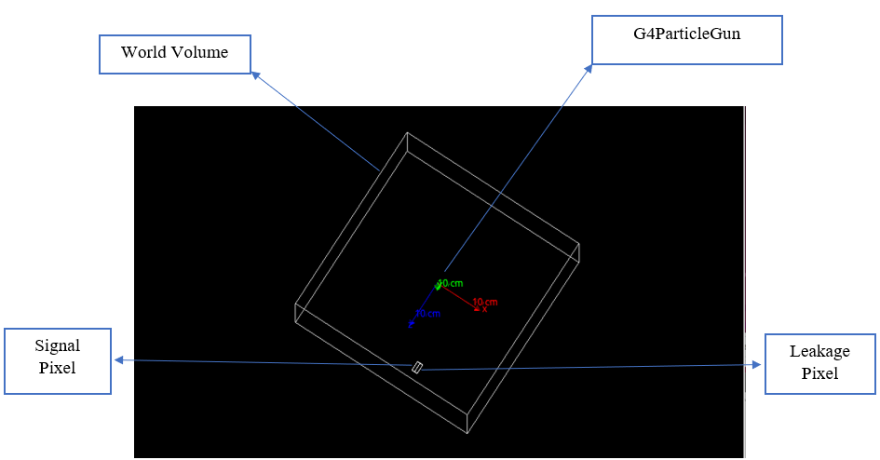

Slide 10
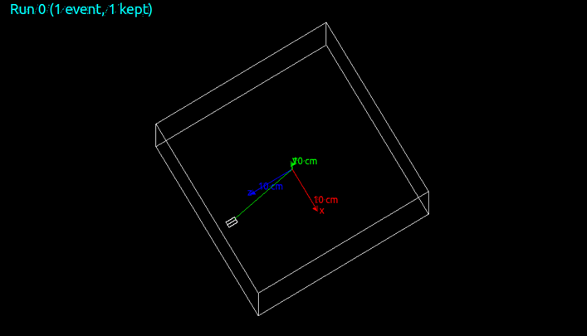
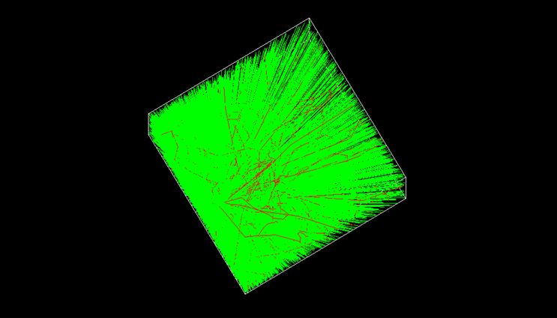


Results
Figure 5: Visual Results for 10° Offset.

Slide 11
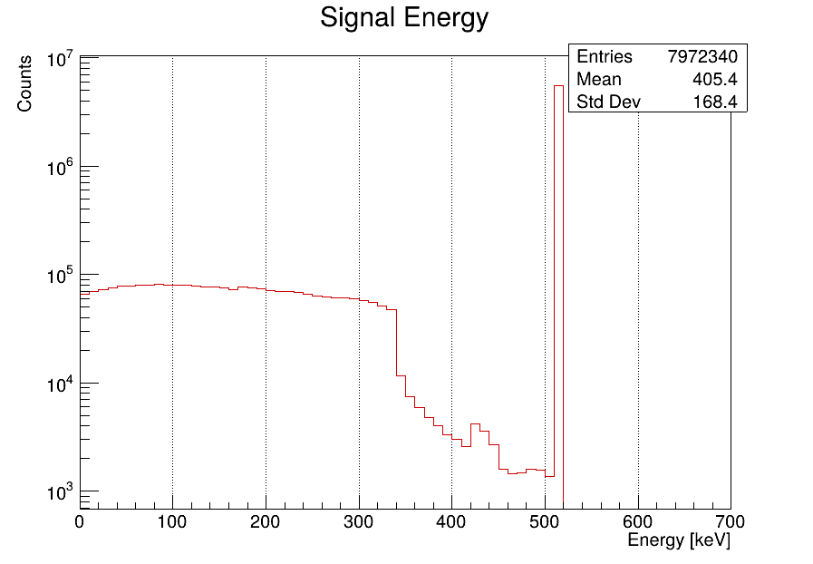
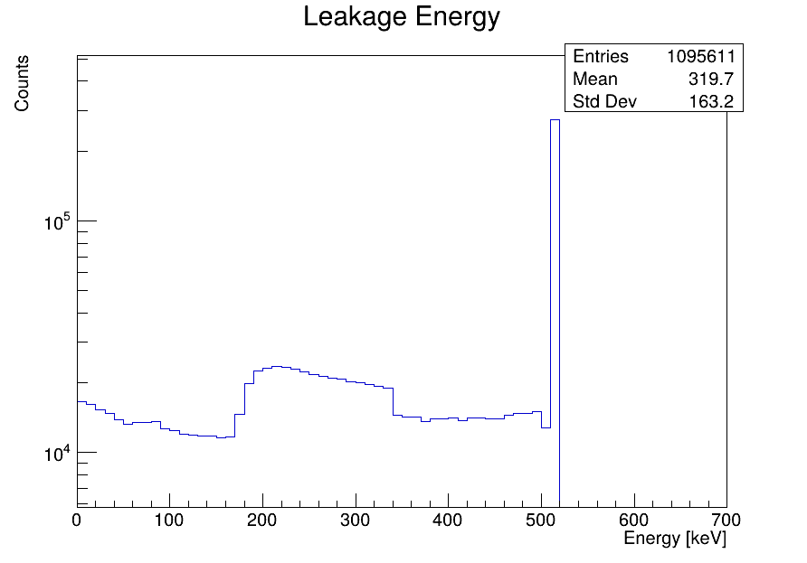
Results continued
Figure 6: Energy Deposition Results for 10° Offset.

Slide 12
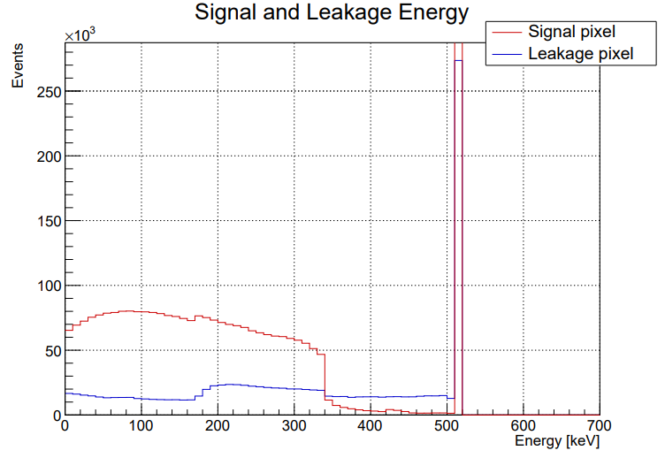
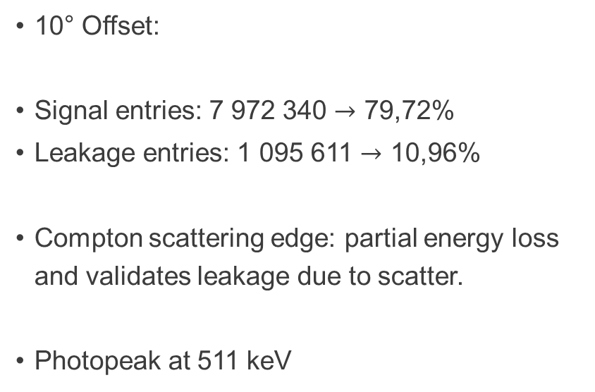
Results: 10° Offset
10° Offset:
Signal entries: 7 972 340 $→$ 79,72%
Leakage entries: 1 095 611 $→$ 10,96%
Compton scattering edge: partial energy loss and validates leakage due to scatter.
Photopeak at 511 keV
Figure 7: Energy Deposition Results for 10° Offset

Slide 13
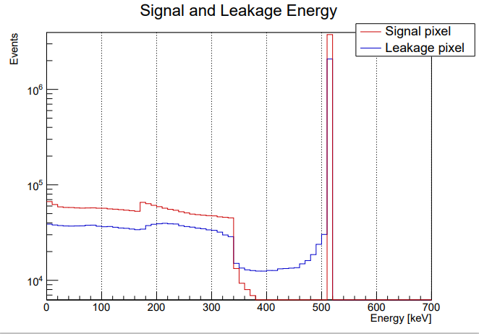
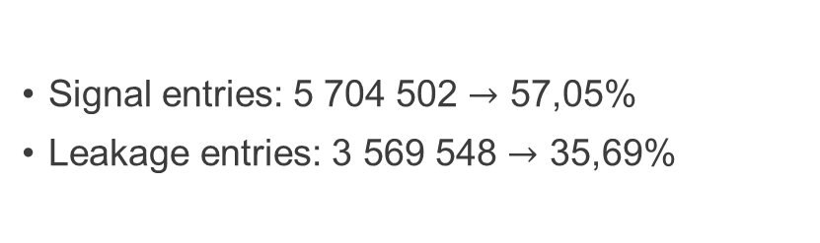
Results: 20° Offset
Signal entries: 5 704 502 $→$ 57,05%
Leakage entries: 3 569 548 $→$ 35,69%
Figure 8: Energy Deposition Results for 20° Offset

Slide 14
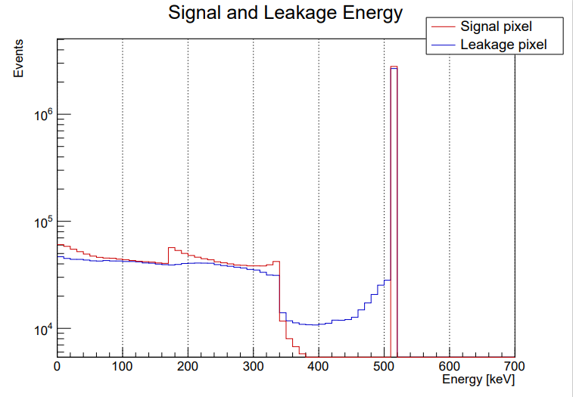
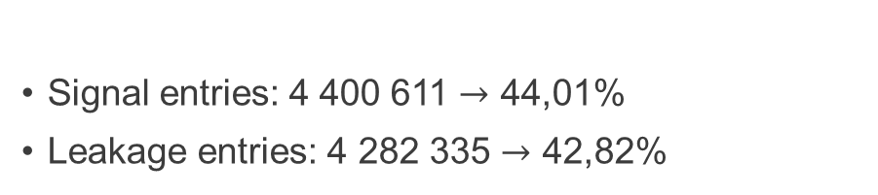
Results: 30° Offset
Signal entries: 4 400 611 $→$ 44,01%
Leakage entries: 4 282 335 $→$ 42,82%
Figure 9: Energy Deposition Results for 30° Offset

Slide 15
Conclusion and Recommendations
Signal leakages increases significantly with angular offset in segmented PET detectors.
•10°: Minimal leakage (~11%), 30°: Significant leakage (~43%).
Leakage linked to Compton scattering and energy spread.
RECOMMENDATIONS
Improve MinPET performance by:
Geometric collimation
Light-sharing correction algorithms

Slide 16
References
[1] https://my.clevelandclinic.org/health/diagnostics/10123-pet-scan
[2] T. Nemakhavhani et al., “The MinPET diamond discovery technique,” Proceedings of SAIP2017, pp. 355–360, 2017
[3] Shalom EO, “LYSO(Ce) Scintillator Arrays,” Shalom Electro-optics Technology Co., Ltd.
[4] M. Makek, D. Bosnar, and L. Pavelić, “Scintillator Pixel Detectors for Measurement of Compton Scattering,” Condens Matter, vol. 4, no. 1, p. 24, Feb. 2019, doi: 10.3390/condmat4010024.

Slide 17
THANK YOU.

