Slide 1
Radiation Damage of 4IR Sensors in Extreme Environments
A van der Merwe - 222021648
Prof Simon Connell
10 October 2025

Slide 2
Contents:
Introduction
Background
Problem
Literature
FBG/ Distributed sensing
Point defects
Experimental Program
Aim
Objectives
Plan
Facilities and equipment
Calibration and Data
Experimental Results
Data
Geant4 Simulation
Conclusion
Discussion
Recommendations

Slide 3
Introduction:
Background:
Great need for energy in the modern world, and the sustainable production and use thereof.
Nuclear energy is one of most sustainable methods, but is not without risk.
Nuclear core requires monitoring, of temperature, radiation flux, etc.
Monitoring done by sensors, such as silica based sensors:
Problem:
No such sensors exist that are currently radiation hard.
Cannot withstand these environments and require frequent replacement.
Aim:
Determine the radiation effects on the Silica glass and how the Fibre Optic sensor’s performance is affected in radiation environments.
Objectives:
Conduct literature, define the aim, research methodology, limitations, analyse results.
Intrinsically powered
Immune to electromagnetic interference
Unintrusive
Allows real-time monitoring

Slide 4

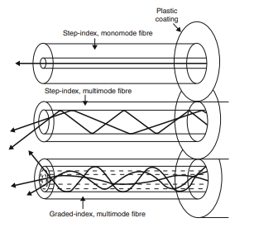
Literature:
Silica-Based Optical Fibres [1]:
3 Main Parts: Core, Cladding, Coating.
Core: Silica (Pure, or Doped)
Cladding ensures total internal reflection (light does not escape out of fibre).
Cladding + Coating provides mechanical strength.
Operation [2]:
2 Different modes:
Fig1: Single Mode Fibre Optic Cable [1].
Single Mode
Multimode
Longer distances
Higher data transmission (bandwidth)
Shorter distances
Lower data transmission
Fig 2: Single mode and Multimode Fibres [2].

Slide 5
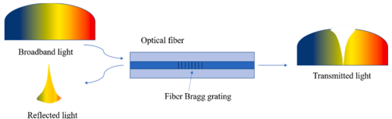
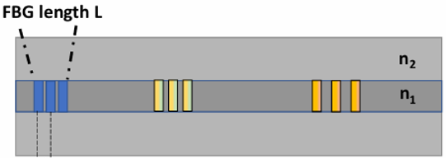
Literature:
2 Classes of sensors [3]:
Fibre Bragg Gratings (FBG)
Distributed Sensing
Gratings with a specific separation between them are inscribed in the fibre core.
The wavelengths of light that correspond to the separation of the gratings will be reflected, while the rest will be allowed to pass through.
When temperature increases, the material expands, and the separation in the gratings increase.
This means, new wavelengths of light will be reflected.
The change between the original and new wavelengths of light that is being reflected, can then be used to determine the total change in temperature in the reactor core.
Uses FBGs along the entire length of the fibre for sensing applications.
Fig 3: Fibre Bragg Grating Operation [3].

Slide 6
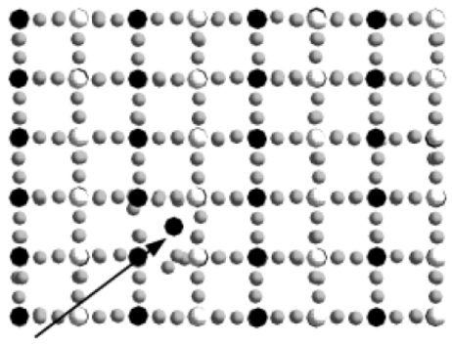
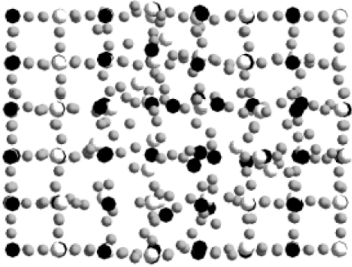
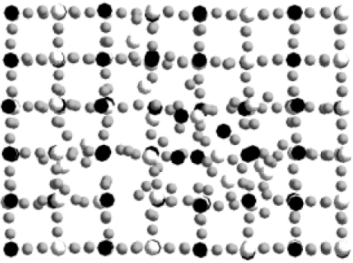
Literature:
Effects of Radiation on Silica:
Incident Particle
Cascading damage
Annealing
Fig 4: Nuclear Damage phases in Materials [4]

Slide 7
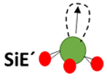

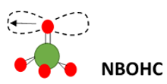
Literature:
Point Defects:
Causes [1]:
Radiation Induced Attenuation (RIA) (loss of signal)
Radiation Induced Emission (RIE) (creation of light)
Radiation Induced Refractive Index Change (RIRIC)
Densification (silica density increases)
These cause difficulty in taking accurate measurements.
Severity depends on total nuclear dose and time of exposure.
Point Defects [1]:
SiE’ (Dangling bonds)
NBOHC (Non-Bridging Oxygen Hole Centres)
3. POR (Peroxy Radicals)
Unpaired electron
Silica atom
Oxygen atom
Fig 5: SiE’ and NBOHC Defects [1].

Slide 8
Experimental Program: Plan
Pre-Irradiation Phase:
Calibration and testing of 3 Fibres (Femto, Fujikura, Telecom)
Exploration of Hyperion Luna si255 instrument capabilities
Development of C++/ Python code for the analysis (wavelengths, power, curve fitting)
Development of Geant4 Simulation
3 Phases
Irradiation Phase (SAFARI-1 Pelindaba):
Irradiation of fibres from 26 June to 27 June
Recording of spectral data
Development of Geant4 Simulation and SRIM Simulation.
Analysis Phase:
Removal and storage of fibres in radiation safe container
Analysis and comparison of data to Simulation data

Slide 9
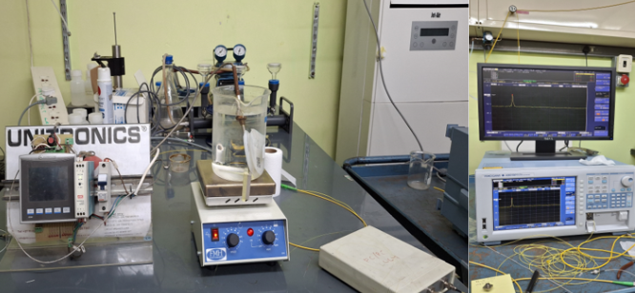
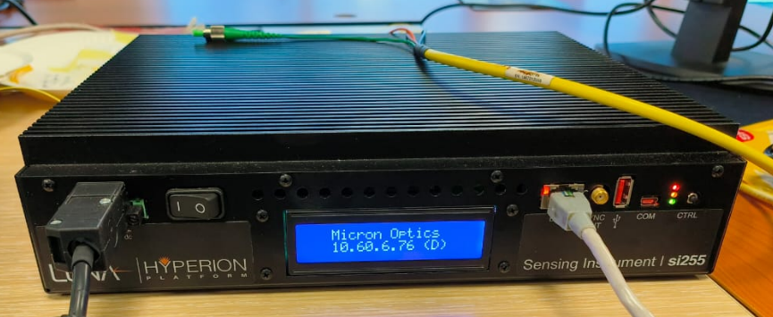
Experimental Program: Equipment and Calibration
Fig 6: Temperature Calibration (100 °C).
Fig 7: Hyperion Luna si255 Optical Interrogator.

Slide 10
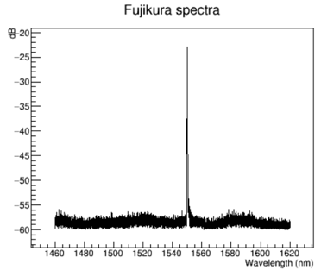
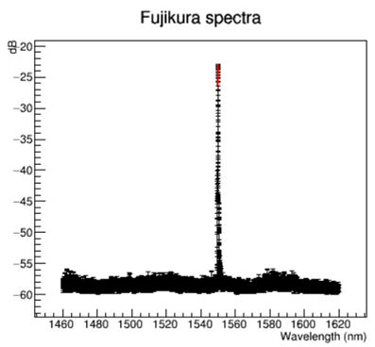
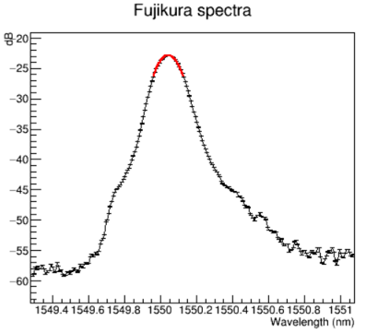
Experimental Program: Equipment and Calibration
Fig 8: Raw Fujikura Spectra for Development of analysis code.
Red fitted curve: Maximum peak power (dB), peak centre position wavelength (nm), Full Width at Half Maximum (nm)
Indicates shift in peak position, loss of signal strength, changes in the bandwidth (amount of data collected).

Slide 11
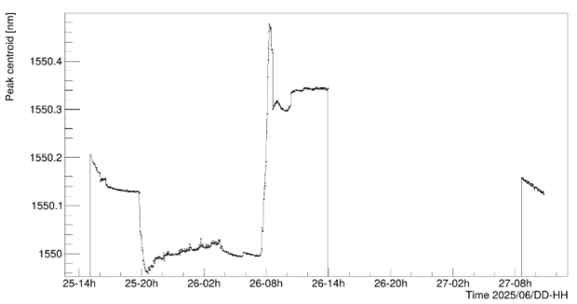
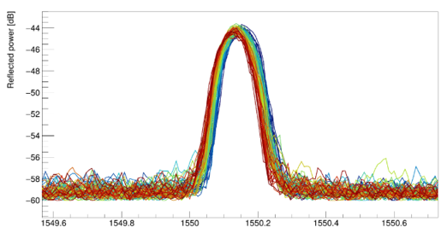
Experimental Results: Data
25 June – 14h00 Reactor startup (mostly gamma)
26 June – 08h00 Reactor at full power
26 June – 14h00 Fibres removed due to suspected presence of an artifact
Artifact was actually a rapidly decaying live peak (Telecom fibre).
27 June – 08h40 to 10:40 Data acquisition continued.
Fig 10: Spectral shift of 2 hour run on 27 June.
Fig 9: Peak centre position versus Time.
Linear fit was applied over data on 27th .
Peak centre shift: -13.44 pm/hour. Peak power decay: -0.13 dB/hour.
Figure 10 indicates the shift (from Blue to Red) in the light peak centroid (centre) over the 2 hours of operation on the 27th of June.

Slide 12
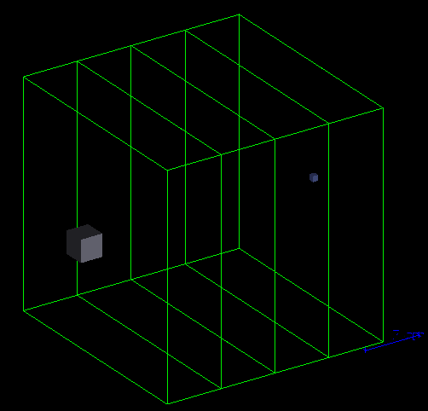
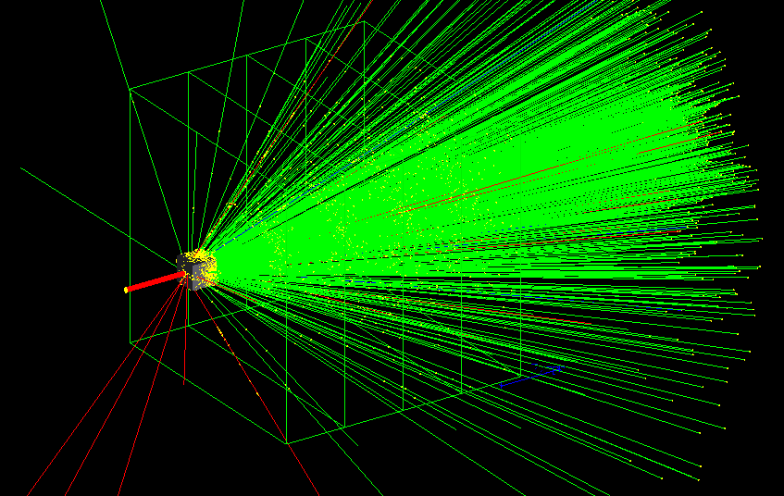
Experimental Results: Geant4 Simulation
Fig 11: Geant4 Simulation Environment.
Fig 12: Geant4 Simulation ran with 10 000 events.
(Just for visualisation – actual simulation was with 1000 000 events.)

Slide 13
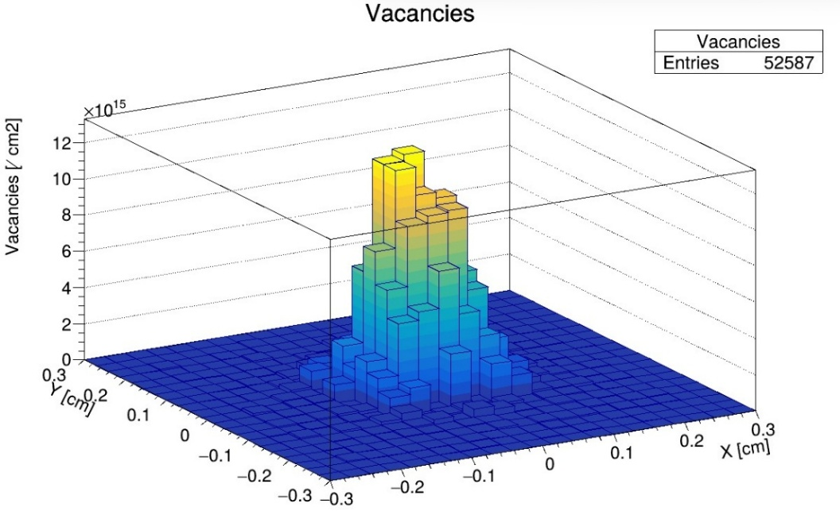
Experimental Results: Geant4 Simulation
For a simulation with 1000 000 events,
an average of 2.64 million vacancies were produced.
From the bar graph (Fig 13), it can also be seen that the highest concentration of vacancies were at the centre of the target.
Indicating most incident neutrons on the sides (at an angle) were mostly reflected.
Also indicates that neutrons entering from the front, (mostly perpendicular to the target) penetrated the silica and caused displacements/ recoils in the atoms.
Fig 13: Vacancy Distribution over the 0.6 by 0.6 cm Silica target.

Slide 14
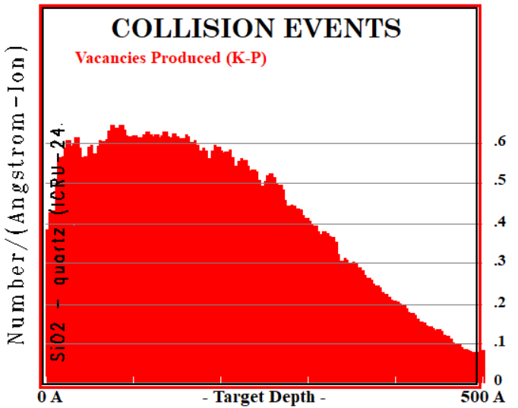
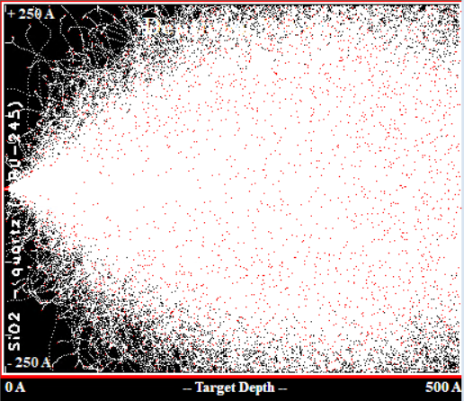
Experimental Results: SRIM (Stopping Range of Ions in Matter)
Fig 14: Penetration depth at 21.5 keV for Silica ions.
(30 000 events simulated)
Fig 15: Damage produced with 21.5 keV ions.
(243.1 Vacancies per ion)

Slide 15
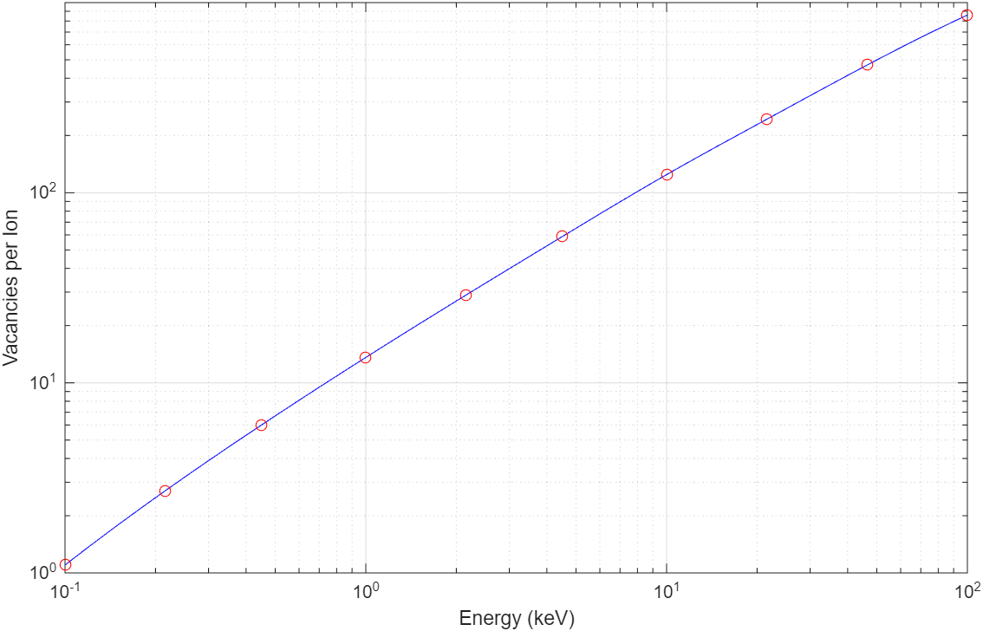
Experimental Results: SRIM
For increasing ion energy, more vacancies are produced.
Note: Scale is logarithmic.
Higher energy means it’s easier to displace an atom from its place in the structure (lattice site).
More energy also means the atom is displaced further, meaning, there’s a lower probability that it will return to its original position.
Like billiard balls (atoms/ions), that disperse or move from its original position, when struck with the cue ball (incident ion).
Fig 16: Vacancies produced versus incident ion energy.

Slide 16
Conclusion: Discussion
≂ -55 dB
Baseline Region
The lowest point, to where measurements can be taken with sufficient accuracy is projected to be -55 dB.
Beyond this, it enters the Baseline Region, which has too much noise and distortion of the signal to give reliable measurements.
After applying a linear fit to the data, with a slope of -0.13 dB/hour, it is projected that the fibre will last for 84.61 hours (3.5 days)

Slide 17
Conclusion:
This decay (shrinking) of the peak is due to the annealing of the Fibre Bragg Gratings due to elevated temperatures (is in the case of the Ordinary Telecom Fibre).
Decay is also due to the formation of point defects, which cause Radiation Induced Attenuation (RIA), meaning light is absorbed and the signal strength decreases.
More vacancies (displaced atoms) result in increased damage and formation of point defects.

Slide 18
Recommendations:
Fibres should be irradiated for longer periods to collect more data.
Longer irradiation periods, such as 3.5 days, will confirm or disprove the projected survival period.
X-ray Diffraction techniques should be used to analyse the new atomic structure of the irradiated fibres, to gain a better understanding of the types of defects present and the concentration thereof. (Future studies)

Slide 19
References:
[1] S. Girard et al., “Overview of Radiation Effects on Silica-Based Optical Fibers and Fiber Sensors,” IEEE Trans Nucl Sci, pp. 1–38, 2024, doi: 10.1109/TNS.2024.3511455.
[2] C. R. Bayliss and B. J. Hardy, “Cables,” in Transmission and Distribution Electrical Engineering, Elsevier, 2012, pp. 397–466. doi: 10.1016/B978-0-08-096912-1.00012-5.
[3] R. Min, Z. Liu, L. Pereira, C. Yang, Q. Sui, and C. Marques, “Optical fiber sensing for marine environment and marine structural health monitoring: A review,” Opt Laser Technol, vol. 140, pp. 1–12, Aug. 2021, doi: 10.1016/j.optlastec.2021.107082.
[4] Michigan Institute of Technology, “Cascading Stages,” in Radiation Stopping Power, Damage Cascades, Displacement and the DPA, MIT OpenCourseWare, 2015, pp. 1–112. Accessed: Oct. 04, 2025. [Online]. Available: https://ocw.mit.edu/courses/22-14-materials- in-nuclear-engineering-spring- 2015/8241f0e169803b7fe06729844559ddc5_MIT22_14S15_Lecture5.pdf

Slide 20
Thank you
Questions?

