Slide 1


Gaol.
Studying the Absorption & Scattering of PET Photons in Medical & Mineral PET
Prince Nqobizitha Ncube
10 October 2025

Slide 2
Backgroundjj
PRESENTATION CONTENTS
Background
Rationale for conducting the project
PET and MinPet
Project Aim
Simulation Setup
Simulation Results
Experimental results

Slide 3
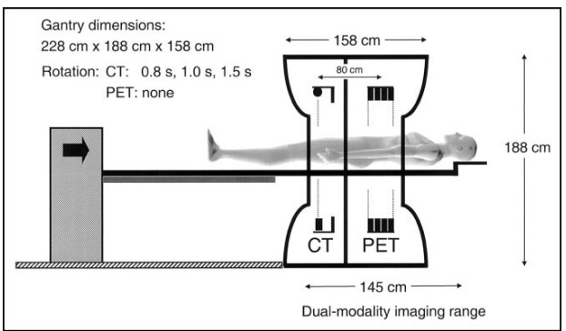
PET Background
Radioactive material similar to glucose is injected in a body.
It releases positrons.
Annihilation
Detectors detect the photons.
Algorithm creates a 3D reconstruction.
Primarily used in:
: tumor detection.
: Assessing myocardial perfusion and viability.
: diagnosis of epilepsy & Alzheimer's disease
Figure 1.1

Slide 4
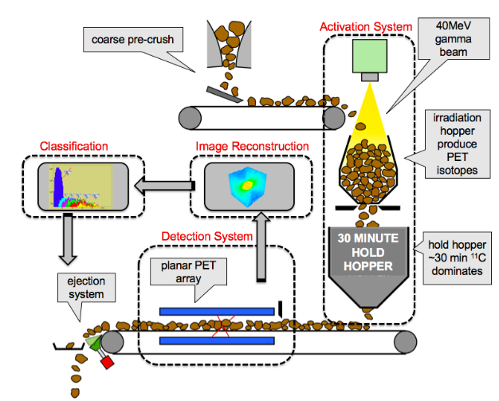
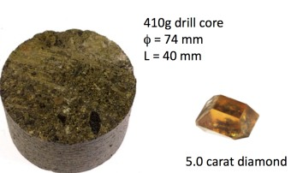
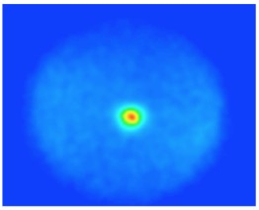
Adaptation To MinPet
Reduces barren rock processing
Avoids accidental diamond crushing
Rapid detection (<20 s per decision)
Reducing sediment runoff
Energy Use Reduction
Elimination of exploitative labour (in manual processing
Figure 1.2
Figure 1.3(a)
Figure 1.3(b)

Slide 5
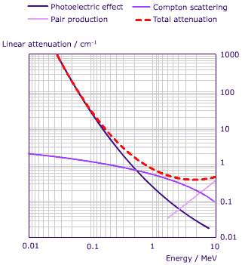
Photon Interaction
Photoelectric effect – photon is absorbed. photoelectron released.
Compton scattering – photon transfers some energy and knocks off electron. Photon deflected.
Pair Production – Due to photon-nucleus interaction. A positron-electron pair formed (1.022 MeV threshold)
511 keV photons primarily interact via Compton scattering & photoelectric effect.
Figure 1.4

Slide 6
Why Study this Photon Behavior?
Contrast ?
Photon Passage through material
Image Reconstruction
Annihilation
Detector
No standard reference exists for kimberlite - photon interaction
We must understand how signal is influenced kimberlite
This helps optimize detector placement and shielding.
Supports MinPet development

Slide 7
Project Aim
To study how PET photons behave in kimberlite slabs
Through
Comparing measured and GEANT4 simulated absorption and scattering

Slide 8
Key Variables
Type | Variable
Control Variables | Photon energy
 | Detector type and position
 | Source-detector distance
 | Kimberlite composition
 | Simulation model
Independent Variable | Kimberlite slab thickness
Dependent Variables | Photon count rate at detector
 | Energy spectrum at detector
 | Attenuation coefficient (μ)

Slide 9
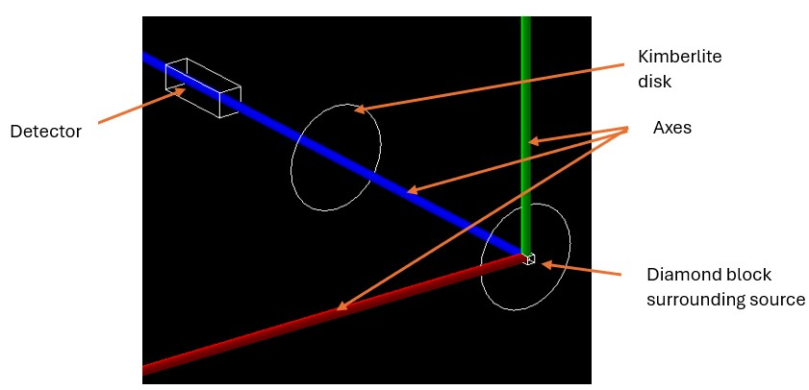
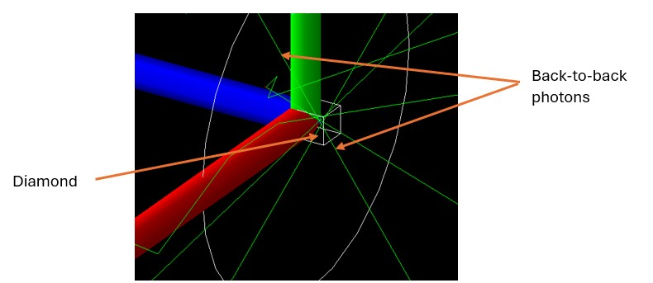
Simulation
Figure 1.5
Figure 1.6
Positrons from Na-22 annihilate with diamond electrons
511 keV photons emitted in all directions.
Photons interact with kimberlite
What we measure at the detector informs us how the material affects the signal.

Slide 10
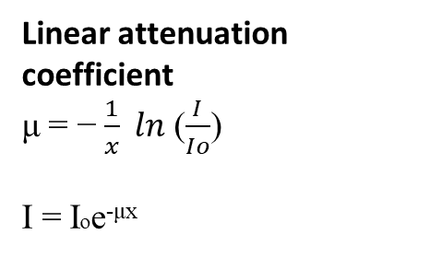
Simulation Results
Linear attenuation coefficient
μ = − $\frac{1}{x} ln$ ($\frac{I}{Io}$)
I = Ioe^{-μx}
µsimulation = 24.96 ± 0.62 m ⁻¹
Figure 1.7

Slide 11
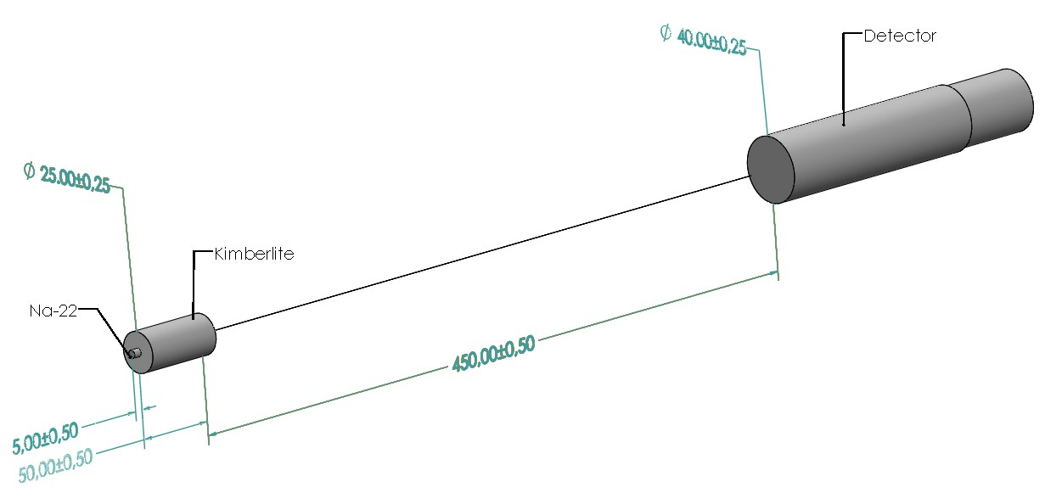
Experimental Setup
Random Experimental deviate for 10000 counts
Figure 1.7

Slide 12
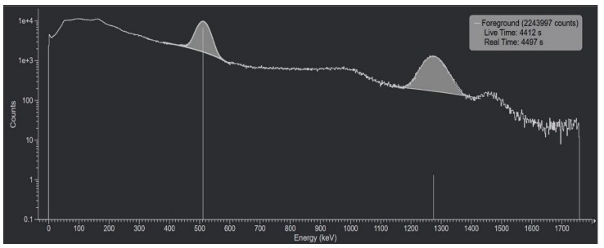
Experimental Results
511 keV Peak
Figure 1.8

Slide 13
Experimental Results
µexperimental = 19.56 ± 0.51 m ⁻¹
Figure 1.8

Slide 14
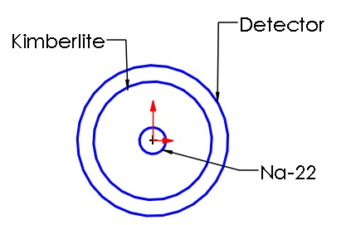


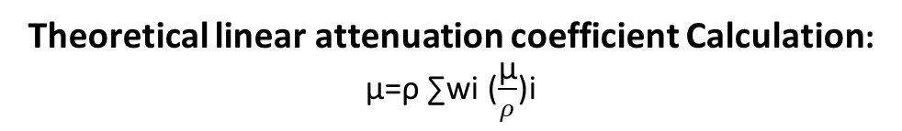
Theoretical coefficient Benchmarking
Theoretical linear attenuation coefficient Calculation:
μ=ρ ∑​wi​ ($\frac{\text{μ}}{ρ}$)i
Kimberlite Density = [ 2.5 – 3.1 $\frac{g}{\text{cm}\text{ 3}}$]
Theoretical | [21.65 m⁻¹ , 26.85 m⁻¹] | Benchmarking
Experimental | 19.56 ± 0.51 | Not in range
Simulation | 24.96 ± 0.62 | In range
Mass attenuation coefficient ($\frac{\text{μ}}{ρ})\text{ = }\text{0.0866 }\text{cm}\text{²/}\text{g}$
Sources of Experimental Error:
a) Hand-Sawn Slabs
b) Concentric Alignment:
Figure 1.9

Slide 15
Conclusion
Aim: To study how PET photons behave in kimberlite slabs
Result: No confluence of the 3 values of linear coefficient of attenuation
Although there is not confluence, this is still a valuable study.
Recommendations: Future study utilizing more accurate machining methods.
Improve alignment using a laser
Measure the density of all the slabs and adjust for the density.

Slide 16
THANK YOU!
QUESTIONS ?

