Slide 1




Investigating the Use of Big Data Tools in High-Energy Physics for Identifying Unique Dark Matter Signatures
Unathi Bosika - 221117812
Supervisor – Prof Simon Connel
Co-Supervisor – Mr Xola Mapekula
10 October 2025
‹#›

Slide 2

Contents
Introduction
Aims and Objectives
Literature Review
Experimental Set-up
Methodology
Results and Discussion
Conclusion
6
Notes:
The pictures are obtained from sources “S. Phoengsongkhro, P. Tangpornprasert, P. Yotnuengnit, M. Samala, and C. Virulsri, “Development of four-bar polycentric knee joint with stance-phase knee flexion,” Sci Rep, vol. 13, no. 1, pp. 1–11, Dec. 2023” and “Computational assessment of carbon fabric reinforced polymer made prosthetic knee: Mechanics, finite element simulations and experimental evaluation by Kannan Amudhan, 2024, The International Journal for Numerical Methods in Biomedical Engineering”

Slide 3
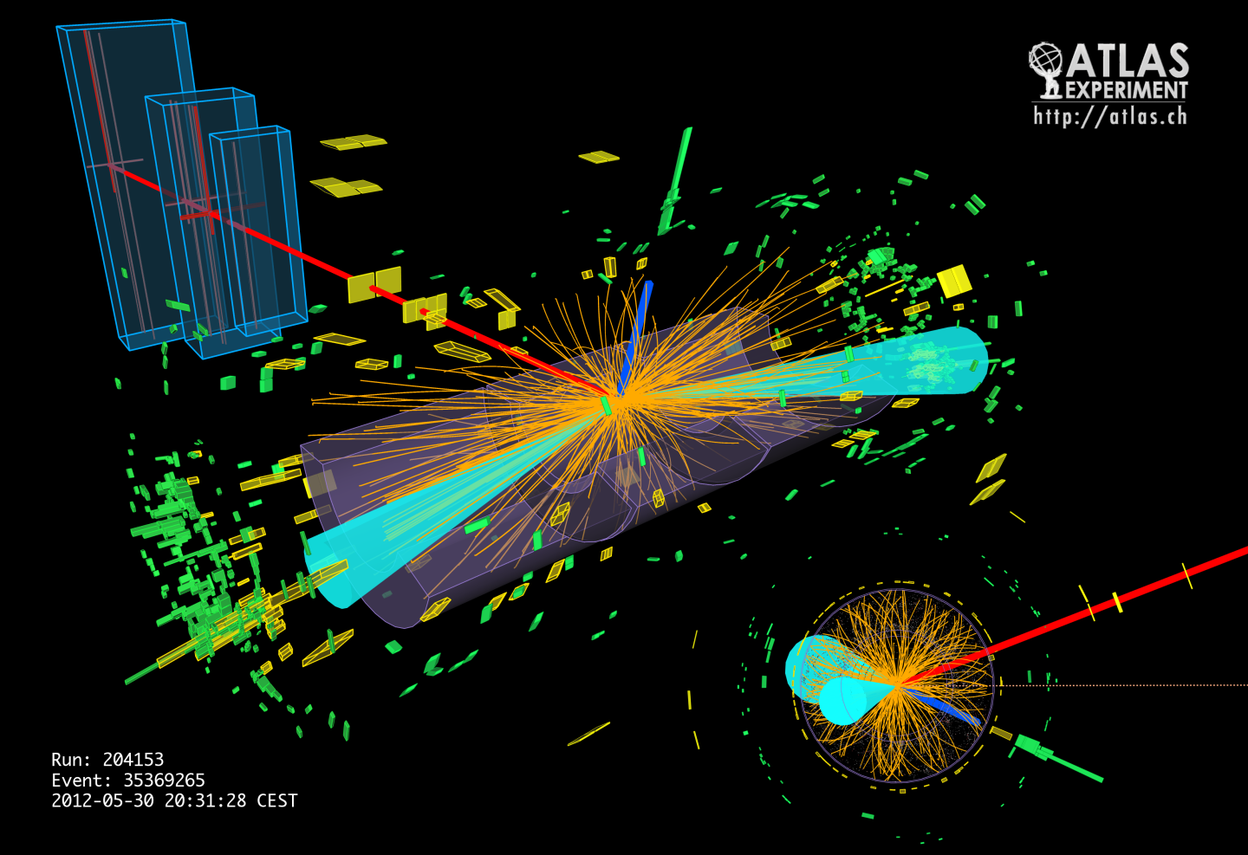
Introduction
Higgs Discovery (2012):
  Found at the Large Hadron Collider (LHC).
  Completed the Standard Model (SM) by explaining how particles acquire mass.
Beyond The Standard Model (BSM):
  Physicists study rare and exotic Higgs decay channels.
  These decays could uncover new physics and insights into dark matter.
Dark Matter Overview
Dark Sector Hypothesis
Figure 1. Higgs Event Digital Reconstruction [1].
6
Notes:
The Higgs boson is a fundamental particle that gives mass to other particles — it’s often called “the God particle” because it explains why matter has mass at all. One intriguing hypothesis is that dark matter may be connected to a hidden or “dark” sector, containing new particles like a dark Z boson ($Z_{d}$), which could couple weakly to Standard Model particles.

Slide 4
Aim and Objectives
Aim:
  Search for distinctive dark matter signatures using big data analysis techniques .
Objectives:
  Data Collection.
  Data Processing and Reduction.
  Simulated Data Analysis
  Real Data Analysis
  Data Visualization and Interpretation
6
Notes:
The Higgs boson is a fundamental particle that gives mass to other particles — it’s often called “the God particle” because it explains why matter has mass at all.

Slide 5
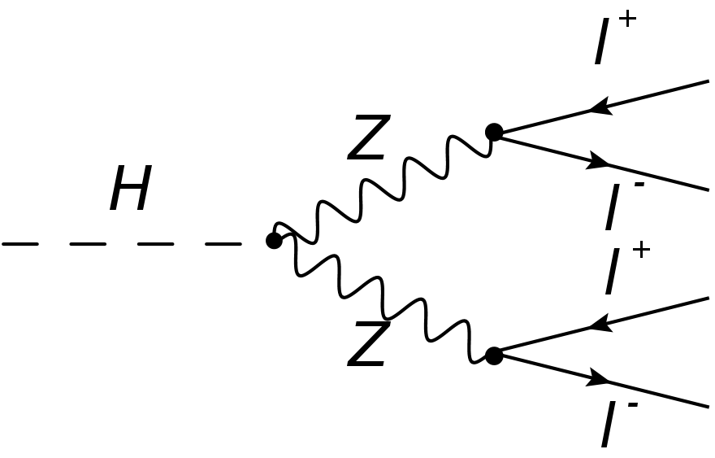
Literature Review
Standard Model (SM):
  Higgs decays into two Z bosons → four charged leptons (H→ZZ→4l*)
  Invariant masses: one near 91 GeV (Z mass), the other broad (30–60 GeV).
Beyond the SM (BSM):
  Higgs may decay into two dark Z bosons (Zd) → H→ZdZd→4l.
  Both dilepton invariant masses cluster near Zd mass (~30–60 GeV).
  Indicates possible new physics beyond the SM.
Dark Sector Search at LHC:
  Zd bosons interact weakly, but their lepton decay products are detectable.
  By analyzing invariant mass peaks, scientists can infer new particles.
  The Higgs acts as a portal to the dark sector and possibly dark matter.
Figure 2. Higgs decay into ZZ to 4l [2].
”
6

Slide 6
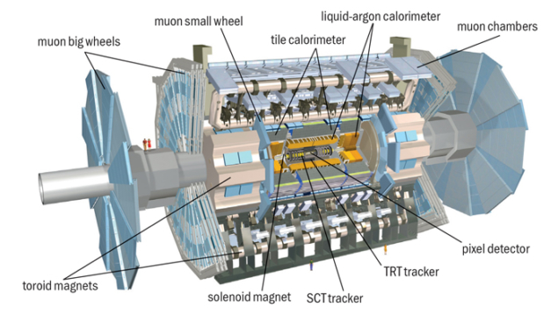
Experimental Set-Up
ATLAS Detector
Main Components:
  Inner Detector: Tracks charged particles using silicon sensors and a transition radiation tracker.
  Calorimeters:
    Electromagnetic: Measures electrons and photons.
    Hadronic: Measures hadrons (protons, neutrons).
  Muon Spectrometer: Detects and measures muons that penetrate outer layers.
Figure 3. ATLAS Detector[3].
”
6

Slide 7
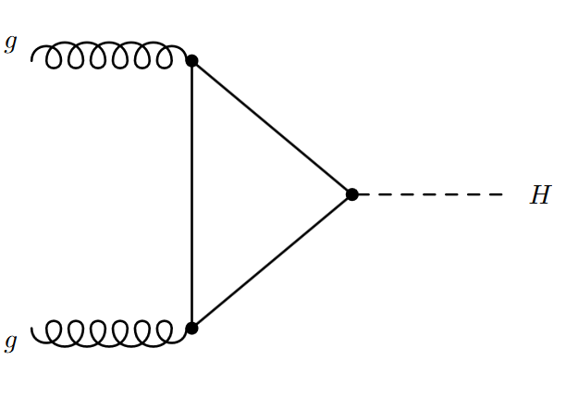
Methodology
Monte Carlo Simulations:
  Model proton–proton collisions and detector responses in ATLAS.
  Include backgrounds like ggF and VBF that can mimic Higgs decays.
Data Collection:
  Use real collision data recorded by the ATLAS detector..
Event Selection:
  Select four isolated leptons (electrons or muons) with opposite charges.
  Pair into two same-flavor, opposite-sign dileptons.
  Apply mass cuts on m₁₂, m₃₄, and m₄ to remove background
Result:
  Cuts improve signal purity and highlight potential dark-sector Higgs decays (H→Z_dZ_d→4l).
Figure 4. Gluon – Gluon Fusion [3]
”
6

Slide 8
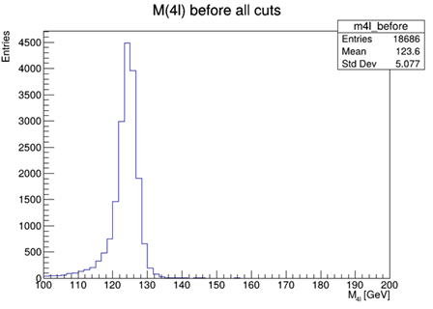
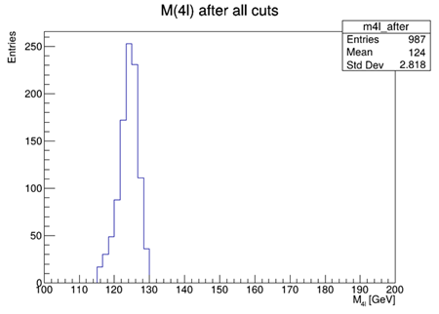
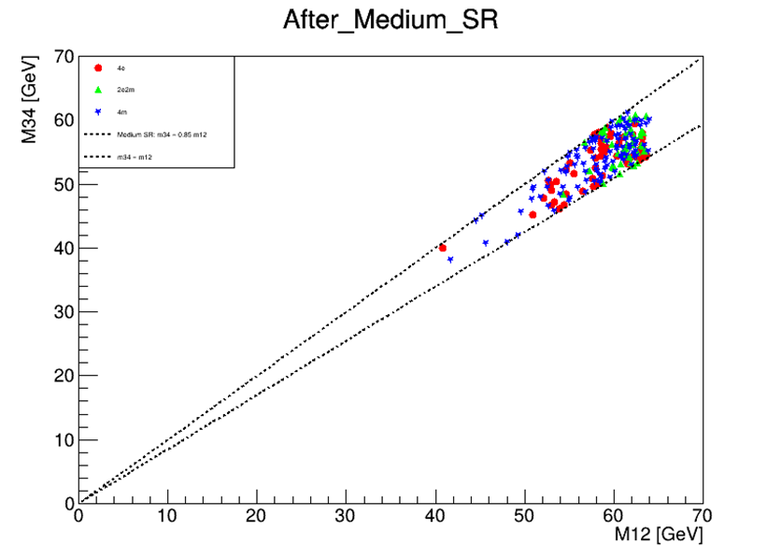
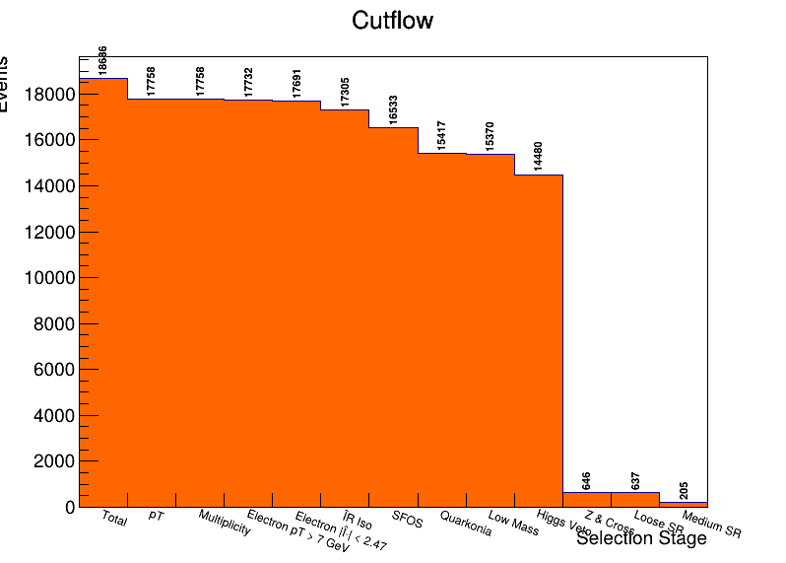
Results and Discussion
Proton – Proton Collison:
  Selection cuts applied to Monte Carlo data.
  Histogram shows a clear Higgs peak near 125 GeV after event reduction.
  Indicates cuts effectively preserved genuine Higgs events.
  Background processes significantly reduced, confirming cleaner detection.
Figure 5. Mass Region Before Cuts
Figure 6. Mass Region After Cuts
Figure 8. Invariant Mass Region Plot
Figure 9. Cutflow Diagram
6

Slide 9
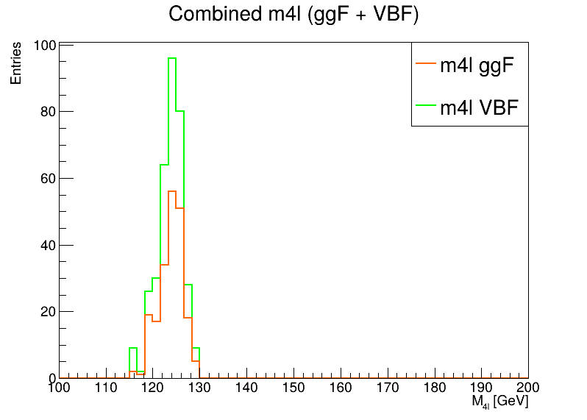
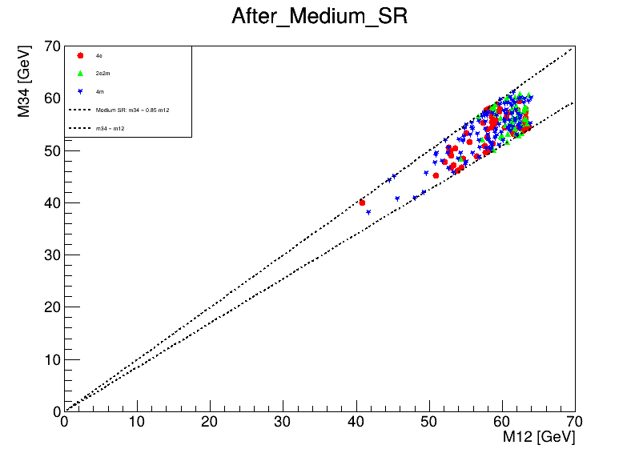


Results and Discussion
Gluon-Gluon and Vector Boson Fusion:
  Selection cuts applied to Monte Carlo data.
  Histogram shows a clear Higgs peak near 125 GeV after event reduction.
  Indicates cuts effectively preserved genuine Higgs events.
  Background proccesses significantly reduced, confirming cleaner signal detection.
Figure 10. ggf and vbf mass regions
Figure 11. ggf Invariant mass plot
Figure 12. Vbf Invariant mass plot
Figure 13. Cutflow Diagram
”
6

Slide 10
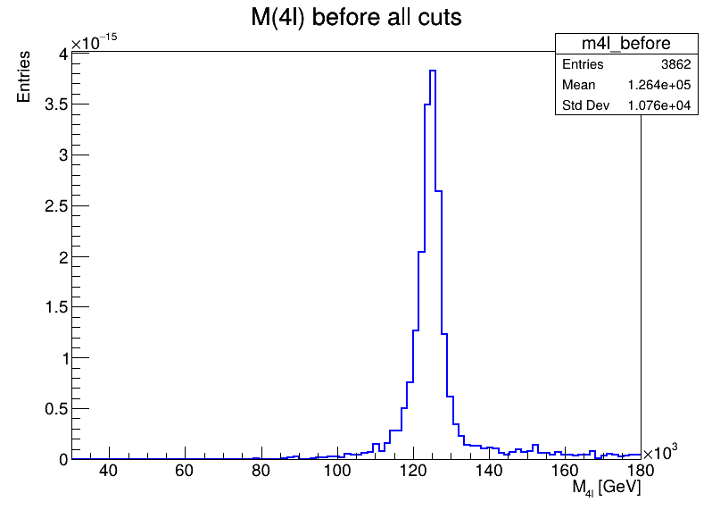
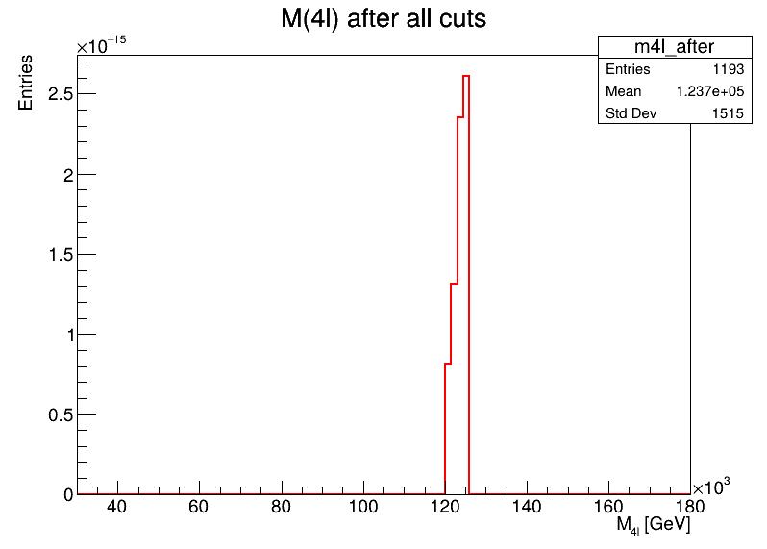
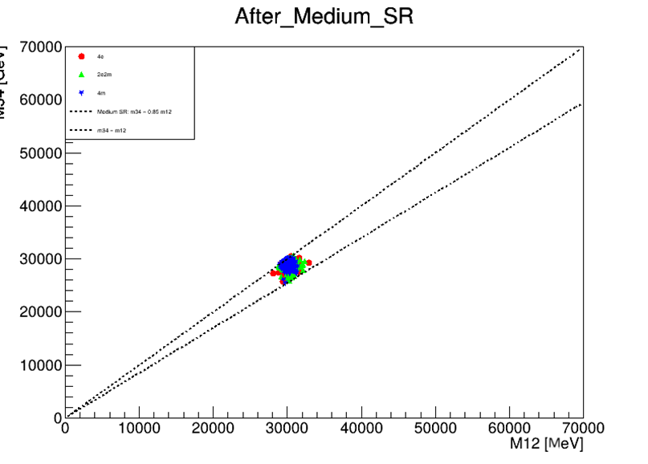
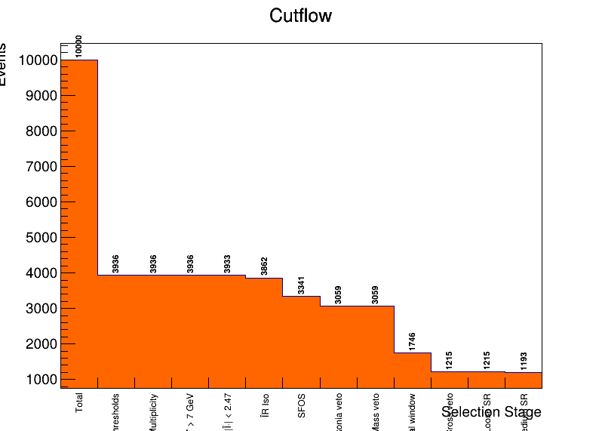
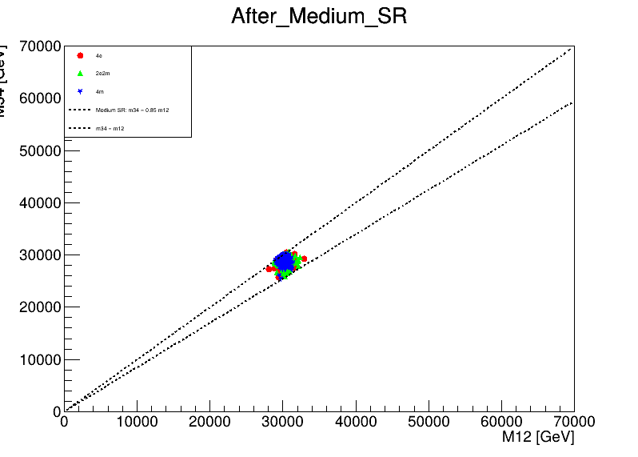
Results and Discussion
Proton – Proton ATLAS Collision Data
  Cluster observed near (m₁₂, m₃₄) ≈ (30, 30) GeV in the signal sample.
  Suggests both dilepton pairs come from identical intermediate particles.
  Matches the expected signature of H→Z_dZ_d→4l decays.
Distinct from SM H→ZZ* background
  One dilepton mass ≈ 91 GeV (Z boson).
  Other broadly distributed below 91 GeV.
Next step: Compare with Standard Model MC predictions (ggF) and (vbF) to confirm.
Figure 14. Mass region before cut
Figure 15. Mass region after cut
Figure 16. Invariant mass region
Figure 17. Cutflow Diagram
6

Slide 11


Discussion
Interpretation:
  ggF (SM) sample: Dilepton masses cluster around ≈60 GeV (off-shell Z* region).
  Signal sample: Shows a tight cluster near ≈30 GeV.
  The 30 GeV feature cannot be explained by standard SM kinematics.
  Suggests an additional process — consistent with H→ZdZd decays.
Figure 18. MC Proton Proton - Collision
Figure 19. Gluon Gluon Fusion - Collision
Figure 20. Vector Boson Fusion - Collision
Figure 21. ATLAS Proton – Proton - Collision
6

Slide 12
Conclusion
Baseline: Standard Higgs decay H→ZZ*→4l.
Extension: Search for exotic decay H→Z_dZ_d→4l.
Results:
  Signal cluster: (m₁₂, m₃₄) ≈ (30, 30) GeV.
  Background (ggF and vbF): around 50–70 GeV.
  Pattern supports H→ZdZd hypothesis.
Big-Data Tools
  Monte Carlo + Geant4 for realistic event simulation.
  Scalable storage systems: Handled terabytes of collision data securely and accessibly.
  Visualization and statistical tools: Used to identify patterns like the (30,30) GeV cluster..
Takeaway:
  Big-data techniques enable exploration of dark-sector signals in the Higgs decay channel.
6

Slide 13
References
[1] ATLAS Collaboration, “Search for Higgs boson decays to beyond-the-Standard-Model light bosons in four-lepton events with the ATLAS detector at $\sqrt{s}=13$ TeV,” Journal of High Energy Physics, vol. 2018, no. 6, Jul. 2018, doi: 10.1007/JHEP06(2018)166.
[2] “Gluon fusion (ggF) | ATLAS Experiment at CERN.” Accessed: Oct. 10, 2025. [Online]. Available: https://atlas.cern/glossary/gluon-fusion
[3] “Published for SISSA by Springer Search for Higgs bosons decaying into new spin-0 or spin-1 particles in four-lepton final states with the ATLAS detector with 139 fb −1 of pp collision data at √ s = 13 TeV The ATLAS collaboration”, doi: 10.1007/JHEP03(2022)041.
[4] ATLAS Collaboration, “Search for new light gauge bosons in Higgs boson decays to four-lepton final states in $pp$ collisions at $\sqrt{s}=8$ TeV with the ATLAS detector at the LHC,” Physical Review D - Particles, Fields, Gravitation and Cosmology, vol. 92, no. 9, Nov. 2015, doi: 10.1103/PhysRevD.92.092001.
[5] “Search for new light gauge bosons in Higgs boson decays to four-lepton final states in $pp$ collisions at $\sqrt{s}=8~$TeV with the ATLAS detector at the LHC.,” Mar. 17, 2015. Accessed: Oct. 10, 2025. [Online]. Available: https://cds.cern.ch/record/2002118
[6] “particle physics - What dictates how the Higgs boson will decay? - Physics Stack Exchange.” Accessed: Oct. 10, 2025. [Online]. Available: https://physics.stackexchange.com/questions/426243/what-dictates-how-the-higgs-boson-will-decay

Slide 14

THANK YOU

