Slide 1

Optimisation of XRT Sorting.
Goitsemodimo Zeanest Meno - 222048662
Supervisor: Prof. S Connel
CoSupervisor: T Brooks
Project Investigation (PJMMCY4)

Slide 2
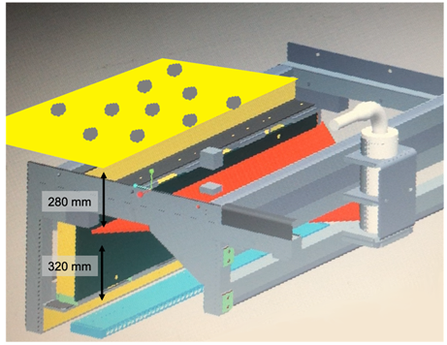
Introduction
Brief Background
XRT is a sensor-based sorting method that differentiates materials by density.
It is used in medical scans and mining.
Materials such as diamonds, chromite, coal, iron ore, limestone, etc, are detected using XRT in mines.
Diamonds in mines are identified in kimberlites using XRT.
By obtaining an X-ray radiograph of kimberlite rock.
Figure 1: XRT Machine [1]
PROJECT INVESTIGATION 4

Slide 3
Introduction
Problem Statement
Inaccurate sorting for larger rocks >3cm.
False positives due to large kimberlite rocks
Loss of diamonds.
Aim
Identify the shortcomings of an XRT sorting machine and improve through digital prototyping. With the use of Geat4, and Root.
PROJECT INVESTIGATION 4
Notes:
X-Ray transmission

Slide 4
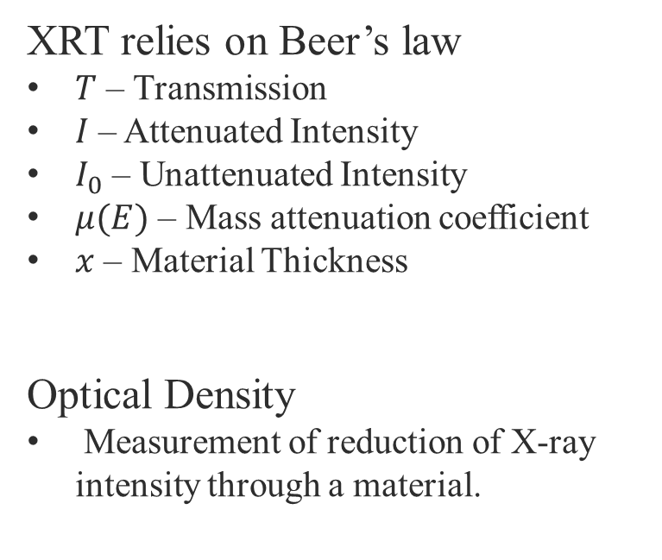

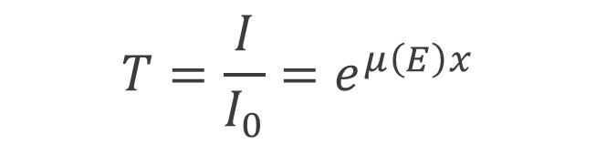
Physics of XRT Sorting
XRT relies on Beer’s law
$T$ – Transmission
$I$ – Attenuated Intensity
$I_{0}$ – Unattenuated Intensity
$μ(E)$ – Mass attenuation coefficient
$x$ – Material Thickness
Optical Density
Measurement of reduction of X-ray intensity through a material.
$$T=\frac{I}{I_{0}}=e^{μ\left(E\right)x}$$
$$D=−\ln{T}=−\ln{\frac{I}{I_{0}}=μx}$$
PROJECT INVESTIGATION 4

Slide 5
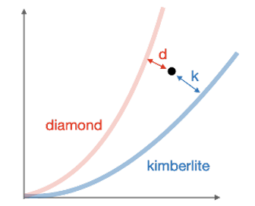

Segmentation
Power law model is used to identify type:
$$D_{m}^{H}=a{\left(D_{m}^{L}\right)}^{b}$$
Ratio of mass attenuation coefficient of individual material:
$$\frac{μ_{m}\left(E^{H}\right)}{μ_{m}\left(E^{L}\right)}$$
There is a difference of 11% between the slope of kimberlite and diamond.
Figure 2: High vs low optical density [2]
Greater distance from origin means higher optical densities will correspond to thicker materials.
PROJECT INVESTIGATION 4

Slide 6
Data Acquisition Process
Run Geant4 simulations with different parameter sets.
Parameters Varied: Tube voltage (energy, e.g., 80–160 keV)
phantom thickness.
Simulation event count (Beam count)
Record photon interactions at detector volumes.
Export energy deposition histograms into ROOT files.
Analyse and smooth data using ROOT macros or fitting routines.
Expected Output:
Characteristic X-ray peaks.
Increasing photon counts with tube voltage
Distinct detector responses across configurations
PROJECT INVESTIGATION 4
Notes:
Sensitivity analysis. To determine which factors significantly affect detection efficiency and energy response before physical calibration

Slide 7
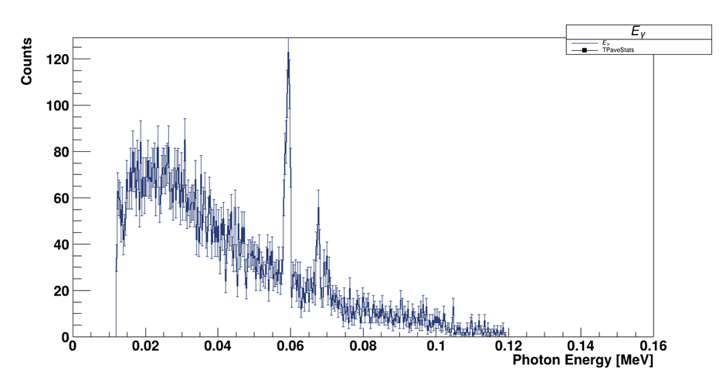
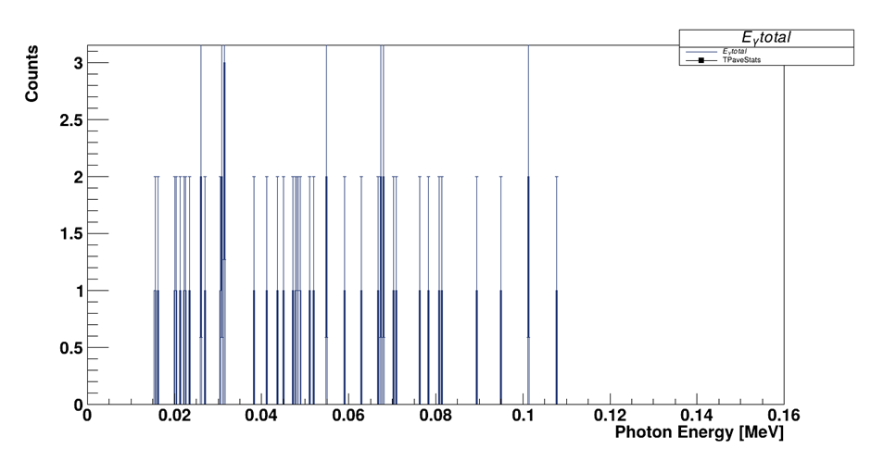
Simulation Hit Patterns and Geometry
Figure 3: Raw spectrum of photon energy
Figure 4: filtered hits of photon energy
Noise due to limited counts and statistical fluctuations.
Selection of interaction classes, only discrete photon energies remain.
Sharp peaks are the characteristic X-ray lines of the anode material (Tungsten).
PROJECT INVESTIGATION 4
Notes:
The raw data may include minor artifacts from the detector's response that smoothing algorithms are designed to correct. 160 (k electron volatage) determines the maximum energy

Slide 8
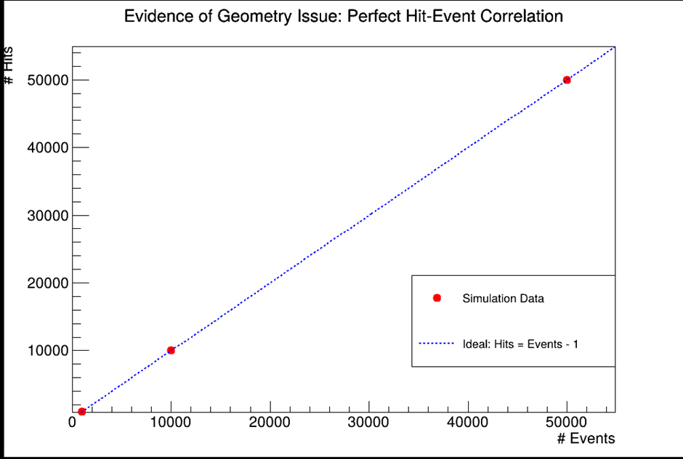
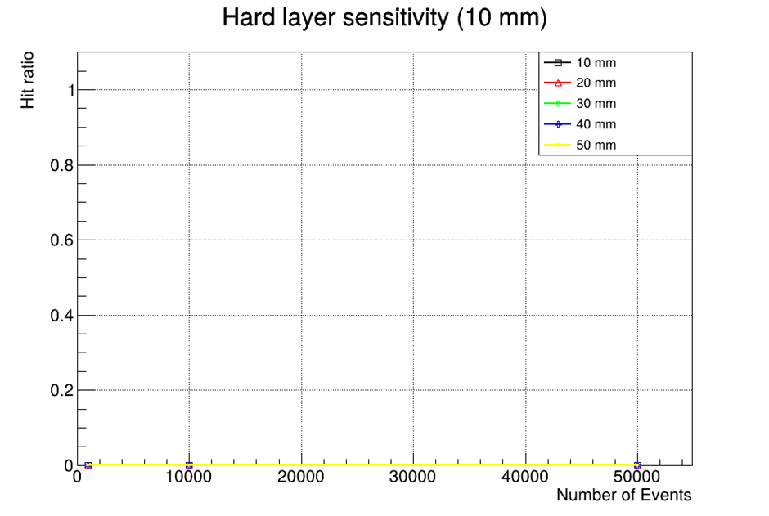
Detector Pixel Hit Distribution
Figure 6: Hard layer sensitivity: Hit ratio
Figure 5: Events vs hits
The number of hits equals the number of events, suggesting no particles reaches the detector.
The hard layer hit ratio indicates that the simulated beam misses the sensitive volumes.
PROJECT INVESTIGATION 4
Notes:
Such results point to a misalignment between the X-ray beam and the detector modules, or a rotated tube causing the beam to bypass the detectors

Slide 9
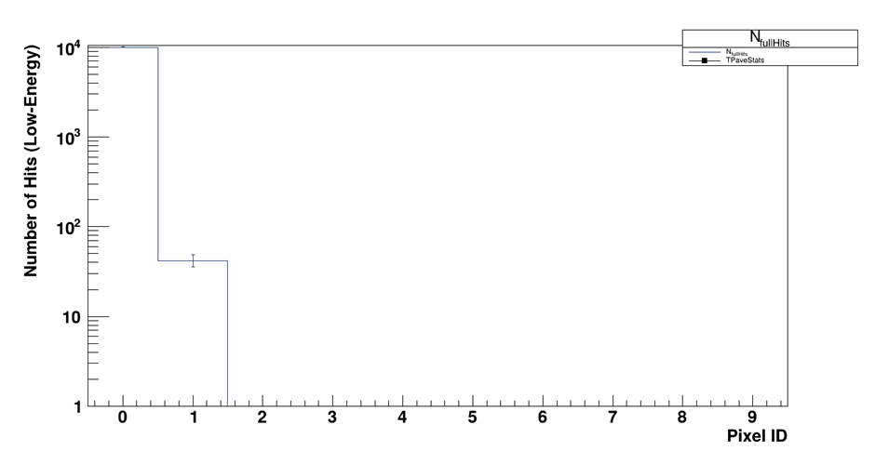
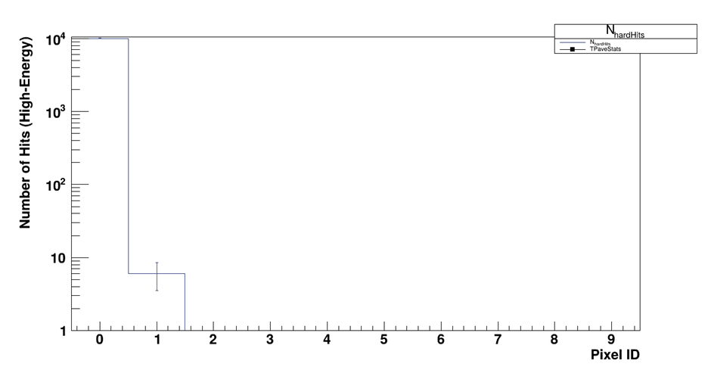
Simulation Hit Patterns and Geometry
Figure 7: Low Energy hits
Figure 8: High Energy hits
Counts in pixel 0.
Minimal counts in Pixel 1.
Particles intersect the edge of the detector assembly rather than passing through its full array.
Low-energy photons are more easily absorbed
PROJECT INVESTIGATION 4
Notes:
Correct positioning of the detectors and beam alignment will spread hits across multiple pixels.

Slide 10
Summary of Detector Data
Raw data shows expected statistical variations
Suggested smoothing algorithms for data processing.
Misalignment between the X-ray beam and the detector modules
Rotated tube causing the beam to bypass the detectors
PROJECT INVESTIGATION 4

Slide 11
Optimisation
Correct the geometry: align the X-ray tube with the phantom and detector array.
Re‑run sensitivity scans varying phantom size, material, and beam settings
Perform smoothing on spectral data to highlight characteristic peaks and calculate signal‑to‑noise ratios.
PROJECT INVESTIGATION 4

Slide 12
References
[1] S. Ballestrero et al., “Gem Sorter Report,” Jun. 2021.
[2] T. Brooks, M. Cook, and S. Connell, “Report on XRT evaluation and simulation,” Jun. 2023.
PROJECT INVESTIGATION 4

Slide 13
THANK YOU…
PROJECT INVESTIGATION 4

