Slide 1
Fibre Optic Sensing for Structural Health Monitoring of an Aircraft
By Bhavesh Singh (217026842)
Supervisor: Dr. T.N.L. Truong, Co Supervisor: AS Cassim
10 October 2025 (PJMMCY4)

Slide 2
Introduction
Current technology
Fibre Optics
Methadology and Experimental Results
Results
Conclusion and recomendations

Slide 3
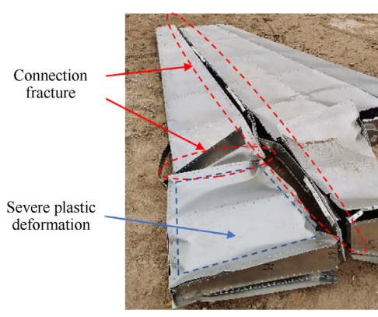
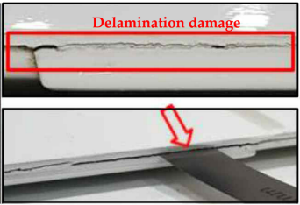
Introduction
Aircraft maintenance
Mechanical failure
Damage detection
Aircrafts experience multiple Loads
Multiple points of failure across aerodynamic body
Wing is critical component that experiences multiple forces
Figure 1: skin and structural failure of a wing
Figure 2: delamination failure in a wing

Slide 4
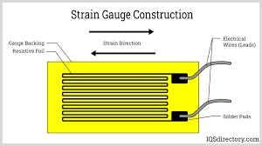
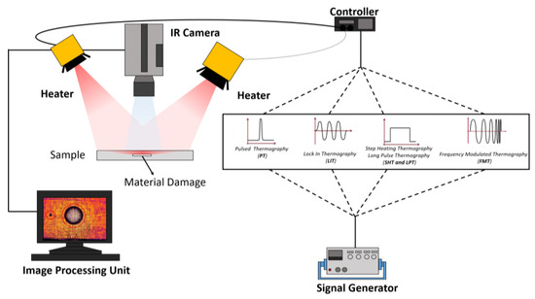
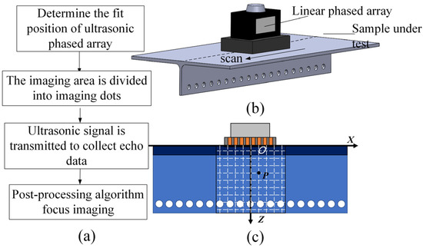
Current Technology used for Structural Health Monitoring
Strain Gauges
Infrared Thermography
Ultrasonic Testing
Figure 3: Ultrasonic testing procedure
Figure 4: Strain Gauge construction
Figure 5: IRT fault detection procedure
Accurate but requires downtime
Low cost, but sensitive to EMI and limited to point measurements[2]
Useful for composites, expensive and skill-dependent[3]
[
4

Slide 5
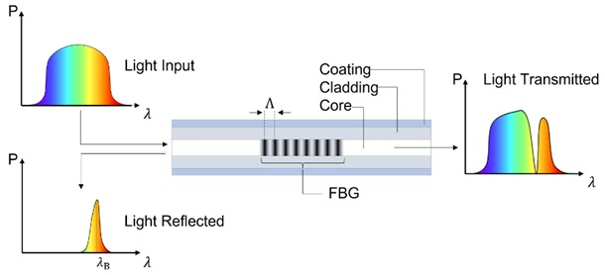
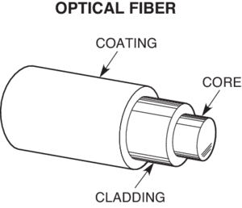
Fibre Optics
Optical fibre work through the principles of wavelength shift
Detect strain and temperature with wavelength shifts
Lightweight and highly sensitive to changes in wavelength
Highly durable and low maintenance
Figure 6: Spectre view of a FBG sensor
Figure 7: Ultrasonic Cross sectional view of fibre

Slide 6
Problem statement
Strain measurement in aircraft wings is challenging due to harsh environments, weight constraints, and the need for minimal intrusion. Traditional strain gauges are bulky and inaccurate under dynamic loading. There is a need for a lightweight, accurate, and durable sensing system.
Aim
To investigate the use of embedded Fibre Bragg Grating (FBG) sensors for real time strain monitoring in an aircraft wing
Objectives
Design and manufacture an aircraft wing model
Fabricate fibre optic sensors and embed them on the wing
Conduct experimental testing and collect strain data
Perform FEA analysis
Compare results

Slide 7
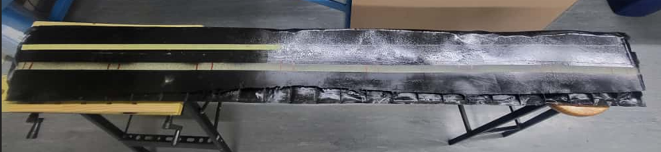
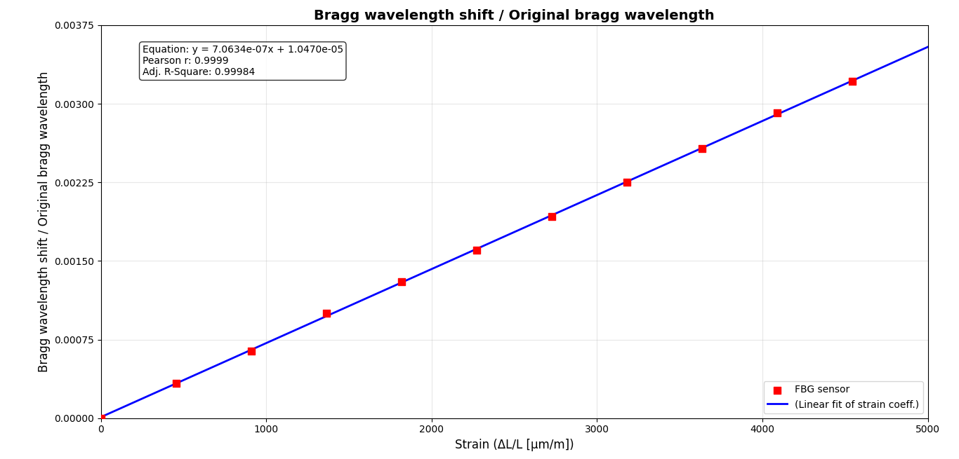
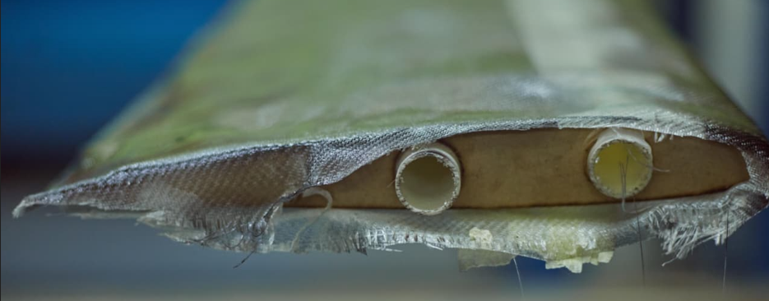
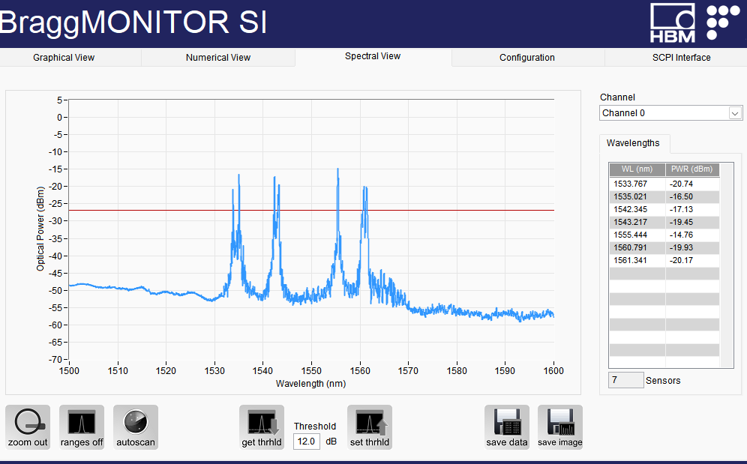
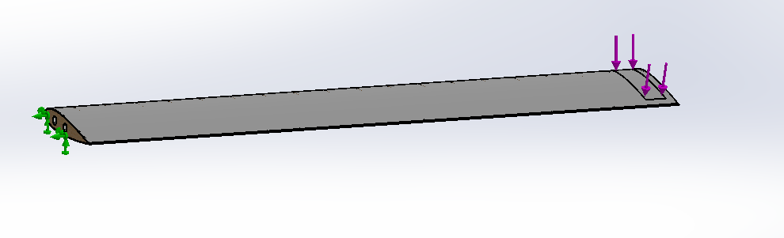
Methodology
1
Wing construction
2
Calibration
Strain
Temperature
Carbon fibre skin
MDF wood ribs
PVC spars
3
Analysis
4
FEA
FBG wavelength plot
Sensor peaks
Boundary Conditions
Applied- Load

Slide 8
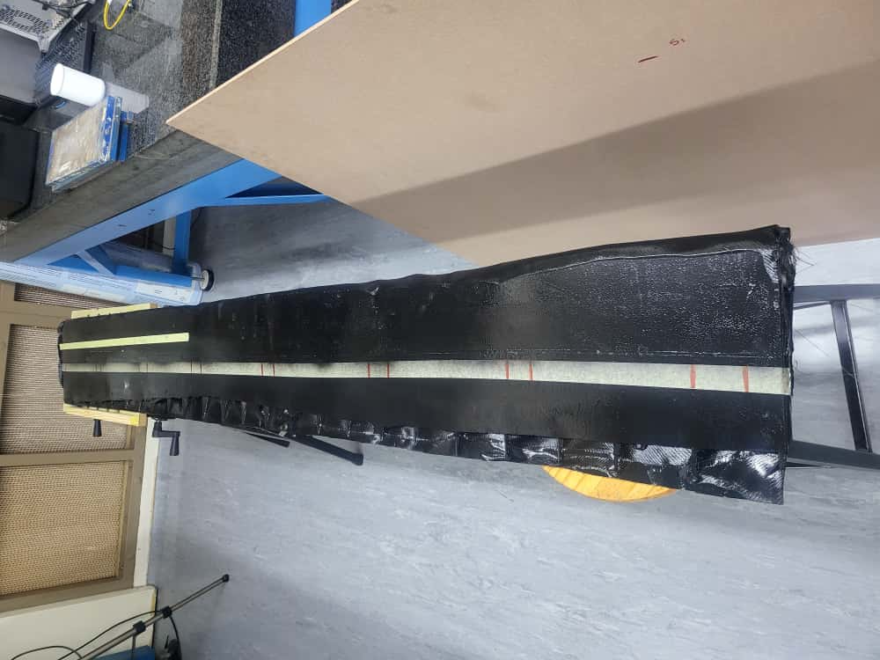
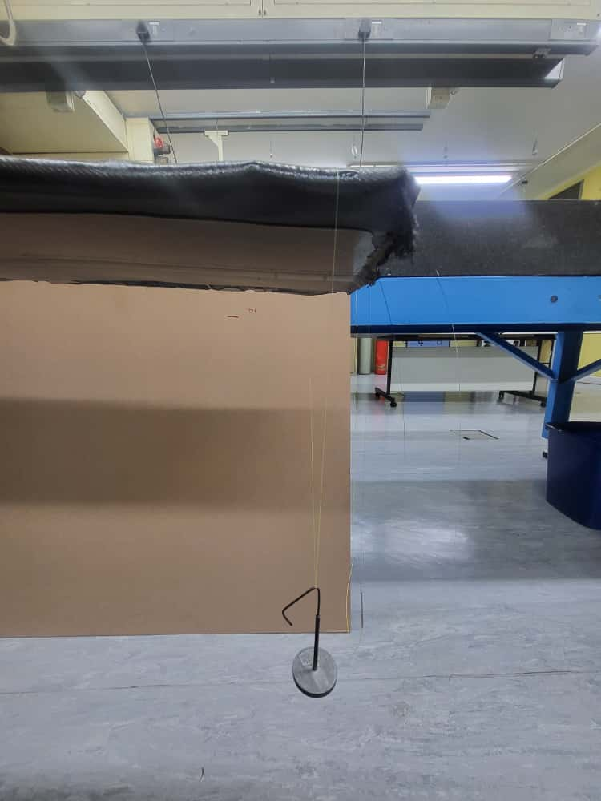
Experimental setup
Experimental Procedure
100g
200g
300g
400g
500g
Load Applied
Sensor Location
As seen in the figure above we note the position of the sensors embedded in the bottom of the wing as shown by the red marking positions on the wing itself

Slide 9
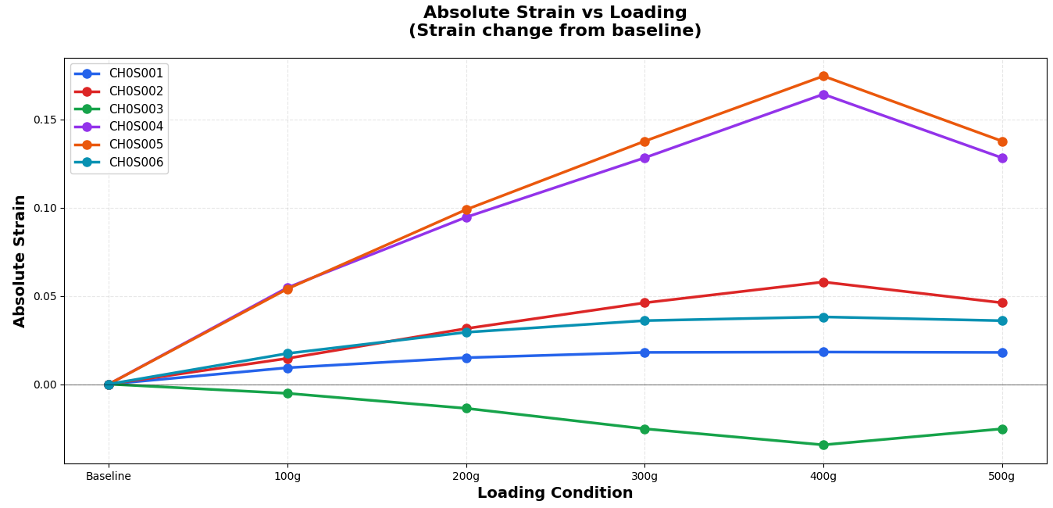
Experimental Results
Interrogator plots strain changes vs time
Trends consistent with expected compression behavior
Correlation between loading and sensor response for each sensor
Under compressive loading, the material shortens as internal stresses build up, which is detected by the strain sensors as increasing absolute strain.
9

Slide 10
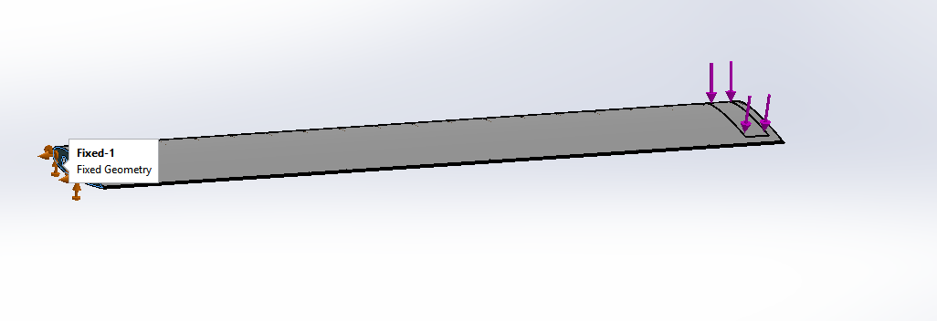
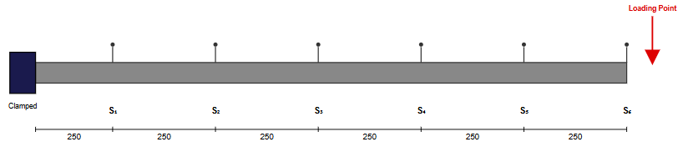
FEA Analysis
FEA simulations conducted on wing
Boundary conditions
Load Applied
Strain results obtained
9

Slide 11
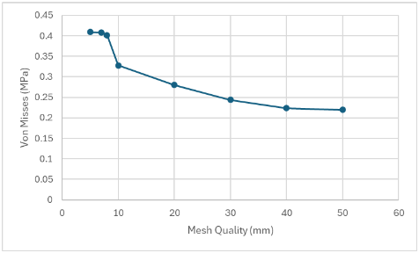
FEA Analysis, mesh sensitivity
Finer mesh = higher stress values
Convergence occurs around 7mm mesh size
Stress ranges from 0.21 to 0.41 MPa
Optimal balance between accuracy and computation
Results stabilize, indicating mesh independence
7mm mesh recommended for reliable analysis
9

Slide 12
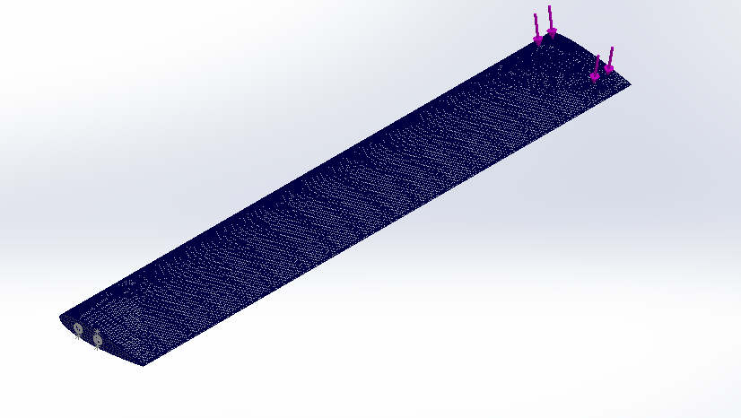
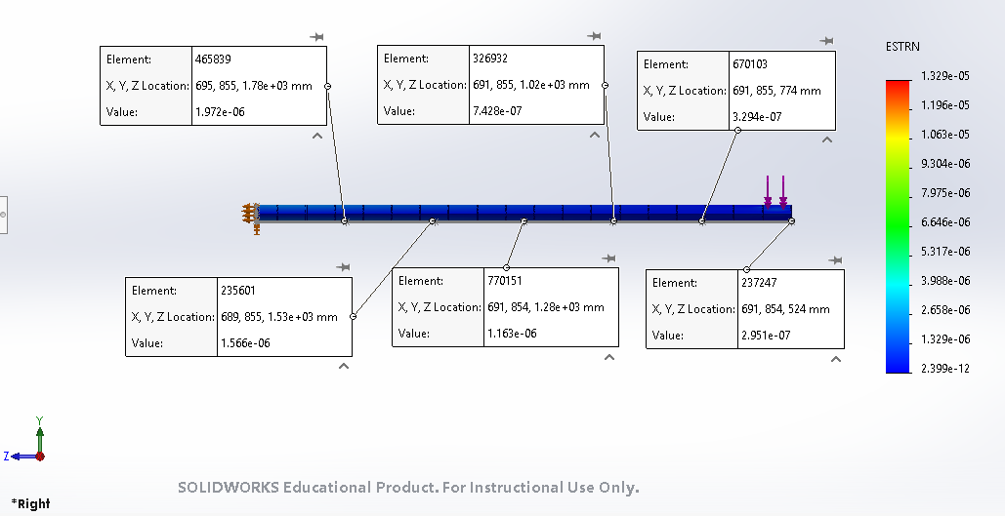
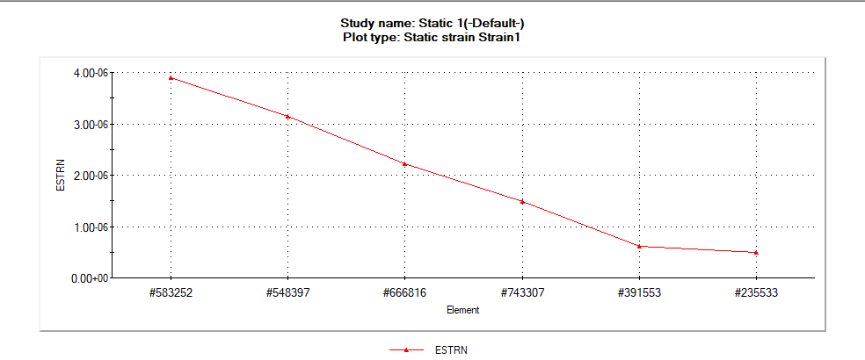
FEA Results
Mesh quality
Strain values across points correlating to sensor position
General trend observed
9

Slide 13
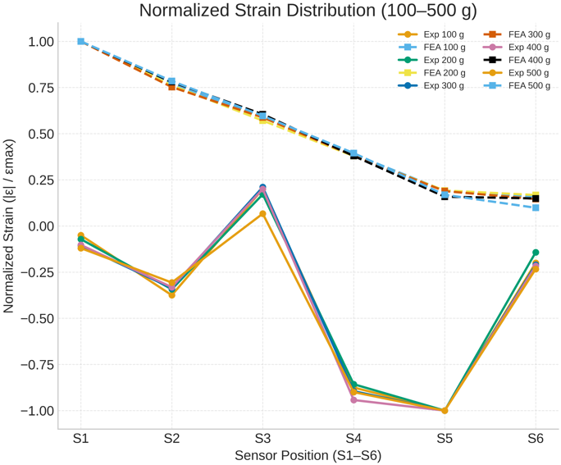
Results: Experimental vs FEA
9

Slide 14
Conclusion
This project shows promise with a general trend in compression data from FEA vs Experimental results
The faults observed/data anomalies in 1 of the sensors could be from a multitude of factors such as: sensor placement, epoxy bonding conditions, pre-tensioned bonding, wing geometry, improper wing build ect.
Recommendations
Going forward we can control the manufacturing of any models by outsourcing the building to professional workshops
Sensor placements during facrication can be improved by controlling the printing more accurately
Sensors can be calibrated using other measns to eliminate other factors such as bending and curvature experienced by sensors

Slide 15
Thank you for Listening
Questions?

Slide 16
Refrences
[1] V. R. Gharehbaghi and E. N. Farsangi, "A critical review on structural health monitoring: Definitions, methods, and perspectives," Arch. Comput. Methods Eng., vol. 29, pp. 1217–1245, 2022.
[2] B. Kurian and R. Liyanapathirana, "Machine learning techniques for structural health monitoring," in Damage Assessment of Structures, Springer, 2019, pp. 1–14.
[3] R. Miorelli, P. Luraschi, M. Di Maio, D. Bianchi, and M. Guagnelli, "Supervised learning strategy for classification and regression tasks applied to aeronautical structural health monitoring problems," Ultrasonics, vol. 111, 2021, Art. no. 106309.

