Slide 1
Development of Vibration Detection Analysis
TR Chauke 221028189
Project Investigation (PJMMCY4)
Supervisor: Dr TNL Truong, Co-supervisor: Mr AS Cassim
10 October 2025

Slide 2
Presentation outlines
Introduction
Problem statement, aim and objectives
Brief key findings from literature
methodology
Data analysis
results
Conclusion

Slide 3
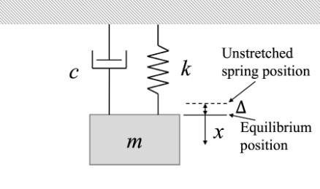
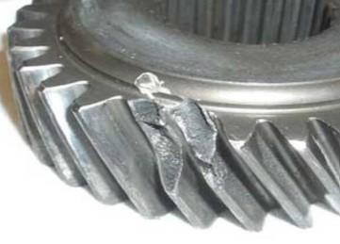
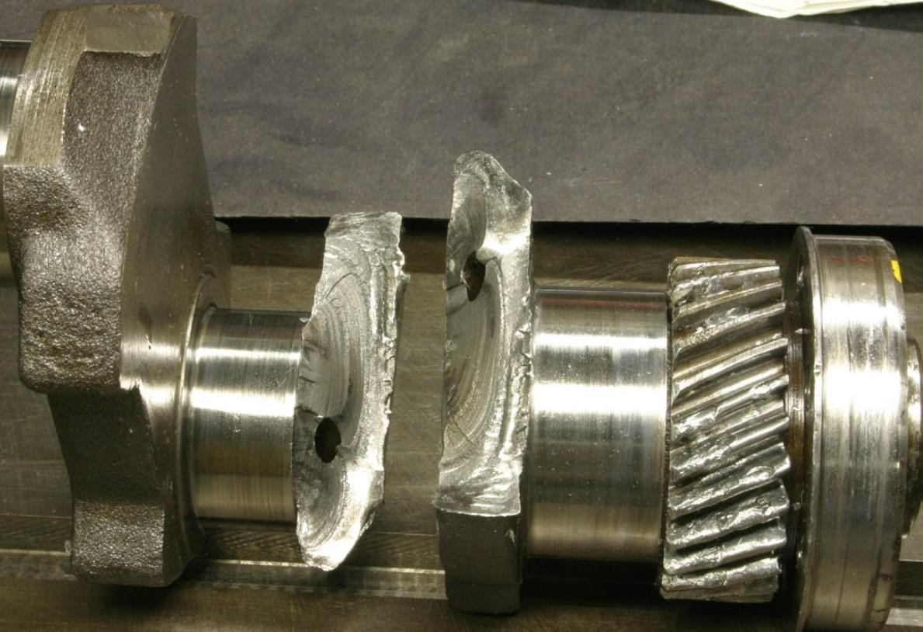
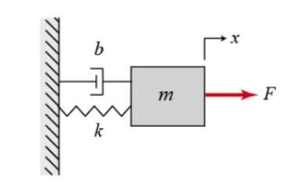
Introduction
BACKGROUND
Vibrations may be defined as an oscillatory motion of a system [1].
Two common types of vibrations:
Free vibration
Forced vibration
Figure 1: Free vibration [2]
Figure 3: Gear failure [3].
Figure 4: Shaft failure [4]
Figure2: Forced vibration [2]

Slide 4
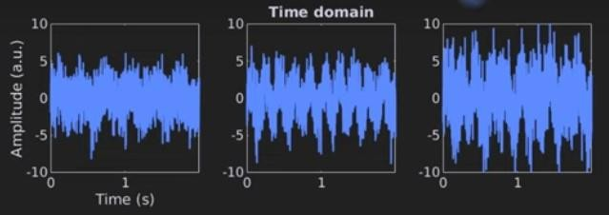
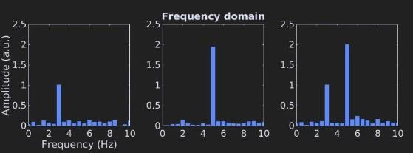
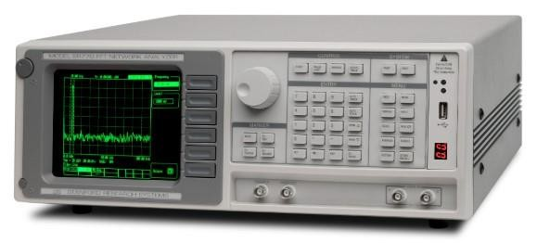
Types of Vibration Analysis
Time-Domain Analysis
Frequency-Domain Analysis
Vibration Modal Analysis
This technique evaluates raw vibration signals from waveforms [5].
It identifies transient events, tracks vibration levels, and sets operational limits.
This technique typically utilizes the Fast Fourier transform (FFT) to convert time-domain signals into frequency- domain [5].
An advanced method that pinpoints a machine’s natural frequencies aiding in understanding the machine’s dynamic behavior and potential structural or resonance issues [5].
Figure 7: Time domain signals
Figure 8: FFT spectrum
Figure 9: Analyzer

Slide 5
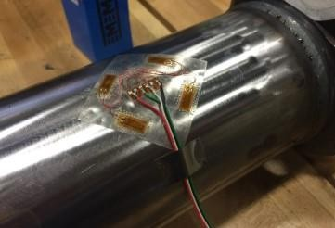
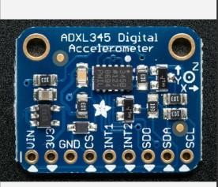
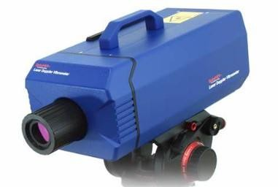
Vibration Measurements Techniques
Strain Gauges
Laser Doppler Vibrometer
Accelerometer
Uses doppler effect to detect the moving surface.
Advantages
Non contact.
High precision.
Disadvantages
Expensive.
Not suitable for all surfaces.
Measures accelerations directly via Micro-Electro-Mechanical System (MEMS) or piezoelectric sensors.
Advantages
Compact and cheap.
Accurate.
Disadvantages
Very sensitive to noise.
Measures strain directly infer vibrations.
Advantages
Good for structural analysis.
Disadvantages
Limited frequency range.

Slide 6
Problem Statement, Aim and Objectives
Problem Statement
MEMS accelerometers commonly used.
Chosen for low cost and ease of use.
Infiltrated by noise from the environment.
Need for better data analysis to detect vibrations.
Aim of the experiment
To measure vibration on a rotating shaft apparatus.
Objectives
Review vibration data analysis methods.
Design a data acquisition system using accelerometers.
Measure acceleration data from shaft apparatus.
Develop data analysis method to obtain vibration.
Present vibration results.
Measuring vibration
Mitigate damages in a machinery
Prevent failure and reduce costs

Slide 7
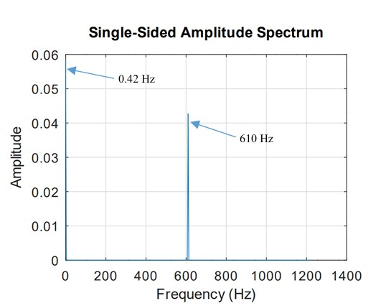
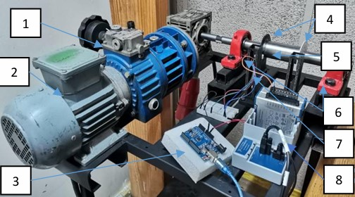
The Previous Study
The apparatus used in this experiment was used for torsional vibrations.
The optical sensors were used and found a 610 Hz signal stemming from the gearbox.
Figure 10: The shaft apparatus used for previous study [6].
Figure 11: Previous study results [6]

Slide 8
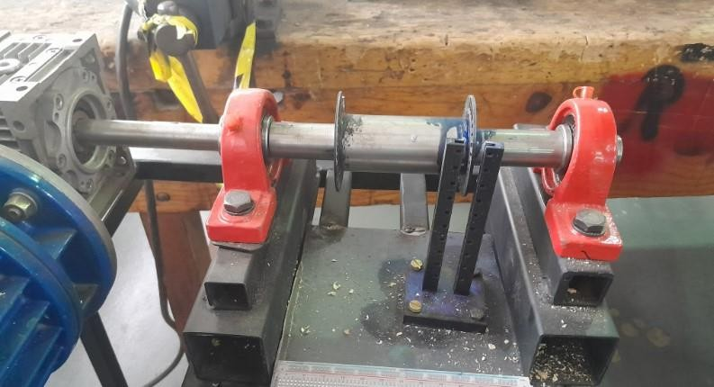

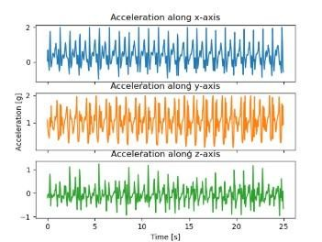
Methodology
The following steps were followed to obtain the desired data.
Shaft test rig
Mounting of the ADXL 345 accelerometer
Data acquisition (IDE)
Data visualization and data analysis (time-domain and frequency domain analysis FFT)
Data filtering, smoothening and normalization

Slide 9
Experimental Matrix
The experimental matrix used for the experiments.
Table 1: Experimental matrix
 | Sampling frequency | Mounting orientation
High speed (150 RPM) | 1300 | Top of bearing
Medium to low (50 RPM) | 1300 | Top of bearing
High speed (150 RPM) | 1500 | Top of bearing
Medium to low (50 RPM) | 1500 | Top of bearing
High speed (150 RPM_ | 1300 | Side of bearing
Medium to low (50 RPM) | 1300 | Side of bearing
High speed (150 RPM) | 1500 | Side of bearing
Medium to low (50 RPM) | 1500 | Side of bearing

Slide 10
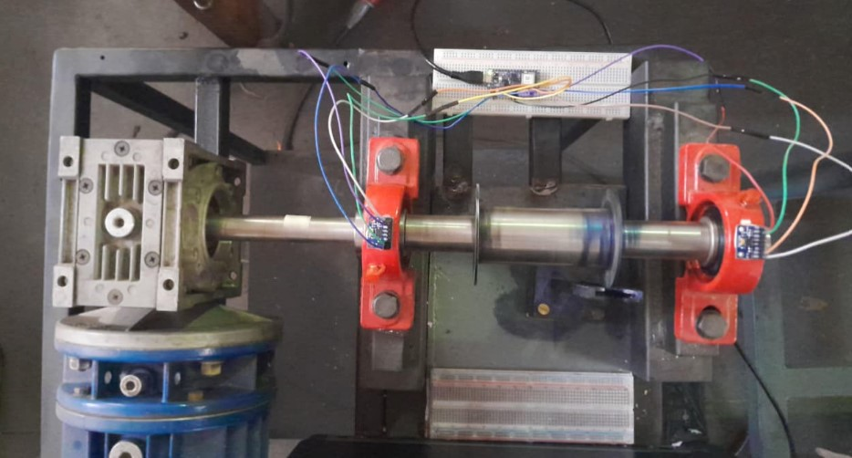
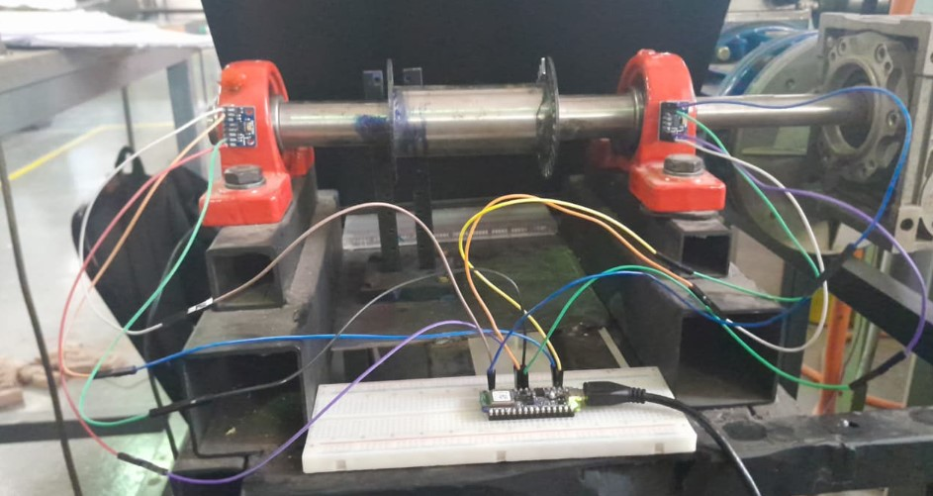
Methodology Cont.
The 2 experiments were conducted by mounting the sensors at 2 different locations: Top and side of the bearing.
Gearbox
Sensor
Arduino
Shaft
Breadboard
Bearing
Figure 12: Configuration 1
Figure 13:Configuration 2

Slide 11
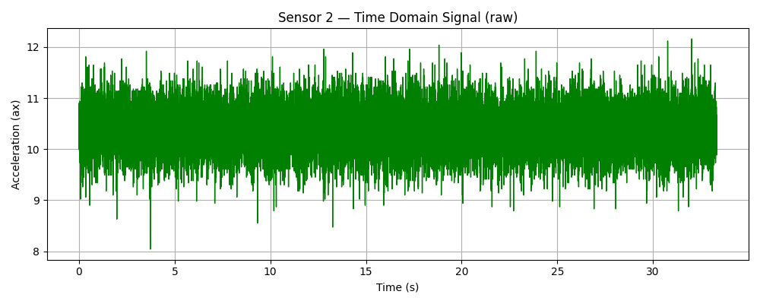
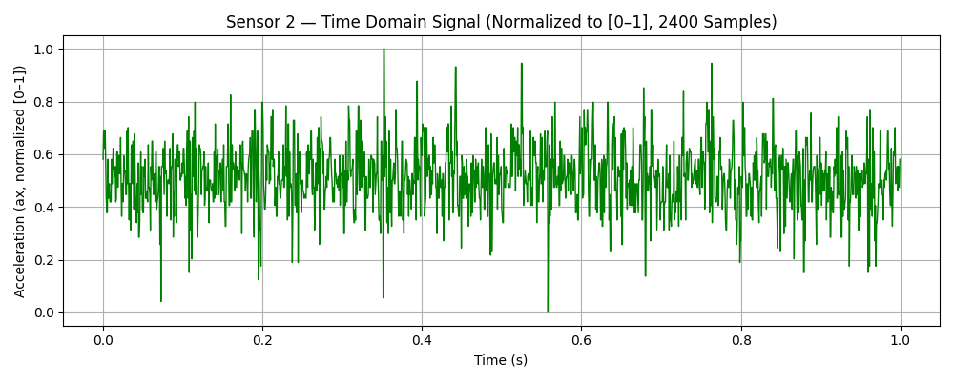
Data Analysis
Sensor setup
ADXL 345 mounted on the bearing house.
Orientation calibrated.
Frequency of the motor 22 Hz.
Data acquisition
Sampling frequencies: 1300 Hz, 1500 Hz.
Test shaft speeds: High speed of 150 RPM and medium to low speed of 50 RPM .
Start of the test
Filtering
Savitzky Golay smoothening (window length = 51 and the polynomial order 3.
Detrending
Remove DC offset (subtracts the average to analyze true vibration)
Perform time domain and frequency domain analysis

Slide 12
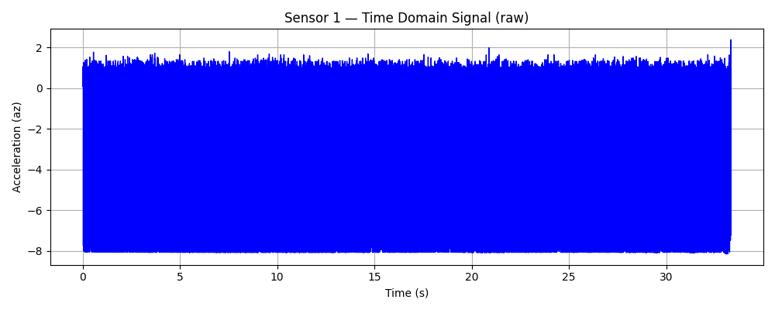
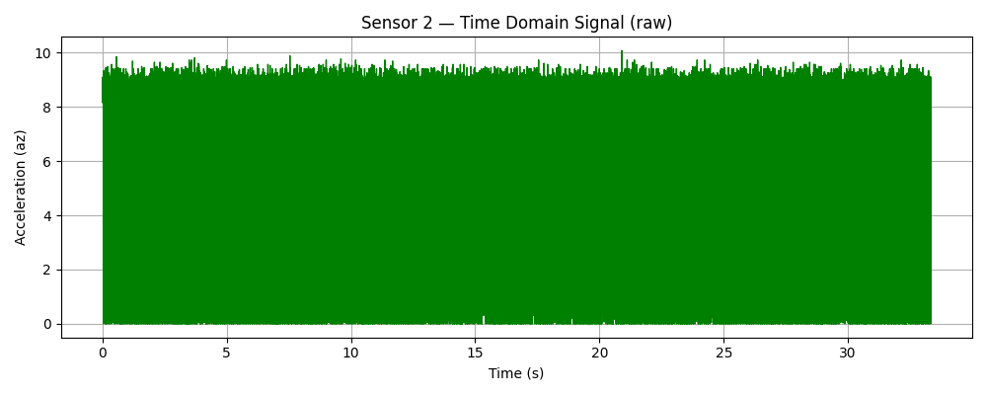
Results – Time Domain (Configuration 1)
Table 1: Parameters used configuration 1
Sampling frequency | Mounting orientation | Motor speed
1500 Hz | Top of bearing | 1320 RPM
Figure 14: Sensor 1 results
Figure 15: Sensor 2 results

Slide 13
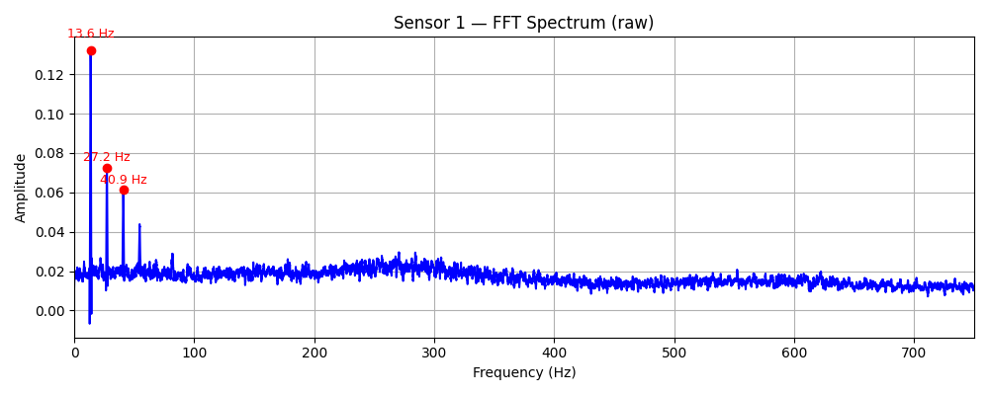
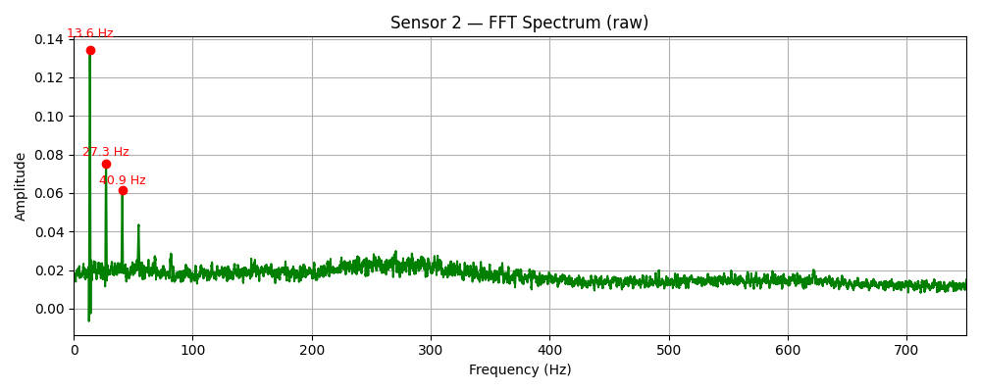
Results – FFT (Configuration 1)
The FFT spectrums of the raw data of the two sensors looks exactly the same.
Figure 16: Sensor 1 FFT spectrum
Figure 17: Sensor 2 FFT spectrum

Slide 14
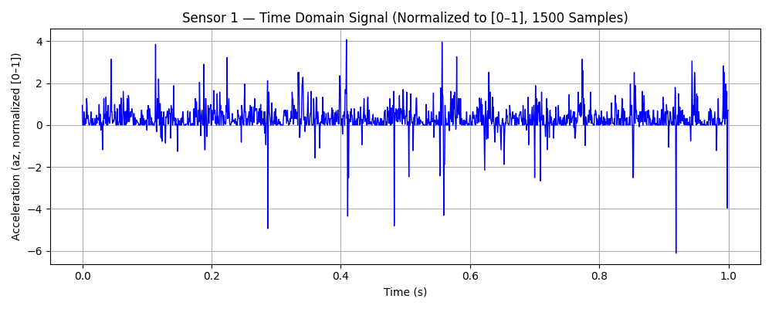
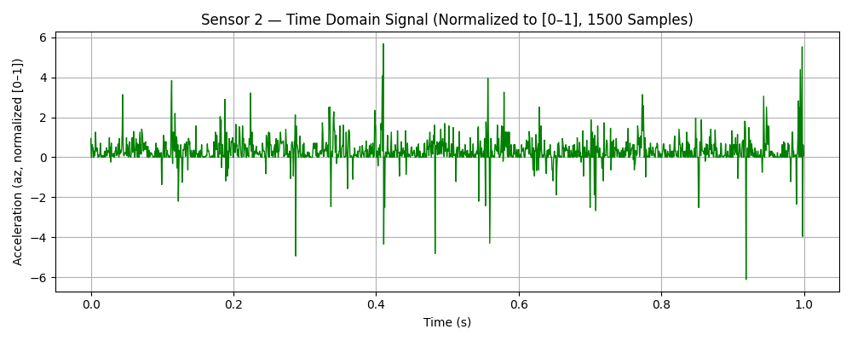
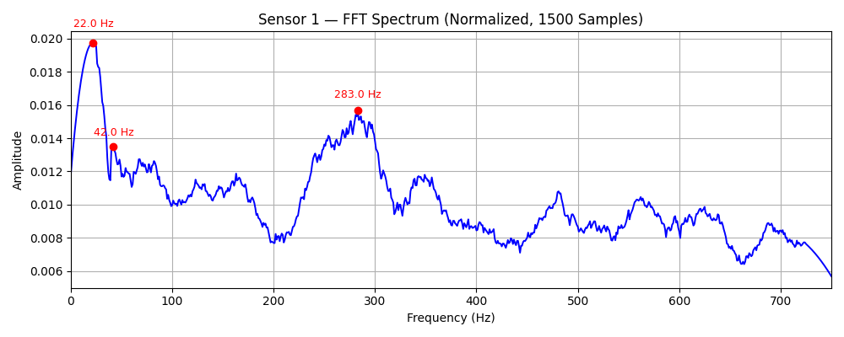
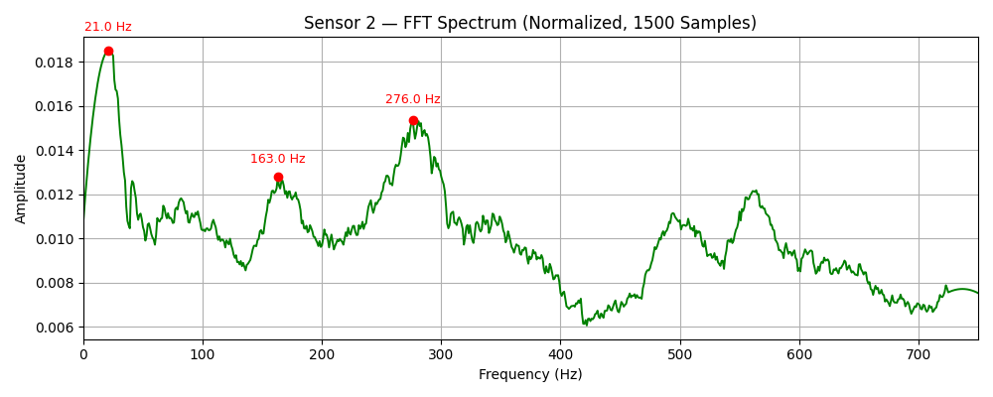
Results – Configuration 1 (Reduced Samples)
Figure 18: Sensor 1 time domain signals
Figure 19: Sensor 2 time domain signals
Figure 20: Sensor 1 FFT spectrum
Figure 21: Sensor 2 FFT spectrum

Slide 15
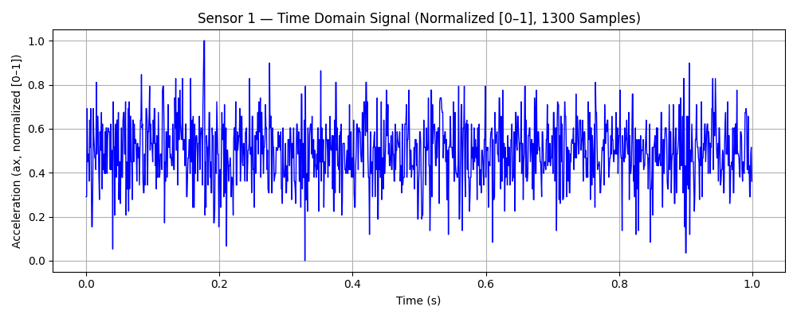
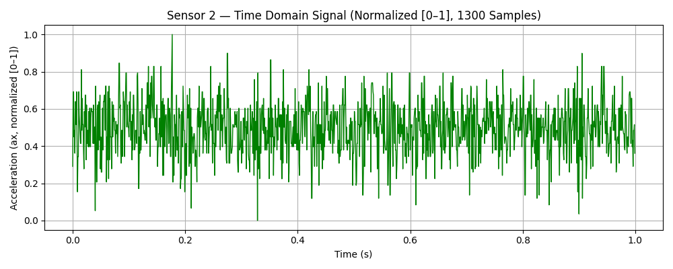
Results Cont. – Time Domain (Configuration 2)
Table 2: Parameters for configuration 2
Sampling frequency | Mounting orientation | Motor speed
1300 Hz | Side of bearings | 1320 RPM

Slide 16
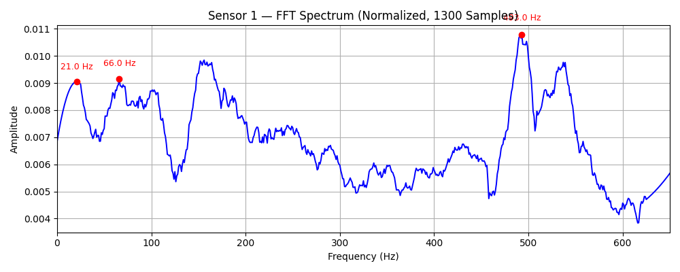
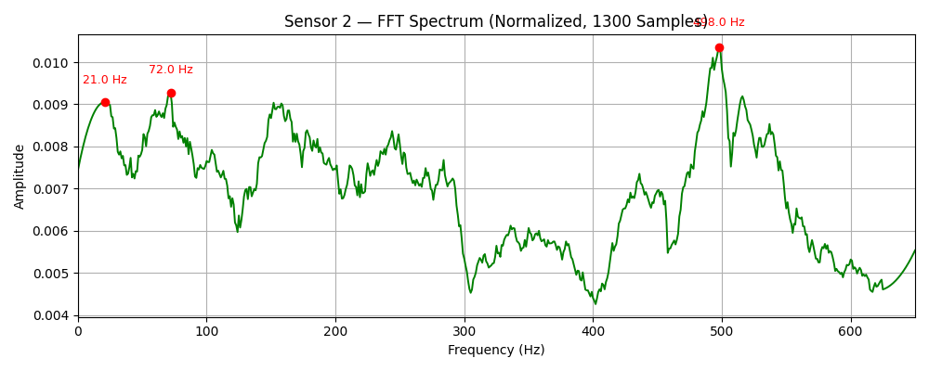
Results – FFT (Configuration 2)
The FFT spectrum of the sensor shows that the both sensor 1 and 2 were able to pick up the same frequency of 21 Hz.

Slide 17
Conclusion
Accelerometer are very sensitive to noise so therefore proper filtering were needed for data analysis.
The experiment was conducted for two different configurations, configuration 1, the sensors were mounted at the top of the bearings and configuration 2, the sensors were mounted by the side of the bearings.
The 1 second samples gives better time domain and FFT for visualization.
For configuration 1, the sensor 1 was able to pick the frequency motor of 22 Hz and configuration 2, was able to pick the frequency of 21 Hz for both sensors.
For both experiments, the sensors were not able to pick the exact frequency of the bearing frequency and gear mesh frequency, however new vibrations were picked.
The new peaks that were picked on both experiment needs further investigation.
Overall, the aim of the project was successfully met.

Slide 18
References
[1] D. Goyal and B. S. Pabla, “The Vibration Monitoring Methods and Signal Processing Techniques for Structural Health Monitoring: A Review,” Archives of Computational Methods in Engineering, vol. 23, no. 4, pp. 585–594, Dec. 2016, doi: 10.1007/s11831-015-9145-0.
[2] “Mechanics Map - Undamped Harmonic Forced Vibrations.” Accessed: Sep. 01, 2025. [Online]. Available: https://mechanicsmap.psu.edu/websites/16_one_dof_vibrations/16-4_undamped_harmonic/16-4_undamped_harmonic.html
[3] V. P. Raj, Dr. K. Natarajan, Sri, and T. G. Girikumar, “Induction motor fault detection and diagnosis by vibration analysis using MEMS accelerometer,” 2013 International Conference on Emerging Trends in Communication, Control, Signal Processing and Computing Applications (C2SPCA), pp. 1–6, 2013, [Online]. Available: https://api.semanticscholar.org/CorpusID:18282480.
[4] S. B. Chaudhury, M. Sengupta, and K. Mukherjee, “Vibration Monitoring of Rotating Machines Using MEMS Accelerometer,” 2014, [Online]. Available: www.ijser.in.
[5] A. D. Nembhard, J. K. Sinha, A. J. Pinkerton, and K. Elbhbah, “Combined vibration and thermal analysis for the condition monitoring of rotating machinery,” Struct Health Monit, vol. 13, no. 3, pp. 281–295, 2014, doi: 10.1177/1475921714522843.
[6] A. S. Cassim, D. M. Madyira, and R. T. Tebeta, “Investigating Torsional Vibration Monitoring Using Optical Sensors and Encoder Wheels,” in 2024 15th International Conference on Mechanical and Intelligent Manufacturing Technologies, ICMIMT 2024, Institute of Electrical and Electronics Engineers Inc., 2024, pp. 74–79. doi: 10.1109/ICMIMT61937.2024.10585646

Slide 19
Any Questions?

Slide 20



