Slide 1



Data Analysis for Fiber Optic Sensors in the SAFARI-1 Nuclear Reactor
NGOMANE Z
221122211
Project Investigation 4000
Faculty of Engineering and the Built Environment Department of Mechanical Engineering Science

Slide 2


Introduction Research objectives Experimental set up Results Radiation effect Conclusion
Contents

Slide 3
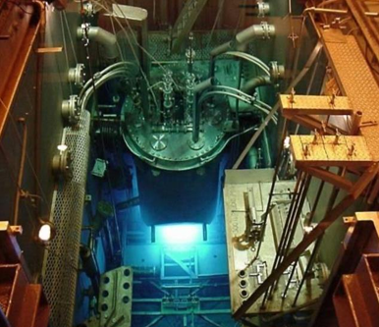
INTRODUCTION
What is a nuclear reactor?
A nuclear reactor is a system that controls a sustained chain reaction, typically to produce energy, conduct research, or create medical isotopes.
Operates under extreme temperature and radiation.
Temperature monitoring is critical for safety.
Purpose
Test the use of optical fiber sensors for temperature
measurement.
Why fibre optic sensors?
Traditional sensors degrade in radiation.
FBGs: radiation-resistant up to 12 GGy.
Figure 1: Top view of the SAFARI-1 reactor [1].

Slide 4
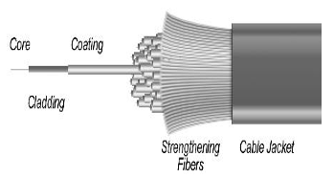
INTRODUCTION (cont.)
Fiber Optic Sensor
Fibre Optic Sensors (FOS): These are gadgets that sense and measure environmental conditions. Function: They turn pressure, temperature, or strain into modulated light signals. Transmission: The light signals move through optical fibers with silica core. Design: The fibers come with special coatings that boost sensitivity. Durability: They are designed to work reliably, even in tough or extreme environments.
Figure 2: Optical Fiber [2].

Slide 5
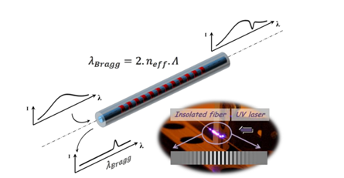
INTRODUCTION (cont.)
Fiber Bragg Gratings
Fiber Bragg Gratings (FBGs): Optical sensors in fiber cores. Function: Reflect specific wavelengths of light. Use: Measure temperature, strain, and pressure accurately.
Figure 3:Spectral response of a standard FBG photowritten [3].

Slide 6
RESEARCH OBJECTIVES
Develop computational algorithms using Python and ROOT.
Validate algorithms using real-time reactor data.

Slide 7
EXPERIMENTAL SET UP
Sensor Preparation
FBGs inscribed and calibrated overnight
Assembly
4-channel fiber (Telecom, Fujikura, Ge/B-doped, iXBlue) crimped & connected.
Installation
Sensor lowered into reactor test postion
Data Collection.
Record Spectra
Processing
Detect peaks
Convert to Temperature output

Slide 8
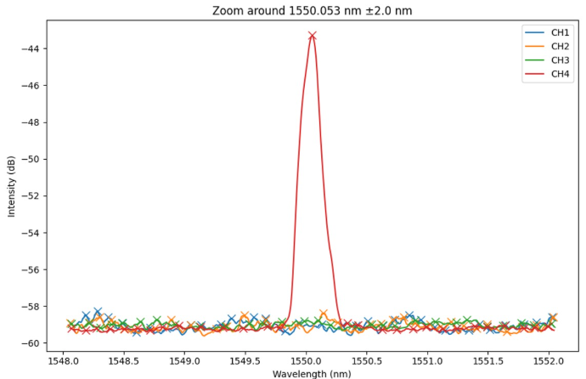
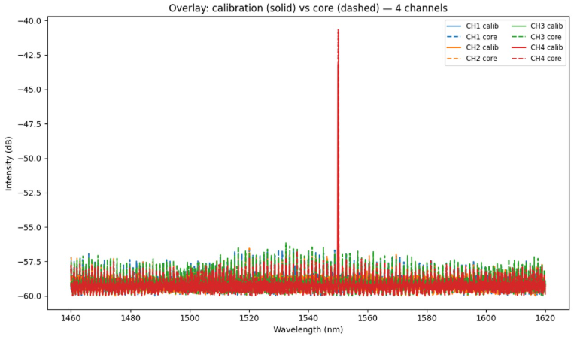
Results
Spectra response.
Why channel 4 (iXBlue).

Slide 9
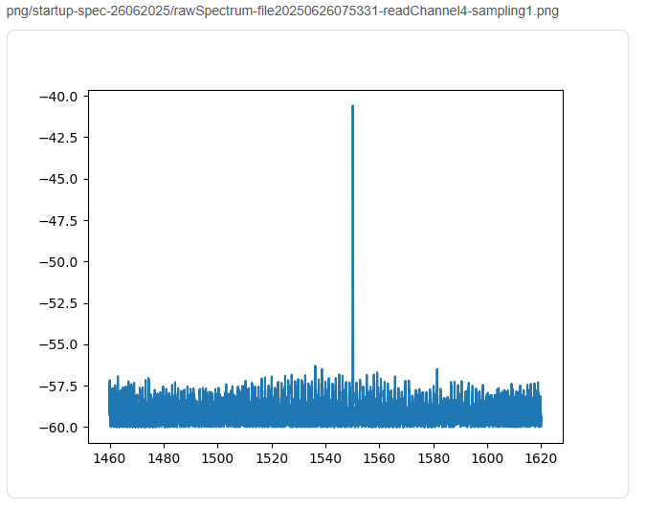
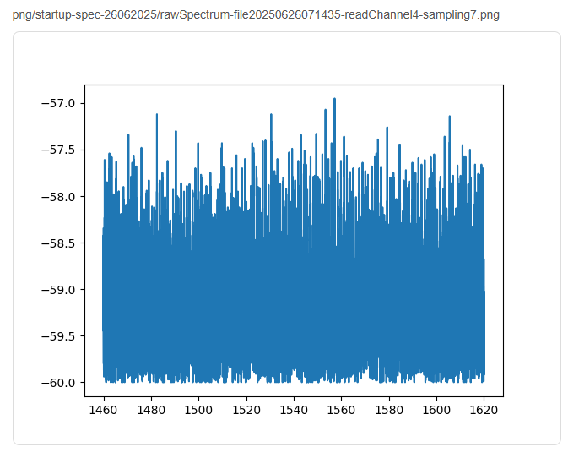
Results (cont.)
Channel 4 read outs.

Slide 10
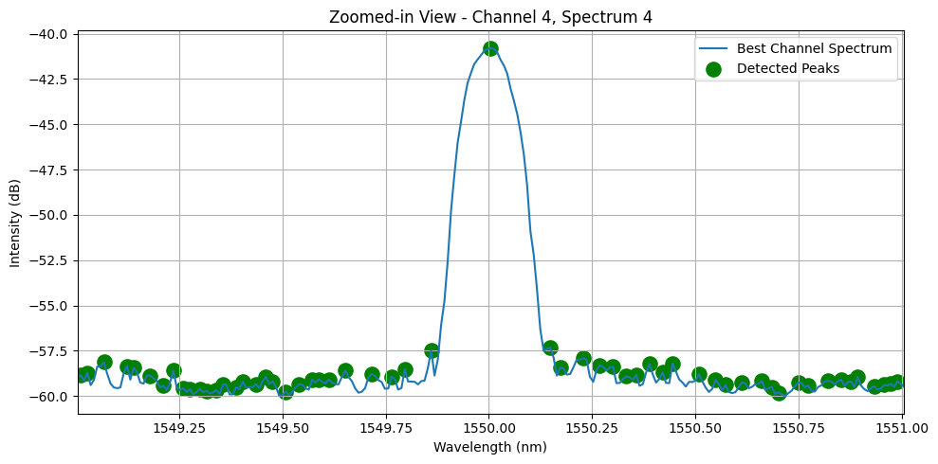
Results (cont.)
Channel 4 peaks.

Slide 11
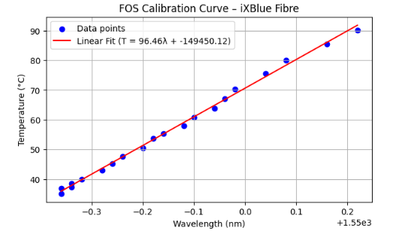
Results (cont.)
Calibration

Slide 12
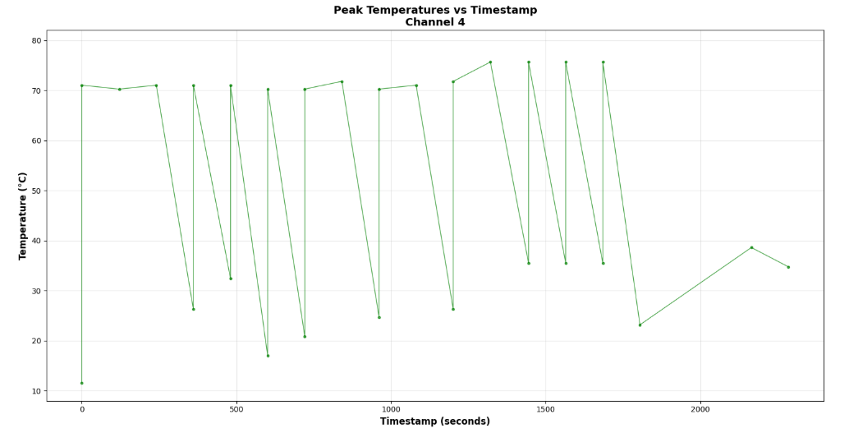
Results (cont.)
Output temperature

Slide 13
Radiation effect
Wavelength range: 1549.4–1550.0 nm →stable under irradiation.
Temperature range: 15–75 °C (expected reactor variation).
Effect: Minor red-shift during exposure, reversible after cooling.
Signal: Low peak count → radiation noise.

Slide 14
CONCLUSION
Fibre optic sensors accurately measured temperature inside the reactor.
Radiation caused only small, reversible wavelength shifts.
Sensors remained stable, fast, and radiation-resistant ideal for nuclear monitoring

Slide 15
Thank you. Any Questions?

