Slide 1
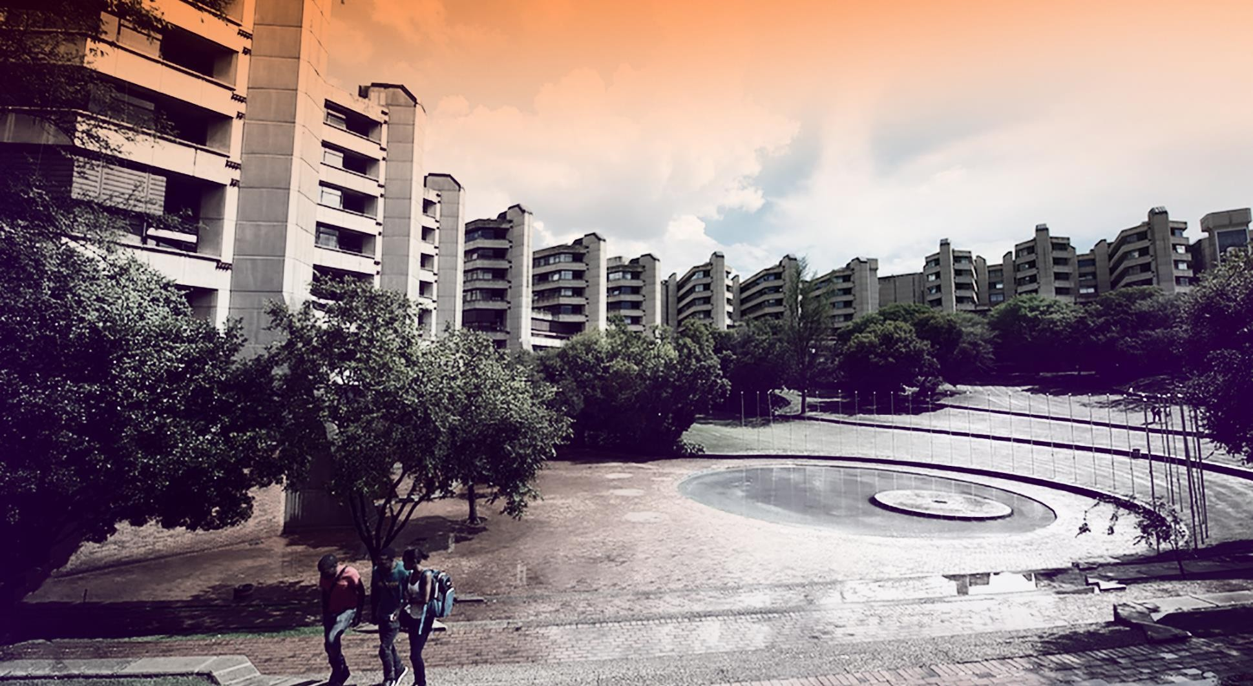

Gaol.
GEANT4 SIMULATION FOR FOS PACKAGE AT ATLAS ITk
LN MKHWANAZI
PROJECT INVESIGATION (PJMMCY4)
10 OCTOBER 2025
1

Slide 2
Contents
Brief background of project apparatus
Fibre optic sensors (FOS)
Problem statement and aim
Methodology
SolidWorks model
GEANT4 simulation
Radiation maps
Results analysis
2

Slide 3
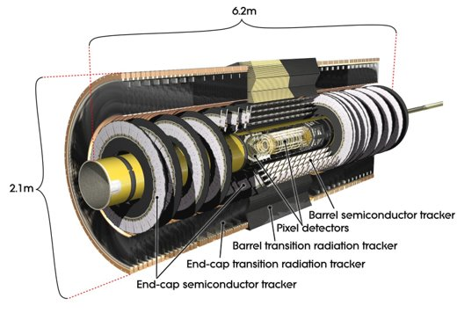
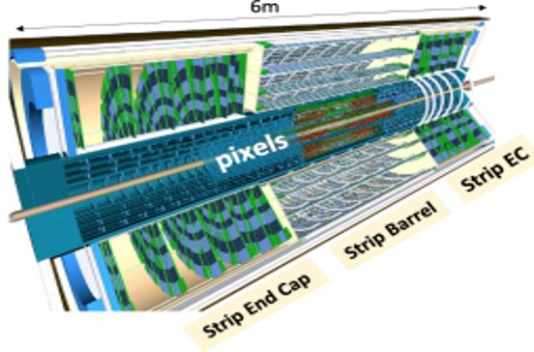
Background on Project Apparatus
LHC and HL-LHC
Explores fundamental components of matter and governing interaction forces.
Particle colliders: Accelerate particles and colliding them.
World’s biggest and most powerful particle accelerator.
Located at CERN (European Oganization for Nuclear Research) in Geneva, Switzerland.
Although the LHC has been monumental in particle physics, upgrades are required heighten its capabilities.
Inception of the High-Luminosity Large Hadron Collider (HL-LHC) project.
Inner Detector (ID) & Inner Tracker (ITk)
ID is the innermost component of the ATLAS detector, closest to the proton-proton collision points.
Tracks the paths of charged particles as they emerge from collision point.
ITk - new all silicon tracking system, upgraded version of ID.
Figure 2 – ATLAS inner detector [2]
ATLAS Detector
ATLAS – A Toroidal LHC ApparatuS.
One of the major multi-purpose particle detectors at LHC.
Surrounds one of the four main collision points.
Figure 1 – ATLAS inner tracker [1]
3

Slide 4
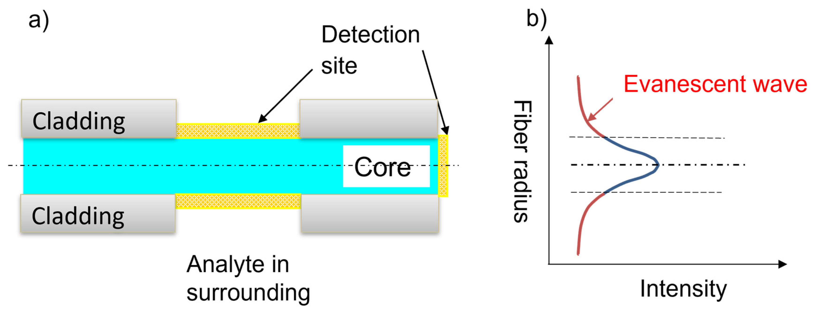
Fibre Optic Sensors (FOS)
Advanced sensing devices that use optical fibres to detect and measure physical, chemical or environmental parameter.
Two main types of FOSs:
- Long Period Gratings (LPG) - Fibre Bragg Gratings (FBG)
Table 1: Why FOS selected for ID and ITk?
Challenge | Sensor Requirement | FOS Advantage
High radiation | Radiation hardness | Properly selected fibers withstand high doses
Strong magnetic field | No electromagnetic interference | Optical sensors unaffected by EM fields
Temperature gradients | High-resolution temperature measurement | FBGs or distributed sensing
Limited access | Reliability and minimal need for maintenance | Passive and long-life components
Figure 3 – Schematic of FOS [3].
Basic Principle of FOS: Based on the interaction between light and the environment.
Light Alteration: External influences can modify the light traveling through the fibre.
Property Changes: These influences alter the properties of the light, therefore transmitting light.
Material: FOS used in ID & ITk made from silica.
4
4

Slide 5
Problem Statement and Aim
Problem Statement
System comprised of multiple FOS packages is being developed for the ATLAS ITK.
Exposed to hostile conditions including harsh radiation emitted by colliding particles.
Effects of radiation include damage to sensors, operation mechanics and material degradation.
Investigate radiation effects on FOS packages to be installed inside ATLAS ITK at the HL-LHC.
Aim
This study aims to:
Obtain a model for a FOS package body through SolidWorks
and
Create a GEANT4 simulation to assess the level of radiation and possible impairments on the FOS package body.
5
5

Slide 6
Methodology
1. FOS SolidWorks model
Provision of FOS SolidWorks model used to for this project.
2. Simulation approach
Simulation conducted on lxplus high performing computing cluster locating at CERN.
Use of GEANT4 framework formulated based Monte Carlo methods.
Change in simulation configuration.
Implementation of FOS geometry and material in simulation.
3. Radiation maps
Use of simulation output data to form radiation maps.
4. Analysis
Calculation of TID and fluence.
Calculation of radiation dose.
6
6

Slide 7
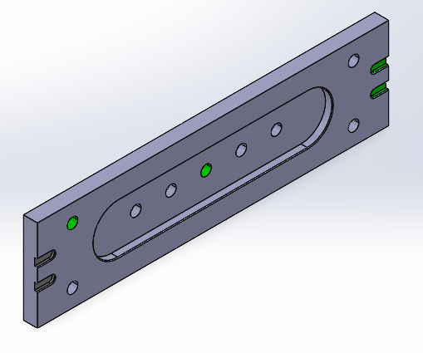
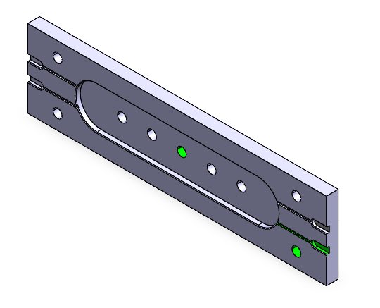
FOS SolidWorks Model
Provision of FOS SolidWorks model used to for this project.
Figure 4 – CAD model of FOS package
7
7

Slide 8
Simulation Approach
Overview
Simulation Functionality
Goal: To model how radiation is transferred during particle collisions in the ATLAS ITk.
Expected results: Used to show the intensity of radiation expected on different sections of the ATLAS detector.
Tools: The GEANT4/Athena framework used.
Configuration: Simulation setup is based on the HL-LHC ITk Run-4 operating conditions, with 14 TeV proton-proton collisions.
Process: 3 proton-proton events per dataset.
Time: Approx. takes 1.5 hours to run for 3 events.
Output: Simulation results in .root file containing pseudo-density plots, 2D and 3D radiation map data
GEANT4/Athena framework tracks particle paths and energy deposit
As they interact with each other (and with detector material) when move within detector.
Tracked particle path provide info on:
Type & position of particle, velocity, particle composition.
Results saved as data further processed into maps that provide radiation quantities.
TID
Fluence
NEUT
Density
SEE
8
8

Slide 9
Radiation Quantities
Total Ionizing Dose (TID)
Fluence (ϕ)
TID measures energy deposited in through ionization per unit mass.
Expressed through unit, grey (Gy = J/kg) defined as the absorption of one joule of radiation energy per kilogram of matter.
Number of particles passing through a surface per unit area.
Energy fluence (J/m²) defined as the energy transported by particles through a unit area.
Single Event Effects (SEE)
Non-Ionizing Energy Loss (NIEL)
Fluence of hadrons (proton and neutrons).
Parameterized by hadron fluence greater than 20 MeV (h>20 MeV/cm²).
Defined as the part of the incident particle energy consumed through Coulombic, nuclear elastic and inelastic interactions.
Interactions that occur between lattice atoms and incident particle.
Aims to produce vacancy-interstitial pair which is the displacement damage.
Density (ρ)
Spatial distribution of energy deposited (dE/dV) or radiation dose (D = dE/dm) per unit volume .
NEUT
Fluence of neutrons.
Parameterized by netron fluence greater than 100 keV (h>100 keV/cm²).
9
9

Slide 10
Radiation Maps
Creation of radiation maps
Process split into two sections.
Platform: Code ran on ROOT (software framework developed by CERN).
Source: C files obtained from gitlab forum with code needed to evaluate simulation output data.
1. AverageRadMaps.C
2. PlotRadMaps.C
Input: Results from conducted simulation, stored as root file.
averageRadMaps_25events_R2-2025-01-00-01-14TeV.root
Takes directory of ROOT files with 2D or 3D histograms.
Computes average value per bin across all input histograms.
Output: Saved into RadMaps.root file that contains:
Averaged histogram for each plot based on radiation quantities.
Input: Output root file from first section.
RadMaps.root
Code variables: Used to physically scale histograms.
No. of Events = 3 events
Luminosity = 4000 fb⁻¹
Cross section = 79 mb.
Reads histograms from attached RapMaps.root file.
Defines histogram names based on radiation quantities.
Normalize based variables and draw revised histograms.
Output: Radiation maps and radmaps.txt file with plot data.
10
10

Slide 11
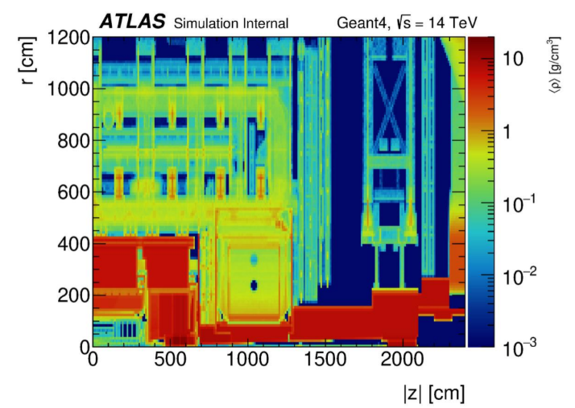
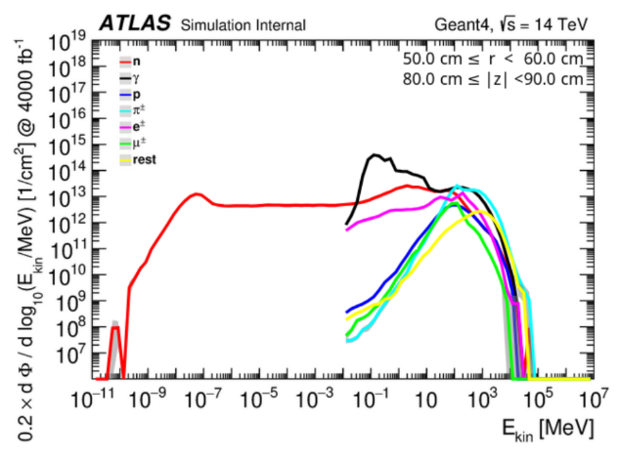
Radiation Maps
Density Plot
Particle spectra visualization plot
Figure 5 - Resultant radiation distribution map based on density. [6]
Figure 6 – Particle spectra visualization plot. [6]
11
11

Slide 12
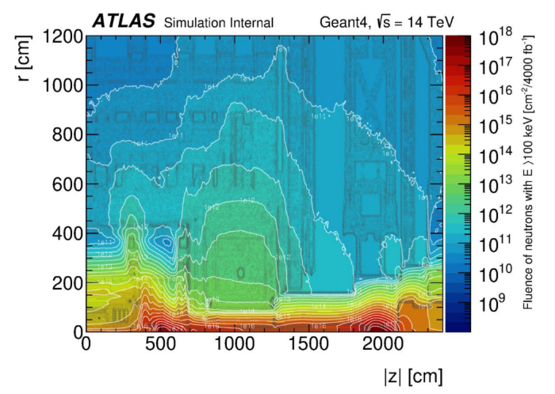
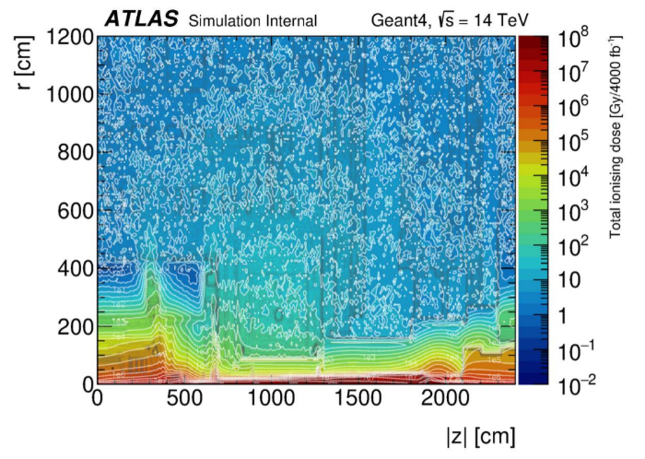
Radiation Maps
NEUT Plot
TID Plot
Figure 7 - Resultant radiation distribution map based on NUET. [6]
Figure 8 - Resultant radiation distribution map based on TID. [6]
12
12

Slide 13
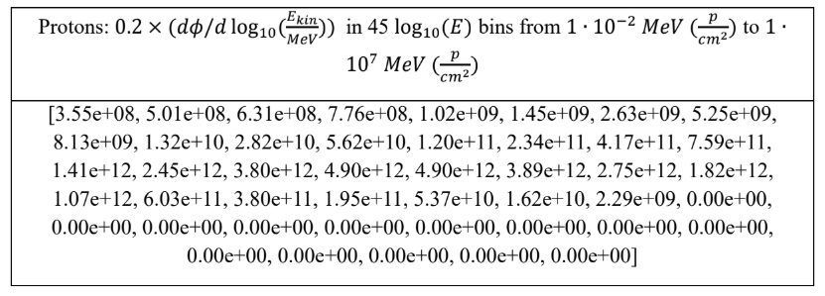
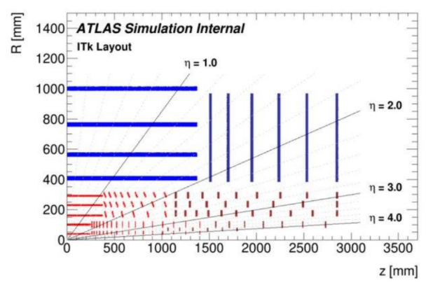
Results Analysis
Computed data at set position
Using FOS positions at ITk, each are selected on interactive radiation map.
Data produced for each particle (protons, neutrons, electrons, pions, muons and gamma) at each sensor position for HL-LHC ITk Run-4.
Table 2 - Fluence output data for protons provided by simulations.
To get overall fluence, the data depicted in table are summed for each particle.
Figure 9 - 2D layout of the ITk, with the blue lines representing the strip detector and the red lines representing the pixel detector. [5]
13
13

Slide 14
Results Analysis
Computed data at sensor positions
Position of sensor [radius/z-axis] (mm) | Protons | Electrons | Pions | Neutrons | Muons | Gamma
399/0 | 1.44e⁰⁶ | 5.52e⁰⁸ | 0.00e⁰⁰ | 1.87e¹¹ | 3.45e⁰⁸ | 3.08e¹⁰
562/813 | 1.44e⁰⁹ | 9.95e⁰⁹ | 0.00e⁰⁰ | 2.47e¹² | 8.87e⁰⁸ | 1.18e¹²
762/934 | 8.32e⁰⁸ | 6.49e⁰⁹ | 0.00e⁰⁰ | 1.34e¹² | 1.32e⁰⁸ | 7.06e¹¹
1000/1200 | 2.34e⁰⁸ | 5.20e⁰⁹ | 0.00e⁰⁰ | 5.89e¹¹ | 1.52e⁰⁸ | 3.83e¹¹
1058/943 | 2.70e⁰⁸ | 5.92e⁰⁹ | 0.00e⁰⁰ | 4.26e¹¹ | 1.23e⁰⁸ | 3.33e¹¹
Table 3 - Fluence output data for different particles at various sensor locations
14
14

Slide 15
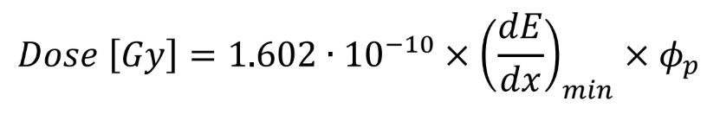

Results Analysis
Obtaining TID
An estimation of the TID (Gy) through using the proton fluence [4].
Obtaining NIEL
The equivalent 1 MeV neutron fluence was calculated through multiplying the proton fluence
φ_{protons} by the hardness factor k [4]:
15
15

Slide 16
Results Analysis
Computed TID
Computed NIEL
Position of sensor [radius/z-axis] (mm) | Protons [ϕ_{p}] (cm⁻²) | Calculated TID (Gy)
399/0 | 1.44e⁰⁶ | 1.44e⁻⁰⁴
562/813 | 1.44e⁰⁹ | 3.84e⁻⁰¹
762/934 | 8.32e⁰⁸ | 2.22e⁻⁰¹
1000/1200 | 2.34e⁰⁸ | 6.24e⁻⁰²
1058/943 | 2.70e⁰⁸ | 7.20e⁻⁰²
Position of sensor [radius/z-axis] (mm) | Protons [ϕ_{p}] (cm⁻²) | Calculated NIEL (Gy)
399/0 | 1.44e⁰⁶ | 8.93e⁰⁵
562/813 | 1.44e⁰⁹ | 8.93e⁰⁸
762/934 | 8.32e⁰⁸ | 5.12e⁰⁸
1000/1200 | 2.34e⁰⁸ | 1.45e⁰⁸
1058/943 | 2.70e⁰⁸ | 1.67e⁰⁸
Table 3 – Calculated proton fluence and TID.
Table 4 – Calculated proton fluence and NIEL.
16
16

Slide 17
Results Analysis
Comparison of TID
Comparison of NIEL
Position of sensor [radius/z-axis] (mm) | TID from radiation maps (Gy) | Calculated TID (Gy)
399/0 | 4.86e⁻⁰¹ | 1.44e⁻⁰⁴
562/813 | 1.08e⁰⁰ | 3.84e⁻⁰¹
762/934 | 5.32e⁰⁰ | 2.22e⁻⁰¹
1008/1202 | 4.28e⁰⁰ | 6.24e⁻⁰²
1058/943 | 4.55e⁰⁰ | 7.20e⁻⁰²
Position of sensor [radius/z-axis] (mm) | NIEL from radiation maps (Gy) | Calculated NIEL (Gy)
399/0 | 4.82e¹⁰ | 8.93e⁰⁵
562/813 | 5.79e¹¹ | 8.93e⁰⁸
762/934 | 2.88e¹¹ | 5.12e⁰⁸
1008/1202 | 1.29e¹¹ | 1.45e⁰⁸
1058/943 | 1.05e¹¹ | 1.67e⁰⁸
Table 6 – Comparison of TID
Table 7 – Comparison of TID
17
17

Slide 18
Conclusion
Through the calculation of TID and NIEL, the values are compared to TID and NIEL values obtained from the radiation maps data.
Calculated values are less than values from radiation maps.
Cause: Calculated TID and NIEL values are only based on protons, compared to the inclusion of all particles for the other values.
Results: Fundamentally proves that data obtained from conducted simulation corresponds with the existing TID and NIEL values.
Radiation dosage levels acting on FOS packages.
Last development
Integration of FOS geometry and material to evaluate changes.
Material and geometry updated in code files.
Wait on colleagues at CERN to finalize simulation.
18
18

Slide 19
References
[1] I. Béjar Alonso, O. Brüning, P. Fessia, M. Lamont, L. Rossi, L. Tavian, M. Zerlauth. “Vol. 10 (2020): High-Luminosity Large Hadron Collider (HL-LHC): Technical design report”. Accessed: May 20, 2025. ISBN 978-92-9083-586-8. https://doi.org/10.23731/CYRM-2020-0010
[2] ATLAS Collaboration. “The ATLAS Experiment at the CERN Large Hadron Collider: A Description of the Detector Configuration for Run 3”. Instrumentation and Detectors (physics.ins-det); High Energy Physics – Experiment. Accessed: May 20, 2025. https://doi.org/10.1088/1748- 0221/19/05/P05063
[3] M. Elsherif, A. Salih. “Optical Fiber Sensors: Working Principle, Applications, and Limitations”. Advanced Photonics Research. Accessed: May 20, 2025. https://doi.org/10.1002/adpr.202100371
[4] F. Ravotti, "Dosimetry Techniques and Radiation Test Facilities for Total Ionizing Dose Testing," in IEEE Transactions on Nuclear Science, vol. 65, no. 8, pp. 1440-1464, Aug. 2018, doi: 10.1109/TNS.2018.2829864. keywords: {Ionizing radiation sensors;Dosimetry;Radiation effects;total ionizing dose;Dosimetry;ionizing radiation sensors;radiation effects;test facilities;total ionizing dose (TID)},
[5] T. Saleem, ‘Development of pixel detector for ATLAS Inner Tracker(ITK) upgrade at HL-LHC and Searching for the Standard Model Higgs boson decay into b-quark pair with ATLAS experiment’, Université Paris Saclay (COmUE), 2019. Accessed: May 05,2025. [Online]. Available: Université Paris Saclay (COmUE)
[6] Mika Huhtinen, Sven Menke, “Radiation Maps from Geant4 Simulations.” Accessed: Sep. 09, 2025. [Online]. Available:https://twiki.cern.ch/twiki/bin/viewauth/Atlas/RadiationMapsGeant4View#Radiation_Maps_for_Phase_II
19
19

Slide 20
THANK YOU

Slide 21
BACKUP

Slide 22
Performance Improvements of ID and ITK
Feature | Current Inner Detector | Itk
Peak luminosity | 10³⁴ cm⁻²s⁻¹ | 7,5 * 10³⁴ cm⁻²s⁻¹
Extreme pile up | 20 - 40 proton-proton collisions | 200 proton-proton collisions
Radiation tolerance | Up to 100 Mrad | >1 Grad
Granularity | mm-scale (TRT) | um-scale (pixels)
22

Slide 23

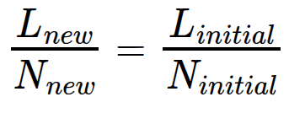
Creating Radiation Maps
Luminosity calculation
To obtain the luminosity used for this simulation, the formula below is used.
Where N is the number of events, σ is the cross section (79 mb) and L is the luminosity.
Since cross section is constant, formula is manipulated to obtain desired values.
Given the values: L_{initial} = 4000 fb⁻¹, N_{initial} = 21•10⁶ events and N_{new} = 3 events.
Calculated luminosity to be used in simulation is:
L_{new} = 5.714285714 • 10⁻⁴ fb⁻¹
23

Slide 24
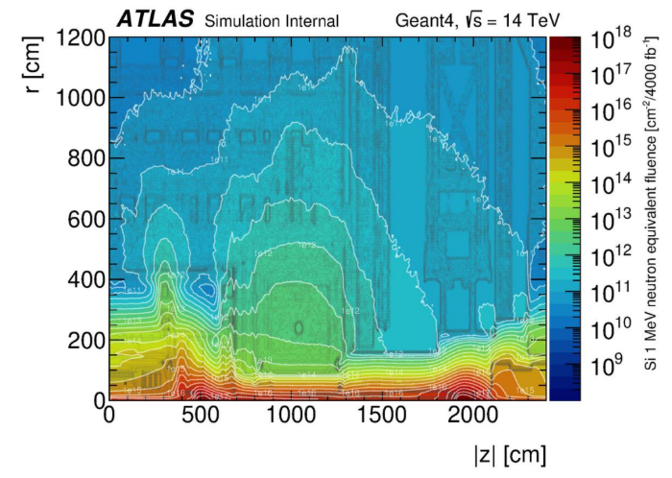
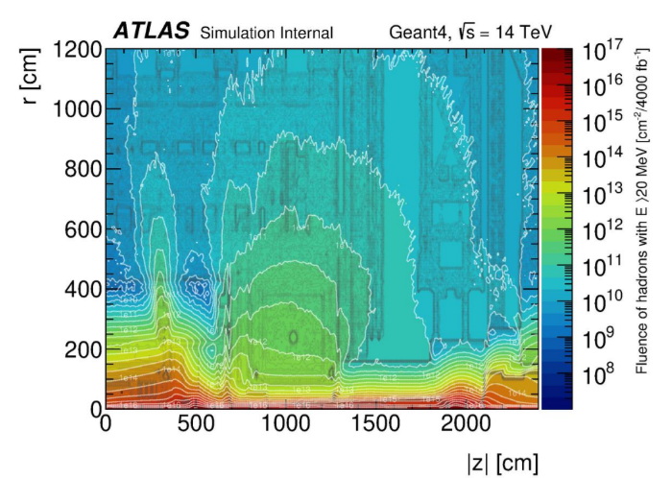
Radiation Maps
NIEL Plot
SEE Plot
Figure __ - Resultant radiation distribution map based on NIEL.
Figure __ - Resultant radiation distribution map based on SEE.
24
24

