Slide 1
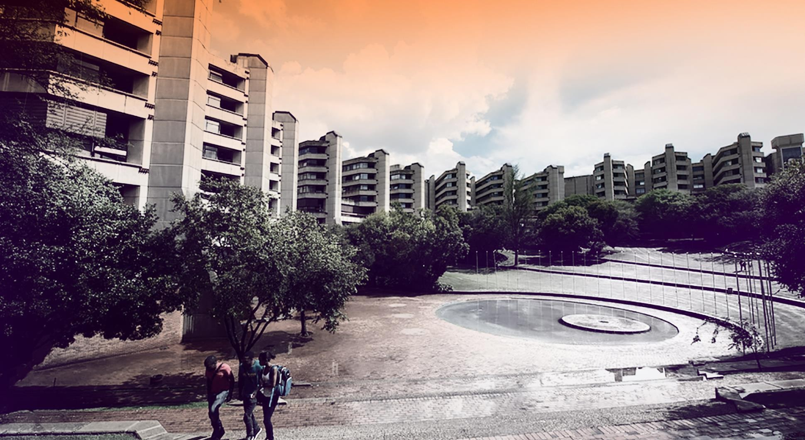


Data Analysis For Fibre Optic Sensors In The ATLAS Inner Detector At The Large Hadron Collider
Lwazilwenkosi Ndumiso Mthethwa
222015002
Project Investigation (Mechanical) 4
Faculty of Engineering and the Built Environment Department of Mechanical Engineering Science
Supervisor: Dr Truong

Slide 2
Contents
CERN & ATLAS Inner Detector Overview
Problem statement, Aim and Objectives
Fibre Optic Sensors
Experimental set up and methodology Results Conclusion
References

Slide 3
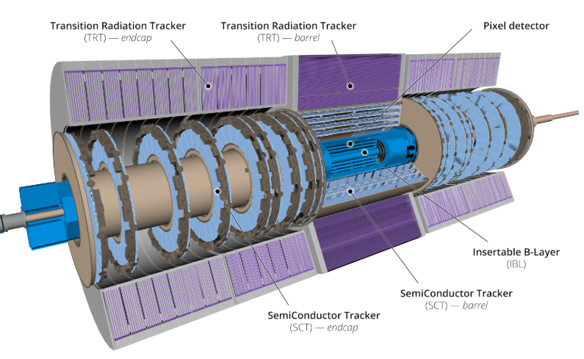
CERN & ATLAS Inner Detector Overview
CERN – Geneva (Switzerland–France border)
Home to the Large Hadron Collider (LHC)
Enable high-energy proton and heavy ion collisions to study fundamental particles and forces
ATLAS Detector
46 m × 25 m, ~7 000 tonnes
Studies particle interactions and radiation effects
Inner Detector (Core of ATLAS)
Tracks charged particles, measures momentum
Operates in high radiation & magnetic fields
Needs stable temperature & humidity
6.2 m × 2.1 m
Figure 1: Cross-sectional view of the ATLAS ID showing the arrangement of the pixel detector, semiconductor tracker and transition radiation tracker. [1]

Slide 4
Problem statement, Aim and Objectives
Problem statement
Fibre optic sensors were installed in 2019 to monitor environmental conditions.
Over time, radiation exposure degraded calibration accuracy.
Sensors still function, and measurements are no longer reliable without correction.
Aim
This research aims to develop a new calibration method for analysing environmental readings from the ATLAS ID installed at the LHC.
Objectives
Analyse spectral output from installed FOS over time
Identify how radiation affects temperature and humidity readings
Develop a correction model

Slide 5
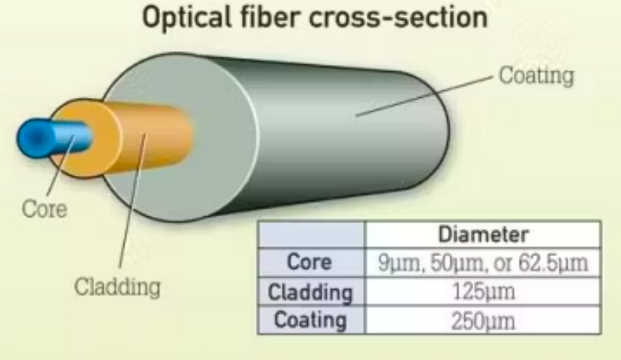
Fibre Optic Sensors
Principle: Light is guided through the core by total internal reflection at the core-cladding boundary.
Fibres for ATLAS use pure silica or fluorine-doped cores for superior performance in high-radiation environments.
Components
Core: Central channel, carries the light.
Cladding: Surrounds the core with a lower refractive index to trap light via Total Internal Reflection.
Coating: Protective layer for durability and handling. Intensive radiation.
Figure 2: Dimetric view of the fiber optic sensor. [2]
External environmental factors like Temperature, Strain, or Pressure interact with the optical fibre.
This interaction alters the properties of the light traveling through it (its wavelength, intensity, or phase).
By precisely measuring these changes in the light, we derive quantitative physical measurements

Slide 6
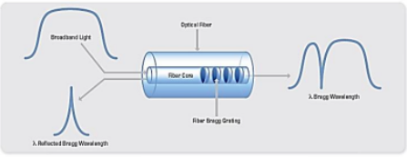
Fiber optic sensors cont.
Fiber Bragg Gratings (FBGs)
What is it? A periodic grating inscribed in the fibre core that reflects a specific wavelength.
Working Principle:
Changes in temperature shift the Bragg wavelength.
Key Features:
High Multiplexing: >100 sensors on a single fibre.
Radiation Tolerant: Up to 10 GGy.
Fast Response: <100 ms.
Applications:
Structural health monitoring, and temperature/strain mapping in the ATLAS Inner Detector.
Figure 3: FBG sensor [3, 4].

Slide 7
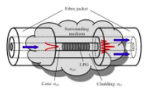
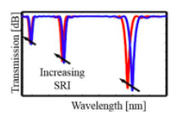
Fiber optic sensors cont.
Long Period Gratings (LPGs)
What is it:
A grating that couples core light to cladding modes, creating attenuation bands.
Key Feature:
High sensitivity to refractive index and chemical environment.
Applications:
Chemical sensing and environmental monitoring
Critical Use Case in ATLAS: Replaced failing commercial humidity sensors.
Integrated into the Inner Detector endplate for reliable dew-point monitoring during operation
Figure 4: LPG sensor [3]
Figure 5: LPG expected plot [3].

Slide 8
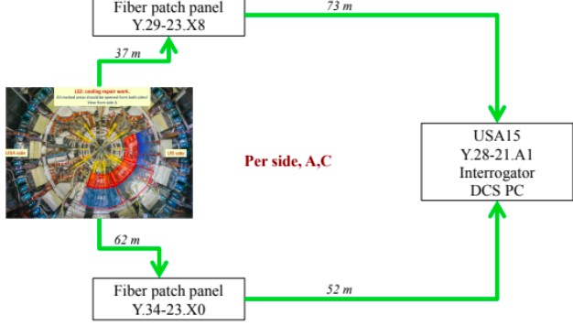
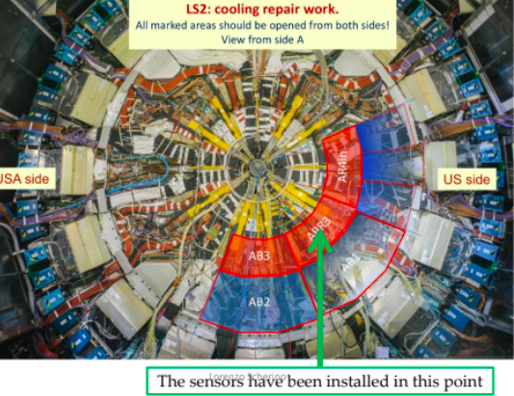
Experimental set up and methodology
During a maintenance shutdown, we installed sensor bundles directly onto key structural points (ABR3) inside the detector.
The sensors were installed on side A and C
Figure 7:Installation in the ATLAS IDEP [3].
This diagram traces the signal's journey from the detector, through over 70 meters of fiber optic cables and patch panels, to the interrogator and control PC in the USA15 service room."
It shows the critical infrastructure that brings the data from the harsh experimental environment to a safe location where we can read and analyse it.
Figure 6: FOS installation [3].

Slide 9
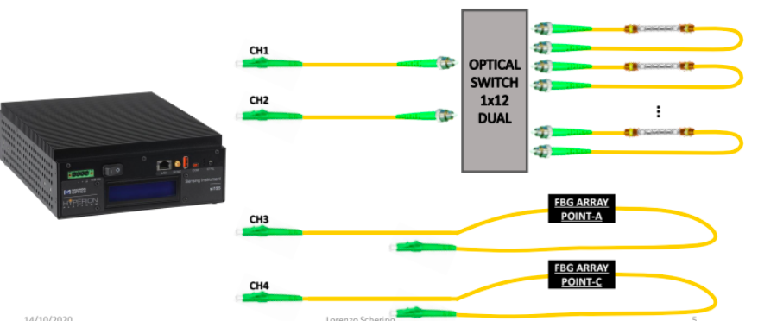
Experimental set up and methodology cont.
Readout and analysis
The interrogator in USA15 measures the tiny wavelength shifts in the light.
Python scripts
Raw spectral data was processed and convert it into temperature and humidity values on the DCS PC.
Enabling real-time monitoring of the detector through automated data visualization and analysis.
Figure 8: ATLAS FOS final setup scheme [3]
The key additions are:
Python scripts for data processing
Raw spectral data as the input
Automated data visualization and analysis to describe the plotting functionality

Slide 10
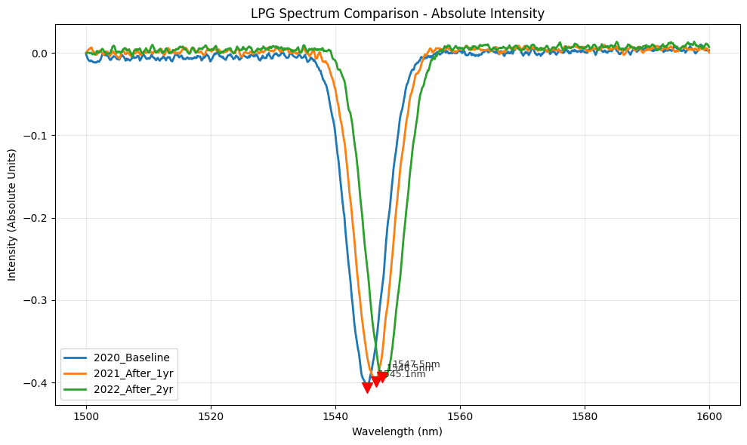
Results
Method: Comparative Historical Analysis
Conducted a direct comparison of the LPG attenuation dip wavelengths across three years: 2020, 2021, and 2022.
This analysis aimed to identify any systematic shifts in the sensor's spectral response over time.
Key Finding: Confirmed Wavelength Shift
A clear and progressive shift in the central wavelength of the LPG attenuation dip was observed between 2020 and 2022.
This shift indicates a change in the sensor's baseline calibration, consistent with the effects of cumulative radiation exposure.

Slide 11
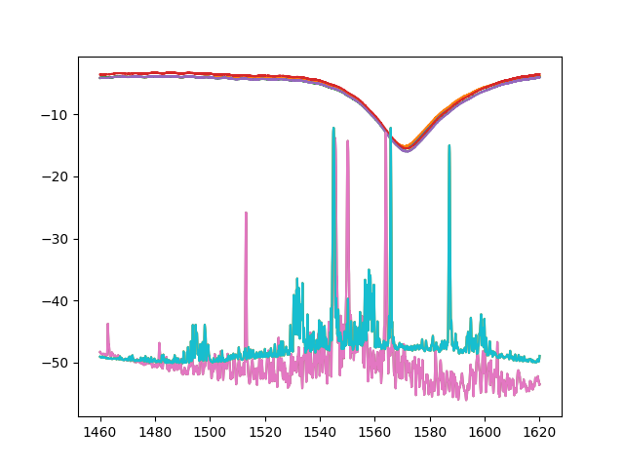
Results cont.
Supporting FBG Data
Initial plots of FBG sensors also show wavelength shifts over the same period, reinforcing the trend of radiation-induced drift affecting different sensor types.
Interpretation
The year-on-year change in the LPG dip provides direct evidence of calibration degradation.
This confirms the problem statement: while the sensors are functional, their readings are no longer reliable without applying a correction for this drift.

Slide 12
Conclusion
Findings
The comparative analysis successfully identified a progressive, radiation-induced wavelength shift in the LPG sensors from 2020 to 2022.
This confirms the initial degradation of sensor calibration, validating the core problem of this investigation.
Significance
This work provides the essential foundational evidence needed to justify the development of a correction model.
It proves that the sensor drift is measurable and systematic, making it possible to correct.
Next Steps for Model Development
Develop Correction Algorithm: Use the quantified drift to create a mathematical model that can adjust raw sensor data back to its accurate value.
Final Goal
To deliver a robust calibration method that restores the accuracy of the environmental monitoring system, ensuring the long-term stability of the ATLAS Inner Detector.

Slide 13
References
[1] “LHC The guide,” CERN, [Online]. Available: http://press.cern/press-kit. [Accessed 07 08 2025].
[2] ATLAS collaboration, “The ATLAS experiment at the CERN Large Hadron Collider: a description of the detector configuration for Run 3,” Journal of Instrumentation, vol. 19, no. 5, May 2019
[3] L. Scherino, E.J. Schioppa, A. Arapova, G.M. Berruti, W.J. Bock, A. Boniello, A. Borriello, S. Campopiano, M. Consales, A. Cusano, F. Esposito, A. Iadicicco, S. Kachiguine, P. Mikulic, K. Nagai, T. Neves, P. Petagna, G. Quero, D. Robinson, A. Srivastava,, “Fiber optic sensors in the ATLAS Inner Detector,” Nuclear Instruments and Methods in Physics Research Section A: Accelerators, Spectrometers, Detectors and Associated Equipment, vol. 1029, no. 10.1016/j.nima.2022.166470, Aprill 2022.
[4] Q. Wu, Y. Qu, J. Liu, J. Yuan, S.-P. Wan, T. Wu, X.-D. He, B. Liu, D. Liu, Y. Ma, Y. Semenova, P. Wang, X. Xin, G. Farrell , “Singlemode-multimode-singlemode fiber structures for sensing applications—A review,” IEEE Sensors Journal, vol. 21, no. 11, p. 12734–12751, June 2001.

Slide 14
THANK YOU Any Questions?

