Slide 1
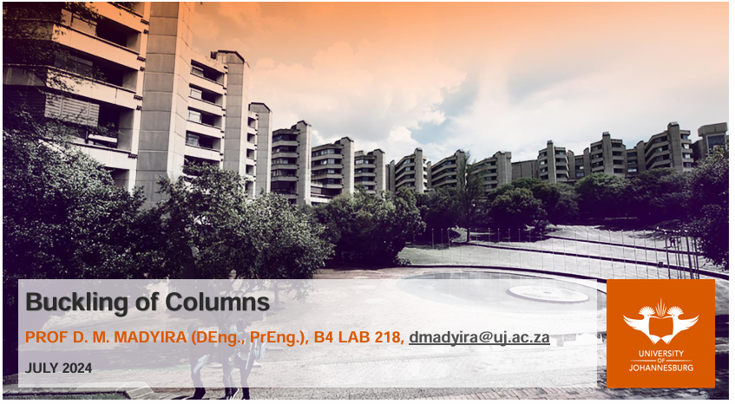
Investigation of radiation damage to fibre optic humidity sensors inside the Inner Detector in the ATLAS detector
Enrique Moodley
10/10/2025

Slide 2
Contents
Introduction to project
Brief of a Fibre optic sensor (FOS)
The problem statement and aim for this simulation
The procedure
Results and conclusion

Slide 3
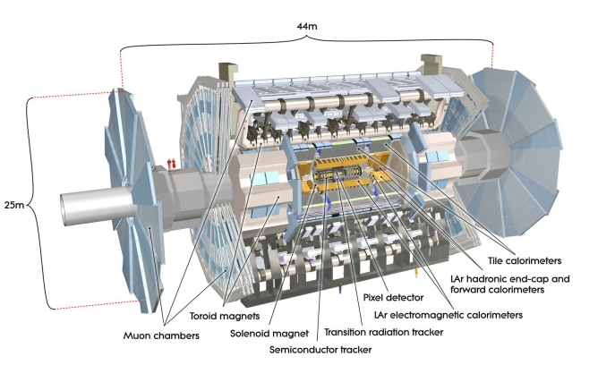
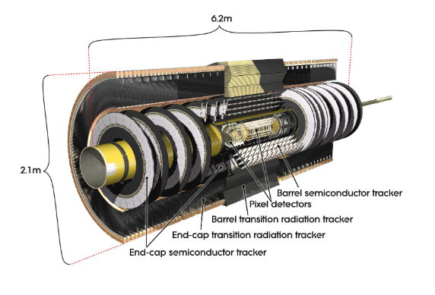
Introduction
What is the ATLAS detector and the Inner Detector
ATLAS detector is a versatile particle physics experiment at CERN's Large Hadron Collider (LHC) [1],
The Inner Detector is responsible for tracking particle movement and requires stable environmental conditions, including controlled humidity.
Figure 1: The ATLAS detector [1]
Figure 2: The Inner detector [2]
Notes:
ATLAS: engineered to fully leverage the LHC's particle physics discovery potential and expand the boundaries of scientific understanding about almost everything
CERN’s Large Hadron Collider (LHC) hosts the ATLAS detector, whose Inner Detector precisely tracks charged particles from high-energy collisions.

Slide 4
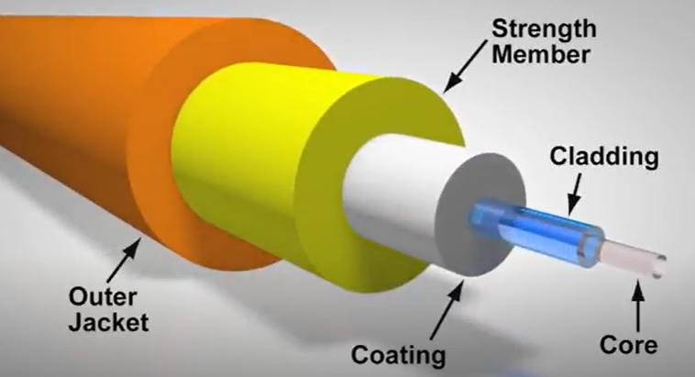
Fibre Optic Sensors (FOSs)
Reasons for their use [4]:
  Radiation tolerance,
  Immunity to electromagnetic interference
  Small size
There two main types of FOSs used in the Inner Detector
Fibre Bragg Gratings (FBG)
Long Period Gratings (LPG)
Figure 3: Optical fibre cross section [3]

Slide 5
The problem statement and aim of this investigation
Problem Statement:
  Humidity FOS are exposed to large amounts of radiation and this causes damage to the sensors, resulting in existing calibration methods to not be accurate enough to fully resolve the spectrum data.
  There is a need to assess the level of radiation the sensors are exposed to and adjust the calibration of the FOS sensors in order to obtain the correct dew point temperature readouts.
Aim:
To assess the level of radiation experienced by the FOS body (dose) using the GEANT4 simulation software.

Slide 6
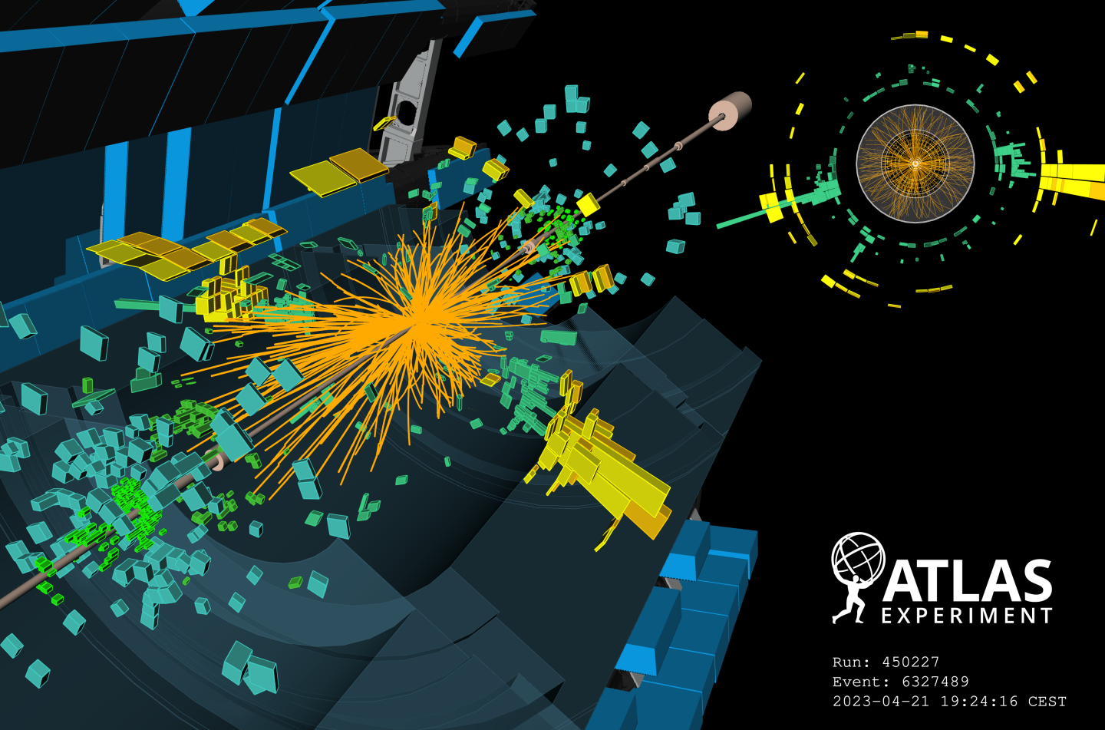

Methodology
The LPG FOS model was recreated in SolidWorks, including the fibre core, cladding, grating, and TiO₂ coating.
The simulation was run on the lxplus High-Performance Computing (HPC) cluster, and radiation plots were made using GitLab tools.
The total radiation doses were then calculated and recorded.
Radiation doses for other years were calculated using the luminosity ratio between 2021 and those years. (Proportional to the number of collisions which happen in a unit area and time)
The GEANT4 Monte Carlo simulation code (C++) was updated to include the FOS geometry.
Figure 7: ATLAS Event Displays: First 13.6 TeV proton-proton collisions of 2023 [5]
Notes:
Note cluster : lxplus high performance computing cluster HPC @cern.
Reduce text and add images

Slide 7
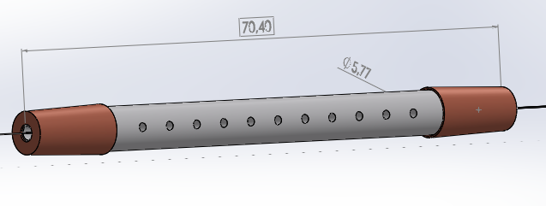
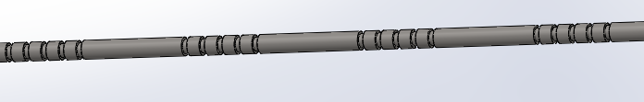
Replication of FOS in SolidWorks
Cladding
Copper end covers
Ceramic cover
Fibre Optic
Gratings on Fibre Optic
Figure 4: FOS package
Figure 5: FOS gratings
Notes:
Put size as well

Slide 8
The Simulation [4]:
But how does it work? [4]
`GEANT4 tracks every particle as it moves and interacts inside the detector.
Each “step” records what happens:
  Particle type, position, energy loss, time, and material details.
Uses the “Shielding_HP” physics list:
  Handles neutrons down to thermal energies.
  Includes radioactive decays from activated materials.
Results are saved in maps which display quantities such as:
  Ionising dose
  Different fluences of particles
Monte Carlo sample Generated by Pythia 8 (A3 minimum-bias tune).
Aim: The simulation models radiation inside the ATLAS detector during proton–proton collisions.
Tools: uses the Athena/GEANT4 framework, the same software used for ATLAS physics simulations.
Configuration: The setup is based on LHC Run-3 (2021–2026) conditions with 13.6 TeV pp collisions at ATLAS
Notes:
What run is 2025 apart of

Slide 9
Explaination of NIEL, TID , Fluence, Density and SEE
NIEL (Non-Ionizing Energy Loss): Shows how much damage moving particles cause inside a material’s structure.
TID (Total Ionizing Dose): Tells how much total radiation energy is absorbed by the material.
Density: Describes how tightly the material’s mass is packed in a given space.
SEE (Single Event Effects): Counts how often radiation causes single small errors in electronics.
Fluence: Measures how many radiation particles pass through a certain area.
Notes:
Explain in simple terms only NIEL NEUT SEE

Slide 10
Creating the Radiation maps
averageRadMaps.C from Gitlab
plotRadMaps.C from Gitlab
Purpose:
This program takes several radiation map results from simulations and combines them into one averaged map.
How It Works:
  Calculates radiation values at each (r, z) position in the detector with 4 cm resolution, creating one file that represents the overall radiation pattern for that dataset.
Purpose:
This program takes the averaged radiation map and turns it into a visual representation.
How It Works:
  Converts averaged simulation data into color-based images that visually show radiation intensity across the detector, with bright and dark areas representing higher and lower doses.
Notes:
45 seconds, different events combined (Results include TID etc.) Normalized to a relevant lum

Slide 11
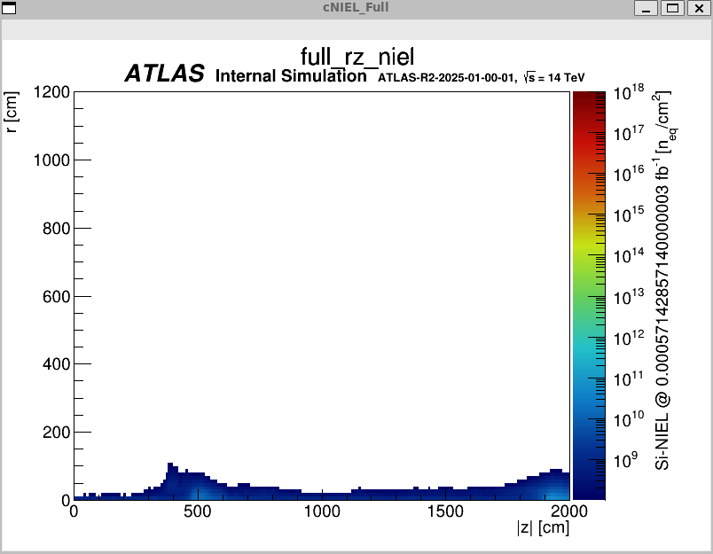
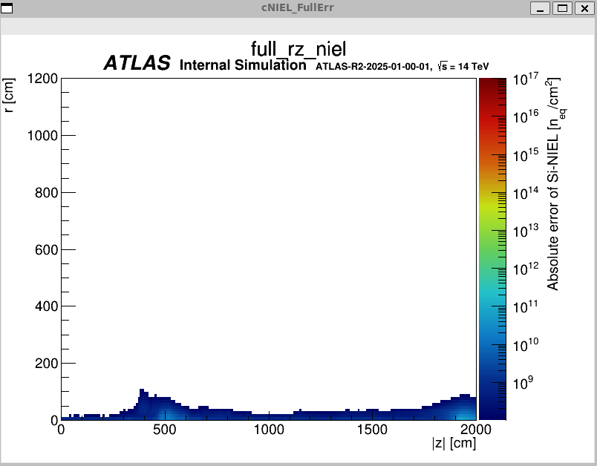
Simulation results for the Non-Ionizing Energy Loss (NIEL) plots:
Figure 8: Full NIEL plot
Figure 9: Full NIEL error plot
Notes:
NEUT refers to the fluence of neutrons with kinetic energy above 100 keV, which contribute to material damage in detectors.
NIEL (Non-Ionizing Energy Loss) measures the energy deposited by particles that displace atoms in a material’s lattice, causing long-term structural damage.
Brighter or darker colors indicate areas of higher or lower radiation intensity.
Log scale gradient

Slide 12
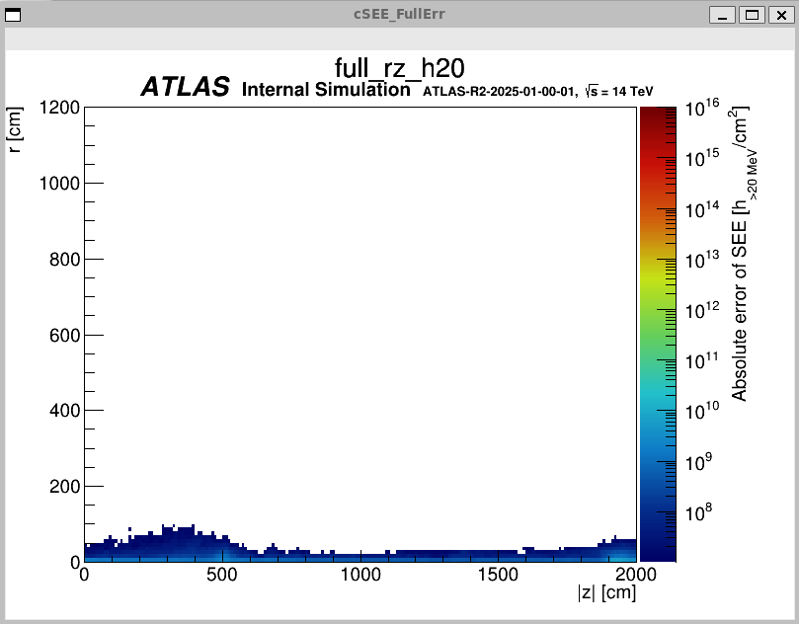
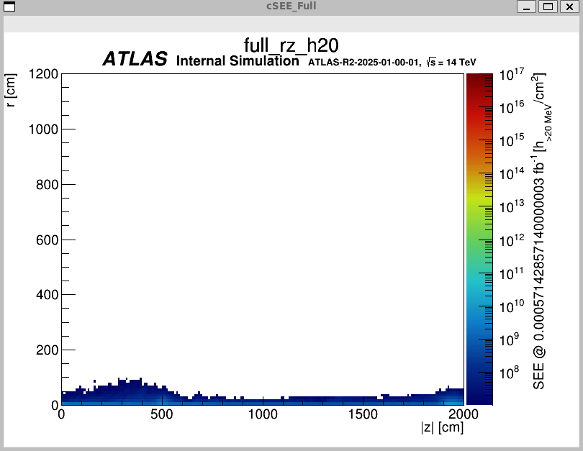
Single Event Effect (SEE) plots:
Figure 10: SEE plot
Figure 11: SEE error plot

Slide 13
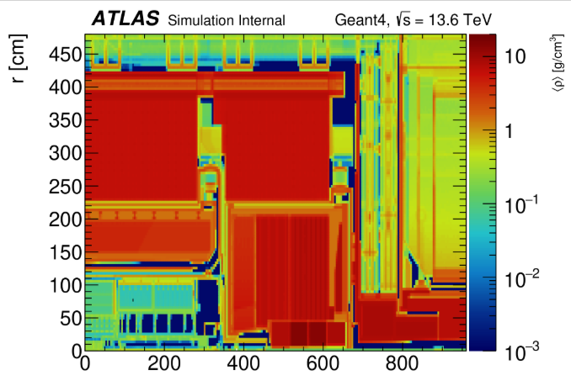
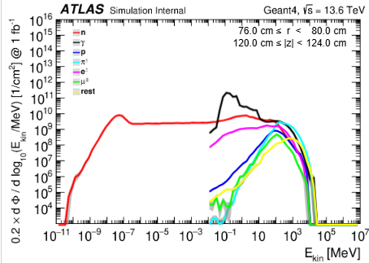
Relating to the Interactive plots
Figure 12: The Radiation Map generated using 50K events [7].
Figure 13: Fluence plotted against energy for a single point on the Radiation map [7].
Notes:
The integrated luminosity Normalized to 1 fb^-1, validated using fluence

Slide 14
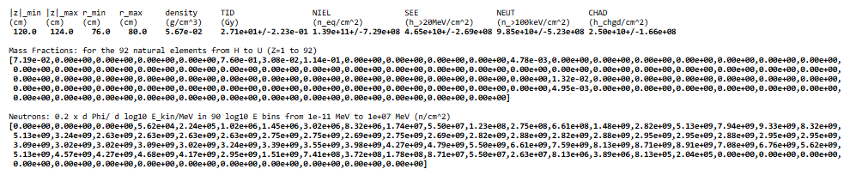
Data used for the Fluence vs Kinetic Energy plot:
Figure 14: The data used to plot the graphs seen in Fluence vs Energy graph [7].

Slide 15
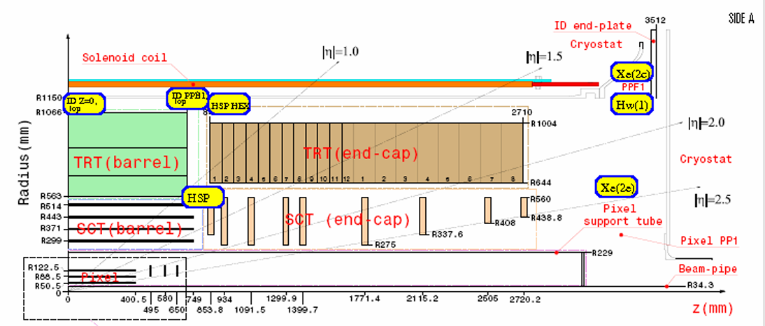
Calculations:
FOS position is selected on the interactive radiation map (514 mm/853 mm).
This was done for each particle shown in in Figure 13 (Neutrons, Muons, Electrons, Pions, Gamma and the rest) for each different sensor position and for Run 3 in 2021.
Next, the total fluence for the proton particles is the sum of the values taken from Figure 14 which resulted in a proton fluence of 8,72E+09 p/cm².
Notes:
Use key words and improve visuals

Slide 16
This was done for each sensor position and resulted in the following table:
Table 1: Summation of Fluences for different particles at different sensor positions.
 | Particle Fluence
Position of sensor (radius/Z-axis location) (mm) | Neutrons | Gamma | Protons | Pions | Electrons | Muons | Rest
514/853 | 2,27E+11 | 1,12E+12 | 7,58E+09 | 3,36E+10 | 4,73E+10 | 4,21E+09 | 3,92E+09
1066/0 | 1.73E+11 | 5,44E+11 | 1,49E+09 | 6,83E+09 | 1,06E+10 | 6,41E+08 | 8,94E+08
563/3125 | 4.73E+11 | 5,03E+12 | 1,85E+10 | 5,22E+10 | 8,45E+10 | 6,09E+09 | 5,99E+09
1066/934 | 1.81E+11 | 6,00E+11 | 1,83E+09 | 6,76E+09 | 1,88E+10 | 6,03E+08 | 8,76E+08
1150/749 | 1.74E+11 | 5,19E+11 | 1,52E+09 | 5,59E+09 | 1,15E+10 | 4,46E+08 | 8,06E+08
1450/3512 | 3.52E+11 | 7,24E+11 | 2,11E+09 | 4,60E+09 | 2.65E+11 | 6,47E+08 | 4,56E+08
1066/3512 | 5.43E+11 | 1,92E+12 | 5,98E+09 | 1,48E+10 | 4,20E+10 | 1,94E+09 | 1,37E+09

Slide 17
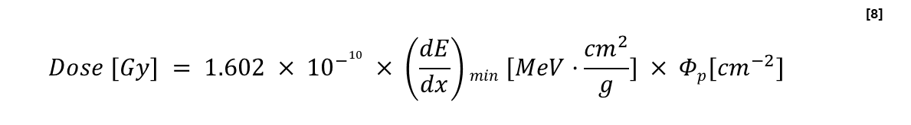
Determining the dose and the equivalent Neutron fluence (NIEL)
Where:
  Φ_{p} – stands for the proton fluence [cm⁻²]
  (dE/dx)_{min} are the values of kinetic energy shown in Figure 13 for which the proton particles are plotted against [MeV·cm²/g] for various materials and compounds.
                [9]
$$Dose [Gy] = 1.602 × {10}^{−10} × \left(\frac{dE}{dx}\right)min [MeV·\frac{{cm}^{2}}{g}] × Φp[{cm}^{−2}]$$ | [8]
Here k is the proton hardness factor.
Notes:
dE/dx was det by subtracting the appropriate values and dividing it by the pseudo density
Include other equations

Slide 18
Results from the Neutron Fluence equation is:
Table 2: Equivalent Neutron Fluence (NIEL).
Position of sensor (radius/Z-axis location) (mm) | Equivalent neutron fluence
514/853 | 1512800000
1066/0 | 1,0726E+11
563/3125 | 2,93E+11
1066/934 | 1,81E+11
1150/749 | 1,08E+11
1450/3512 | 2,18E+11
1066/3512 | 5,43E+11
Notes:
Add NIEL equation results also

Slide 19
Final results
Although these results were normalized for a luminosity of 1 fb⁻¹
Table 3: Radiation dose (TID) due to protons at different sensor positions for 2021.
By multiplying each result by the ratio of its luminosity to other years’ luminosities, the dose for each year can be calculated and summed to find the total dose over all years.
Position of sensor (radius/Z-axis location) (mm) | Radiation dose due to protons particles(Gy)
514/853 | 2,67E+00
1066/0 | 3,97E-01
563/3125 | 4,93E+00
1066/934 | 4,88E-01
1150/749 | 4,05E-01
1450/3512 | 5,63E-01
1066/3512 | 1,59E+00
Table 4: Luminosity for the different years.
Year | Luminosity (fb⁻¹)
2021 | 1
2022 | 35,7
2023 | 29,7
2024 | 123
2025 | 99,6

Slide 20
For the rest of the years
Table 5: Radiation dose (TID) due to protons at different sensor positions for 2022.
Table 6: Radiation dose (TID) due to protons at different sensor positions for 2023.
2022
Position of sensor (radius/Z-axis location) (mm) | Radiation dose due to protons particles (Gy)
514/853 | 9,54E+01
1066/0 | 1,42E+01
563/3125 | 1,76E+02
1066/934 | 1,74E+01
1150/749 | 1,45E+01
1450/3512 | 2,01E+01
1066/3512 | 5,69E+01
2023
Position of sensor (radius/Z-axis location) (mm) | Radiation dose due to protons particles (Gy)
514/853 | 7,94E+01
1066/0 | 1,18E+01
563/3125 | 1,47E+02
1066/934 | 1,45E+01
1150/749 | 1,20E+01
1450/3512 | 1,67E+01
1066/3512 | 4,73E+01
Table 7: Radiation dose (TID) due to protons at different sensor positions for 2024.
Table 8: Radiation dose (TID) due to protons at different sensor positions for 2025.
2024
Position of sensor (radius/Z-axis location) (mm) | Radiation dose due to protons particles (Gy)
514/853 | 3,29E+02
1066/0 | 4,88E+01
563/3125 | 6,07E+02
1066/934 | 6,00E+01
1150/749 | 4,99E+01
1450/3512 | 6,92E+01
1066/3512 | 1,96E+02
2025
Position of sensor (radius/Z-axis location) (mm) | Radiation dose due to protons particles (Gy)
514/853 | 2,66E+02
1066/0 | 3,95E+01
563/3125 | 4,91E+02
1066/934 | 4,86E+01
1150/749 | 4,04E+01
1450/3512 | 5,60E+01
1066/3512 | 1,59E+02
Notes:
Add table of luminosity for each year

Slide 21
Final results
Table 9: Total Radiation dose due to protons at different sensor positions from 2021-2025 (07/10/2025).
Position of sensor (radius/Z-axis location) (mm) | Total Radiation dose due to protons particles (Gy)
514/853 | 7,72E+02
1066/0 | 1,15E+02
563/3125 | 1,43E+03
1066/934 | 1,41E+02
1150/749 | 1,17E+02
1450/3512 | 1,63E+02
1066/3512 | 4,60E+02

Slide 22
Conclusion
The sensor at position 563/3125 mm received the highest radiation dose of 1.43×10³ Gy — about ten times more than the others.
Next, fluence–dose relationships for other particles can be studied to help engineers and physicists improve or refine the humidity FOS calibration.

Slide 23
Thank you

Slide 24
References:
[1] CERN, “ATLAS.” Accessed: Feb. 23, 2025. [Online]. Available: https://home.cern/science/experiments/atlas#:~:text=ATLAS%20is%20one%20of%20two,could%20make%20up%20dark%20matter.
[2] CERN, “The Inner Detector.” Accessed: Feb. 26, 2025. [Online]. Available: https://atlas.cern/Discover/Detector/Inner-Detector
[3] Thorlabs, “Introduction to Fiber Optics.” Accessed: May 19, 2025. [Online]. Available: https://www.thorlabs.com/newgrouppage9.cfm?objectgroup_id=10759
[4] L. Scherino et al., “Fiber optic sensors in the ATLAS Inner Detector,” Nucl Instrum Methods Phys Res A, vol. 1029, p. 166470, Apr. 2022, doi: 10.1016/j.nima.2022.166470.
[5] The ATLAS Collaboration, “ATLAS Event Displays: First 13.6 TeV collisions of 2023” Oct. 08, 2025. [Online]. Available: https://cds.cern.ch/record/2856820
[6] The ATLAS Collaboration, “Interactive web pages for radiation environment exploration of ATLAS,” Oct. 2020. Accessed: Oct. 08, 2025. [Online]. Available: https://cds.cern.ch/record/2742378/files/ATL-SOFT-PUB-2020-003.pdf
[7] Sven Menke, “Radiation Maps from Geant4 Simulations.” Accessed: Sep. 07, 2025. [Online]. Available: https://twiki.cern.ch/twiki/bin/viewauth/Atlas/RadiationMapsGeant4View#Radiation_Maps_for_Run_1
[8] F. Ravotti, “Dosimetry Techniques and Radiation Test Facilities for Total Ionizing Dose Testing,” IEEE Trans Nucl Sci, vol. 65, no. 8, pp. 1440–1464, Aug. 2018, doi: 10.1109/TNS.2018.2829864.

Slide 25
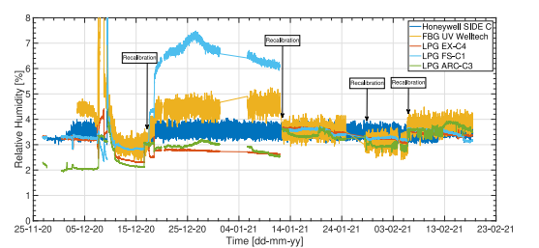
Backup slides
The characterization chamber uses a chilled mirror hygrometer and electrical sensors as reference.

Slide 26
About 50 000 proton–proton events are simulated per dataset.
Events are split into small batches (25 each) to check accuracy.
The jobs run in parallel on the Worldwide LHC Computing Grid (WLCG), finishing in a few days.
Output files include:
  2D and 3D radiation maps
  “Pseudo-density” plots that help verify detector geometry.
Typical precision:
  < 1 % uncertainty near the inner detector
  A few % in calorimeters
  Up to 10 % in shielded regions
Notes:
Add N=sigma*Luminosity

Slide 27
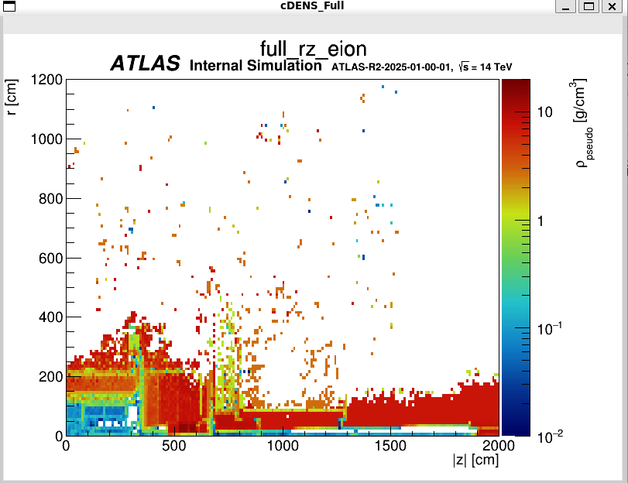
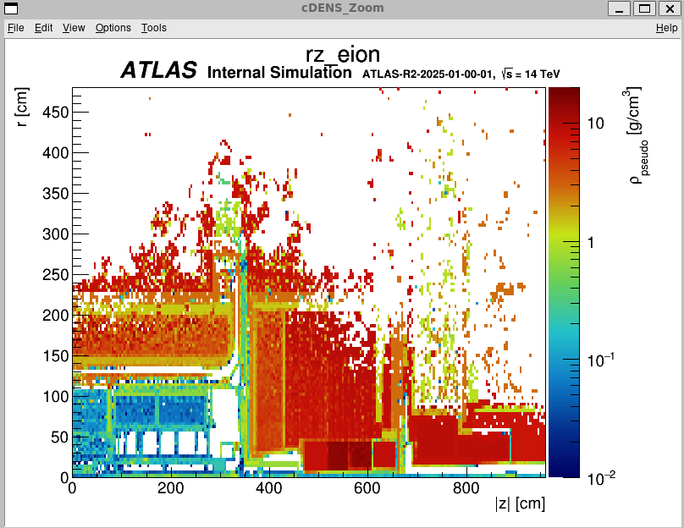
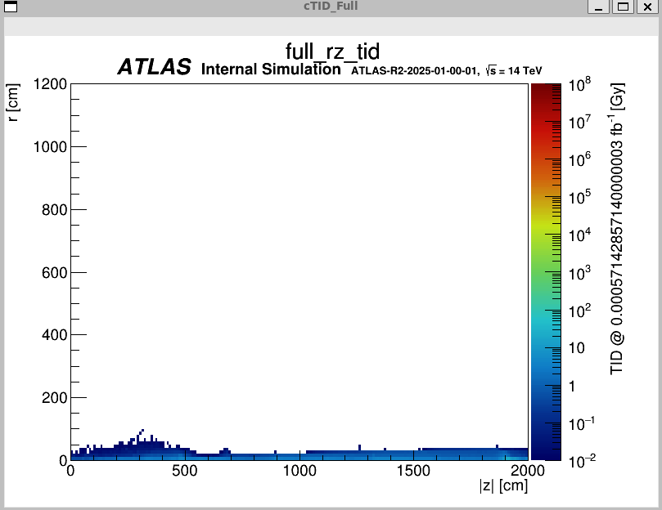
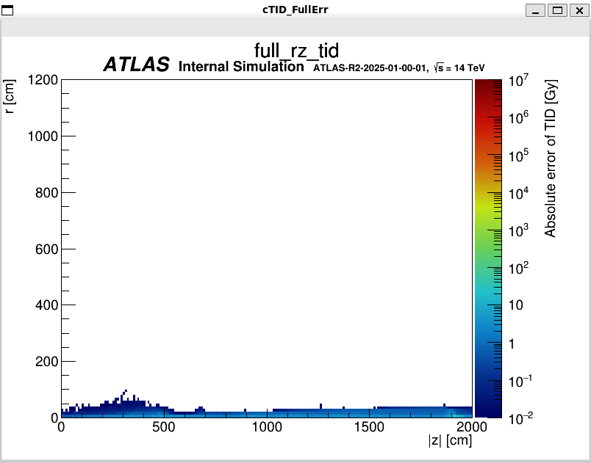
Results of the simulation

