Slide 1
INVESTIGATING THE ENVIRONMENTAL CONDITIONS IN A GREENHOUSE: A CFD STUDY
.
PARDON T. MURINGANI (222000895)
Supervisors: Prof Simon Connell, Dr Emmanuel Igumbor, Abdool Sattar Cassim

Slide 2
DISCUSSION POINTS
INTRODUCTION
LITERATURE REVIEW
RESEARCH METHODOLOGY
RESULTS
PROJECT MANAGEMENT

Slide 3
INTRODUCTION
Background
Food Importance: Food provides essential nutrients for body maintenance, growth, activity, and functions.
Limited Arable Land: Regions like the Middle East face arable land scarcity, requiring innovative agricultural solutions.
Crop-Specific Needs: Different crops thrive in different conditions (e.g., soybeans in heat, cabbage/broccoli in cool weather).
Greenhouse Solution: Greenhouses offer a way to address climate change and land limitations by providing controlled environments for crop, poultry, and aquaculture production.
Environmental Control Importance: Internal greenhouse conditions (temperature, humidity, airflow) must be well-managed for optimal production, influenced by design and external climate.
Regional Variability: Greenhouse design and control strategies must be tailored to local climate and crop requirements.
PJMMCY4

Slide 4
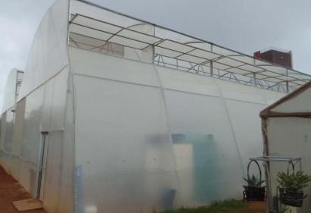
INTRODUCTION
Background
Use of CFD: Computational Fluid Dynamics (CFD) applies numerical methods to model airflow and climate conditions in greenhouses.
Benefits of CFD: Enables analysis and optimization of greenhouse environments, enhancing sustainability and efficiency.
Aim
Study and optimization of the environmental conditions in a greenhouse situated at UJ APB campus.
Increasing food production and food quality, and the application of CFD in real-time problem solving in greenhouses
Figure 1: APB Greenhouse
PJMMCY4

Slide 5
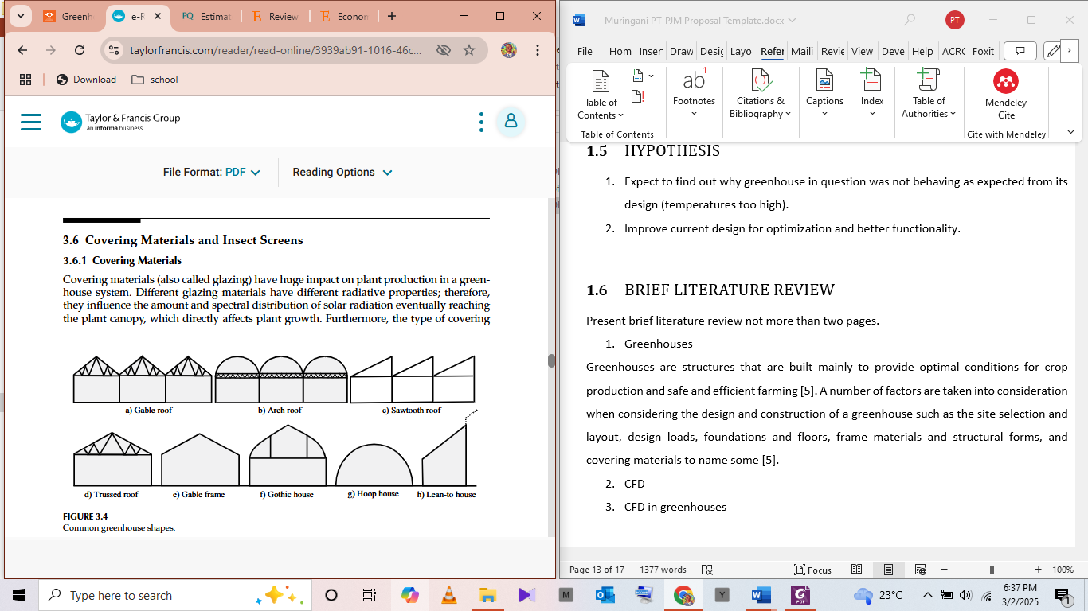
LITERATURE REVIEW
.
Key Design Factors
Site selection, geometry and orientation, structural forms, foundation and flooring, cover materials, ventilation systems
.
Environmental and Climate Considerations
External climate (temperature, wind speed, solar radiation) strongly influences internal greenhouse conditions.
Designs must be region-specific to address diverse climate challenges.
Figure 2: Different greenhouse geometries
PJMMCY4

Slide 6
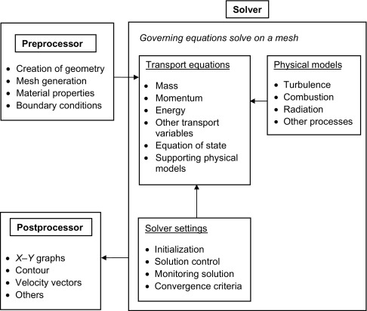
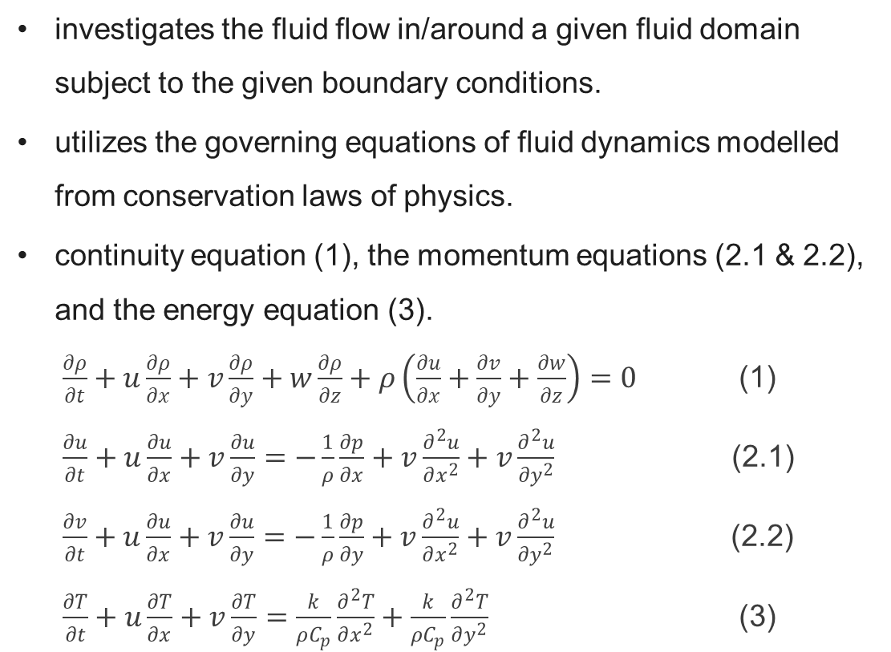
LITERATURE REVIEW
.
Computational Fluid Dynamics
investigates the fluid flow in/around a given fluid domain subject to the given boundary conditions.
utilizes the governing equations of fluid dynamics modelled from conservation laws of physics.
continuity equation (1), the momentum equations (2.1 & 2.2), and the energy equation (3).
$\frac{∂ρ}{∂t}+u\frac{∂ρ}{∂x}+v\frac{∂ρ}{∂y}+w\frac{∂ρ}{∂z}+ρ\left(\frac{∂u}{∂x}+\frac{∂v}{∂y}+\frac{∂w}{∂z}\right)=0$ (1)
$\frac{∂u}{∂t}+u\frac{∂u}{∂x}+v\frac{∂u}{∂y}=−\frac{1}{ρ}\frac{∂p}{∂x}+v\frac{∂^{2}u}{∂x^{2}}+v\frac{∂^{2}u}{{∂y}^{2}}$ (2.1)
$\frac{∂v}{∂t}+u\frac{∂u}{∂x}+v\frac{∂u}{∂y}=−\frac{1}{ρ}\frac{∂p}{∂y}+v\frac{∂^{2}u}{∂x^{2}}+v\frac{∂^{2}u}{{∂y}^{2}}$ (2.2)
$\frac{∂T}{∂t}+u\frac{∂T}{∂x}+v\frac{∂T}{∂y}=\frac{k}{ρC_{p}}\frac{∂^{2}T}{∂x^{2}}+\frac{k}{ρC_{p}}\frac{∂^{2}T}{∂y^{2}}$ (3)
Figure 3: CFD solution procedure
PJMMCY4

Slide 7
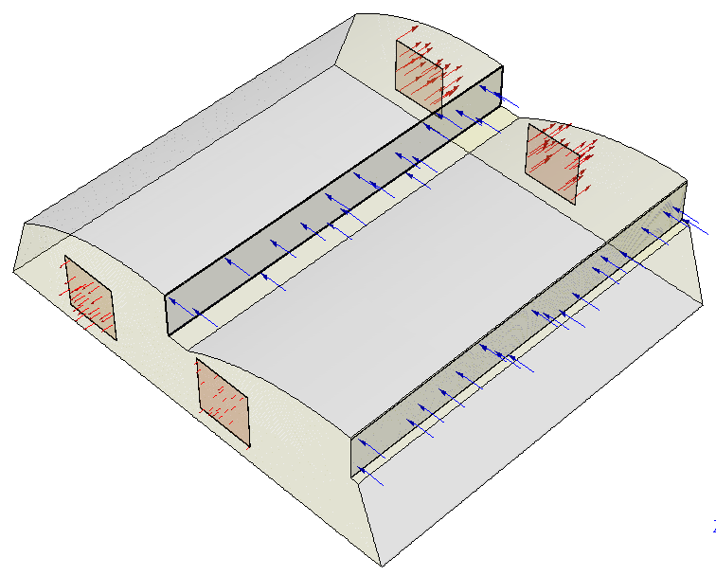
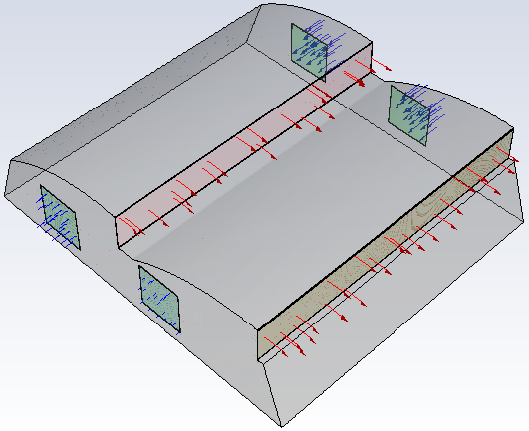
RESEARCH METHODOLOGY
Table 1: Inlet/outlet conditions
Case | Inlets | Outlets
A | Upper vents | Windows
B | Windows | Upper vents
Figure 4: Case A
Figure 5: Case B
PJMMCY4

Slide 8
RESEARCH METHODOLOGY
Table 2: Greenhouse configurations
Configuration 1
Greenhouse parameter | Outer vent | Inner vent | Windows
Status | Open | Open | Open
Configuration 2
Greenhouse parameter | Outer vent | Inner vent | Windows
Status | Closed | Open | Open
Configuration 3
Greenhouse parameter | Outer vent | Inner vent | Windows
Status | Open | Closed | Open
PJMMCY4

Slide 9
RESEARCH METHODOLOGY
Table 3: Environmental conditions
Time | Internal temp (°C) | External temp (°C) | Wind speed (m/s) | Humidity (%)
Midnight (12 am) | 18 | 18.33 | 7.76 | 51.15
Morning (6 am) | 25 | 23.99 | 18.62 | 65.77
Afternoon (12 pm) | 35 | 27.57 | 8.63 | 36.3
Evening (6 pm) | 30 | 21.54 | 10.85 | 67.2
Table 4: Temperature gradient
Time | Internal temperature (°C)
 | P1 | P2 | P3
Afternoon (12 pm) | 37 | 33 | 32
Evening (6 pm) | 25 | 23 | 21
PJMMCY4

Slide 10
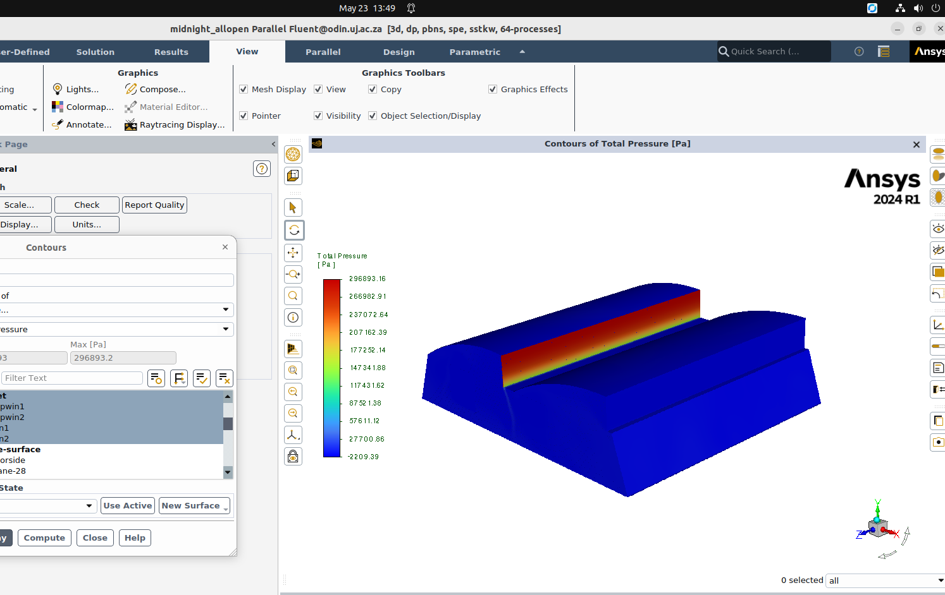
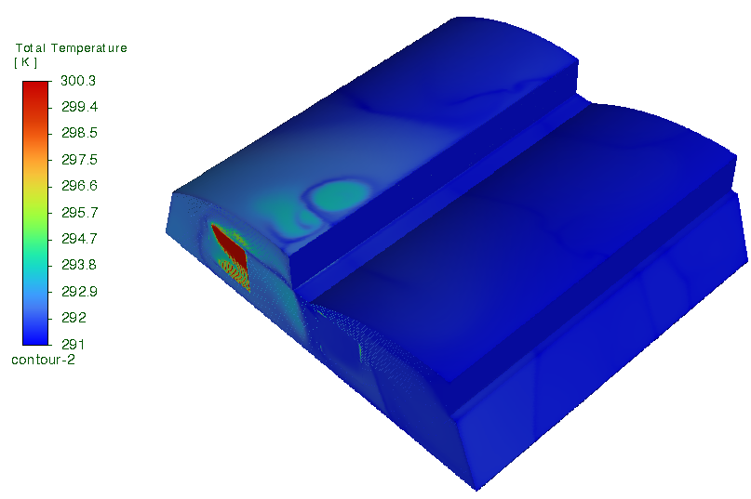
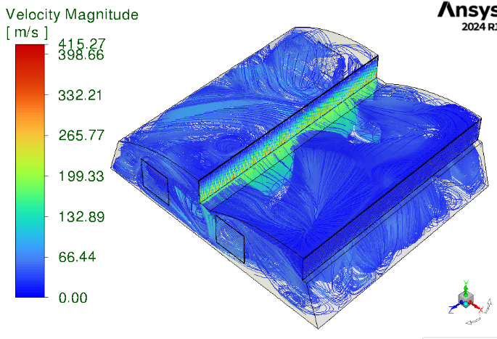
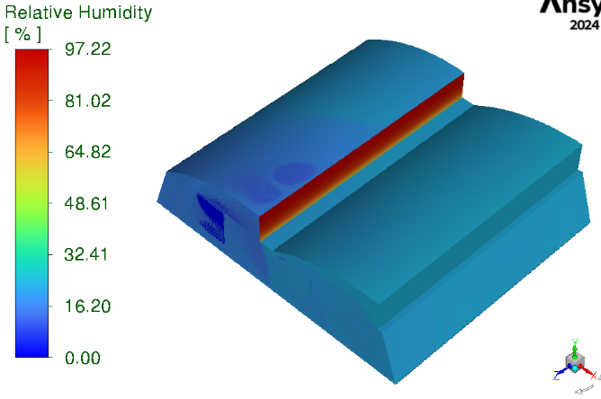
RESULTS
Case A, configuration 1
PJMMCY4

Slide 11
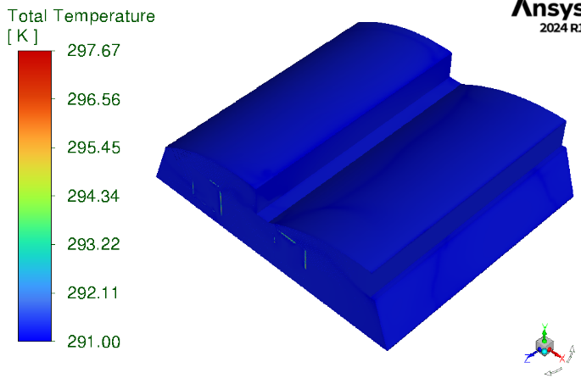
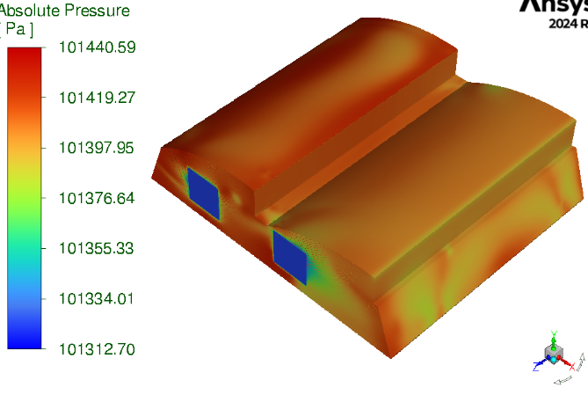
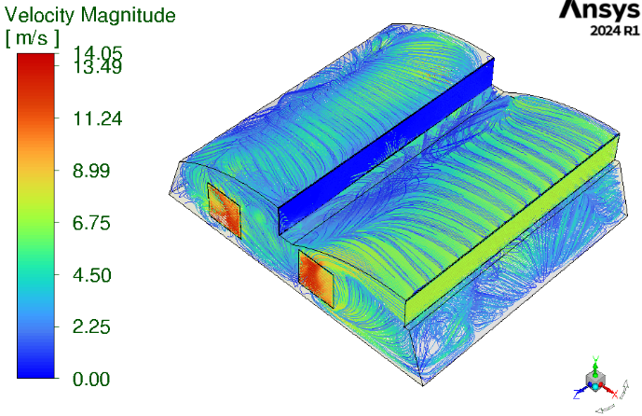
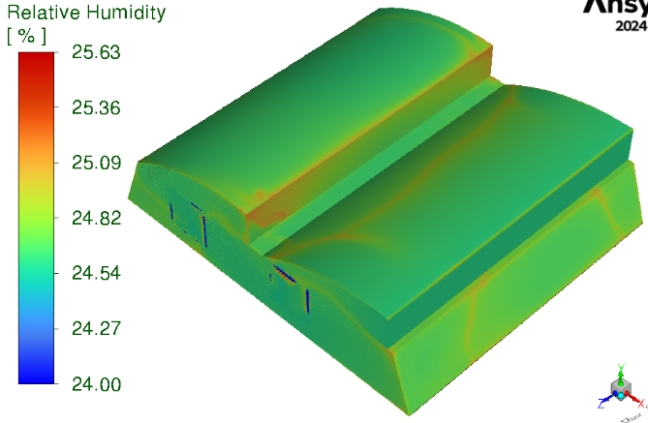
RESULTS
Case A, configuration 2
PJMMCY4

Slide 12
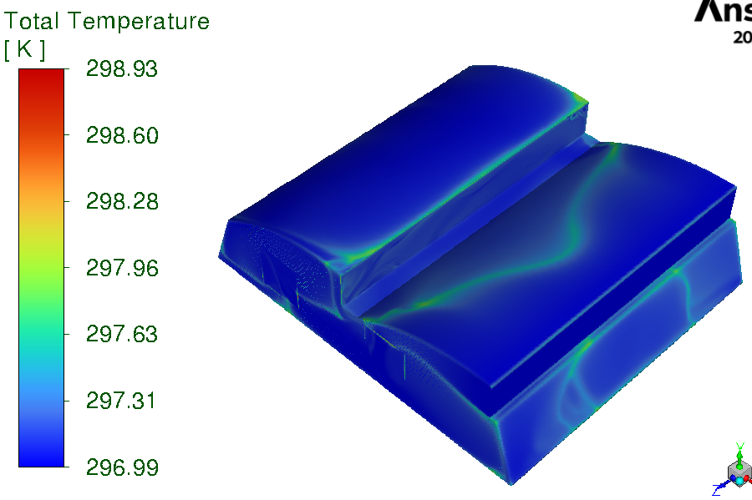
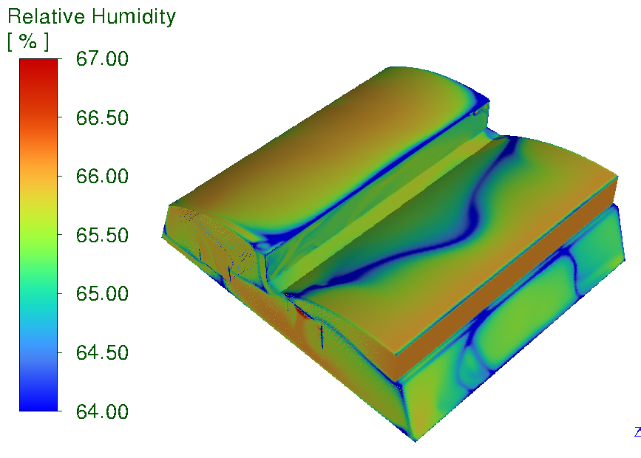
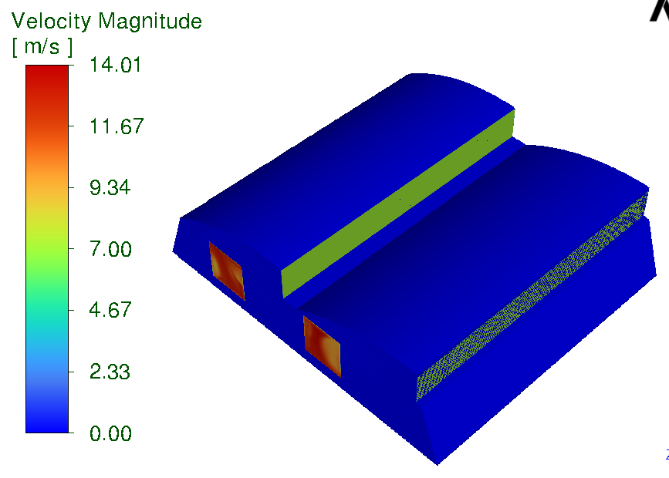
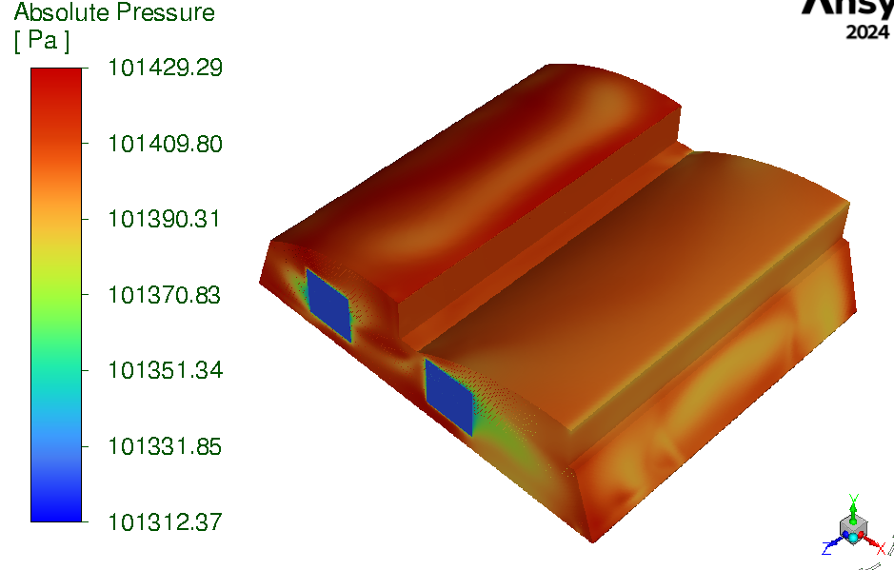
RESULTS
Case A, configuration 3
PJMMCY4

Slide 13
PROJECT MANAGEMENT
GANTT CHART
 | Project Start Date | 10-Feb |  | Muringani PT
 | Current Date | 10-Jul |  | 222000895
 | Project Name | Environmental conditions in a greenhouse: A CFD Study
# | Activity | Start | End | Days | Status | % Done | % Done |  | 10-Feb | 17-Feb | 24-Feb | 3-Mar | 10-Mar | 17-Mar | 24-Mar | 31-Mar | 7-Apr | 14-Apr | 21-Apr | 28-Apr | 5-May | 12-May | 19-May | 26-May | 2-Jun | 9-Jun | 16-Jun | 23-Jun | 30-Jun | 7-Jul | 14-Jul | 21-Jul | 28-Jul | 4-Aug | 11-Aug | 18-Aug | 25-Aug | 1-Sep | 8-Sep | 15-Sep | 22-Sep | 29-Sep | 6-Oct | 13-Oct | 20-Oct
1 | Topic selection | 10-Feb | 17-Feb | 7 | Complete | 100% | 100%
2 | Project proposal | 18-Feb | 10-Mar | 20 | Complete | 100% | 100%
3 | Literature review | 10-Mar | 31-Mar | 21 | Complete | 100% | 100%
4 | Greenhouse measurements | 1-Apr | 5-Apr | 4 | Complete | 100% | 100%
5 | Greenhouse modelling | 6-Apr | 13-Apr | 7 | Complete | 100% | 100%
6 | Simulations | 13-Apr | 2-Jun | 50 | Overdue | 60% | 60%
7 | Data analysis & validation | 3-Jun | 16-Sep | 105 | In progress | 40% | 40%
8 | Preliminary report 1 | 27-Apr | 5-May | 8 | Complete | 100% | 100%
9 | Preliminary report 2 | 29-Jul | 8-Sep | 41 | Not started | 60% | 60%
10 | Poster submission | 17-Sep | 26-Sep | 9 | Not started | 0% | 0%
11 | Final presentation | 1-Oct | 15-Oct | 14 | Not started | 0% | 0%
12 | Mini dissertation | 1-Oct | 13-Oct | 12 | Not started | 0% | 0%
PJMMCY4

Slide 14


