Slide 1
Investigation of radiation damage to fibre optic humidity sensors inside the Inner Detector at the LHC
Enrique Moodley
21/05/2025

Slide 2
Contents
Introduction to project
Relevant findings about Fibre Optic Sensor (FOS)
The reason and aim for this experiment
How the simulation will be done

Slide 3
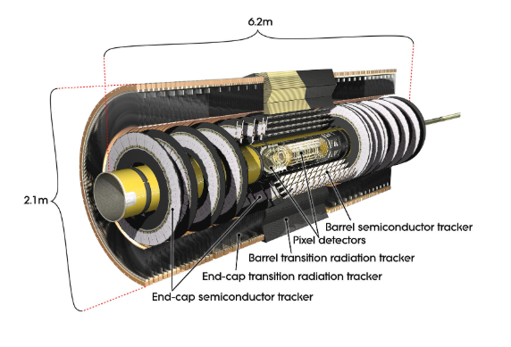
Introduction
What is the ATLAS detector and the Inner Detector
ATLAS detector is a versatile particle physics experiment at CERN's Large Hadron Collider (LHC) [1],
The Inner Detector is responsible for tracking particle movement and requires stable environmental conditions, including controlled humidity.
This helps the electronic sensors in manner which is for accurate data collection as the sensors are affected by the conditions of the detector [2].
Figure 1: The ATLAS detector [1]
Figure 2: The Inner detector [2]
Notes:
ATLAS: engineered to fully leverage the LHC's particle physics discovery potential and expand the boundaries of scientific understanding about almost everything

Slide 4
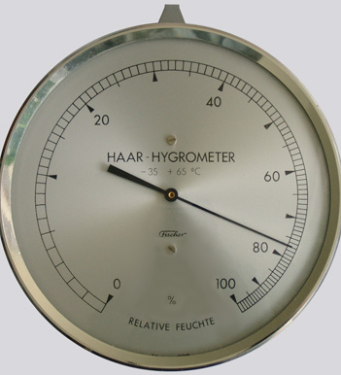
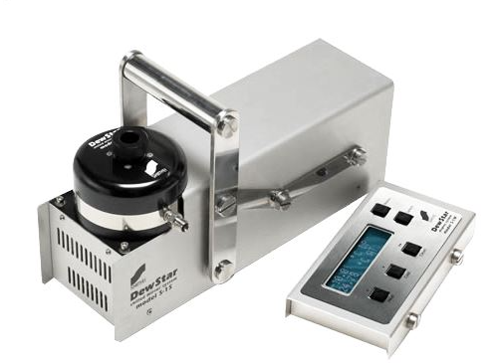
Humidity monitoring
Measures water vapour content using methods such as relative humidity (RH) and/or absolute humidity [3].
There are many different types of humidity monitoring systems
Mechanical Hygrometers (strain gauges)
Chilled Mirror Hygrometers (dew point detection)
Electronic Sensors (capacitive and resistive)
Figure 4: Electronic sensors [4]
Figure 3: Mechanical Hygrometer [4]
Figure 5: Chilled Mirror Hygrometer [4]
Notes:
Humidity monitoring is essential across industries, from manufacturing to agriculture and climate research. It measures water vapour content using methods such as relative humidity (RH) (water vapour pressure relative to saturation) and absolute humidity (actual water vapour content in air).
While effective, these conventional methods are not well-suited for harsh environments, necessitating specialized sensors like fibre optic sensors (FOSs).

Slide 5
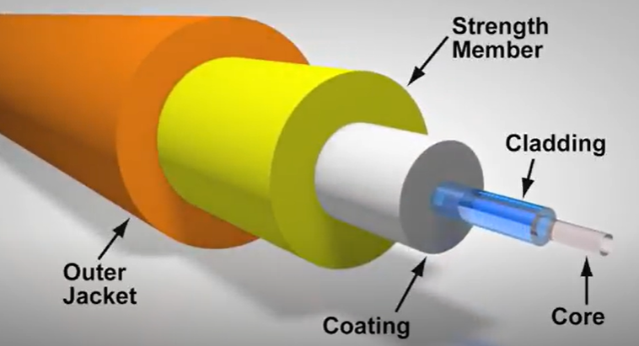
Fibre Optic Sensors (FOSs)
Optical fibre is a bendable, see-through cylindrical waveguide made of either silica or plastic, a bit thicker than a human hair and is developed to convey light over extended lengths with minimal loss [5].
Figure 5: Optical fibre cross section [6]

Slide 6
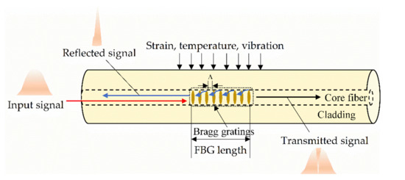
FOSs used in the Inner detector
There two main types of FOSs used in the Inner Detector
Fibre Bragg Gratings (FBG)
Long Period Gratings (LPG)
Figure 6: Fibre Bragg Grating FOS [8]
Reasons for their use [7]:
Radiation tolerance,
Immunity to electromagnetic interference
Small size
Notes:
Other fibre optic sensors also make use of:
In-Fibre Gratings for refractive index sensing,
Interferometric methods for phase change detection,
Evanescent Wave Sensing for absorption/refraction-based measurement, and
Spectroscopic Techniques for chemical sensing.

Slide 7
FOS package
Consists of:
A ceramic perforated tube
with copper extremities
And the LPG runs through the centre of the tube
Figure 7: Fibre Bragg Grating FOS [7]
Figure 8: The LPG sensors inside their packaging inside the Inner detector [7]

Slide 8
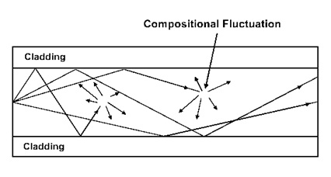
Radiation effects on FOS [10]
Radiation Induced Attenuation (RIA)
Radiation-Induced Emission (RIE)
Radiation-Induced Compaction (RIC)
Radiation
Cladding
Figure 9: Showing RIA Inside the FOS [9]
Grain structure of optic fibre
Cladding
Release of light from radiation
Figure 10: Showing RIE Inside the FOS
Figure 11: Showing RIA Inside the FOS
Notes:
Radiation impacts optical fibres in three main ways:
Radiation-Induced Attenuation (RIA): Causes signal loss due to defect formation in fibres.
Radiation-Induced Emission (RIE): Includes Cerenkov radiation (fast-moving particles emitting light) and radio-luminescence (light from defect interactions).
Radiation-Induced Compaction (RIC): This leads to structural densification and affects optical and mechanical properties.

Slide 9
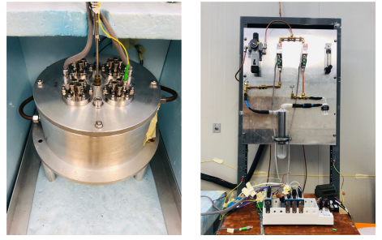
Current characterization methods
Using a custom chamber to characterize the LPG relative humidity sensors.
Using reference sensors to ensure the precise humidity measurement [7].
This is done by setting the temperature to be constant @ 25.5 ֯C and varying the humidity [7].
Other methods of this involve using a dummy sensors inside the detector to get an accurate reference of the humidity in the designed environment [7].
Figure 12: Showing the chamber of the left and on the right shows the control system for chamber [7].
Notes:
CERN developed a custom calibration chamber to characterize LPG sensors, ensuring precise humidity measurement. The chamber regulates temperature) and humidity with ultra-vacuum feed-throughs and optical interrogation. Automated recalibration ensures long-term stability.
Other examples include using a dummy sensor to calibrate the real sensor and after a while the dummy sensor will stop working but the actual one will continue to work.

Slide 10
The reason and aim of this investigation
Reason:
Humidity FOS are exposed to large amounts of radiation and this causes damage to the sensors, resulting in existing calibration methods to not be accurate enough to fully resolve the spectrum data.
There is a need to assess the level of radiation the sensors are exposed to and adjust the calibration of the FOS sensors in order to obtain the correct dew point temperature readouts.
Aim:
To assess the level of radiation experienced by the FOS body using the GEANT4 simulation software.

Slide 11
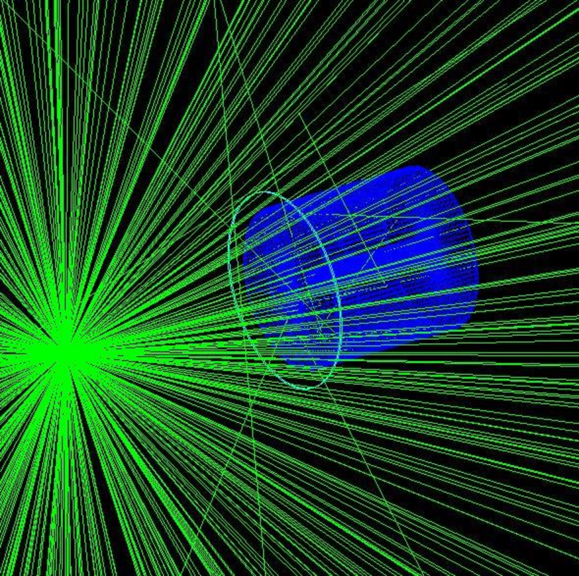
How the simulation will be done
The simulation will be done using the GEANT4 software as it allows [12]:
Flexible physics models across energy ranges,
Graphical and command-line interfaces for user control,
Object-oriented design, allowing easy integration with external tools.
Figure 13: An example of a GEANT4 simulation[4]
Notes:
GEANT4 is an advanced C++-based simulation tool originally developed at CERN for particle interactions in matter. It provides:
Flexible physics models across energy ranges,
Graphical and command-line interfaces for user control,
Object-oriented design, allowing easy integration with external tools (e.g., CAD, databases).
GEANT4 is crucial for simulating ATLAS experiments, aiding in detector design, material interactions, and radiation effect predictions

Slide 13
The data will be collected in the following table
Position of sensor (radius/Z-axis location) (mm) | Radiation dose (MGy)
514/853.8 | Reading 1 | Reading 2 | Reading 3 | Reading 4 | Reading 5 | Reading 6
1066/0 | Reading 7 | Reading 8 | Reading 9 | Reading 10 | Reading 11 | Reading 12
563/3125 | Reading 13 | Reading 14 | Reading 15 | Reading 16 | Reading 17 | Reading 18
1066/934 | Reading 19 | Reading 20 | Reading 21 | Reading 22 | Reading 23 | Reading 24
1150/749 | Reading 25 | Reading 26 | Reading 27 | Reading 28 | Reading 29 | Reading 30
1450/3512 | Reading 31 | Reading 32 | Reading 33 | Reading 34 | Reading 35 | Reading 36
1066/3512 | Reading 37 | Reading 38 | Reading 39 | Reading 40 | Reading 41 | Reading 42

Slide 14
Thank you

Slide 15
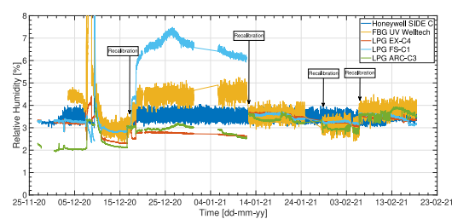
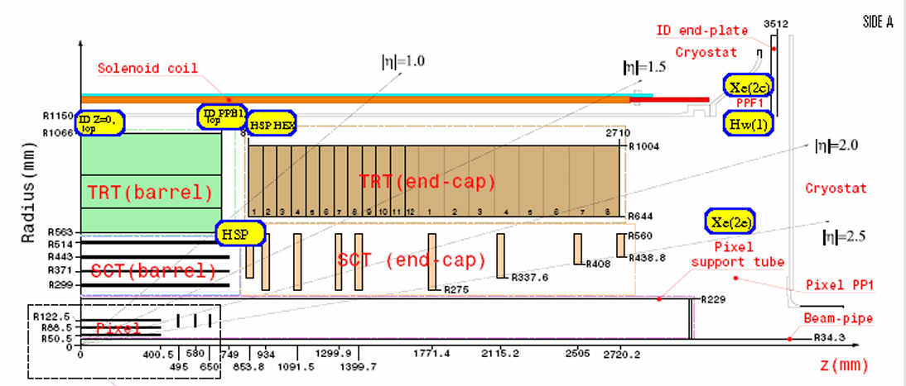
Backup slides
The characterization chamber uses a chilled mirror hygrometer and electrical sensors as reference.

Slide 16
References:
[1] CERN, “ATLAS.” Accessed: Feb. 23, 2025. [Online]. Available: https://home.cern/science/experiments/atlas#:~:text=ATLAS%20is%20one%20of%20two,could%20make%20up%20dark%20matter.
[2] CERN, “The Inner Detector.” Accessed: Feb. 26, 2025. [Online]. Available: https://atlas.cern/Discover/Detector/Inner-Detector
[3] T. L. Yeo, T. Sun, and K. T. V. Grattan, “Fibre-optic sensor technologies for humidity and moisture measurement,” Sens Actuators A Phys, vol. 144, no. 2, pp. 280–295, Jun. 2008, doi: 10.1016/j.sna.2008.01.017.
[3] G. Berruti et al., “A Comparative Study of Radiation-Tolerant Fiber Optic Sensors for Relative Humidity Monitoring in High-Radiation Environments at CERN,” IEEE Photonics J, vol. 6, no. 6, pp. 1–15, Dec. 2014, doi: 10.1109/JPHOT.2014.2357433
[4] Muh. S. Sriwa, Heranudin, T. Trikasjono, Marlina, and Moch. Subechi, “Characterization of a Germanium Detector by Means of Experimental Measurements and GEANT4 Monte Carlo Simulations,” J Phys Conf Ser, vol. 2705, no. 1, p. 012019, Feb. 2024, doi: 10.1088/1742- 6596/2705/1/012019.
[5] M. Consales et al., “Fiber optic humidity sensors for high-energy physics applications at CERN,” Sens Actuators B Chem, vol. 159, no. 1, pp. 66–74, Nov. 2011, doi: 10.1016/j.snb.2011.06.042.
[6] Thorlabs, “Introduction to Fiber Optics.” Accessed: May 19, 2025. [Online]. Available: https://www.thorlabs.com/newgrouppage9.cfm?objectgroup_id=10759

Slide 17
[7] L. Scherino et al., “Fiber optic sensors in the ATLAS Inner Detector,” Nucl Instrum Methods Phys Res A, vol. 1029, p. 166470, Apr. 2022, doi: 10.1016/j.nima.2022.166470.
[8] Y. W. Sasy Chan, H.-P. Wang, and P. Xiang, “Optical Fiber Sensors for Monitoring Railway Infrastructures: A Review towards Smart Concept,” Symmetry (Basel), vol. 13, no. 12, p. 2251, Nov. 2021, doi: 10.3390/sym13122251.
[9] Elprocus, “What is Attenuation : Different Types & Its Causes.” Accessed: May 19, 2025. [Online]. Available: https://www.elprocus.com/attenuation-in-optical-fibre-types-and-its-causes/
[10] S. Girard et al., “Radiation Effects on Silica-Based Optical Fibers: Recent Advances and Future Challenges,” IEEE Trans Nucl Sci, vol. 60, no. 3, pp. 2015–2036, Jun. 2013, doi: 10.1109/TNS.2012.2235464.
[11] Geant4 Collaboration, “Geant4 Documentation.” Accessed: Mar. 09, 2025. [Online]. Available: https://geant4.web.cern.ch/docs/
[12] Geant4 Collaboration, “Introduction to Geant4,” Dec. 2024.

