Slide 1
Data Analysis For Fiber Optic Sensors On ATLAS Inner Detector At The Large Hadron Collider
By
LN Mthethwa
222015002

Slide 2
Introduction
CERN (European Organisation for Nuclear Research) is located near Geneva, on the border between Switzerland and France.
It is home to the Large Hadron Collider (LHC), the world's most powerful particle accelerator.
The LHC enables high-energy proton collisions to explore the structure of matter and fundamental forces.

Slide 3
Large Hadron Collider (LHC)
Major experiments are:
ALICE
ATLAS
CMS
LHCb

Slide 4
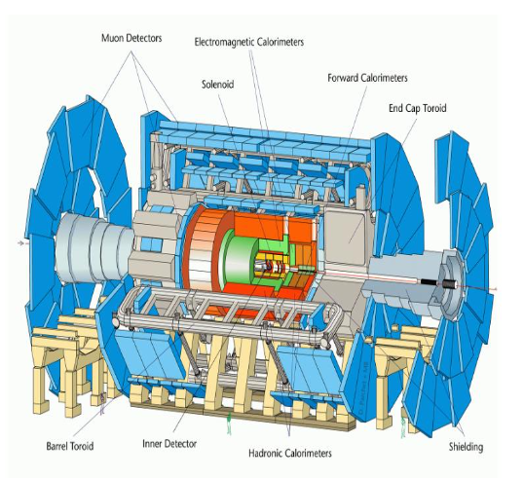
ATLAS
It is a general-purpose detector built to detect particles from high-energy collisions.
Length: 46 meters
Height/Diameter: 25 meters
Weight: ~7,000 tonnes
Purpose:
Study particle interactions and decay
Investigate detector response and radiation effects.
ATLAS experimental apparatus

Slide 5
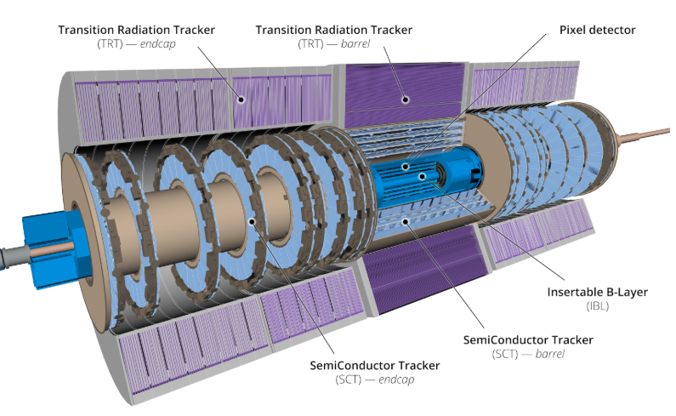
Inner Detector
Located at the core of the ATLAS detector, surrounding the collision point.
It is responsible for tracking charged particles and measuring momentum.
Dimensions of the Inner Detector:
Length: 6.2 meters
Diameter: 2.1 meters
Radial layers: Pixel detector (innermost), Semiconductor Tracker (SCT), and Transition Radiation Tracker (TRT)
Operating in a high-radiation and high-magnetic-field environment.
Requires stable temperature and humidity to preserve mechanical alignment and data accuracy.
Section view of the inner detector

Slide 6
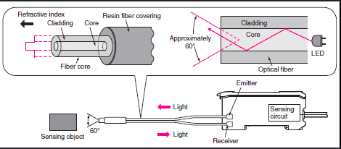
Fiber Optic Sensor
Used to monitor temperature and humidity within the ATLAS Inner Detector.
Working Principle: FOS reflect specific wavelengths of light. Changes in strain or temperature shift the reflected wavelength, allowing precise measurements.
Size and Dimensions:
Core diameter: ~9 µm (for single-mode fiber)
Cladding diameter: ~125 µm
Coated fiber diameter: ~250 µm (with protective polymer coating)
Sensor length: Typically 5–20 mm for the sensing region
Material: Made from high-purity silica glass with a reflective grating inscribed in the core.
Why FOS?
Immune to electromagnetic interference
High sensitivity to small changes in temperature and strain
Small, flexible, and easy to install in confined detector geometry
Excellent radiation tolerance
Fiber optic sensor

Slide 7
Problem statement
Fiber optic sensors were installed in 2019 to monitor environmental conditions.
Over time, radiation exposure degraded calibration accuracy.
Sensors still function, but measurements are no longer reliable without correction.
Goal is to develop a new calibration approach to correct affected spectral data.

Slide 8
3. Research objectives
Analyse spectral output from installed FOS over time
Identify how radiation affects temperature and humidity readings
Reverse-engineer spectral drift to develop a correction model
Validate corrected data against reference measurements

Slide 9
4. Experimental design
Data Collection: Extract historical FOS spectra from ATLAS database
Spectral Analysis: Compare sensor readings to original 2019 spectrum
Reverse Calibration: Adjust distorted spectra to match baseline conditions
Validation: Compare corrected outputs to known reference sensors

Slide 10
5. Methodology
Tools Used (all for analysis and data processing):
Python: Main platform for data analysis and plotting
C++: Used primarily for high-performance processing of large datasets
ROOT Framework: Statistical analysis and visualization (developed by CERN)

Slide 11
Techniques
Spectral tracking and calibration
Reverse correction method using initial spectrum

Slide 12
6. Expected outcomes
Identify specific spectral distortions caused by radiation
Apply effective recalibration methods
Improve the reliability of temperature and humidity monitoring
Provide future-proof methods for sensor recalibration in harsh environments

Slide 13
Conclusion
FOS are crucial for ensuring a stable environment in the ATLAS Inner Detector.
Radiation exposure affects sensor calibration, especially for temperature and humidity readings.
This study proposes a data-driven recalibration method using original spectra as reference.
Results will improve operational stability and inform future sensor deployment strategies.

Slide 14
Thank you
Questions?

Slide 15
References
T. G. Cornelissen, Track fitting in the ATLAS experiment, CERN-THESIS-2006-072, 2006.
ATLAS Collaboration. The ATLAS Experiment at the CERN Large Hadron Collider, JINST 3 S08003, 2008.
M. Nikl, Radiation damage to optical fibers in high-energy physics detectors, Nucl. Instrum. Methods, 2011.
M. Becker et al., Fibre Bragg Grating sensors for the ATLAS tracker, JINST, 2015.

