Slide 1
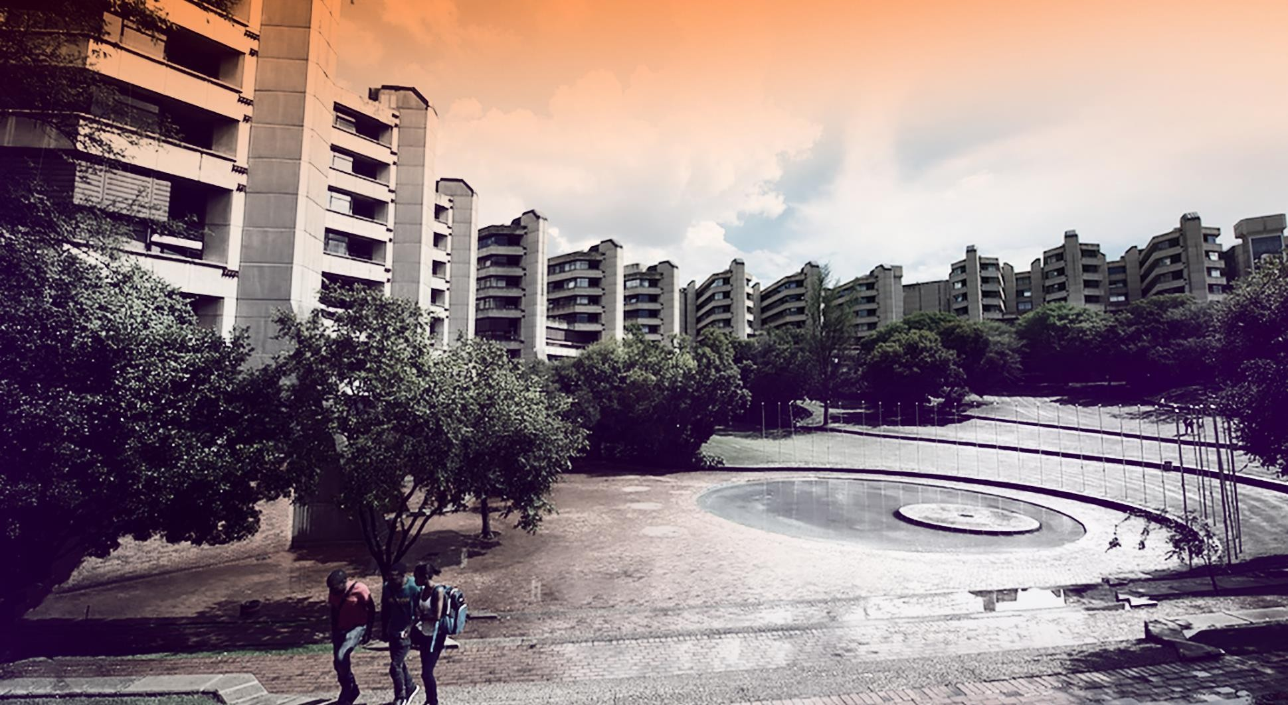
Gaol.
DESIGN and GEANT4 SIMULATION FOR FOS PACKAGE
LN MKHWANAZI
PROJECT INVESIGATION (PJMMCY4)
21 MAY 2025

Slide 2
Contents
Background
Problem statement and Approach
Aim
Experimental design of project

Slide 3
Principles of Particle Physics
Field of science that explores the most fundamental components of matter and the forces that govern their interactions.
Theoretical predictions still need to be practically tested.
Particle colliders
Accelerate particles to very high energies and collide them
Subatomic particles are propelled along two beams to move in opposite directions.
With the use of accelerating structures and superconducting magnets, the beams are set to collide at specific locations.

Slide 4
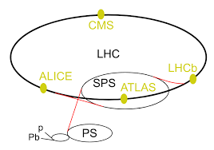
LHC and HL-LHC
World’s biggest and most powerful particle accelerator
Located in at CERN in Geneva, Switzerland.
Although the LHC has been monumental in particle physics, upgrades are required heighten its capabilities.
Inception of the High-Luminosity Large Hadron Collider (HL-LHC) project.
Why the upgrade [2]:
Increased collision rate
Stronger superconducting magnets to focus the particle beams better
Can handle more collisions and produce clearer data.
Figure 1 – LHC accelerator complex [1]

Slide 5
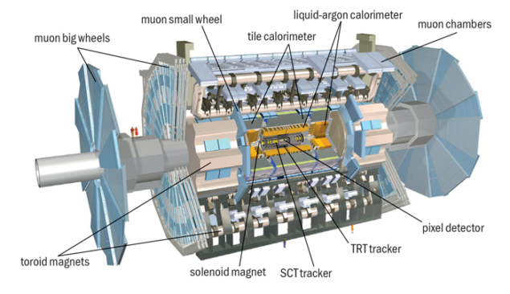
ATLAS Detector
Dimensions [3]:
25 m high, 44 m long.
Weighs around 7000 tons.
ATLAS – A Toroidal LHC ApparatuS.
One of the major multi-purpose particle detectors at LHC.
surrounds one of the four main collision points
Tracks and Explores [4]:
Particle paths (using the inner detector).
Energy of particles (with calorimeters).
Particle identities.
Origin of mass.
Components:
Inner detector
Calorimeters
Muon Spectrometer
Magnet System
Current inner detector
Figure 2 – ATLAS detector [3]

Slide 6
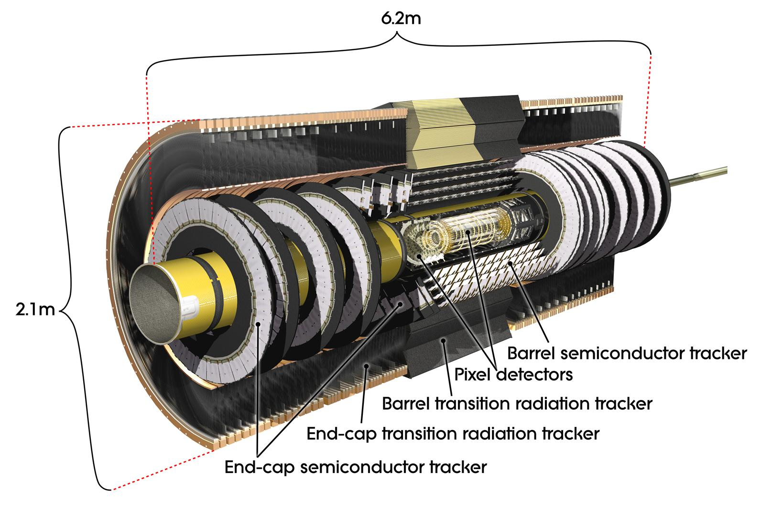
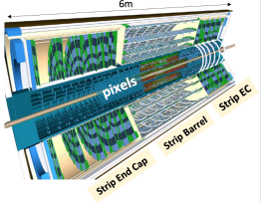
Inner Detector (ID) and Inner Tacker (ITk)
ID innermost part of ATLAS detector, closest to the proton-proton collision points.
Tracks the paths of charged particles as they emerge from collision point.
ITk – a new all-silicon tracking system upgraded version of ID.
Why Upgrade [4]:
Higher collisions per second.
Increased radiation.
More radiation, better resolution, and faster data processing
Figure [3] – ATLAS inner detector
Figure [4] – ATLAS inner tracker

Slide 7
Operating Conditions at ITk
The ATLAS Inner Detector is located in an extremely hostile environment, with:
High radiation from collisions
Tightly controlled environmental conditions like moisture and temperatures cause dew point
High radiation:
Intense bursts of radiation
Materials in the ID accumulate radiation doses
Darkens and degrades electronics and sensors
Humidity:
The Inner Detector and ITk are cooled below 0°C, sometimes to −20°C or lower.
Relative humidity of below 10%
Leads to formation of:
Water vapor
Condensation

Slide 8
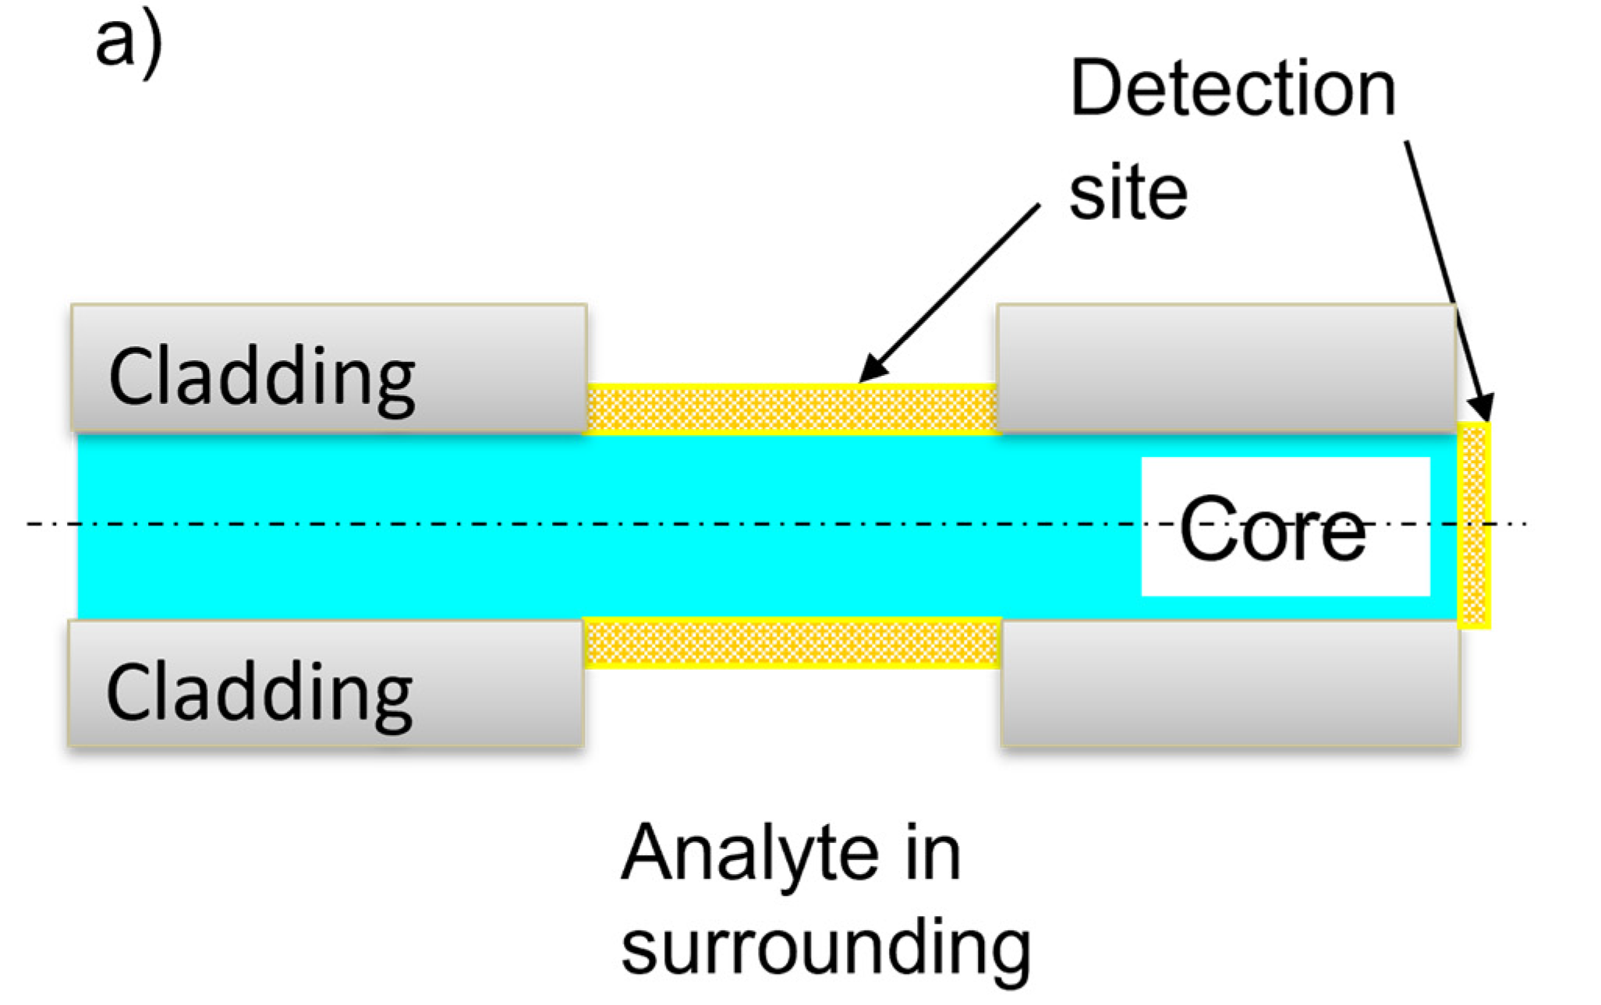
Fiber Optic Sensors (FOS)
Advanced sensing devices that use optical fibres to detect and measure physical, chemical or environmental parameter.
Figure 5 – Schematic of FOS [5]
Why FOS selected for ITk? [6]
Challenge | Sensor Requirement | FOS Advantage
High radiation | Radiation hardness | Properly selected fibers withstand high doses
Strong magnetic field | No electromagnetic interference | Optical sensors unaffected by EM fields
Temperature gradients | High-resolution temperature measurement | FBGs or distributed sensing
Limited access | Reliability and minimal need for maintenance | Passive and long-life components
Basic Principle of FOS: Based on the interaction between light and the environment.
Light Alteration: External influences can modify the light traveling through the fibre.
Property Changes: These influences alter the properties of the light.
Data Measurement: Detect & measure these changes, info about physical conditions can be obtained.

Slide 9
Problem Statement and Approach
A system comprised of multiple FOS packages is being developed for the ATLAS ITK.
Exposed to hostile conditions, that require constant humidity and temperature monitoring.
Exposed to hostile conditions, that require constant humidity and temperature monitoring.
Study aims to investigate radiation effects on FOS packages to be installed in new HL-LHC & ATLAS ITK
Effects of radiation include damage to sensors, mechanical and material degration .
Conditions include harsh radiation emitted on colliding particles.

Slide 10
Aim
This study aims to:
Provide a design and model for a FOS package body through SolidWorks
And
Create a GEANT4 simulation to assess the level of radiation and possible impairments on the FOS package body

Slide 11
Experimental Design
1. DESIGN OF FOS PACKAGE
Although FOS packages have already been developed for the LHC, a new package has to be designed for the upgraded HL-LHC.
This design is expected to be done through SolidWorks where the model specifications are upgraded and altered to interlink with new expected standards.

Slide 12
EXPERIMENTAL DESIGN
2. PERFORM A SIMULATION OF FOS PACKAGE
A simulation is developed to mimic the operating conditions.
This simulation is conducted through the use of the simulation software, GEANT4 using C++, which determines how particles interacts with different materials.
This information is then analyzed, determining the optical geometries and radiation levels the model could withstand.

Slide 13
Experimental Design
2. PERFORM A SIMULATION OF FOS PACKAGE
Basic Description of steps:
1. Define Geometry of FOS packages.
2. Define Material of FOS packages.
3. Integration of FOS package into simulation software.
5. Run Simulation.
6. Post-Processing of Results.
7. Interpretation of Results.

Slide 14
Experimental Design
DESIGN VARIABLES
Variables | Parameters
Dependent variables | Radiation source Time
Independent variable | Placement of FOS Environmental conditions
Constant variable | Geometry of FOS package FOS material properties

Slide 15
Progress and Conclusion
Progress:
At this point of the project, completion of the First Preliminary Report has occurred.
Skills development on programming language is close to completion and requires testing.
Development of SolidWorks packages scheduled to commence on upcoming weeks.
Conclusion:
This project is expected to be completed in October.
Aims to further the advancement of knowledge around the field of particle physics.

Slide 16
References
[1] M. Hauschild. “The CERN Accelerators”. Accessed: May 20, 2025. Exploring the Large Hadron Collider - CERN and the Accelerators. essentials(). Springer, Wiesbaden. https://doi.org/10.1007/978-3-658-32726-2_2
[2] I. Béjar Alonso, O. Brüning, P. Fessia, M. Lamont, L. Rossi, L. Tavian, M. Zerlauth. “Vol. 10 (2020): High-Luminosity Large Hadron Collider (HL-LHC): Technical design report”. Accessed: May 20, 2025. ISBN 978-92-9083-586-8. https://doi.org/10.23731/CYRM-2020-0010
[3] B. Di Girolamo, M. Nessi “ATLAS undergoes some delicate gymnastics.” CERNCourier. Accessed: May, 20, 2025. Available: Bsol-bsigroup-com.eu1.proxy.openathens.net
[4] ATLAS Collaboration. “The ATLAS Experiment at the CERN Large Hadron Collider: A Description of the Detector Configuration for Run 3”. Instrumentation and Detectors (physics.ins-det); High Energy Physics – Experiment. Accessed: May 20, 2025. https://doi.org/10.1088/1748- 0221/19/05/P05063
[5] M. Elsherif, A. Salih. “Optical Fiber Sensors: Working Principle, Applications, and Limitations”. Advanced Photonics Research. Accessed: May 20, 2025. https://doi.org/10.1002/adpr.202100371

Slide 17
, , , , , ,
References
[6] L. Scherino, E.J Schioppa, A. Arapova, G.M Berruti. “Fiber optic sensors in the ATLAS Inner Detector”. Nuclear Instruments and Methods in Physics Research Section A: Accelerators, Spectrometers, Detectors and Associated Equipment. Accessed: May 20, 2025.

Slide 18
THANK YOU

Slide 19
BACKUP

Slide 20
Performance Improvements of ID and ITK
Feature | Current Inner Detector | Itk
Peak luminosity | 10³⁴ cm⁻²s⁻¹ | 7,5 * 10³⁴ cm⁻²s⁻¹
Extreme pile up | 20 - 40 proton-proton collisions | 200 proton-proton collisions
Radiation tolerance | Up to 100 Mrad | >1 Grad
Granularity | mm-scale (TRT) | um-scale (pixels)

