Slide 1
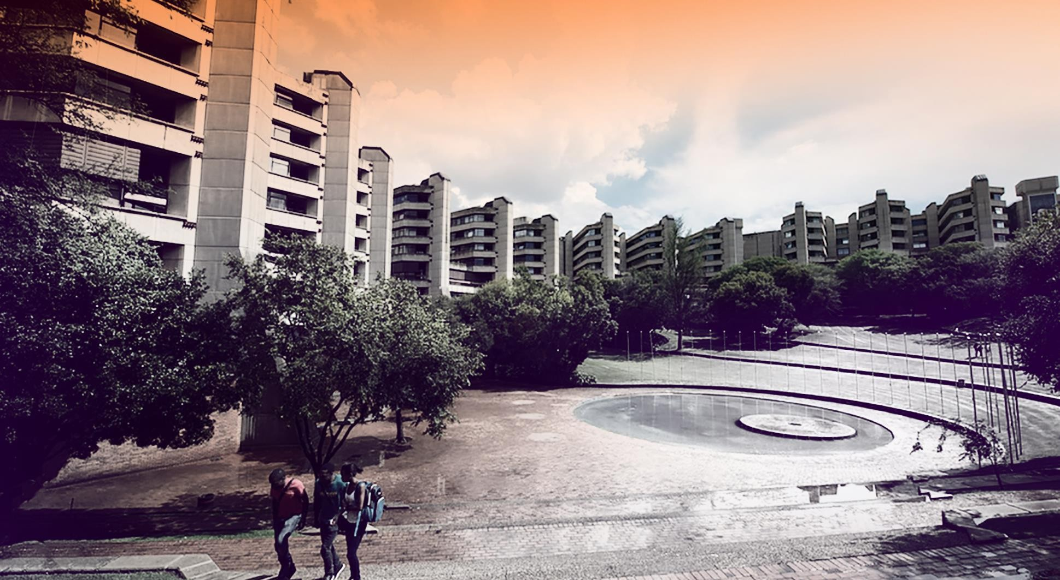
Data Analysis for Fiber Optic Sensors in the SAFARI-1 Nuclear Reactor
NGOMANE Z
221122211
Project Investigation 4000
Faculty of Engineering and the Built Environment Department of Mechanical Engineering Science

Slide 2
Introduction
Research objectives
Methodology
Experimental Plan
Evaluation Strategy
Expected outcomes
Conclusion
Contents

Slide 3
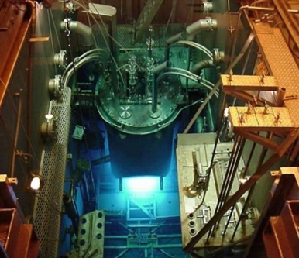
INTRODUCTION
What is a nuclear reactor?
A nuclear reactor is a system that controls a sustained chain reaction, typically to produce energy, conduct research, or create medical isotopes.
Operates under extreme temperature and radiation.
Temperature monitoring is critical for safety.
Why fibre optic sensors?
Traditional sensors degrade in radiation.
FBGs: radiation-resistant up to 12 Ggy [1].
Accurate to ±0.1°C; response time <100 ms [1].
Support 100+ sensors per fiber [1].
Figure 1: Top view of the SAFARI-1 reactor [1].
3

Slide 4
INTRODUCTION (cont.)
FOS Operation
An optical fibre receives light signals from a source, as temperature or strain being monitored. A detector then transforms the light into electrical signals, while signal processors analyse the data for real-time monitoring
Purpose
Current sensors fail in high-radiation zones.
FBGs installed, but accurate interpretation is difficult.
Need reliable data analysis method for real-time use.
Figure 2: Basic operation of a FOS system [2].
4

Slide 5
RESEARCH OBJECTIVES
Conduct a literature review on FOS technology and applications.
Develop computational algorithms using C++ and ROOT.
Validate algorithms using real-time reactor data.

Slide 6
METHODOLOGY
Use real data from SAFARI-1 reactor (NECSA)
Implement Gaussian peak fitting
Use C++ and ROOT for signal processing
Compare with reference sensor data (RTDs)
Spectral data from NECSA
Data Processing
Spectral Feature Extraction
Final output
Validation
Temperature Estimation
6

Slide 7
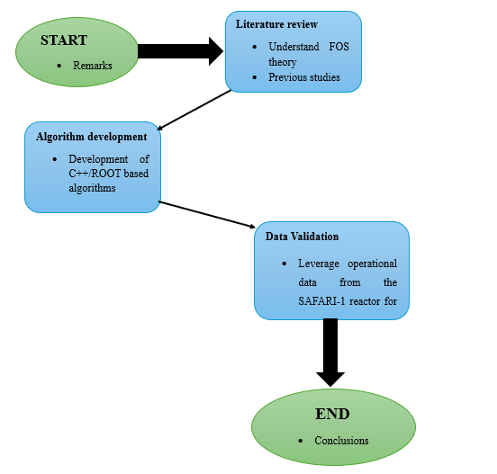
EXPERIMENTAL PLAN
Phase 1: Literature groundwork
Phase 2: Algorithm development
Phase 3: Data validation with SAFARI-1 logs
7

Slide 8
EVALUATION STRATEGY
The primary dataset comes from FBGs operating inside SAFARI-1.
I’ll apply peak-fitting and filtering to derive temperature estimates.
Data Type | Source | Analysis Method | Output
Real FBG Data | NECSA (SAFARI-1 reactor). | Preprocessing (moving-average filter), comparative analysis with RTDs. | Temperature error distribution.
Radiation-Degraded Data | Simulated (based on CERN/ITER). | Signal-to-noise ratio (SNR) calculation, peak detection accuracy. | Maximum tolerable radiation dose before failure.
Table 1: Strategy for Data Gathering and Evaluation.
8

Slide 9
EXPECTED OUTCOMES
I expect to deliver a working algorithm that accurately estimates temperature in real-time using FBG data. It will significantly reduce signal drift and error, supporting reactor operators with more reliable insights. Ultimately, this will help prevent thermal irregularities and improve operational safety in SAFARI-1
9

Slide 10
CONCLUSION
In conclusion, FBGs provide a powerful solution for monitoring temperature in harsh nuclear environments. This project contributes by improving the way we interpret FBG data, using custom algorithms tailored for real-time use. It directly supports better safety, monitoring, and decision-making at SAFARI-1.

Slide 11
Thank you. Any Questions?

