Slide 1
Fibre Optic Sensing for Structural Health Monitoring of an Aircraft
By Bhavesh Singh (217026842)
Supervisor: Dr. T.N.L. Truong, Co-Supervisor: Mr A.S Cassim
21 May 2025

Slide 2
Content
Background
Problem statement, Aim, Objective .
Existing technology
Current wing specifications
Literature findings
Fibre Optics
Methodology
Conclusion
Refrences

Slide 3
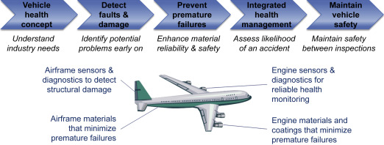
Background
Structural Health Monitoring (SHM) is essential in aviation for real-time damage detection and predictive maintenance. Traditional sensors are limited by EMI sensitivity and poor integration with composite materials[1].
Structural health monitoring analysis of an aircraft
21 May 2025, Bhavesh Singh, FOS for aircraft, PJM presentation 1 [UJ]
1

Slide 4
Problem statement, Aim, Objectives
Problem statement
Measuring strain in aircraft wings is difficult due to harsh environments and weight limits.
Traditional strain gauges are bulky and unreliable under dynamic loads.
A lightweight, accurate, and durable sensing solution is needed.
Aim
To investigate the use of embedded fibre-optical sensors for strain monitoring in aircraft wings and compare results with Finite Element Analysis (FEA).
21 May 2025, Bhavesh Singh, FOS for aircraft, PJM presentation 1 [UJ]
2

Slide 5
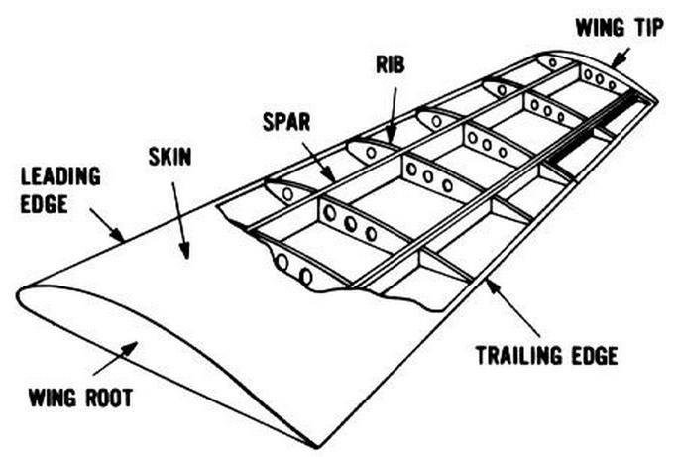
Problem statement, Aim, Objectives cont
Objectives
Conduct a Literature review on Optical sensors and SHM systems
Design and simulate the wing structure using SolidWorks and FEA
Attach FBG sensors into a physical test wing
Acquire and process strain data
Compare experimental and simulated results
Internal Structure of a glider
21 May 2025, Bhavesh Singh, FOS for aircraft, PJM presentation 1 [UJ]
3

Slide 6
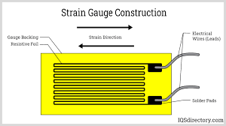
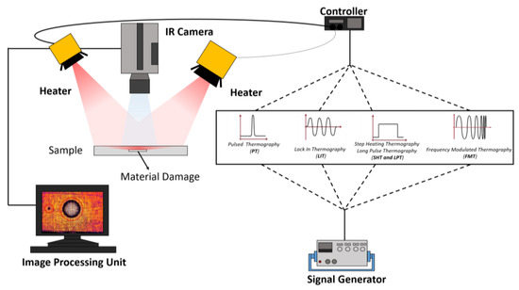
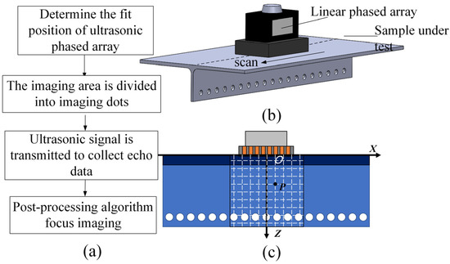
Current Technology used for Structural Health Monitoring
Strain Gauges
Infrared Thermography
Ultrasonic Testing
Ultrasonic testing procedure
Strain Gauge construction
IRT fault detection procedure
Accurate but requires downtime
Low cost, but sensitive to EMI and limited to point measurements[2]
Useful for composites, expensive and skill-dependent[3]
21 May 2025, Bhavesh Singh, FOS for aircraft, PJM presentation 1 [UJ]
4

Slide 7
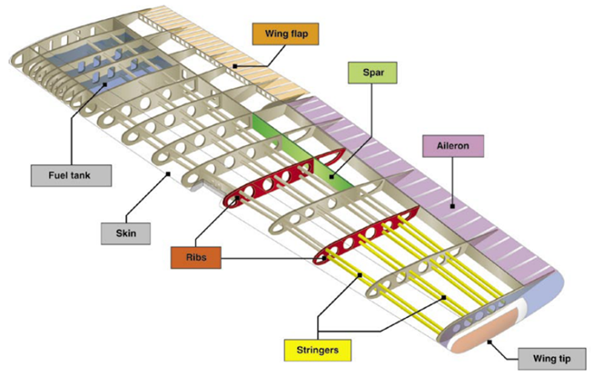
Wing Design Specification
Parameter | Calculated Value
Wing Area (S) | 12.06 m2
Wingspan (b) | 15.53 m
Mean Aerodynamic Chord (MAC) | 0.78 m
Aspect Ratio (AR) | 20
Stall Speed (V_S verification) | 23.04 m/s (83 km/h)
Aircraft Length (L) | 9.32 m
The Design approach was based on “An introduction to experimental light aircraft design” by Anton Maneschjin, and the calculations performed are based on full-scale aircraft design. The actual wing will be scaled down to be physically modelled, and built proposed scale is 1:8
Internal Wing Structure
21 May 2025, Bhavesh Singh, FOS for aircraft, PJM presentation 1 [UJ]
5

Slide 8
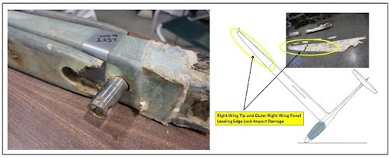
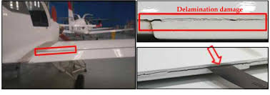
Aircraft structural failures
Load Management: Aircraft wings experience complex loading including bending, shear, and torsion, particularly under turbulent and manoeuvring conditions.
Fatigue and Crack Propagation: Cyclic stresses can initiate cracks at material interfaces, fastener holes, and other stress concentration points, posing a serious risk if not detected early[4].
Internal glider rib failure
Delamination structural degradation
21 May 2025, Bhavesh Singh, FOS for aircraft, PJM presentation 1 [UJ]
6

Slide 9
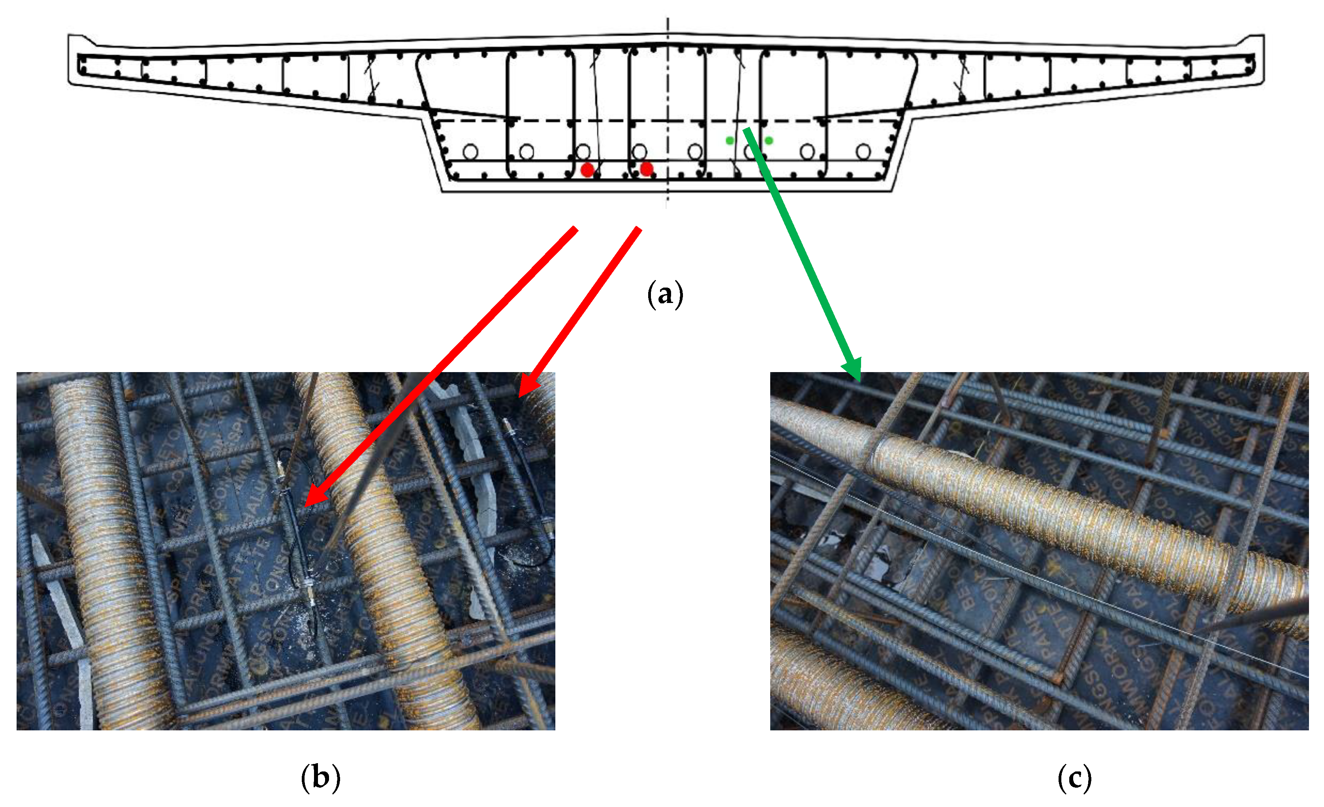
Structural health monitoring
Structural Health Monitoring (SHM)
Uses sensors to monitor structures in real-time
Detects early signs of damage (strain, fatigue, failure)
Prevents major failures through early intervention
In current applications
SHM enables real-time strain monitoring in buildings
Uses smart sensors and AI for stress detection
Supports predictive maintenance and extends infrastructure life
Enhances safety in aging or complex building system
FBG sensor implementation in concrete
21 May 2025, Bhavesh Singh, FOS for aircraft, PJM presentation 1 [UJ]
7

Slide 10
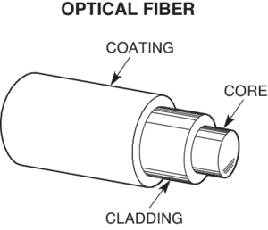
Fibre Optics
Fibre Bragg Grating (FBG) sensors, made from optical fibres with periodic refractive index variations, detect strain and temperature by reflecting specific wavelengths of light that shift under physical changes. They are lightweight, highly sensitive, immune to electromagnetic interference, and well-suited for embedding in composite structures [5].
Simplified View of optical fibre
Expanded view of fibre-Bragg grating sensor
21 May 2025, Bhavesh Singh, FOS for aircraft, PJM presentation 1 [UJ]
8

Slide 11
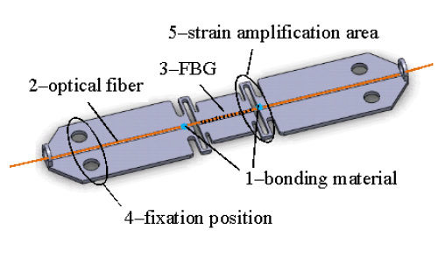
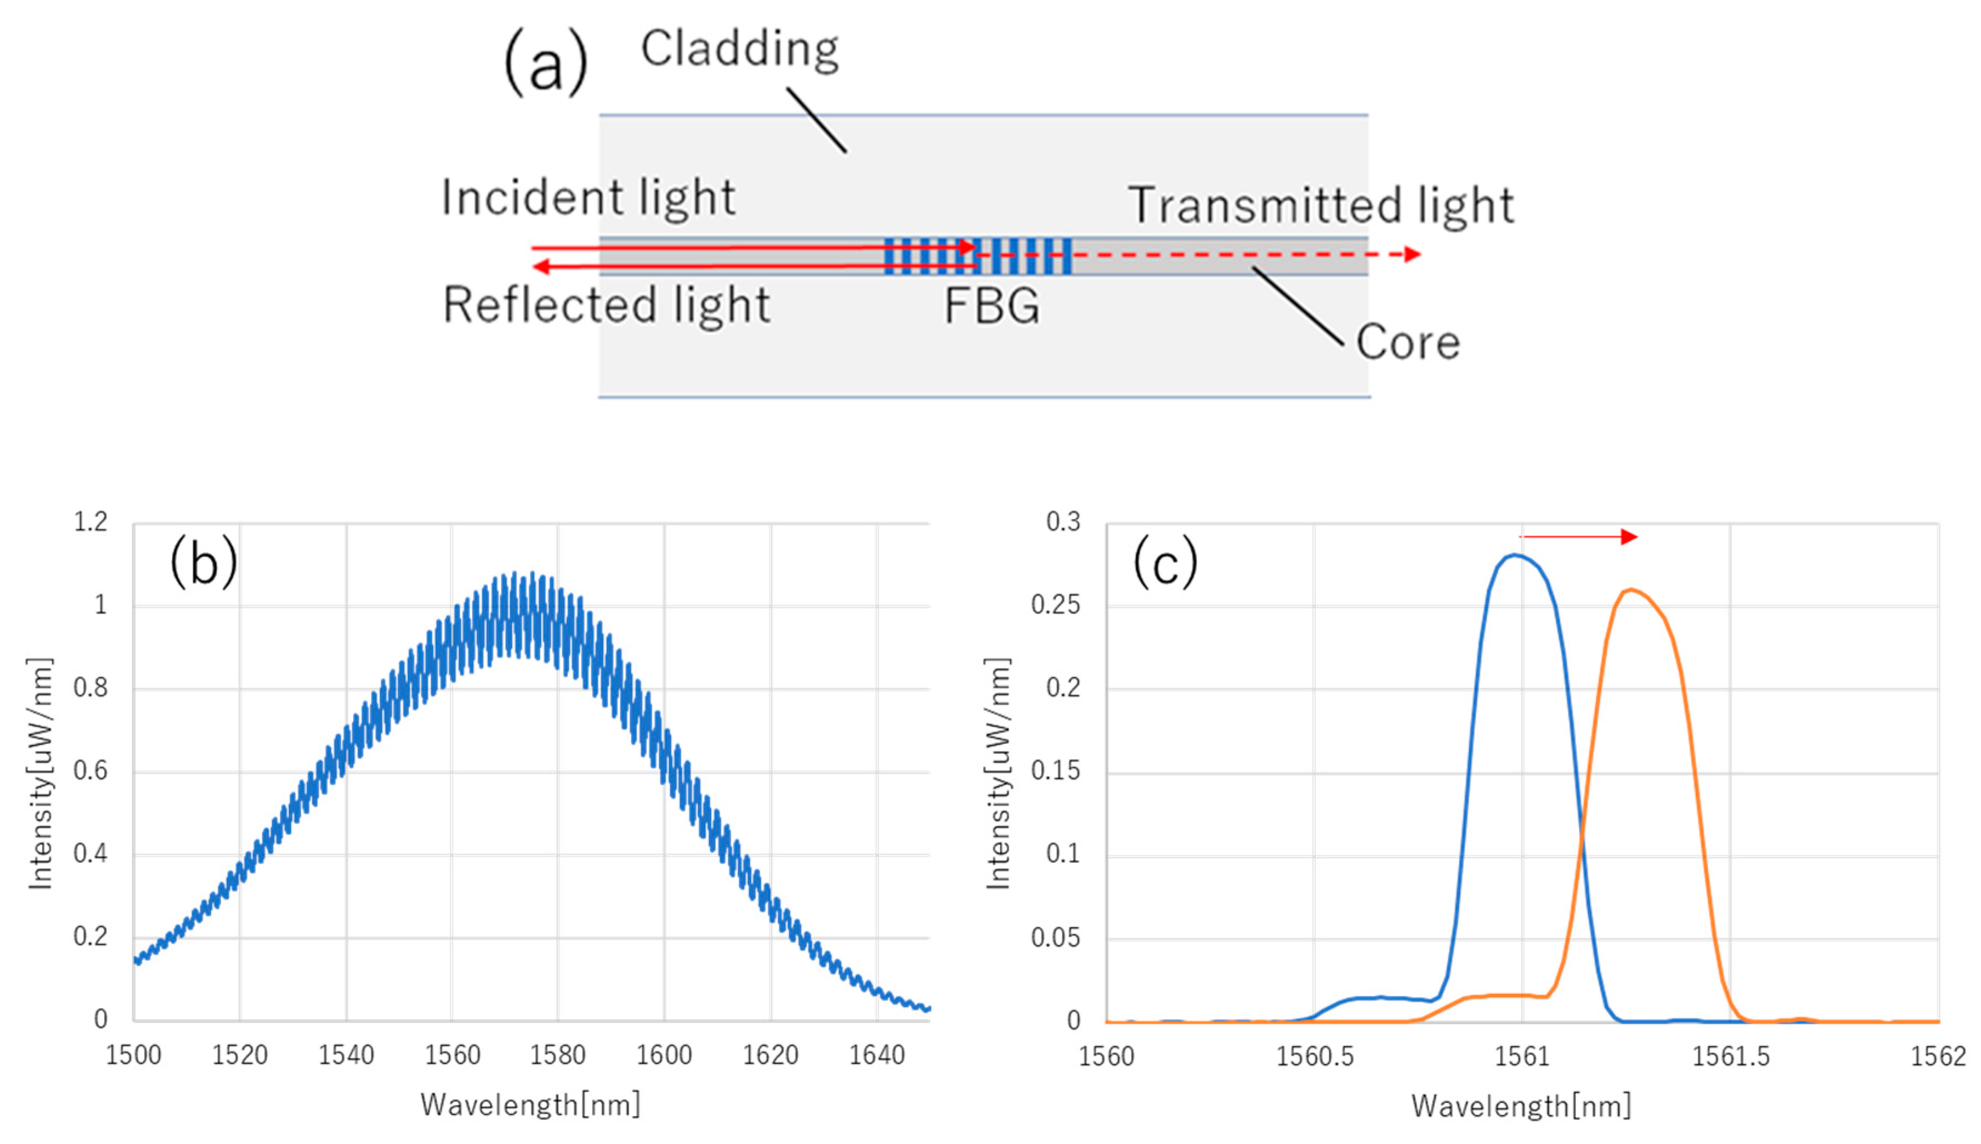
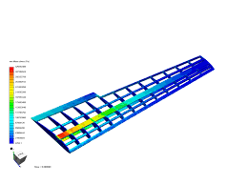
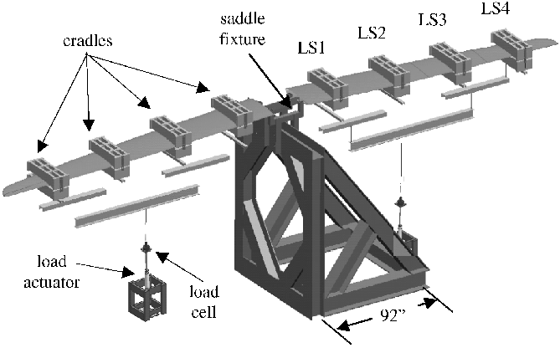
21 May 2025, Bhavesh Singh, FOS for aircraft, PJM presentation 1 [UJ]
9

Slide 12
Conclusion
Next phase
Designing the Solidworks model
Performing FEA
Building of the wing
Printing of FBGs and attaching them to the wing
Testing the physical wing and obtaining data
Performing Data processing on all acquired data from testing
Comparing simulated results with real-world results
21 May 2025, Bhavesh Singh, FOS for aircraft, PJM presentation 1 [UJ]
10

Slide 13
References
[1] V. R. Gharehbaghi and E. N. Farsangi, "A critical review on structural health monitoring: Definitions, methods, and perspectives," Arch. Comput. Methods Eng., vol. 29, pp. 1217–1245, 2022.
[2] B. Kurian and R. Liyanapathirana, "Machine learning techniques for structural health monitoring," in Damage Assessment of Structures, Springer, 2019, pp. 1–14.
[3] R. Miorelli, P. Luraschi, M. Di Maio, D. Bianchi, and M. Guagnelli, "Supervised learning strategy for classification and regression tasks applied to aeronautical structural health monitoring problems," Ultrasonics, vol. 111, 2021, Art. no. 106309.
[4] Y. Choi, S. H. Abbas, and J. R. Lee, "Aircraft integrated structural health monitoring using lasers, piezoelectricity, and fibre optics," Measurement, vol. 124, pp. 161–171, 2018.
[5] A. Hamdan, M. T. H. Sultan, and F. Mustapha, "Structural health monitoring of biocomposites, fibre-reinforced composites, and hybrid composite," in Structural Health Monitoring of Biocomposites, Elsevier, 2019, pp. 241–260.
21 May 2025, Bhavesh Singh, FOS for aircraft, PJM presentation 1 [UJ]
11

Slide 14
Thank you Questions
21 May 2025, Bhavesh Singh, FOS for aircraft, PJM presentation 1 [UJ]

