Slide 1
INVESTIGATING THE ENVIRONMENTAL CONDITIONS IN A GREENHOUSE: A CFD STUDY
.
PARDON T. MURINGANI (222000895)
Supervisors: Prof Simon Connell, Dr Emmanuel Igumbor, Abdul Sattar Cassim

Slide 2
DISCUSSION POINTS
INTRODUCTION
LITERATURE REVIEW
RESEARCH METHODOLOGY
RESULTS

Slide 3
INTRODUCTION
Background
Food Importance: Food provides essential nutrients for body maintenance, growth, activity, and functions.
Climate Change Impact: Crop performance is affected by temperature, precipitation, humidity, wind speed, sunshine duration, and evaporation.
Population Growth: Global population surpassed 8 billion by 2022 (expected to grow to 6.3 billion by 2050) .
Limited Arable Land: Regions like the Middle East face arable land scarcity, requiring innovative agricultural solutions.
Greenhouse Solution: Greenhouses offer a way to address climate change and land limitations by providing controlled environments for crop, poultry, and aquaculture production.
Environmental Control Importance: Internal greenhouse conditions (temperature, humidity, airflow) must be well-managed for optimal production, influenced by design and external climate.
Regional Variability: Greenhouse design and control strategies must be tailored to local climate and crop requirements.
Crop-Specific Needs: Different crops thrive in different conditions (e.g., soybeans in heat, cabbage/broccoli in cool weather).
PJMMCY4

Slide 4
INTRODUCTION
Background
Use of CFD: Computational Fluid Dynamics (CFD) applies numerical methods to model airflow and climate conditions in greenhouses.
Benefits of CFD: Enables analysis and optimization of greenhouse environments, enhancing sustainability and efficiency.
Problem statement
The changing climate conditions and rapidly rising population has revealed the need for sustainable agriculture methods such as precision agriculture and controlled environment agriculture. With that, the importance of optimizing greenhouse environments arises to allow for efficient allocation of the earth’s already limited resources.
PJMMCY4

Slide 5
INTRODUCTION
Aim
The aim of this investigation is the study and optimization of the environmental conditions in a greenhouse situated at UJ APB campus. From this the goal is to improve the current agricultural sector by increasing food production and food quality, and the application of CFD in real-time problem solving in greenhouses
Figure 1: APB Greenhouse
PJMMCY4

Slide 6
LITERATURE REVIEW
.
Key Design Factors
Site selection, geometry and orientation, structural forms, foundation and flooring, cover materials, ventilation systems.
Environmental and Climate Considerations
External climate (temperature, wind speed, solar radiation) strongly influences internal greenhouse conditions.
Designs must be region-specific to address diverse climate challenges.
Computational Fluid Dynamics (CFD)
CFD solves the Navier-Stokes equations to model fluid flow, ideal for scenarios that are costly or impossible to study experimentally.
Procedure involves preprocessing (geometry/mesh setup), solving (equation discretization), and postprocessing (visualization via plots).
PJMMCY4

Slide 7
RESEARCH METHODOLOGY
Create CAD model
Mesh the model
Specify material properties
Select appropriate equation parameters (Energy, Viscous-k omega turbulent
Specify boundary conditions (inlet air velocity & temperature, internal temperature)
Procedure
PJMMCY4

Slide 8
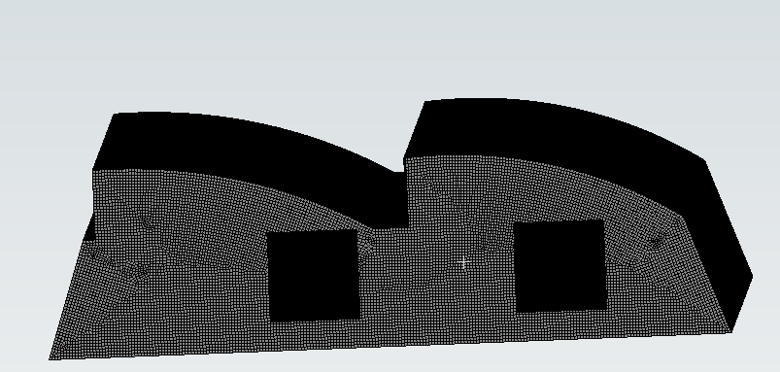
RESULTS
Mesh
Figure 2: Meshed geometry
PJMMCY4

Slide 9
RESULTS
Test simulation
Energy ON
Viscous set to turbulent (k-omega)
Material: Fluid-air, Solid LDPE polyethylene
Inlet vents - air at temperature 250 K and velocity 1.67 m/s
Greenhouse internal temperature – 310 K
PJMMCY4

Slide 10
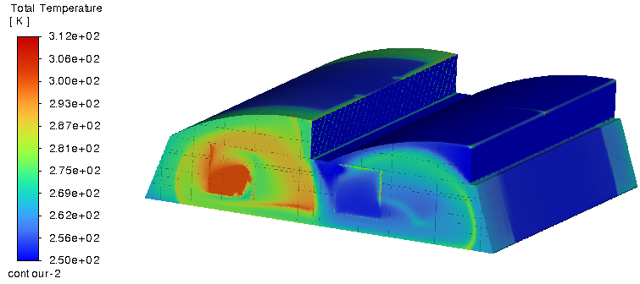
RESULTS
Test simulation
Figure 3: Temperature contour
PJMMCY4

Slide 11
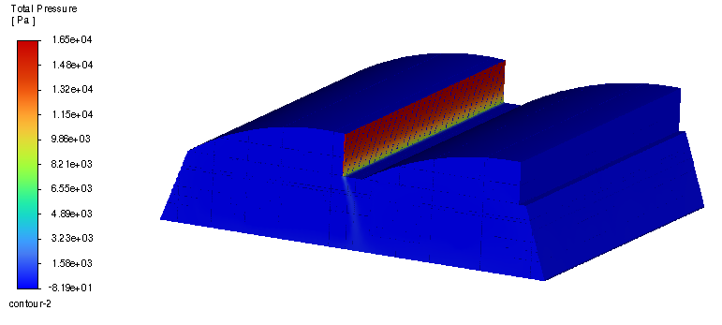
RESULTS
Test simulation
Figure 4: Pressure contour
PJMMCY4

Slide 12
REFERENCES
.
Key Design Factors
Site selection, geometry and orientation, structural forms, foundation and flooring, cover materials, ventilation systems.
Environmental and Climate Considerations
External climate (temperature, wind speed, solar radiation) strongly influences internal greenhouse conditions.
Designs must be region-specific to address diverse climate challenges.
Computational Fluid Dynamics (CFD)
CFD solves the Navier-Stokes equations to model fluid flow, ideal for scenarios that are costly or impossible to study experimentally.
Procedure involves preprocessing (geometry/mesh setup), solving (equation discretization), and postprocessing (visualization via plots).
PJMMCY4

