Slide 1
Investigating the Use of Big Data Tools in High-Energy Physics for Identifying Unique Dark Matter Signatures
Unathi Bosika

Slide 2
Table of contents
01
02
03
04
05
06
Aims and Objectives
Dark Matter Background
Standard Model of Physics
ATLAS Detector
Data Analysis Framework
Monte Carlo Simulations

Slide 3
Aims and Objectives
Research Aim
Investigating the Use of Big Data Tools in High-Energy Physics for Identifying Unique Dark Matter Signatures
Key Objectives
Collect and reduce ATLAS collision data
Investigating the Use of Big Data Tools in High-Energy Physics for Identifying Unique Dark Matter Signatures
Visualize events to isolate dark matter signatures

Slide 4
Research objectives
Exploration
Investigation
Analysis
Collect and reduce ATLAS collision data
Analyze simulated and real data using Big Data & ML techniques
Visualize events that survive cut flow

Slide 5
Background

Slide 6
Dark Matter Background
Since the 1970s, observations of galaxy rotation curves, gravitational lensing in clusters, and the cosmic microwave background have consistently pointed to an unseen “dark” component making up roughly 27 % of the universe’s energy budget—and about 85 % of its total matter content .
Despite this overwhelming indirect evidence, dark matter has never been observed through electromagnetic or strong interactions, indicating it lies beyond the Standard Model .

Slide 7
Dark Matter Background
Gravitational Lensing: Light from background galaxies is bent into arcs by mass in galaxy clusters; lensing maps show far more mass than is visible, pointing to dark matter
To accommodate dark matter, scientists introduce a “hidden” sector featuring new fields vector bosons and scalars—that couple to the SM through portal interactions

Slide 8
Standard Model of Particle Physics

Slide 9
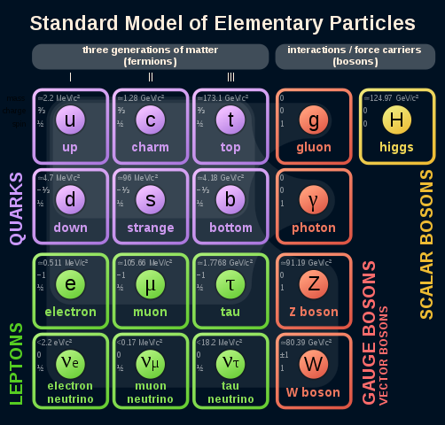
Fundamental Constituents
Fermions (spin-½): Three generations of quarks (up, down; charm, strange; top, bottom) and leptons (electron, muon, tau + their neutrinos)
Bosons (spin-1): Gauge carriers—photon (electromagnetism), W⁺/W⁻/Z⁰ (weak force), and gluons (strong force)
Higgs Boson (spin-0): Unique scalar responsible for electroweak symmetry breaking and mass generation through the Higgs mechanism

Slide 10
Key Features
Spontaneous Symmetry Breaking: Higgs field giving mass to W/Z bosons and fermions without violating gauge invariance.

Slide 11
Limitations and Dark Matter Gap
No Dark Matter Candidate: All SM particles either interact electromagnetically or are too light/relativistic to account for observed cosmic structure.
Beyond-SM Necessity: Motivates hidden-sector extensions (dark photons, dark Higgs) to provide viable candidates coupling through portal interactions.

Slide 12
Experimental Signatures of Dark Matter

Slide 13
Mono-Z, Higgs and Benchmark Models
For DM signatures, we look for events with a Standard-Model Z boson decaying to ℓ+ℓ− and large missing transverse momentum from undetected dark-sector particles
Higgs decays into two dark gauge bosons (𝑍𝑑​ ), each yielding a dilepton pair
Hidden Abelian Higgs Model: kinetic + mass mixing between dark U(1) and electroweak sector

Slide 14
Experimental Setup

Slide 15
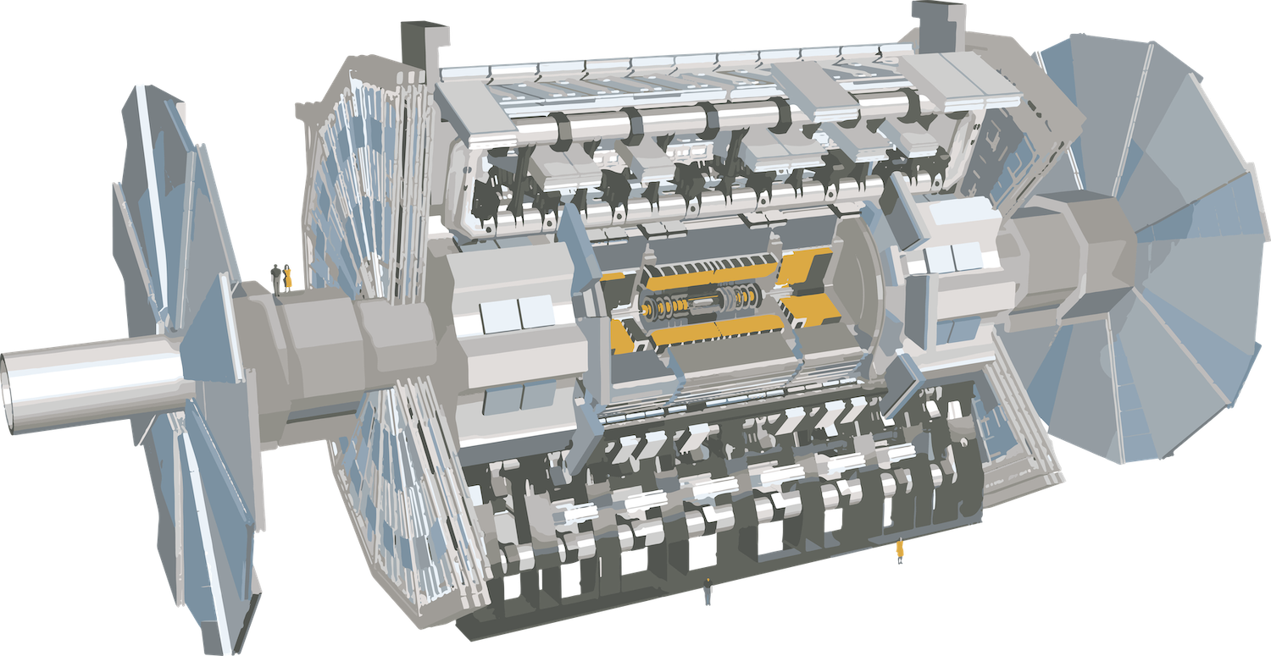
Detector, Trigger and DAQ, Data Rates Overview
7,000 ton, 80 million readout channels, 40 MHz collision rate
Subsystems: Inner Detector, Calorimeters, Muon Spectrometer
Level-1 (L1): hardware-based L1Calo & L1Muon → coarse energy/muon triggers
Three-tier TDAQ reduces 40 MHz → 200 Hz for offline storage
Raw data rates: ∼6 GB/s → after trigger ⟶ 320 MB/s

Slide 16
Data Analysis Framework

Slide 17
Root and Core Components
ROOT is a CERN-developed, object-oriented C++ toolkit for high-energy physics data analysis, providing I/O, histogramming, fitting, and visualization capabilities.
TTree/TTreeReader: efficient columnar storage and access of event data
TH1/TH2 Histograms & TF1 Fits: built-in statistical tools for data exploration and model fitting

Slide 18
Methodology

Slide 19
Monte Carlo Simulations

Slide 20
Role and Scope
Monte Carlo (MC) simulations are the sole method to model ATLAS’s intricate detector response and connect experimental data with theory predictions
Detector simulation: GEANT4-based ATLAS framework for full tracking, calorimetry, and muon-system response

Slide 21
Event Generation
POWHEG v2.0 at NLO for Higgs production.
JHUGen 7.4.0 at LO to model dark-boson (ZdZ_dZd​) mass & lifetime in decays.
This theoretical MC framework underpins the search for 𝐻→𝑍𝑑𝑍𝑑→4ℓ signals and the estimation of both signal efficiency and background rates.

Slide 22
Concluding Remarks
The experiment provides a scalable framework to search for hidden-sector mediators (dark photons 𝑍𝑑​ ) in LHC data
It also enhances sensitivity to both dark matter signatures and visible exotic decays, covering a broad dark-matter parameter space

Slide 23
Thank You

