Slide 1
Gaol.
Studying the Absorption & Scattering of PET Photons in Medical & Mineral PET
Prince Nqobizitha Ncube
17 MAY 2025

Slide 2
Backgroundjj
PRESENTATION CONTENTS
Background
Rationale for conducting the project
PET and MinPet
Kimberlite
Project Aim
Experimental Plan

Slide 3
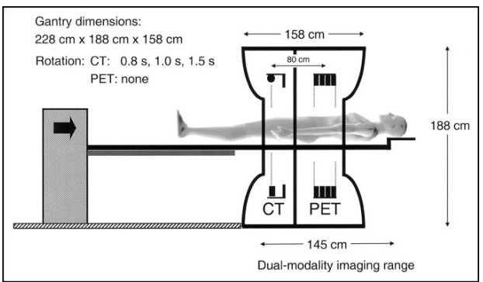
Background
Radioactive material is injected in a body.
It releases positrons.
Annihilation upon contact with an electron, creating two 511 keV photons.
Detectors around the body detect the photons.
An algorithm uses this data to create a 3D reconstruction.

Slide 4
Medical Application
PET used in oncology - detection of tumors.
In cardiology - PET is used to assess myocardial perfusion and viability.
In neurology, it aids in Alzheimer's disease, diagnosis of epilepsy & Alzheimer's disease

Slide 5
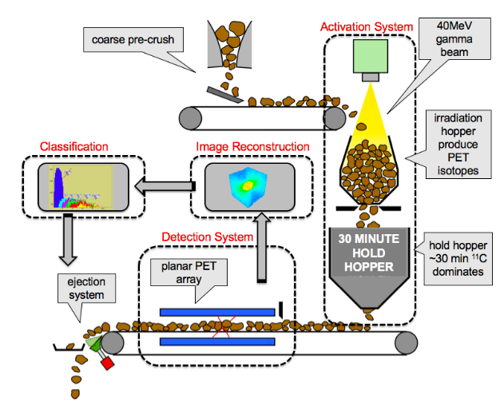
PET Beyond Medical Use
Tracking the flow of fluids or particles inside pipes or reactor.
Monitoring nutrient or water movement in plants
Ongoing adaptation for mineral scanning, particularly for tracking dense or fine particles.
Such as the MinPet project for diamond detection

Slide 6
Why Study PET Photon Behavior?
We must understand how much is scattered, absorbed, or transmitted.
This helps optimize detector placement, shielding, and image reconstruction.

Slide 7
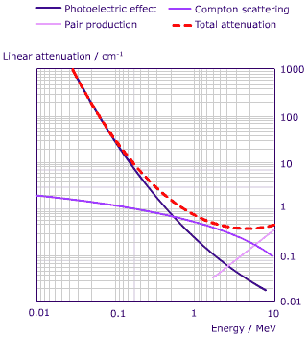
Photon Interaction
Photoelectric effect – photon is absorbed. A photoelectron is released. (significant at low energy)
Compton scattering – photon transfers some energy and knocks off electron. Photon deflected.
Pair Production – Due to photon-nucleus interaction. A positron-electron pair is formed (1.022 MeV threshold)
511 keV photons primarily interact via Compton scattering & photoelectric effect.

Slide 8
Kimberlite
Kimberlite is the host rock for most natural diamonds.
Diamonds are not directly visible to PET, but kimberlite affects photon travel.
Understanding photon attenuation in kimberlite supports development in diamond exploration.
No standard reference exists for kimberlite for how much it scatters and absorbs photons.

Slide 9
Project Aim
The aim of this study is :
To study how PET photons behave in mineral and medical contexts using kimberlite slabs
Through
Comparing measured and GEANT4 simulated attenuation and scattering patterns.

Slide 10
Conceptual Framework
PET source emits 511 keV photons in all directions.
Photons interact with slabs of material
The photons may scatter, pass through, or be absorbed.
What we measure at the detector tells us how material affects the signal.

Slide 11
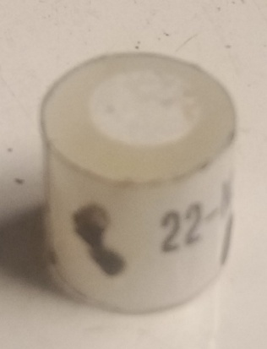
High-Level Experiment Design
PET source (Sodium-22) is placed at fixed distance from detector
Kimberlite slab inserted between them
Measurements taken
Energy and count data collected (using DAQ system)
Thickness is then varied

Slide 12
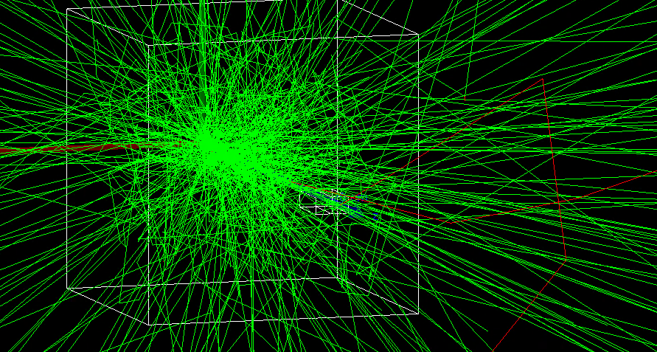
Geant4 Simulation
Source, slab, and detector modelled in GEANT4
Photons fired in all directions
Scoring volumes track how many photons pass, scatter, or get absorbed
ROOT Data Analysis Framework used to view energy spectra and counts
Results compared to experimental data
Interaction with electron

Slide 13
Key Experimental Variables
Type | Variable
Control Variables | Photon energy
 | Detector type and position
 | Source-detector distance
 | Kimberlite composition
 | Simulation model
Independent Variable | Kimberlite slab thickness
Dependent Variables | Photon count rate at detector
 | Energy spectrum at detector
 | Attenuation coefficient (μ)

