Slide 1
Radiation Damage of 4IR Sensors in Extreme Environments
A van der Merwe - 222021648
Prof Simon Connell

Slide 2
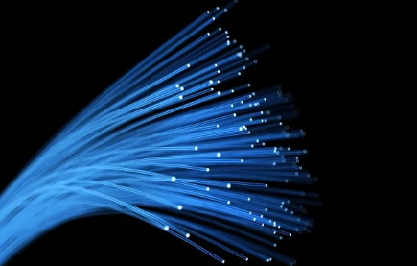
Contents
Introduction
Background
Theory
Problem
Aim
Objectives
Experimentation
Project significance
Conclusion
References
Questions

Slide 3
Introduction:
Project Context: Addressing the need for reliable sensors in nuclear reactors.
Relevance: Current sensors lack full radiation hardness, impacting performance.
Scope: Focus on developing radiation-hard fiber optic sensors using silica glass.

Slide 4
Background:
Global Context: Over 100 countries shifting to green energy and carbon neutrality.
Nuclear Energy: Sustainable, efficient, economically viable, but safety concerns persist.
Fiber Optic Sensors: Enhance safety via in-core monitoring of water level, humidity, temperature, and neutron flux.
Benefits: Small, lightweight, unintrusive, intrinsically powered, high bandwidth, immune to EM.
Applications: Used in CERNs Large Hadron Collider and space instrumentation.

Slide 5
Theory:
Concepts: Utilizes fiber Bragg gratings and distributed sensing for fiber optic sensors.
Radiation Effects: Point defects in silica sensors under radiation cause issues like radiation-induced attenuation, emissions, and refractive index changes [1][2].
Mechanisms: These defects manifest as optical absorption and optical luminescence bands, impacting sensor performance [1].
Implication: Understanding these effects is crucial for developing radiation-hard sensors.

Slide 6
Problem:
Issue: No fully radiation-hard sensors exist; accuracy suffers, requiring replacements every few months.
Cause: Point defects from irradiation cause radiation-induced attenuation, emission, and refractive index changes.
Solution Approach: Shift to fiber optic sensors with fiber Bragg gratings for light reflection and distributed sensing with multiple gratings.
Potential: Silica glass shows promising radiation hardness for in-core measurements; dopants alter properties, necessitating new designs.

Slide 7
Aim:
Goal: Determine optimal composition and dopants for desired radiation hardness in fiber optic sensors for nuclear reactors.
Approach: Understand damage mechanisms including radiation-induced attenuation, emission, refractive index change, lattice dilation, densification, and darkening.
Factors: Analyze effects of point defects and dopants like non-bridging oxygen hole centers, dangling silica bonds, peroxy radicals, self-trapped holes, and self-trapped excitons.
Outcome: Develop sensors with enhanced durability for reactor core applications.

Slide 8
Objectives:
Goals: Analyze results, draw conclusions, and provide recommendations for future research on fiber optic sensors.
Pre-Irradiation: Determine silica glass structure, refractive index, and Bragg wavelength of inscribed fibers.
Post-Irradiation: Assess structural changes in silica glass, changes in refractive index, shifts in Bragg wavelength, and presence of new point defects.
Outcome: Enable better understanding and improvement of radiation-hard sensors for nuclear applications.

Slide 9
Experimentation:
Samples: Fiber samples irradiated at SAFARI-1 Nuclear Research Reactor, NECSA, Pelindaba; potential beam application at ESRF, Grenoble.
Analysis: Silica structures examined via X-ray diffraction techniques.
Measurements: Radiation-induced attenuation and Bragg wavelength shifts assessed with optical spectrometers; point defects detected using electron paramagnetic resonance spectroscopy.
Goal: Validate sensor performance under radiation for nuclear applications.

Slide 10
Project Significance:
Nuclear Plants: Enables real-time monitoring, improves operational efficiency, reduces costs, and enhances safety.
Space Applications: Protects astronauts, instruments and provides reliable cosmic radiation measurements.
Research: Advances knowledge of radiation damage in silica fibers, benefiting facilities like CERN.
Impact: Drives innovation in nuclear, space, and research sectors with durable sensors.

Slide 11
Conclusion:
Summary: Developed framework to design and test radiation-hard fiber optic sensors.
Impact: Potential to revolutionize monitoring in nuclear reactors and space applications.
Future Work: Refine sensor compositions, conduct further irradiation tests, and explore additional dopants.

Slide 12
References:
[1] S. Girard et al., “Overview of Radiation Effects on Silica-Based Optical Fibers and Fiber Sensors,” IEEE Trans Nucl Sci, pp. 1–38, 2024, doi: 10.1109/TNS.2024.3511455.
[2] K. Kajihara, L. Skuja, M. Hirano, and H. Hosono, “Decomposition of peroxy radicals in SiO ₂ glass with X‐rays or KrF laser light,” physica status solidi (c), vol. 2, no. 1, pp. 314–317, Jan. 2005, doi: 10.1002/pssc.200460173.

Slide 13
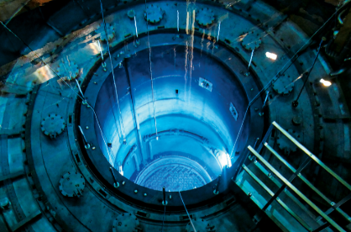
Questions?

