Slide 1
Optimising PET Detector Performance for Diamond Sorting in MinPET
Progress Presentation
21 May 2025
Mwalimu Mandisa Maila

Slide 2
Contents
Introduction
Research Problem and Question
Literature Review
Data Collection
Conclusion

Slide 3
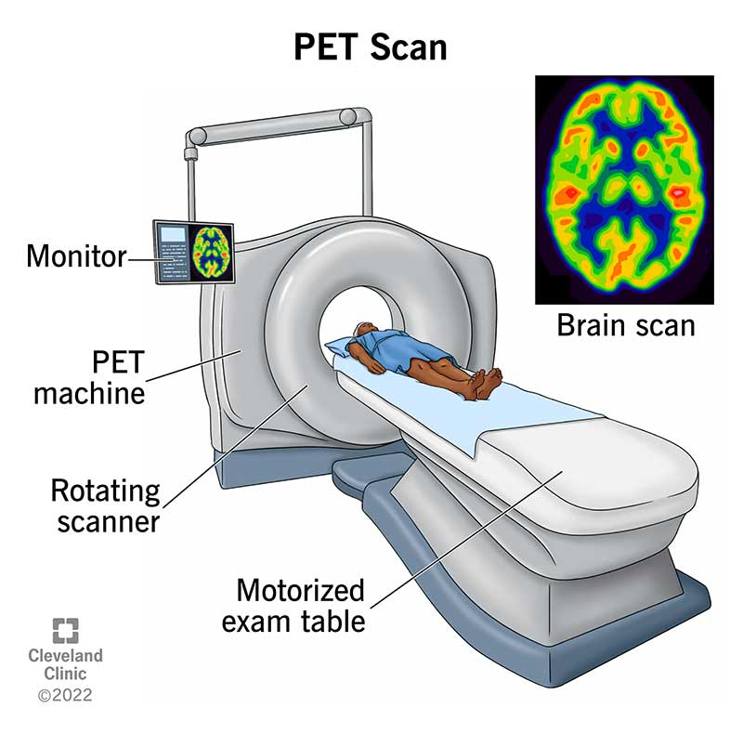
Introduction
Positron Emission Tomography (PET) is a medical imaging technique used to visualise functional processes in the body by detecting gamma photons from positron annihilation.
PET scanners are commonly used in oncology, cardiology, and neurology to trace metabolic activity.
https://my.clevelandclinic.org/health/diagnostics/10123-pet-scan

Slide 4
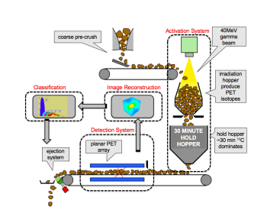
Introduction
MinPET adapts this technique for the mining industry by detecting positron-emitting isotopes formed in diamond-bearing kimberlite.
Unlike traditional methods, MinPET does not require crushing the ore, making it more energy-efficient and less destructive to diamonds.
T. Nemakhavhani et al., “The MinPET diamond discovery technique,” Proceedings of SAIP2017, pp. 355–360, 2017

Slide 5
Research Problem
Traditional sorting methods like XRT, DMS and grease tables have limitations:
Require extensive crushing
Risk diamond breakage
Rely on indirect and surface properties
MinPET offers a non-destructive, carbon-sensitive alternative using PET imaging.
However, current PET systems face challenges in the mining environment:
Low spatial resolution
Background interference from carbonates
Short windows for data acquisition
Research Question: How can PET detector performance be optimised for accurate, high-throughput diamond detection in MinPET?

Slide 6
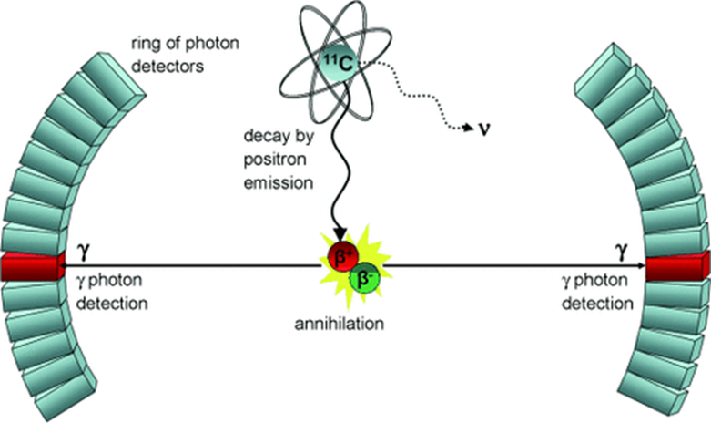
Literature Review and Findings
PET imaging detects 511 keV gamma photons emitted when a positron (from ¹¹C decay) annihilates with an electron.
In MinPET, high-energy photons activate carbon in diamonds, producing short-lived isotopes like ¹¹C.
Recent research explores enhancing PET performance for mining:
Use of SiPMs and LYSO crystals for high resolutionTOFPET2 ASICs for faster timing
FPGA and AI for real-time image reconstruction
MinPET adapts this technique for the mining industry by detecting positron-emitting isotopes formed in diamond-bearing kimberlite.
Unlike traditional methods, MinPET does not require crushing the ore, making it more energy-efficient and less destructive to diamonds.
T. P. W. Miller, N. J. Long, R. Vilar, and A. D. Gee, “Synthesis of 11 C, 18 F, 15 O, and 13 N Radiolabels for Positron Emission Tomography,” Angewandte Chemie International Edition, vol. 47, no. 47, pp. 8998–9033, Nov. 2008, doi: 10.1002/anie.200800222

Slide 7
Data Collection
Simulation Phase
Use Geant4 to model photon interactions in a 17x17 segmented BGO crystal array.
Implement geometric collimation to isolate and evaluate the response of a single crystal pixel.
Simulate photon interactions, annihilation events, and signal leakage.
Experimental Phase
Conduct physical testing in the lab with a radioactive positron source.
Measure the real-world detector response.
Compare simulation results with experimental results.

Slide 8
Conclusion
This project investigates how PET detector performance can be enhanced for accurate, high-throughput diamond sorting in MinPET.
So far:
Conducted a comprehensive literature review on PET principles, technologies, and mining applications.
Defined the experimental framework, including variable selection
Next Steps:
Set up the simulation environment in Geant4 to model detector behaviour.
Simulate photon interactions and assess signal leakage under varied conditions.
Perform physical experimentation to validate simulation results.
Analyse findings to recommend detector improvements for MinPET integration.

Slide 9
THANK YOU.

