Slide 1
Resilience of Diamond in High Radiation Environments
A Study Using Computer Simulations
Presented by,
Sibongakonke Enock Hlongwane
Project management
21 May 2025

Slide 2
Introduction
This project investigates the resilience of diamond as a material in high radiation environments through computer simulations. The study aims to assess the safety of MinPET technology which utilizes high-energy photon beams for diamond extraction, examining the potential radiation damage to diamonds.

Slide 3
Background
Diamond's unique properties make it suitable for extreme environments.
Preservation of diamond quality is essential due to increasing mining challenges.

Slide 4
Problem Statement
The depletion of easily accessible natural diamonds necessitates more efficient extraction methods. Concerns exist regarding the potential impact of photon activation on diamond quality.

Slide 5
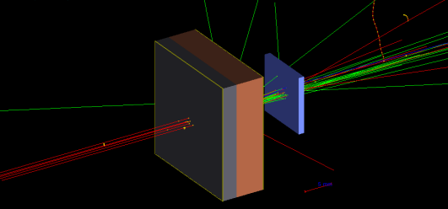
Aim of the Study
To simulate and evaluate the effects of a 40 MeV photon beam on natural diamonds.
To analyze whether MinPET activation impairs diamond integrity.

Slide 6
Objectives
Understand the MinPET process and photon activation. Develop a simulation model using Geant4. Track energy transfer and radiation effects. Quantify radiation damage. Assess the potential impact on diamond quality.

Slide 7
Research Significance
Transition towards environmentally friendly diamond mining practices. MinPET technology can revolutionize extraction methods to improve efficiency and reduce costs.

Slide 8
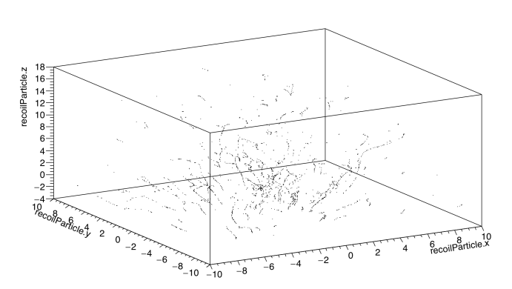
Simulation Framework
Utilizes GEANT4 Monte Carlo toolkit to model interactions of photon beams with diamonds.
Simulations provide insights into defect formation in diamonds caused by radiation.

Slide 9
Expected Outcomes
Identify safe operational parameters for MinPET technology. Ensure diamond quality is preserved during extraction processes.

Slide 10
Experimental design
In the proposed MinPET technology, positron emission tomography is used to detect diamond presence within kimberlite.
Prior to this, diamonds must be irradiated to activate the ¹²C → ¹¹C reaction via a 40 MeV photon beam.
It is essential to ensure that this irradiation does not cause significant structural damage to the diamond.

Slide 11
Experimental design
Geometry Definition: Construct a simulation model of diamond.
Beam Setup: Configure a photon beam source with variable intensities and exposure durations.
Simulation Execution: Track photon interactions, energy deposition, and resulting atomic displacements.
Damage Analysis: Quantify vacancies and analyse radiation
Parametric Study: Evaluate how changes in intensity, exposure time, and lattice orientation affect the radiation damage.

Slide 12
Conclusion
The research emphasizes the potential of MinPET technology in enhancing diamond extraction while ensuring the preservation of diamond integrity, ultimately contributing towards sustainable mining practices.

Slide 13
References
T. Nemakhavhani et al., 'Low Dose Radiation Damage in Diamond from High Energy Electrons and Photons', University of Johannesburg, 2017.
A. T. Collins, 'New Diamond Front. Carbon Technol', New Diamond Frontiers, vol. 17, pp. 47, 2007.
S. Agostinelli et al., 'Nuclear Instruments and Methods', Nuclear Instruments and Methods in Physics Research A, vol. 506, pp. 250–303, 2003.

Slide 14
Thank you!
Any questions?

