Slide 1
FinEstBeAMS atmospheric science beamline at MAX IV Atmospheric pollutants interrogated by photons African Light Source and African Physical Society meeting 2025-11-19
Axel C. Eriksson et al LUND UNIVERSITY (Sweden) https://orcid.org/0000-0002-1692-0376

Slide 2
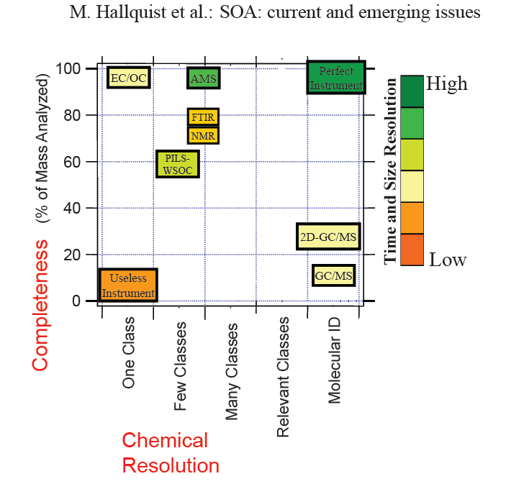
Physico-Chemical analysis of aerosol particles
https://doi.org/10.5194/acp-9-5155-2009
Operation cost
User friendliness
Field Deployability
Level-of-scientific-understanding
(of measurement)

Slide 3
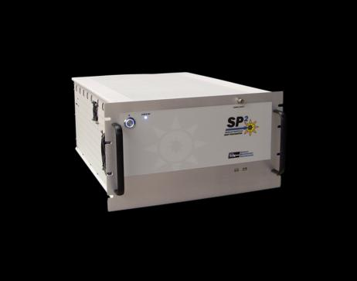
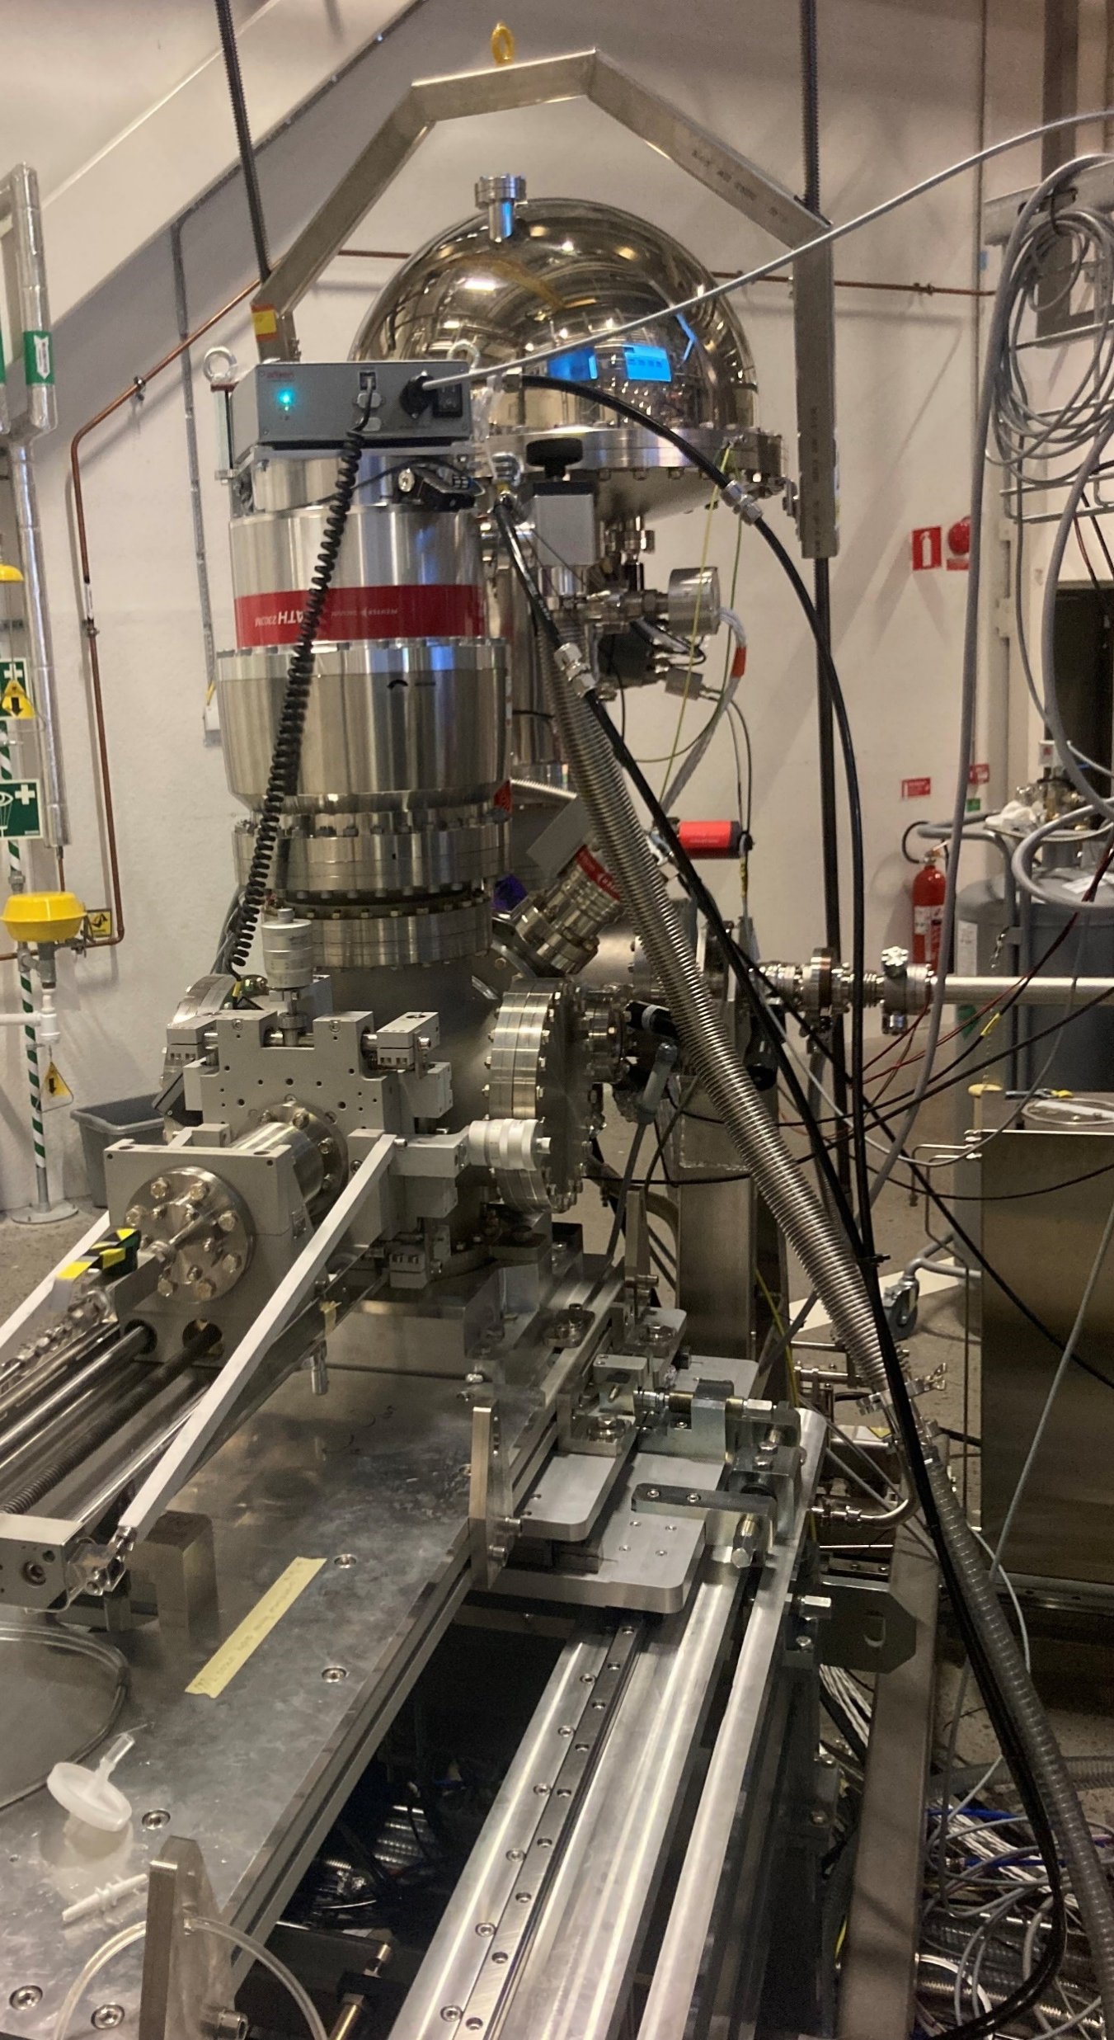
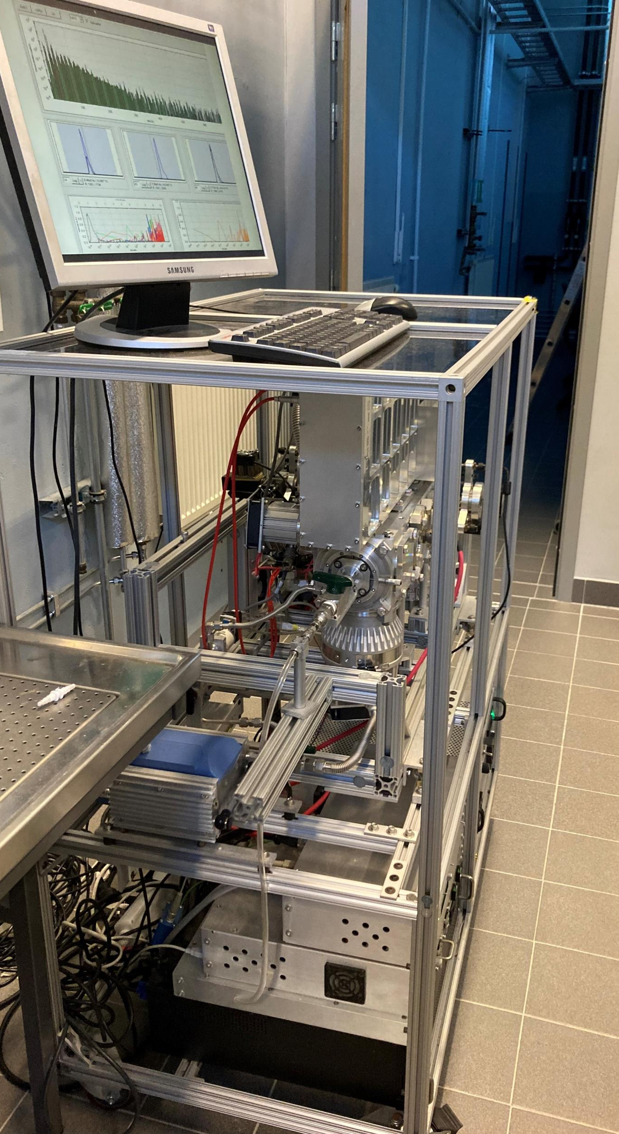
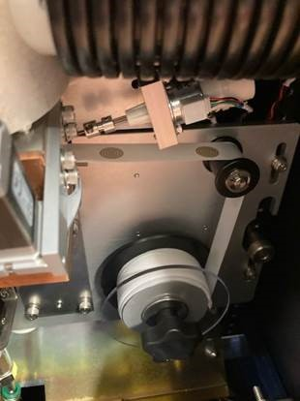
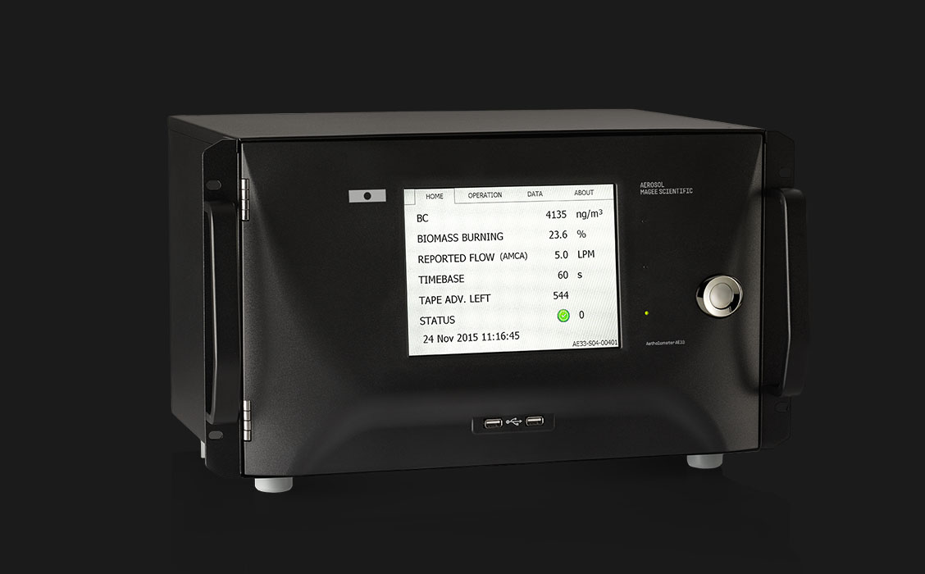
Atmospheric pollutants interrogated by photons
MAX IV synchrotron Aerosol Sample Delivery System
Soot Particle
Aerosol Mass Spectrometer
XACT multimetal monitor
Single particle Soot photometer
7 λ Aethalometer

Slide 4
Atmospheric pollutants interrogated by photons
MAX IV synchrotron Aerosol Sample Delivery System
Soot Particle
Aerosol Mass Spectrometer
XACT multimetal monitor
Single particle Soot photometer
IN-SITU
IN-SITU
IN-SITU
7 λ Aethalometer
Surface
Bulk

Slide 5
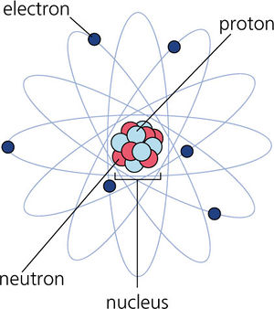

Spectroscopy .
X-ray Spectroscopy
Photon in → change in electronic state of the atom
→ Absorption of the photon (XAS)
→ Electron being kicked out (XPS)
→ Photon emitted during relaxation (XRF)
+
Notes:
Similar information out – BUT: differnt resolution in energy but also sample environment and syrface / bulk sensitivity

Slide 6
Xray electron spectroscopy (XPS) uses ”photoelectric effect” i.e. photons are absorbed by electrons, whereupon electrons are ejected.
The electrons cannot escape more than a few nanometers of marterial without loosing energy, hence XPS is surface specific.
The electron bindning energy carries information about chemical state.

Slide 7
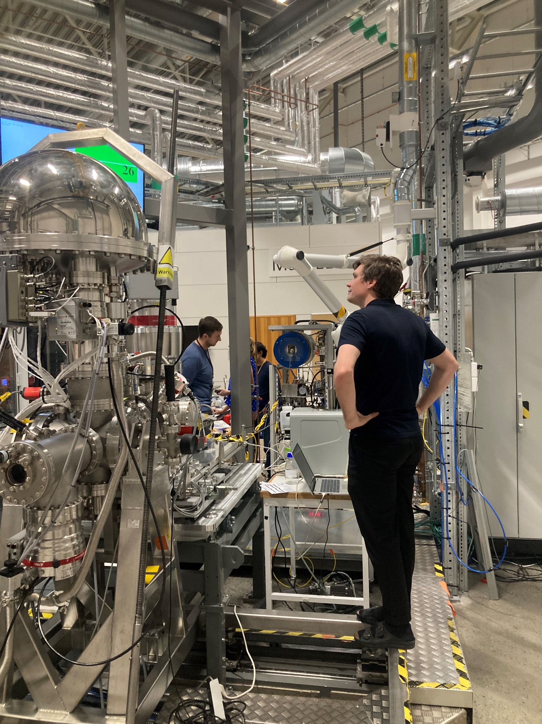
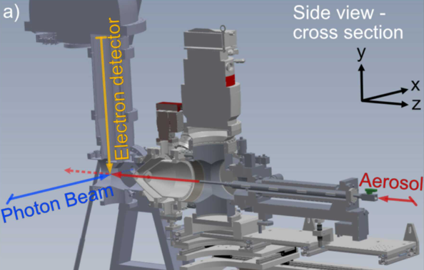
MAX IV synchrotron Aerosol Sample Delivery System
Preger, C., Rissler, J., Kivimaki, A., Eriksson, A. C. and Walsh, N., A versatile sample-delivery system for X-ray photoelectron spectroscopy of in-flight aerosols and free nanoparticles at MAX IV Laboratory. J Synchrotron Radiat. 2024;31(Pt 5):1382-1392.

Slide 8
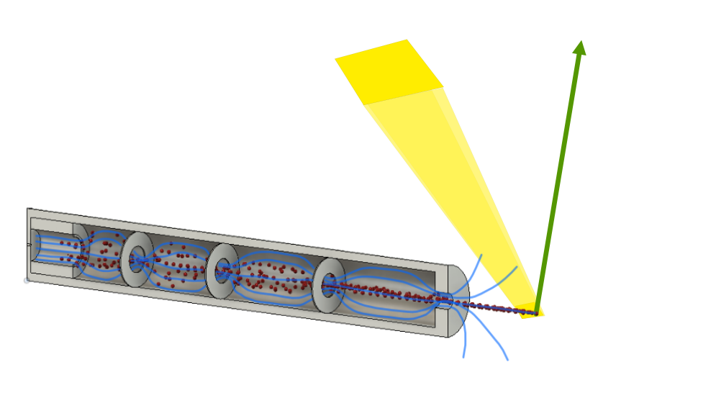
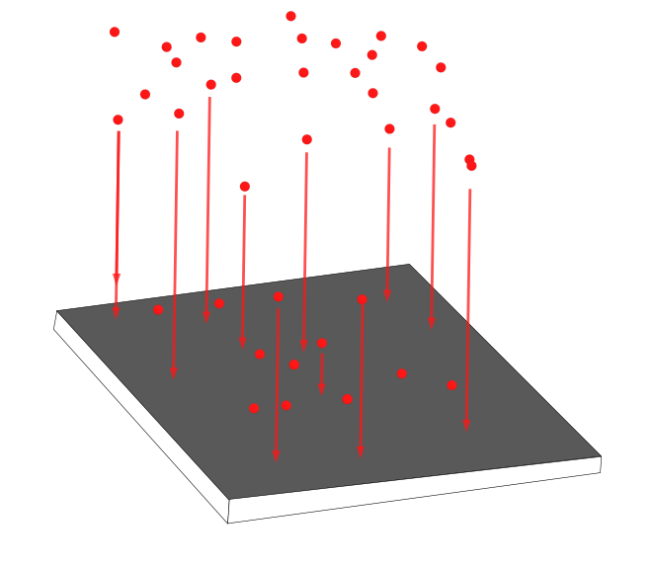
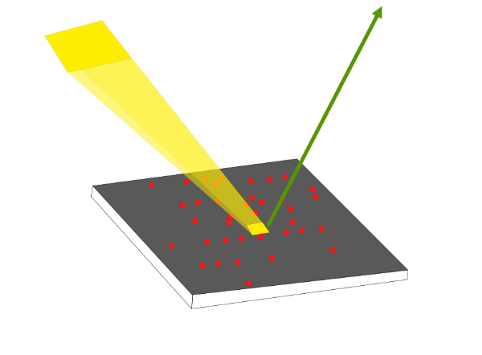
MAX IV synchrotron Aerosol Sample Delivery System
OFFLINE
ONLINE (in-situ)
Aerodynamic lens to form a focus particle beam and bring the aerosol into vacuum.
Collecting the aerosol particles onto a support
Bringing it to MAX IV
Measuring
True aerosol can be studied, post-collection might alter the particle properties
The aerosol is constantly renewed, no beam damage
Study dynamic process and evolution over time
It is no longer a true ‘aerosol’!

Slide 9

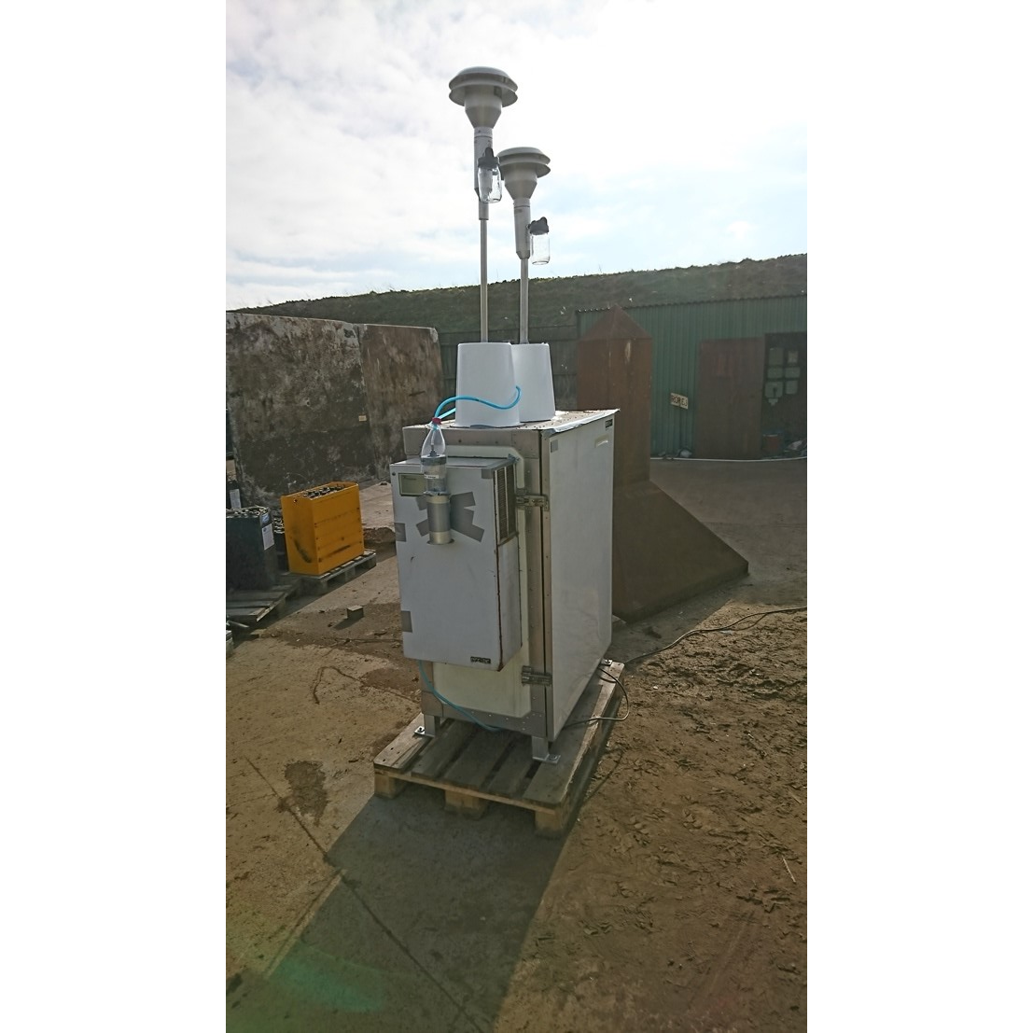
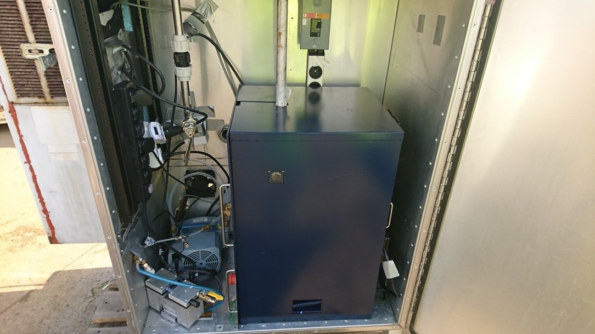
Diffuse dust at lead battery recycling plant
investigated through
X-ray Fluorescence Spectroscopy
Marcus Norlin and Linnea Savér, M.Scs

Slide 10
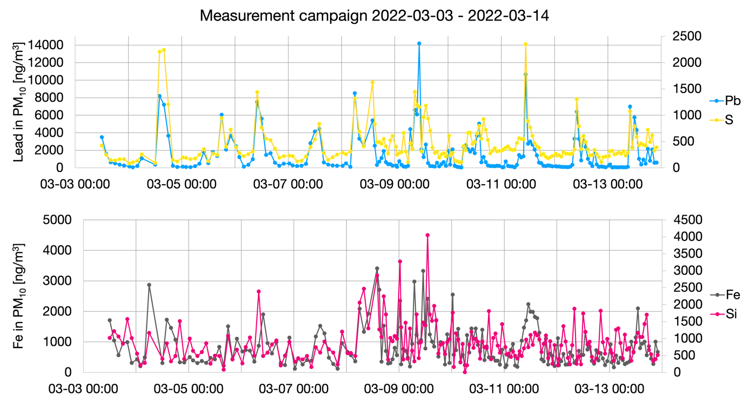
Marcus Norlin and Linnea Savér, M.Scs

Slide 11
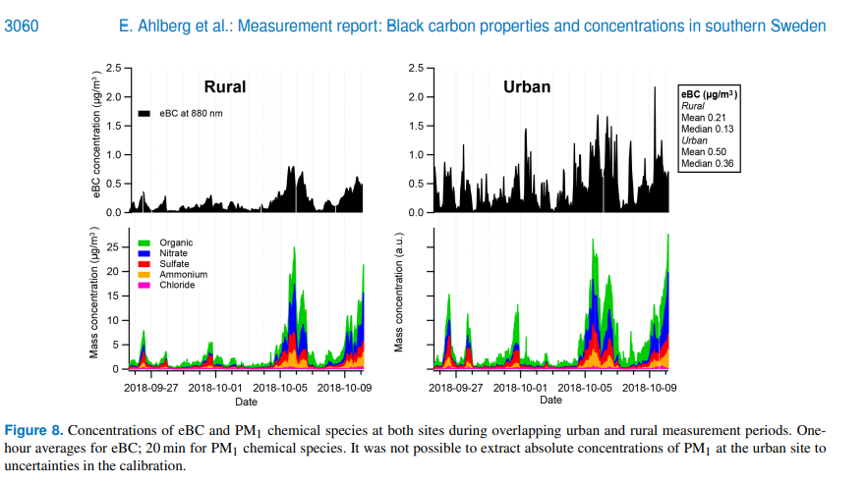
Soot, Organic aerosol, Salt aerosol https://doi.org/10.5194/acp-23-3051-2023

Slide 12
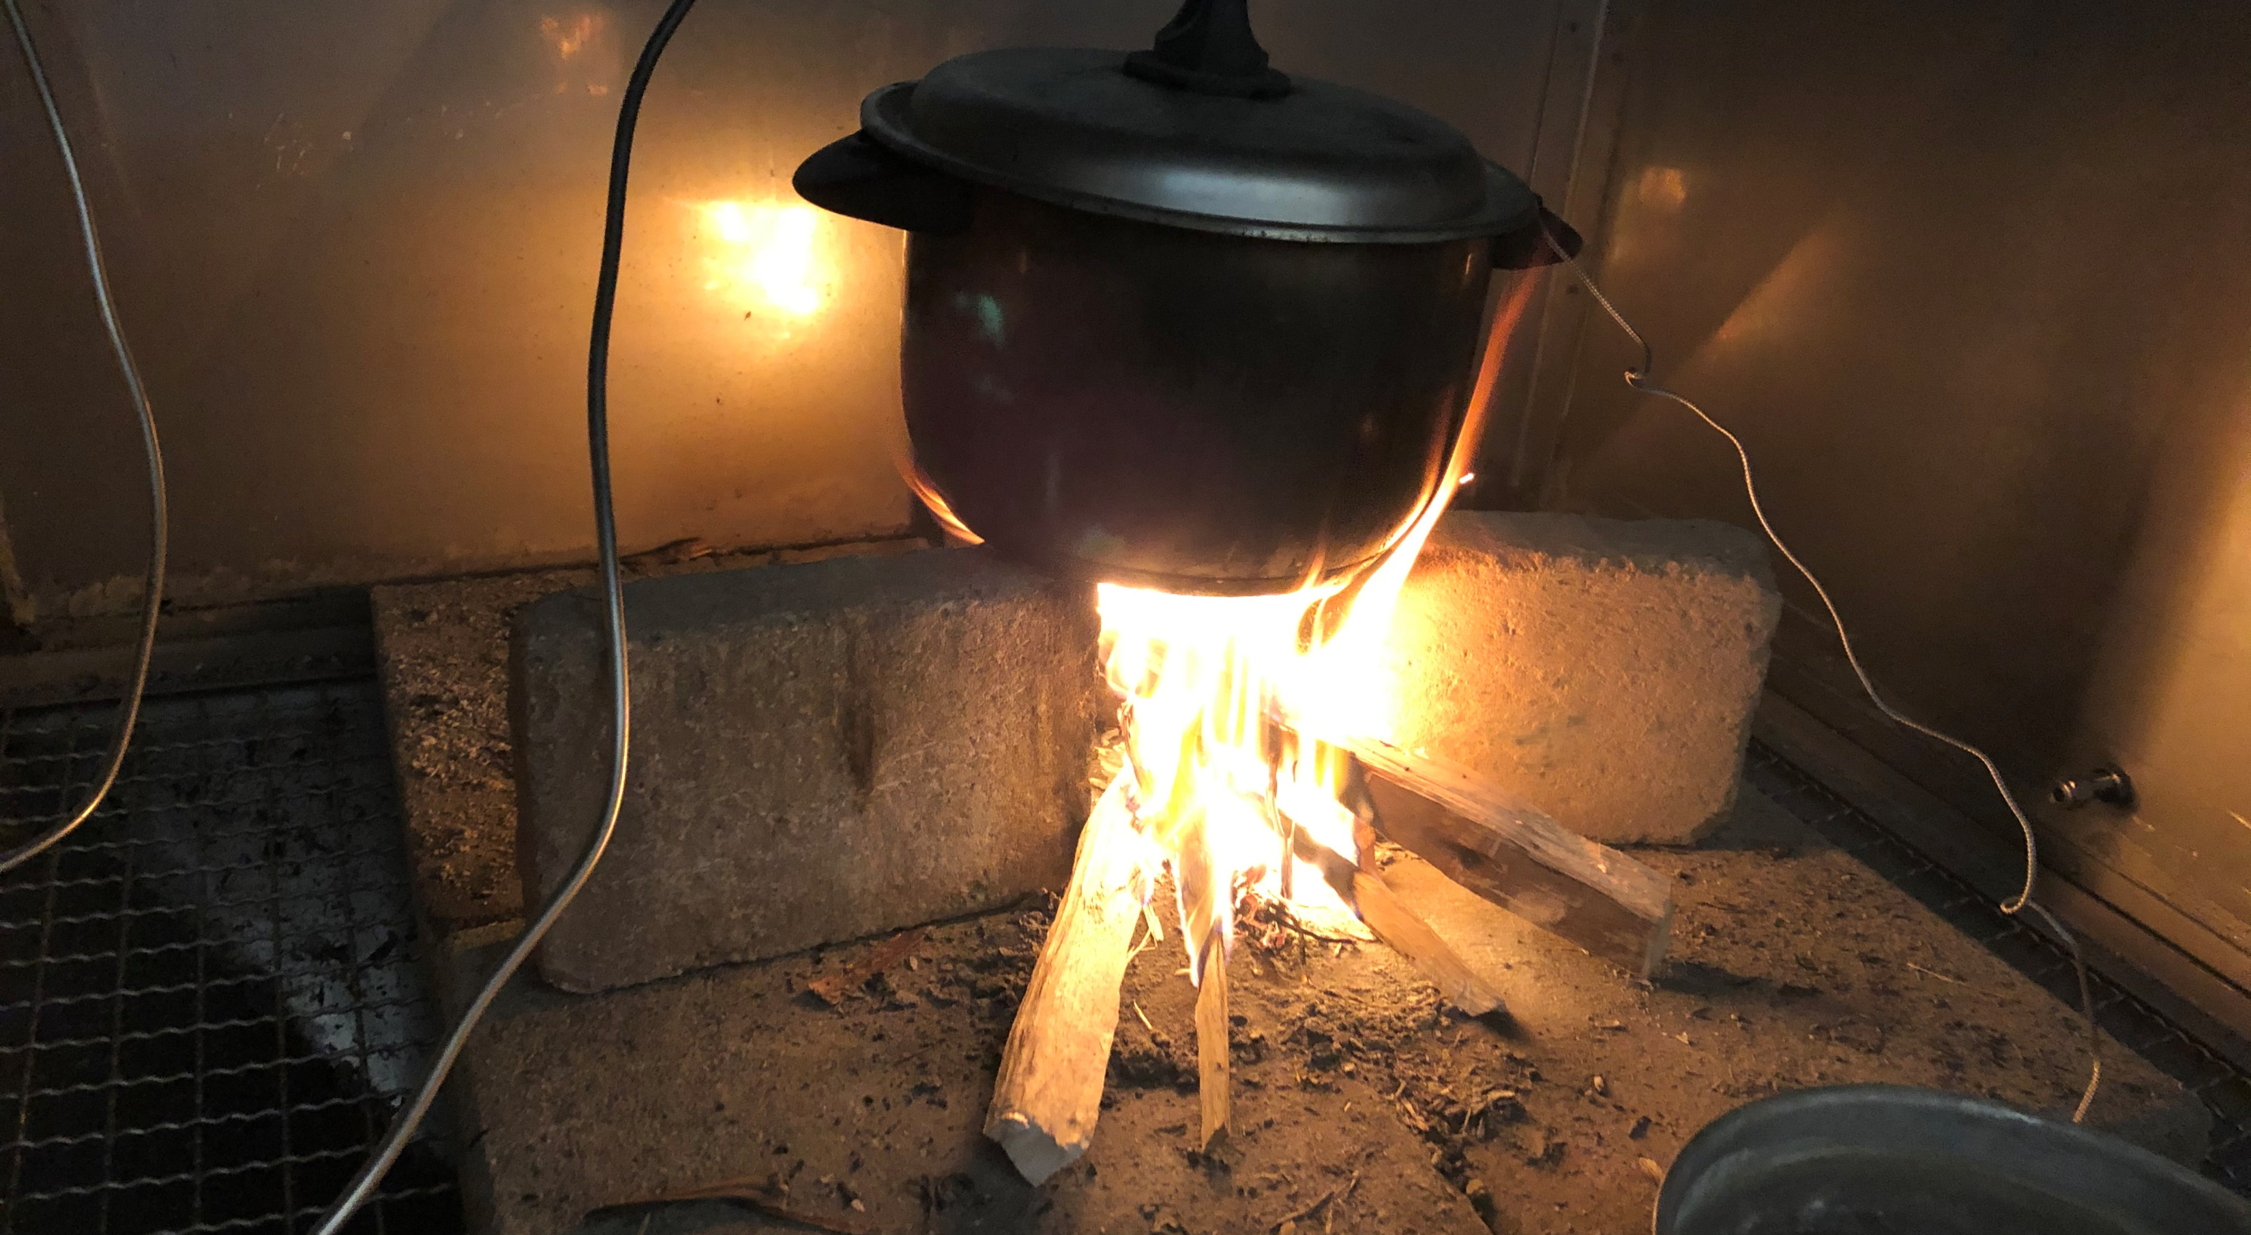
Laboratory Combustion experiments
We measure
Particle:
*mass and number concentration
*chemical composition
*light absorption
*water and ice activity
*toxicity
*CO₂
*CO
*NO_{x}

Slide 13
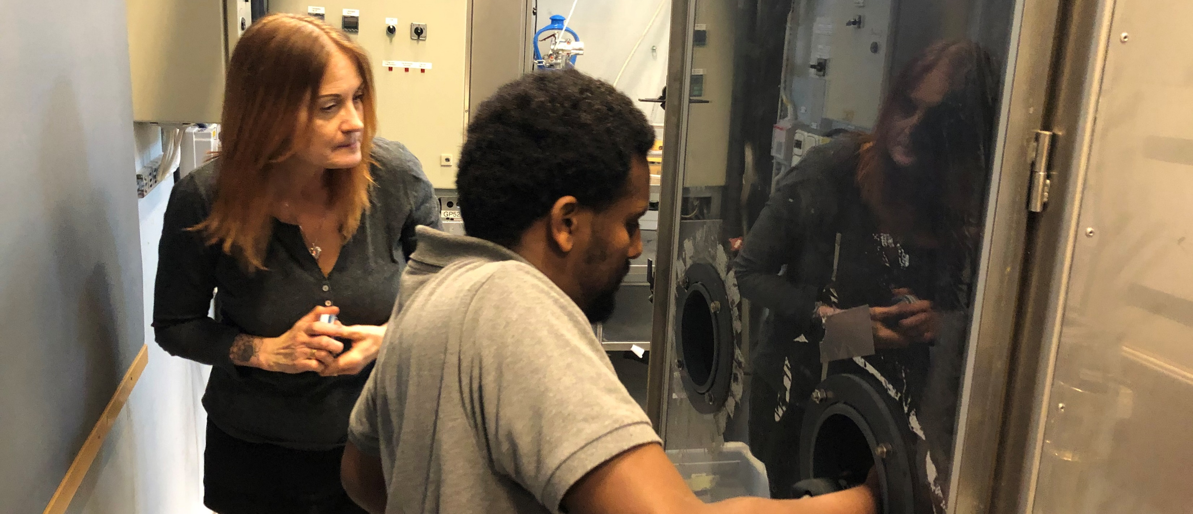
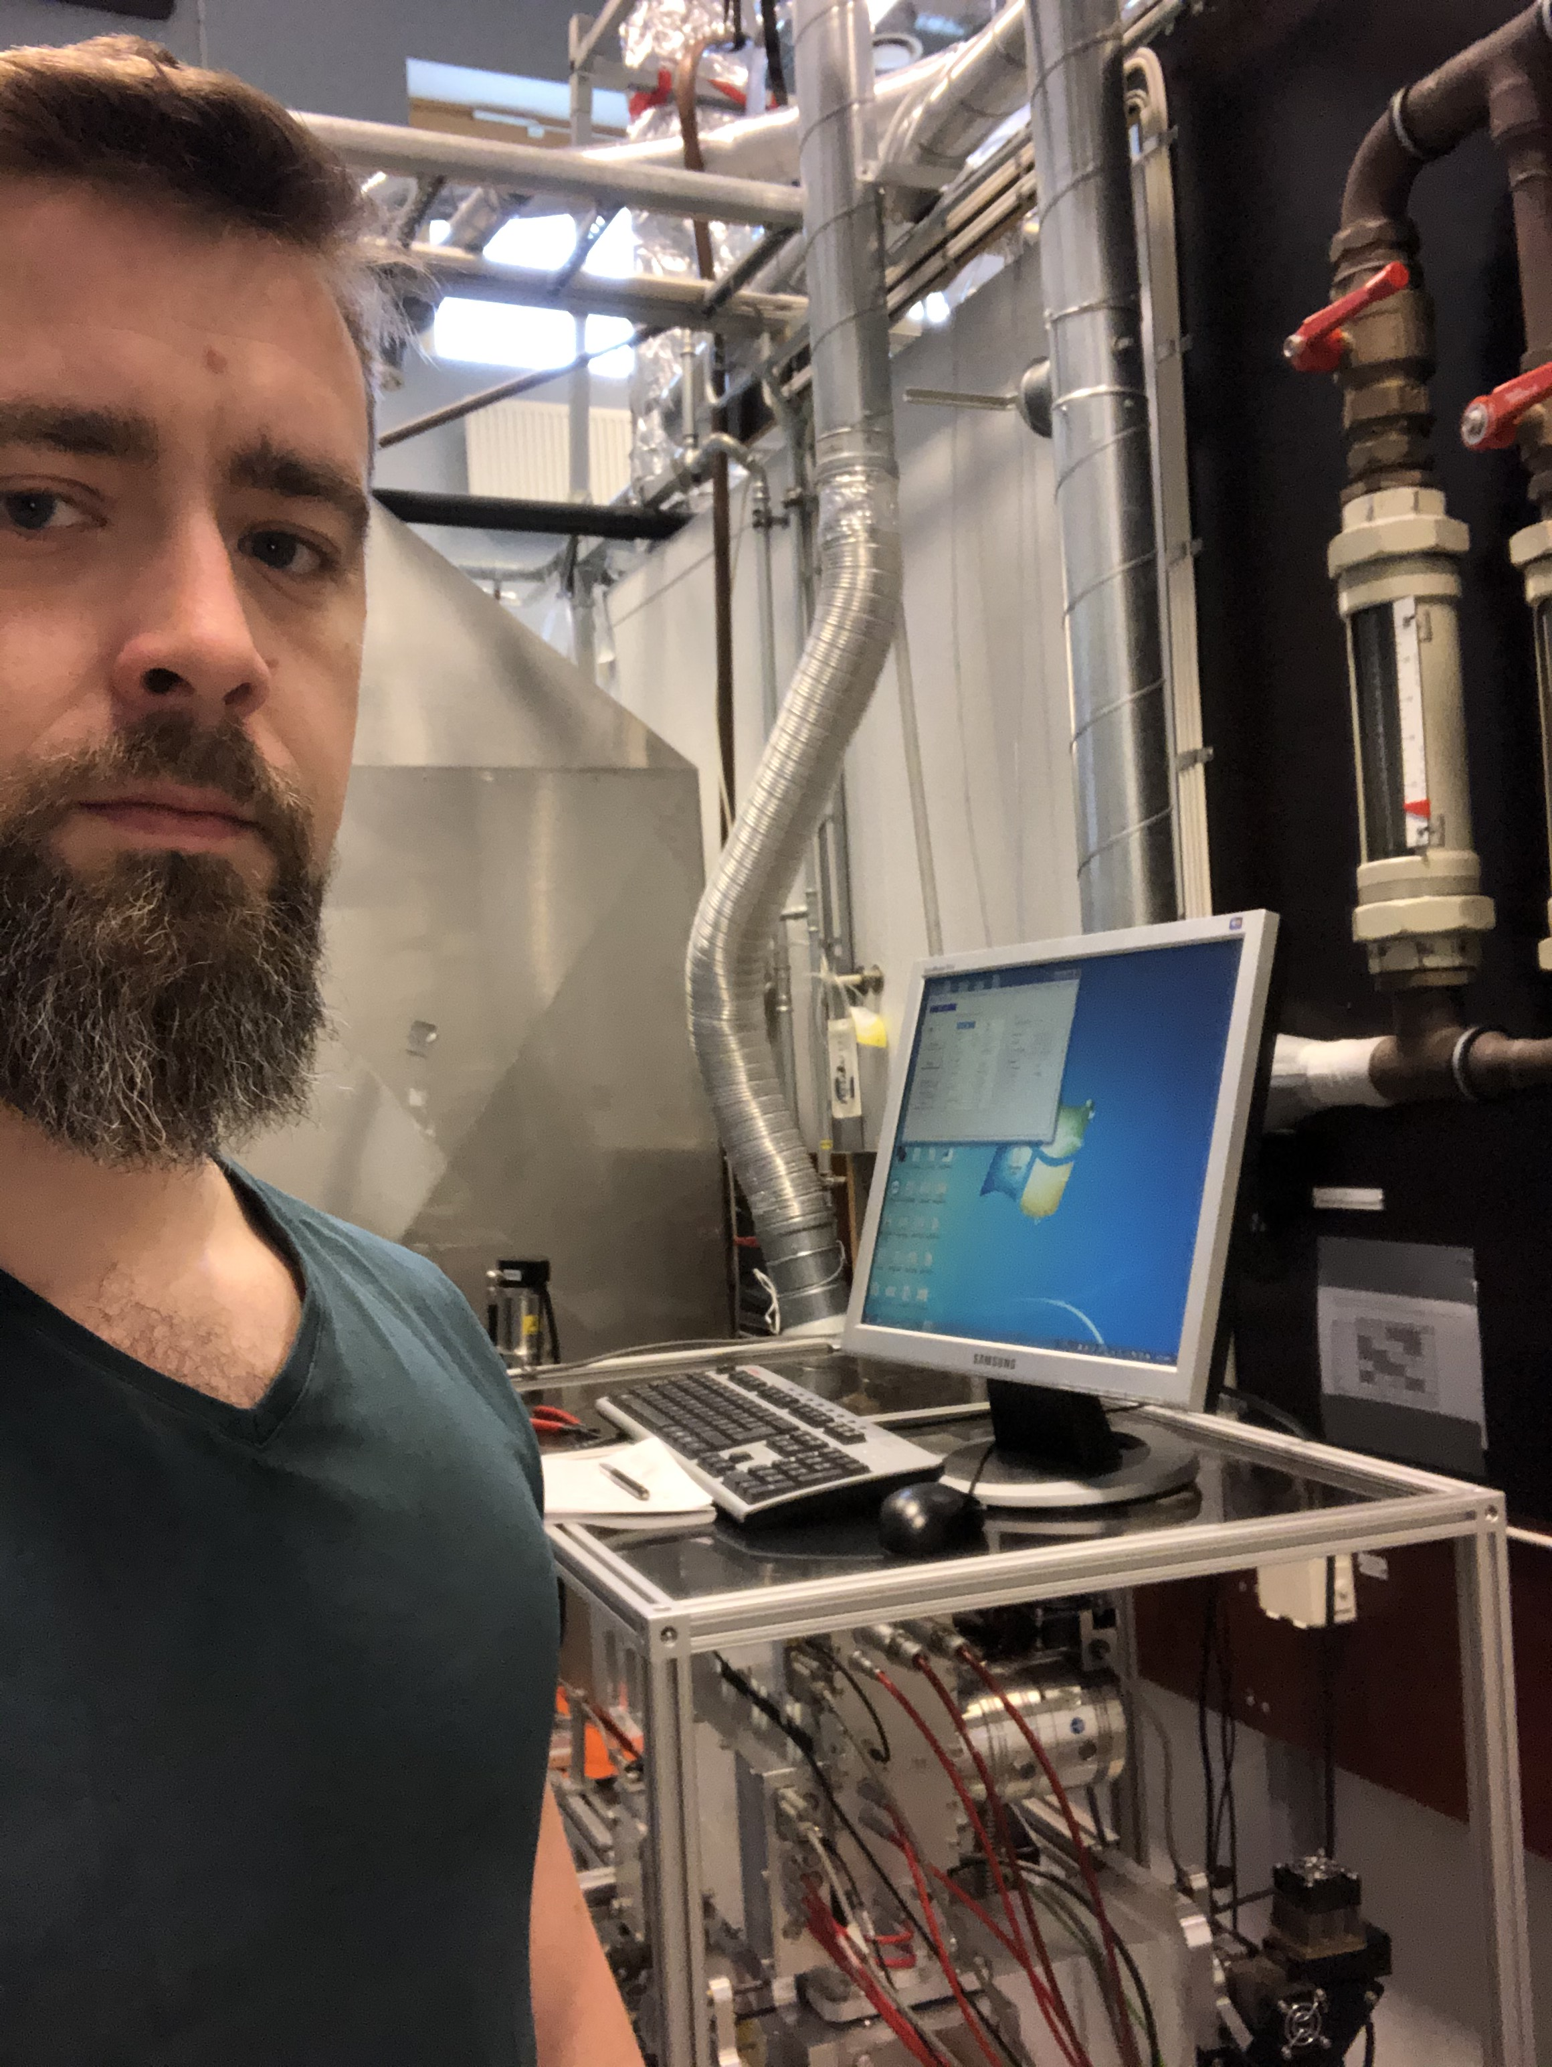
Laboratory Combustion experiments
Christina Isaxon (LTH), Asmamaw Abera Kebede (Addis Ababa University and Armauer Hansen Research Institute)
Axel Eriksson (me)

Slide 14
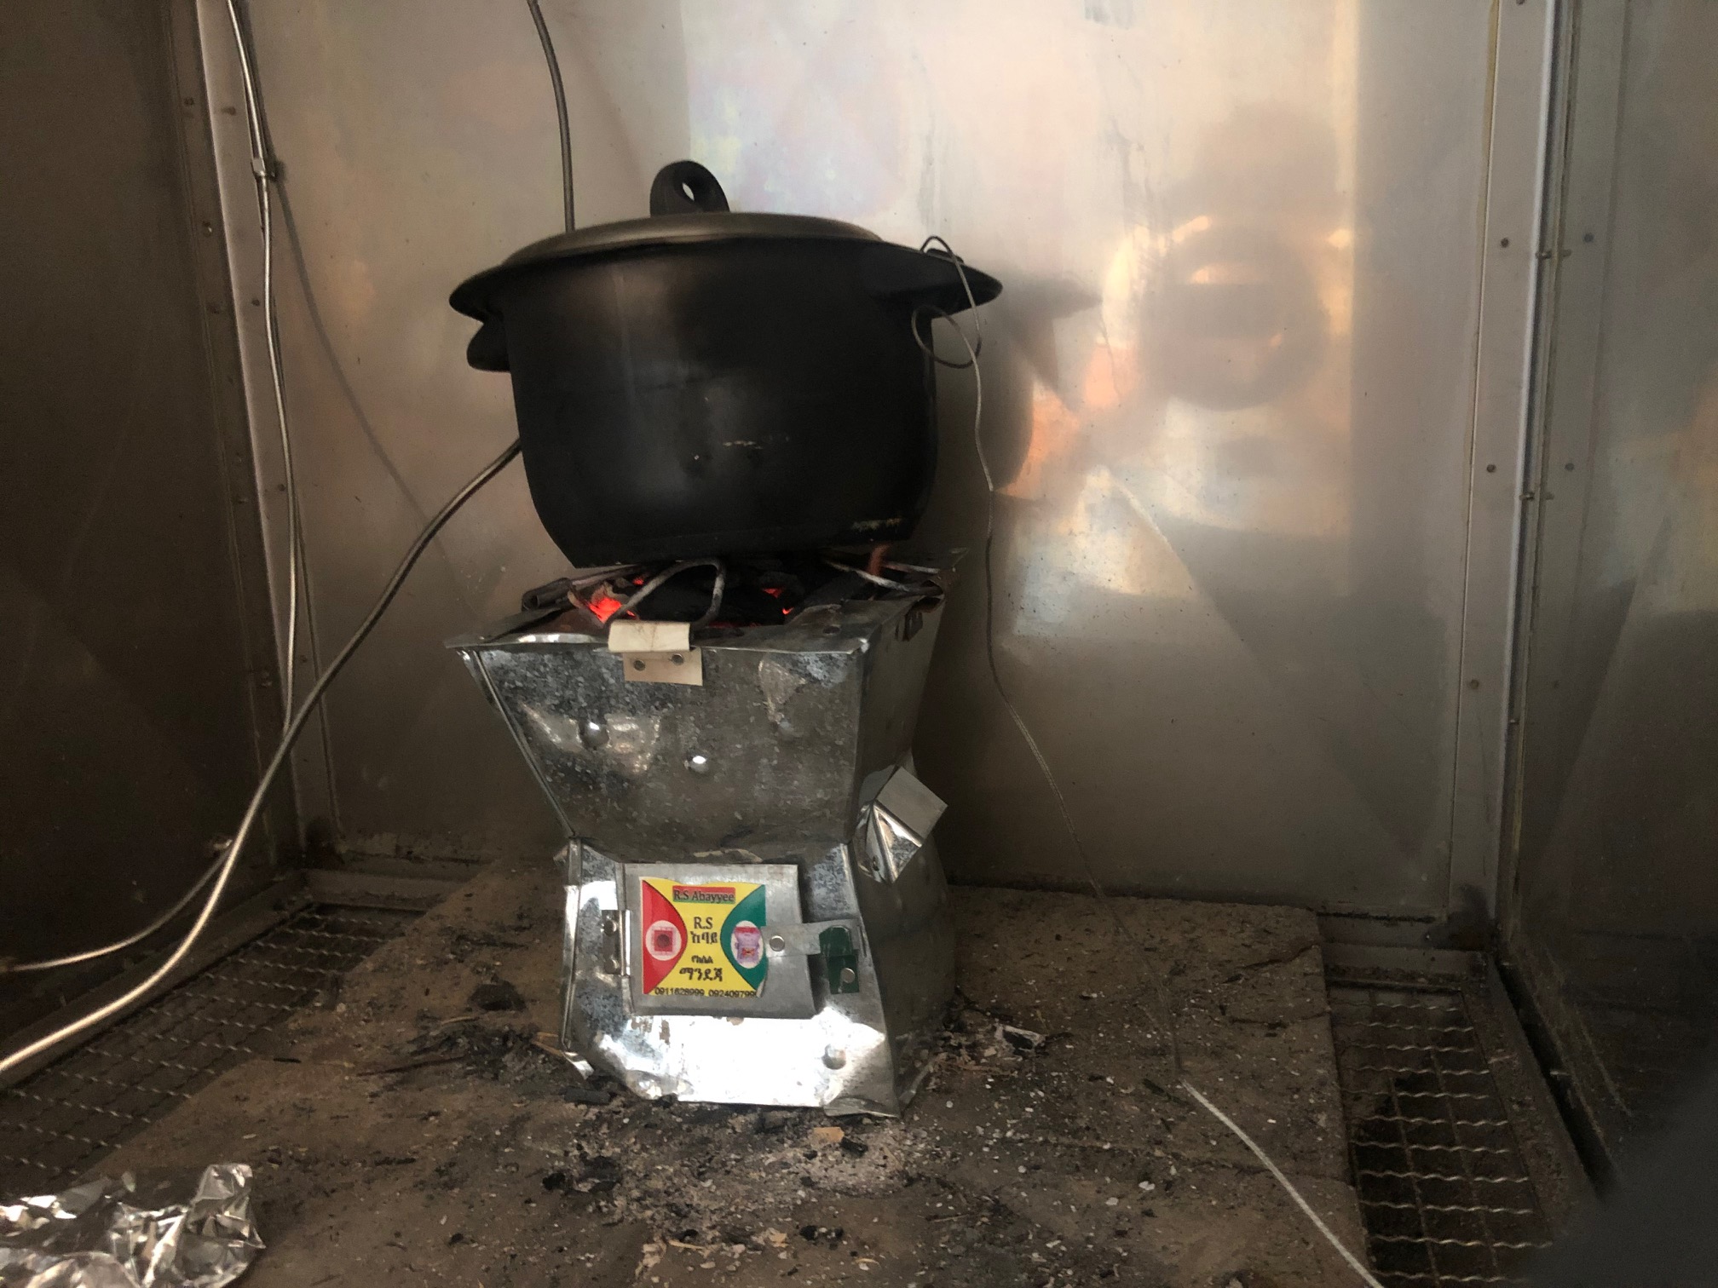
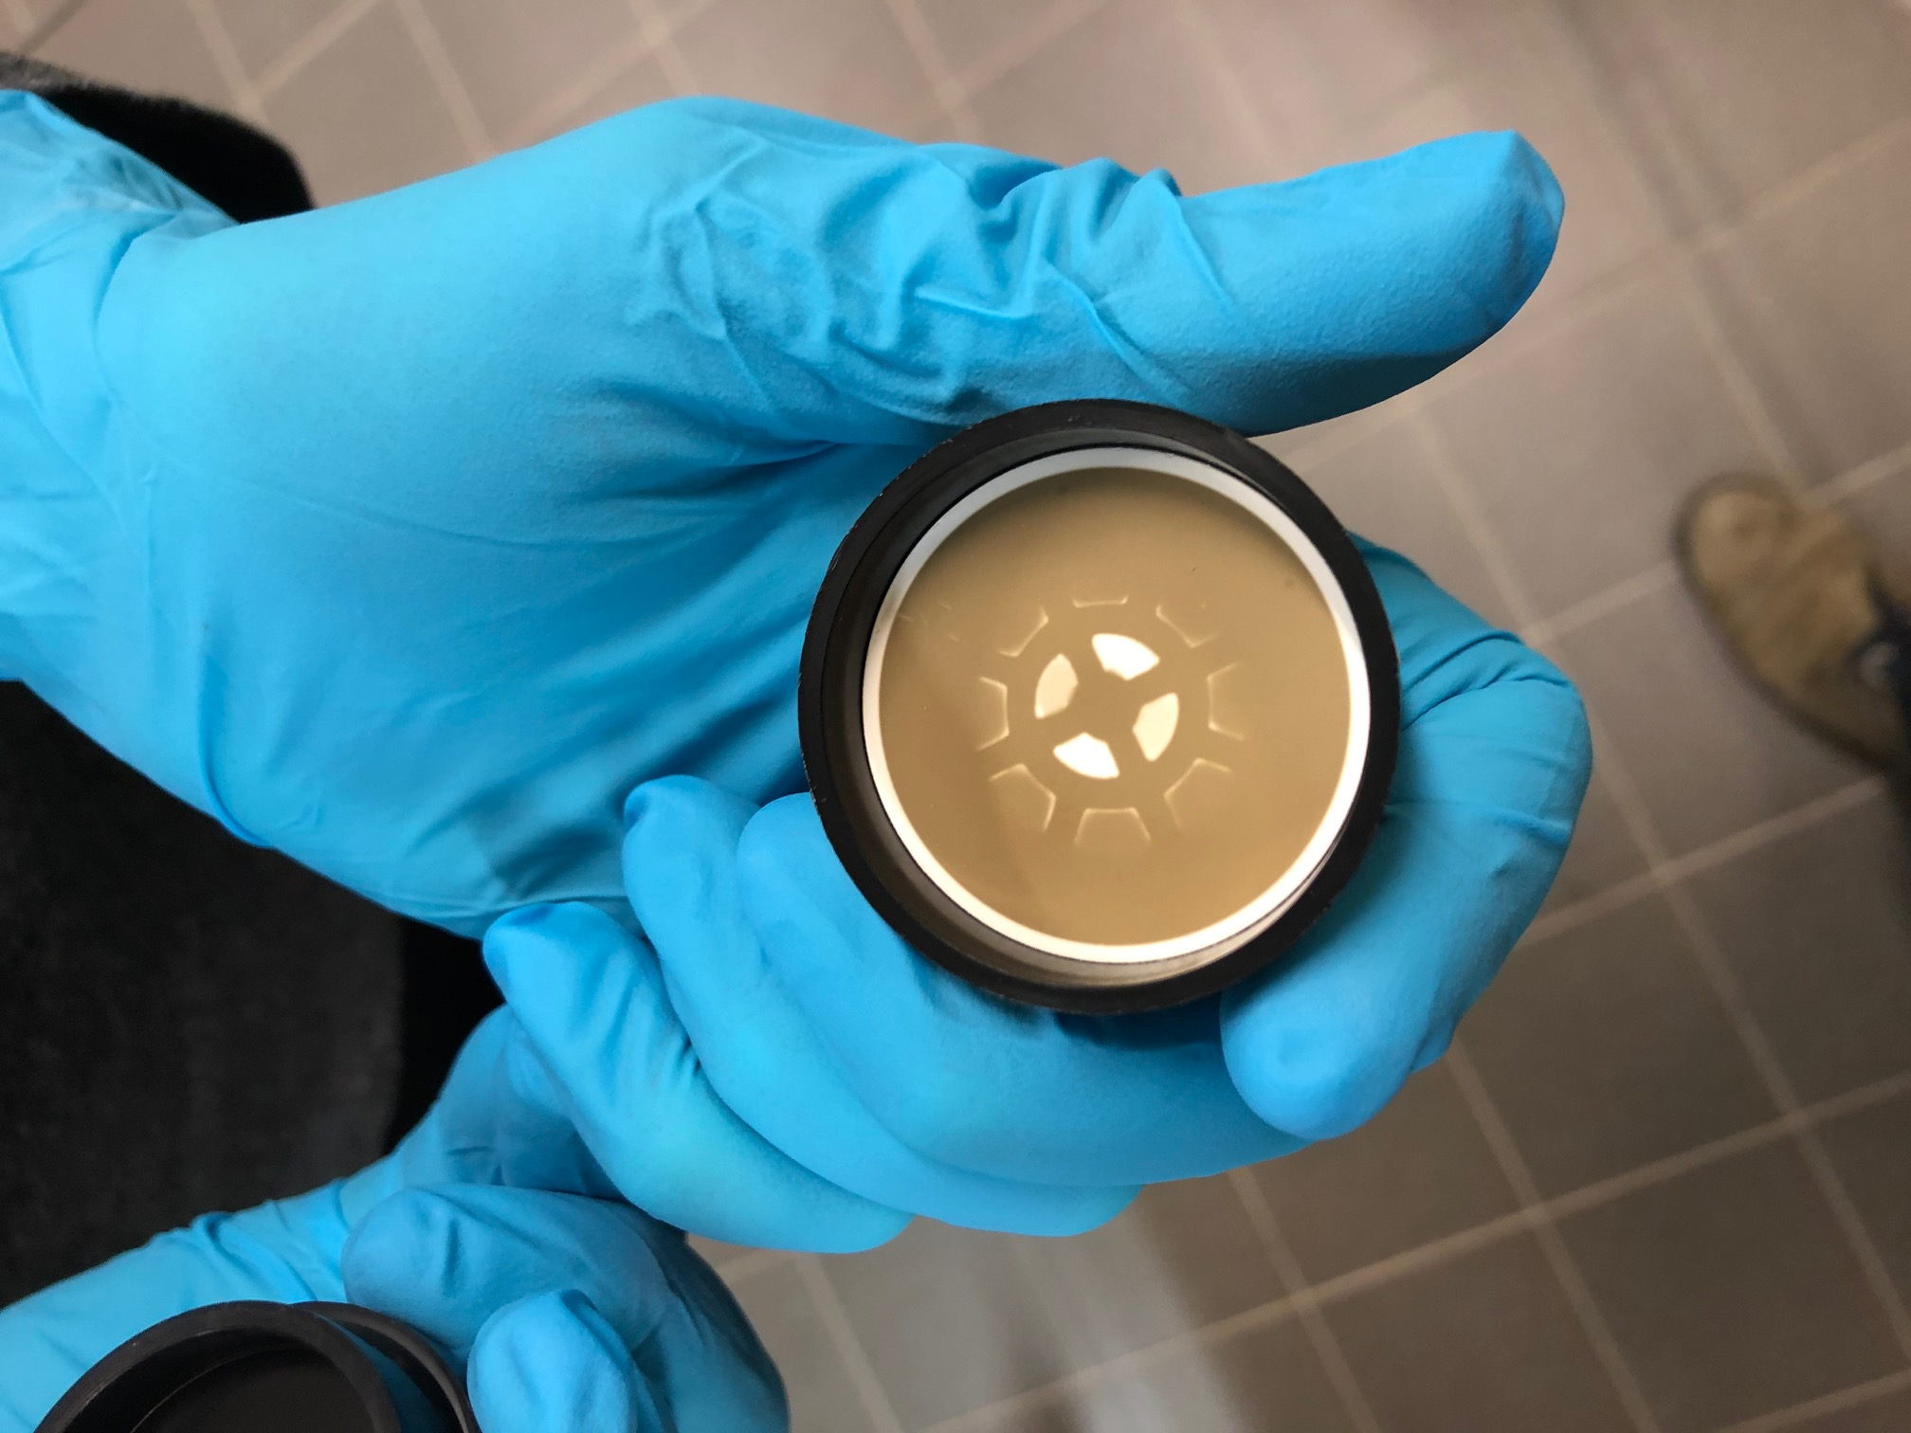
Laboratory Combustion experiments
Charcoal stove
Collected particles

Slide 15
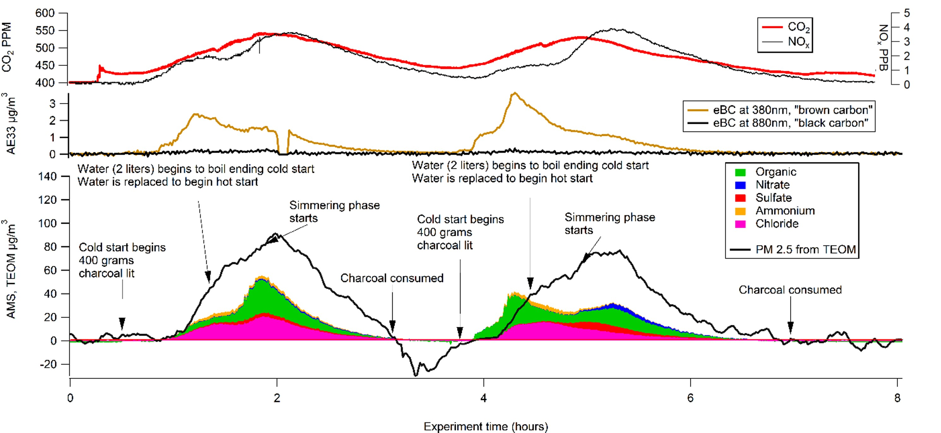
Water boiling test Eriksson et al 2022 DOI: 10.1111/ina.13143

Slide 16
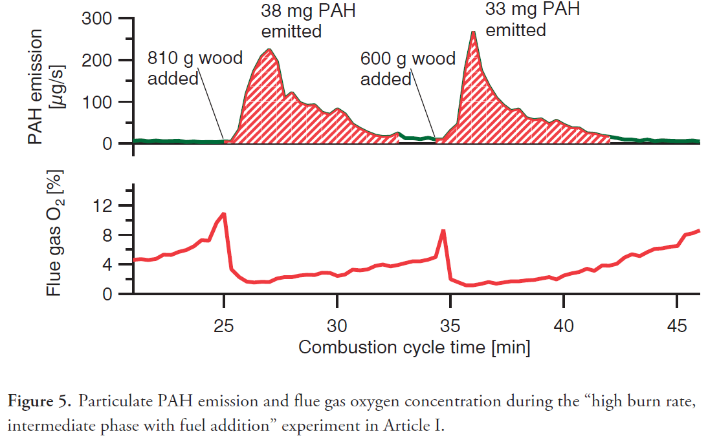
Swedish wood stove PAH emissions

Slide 17
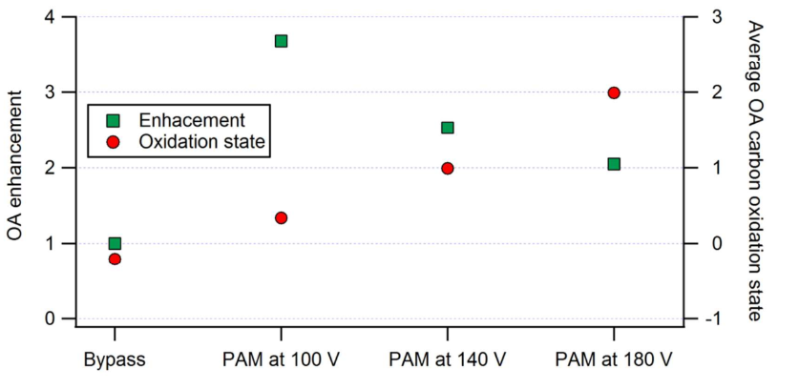
Swedish wood stove –atmospheric ageing
Enhancement= mass growth upon oxidation

Slide 18
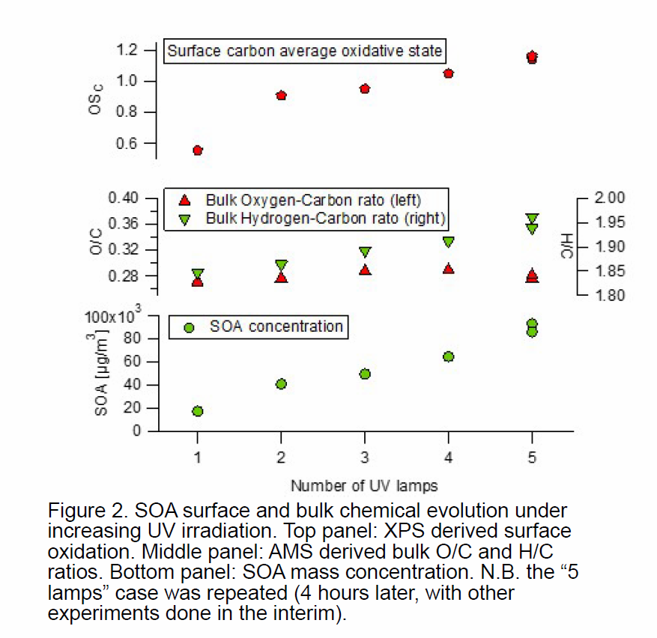
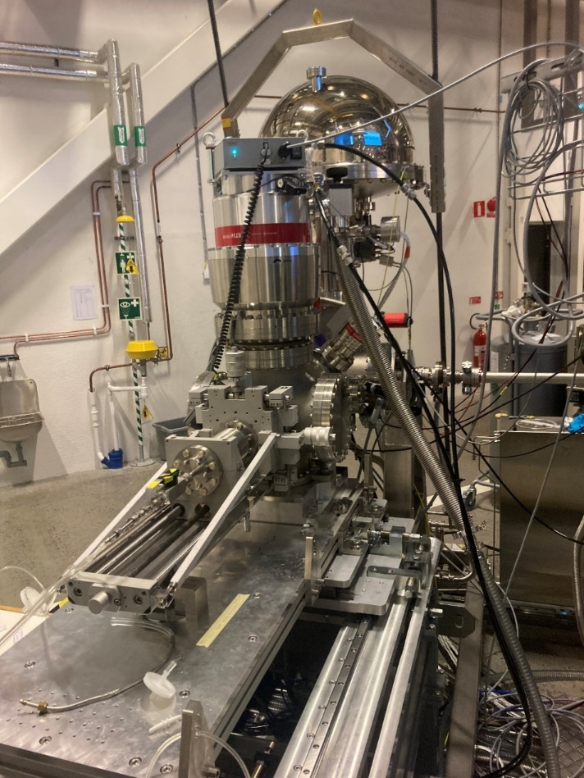

Secodary organic aerosol (SOA) surface and bulk measurement in situ
Photoelectrons from
Particle surfaces
Energy shows chemical state
Pilot data using OCU* flow reactor
on alpha pinene (g)
Show divergent bulk and surface oxidation
X-rays
X-rays
Aerosol
Keller et al 2022 The organic coating unit https://doi.org/10.1080/02786826.2022.2110448

Slide 19
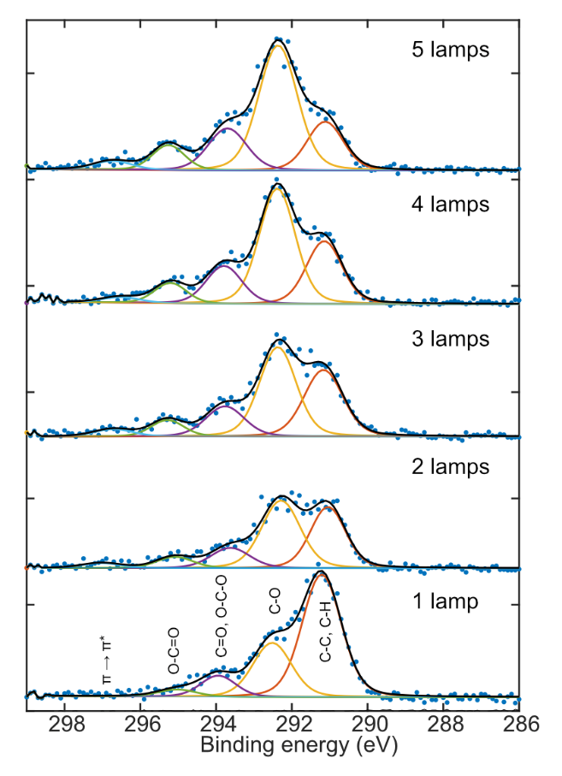


Slide 20
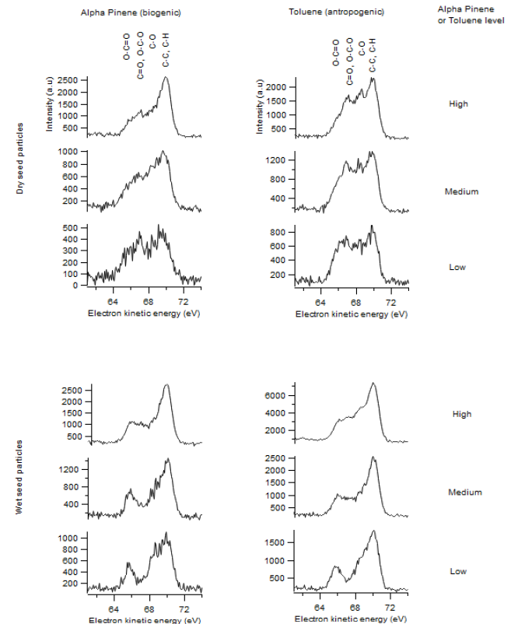
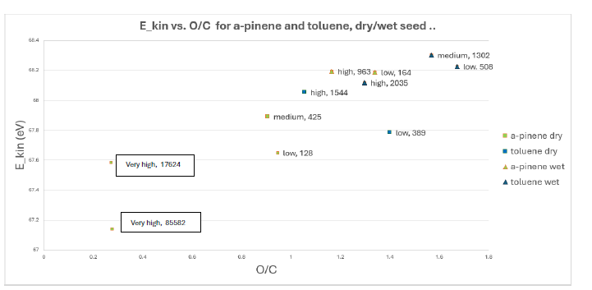
We grow Seconday Organic Aerosol by oxidation of gas phase precursors onto seed particles
Seed particle wetness more impactful than precursor molecule on surface composition highlighting importance of particle surface processes
divergent bulk and surface oxidation
Less oxidized surface
More oxidized bulk

Slide 21
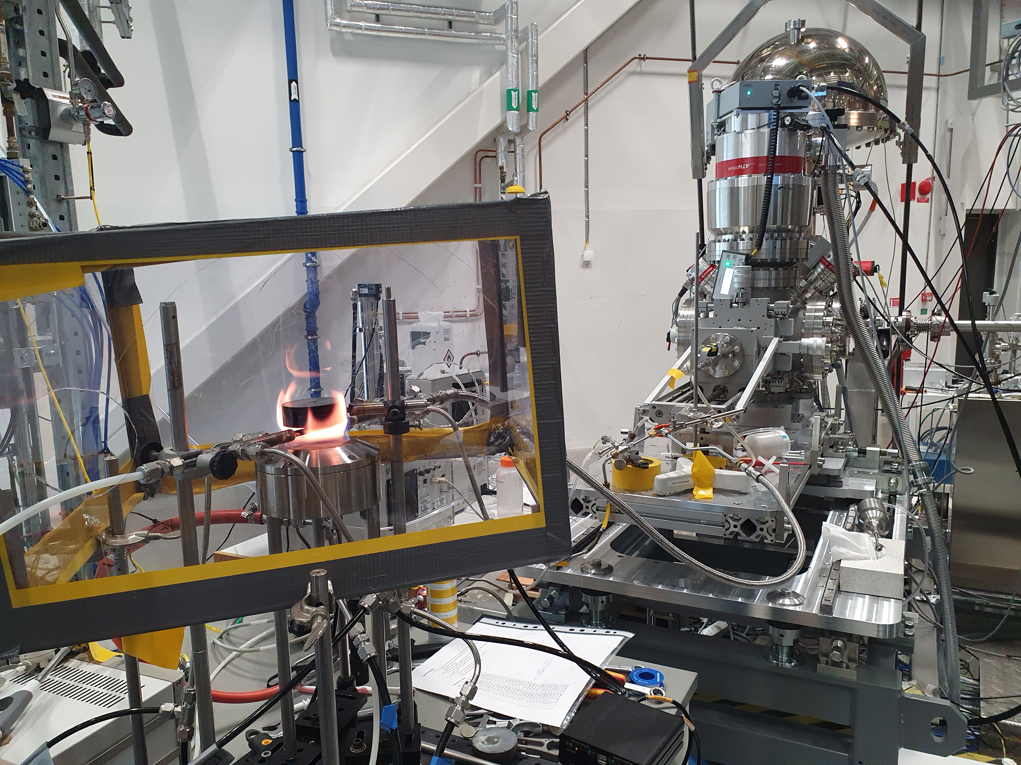
Flame experiments with the ASDS
Side from Dr Antti Kivimäki
General users performed the first open-flame experiments at FinEstBeAMS (and at MAX IV) in October 2023
Soot and other product formation was studied in different burning conditions for propane and ethylene
Products were transported to the entrance of the aerosol sample delivery system with the aid of a carrier gas (N₂)
C 1s photoelectron spectra were measured at hν=350 eV
African Light Source Conference, 15 Nov. 2023

Slide 22
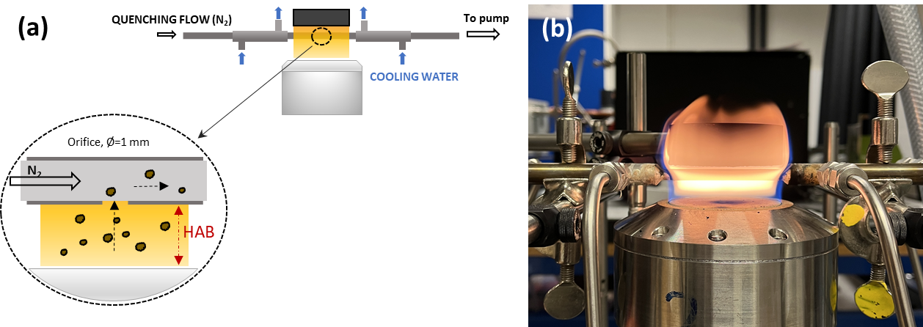
In flight X-ray photoelectron spectroscopy (XPS) for surface study
A sampling probe used for extracting soot from the flame
Aerosol sample delivery system at Max IV
S. Bergqvist, PhD thesis (2025)
Saga_Bergqvist_-_WEBB.pdf
Preger, C., Rissler, J., Kivimaki, A., Eriksson, A. C. and Walsh, N., A versatile sample-delivery system for X-ray photoelectron spectroscopy of in-flight aerosols and free nanoparticles at MAX IV Laboratory. J Synchrotron Radiat. 2024;31(Pt 5):1382-1392.
Kim Cuong Le https://orcid.org/0009-0003-3441-3575
Notes:
ASDS is that it brings aerosols generated by laboratory sources from atmospheric pressure to a vacuum chamber in a continuous flow, enabling in-flight measurements using e.g. XPS. The aerosol particles are transmitted through an ADL (Aerodyne PM1) such that, after exiting the ADL, they form a narrow and collimated beam. The defined particle beam intersects the photon beam coming from the (FinEstBeAMS) beamline, just below the end of the electron lens of a SCIENTA R4000 electron analyzer. The SCIENTA R4000 hemispherical electron analyzer measures the kinetic energies of the emitted electrons, Fig. 1.
The ASDS is a multi-stage pumping system consisting of two chambers – the source chamber [SC in Figs. 1(b) and 1(c)], which connects to the external aerosol generators via a small 100 µm orifice, and a differential pumping chamber [DC in Figs. 1(b) and 1(c)]. These two chambers are separated by a skimmer [1–2 mm opening diameter, SK′ in Fig. 1(c)]. The differential pumping chamber is separated from the main interaction chamber [IC in Figs. 1(b) and 1(c)] by a second skimmer [0.5–2 mm opening diameter, SK in Fig. 1(c)] that is aligned to ensure overlap of the particle beam with the interaction region of the endstation (GPES), Fig. 1

Slide 23
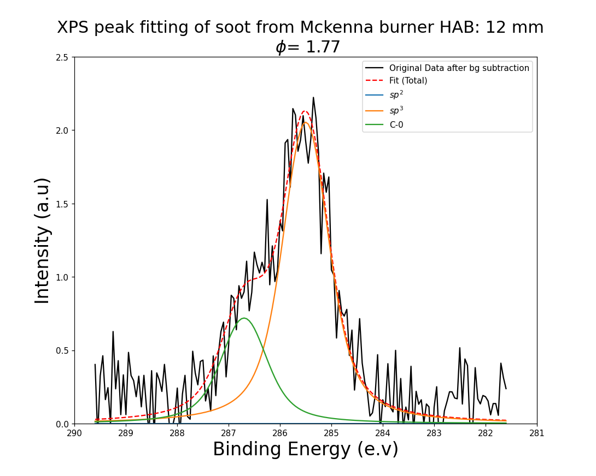
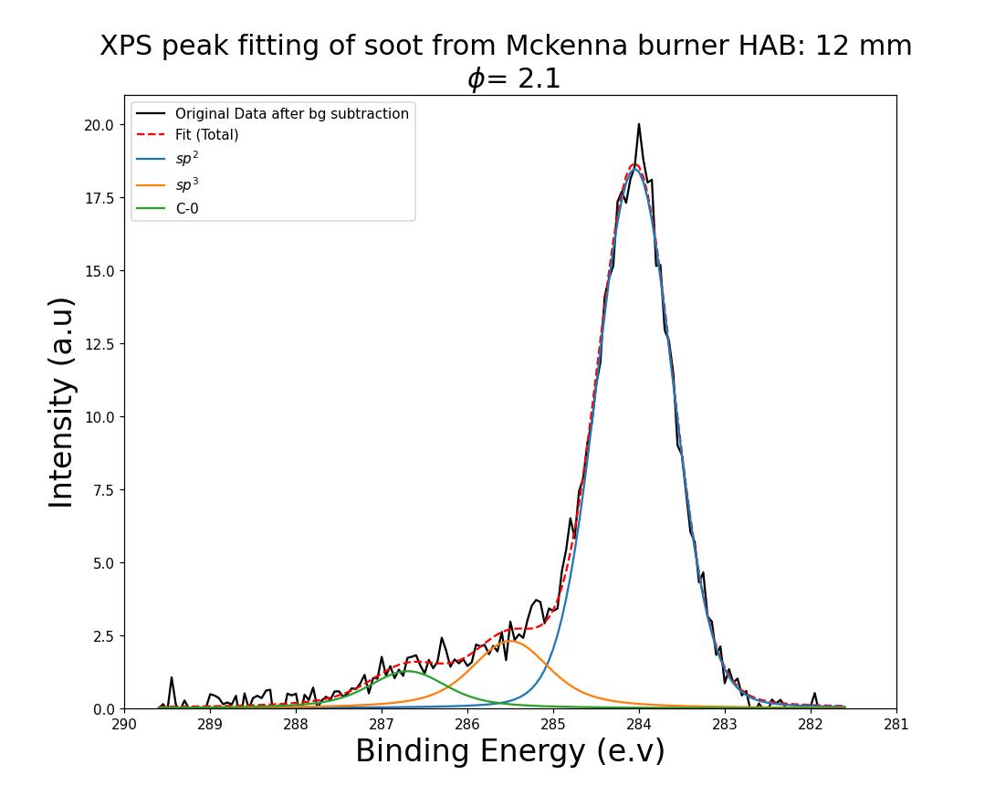
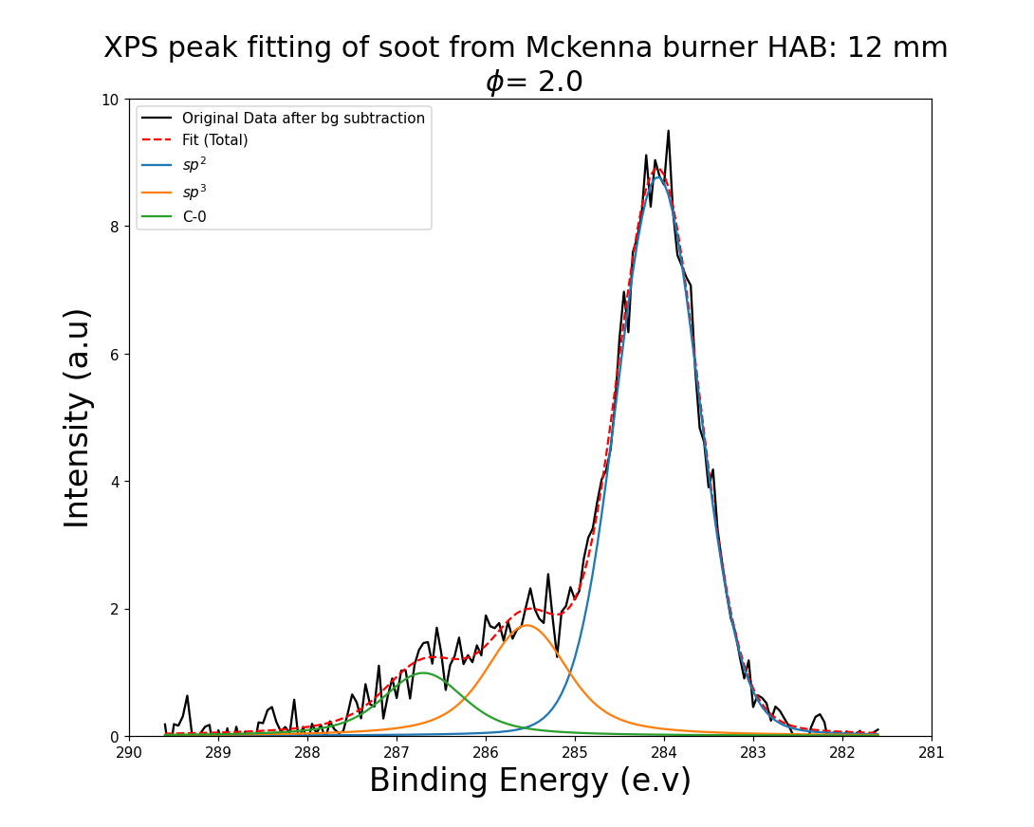
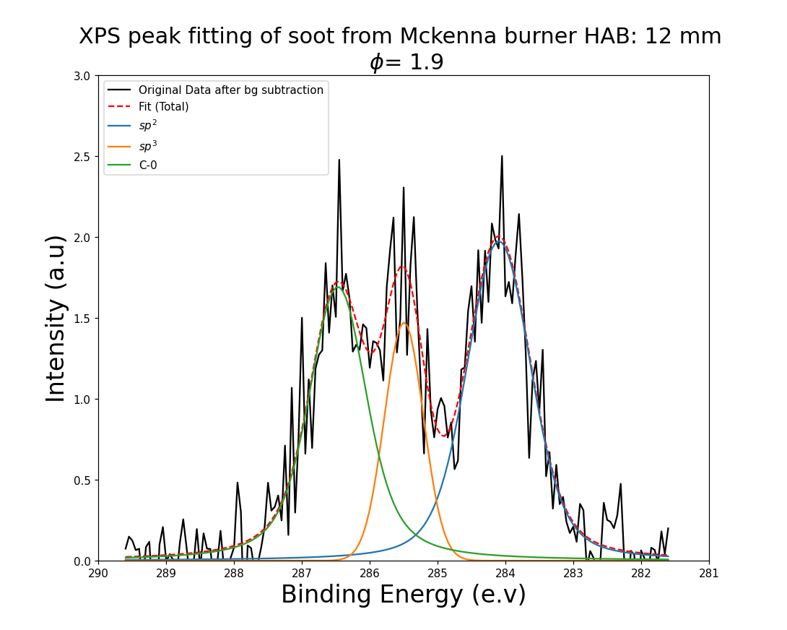
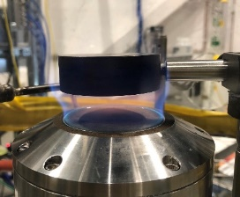
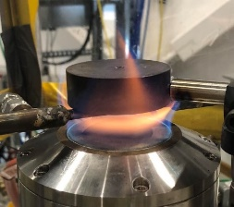
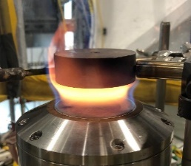
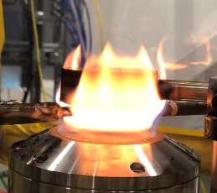

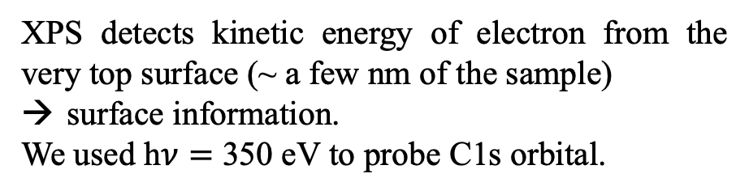



In flight X-ray photoelectron spectroscopy (XPS) for surface study
At FinEstBeAMS
XPS detects kinetic energy of electron from the very top surface (~ a few nm of the sample)
surface information.
We used h$ν=$ 350 eV to probe C1s orbital.
sp² (-C=C- )
sp³ (C-H )
C-O
290
281
$$∅=1,77$$
$$∅=1,9$$
$$∅=2,0$$
$$∅=2,1$$
Notes:
Why XPS can probe the surface? How can we know the thickness?
ChatGPT said:
ChatGPT
Why XPS Can Probe the Surface
X-ray Photoelectron Spectroscopy (XPS) is a surface-sensitive technique because of the limited mean free path of photoemitted electrons in solids. When X-rays strike a material, they eject core-level electrons, which have specific binding energies characteristic of the elements and chemical states present.
Surface Sensitivity: The ejected electrons interact with atoms as they travel through the material. These interactions cause energy losses or deflection, and only electrons originating from a shallow depth (a few nanometers) can escape without significant energy loss. As a result, the XPS signal predominantly represents the topmost atomic layers (1–10 nm).

Slide 24

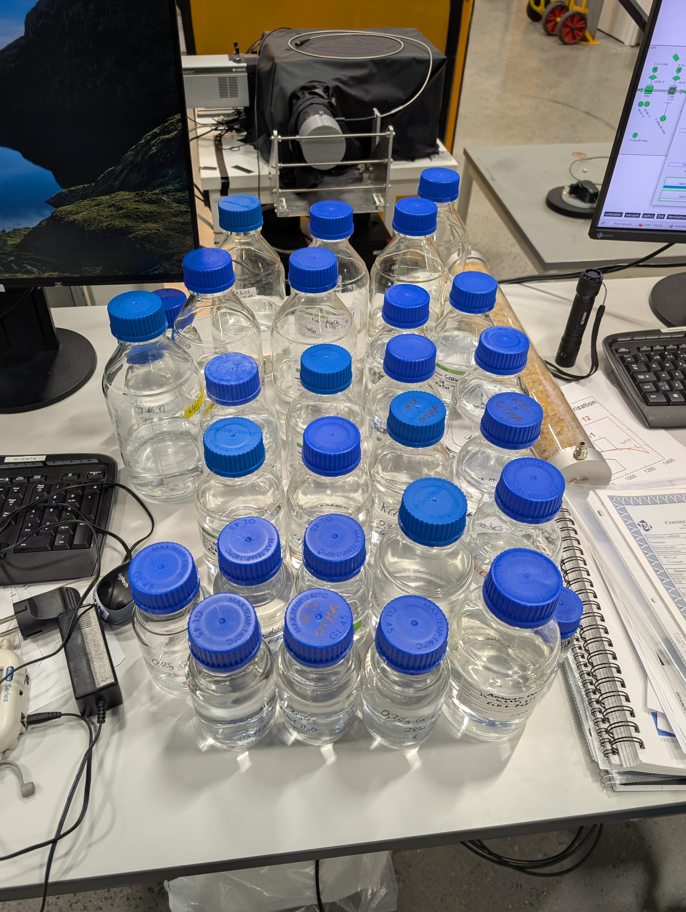
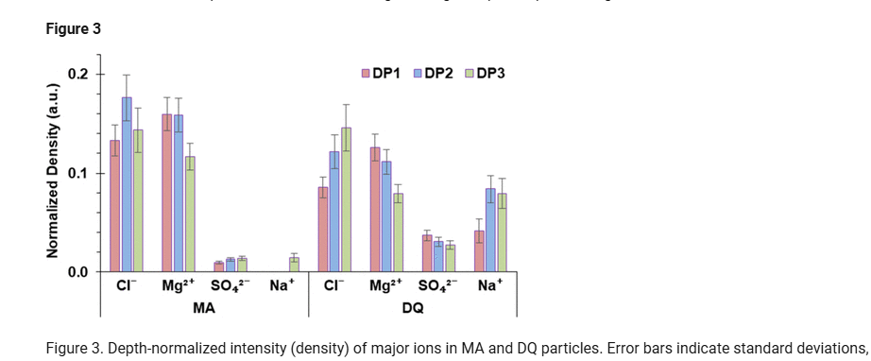
https://orcid.org/0000-0002-7205-0723

Slide 25
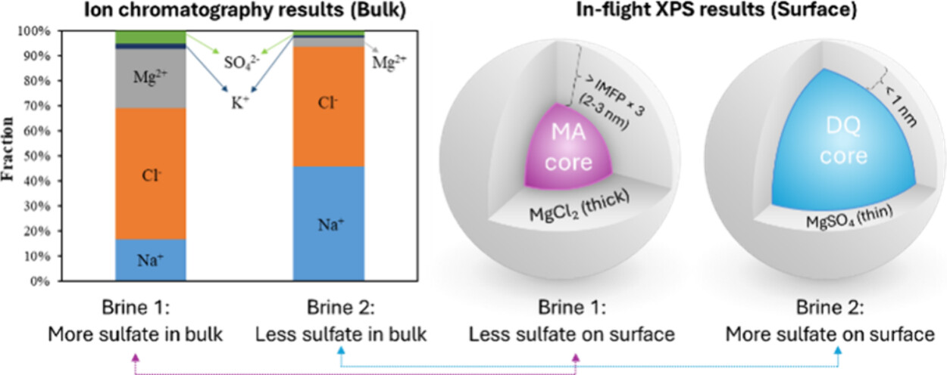
DOI: (10.1021/acs.estlett.5c00398)
https://orcid.org/0000-0002-7205-0723

Slide 26
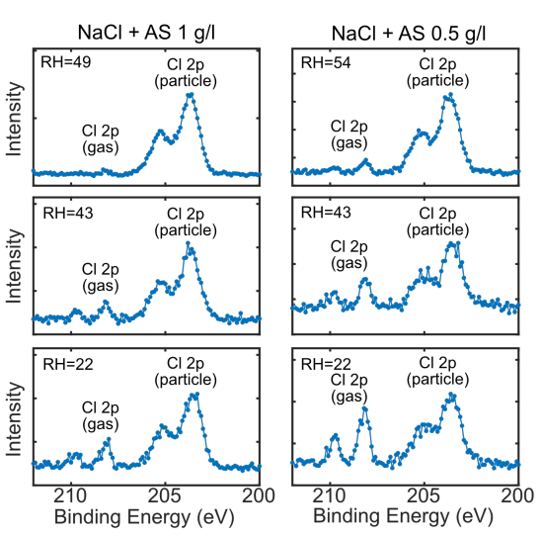
Gas-particle partitioning from mixing sea salt and inert sulfate
According to thermodynamics, it is expected that Cl⁻ ions evaporate and form HCl gas during aerosol generation and drying, but only if relative humidity (RH) or particle mass concentration is low enough
The Cl 2p signal from the gas molecules (HCl) is shifted in binding energy with respect to the Cl 2p signal from the aerosol particles
The ratio between the Cl 2p gas and particle signals changed when changing the salt concentration and RH
AS = ammonium sulphate = (NH₄)₂SO₄

Slide 27
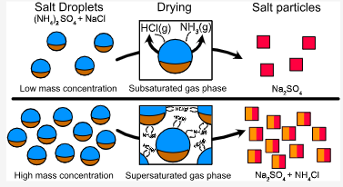
Gas-particle partitioning from mixing sea salt and inert sulfate

Slide 28
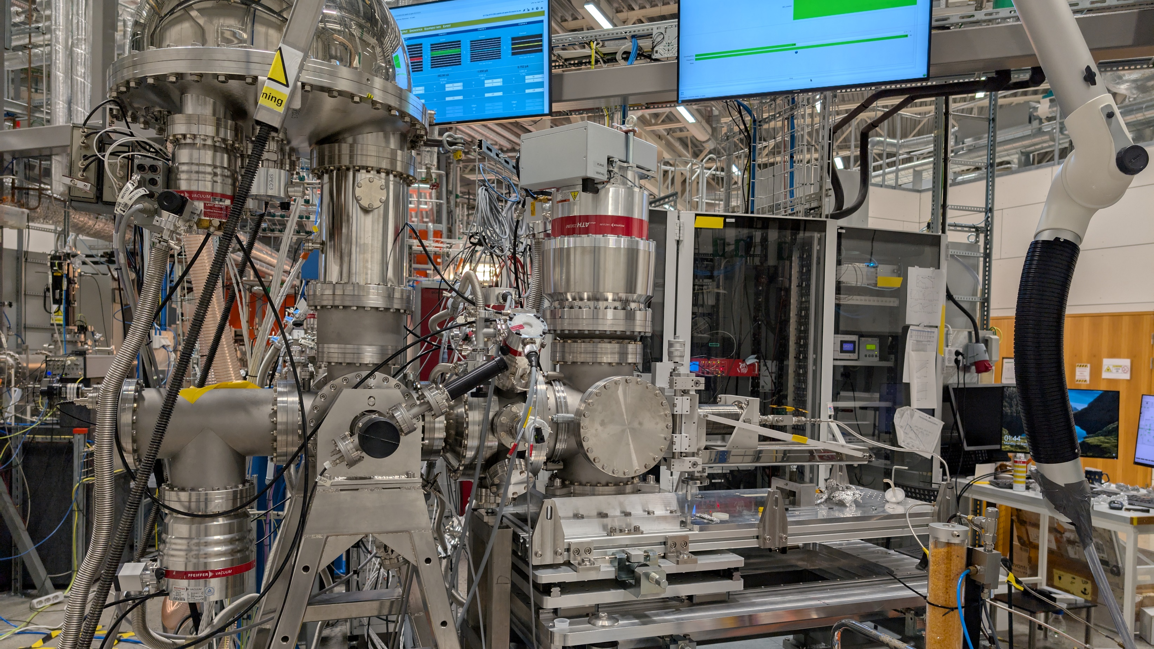
MAXIV 2025 Engineered Carbon Nanomaterials
Beamtime 12-16 March
Vilhelm Malmborg
https://orcid.org/0000-0002-4362-1646

Slide 29
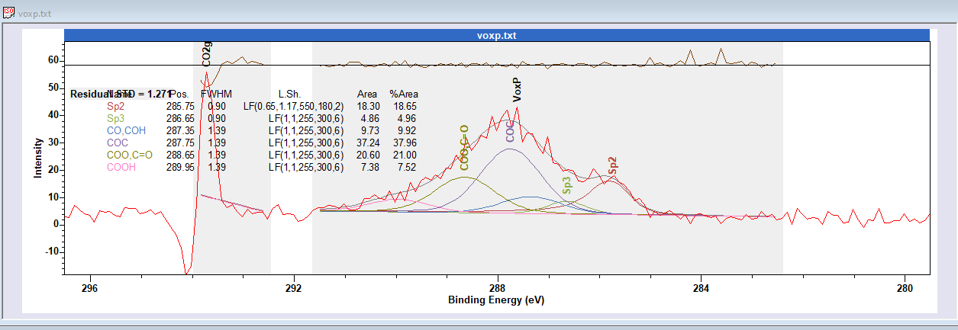
Setup
XPS
Aerodynamic Lens
O₃
AIR
0.75l
Denuder
Silica Drier
Volume
2.2m
HEPA
0.6m
SMPS
O3 Monitor
Particle Suspension: MilliQ / Carbon Nanomaterials
Sonicated for >15 min, repeated when signal declined
PINQ
29

Slide 30
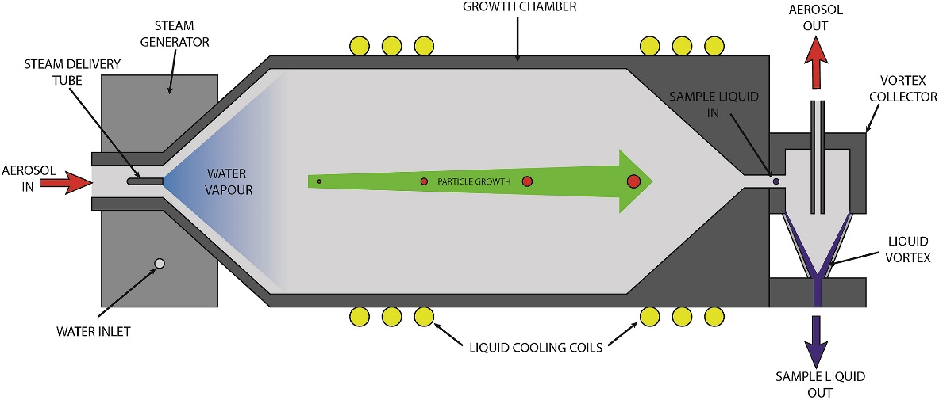
The sample liquid fluorescence is continuously measured in a small flow-through quartz cell contained within a stainless steel housing. The excitation source is a 450 nm diode laser, and the fluorescence response measured perpendicularly with an Oceanoptics USB2000+ spectrometer
Based on 9,10-bis (phenylethynyl) anthracene-nitroxide (BPEAnit) ROS assay,
1 min resolution,
sensitivity to a broad range of ROS,
Detects both particle phase and gas-phase ROS

Slide 31

The sample liquid fluorescence is continuously measured in a small flow-through quartz cell contained within a stainless steel housing. The excitation source is a 450 nm diode laser, and the fluorescence response measured perpendicularly with an Oceanoptics USB2000+ spectrometer
Based on 9,10-bis (phenylethynyl) anthracene-nitroxide (BPEAnit) ROS assay,
1 min resolution,
sensitivity to a broad range of ROS,
Detects both particle phase and gas-phase ROS ( crucial to combine with PTRMS)

Slide 32

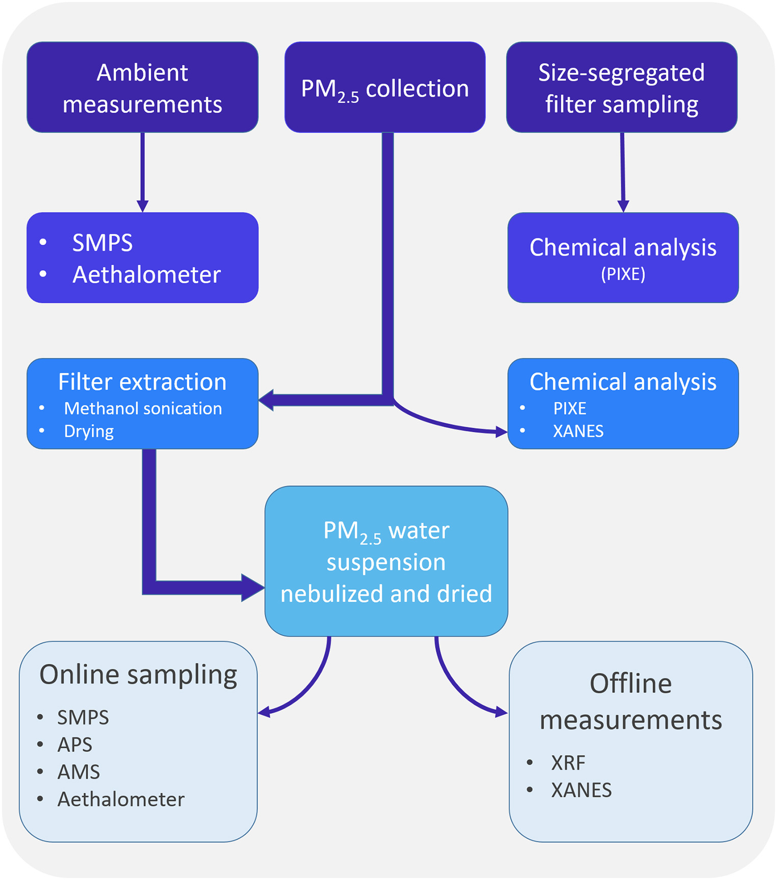
Online-offline aerosol experiments
Collection
Extraction
Re-aerosolization (nebulizer)
Analysis in aerosol phase

Slide 33
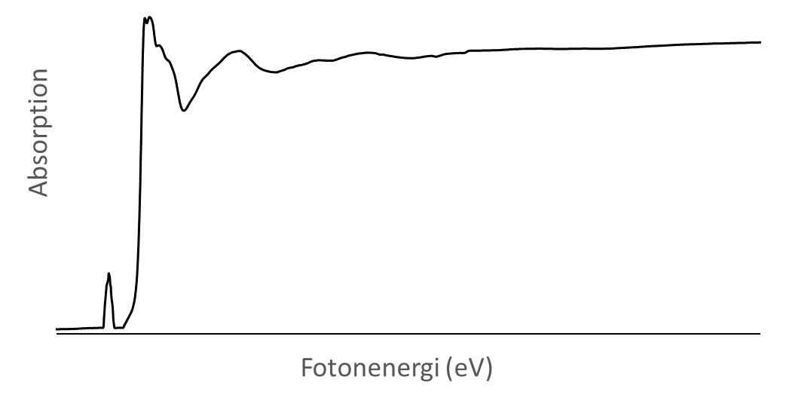
X-ray Absorption Spectroscopy XAS
The absorbed X-rays at a specific wavelength is measured
Monodisperse X-rays are scanned over the absorption edge of a specific element and the absorption is detected as a function of photon energy
+
Sample
Monochromatic X-rays
Transmitted X-rays
E
Notes:
Tuneability needed in a wide range of photon energies – a synchrotron needed for XAS (benh top possible for specific wave lengths)

Slide 34


Offline XANES results
Iron: no change in chemical state from re-aerolization
XANES is used to fingerprint an atoms chemical state
Offline
Particle bulk
Zink: change in chemical state from re-aerolization

Slide 35
Take home messages
Aerosol science at FinEstBeAMS (maxiv) via aerosol sample delivery system ASDS to study aerosol particle surfaces in-flight.
Half dozen P.I.s (some highligted here) use the ASDS for climate and health relevant reserach.
Aerosol particle surfaces are distinct from aerosol particle bulk. At the surface, growth and oxidation takes place.
For non-soluble particles surface is likely driver of advese health effects.
The ASDS can be used to study African aerosol now.
There is also non-aerosol atmosperic science done at MAXIV, and aerosol science which is not atmospheric (nanotech).
A future AfLS beamline for aerosol, please!

