Slide 1

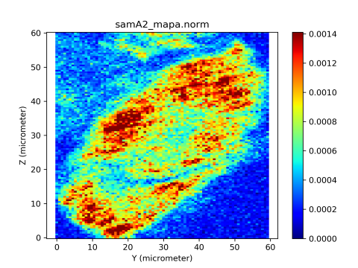
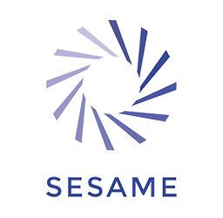
Joint African Light Source and
African Physical Society
Conference 2025 19 Nov 2025
Synchrotron radiation enabled advances in Human Bioarchaeology: Current research and future potential
Kirsi O. Lorentz, BioMERA Platform & BioMERAplus
Science and Technology in Archaeology and Culture Research Center (STARC),
The Cyprus Institute (CyI), k.lorentz@cyi.ac.cy

Slide 2

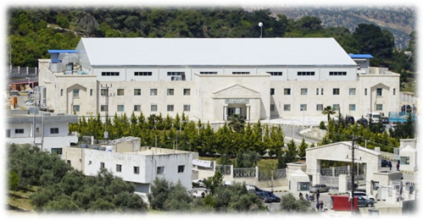
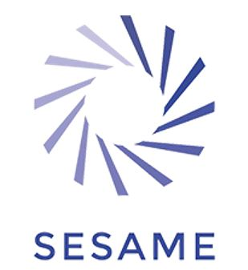
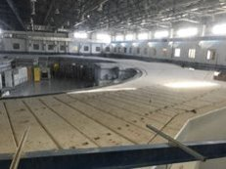
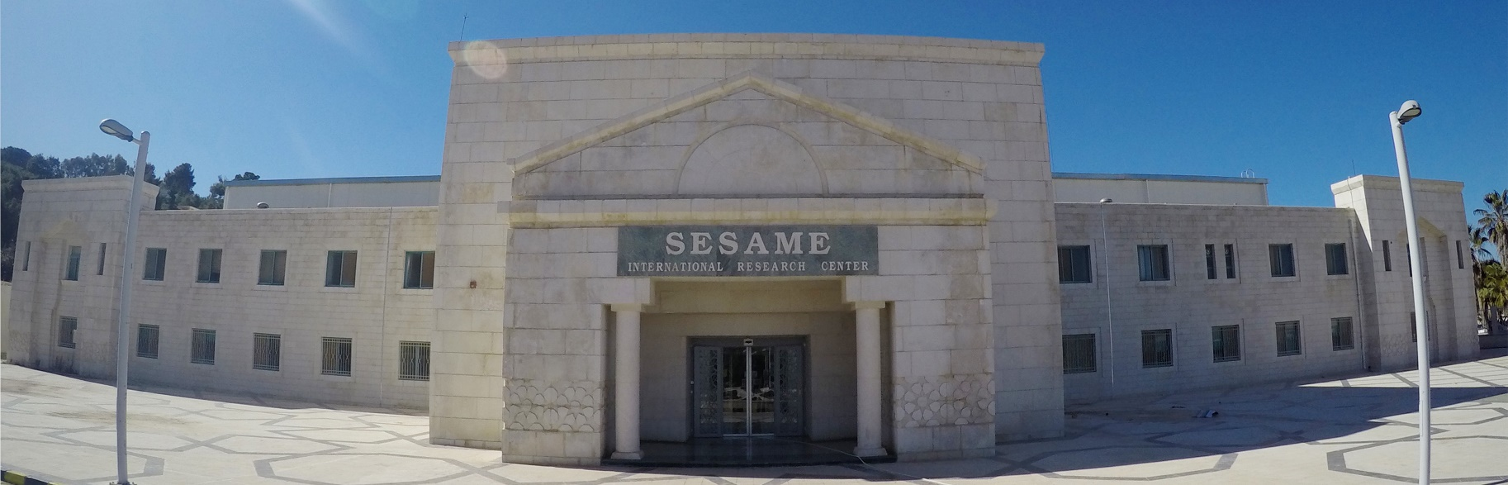
SESAME: The SR facility which opened its doors with first user beamtime on human bioarchaeology
SESAME: Synchrotron-Light for Experimental Science and Applications in the Middle East
Third-generation synchrotron light source that was officially opened in Allan (Jordan) on 16 May 2017.
The first synchrotron light source in the Middle East and neighbouring countries; the region’s first major international centre of excellence
https://www.sesame.org.jo

Slide 3
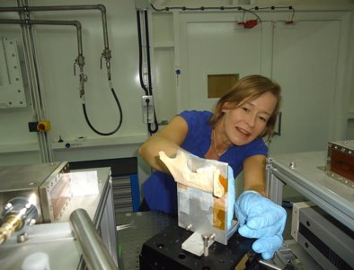
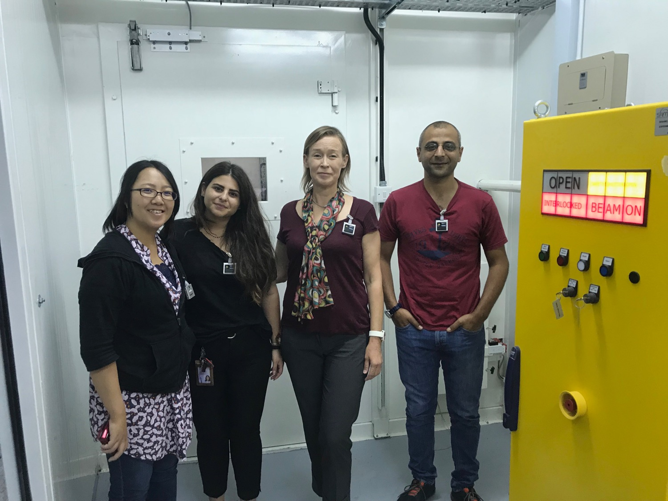






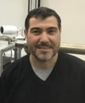
SESAME's first official user beamtime on human bioarchaeology: human metal exposure
https://www.sesame.org.jo/news/sesame-hosts-its-first-users

Slide 4
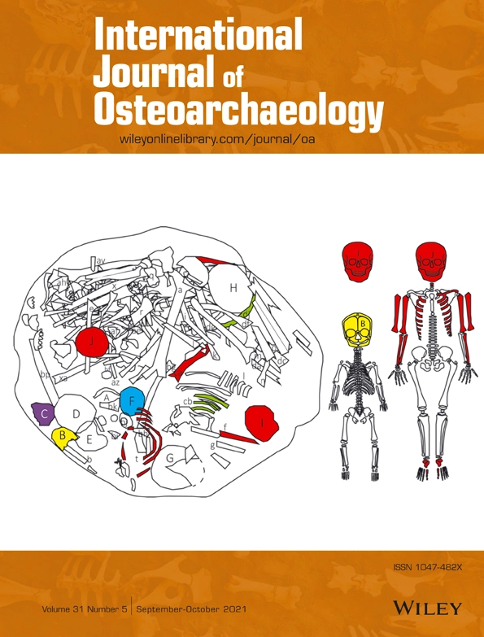
(Human) Bioarchaeology is the study of human remains from archaeological contexts... The field emphasizes integrative, interdisciplinary analysis of the links between biology and culture in past societies. This approach has contributed to an informed understanding of the range of social, behavioral, and economic conditions and circumstances that have shaped the human experience – especially health and well-being, lifestyle, and quality of life – during the last 10,000 years of human evolutionary history.
Clark Spencer Larsen
Bioarchaeology: Definition. In: Smith C. (eds) Encyclopedia of Global Archaeology. Springer, New York (2014)
Lorentz et al. (2021) Disposed young: Nonadult element representation and bone positioning in complex mortuary programmes in Chalcolithic Cyprus

Slide 5
First publication of SR data capture on human hair
@NSLS, SR-XRF, XRD, EXAFS
The first year with multiple publications (3)
First publication of SR application to archaeology
@LURE, SR-XRF
2003
First publication of SR application to bone (animal)
@DESY, SR-XRF
2007
1989
1 publication almost every year
1999
2000
2022
First publication on SR data capture on human teeth (+bone) @LURE, SR-XRF
The year with most publications (7)
2005
2017
1995
First publication of SR application to human skin
@NSLS, SR-IR
First publication of SR application to
human nail
@CLS, SR-XRF
First publication on SR data capture on dental calculus @NSLS, SR-XRF

Slide 6


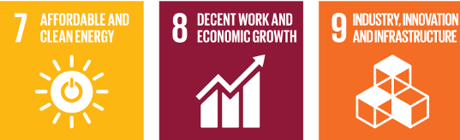

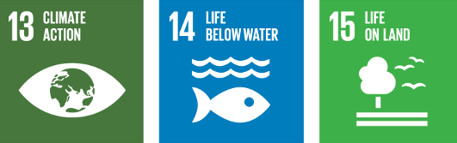

Why should we/you care?
SR use in Human Bioarchaeology, its history, challenges and potential highlight the need for
SR user community building
infrastructure development (feeder facilities; synchrotron beamlines)
regional and transnational collaboration
UN sustainable development goals
synchrotron radiation enabled human bioarchaeology can afford us insights into many of the UN sustainable development goals, with a long historical/archaeological perspective
An example: Human metal use and metal exposure – past & present
Relevant UN sustainable development goals: 3 Good health and well being; 5 gender equality; 6 Clean water; 8 Decent work and economic growth; 9 Industry, innovation, and infrastructure; 10 reduced inequalities; 11 sustainable cities and communities; 12 Responsible consumption and production; 14 Life below water; 15 Life on land...
ability to ask NEW research questions with real impact
https://worldtop20.org/global-movement/

Slide 7
OUTLINE
Human Bioarchaeology: An introduction
Advances: A brief history of Human Bioarchaeology and synchrotron radiation
Research questions
SR techniques
Challenges: From excavation to laboratory to synchrotron
Case studies in Human Bioarchaeology and SR: SESAME and ESRF
Potential: Future prospects

Slide 8
Human Bioarchaeology:
An introduction

Slide 9
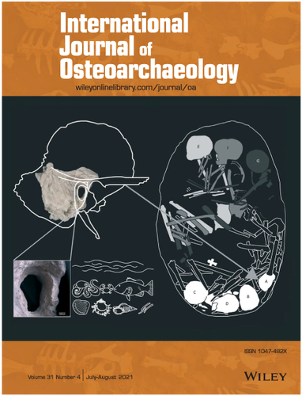
Human bioarchaeology
study of human remains from archaeological sites
lifestyle, health and disease, cultural practices, mortuary practices
different scales of analysis:
population level
individual level: life histories (osteobiography)
tissue level
our most direct avenue to access information on past people – our ancestors
Lorentz & Casa B. (2021). External auditory exostoses, repetitive aquatic activity and increasing social complexity in Chalcolithic Cyprus: Specialists of the sea?

Slide 10
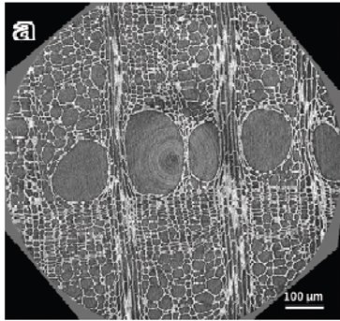
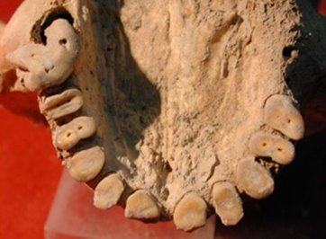
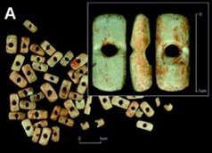
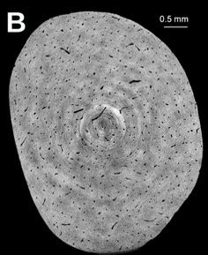
​(Bio)archaeological samples
focus today
Any biological remains recovered archaeologically, e.g.:
Animal remains
Plant remains
Human remains
Organic materials/artefacts
Other organic remains
Ancient wood (Hwang et al., 2020)
Human remains
(Lorentz et al., 2020)
Animal bone, antler (Vercoutère et al. 2011)

Slide 11
Human Bioarchaeology and synchrotron radiation: a brief history

Slide 12
First publication of SR data capture on human hair
@NSLS, SR-XRF, XRD, EXAFS
The first year with multiple publications (3)
First publication of SR application to archaeology
@LURE, SR-XRF
2003
First publication of SR application to bone (animal)
@DESY, SR-XRF
2007
1989
1 publication almost every year
1999
2000
2022
First publication on SR data capture on human teeth (+bone) @LURE, SR-XRF
The year with most publications (7)
2005
2017
1995
First publication of SR application to human skin
@NSLS, SR-IR
First publication of SR application to
human nail
@CLS, SR-XRF
First publication on SR data capture on dental calculus @NSLS, SR-XRF

Slide 13
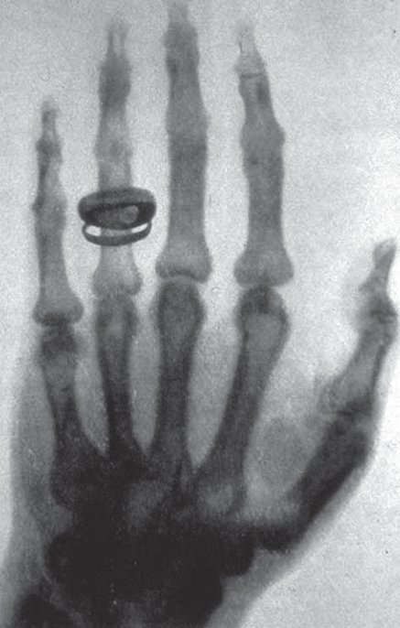
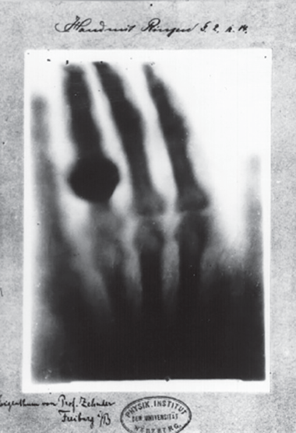
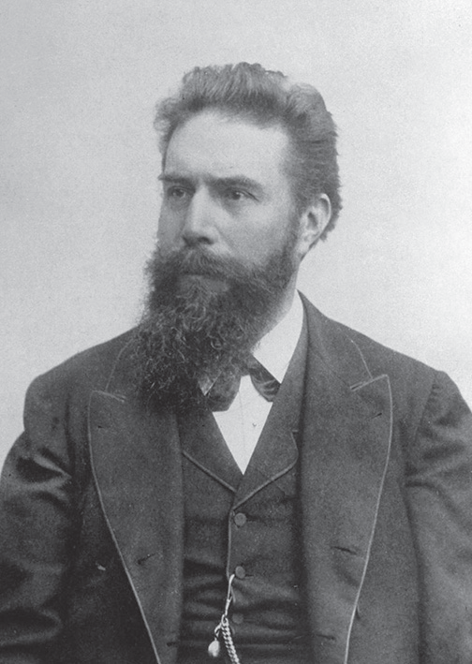
Rapid uptake of other technologies: Radiography
Röntgen
Hand mit Ringen (Hand with Rings). One of the first radiographs by Röntgen of the left hand of his wife Bertha, presented to Prof. Ludwig Zehnder of the Physik Institut, University of Freiburg, on 1st January, 1896 (Wikimedia Commons)
Radiograph) taken by Röntgen of Albert von Kölliker’s hand at a public lecture (Wikimedia Commons)

Slide 14
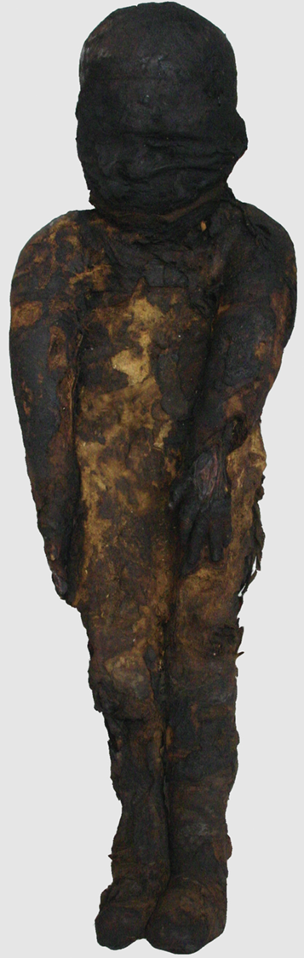
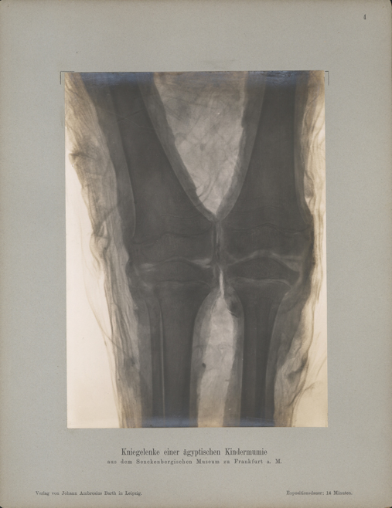
Rapid uptake of other technologies: Radiography
X-rays used on archaeological human remains soon after their discovery by Röntgen
W. König 1896 ‘14 photographs with X-rays…’
Röntgen made the radiograph of his wife’s hand in December 1895
Photograph of the bandaged ancient Egyptian child mummy from the Senckenberg Museum of Natural History in Frankfurt a.M. (inventory number ÄS 18).
(Zesch et al 2016)
W. König 1896 14 Photographien mit Röntgen-Strahlen aufgenommen im Physikalischen Verein zu Frankfurt a. M., Johann Ambrosius Barth, Leipzig.

Slide 15
SR beamlines used so far for human bioarchaeology
One human bioarchaeology paper:
LURE D43 (XRD)
LURE MIRAGE-SAS (IR)
SOLEIL DIFFABS (XRF)
DESY P06 (XRF)
DESY P07 (microCT)
DESY HASYLAB (microCT)
APS 2-BM-A (microCT)
ESRF ID21 (XRF)
ESRF BM05 (microCT)
ESRF ID13 (XRD)
ESRF ID22 (XRF)
ESRF ID18 (SAXS)
NSLS X27A (XRF)
NSLS U10B (IR)
DLS B16 (XRD)
SSRL 7-3 (XAS)
ALS 10.3.2 (XRF, XANES, XRD)
ALS 1.4.3 (IR)
ALS 8.3.2 (microCT)
XRF, XANES, EXAFS
microCT
IR
XRD

Slide 16
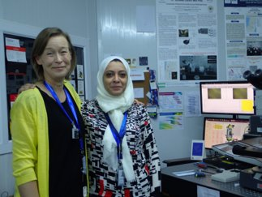
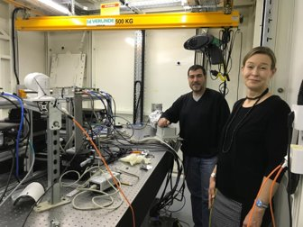
SESAME has the core techniques for Human Bioarchaeology and CH applications
Synchrotron radiation applications to bioarchaeology
IR (operational)
XRF, XAFS (operational)
SR-µCT (operational)

Slide 17
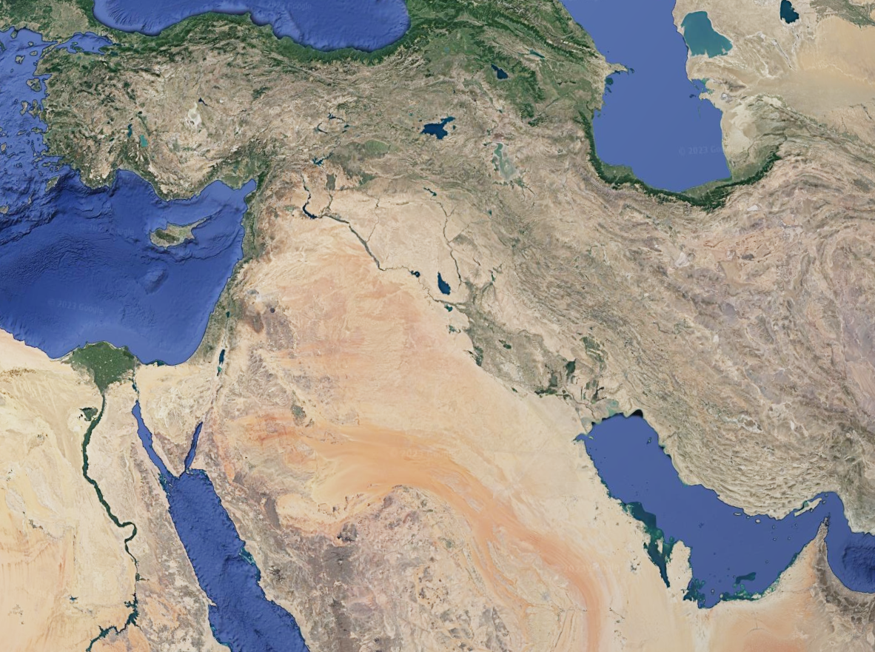
Google Earth

Slide 18
SESAME: The SR facility which opened its doors with first user beamtime on human bioarchaeology
SESAME: Synchrotron-Light for Experimental Science and Applications in the Middle East
Third-generation synchrotron light source that was officially opened in Allan (Jordan) on 16 May 2017.
The first synchrotron light source in the Middle East and neighbouring countries; the region’s first major international centre of excellence
https://www.sesame.org.jo

Slide 19
https://www.sesame.org.jo/sites/default/files/images/Brochures/SESAME_Brochure.pdf

Slide 20
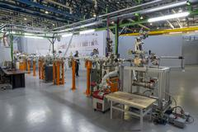
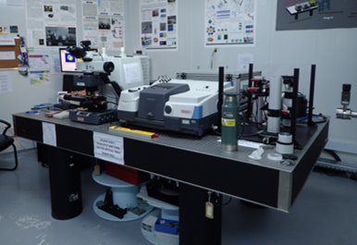
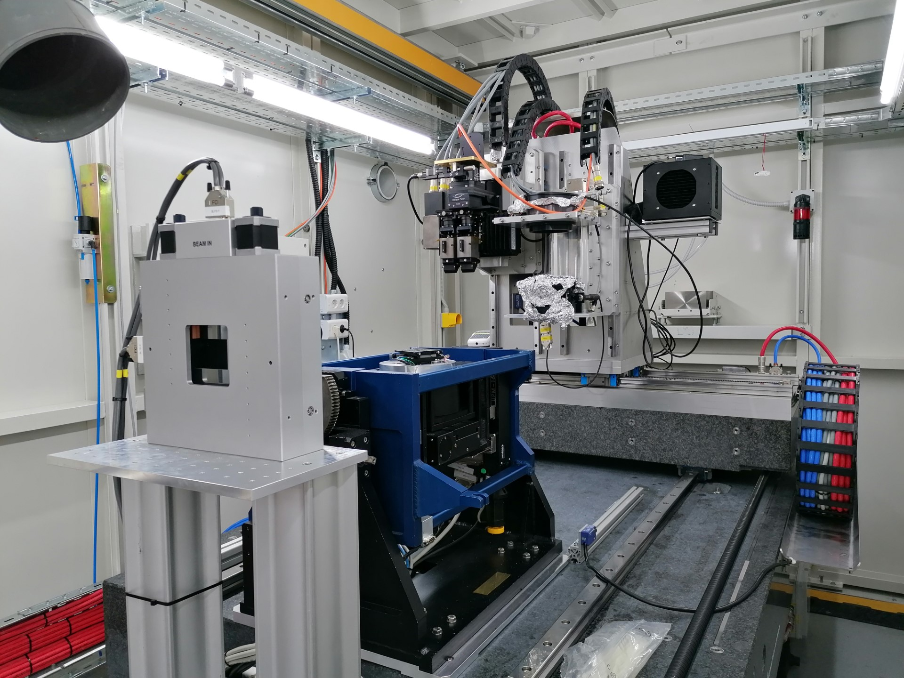
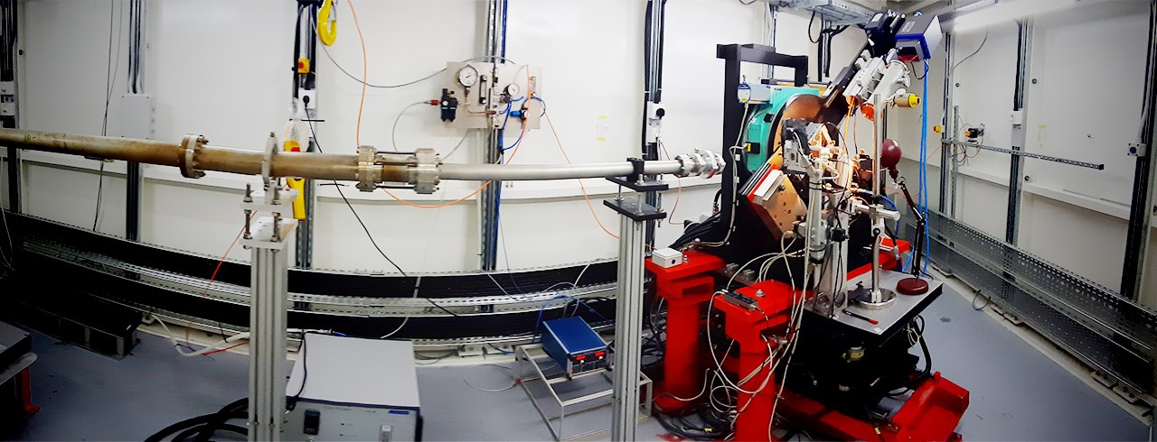
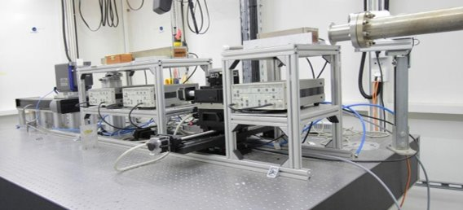
HESEB
IR
SESAME beamlines
Current Beamlines
XAFS/XRF (X-ray Absorption Fine Structure/X-ray Fluorescence) spectroscopy
IR (Infrared) spectromicroscopy
MS (Materials Science)
HESEB (HElmholtz-SEsame Beamline) – Soft X-ray; inaugurated 12 June 2022
BEATS (BEAmline for Tomography at SESAME); inaugurated 6 Jun 2023
TXPES (Turkish soft X-ray PhotoElectron Spectroscopy) beamline - inauguration 8 Dec 2025
Constructed by a Turkish consortium led by TENMAK (Turkish Energy, Nuclear and Mineral Research Agency); it is the first beamline at SESAME to be designed and built by the national community of one of SESAME’s Members (Turkey)
https://heseb.desy.de/gallery
MS
https://www.sesame.org.jo/beamlines/ms
BEATS
The future… an African beamline?
XAFS/XRF

Slide 21
SESAME's first official user beamtime on human bioarchaeology: human metal exposure
https://www.sesame.org.jo/news/sesame-hosts-its-first-users

Slide 22
Research questions in Human Bioarchaeology addressed through use of synchrotron radiation
Preservation status
Analysis of tissue structure and alterations
Age-at-death estimation
Osteobiographical reconstructions
Dietary reconstruction
Ancient medical treatment techniques
Human metal exposure

Slide 23
Foci of bioarchaeology publications using SR
SR and archaeological human remains: answers to key questions?
Pathologies
Histology (microstructure)
State of preservation
Diagenetic alterations
Differentiation between ancient and modern samples
Characterisation of organic and inorganic components
Compositional quantification of organic and inorganic components
Evaluation of long-term alterations
Metal element content

Slide 24
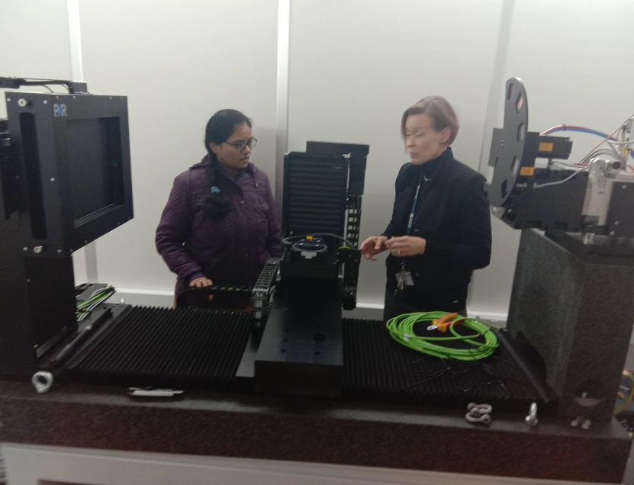
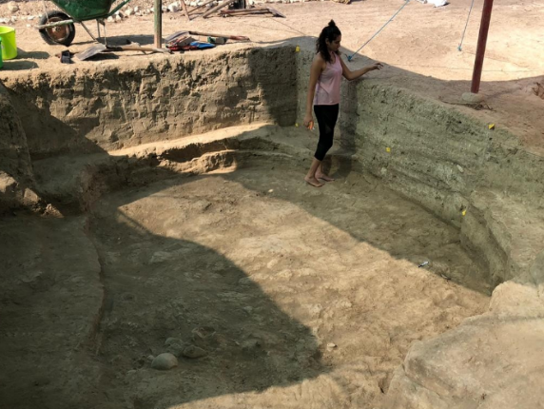
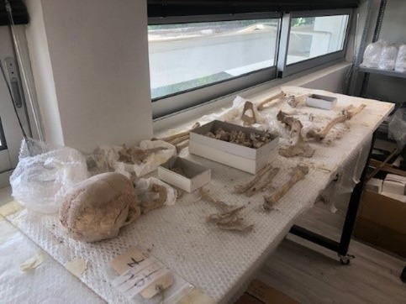
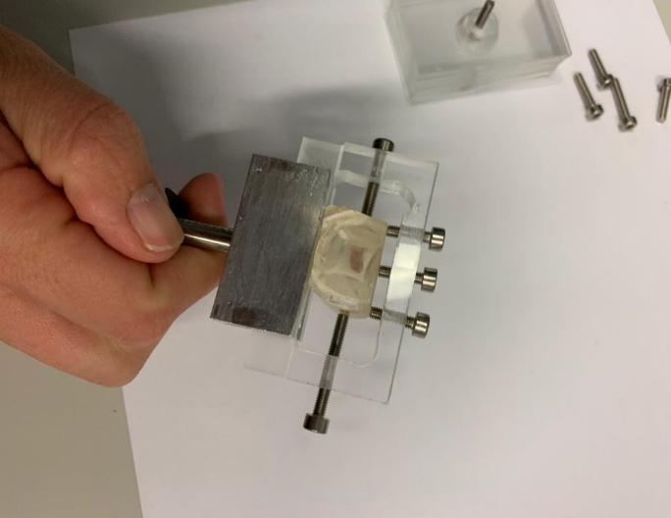
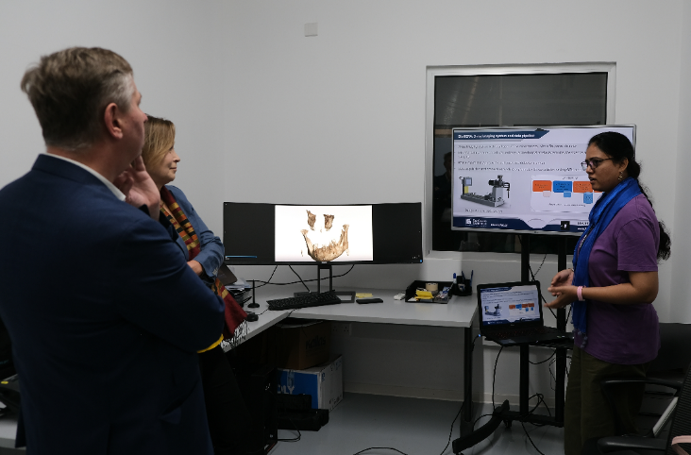
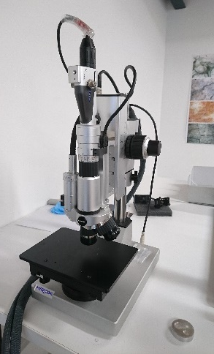
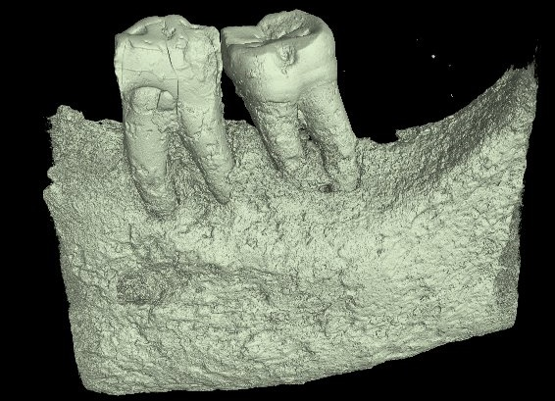
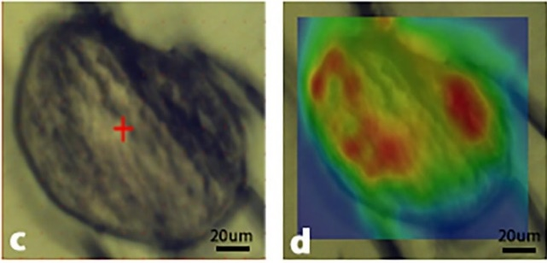
Challenges: From excavation to laboratory to synchrotron

Slide 25

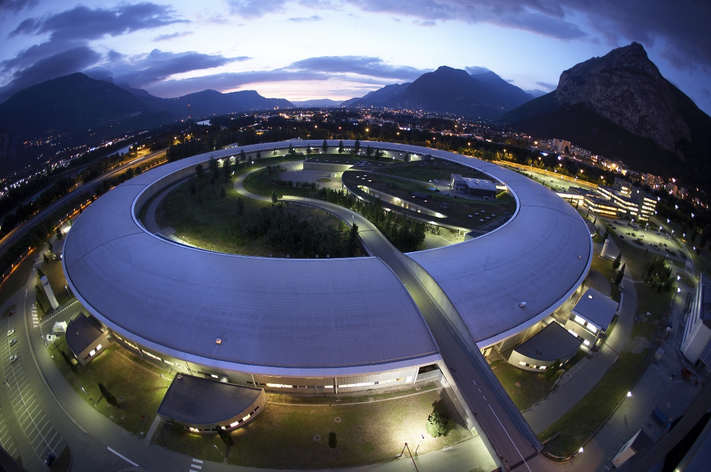
The trajectory: from the soil via lab to synchrotron...?

Slide 26
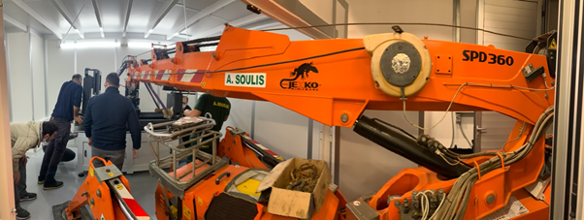
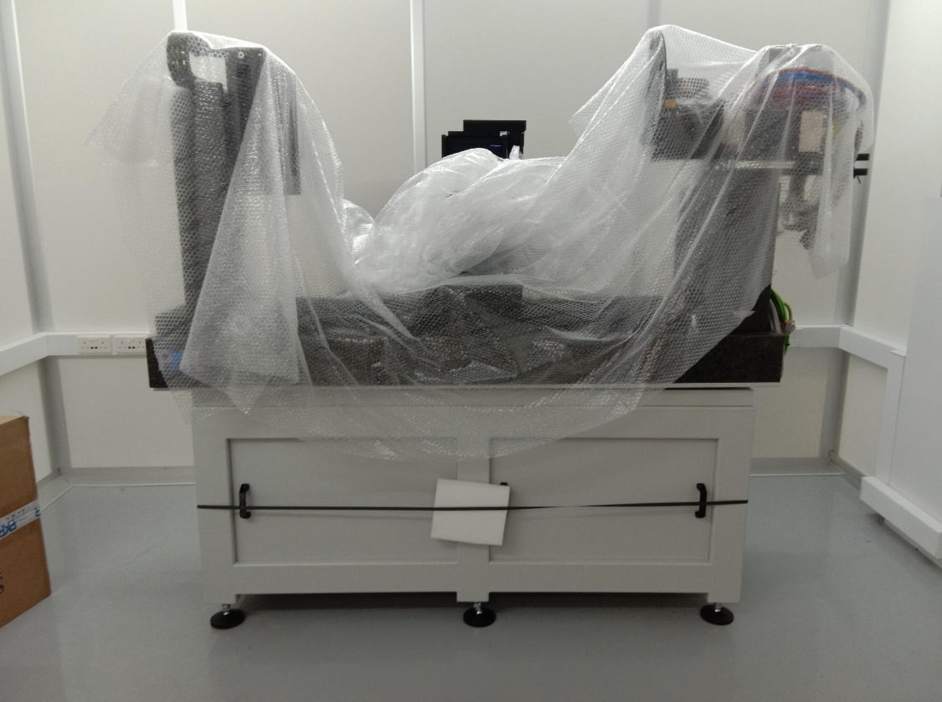

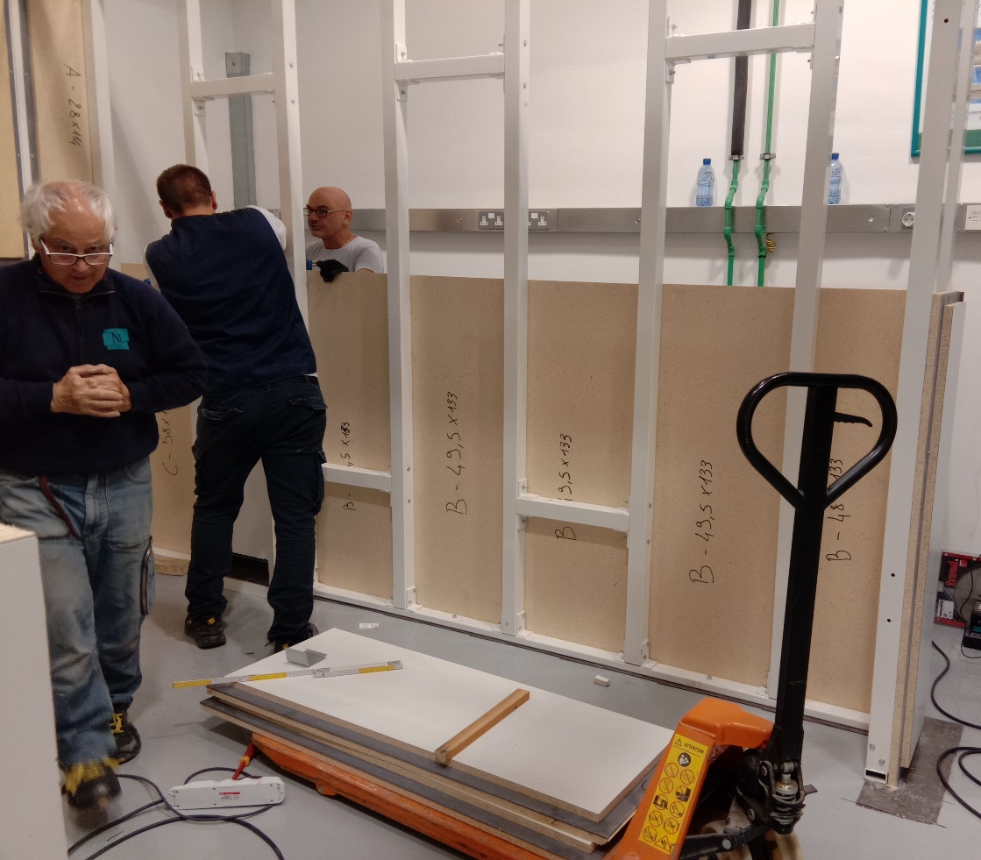
…but sometimes it is necessary to construct new facilities...

Slide 27
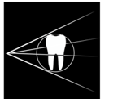


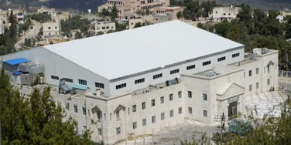




















​Importance of laboratory platforms prior to accessing synchrotron radiation facilities
Platform for Biosciences and Human Health in Cyprus:
MicroCT and Synchrotron Radiation Enabled Analyses
RIF: 1 million Eur
https://biomera.cyi.ac.cy/
PI: Kirsi O. Lorentz, The Cyprus Institute
The Project INFRASTRUCTURES/1216/0009 is co-financed by the European Regional Development Fund and the Republic of Cyprus through the Research and Innovation Foundation​

Slide 28

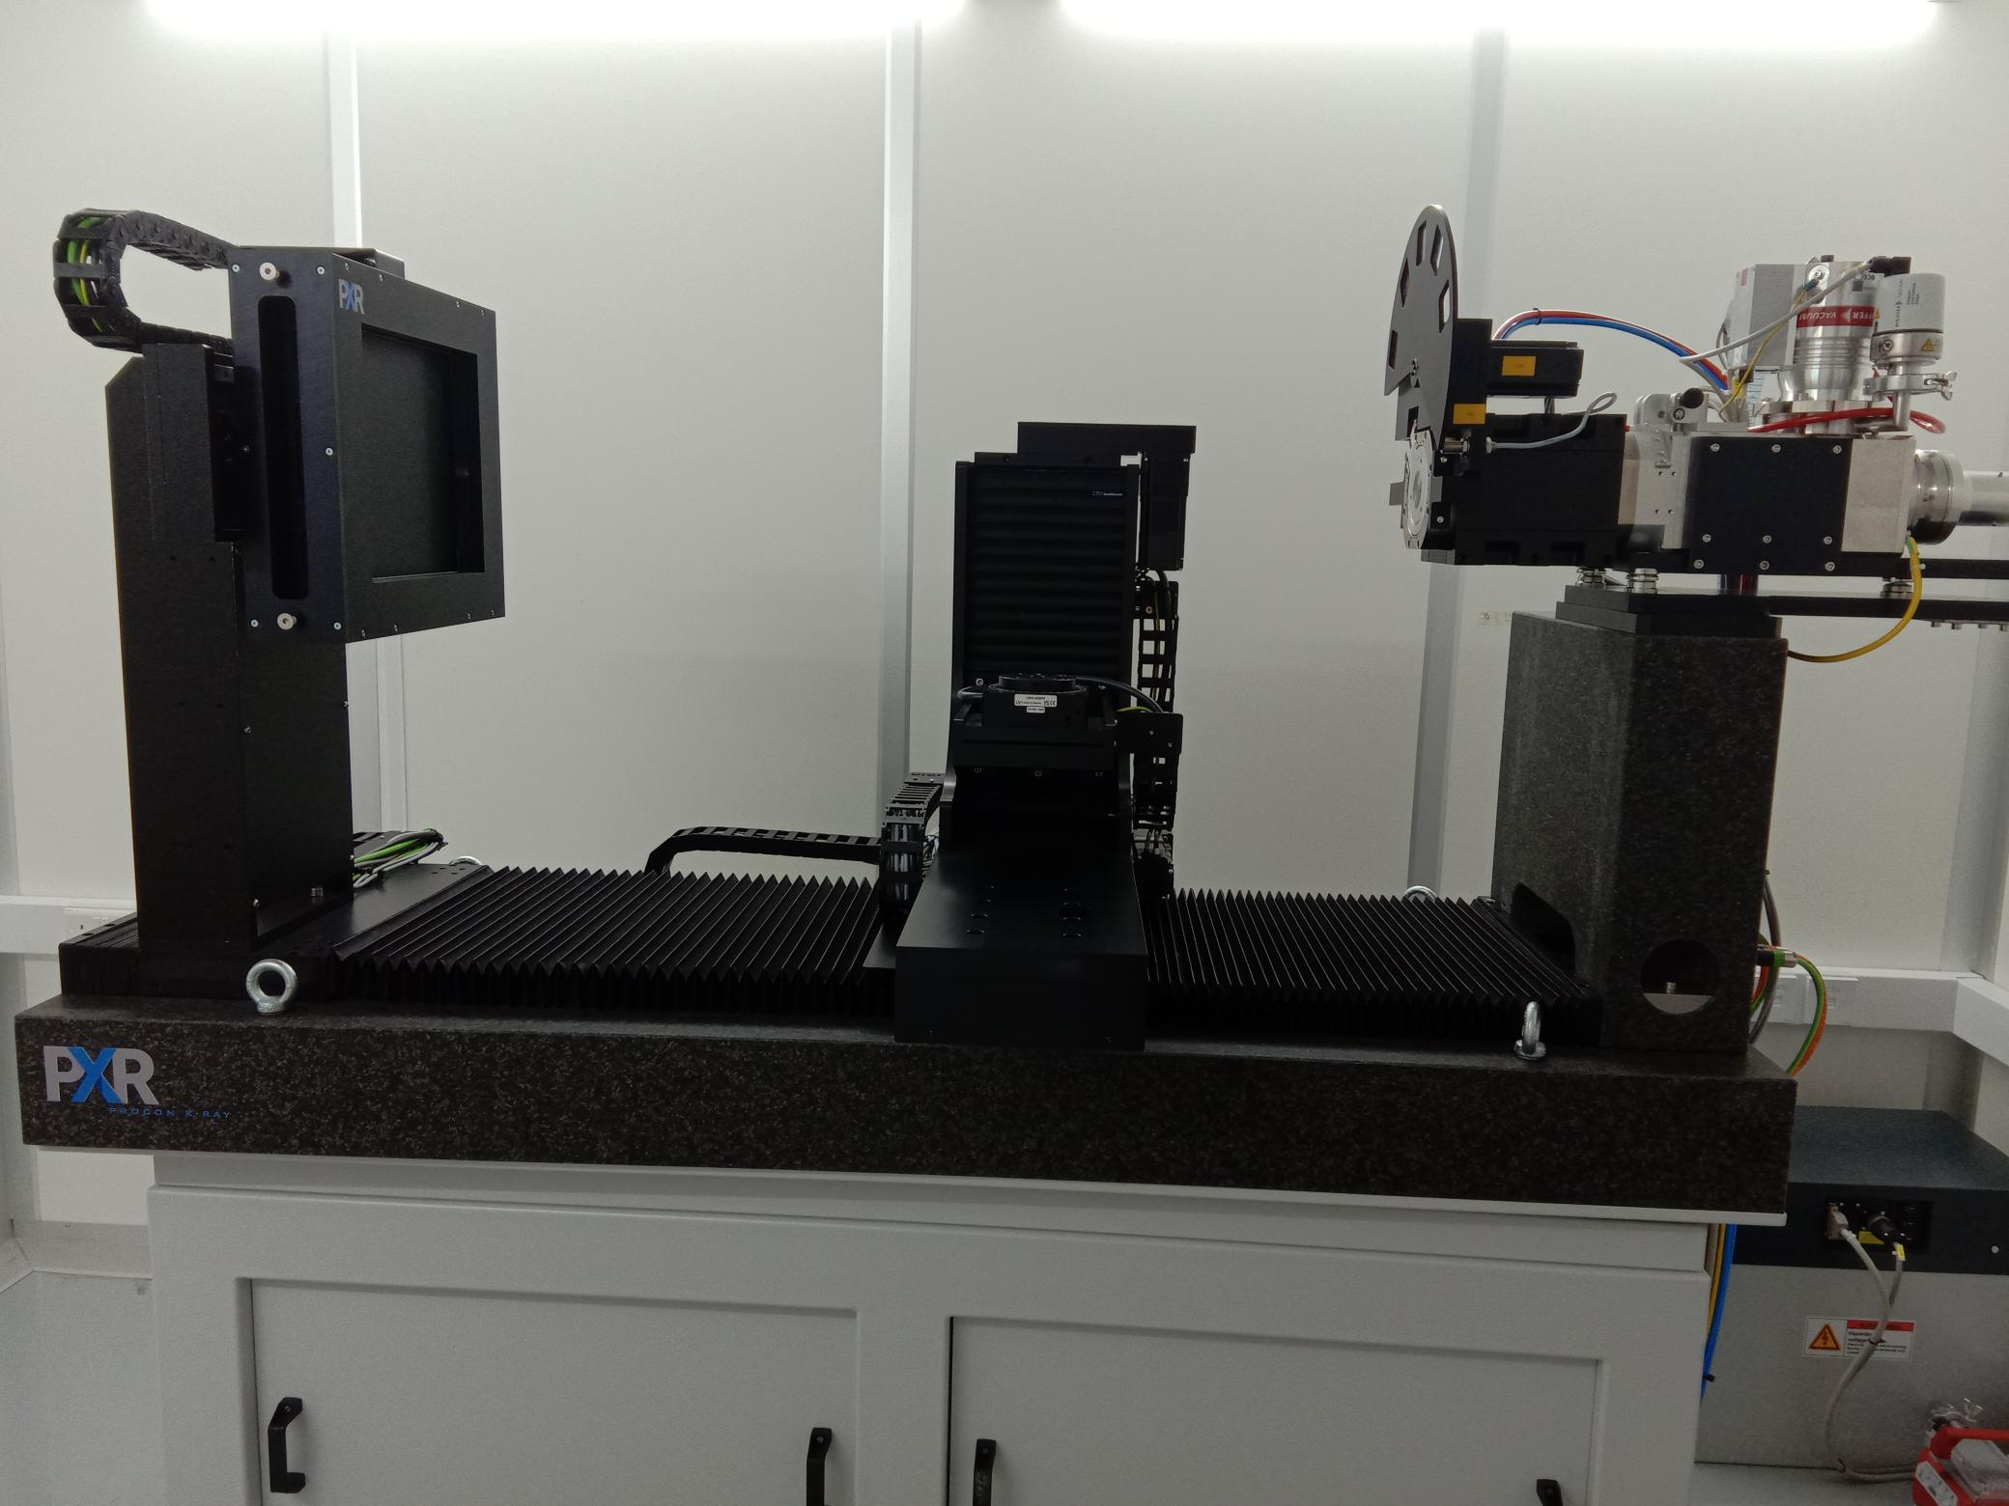
BioMERA X-ray microCT system
X-ray imaging system: 5 micron focal spot, flat panel detector, 2 micron voxel size
microCT data capture on any material samples: life science, material science, cultural heritage/archaeology, food industry...
phase contrast imaging with small pixel size detector planned
BioMERA microCT system

Slide 29
​New XAFS and XRF infrastructure in Cyprus: BioMERAplusCHEM
BioMERAplusCHEM
Research and Innovation Foundation fudning: 0.5 million Eur
https://biomera.cyi.ac.cy/
PI: Kirsi O. Lorentz, The Cyprus Institute
The Project OPEN INFRA/0625/0030 is co-financed by the European Regional Development Fund and the Republic of Cyprus through the Research and Innovation Foundation​

Slide 30
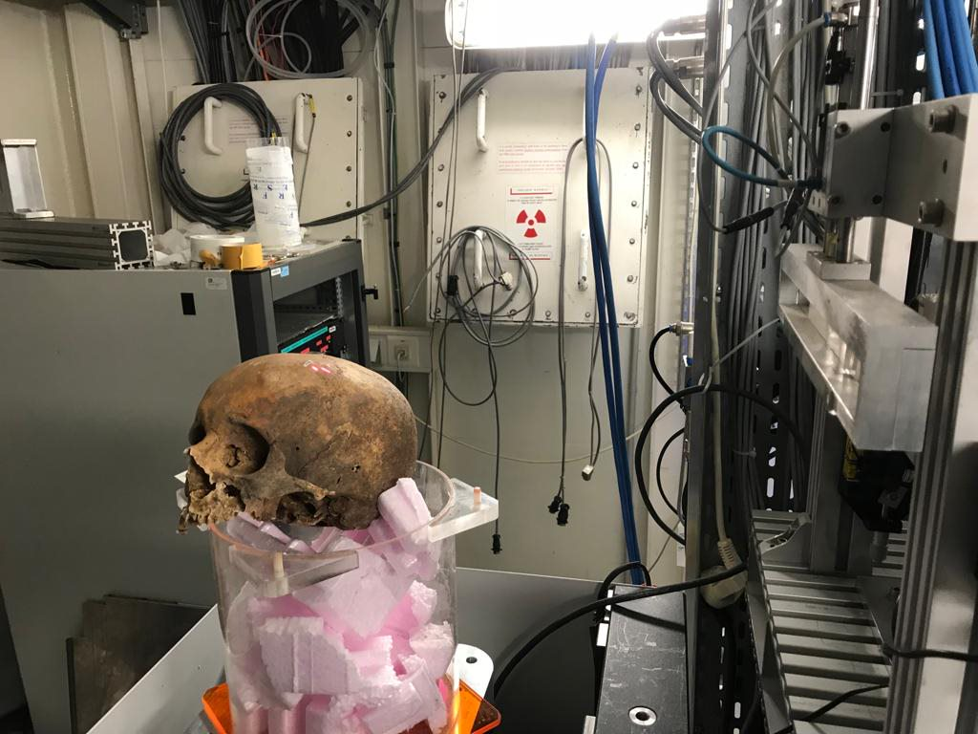
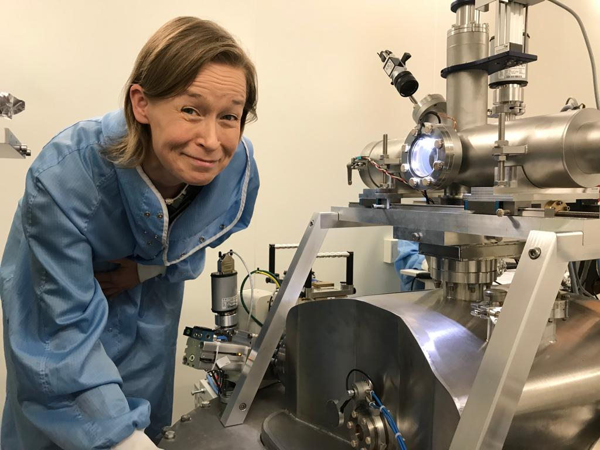
Challenges
Identifying the right approach
Prior laboratory analyses – access to appropriate facilities
Sample preparation
Data analysis, incl. availability of specialised software; expertise
Aquisition of an archaeologically representative number of data points (limited beamtime; 'quest for firsts and then its over?')
Exploring frontiers together: pushing the limits of techniques whilst exploring and identifying new research questions enabled by new developments in SR techniques
Heterogenous samples – correlated multimodal imaging

Slide 31
Case studies in Human Bioarchaeology and SR: SESAME and ESRF

Slide 32

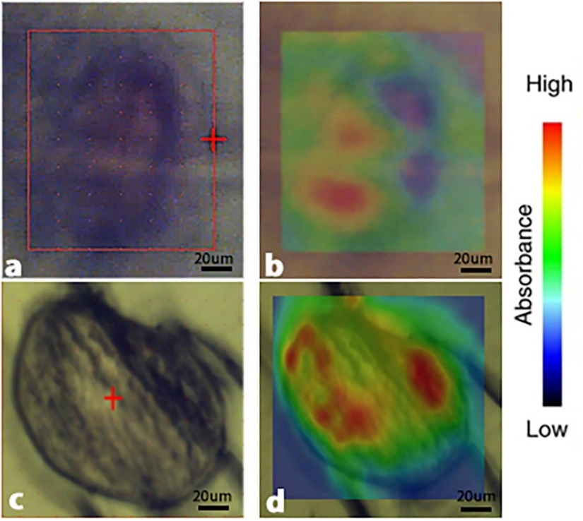
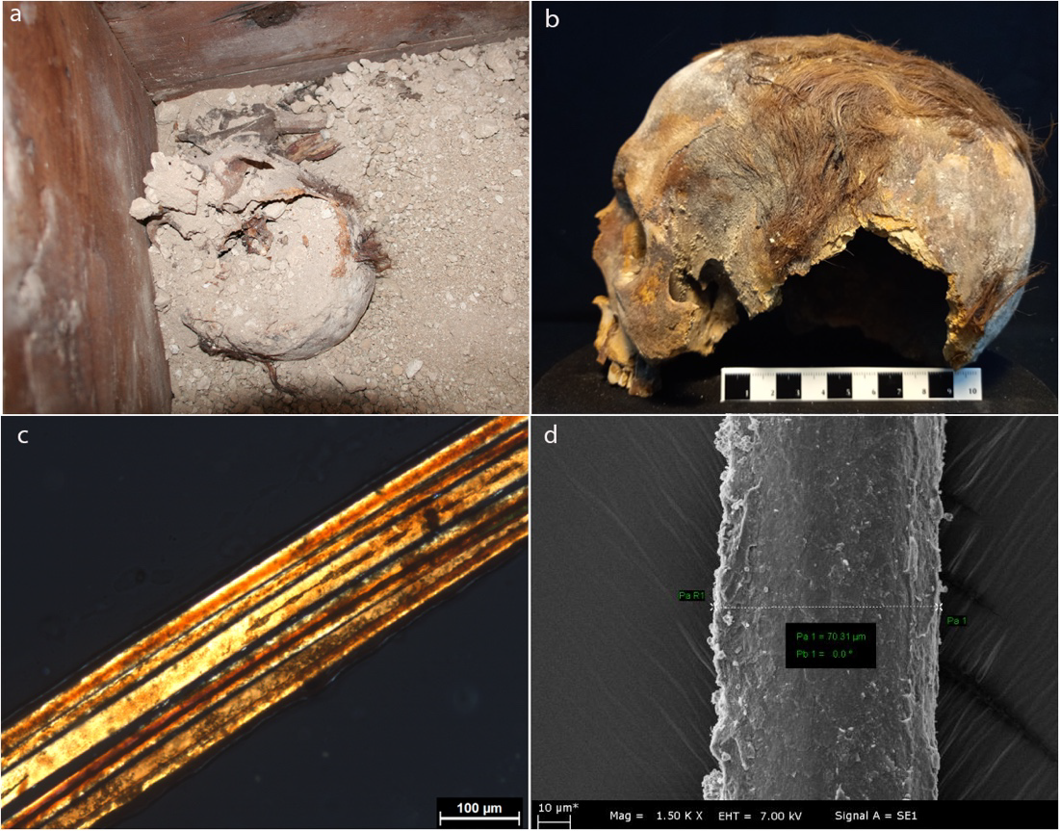
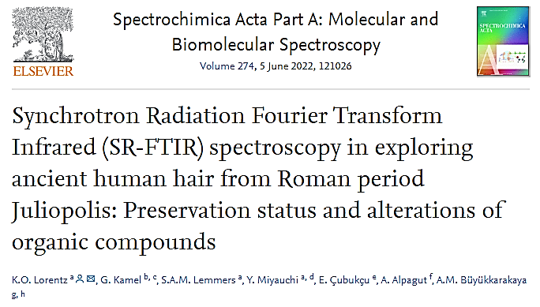
(I): Ancient human hair, Roman Juliopolis: Alterations of organic compounds, SR-FTIR spectroscopy
K.O. Lorentz, G. Kamel, S.A.M. Lemmers, Y. Miyauchi, E. Cubukcu, A. Alpagut, A.M. Buyukkarakaya

Slide 33

​SR-FTIR mapping of ancient human hair
​SR-IR mapping of ancient human hair
Research aim
evaluate preservation status and alterations of organic compounds prior to putative destructive analyses (e.g. diet – stable isotopes, aDNA)
alterations of organic compounds in archaeological human hair are caused by biological degradative processes dependent on multifactorial processes acting on the hair since the deposition of a body in a mortuary context
Lorentz et al. 2022; Büyükkarakaya et al. 2018

Slide 34


​SR-FTIR mapping of ancient human hair
​SR-IR mapping of ancient human hair
Human hair from archaeological contexts has high analytical value: diet, geographical origin, ancient DNA, metal exposure...
⇨ evaluation of preservation of organic compounds critical
Material
Roman period human hair, M196 from Juliopolis (c. 2000 years BCE)

Slide 35



Büyükkarakaya et al. 2018, http://www.nallihan.gov.tr/juliopolis , https://ayder.com.tr/lokasyon/nallihan-juliopolis-antik-kent/650 http://anadoluatlasi.com/index.php/en/ana-sayfa/kayip-kent-juliopolis

Slide 36



​SR-IR mapping of ancient human hair
Method
SR-FTIR microspectroscopy at the IR beamline, SESAME
IR chemical mapping
Experimental parameters
infrared spectra acquired in transmission mode
spectra recorded with a 32x Schwarzschild objective and a matching 32x condenser using a double path single masking aperture size of 20x20µm
mid-infrared range 4000-650 cm⁻¹
4 cm⁻¹ spectral resolution
128 coadded scans using OMNIC AtlµsTM mapping software (Thermo Fisher Scientific©, USA)
background spectra collected repeatedly to assess its spectral contribution
acquired data analysed by Thermo OMNIC© software (Thermo Fisher Scientific©, USA)

Slide 37

Transmission IR spectra showing the typical features of lipids in the region (3000-2800cm⁻¹) for both the modern reference and ancient hair
​SR-IR mapping of ancient human hair
Results
keratin: more degraded in comparison to a modern reference sample
clear potential for further analyses with techniques relying on organic compound preservation
e.g. diet, geographical origins, aDNA, metal exposure
these data make significant contributions to the life history of the individual (osteobiography), as well as contribute towards key archaeological questions

Slide 38
Human bioarchaeology publication from SESAME
Optical (a, c) and FTIR (chemical) imaging (b, d) of ancient hair cross sections (sub-figures a, b) from Juliopolis (JP M196), and a modern reference (sub-figures c, d).
The chemical maps are based on normalized and baseline-corrected transmission infrared average spectra, as blended 2D map and video images.
https://doi.org/10.1016/j.saa.2022.121026

Slide 39

Acknowledgements for Case Study 1:
KL acknowledges SESAME for the beamtime awarded (IR beamline, 20185110), and the Cyprus Institute, LAAAMP, SESAME, and CALYPSOplus project (under Grant Agreement 730872 from the EU Framework Programme for Research and Innovation HORIZON 2020) for travel funds to the SESAME synchrotron. The authors would like to acknowledge all SESAME staff, SESAME Council, SESAME sponsors and all SESAME supporters for making this research possible; those who conceptualised, nurtured, financed, built and first operated SESAME; and those who continue to do so. AMB acknowledges the Bioarchaeological and High-Tech Research on Skeletal Remains of Juliopolis project. The authors acknowledge the financial support of the project BioMERA: Platform for Biosciences and Human Health in Cyprus - MicroCT and Synchrotron Radiation Enabled Analyses, which is cofinanced by the European Regional Development Fund and the Republic of Cyprus through the Research and Innovation Foundation (grant no. INFRASTRUCTURES/1216/09).
Add text – front page
Add text – front page
FRONT COVER

Slide 40





(II): Metals and health at 3rd millenium BCE Shahr-i Sokhta (Iran)
Mapping metal element localisation in ancient hair, SR-XRF
Kirsi O. LORENTZ, Marine COTTE, Wout de NOLF, Grigoria IOANNOU, Mohammad Rajab ZARURI, Farzad FORUZANFAR, Mansur SAJJADI

Slide 41







Metal element localisation in ancient hair
Notes:
The Cyprus institute is a technologically oriented research and educational institution that addresses challenges facing the Island and the region.

Slide 42



Slide 43

Key question in archaeology: Metal exploitation and health
production and manufacturing of copper has an extensive history in South West Asia, and the Eastern Mediterranean
written records on the detrimental effects to human health of some ancient mining practices
Xenophon (434–359 BCE), Lucretius (98–55 BCE)
smoke of lead mines in Attica was harmful to human health
Pliny
‘exhalations from silver mines (i.e. galena mines) are dangerous to all animals’
we have very little evidence as to human health in relation to e.g. copper mining and manufacturing during the prehistoric periods
-> human remains as source of critical data answering a key archaeological question
data acquisition on hair requires SR source
Reconstructed image of smelting site of Almas (c. 400BCE), Cyprus
©Cyprus Tourism Organisation

Slide 44
Key archaeological question: Effects of intensive metal and craft work on human health?
biogenetic versus diagenetic/environmental uptake of metals
potential sources of exposure in the past:
legacy soil contamination (inhalation, ingestion)
contaminated food and water (ingestion)
pigments in crafts, cosmetics etc (absorption/ingestion/inhalation)
first study of biogenic versus diagenetic metal element localisation in ancient human hair at 1 µm resolution

Slide 45


Ancient human hair, IUR 3211, cranium, posterior
(a)
(b)
(a) Light microscopy image of hair strands from HHE8001; (b) SEM image of a hair strand from HHE8001 (x300)

Slide 46


Metal element localisation in ancient hair
Materials:
ancient hair sections (10 μm) of eight individuals (n=8), as well as modern hair controls (n=2)
from Shahr-i Sokhta, a 3rd millennium BCE large urban site with intensive metalwork and other craft work activities, along trade routes later known as Silk Route
Methods:
scanning X-ray microscopy, optimized for 2D µXRF elemental maps​ ID21 at ESRF
SEM, light microscopy

Slide 47


Metal element localisation in ancient hair
Experimental parameters
31 SR-μXRF elemental maps obtained
three to four different hair cross sections for each individual were mapped in order to confirm consistency of results
elemental maps acquired at
9.1keV (above Cu K-edge)
pixel size of 1μm
over ~100Å~100μm
dwell time of ~0.25s (= 45min/map)
elemental maps acquired at ID21 were analyzed using PyMCA software
ESRF ID21

Slide 48



Metal element localisation in ancient hair
Results:
significant differentiation in the levels and localisation of Cu
hair of a young female (c. 18-20 years old at death; MDX5806) showed particularly elevated levels of Cu
the normalised 2D elemental maps of hair cross sections of the eight individuals analysed show that the Cu values of MDX5806 are significantly higher than in the rest of the individuals
the highest Cu values in MDX5806 are located within the cortex, rather than the cuticle and the medulla area
other individuals buried nearby MDX5803 do not have values anywhere close to hers
the distribution of elevated levels of Cu, together with contextual data, points to biogenic, rather than diagenetic/environmental source for the uptake of Cu
https://www.hairknowhow.com/know-your-hair-structure

Slide 49





Metal element localisation in ancient hair
Broader implications
elevated Cu levels localised in the cortex indicate exposure in life to Cu containing food, water, cosmetics or airborne substances with Cu
(legacy) soil contamination (e.g. due to mining and metal work or other craft work activities) and its effects on food and/or water?
engagement in craft or other activities exposing to ingestion or inhalation of Cu?
use of Cu containing substances in contact with or on the skin (craft pigments, cosmetics)?
any combination of the above?
this young female did something different from the others -> higher Cu exposure (specialisation?)

Slide 50


Human metal exposure is a contemporary challenge
Critical health issues today:
intensive metal and manufacturing work
legacy soil contamination due to mining and manufacturing
These affected individuals and populations since the invention of manufacturing processes involving high temperatures, or compounds containing potentially toxic metal elements
WHO website on lead exposure:
https://www.who.int/news-room/fact-sheets/detail/lead-poisoning-and-health
A child and a woman break rocks extracted from a cobalt mine at a copper quarry and cobalt pit in Lubumbashi, Democratic Republic of the Congo on May 23, 2016. (AFP)

Slide 51




Acknowledgements for Case Study 2:
KL gratefully acknowledges the invitation to study the Shahr-i Sokhta human remains from the Director of the Shahr-i Sokhta excavations, which take place since 1997 by ICAR (Iranian Center for Archaeological Research), under the direction of Prof. S.M.S. Sajjadi. The Shahr-i Sokhta excavations are funded by ICAR. Further, KL gratefully acknowledges the close collaboration with Dr F. Foruzanfar, and all the members of the Shahr-i Sokhta team, as well as staff at ICAR. Funding for research travel enabling sample collection was received from Newcastle University SHS FRF while KL was Director of Wolfson Bioarchaeology Laboratory. Funding for two research residencies at ESRF (European Synchrotron Radiation Facility) enabling sample analyses was provided by two LAAAMP Grants, The Cyprus Institute, Erasmus, and ESRF, which KL and GI gratefully acknowledge. The authors acknowledge further financial support of the Platform for Biosciences and Human Health in Cyprus: MicroCT and Synchrotron Radiation Enabled Analyses (BioMERA) project, which is co-financed by the European Regional Development Fund and the Republic of Cyprus through the Research and Innovation Foundation (grant no. INFRASTRUCTURES/1216/09).
...and Hiram Castillo-Michel for showing his tricks for sample preparation and mounting
Add text – front page
Add text – front page
FRONT COVER

Slide 52
Future prospects

Slide 53



Connecting the dots - or getting out of the comfort zone?
From archaeological excavation to the synchrotron

Slide 54


Future prospects for SR enabled Human Bioarchaeology
Aquisition of an archaeologically representative number of data points/sets - facilitated by upgrades such as ESRF-EBS
Exploring frontiers together: pushing the limits of techniques whilst exploring for and identifying new research questions enabled by new developments in SR techniques
Heterogenous samples – development of truly correlated multimodal imaging approaches and imaging pipelines
Raising awareness of SR techniques within the putative human bioarchaeological user community: both established faculty and the future generations
Feeder facilities and training at feeder facilities

Slide 55



SR analyses within a funded project on Cypriot human remains; relevance to tourism
Face to Face: Meet an Ancient Cypriot
RIF: 1 million Eur
PI: Kirsi O. Lorentz, The Cyprus Institute
https://face2face.cyi.ac.cy/
The Project with Grant No. INTEGRATED/0609/29 is co-financed by the European Regional Development Fund and the Republic of Cyprus through the Research and Innovation Foundation.

Slide 56



SR analyses within a funded project on Cypriot human remains; relevance to tourism
https://en.wikipedia.org/wiki/Cyprus_Museum
The Cyprus Museum

Slide 57

Key archaeological question explored with SXCT: aquatic resource procurement -> Broad spectrum revolution

Slide 58


World's first proportionate dwarf: BioMERA microCT and SXCT at ESRF
Lorentz et al. 2021

Slide 59



Take-home message
Synchrotron radiation enables us to
gather data to provide better answers to longstanding, critical questions in (bio)archaeology
ask entirely new questions

Slide 60
Thank you for your attention
contact: k.lorentz@cyi.ac.cy

