Slide 1

AFRICA QUANTUM CONSORTIUM
Forging Local Strength. Driving Global Impact!
Presented by:
Farai Mazhandu
farai@africaquantum.org
WWW.AFRICAQUANTUM.ORG
Logo design by CQTech, Algeria
Notes:
Africa’s scientific story is entering a new chapter by purpose.
The Africa Quantum Consortium (AQC) - standing proudly on the shoulders of, and in partnership with, the African Physical Society (AfPS) and the African Light Source (AfLS) - brings new energy, structure, and continental alignment to Africa’s quantum march toward scientific sovereignty.
Together, our institutions form a living continuum of leadership:
AfPS united Africa’s physicists and gave the continent a voice in global science.
AfLS envisioned the infrastructure to unlock Africa’s research and development capacity from materials science to medical frontiers.
AQC connects these legacies to the future - embedding quantum science and technology within Africa’s broader strategy for Big Science and Big Goals.
AQC’s role is to bridge research, industry, and policy to transform Africa from a participant to an architect.
Rooted in quantum, yet expansive in vision, AQC aligns the continent’s scientific ecosystem toward a shared destination - impact, independence, and innovation.
This session unveils the architecture of that journey:
The State of Quantum in Africa White Paper - a data-driven snapshot of where we stand.
The Quantum Compact - a continental manifesto for scientific sovereignty. An extract of this compact is reflected in the ASFAP initiative.
The Pan-African Quantum Hackathon — the proving ground for Africa’s next generation of innovators.
The Quantum Circle Roundtable on Dec 12 showcasing women leadership in quantum in Africa.
And the proposed IYQ Africa Leaders Roundtable — a unifying platform to align leadership and strategy beyond 2025 at IYQ closing ceremony.
Big Science. Big Goals.
From vision to impact together. Now!

Slide 2
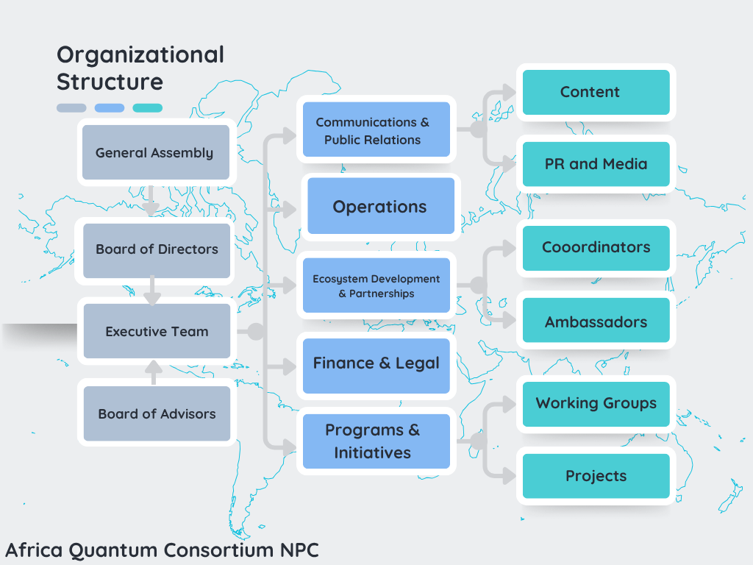


Slide 3
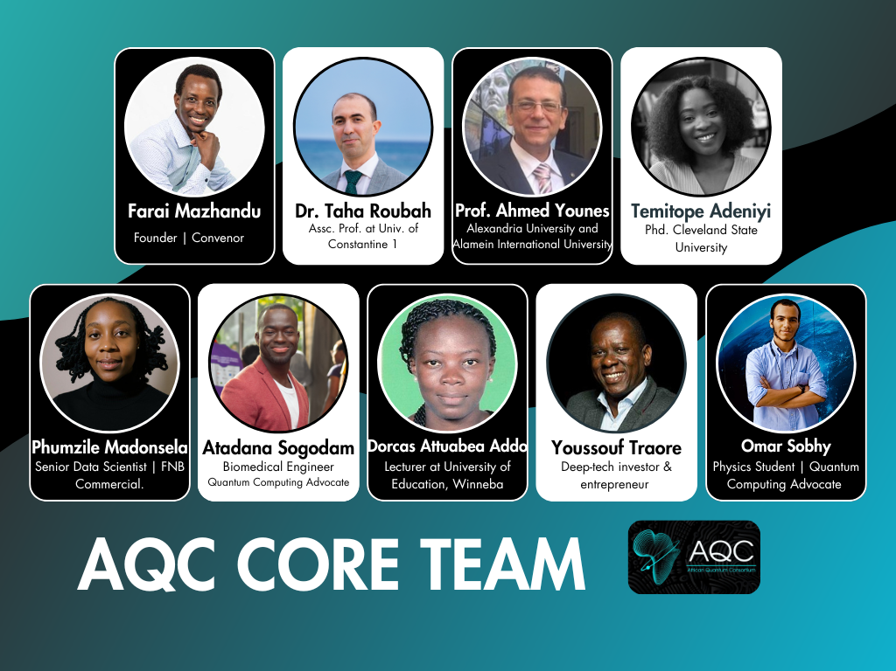
About the Africa Quantum Consortium (AQC)
Vision
To unite Africa's quantum leaders across talent, research, partnerships, industry, and policy to build a powerful quantum economy, rooted in our shared strengths and focused on Africa's sustainable future.
Mission
We drive Africa's quantum growth by connecting diverse leaders, leveraging local expertise, and forging trusted global partnerships. Our aim is clear: to deliver quantum-enabled solutions for sustainable development across the continent.

Slide 4
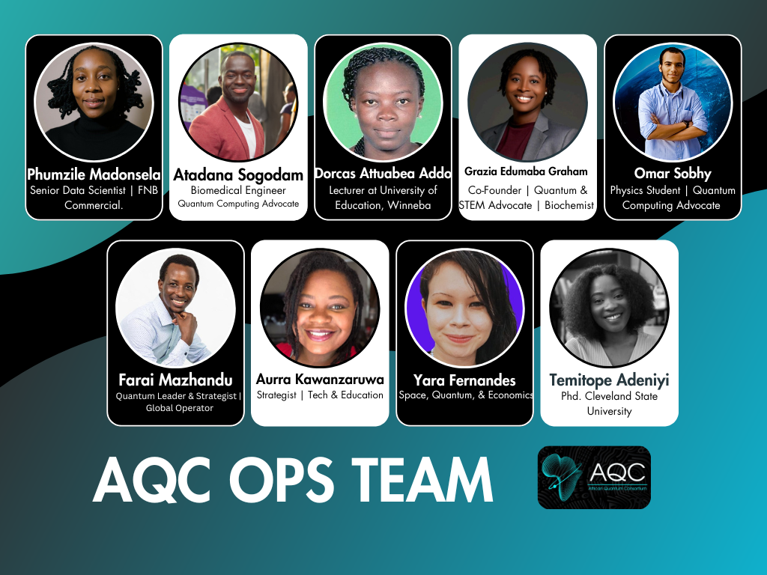
Africa Quantum Consortium Operations Team
These are the “doers and enablers” who turn strategy into action, making sure the AQC functions efficiently across Africa and globally.
Mandate:
Execution & coordination of AQC activities (events, programs, communications).
Operational support for committees, working groups, and special initiatives.
Tracking deliverables and ensuring volunteers or collaborators have clarity on tasks.
Acting as the engine behind the scenes to keep the consortium running smoothly.
DM POC - Atadana
africaquantumconsortium@gmail.com

Slide 5
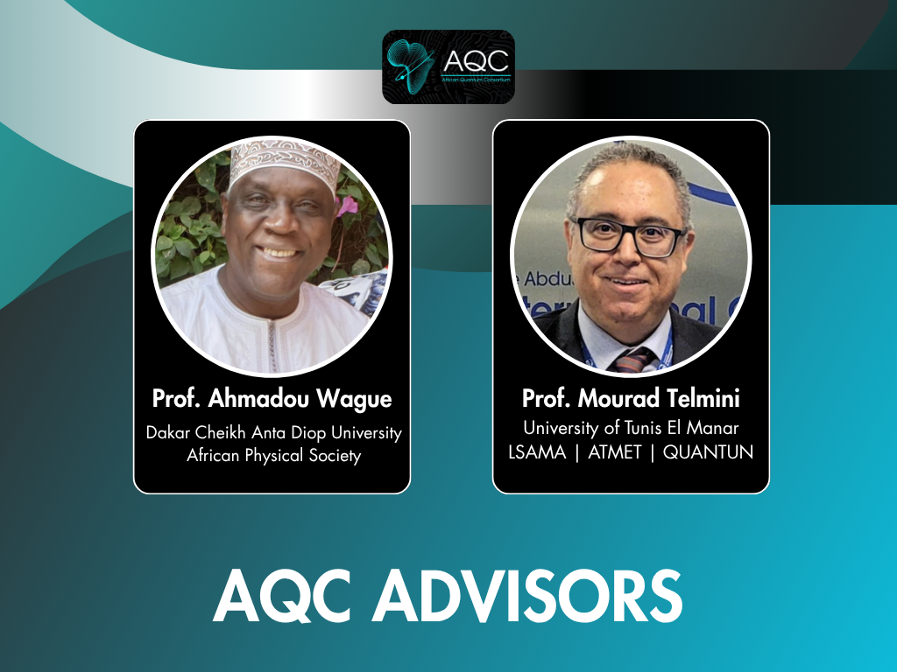
Africa Quantum Consortium Advisors

Slide 6


Turning IYQ2025 spotlight into a sustainable movement.
International Year of Quantum
Spotlight
Movement
Mechanism
Spotlight fades. Systems last.
Our job is to turn this moment into something permanent.
Notes:
The world is paying attention to Africa because of quantum this year. But attention doesn’t last forever. Our job is to turn this short moment of attention into something that keeps going, grows, and actually builds real tools and systems that last.

Slide 7

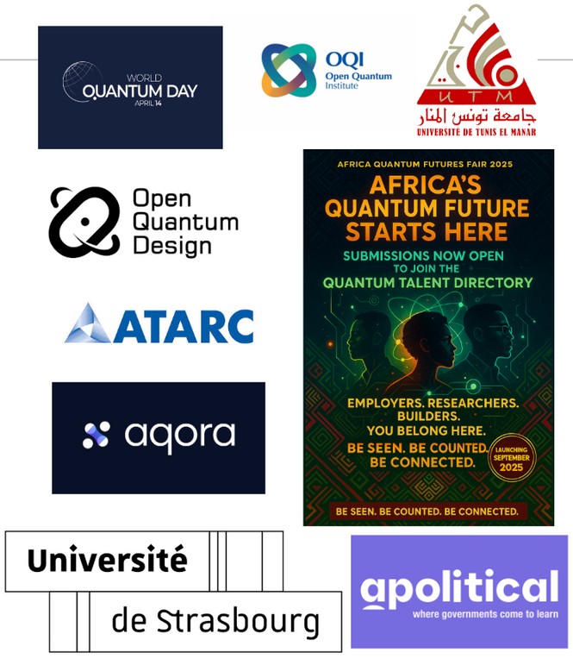










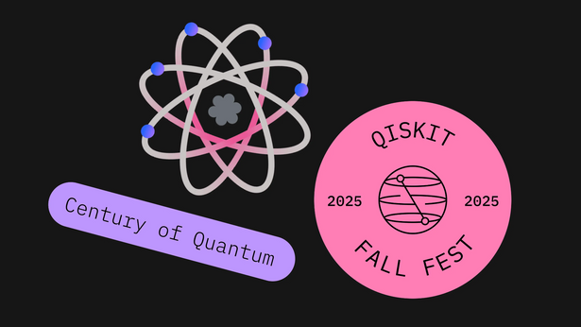

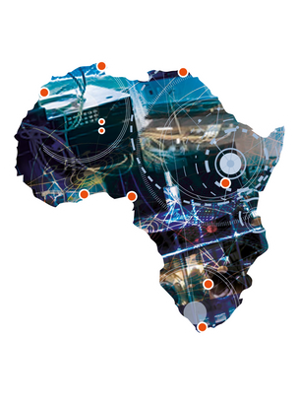





Quantum Milestones: AQC is the backbone. IYQ2025 is the moment to unite & lead
We are Africa’s quantum engine. Pan-African. Globally active.
01
Core Team & Advisory Board across 9 countries. 130+ hours of strategy + community-led content. 200+ leaders on Discord. 25,000+ reached. 1,700+ LinkedIn followers.
02
Three flagship roundtables (190+ leaders), featured in Nature Africa. Education WG finalizing “State of Quantum in Africa” whitepaper. Launching Africa’s first Quantum Career Fair and Hackathon, Quantum Circle (women-led), and Quantum Talent Dashboard & Directory.
03
Enabled 400+ students from 23 countries for IBM Qiskit Summer School. Backing African Graphene Flagship, ASFAP, and emerging startups.
Engagement with of WEF Peer Network, ATARC, IEC. Active in SXSW, Qiskit GSS 2025, IEEE Quantum Week, ATARC, WQD, FDCR, IEC, Quantum Africa 7, QWC25 and IYQ global events.
04
We are Africa’s quantum engine. Pan-African. Globally active.
Notes:
AQC connects research, talent, and policy — making Africa the easiest place to do quantum science.

Slide 8
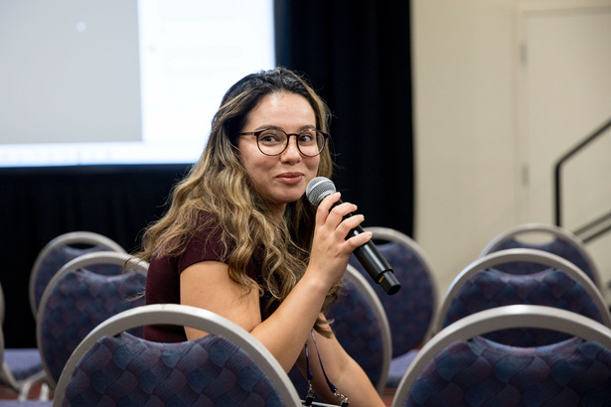
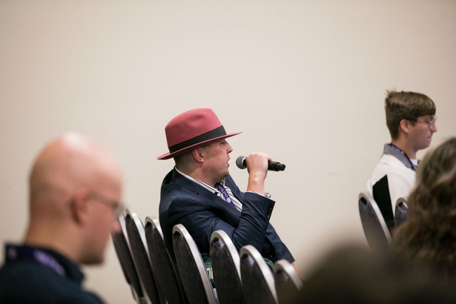
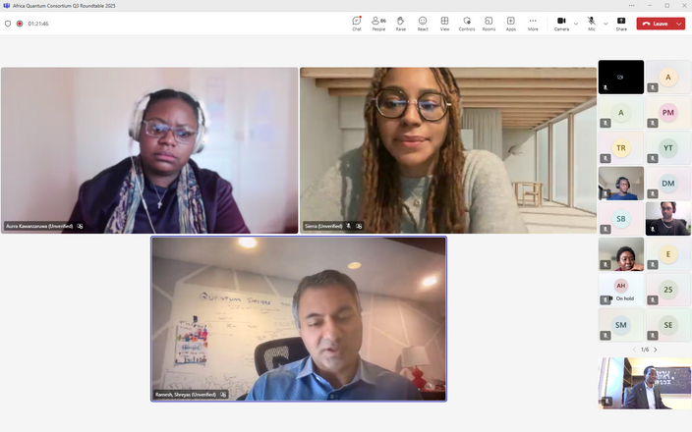
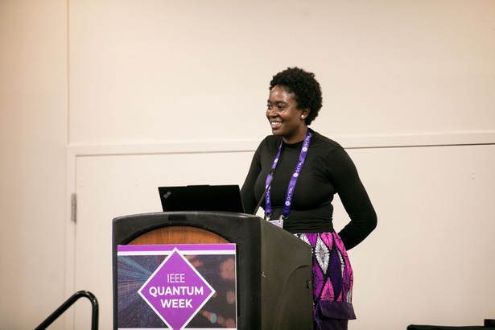
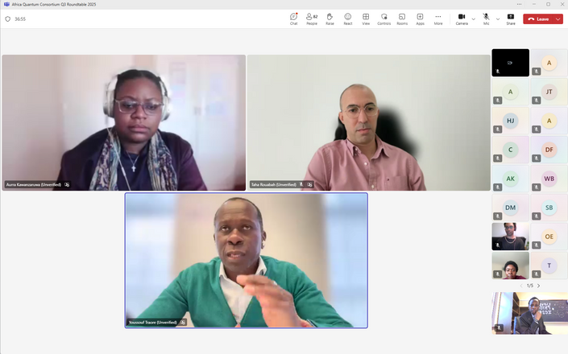
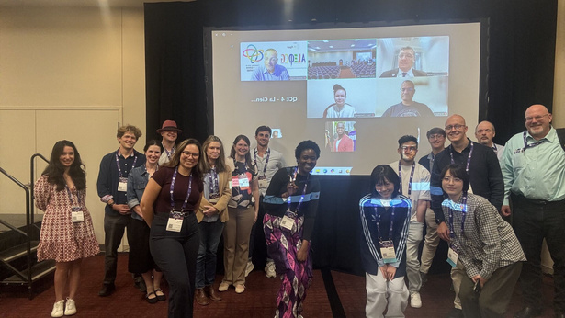
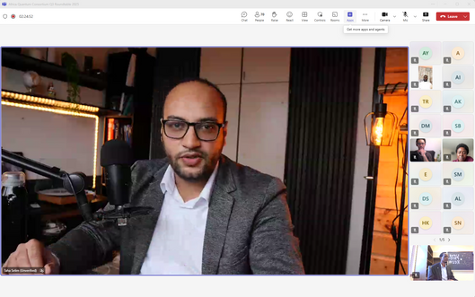
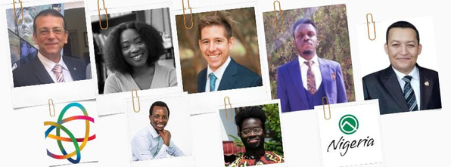
Africa’s Quantum Backbone: Roundtable Key Moves & Breakthroughs
⚙️ Next-Gen Search Algorithms
🤖 Quantum + AI = New Frontier:
01
Alexandria Group’s entanglement-driven upgrade to Grover’s algorithm boosts success rates and cuts inefficiency—pushing real-world quantum use cases like test suite minimization and set ops into sharper focus.
04
Early work integrating quantum with LLMs/SLMs shows disruptive potential in NLP and drug discovery. Still nascent, but watch this space.
Academia–Industry Gaps:
🔐 Quantum x Security
05
🤝 Seagate flagged trust, shared risk, and ROI clarity as missing links. Hackathons, targeted funding, and clear KPIs are key to unlocking true collaboration.
02
Quantum-enhanced signature and commitment protocols signal a new era of secure communication—quantum is no longer just about speed, it's reshaping cryptographic infrastructure.
🧠 QRAM Breakthrough
06
Constant-time (O(1)) QRAM changes the game—massive boost in speed and density, essential for quantum AI. Patent in hand. Cross-platform potential.
🖥️ Smarter Circuits, Fewer Gates
03
Reed-Muller algebra is unlocking leaner quantum circuits—crucial for near-term devices. Momentum is building toward scalable, multi-output quantum logic.
🌍 Grassroots Wins
07
Q Nigeria and similar movements are proving that quantum education at scale is possible. Local language, youth clubs, and policy advocacy are driving a real pipeline
Unify | Clarify | Influence | Fund

Slide 9
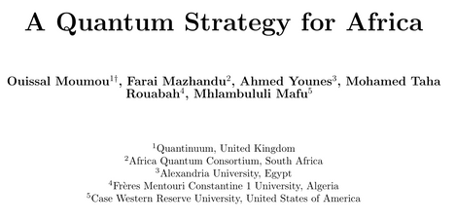
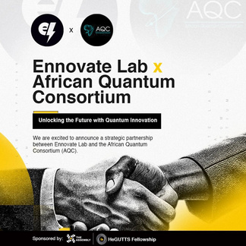
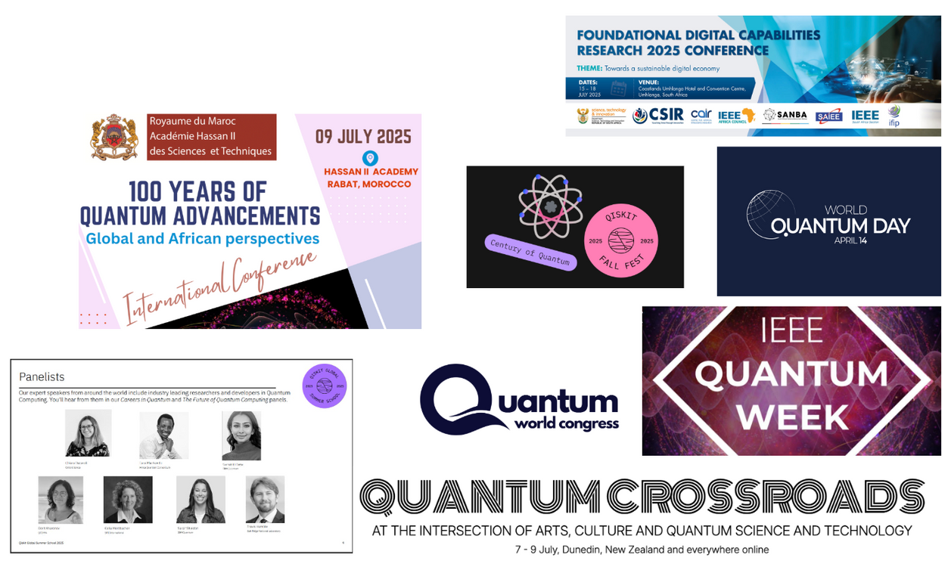
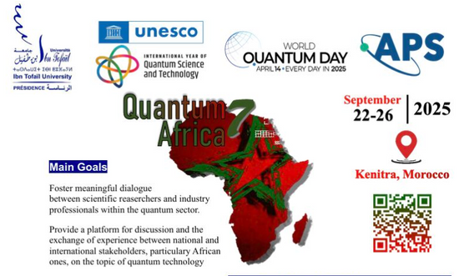
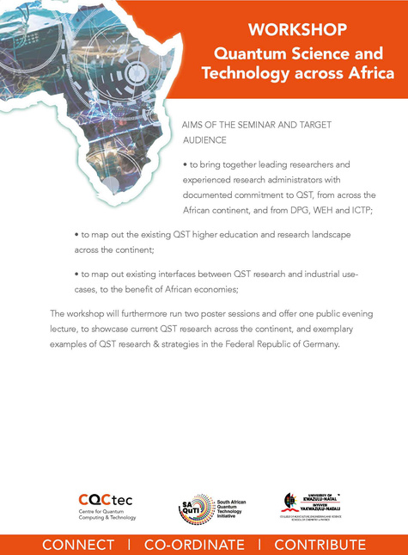
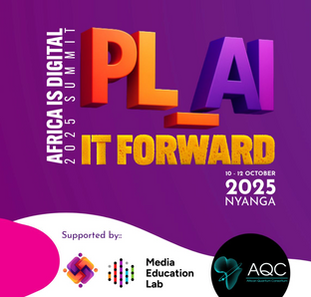
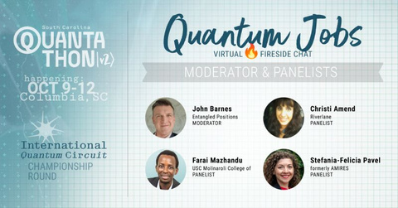
Africa’s Quantum Backbone: We Show Up. We Build. We Represent.
Unify | Clarify | Influence | Fund
Build a Power Network
Unites Africa’s quantum minds—research, policy, industry, education—into one force. 9+ country coordination. Bi-weekly execution. No silos. One mission.
Back African Innovation
We scale talent, shape policy, and champion Africa-led quantum solutions reshaping the global arena.
Plug Africa Into the World
AQC is the bridge—linking Africa to global standards, diaspora, and partners. From IYQ to WEF, we lead.
Why AQC?
🔗 25,000+ stakeholders reached during campaigns
🧠 Bi-weekly sessions + 2 active working groups
🌍 Active across WQD, IYQ, AUDA-NEPAD, WEF, IEC
🤝 Trusted convenor: academia, industry, gov, investors
Let’s Anchor Africa in the Quantum Future
Talent | Networks | Collaboration
Co-invest. Co-create. Collaborate. Now.

Slide 10
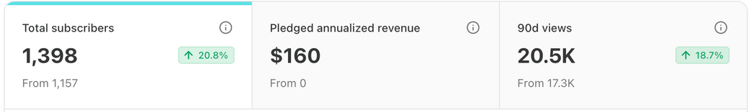
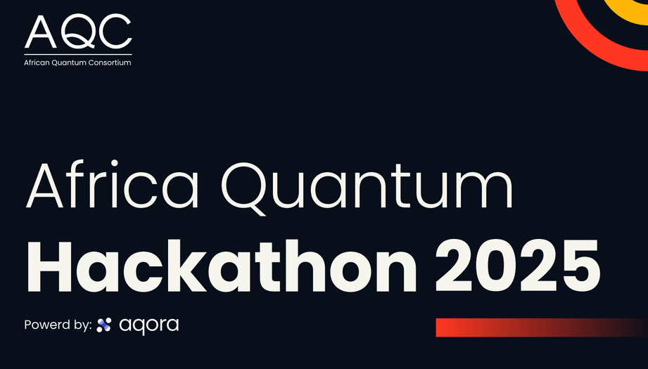

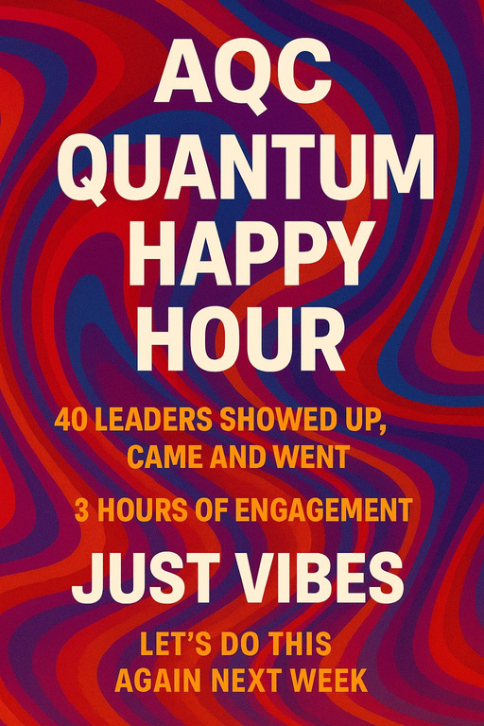
Building Africa's Quantum Ecosystem: From Zero to Critical Mass
Explosive Community Growth:
Rapid attraction and consolidation of Africa's quantum talent, growing our core community by over 220% on platforms like Discord and 145% on LinkedIn, 190+ engaged from 25+ countries across Africa. AQC voices heard at every major quantum stage - Quantum Crossroads, QWC, IEEE, QST Africa, Quantum Africa 7 etc.
Deepening Engagement, Not Just Numbers:
Active, not passive growth. Tripled specialized working groups (from 2 to 5) and grew our "Happy Hour" networking events by +400% (from <30 to 150+ attendees), proving strong community buy-in and network effects.
Translating Community into Strategic Assets:
We are converting this momentum into the foundational pillars of a sovereign ecosystem. Key initiatives launched include:
A National Coordinators program for continent-wide reach (8 countries locked in).
An Education Corps and QuantumCircle to build a diverse talent pipeline (Q4 Roundtable focused on Women in Quantum in Africa).
A centralized Talent Repository (50 CVs received) to map Africa's human capital in the field.
Thought leadership through ASFAP and SOQA.
Securing Strategic Partnerships:
Moving beyond community-building to formalize partnerships with key ecosystem enablers like Aqora (Pan-Africa Quantum Hackathon), AfPS, HKA Marketing and Ennovate Lab, validating our model and extending our reach.
Newsletter
Q3 Roundtable
Notes:
Access. Coordination. Inclusion. Innovation. Ownership.
These are the pillars of our scientific freedom.
The Pan-African Quantum Hackathon is our discovery lab — connecting students, researchers, and startups across borders... to learn quantum and build Africa’s solutions with it.
We are proposing the Africa Quantum Roundtable — a high-level IYQ 2025 side event to bring ministers, scientists, and innovators to one table. Help us make it happen.

Slide 11
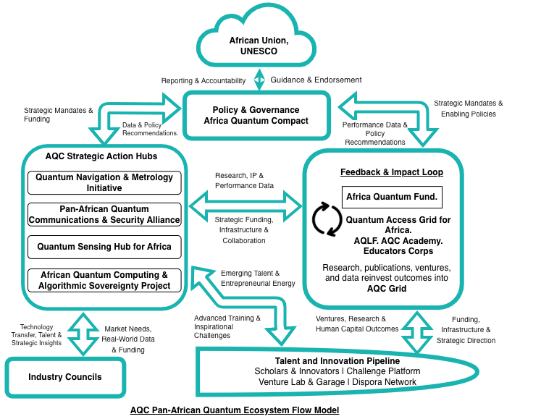
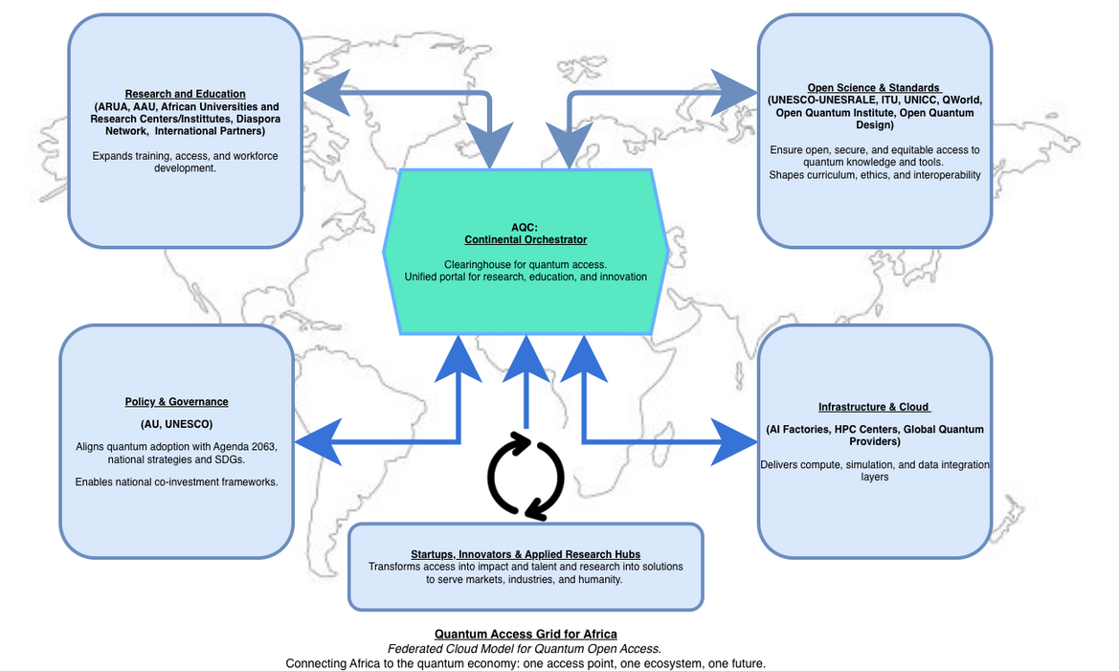
State of Quantum in Africa
Forging Local Strength. Driving Global Impact!
WWW.AFRICAQUANTUM.ORG
Logo design by CQTech, Algeria
Notes:
Inspired by the fact that Every time Africa builds in isolation, someone else patents our future.
Every time we wait, someone else defines the rules.
But every time we act together — we shift history.
UNITE
Pan-African network engine.
Connects leaders, ecosystems, and initiatives.
Ends fragmentation.
We move as one or we don’t move.
CLARIFY
Shared goals, language, and standards.
Defines the trajectory.
No duplication. No drift.
Execution becomes coherent.
INFLUENCE
Africa shapes the global quantum agenda.
From consumer to contributor to co-architect.
We don’t wait for seats; we build tables.
FUND
AQC mobilizes blended finance.
Catalytic capital, venture pathways, and national co-investment.
We build the economic engine that sustains the ecosystem.

Slide 12







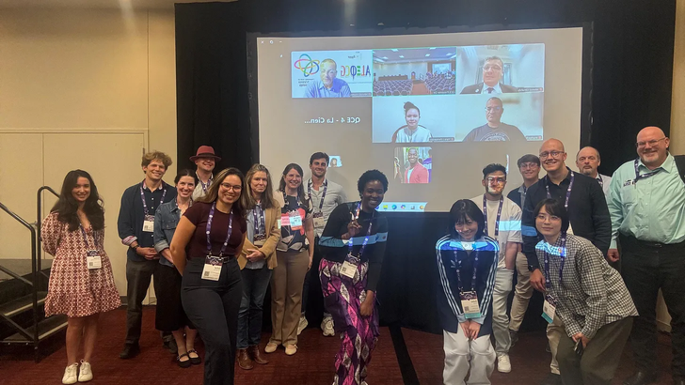
The Quantum Compact
US$100 million
over 15 years
Building the
Sovereign Stack ($40 Million)
A Governance of Trust
and Action ($10 Million)
Forging the Quantum
Generation
($20 Million)
Unleashing the
Innovation Engine
($30 Million)
The Quantum Homecoming
Fellowship
Notes:
Catalyst, Not the Whole Budget
This money is the spark that starts everything.
It reduces the risk so bigger partners can join in.
3–5x Multiplier
Every dollar here pulls in 3–5 more from companies, governments, and global funders.
Right-Sized Investment
This is what it takes to build the skills and tools needed for big problems like quantum-safe security.
Grow All Pillars Together
Talent, ideas, and infrastructure grow side by side.
Backed by a strong Africa + global coalition.
Pillar 1
Strategic Verticals (Near-Term Impact)
Quantum Sensing:
Focus on mineral exploration & precision agriculture.
Provides immediate competitive advantage for Africa's core economic sectors.
Post-Quantum Cryptography (PQC):
A defensive necessity to secure financial & governmental systems.
Establish a dedicated PQC Migration Task Force.
2. The Funding & Policy Engine
Africa Quantum Fund - Capital Structure:
Blended capital: Seek investment from DFIs, foundations, impact investors, & corporate VCs.
Partner with university policy/business schools to engage investors.
Pan-African Policy Engagement:
Engage key organizations: AfDB, African Union, AfCFTA, UNECA.
Use the urgent need for PQC as the immediate catalyst for government collaboration.
Leverage emerging discussions at the ITU to inform strategy.
3. The "Holy Grail": The Pan-African Quantum Computer
The ultimate key to true quantum sovereignty.
More than just access: It provides the independent capacity to build, experiment, and learn.
The engine for Africa's entire quantum ecosystem (driving synergies in sensing, communication, etc.).
Pillar 2
Quantum Educators Corps:
A scalable "train-the-trainer" model.
Top researchers train 200 Champion Teachers.
Champion Teachers then train thousands of peers, creating a sustainable, in-continent educator network.
The Africa-Qubit:
A low-cost, "lab-in-a-sphere" quantum education toolkit.
Investment, not expense: Manufacturing tendered to local African EdTech companies (e.g., Dext Technology, Ghana).
Builds domestic industry & circulates capital within the continent.
Radical Inclusivity:
Scale up dedicated programs like the Quantum Circle.
Provides targeted bootcamps, mentorship, and support for women, girls, and marginalized communities.
Ensures Africa's quantum future is built by all its people.
Pillar 3
Africa Quantum Fund:
A pan-African, evergreen seed & pre-seed fund.
Provides patient capital for deep tech startups solving African challenges.
Self-sustaining: Returns are recycled back into the fund.
The Quantum Foundry:
An intensive venture builder, not a standard accelerator.
Engineered specifically for the realities of the African market.
The "Quantum Mindset" Curriculum:
A bespoke philosophy translating quantum principles into resilient business strategy.
Superposition: Build for both local AND global markets.
Entanglement: Forge critical strategic alliances.
Decoherence Resilience: Design systems to withstand local "noise" (policy shocks, currency swings, etc.).
Core Principle:
A decolonized venture framework (not an imported Silicon Valley model).
Builds robust, context-aware companies.
Pillar 4
Kick-off: The Pan-African Quantum Leadership Summit
An act of radical transparency to publicly ratify the strategy.
Builds broad-based consensus and creates a public mandate.
Designed to make it politically untenable for gatekeepers to obstruct progress.
AQC as the Mission Secretariat
Formally established as the central coordinating body.
Federated Governance Board
Ensures shared ownership and accountability.
Includes representation from:
Four regional hubs
Funding partners
The African Union
Core Objective:
A robust and transparent framework for effective, unified action.
The "Quantum Multiplier Effect":
Every dollar is a catalyst with at least three impacts:
Achieves the primary quantum objective (e.g., training a teacher).
Stimulates a local enterprise (e.g., toolkit manufacturing).
Builds permanent institutional capacity (e.g., AQC governance).
A Closed-Loop Economic Model:
Designed for continental wealth creation.
A stark contrast to traditional aid models where capital flows back out.
The ultimate goal: an investment in Africa's long-term economic sovereignty.

Slide 13
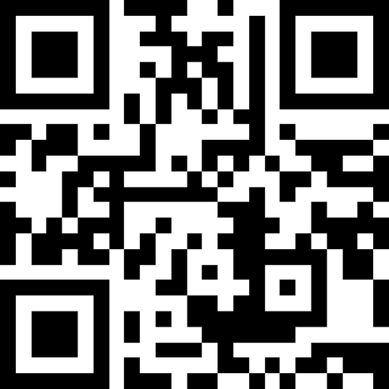

BUILD WITH US
UNIFY | CLARIFY | INFLUENCE | FUND
“It is within the possibility of science and technology to make even the Sahara bloom… Not one of us, working singly and individually, can attain the fullest development.”
www.africaquantum.org
Kwame Nkrumah, OAU Inaugural Address, 25 May 1963
collaborate@africaquantum.org
Let’s Secure Africa’s Quantum Future Together!
Notes:
A Call to Action:
The Coalition
This is an open invitation to build the future together, on new terms.
We call upon a unified front of:
Pan-African Leadership (AU, AfCFTA)
National Governments
Africa’s Scientific Community
The Global African Diaspora
Global Technology Partners
Visionary Capital (DFIs, Foundations, Impact Investors)
International Partners & Friends of Africa
Immediate Next Steps: From Blueprint to Action
A Strategic Partner Addendum has been prepared with tailored roadmaps for each stakeholder.
Examples of First Steps:
African Union: Formally recognize AQC; establish a pan-African quantum research fund.
Global Tech Firms: A co-investment framework for sovereign infrastructure and joint education.
African Universities: Create a unified talent pipeline; host critical research infrastructure.
A Question for History
History will ask what was done at this critical juncture.
The blueprint is before you. For those ready to build, a detailed plan awaits.
The choice is yours. The work begins now.
This is Africa’s moment — our decade to lead not in rhetoric, but in results.
The Africa Quantum Consortium is offering alignment.
Big Science. Big Goals. One Africa.
Pause. Smile.
Let’s move from vision to velocity - together. ⚡🌍

