Slide 1




Partial Melting of Hydrous Carbonated Fertile Peridotite at 3 GPa:
Role of water and CO₂ in Genesis of Komatiites
Sagnik Sarkar^{1,*}, Sujoy Ghosh¹, Dwijesh Ray², Jitendra K Dash¹
1. Dept of Geology & Geophysics, IIT Kharagpur
2. Physical Research Laboratory, Ahmedabad

Slide 2
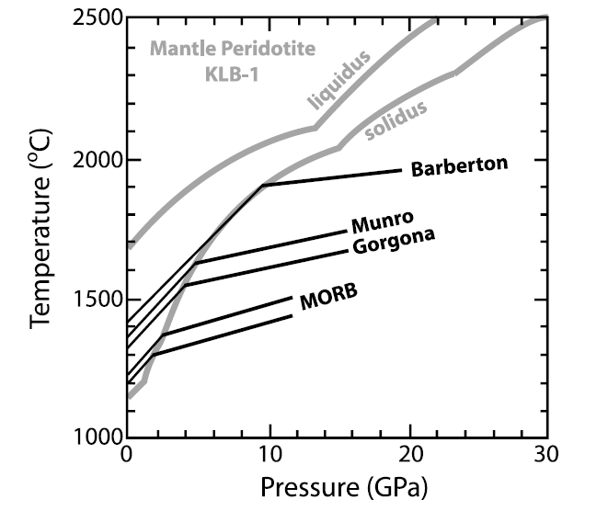
Does the Plume model explain the generation of komatiite?
[Grove & Parman, 2004; EPSL]
Modified from [Herzberg, 1992; J. Geophys. Res.]
Notes:
Komatiites are the hottest magma found on Earth. Highly magnesian ultramafic volcanic rocks formed mostly in Archean and Proterozoic. Here, this figure depicts the depths and temperatures of melting of komatiites in a plume setting, as inferred by Herzberg [1992]. Black lines show the pressure-temperature path experienced by a body of mantle as it ascends adiabatically towards the surface. The gray lines are the solidus and liquidus of KLB-1, a fertile mantle composition. In the plume model, the oldest komatiites (Barberton at 3.5 Ga) record the highest mantle potential temperatures, while late Archean (2.7 Ga) Munro komatiites and Cretaceous (88 Ma) Gorgona komatiites are formed in progressively cooler mantle plumes. However, this model turned into a question by discovery of high SiO2 komatiites from Commondale. Increasing depth of melting induces the melting to lower SiO2 content and higher MgO and FeO bearing phases due to the shift of invariant point to the SiO2 undersaturated side of basalt teterahedron. So for generation of komatiitic magma do they actually need to that much depth?

Slide 3
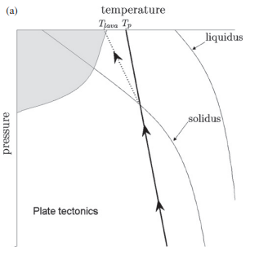
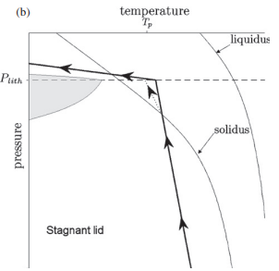
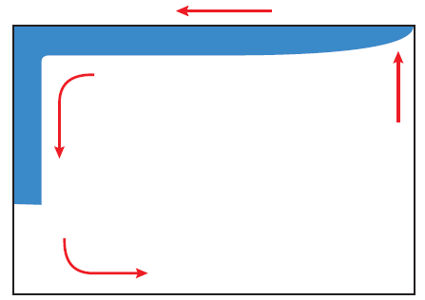
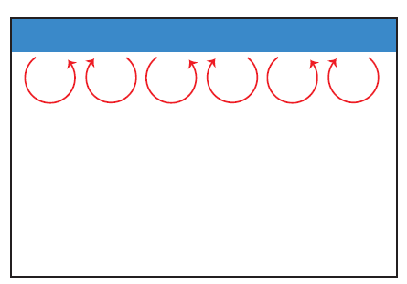
Early Earth plate tectonics
[Kite et al., 2009; TAJ]
Notes:
Mantle hydration hypothesis explained assuming hydration by plate subduction in early Earth [Korenga, 2008a] (b) Dehydration stiffening model affects the heat-flow scaling of early Earth explained by stagnant lid convection [Korenga, 2003]
A schematic diagram explains two models: plate tectonics vs. the stagnant lid. In the familiar plate tectonic model a plate subducts into the mantle and up here we are seeing a schematic structure of temperature – pressure of a planet where solidus and liquidus are drawn as a function of T and P of the planet. By the black line a piece of material is coming up through an adiabat. Once it crosses solidus during upwelling it starts melting. The gray area is where potentially we would have melt in the system. For the stagnant lid on the other hand a thick conductive lid which is not participating in the convection. So when a material comes up from the interior, it hits the conductive lid and cools off very rapidly, which eventually generates a lesser amount of melting. But we know that komatiite generates from higher degree of melting (atleast more that 40 %)

Slide 4
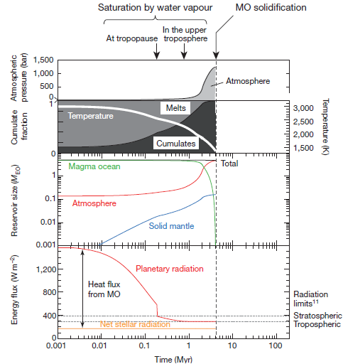
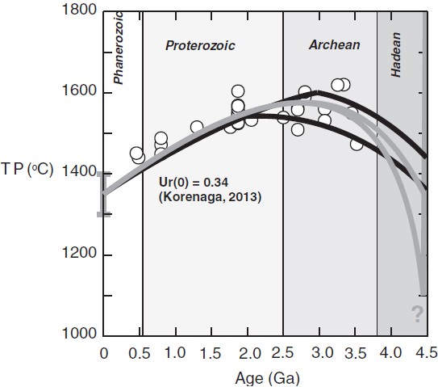
Volatiles in early Earth
[Herzberg, 2016; JOP]
[Hamano et al., 2013; Nature]
Notes:
Left figure explains the thermal history of the Earth. TP is the potential temperature for ambient mantle. White circles are mantle potential temperatures derived by petrological modeling of basalts from Herzberg et al., 2010. Black lines are solutions for stagnant lid and plate-tectonic models, respectively
(Korenaga, 2013); Ur(0) is the ratio of internal heat production to surface heat flux. Grey lines demonstrate the switchover from magma ocean cooling and crystallization to mantle heating by radioactive decay in the Hadean. There is great uncertainty in mantle potential temperature during the Hadean.
In the right diagram evolution of a planet explained which is located at 1 astronomical unit with an initial water mass of five times the current ocean mass on Earth. The grey dotted lines in the bottom panel indicate the radiation limits. At ,0.7 Myr, the planetary radiation reaches the tropospheric radiation limit. After that, the heat flux from the magma ocean (MO) becomes constant. This results in rapid solidification at ,4 Myr. If you look carefully build up of atmospheric reservoir was at it’s peak at 4 Myr old planet.
So, we can think that Hadean ingassing of volatiles like CO₂ and H₂O in the mantle could participate in the genesis of Archaean ultramafic volcanic rock formation

Slide 5
Previous experiments
Volatile-free melting of pyrolite (KR4003) at 3-7 GPa and 1500–1950 ºC [Walter, 1998; JOP]
Hydrous (1 wt.% , 2 wt.% and 5 wt.%) primitive upper mantle (CMAS-H₂O system) melting at 6.5 GPa and 1550–2050 ºC [Asahara et al.,1998; GRL]
Previous studies conducted hydrous experiments on picrites and komatiites, not peridotites [Parman et al.,1997; EPSL and Parman & Grove, 2004; JGR-Solid Earth]
Carbonated peridotite (PERC; Dasgupta et al.; 2007, JOP) can be a source of Alexo & Pyke hill komatiites [Herzberg, 2017; JOP]
Melting of COH–bearing spinel lherzolite in reduced condition (f_{O2}at IW–0.7 to IW–1.0), 2-6 GPa and 1450–1600 ºC [Liu et al., 2023; Chemical Geology]

Slide 6
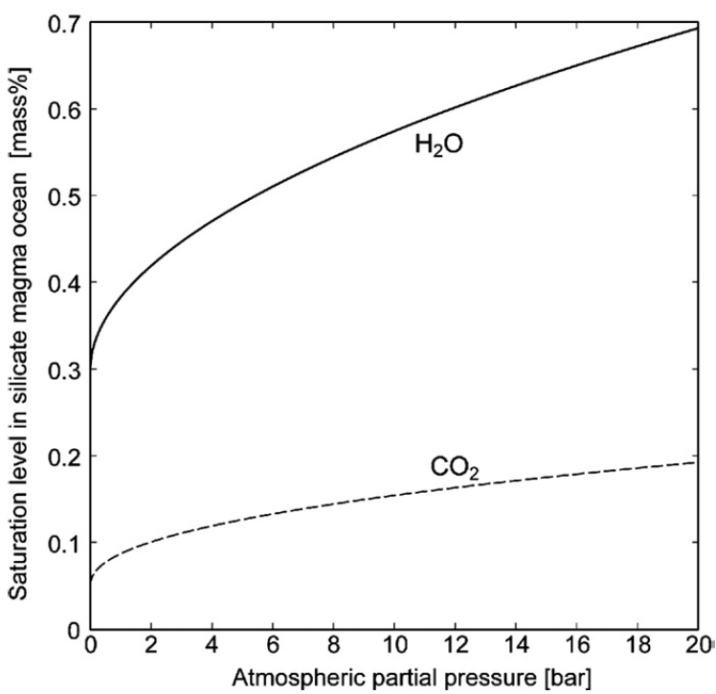
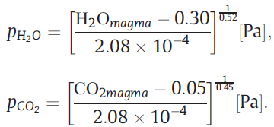
Solubility of CO₂ and H₂O during magma ocean solidification
[Elkins-Tanton, 2008; EPSL]
Notes:
Though at a given pressure, water will remain in silicate liquids in greater concentration than will carbon dioxide ,at a certain depth from the top surface of the magma ocean, both water and CO2 remain in solution in silicate melts at quantities greater than 10 wt.%. CO2 and water saturation data are taken from Papale (1997) and yield the following equations for the atmospheric partial pressures of water pH2O and carbon dioxide pCO2 [Pa] as a function of the magma ocean dissolved water H2O_{magma} and carbon dioxide CO2_{magma} [wt.%] contents.

Slide 7
Objectives
Partial melting experiment has been performed in hydrous carbonated peridotite system with variable proportion of volatiles (H₂O – 2.5 to 5 wt.%; CO₂ – 1 wt.%) at 3 GPa pressure and 1250 - 1575 ºC To understand the genesis of the SiO₂ rich komatiites from in shallow-pressure and temperature conditions
Influence of variable X_{H2O} [X_{H2O} = molar H₂O / (H₂O+CO₂)] and temperature in the partial melt composition
Study the evolution of melt composition in equilibrium with the liquidus phase by olivine fractionation and comparison with global cratonic komatiitic compositions

Slide 8
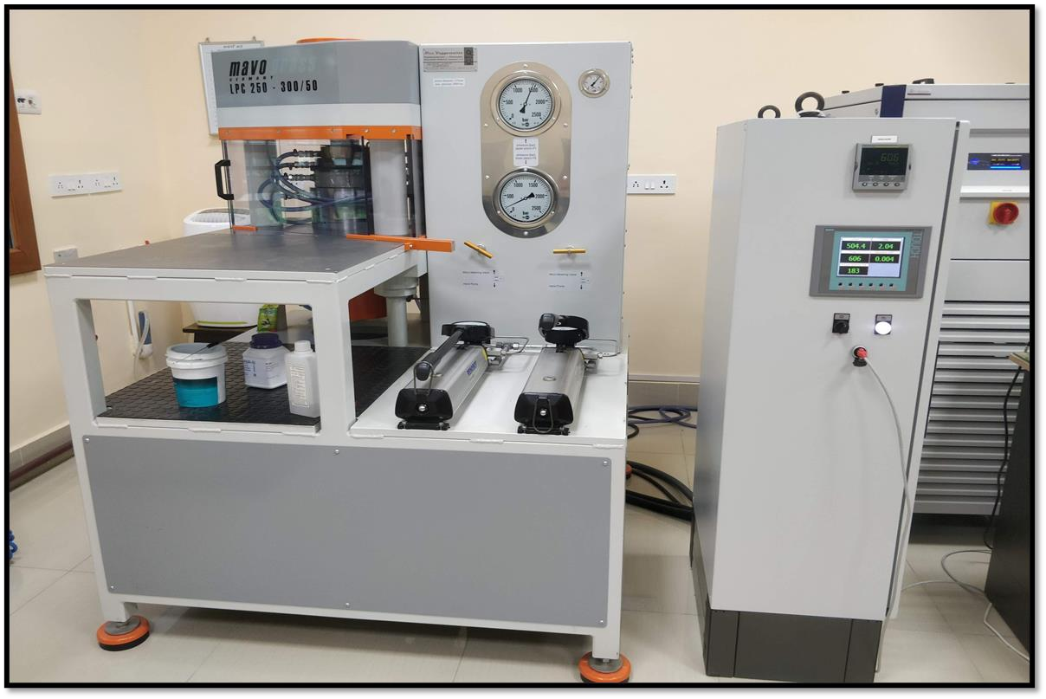
Experiments
2 starting materials P2.5 and P5 were prepared
  P2.5 = KLB-1 + 1 wt.% CO₂ + 2.5 wt.% H₂O
  P5 = KLB-1 + 1 wt.% CO₂ + 5 wt.% H₂O
Mg(OH)₂ was added as a source of H₂O
Pure natural calcite, magnesite, siderite, synthetic Na₂CO₃ and K₂CO₃ were added as a source of CO₂
½ inch Talc-Pyrex cell assembly was used
Experiments were conducted at 3 GPa and 1250 – 1575 ºC
  Static temperature experiments (SE; 1250 – 1350 ºC)
  Controlled temperature experiments (CTE; 1400 – 1575 ºC)
Major oxides from EPMA analysis suggest olivine, orthopyroxene, clinopyroxene, and melt were the resulting phases

Slide 9
Results
Starting material – P2.5 (X_{H2O} = 0.86)
CaO/Al₂O₃ of Interstitial quench – 1.88
Al/Ti of Interstitial melt - 6.27
Starting material – P5 (X_{H2O} = 0.86)
CaO/Al₂O₃ of quenched melt – 1.10
Al/Ti quenched melt - 12.86
Notes:
These are two representative backscattered electron images of our run products. Euhedral grain boundaries define equilibrium during experiments. In the left diagram inclusions in both olivine and orthopyroxenes suggest that they are forming simultaneously. Left diagram is a representation of liquidus phase crystallisation experiment where one olivine grain is in equilibrium with remaining partial melt. All the quenched laths are olivine in composition.

Slide 10
Comparison of major oxides with global komatiites and picrites
Notes:
Major oxide comparison of experimentally derived melt compositions in this study with komatiites and picrites from four different cratons. See the striking similarities between partial melt compositions derived from this study and komatiites reported from the West Australian Craton and Baltic Shield.

Slide 11
Classification of melt compositions
[Al₂O₃] = Al₂O₃ / (2/3 – MgO – FeO)
[TiO₂] = TiO₂ / (2/3 – MgO – FeO)
[Hanski, 1992; JOP]
Notes:
Left diagram is made based on the classification of ultramafic volcanic rocks based on Hanski, 1992. Here we can observe with increasing degree of melting melt composition shifts from picrite to Al depleted komatiite. Right diagram is the classification based on Komatitic melt composition, where ADK means Al depleted komatiites, AUK means Al undepleted and AEK is Al enriched komatiites. Here we can see that increasing the volatile component in the source komatiitic become Al depleted.

Slide 12
Olivine fractionation modelling
HCP-173
Notes:
MgO, CaO, and Al₂O₃ contents of komatiites from West Australian Craton and Baltic Shield compared with CO₂ and H₂O free normalized experimental melt composition 19173 of hydrous carbonated peridotite (P5). Melt composition of experiment no. 19173 has been plotted and 10-70 % olivine has been fractionated from that melt composition. At each 10% interval, evolved liquid compositions and olivine Mg# in equilibrium with them have been plotted. Here we can observe both of the cratonic komatiite compositions are matching greatly with the evolved melt compositions formed by 10 to 60% olivine fractionation.

Slide 13
Conclusions
Possibility of the influence of both of the volatiles CO₂ and H₂O in primary magma generation at Hadean upper mantle conditions, from which komatiitic and picritic lavas formed
Following the classification scheme of Hanski [1992], with increasing degree of melting partial melt compositions shift from picrite to aluminium-depleted komatiites
Liquid line of descent derived by 10 – 60 % olivine fractional crystallization modelling from the experimentally produced melt composition (19173) in equilibrium with liquidus phase is in concordance with komatiites reported from Baltic Shield and West Australian Craton
Thank you

Slide 14
Reference
Anderson, A. T. (1995). CO2 and the eruptibility of picrite and komatiite. Lithos, 34(1-3), 19-25.
Arndt, N., & Fowler, A. (2004). Textures in komatiites and variolitic basalts. The Precambrian Earth: tempos and events., 298-311.
Dasgupta, R., & Hirschmann, M. M. (2006). Melting in the Earth's deep upper mantle caused by carbon dioxide. Nature, 440(7084), 659-662.
Dasgupta, R., Hirschmann, M. M., & Smith, N. D. (2007). Partial melting experiments of peridotite+ CO2 at 3 GPa and genesis of alkalic ocean island basalts. Journal of Petrology, 48(11), 2093-2124.
Dasgupta, R., Mallik, A., Tsuno, K., Withers, A. C., Hirth, G., & Hirschmann, M. M. (2013). Carbon-dioxide-rich silicate melt in the Earth’s upper mantle. Nature, 493(7431), 211-215.
Frost, D. J., & McCammon, C. A. (2008). The redox state of Earth's mantle. Annu. Rev. Earth Planet. Sci., 36(1), 389-420.
Hamano, K., Abe, Y., & Genda, H. (2013). Emergence of two types of terrestrial planet on solidification of magma ocean. Nature, 497(7451), 607-610.
Hanski, E. J. (1992). Petrology of the Pechenga ferropicrites and cogenetic Ni-bearing gabbro-wehrlite intrusions, Kola Peninsula, Russia. Bulletin-Geological survey of Finland, (367).
Herzberg, C. (2016). Petrological evidence from komatiites for an early Earth carbon and water cycle. Journal of Petrology, 57(11-12), 2271-2288.
Korenaga J. 2003. Energetics of mantle convection and the fate of fossil heat. Geophys. Res. Lett. 30:1437
Korenaga, J. (2008). Urey ratio and the structure and evolution of Earth’s mantle. Reviews of Geophysics 46, RG2007.
Korenaga, J. (2013). Initiation and evolution of plate tectonics on Earth: theories and observations. Annual Review of Earth and Planetary Sciences 41, 117–151.
Lara, M., & Dasgupta, R. (2022). Carbon recycling efficiency in subduction zones constrained by the effects of H2O-CO2 fluids on partial melt compositions in the mantle wedge. Earth and Planetary Science Letters, 588, 117578.
Lara, M., & Dasgupta, R. (2023). Effects of H2O–CO2 fluids, temperature, and peridotite fertility on partial melting in mantle wedges and generation of primary arc basalts. Journal of Petrology, 64(7), egad047.
Tenner, T. J., Hirschmann, M. M., & Humayun, M. (2012). The effect of H2O on partial melting of garnet peridotite at 3.5 GPa. Geochemistry, Geophysics, Geosystems, 13(3).
Walter, M. J. (1998). Melting of garnet peridotite and the origin of komatiite and depleted lithosphere. Journal of petrology, 39(1), 29-60.
Whitney, D. L., & Evans, B. W. (2010). Abbreviations for names of rock-forming minerals. American mineralogist, 95(1), 185-187.

Slide 15
Starting mterial | SiO₂ | TiO₂ | Al₂O₃ | Cr₂O₃ | FeO* | MnO | MgO | CaO | Na₂O | K₂O | CO₂ | H₂O | total
MixKLB-1 | 44.54 | 0.21 | 3.7 | 0.23 | 8.08 | 0.14 | 39.3 | 3.52 | 0.29 | 0.01 | - | - | 100.01
P2.5 (X_{H2O} = 0.86) | 41.86 | 0.20 | 3.48 | 0.21 | 7.99 | 0.13 | 38.86 | 3.48 | 0.29 | 0.01 | 1.00 | 2.50 | 100.00
P5 (X_{H2O} = 0.92) | 40.77 | 0.19 | 3.39 | 0.20 | 7.78 | 0.13 | 37.85 | 3.39 | 0.28 | 0.01 | 1.00 | 5.00 | 100.00
Run # | Starting material | T_{initial} (℃) | Ramp rate (℃/h) | T_{final} (°C) | Duration (h) | Phases
CTE (Controlled temperature experiments)
19119 | P2.5 | 1600 | 66.6 | 1400 | 12 | Ol + Opx + Cpx + Melt
19139 | P2.5 | 1650 | 40.2 | 1450 | 12 | Ol + Opx + Cpx + Melt
19176 | P2.5 | 1575 | 25 | 1475 | 6 | Ol + Opx + Melt
19175 | P2.5 | 1650 | 30 | 1500 | 6 | Ol + Opx + Melt
19174 | P5 | 1550 | 39.6 | 1350 | 16 | Ol + Opx + Melt
19144 | P5 | 1600 | 39 | 1400 | 12 | Ol + Opx + Melt
19156 | P5 | 1625 | 33.6 | 1450 | 12 | Ol + Opx + Melt
19165 | P5 | 1600 | 51 | 1500 | 16 | Ol + Opx + Melt
19173 | P5 | 1650 | 19.8 | 1575 | 6 | Ol (39) + Melt (61)
SE (Static temperature experiments)
19185 | P2.5 | - | - | 1250 | 96 | Ol (59) + Opx (17) + Melt (24)
19190 | P2.5 | - | - | 1300 | 50 | Ol (65) + Opx (04) + Melt (31)
19210 | P2.5 | - | - | 1350 | 30 | Ol + Opx + Melt
19180 | P5 | - | - | 1250 | 96 | Ol (45) + Opx (37) + Melt (18)
19179 | P5 | - | - | 1300 | 55 | Ol (50) + Opx (24) + Melt (26)
19178 | P5 | - | - | 1350 | 36 | Ol (50) + Opx (9) + Melt (41)

Slide 16
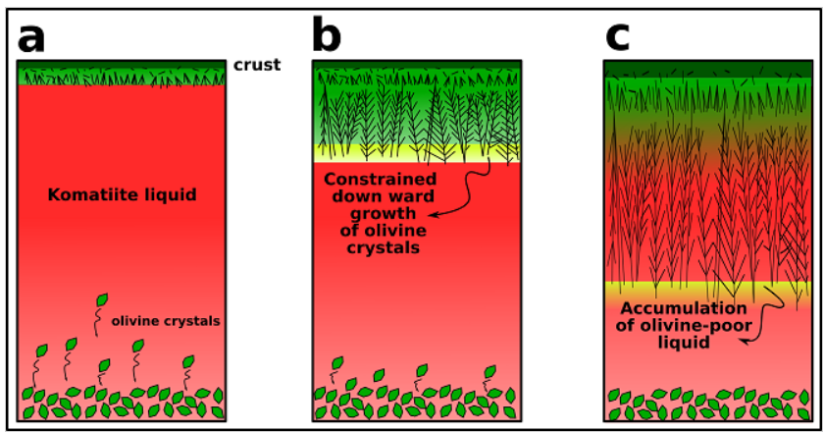
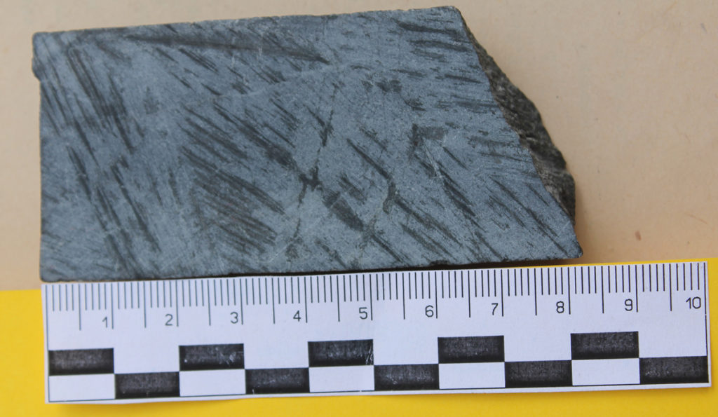
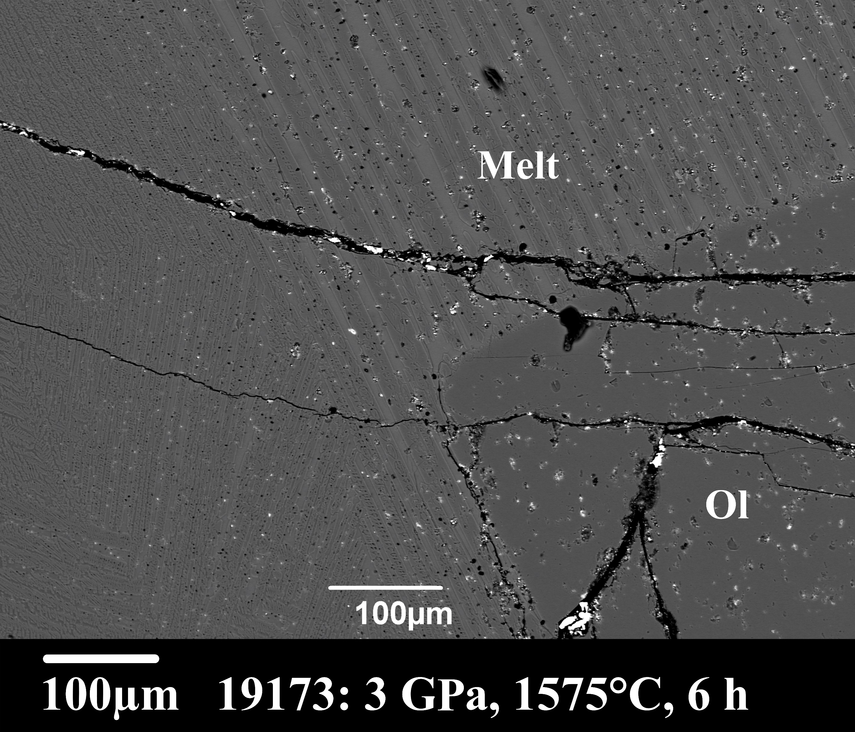
Komatiites and their formation
Komatiites are hottest magma found on Earth
Highly magnesian (18% < MgO < 32%) ultramafic volcanic rocks
Fig.2: Spinifex texture of a komatiite from Kosivtsivsky greenstone belt (~3Ga), Preazovian megablock, Ukrainian Shield, Ukraine. Author: Gogolev Konstantin
Fig.1 [Arndt and Fowler, 2004]
Fig. 3: Experimentally derived Komatiite
Age of occurrence – Mostly found in Archean and early Proterozoic; constituting 25% volcanic sequences [ Puchtel & Arndt, 2025]

