Slide 1



LABORATOIRE ELECTROCHIMIE CORROSION METALLURGIE CHIMIE MINERALE
LECMCM
Prof. R. BAGTACHE
Laboratory of Electrochemistry-Corrosion, Metallurgy and Inorganic Chemistry, Faculty of Chemistry,
(USTHB), BP 32, 16111, Algiers, Algeria

Slide 2
Synthesis and Characterization of Aluminophosphate. Application to photodegradation of Methyl Violet Dye

Slide 3
Outline
Introduction
Synthesis
Application
Results and discussion
Conclusion

Slide 4
Introduction

Slide 5
Introduction
Porous material possess internal voids or pores, allowing for internal distributions that can be tailored to improve overall performance, such as mechanical, thermal, and acoustic properties. These properties are enhanced through designs like functionally graded porosity, which involves varying pore size and density along one or more directions.

Slide 6
Introduction
Porous materials offer great potential due to their properties such as high specific surface area, low density, and high specific strength. Their structure, characterized by continuous and interconnected porosity, facilitates the transport of electrons, ions, and particles.
The chemical compositions of porous materials are well-controlled and diversified and include metals, ceramics, and carbon-based materials. As a result, the development of porous materials is quickly gaining significance. An increasing number of researchers are working to conduct fundamental research on various applications from different perspectives

Slide 7
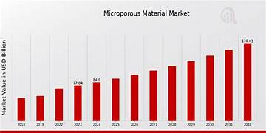
Introduction

Slide 8
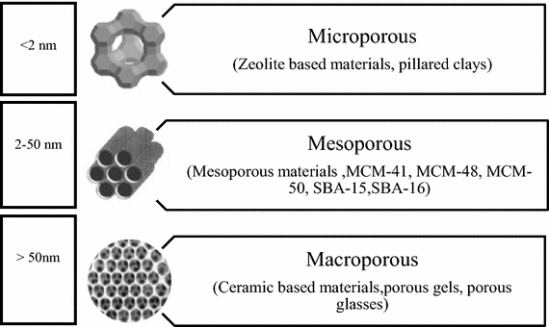
Introduction
Porous
materials

Slide 9
Introduction
At the onset of 1980’s, the Union Carbide laboratories reported a new family of molecular sieves based on aluminophosphates (AlPO-n).
The aluminophosphates (AlPO-n) are microporous inorganic solids with structural and chemical properties similar to those of zeolites, which are naturally occurring and synthetic aluminosilicates.
They are composed of Al and P atoms arranged in a neutral structure. Their crystalline framework, which is built from alternating AlO₄ and PO₄ tetrahedral units and their general formula can be expressed as [(AlO₂)_{x}·(PO₂)_{x}]·yH₂O. These structures can be similar or different to zeolites.

Slide 10
Introduction
In this context, we report the synthesis and its physical characterization of potassium aluminium fluoride phosphate KAlPO₄F, that was further applied in the removal of Methyl Violet.

Slide 11
Applications of AlPO-n
Adsorption and Gas Separation
Catalysis
Ex: with Ti can act as catalysts
Thermal Energy Storage
Some microporous AlPOs are used for water-based thermochemical energy storage (sorption heat storage) — they adsorb and desorb water
Mechanical/ Structural Uses
Their micropores, AlPOs can selectively adsorb gases. Narrow-pore AlPOs (8-ring) are studied for CO₂ separation
Their unusual mechanical behavior (like negative linear compressibility) might be exploited in materials science

Slide 12
SYNTHESIS PROCEDURE
Distilled water
Phosphoric Acid
Aluminium Source
Hydrothermal route
at 180 °C, 3 days
A remineralizing agent
Crystallization
Filtration
Washing and Drying
Characterization
AlKPO₄F

Slide 13
Characterization
XRD pattern
SEM image
Thermal analysis
UV-vis refelectance diffuse

Slide 14
Application

Slide 15
Photocatalysis
Application
Photocatalysis is a physicochemical process that requires two components :
A catalyst and light
Its principle consists of the action of a catalyst, which must be a semiconductor activated by a natural or artificial light source.

Slide 16
Application
Application of photocatalysis
Others
Destruction of
Micro-organisms
  Elimination of atmospheric nitrogen oxides
  Odor elimination
  Self-cleaning surface coatings
  Hydrogen or oxygen production
  Synthesis of organic compounds
  Cancer treatment
  Insecticides
  Pesticides
  Dyes
  Bacteria
  Fungi
  Viruses
Degradation of various pollutants
Air purification

Slide 17
Application
Advantages of photocatalysis
Possibility of total mineralization: formation of H₂O and CO₂
Low energy consumption
Operates at room temperature
Effective at low pollutant concentrations
Catalysts in various physical forms
Page 15

Slide 18
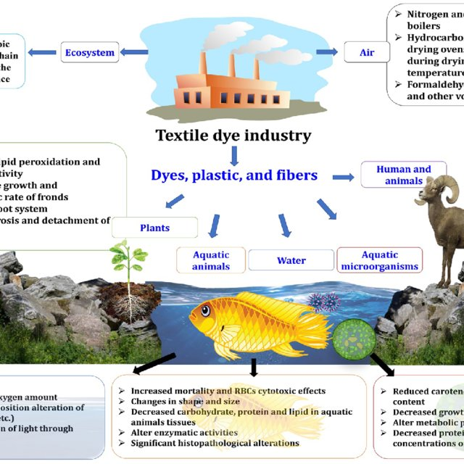
Application

Slide 19
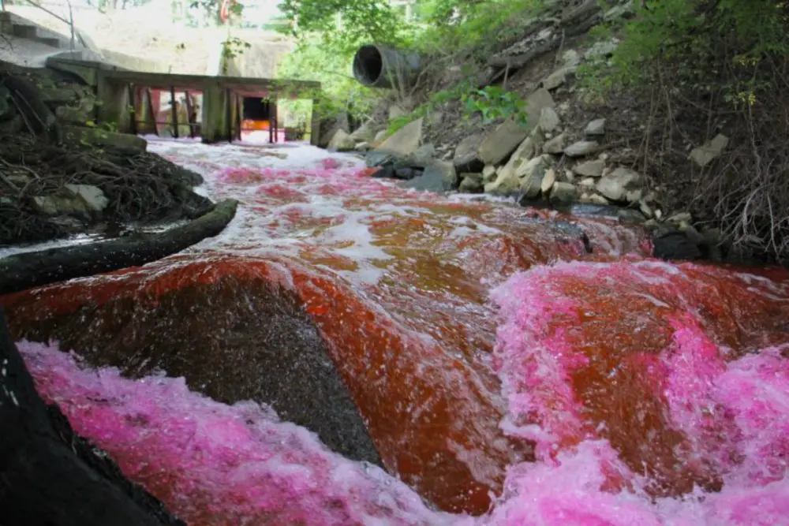
Application

Slide 20
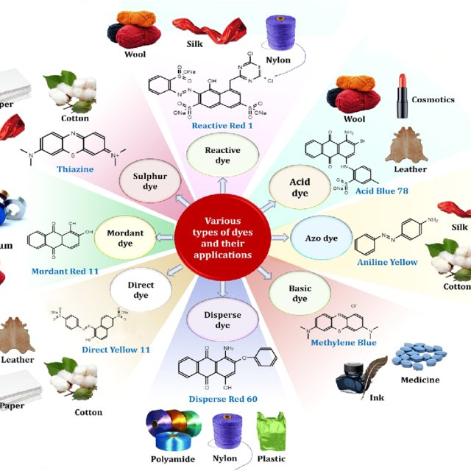
Application

Slide 21
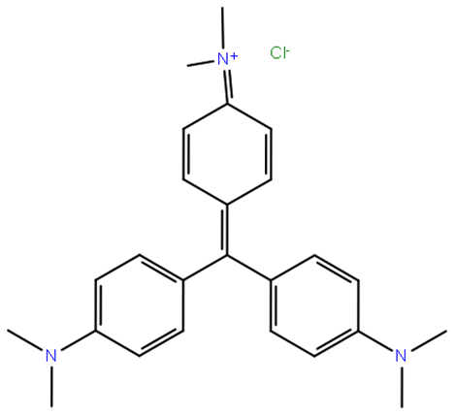
Application
λ_{max} (= 582 nm)
Chemical formula of Methyl Violet (MV): C₂₅H₃₀ClN₃

Slide 22
Results and discussion

Slide 23
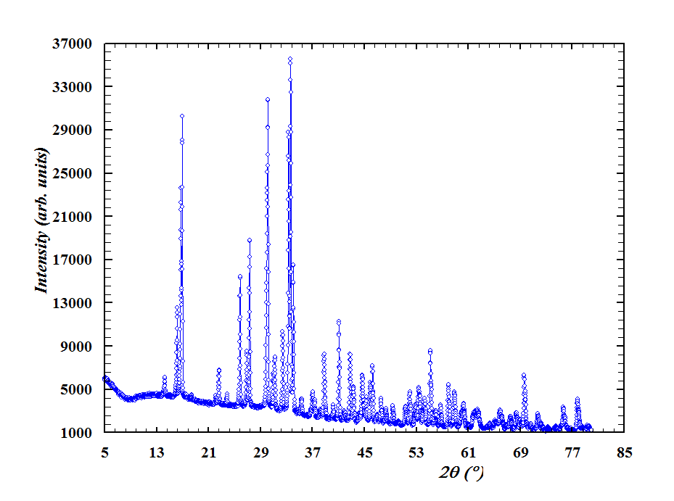
Space Group: Pnna, with the lattice constants:
a=12.612(5) Å, b=10.172(3) Å, c=6.205(0) Å
XRD pattern prepared by hydrothermal route.

Slide 24
Projection of the crystal structure along [001] axis

Slide 25
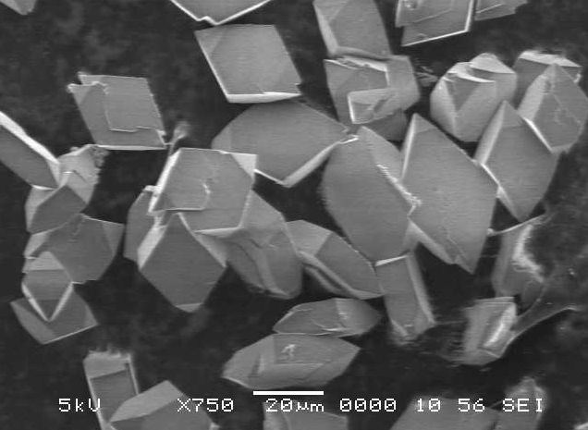
SEM image

Slide 26
Thermal analysis

Slide 27
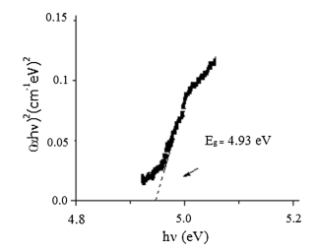
(αhν)^{m} = constant × (hν - E_{g})
Where hν (eV) is the incident photon energy and α (cm⁻¹) the optical absorption coefficient
UV–Visible diffuse reflectance

Slide 28
Results : application
The remaining MV concentration was evaluated by measuring the absorbance at λ_{max} (= 582 nm). The adsorbed amount was calculated from the following expressions:
RD % = [(C₀-C_{t}) / C₀] *100
RD%: percentage of degradation
C₀ : the initial concentration of the dye
C_{t} : the concentration at time t

Slide 29
Application
Changes in the absorption spectrum of MV under sunlight

Slide 30
Conclusion
The aim of this work is the search for crystalline materials, of the aluminophosphate type.
The phase was isolated in crystal form. The oxofluorophosphate KAlPO₄F, a novel photocatalyst, was prepared by hydrothermal route at 180 °C.
Through this study, we have tried to get as close as possible to the structural framework by characterizing it using several other techniques, primarily:
X-ray powder diffraction
SEM/EDX
Thermal analysis
UV-visible diffuse reflectance spectroscopy

Slide 31
Conclusion
The X-ray diffraction, revealed an orthorhombic system with the lattice constants: a=12.612(5) Å, b=10.172(3) Å, c=6.205(0) Å.
The structure is made up of AlF₂O₄ octahedra and PO₄ tetrahedra where the K⁺ ions are
disordered.
SEM images shows crystals with hexagonal sections.
Thermal analysis shows that our phosphate is thermally stable up to 300 °C.
The direct optical transition of 4.93 eV, determined from the diffuse reflectance, is assigned to the charge transfer F⁻ : 2p → K⁺ : 4 s.
The photocatalytic performance was successfully tested through the degradation under solar light of methyl violet (MV), a hazardous and persistent dye. A total discoloration was obtained after 5 h

Slide 32
Thank you for your attention

