Slide 1
Modelling the infectiousness of Influenza virus, mycobacterium tuberculosis and Covid-sars.
Emmanuel Igumbor*, Mbolahasina Ralijaona and Simon Connell
Department of Mechanical Engineering Science, University of Johannesburg, Auckland Park Johannesburg, South Africa
Kennedy Otwombe and Neil Martinson
Perinatal HIV Research Unit Chris Hani Baragwanath Hospital Diepkloof Soweto, South Africa
*elgumuk@gmail.com

Slide 2
Content
Introduction
    Rationale and Objective
      Research gaps
      Aims
Computational model
Results
    Mathematical formalism and modelling
    The infectiousness of droplets due to
        Evaporation, irradiance
        Evaporation and irradiance concurrently
    Validation of results
        Mycobacteria tuberculosis
        Influenza virus
        Covid-SARS
    Summary

Slide 3
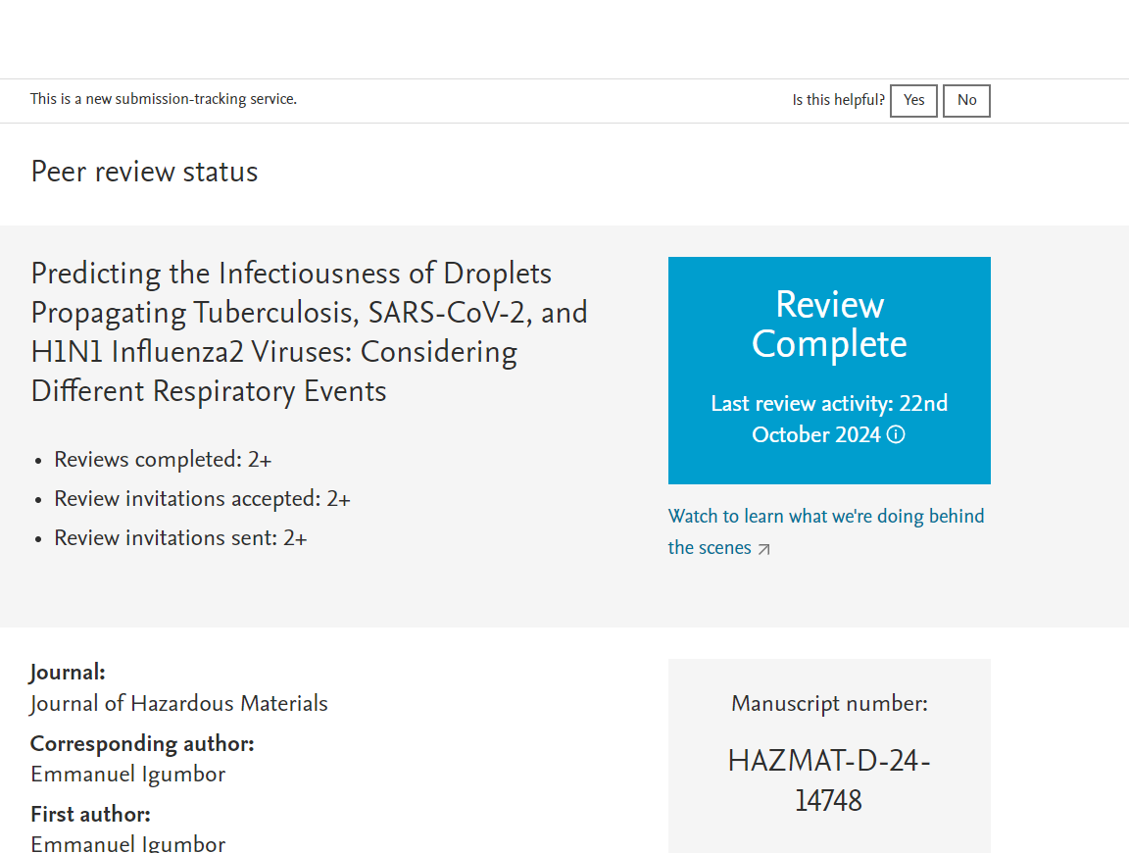
Introduction
Rationale and Objective
Infectious microorganisms are dangerous to the human organs.
    Coronavirus.
    Mycobacterium tuberculosis
    H1N1 influenza virus
Coronaviruses are widespread in humans and several other vertebrates and cause respiratory, enteric, hepatic, and neurologic diseases.
Microorganisms exist as droplets in the range of 1-200 µm
Major deficiency is lack of or relatively little information on how to mitigate harmful microbial species a confined public domain.
    The virus spread worldwide into a state of pandemic with high morbidity and mortality.
Many studies have attempted to identify mitigation measures to
    understand its dynamics, evolution and control and
    reduce its infectiousness using different medical and engineering interventions
There is limited modeling data that shows infectiousness of microorganisms in a confined environment, when subjected to ultra-violet germicidal irradiation (UVGI) coupled with evaporation.

Slide 4
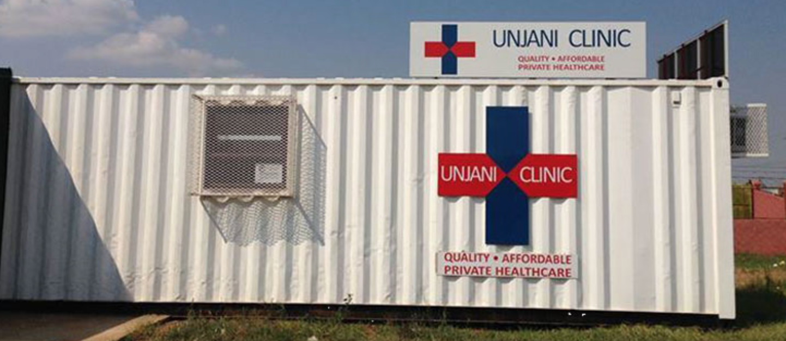

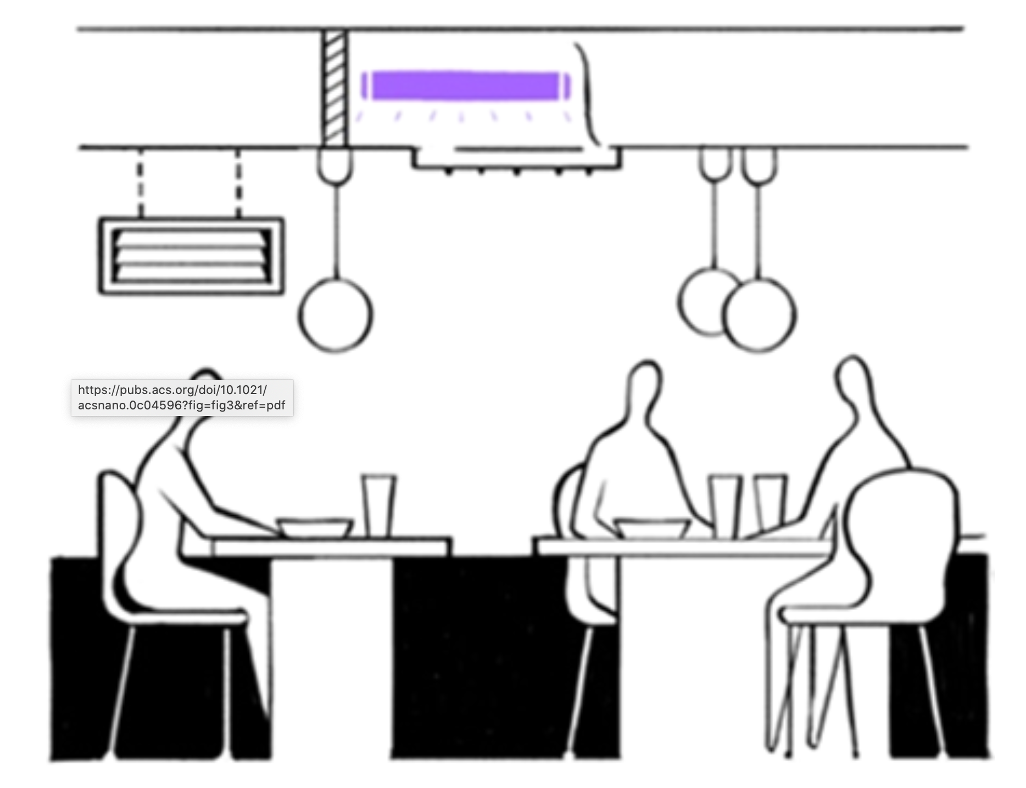
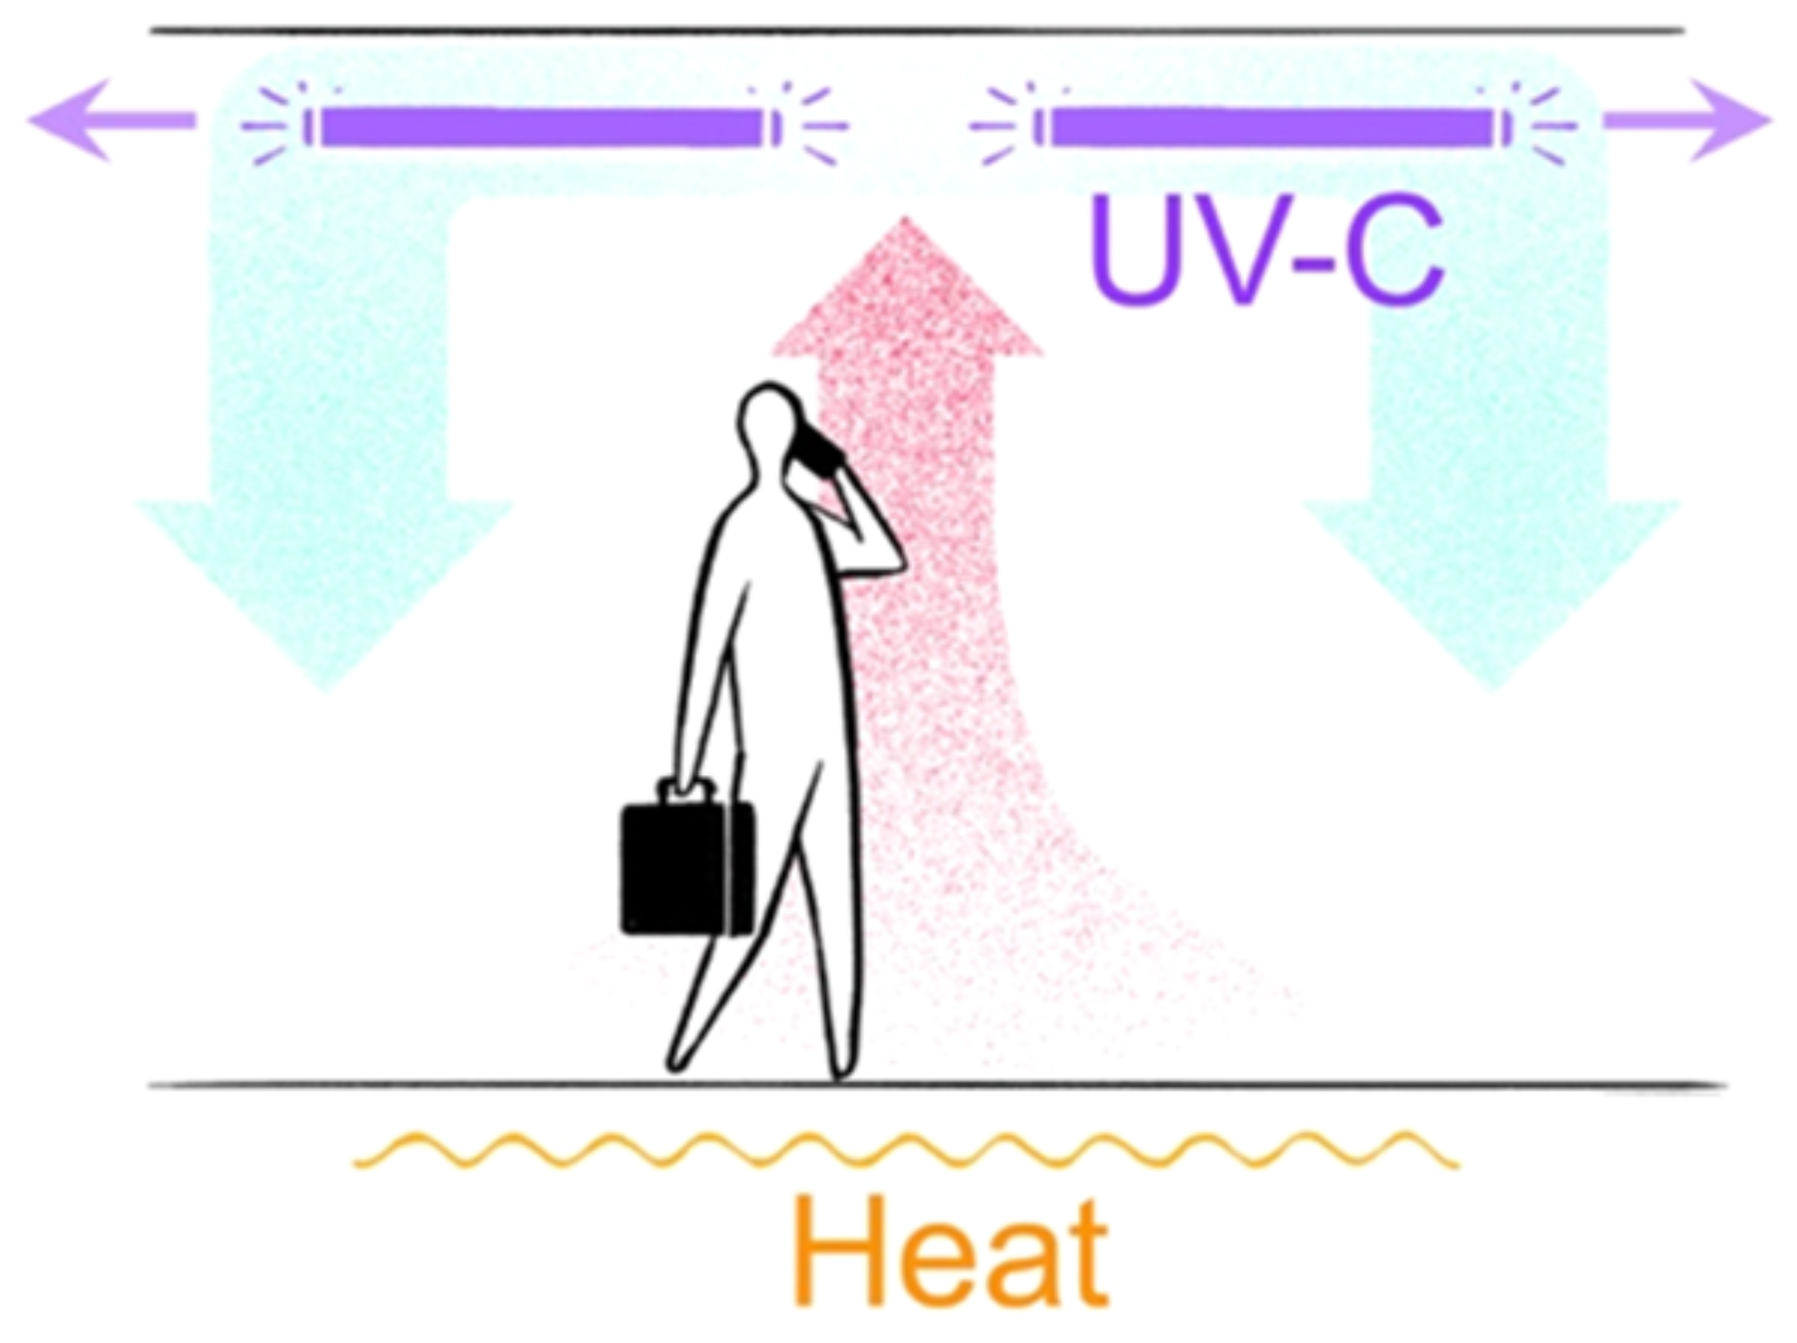
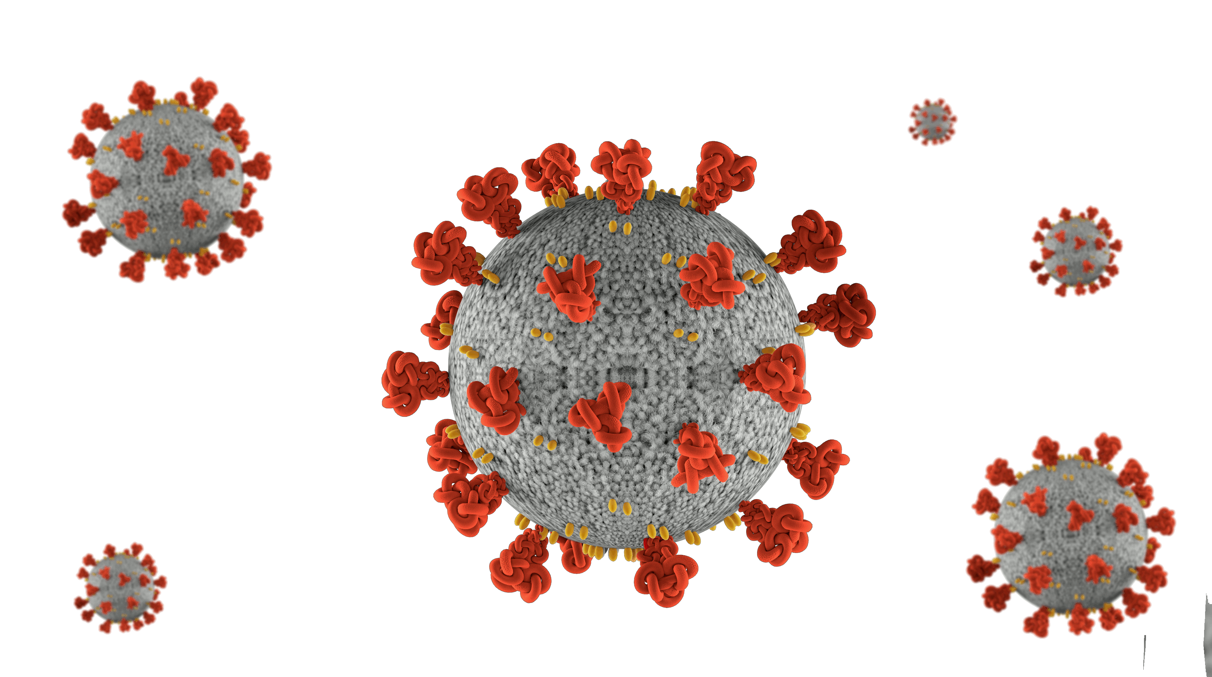
Introduction
Objectives and rationale
Studies show that a UV-C wave with a wavelength of 254 nm can effectively deactivate (sterilize) biological contaminants e.g. Coronavirus, Mycobacterium tuberculosis, H1N1 influenza virus...
In this study we presented the results of microorganisms’ infectiousness decay when exposed to the UVGI coupled with evaporation model in public domains: Clinics, Taxi, ambulance
UV-C (nm) | Pathogen | F₀ (J/m²)
222 | H1N1 | 15
254 | MHV | 6.6
254 | RNA-DNA viruses | 3 - 12
Air Purification Tunnel
v
A_{d}
L_{d}

Slide 5
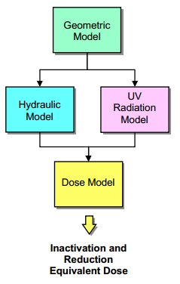
Computational method
Flow diagram of modelling approach
CFD approached as implemented in FLUENT
A geometric model-UVGI is developed.
The developed model was discretized (meshed), appropriate boundary conditions applied for simulation
The geometry is used to model the UV dose required to inactivate viruses.
The hydraulic results and the UV radiation fields are used to calculate the dose needed to inactivate droplets moving through the system.
The distribution of droplets doses was then used to calculate an effective inactivation and reduction equivalent dose
Ho, Clifford K., et al. Modeling UV Disinfection using Integrated Computational Fluid Dynamics and Discrete Ordinates Radiation Models. No. SAND2008-7956C. Sandia National Lab.(SNL-NM), Albuquerque, NM (United States), 2008.

Slide 6
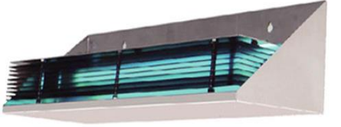
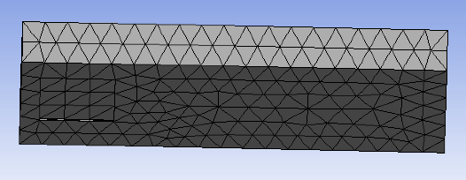
Computational method
UV radiation design
UV system
v
Outlet
A_{d}
Inlet
L_{d}
An example of UR-UVGI
An example of meshed UR-UVGI tunnel
An example of designed UR-UVGI tunnel
UV system model
A user-defined function (UDF) will be implemented to calculate the droplet infectiousness as a they move through the UVC irradiance field.

Slide 7
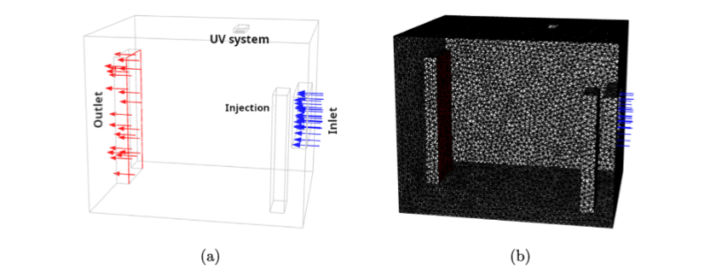
Computational method
Design of the fluid domain
(a) An example of a confined room with mounted UR-UVGI on top and (b) meshed version on the room

Slide 8
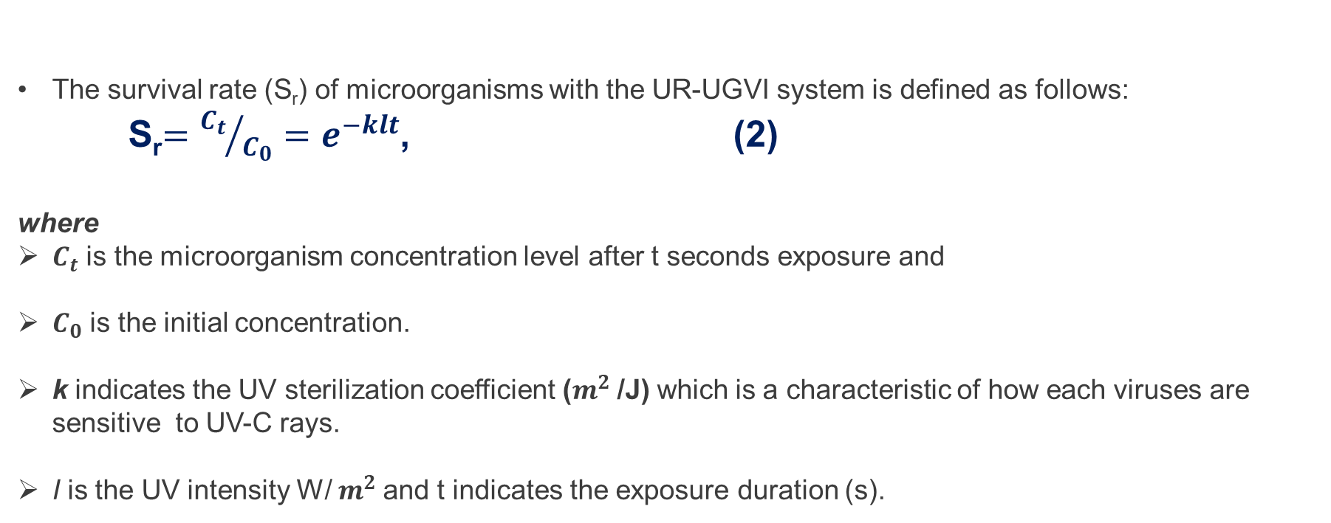
Computational model
Mathematical formalism of survival rate
The survival rate (S_{r}) of microorganisms with the UR-UGVI system is defined as follows:
S_{r}$={C_{t}}/{C_{0}}=e^{−klt}$, (2)
where
$C_{t}$ is the microorganism concentration level after t seconds exposure and
$C_{0}$ is the initial concentration.
k indicates the UV sterilization coefficient ($m^{2}$/J) which is a characteristic of how each viruses are sensitive to UV-C rays.
I is the UV intensity W/ $m^{2}$and t indicates the exposure duration (s).
Pan, Huachen, and Marika Orava. "Performance evaluation of the UV disinfection reactors by CFD and fluence simulations using a concept of disinfection efficiency." Journal of Water Supply: Research and Technology—AQUA 56.3 (2007): 181-189.

Slide 9

Computational model
Mathematical formalism of survival rate
Eq.[2] may be re-written as Eq.[3] in a differential form
$$\frac{∂C}{∂t}=− \text{KIC}$$
(3)
The Eq.[3] enables us to calculate the concentration distribution of airborne viruses decreased by UVGI .
The k; is a value corresponding to the type of airborne viruses and must be decided before the calculation.
For TB (k = 0.472 m2/J) and for H1N1 influenza virus (k = 0.12 m2/J)
C is the concentration of microorganisms per unit volume

Slide 10
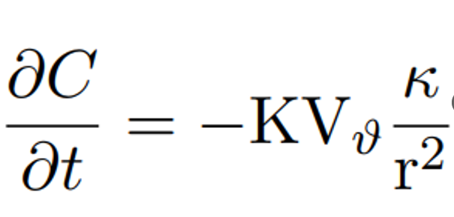
Results
Droplets behavior as a function of the infectiousness, irradiance and volume
(7)
The droplet is considered to experience non uniform irradiance and infectiousness as they travel through the fluid domain for the case IV conditions.
The initial concentration (infectiousness) of the droplets should be the same, and as they pass through the UVGI system.
Droplets are allowed to gradually experience different infectiousness due to different irradiance.

Slide 11

Results
$$The infectiousness of droplets due to$$
$$evaporation and UV irradiance$$
The infectiousness of a droplet is operationally defined as proportional to the viral load carried by the droplet.
Initially, this is the product of the viral concentration and volume of droplet.
In this simple initial model, a droplet is infectious if it has a certain viral load (above a threshold) and no longer infectious when the load is insufficient to cause infection

Slide 12
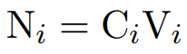
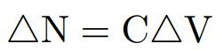

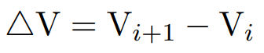

Results
$The infectiousness$ of a droplet
Let the viral load be V_{(load)}
Let the infectiousness be N
Let the volume of a droplet be V
  Evaporation is activated
  UVGI system is on
    Mass reduction
    Diameter reduction
Factors affecting the UVGI performance
  Air velocity,
  temperature and
  Relative humidity
The infectiousness of a droplet is defined as
(8)
Define the change in the infectiousness of a droplet as
(9)
where:
C is the initial concertation of the droplet,
is the difference of volume, and it defined as
(10)
for i= 0, 1, 2,….,n

Slide 13
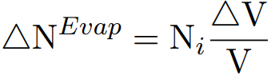
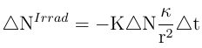
Results
Ultraviolet Germicidal Irradiation optimised by CFD
Mathematical model of $the infectiousness of droplets$
Let the initial infectiousness be defined as
(11)
The infectiousness of a droplet under evaporation is defined as
(12)
The infectiousness of a droplet under UV irradiance is defined as
(13)

Slide 14
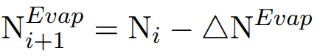
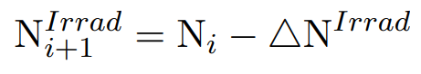
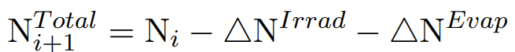
Results
$$The mathematical model of infectiousness of droplets$$
The total infectiousness of droplets due to evaporation is
(7)
The total of infectiousness of droplets under UV irradiance is
(8)
The droplet exposure to irradiance was consider to be
Uniform irradiance
The position of a droplet with respect to a point source (1/r)
The total infectiousness of a droplets under UV irradiance and evaporation is
(9)

Slide 15
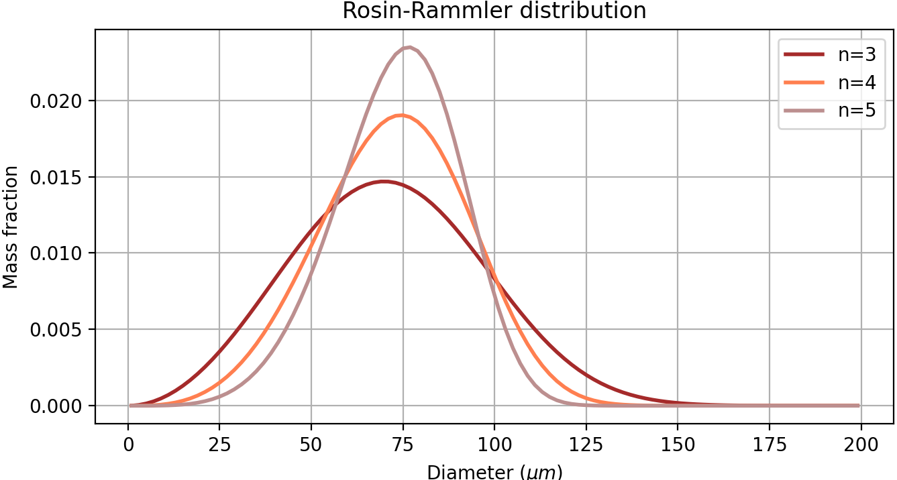




Injection characteristics
DROPLET SIZE DISTRIBUTION
INJECTION VELOCITY (m/s)
DROPLET FLOW RATE
DROPLET INITIAL TEMPERATURE
Rosin-Rammler distribution
$$f\left(d\right)= \frac{n}{\overline{d}} {\left(\frac{d}{\overline{d}}\right)}^{n−1}e^{−{\left(d/{\overline{d}}\right)}^{n}}$$
$d_{min}=1 μm$ ; $d_{max}=200 μm$ ; $\overline{dmean}=80 μm$ ; $n=3,3$
Flow rate of $10 mg/s$
With injection period of $0,3 s$ a total mass of $3 mg$ was injected
Events | Min | Max | Mean
Speaking | 1 | 5 | 3,6
Cough | 6 | 22 | 11
Sneeze | 30 | 100 | 46
$$34℃$$
11/21/2024

Slide 16
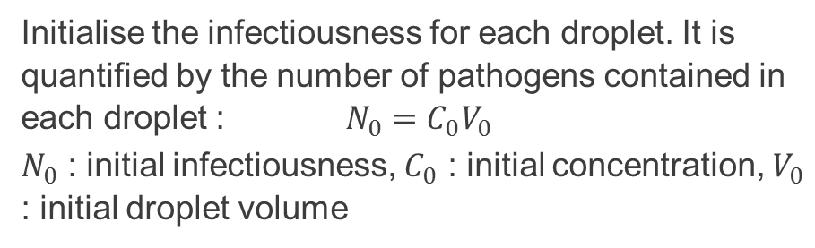
Infectiouness calculation
1
Initialisation
Initialise the infectiousness for each droplet. It is quantified by the number of pathogens contained in each droplet : $N_{0}=C_{0}V_{0}$
$N_{0}$ : initial infectiousness, $C_{0}$ : initial concentration, $V_{0}$ : initial droplet volume
2
Iteration
3
Assumptions
Iterate from initial time until the droplet is evaporated or traped on a wall (reached the ground or a wall).
Pathogens are assumed to be uniformly distributed in the saliva
Pathogens are assumed to instantly disintegrate when dehydrated
21/11/2024

Slide 17
Influence of environmental factors
Different conditions were investigated with various environmental parameters (temperature, RH, environing air speed).
Condition 1 is more favorable for evaporation compared to condition 2.
Parameters | Condition 1 | Condition 2
Temperature | 20°C | 17°C
Relative humidity | 30% | 40%
Air speed | 0,1m/s | 0m/s

Slide 18
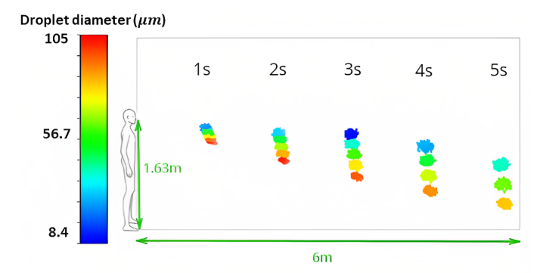
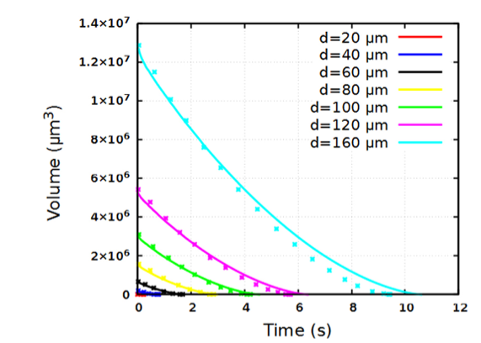
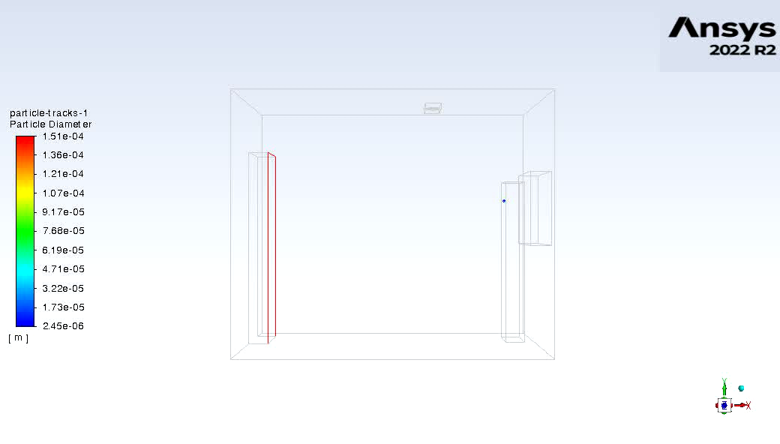
Developing an Infectiousness model for diseases transmission control
Validation
. Plot showing droplet evaporation. The time variation of droplet volume was considered. The droplet sizes were between 20 and 160 μm. Solid lines are the data from this present work and the dotted lines are the results of Liu et al
Liu F, Qian H, Zheng X, Song J, Cao G, Liu Z. Evaporation and dispersion of exhaled droplets in stratified environment. IOP Conf Ser: Mater Sci Eng 2019;609:042059.

Slide 19
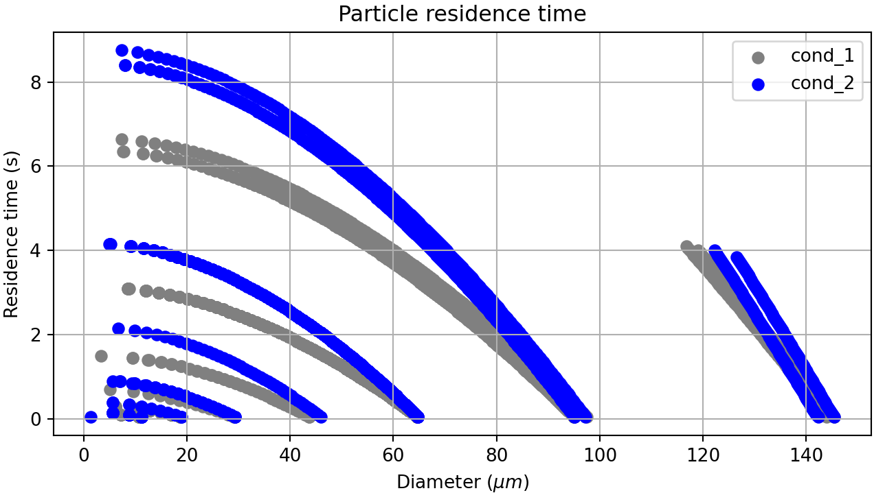
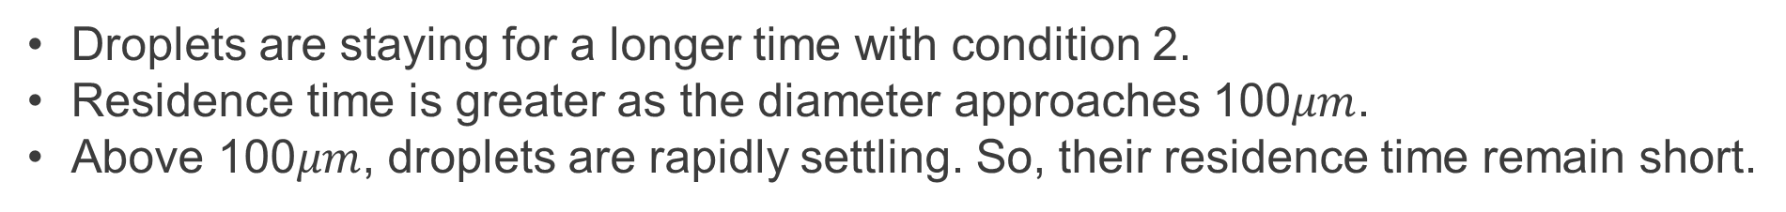
Droplet residence time
Droplets are staying for a longer time with condition 2.
Residence time is greater as the diameter approaches 100$μm$.
Above 100$μm$, droplets are rapidly settling. So, their residence time remain short.

Slide 20
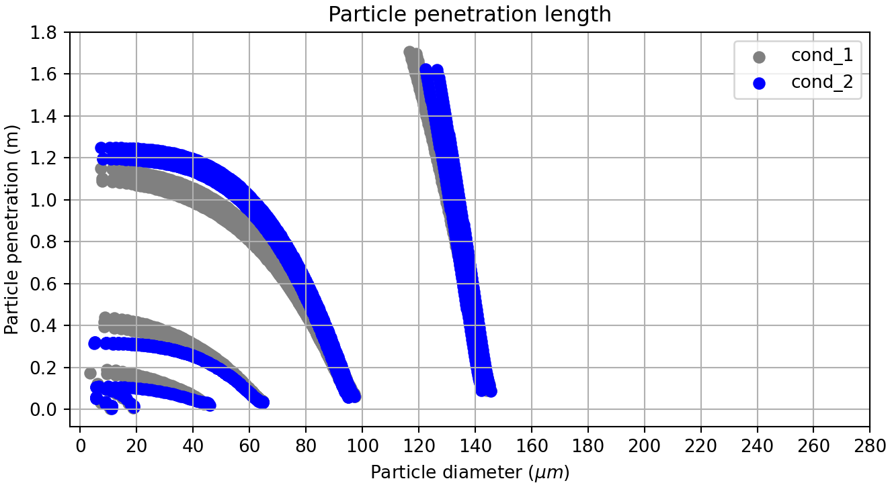
Droplet penetration length
Smaller droplets are subject to air flow. Hence, they have greater penetration length with condtion 1
For larger droplets, air velocity of 0,1m/s is not high enough to transport them. Droplets have higher penetration length with condition 2 due to higher residence time.
Droplets travel distances less than 2m in both cases.

Slide 21
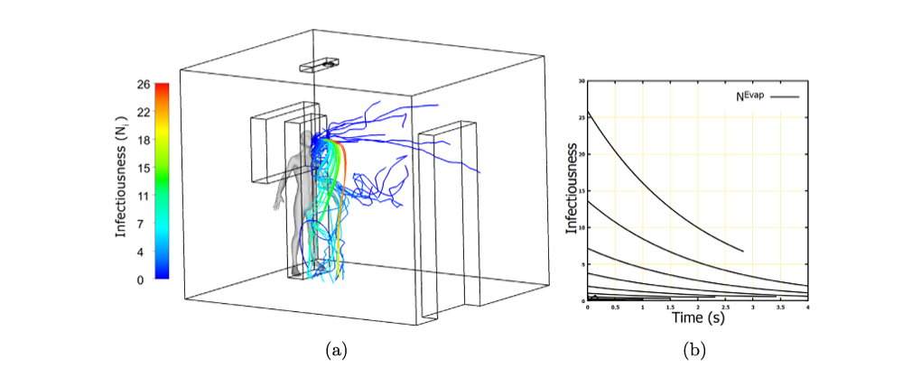
Infectiousness decay due to evaporation
(a) Droplet path lines coloured by infectiousness. The infectiousness decay is introduced proportionally to the size decrease of the droplet; and (b) plot of infectiousness of droplets due to evaporation.

Slide 22
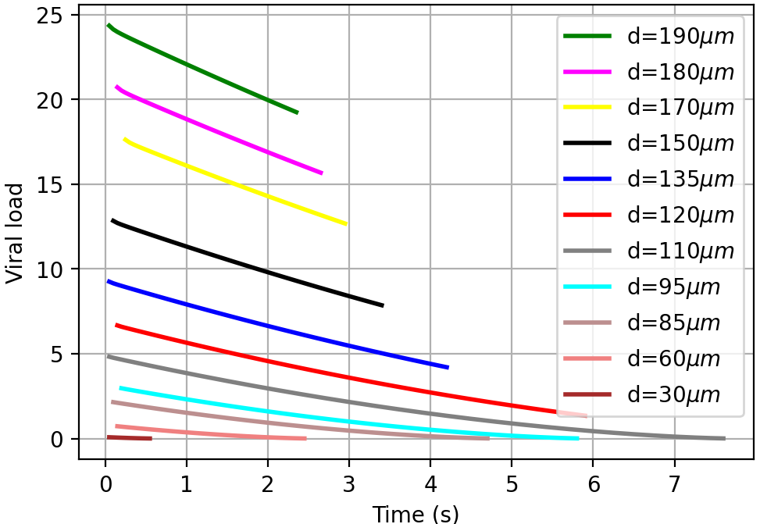
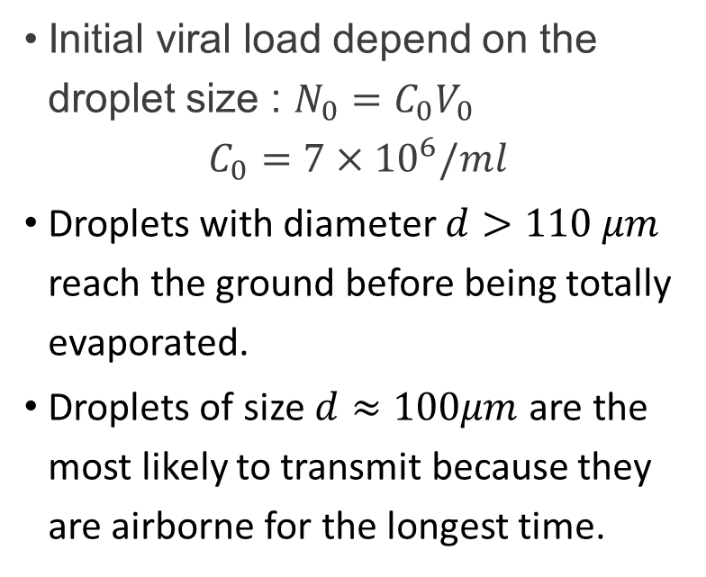
Infectiousness decay due to evaporation
Initial viral load depend on the droplet size : $N_{0}=C_{0}V_{0}$
$$C_{0}=7×{10}^{6}/ml$$
Droplets with diameter $d>110 μm$ reach the ground before being totally evaporated.
Droplets of size $d≈100μm$ are the most likely to transmit because they are airborne for the longest time.

Slide 23
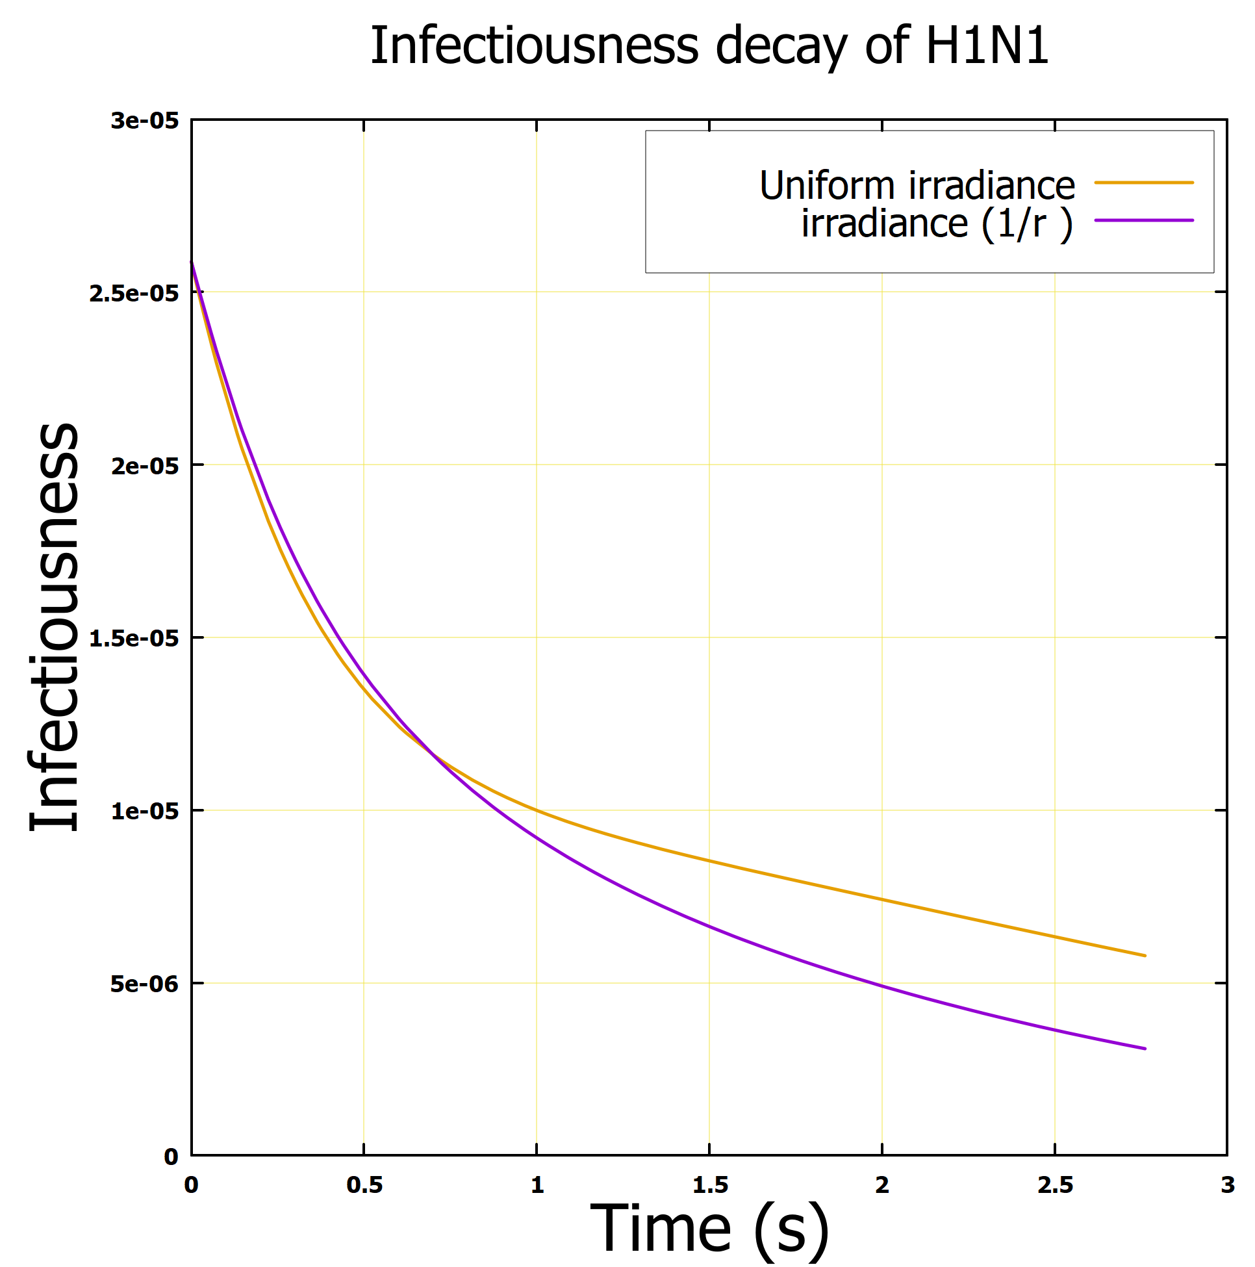
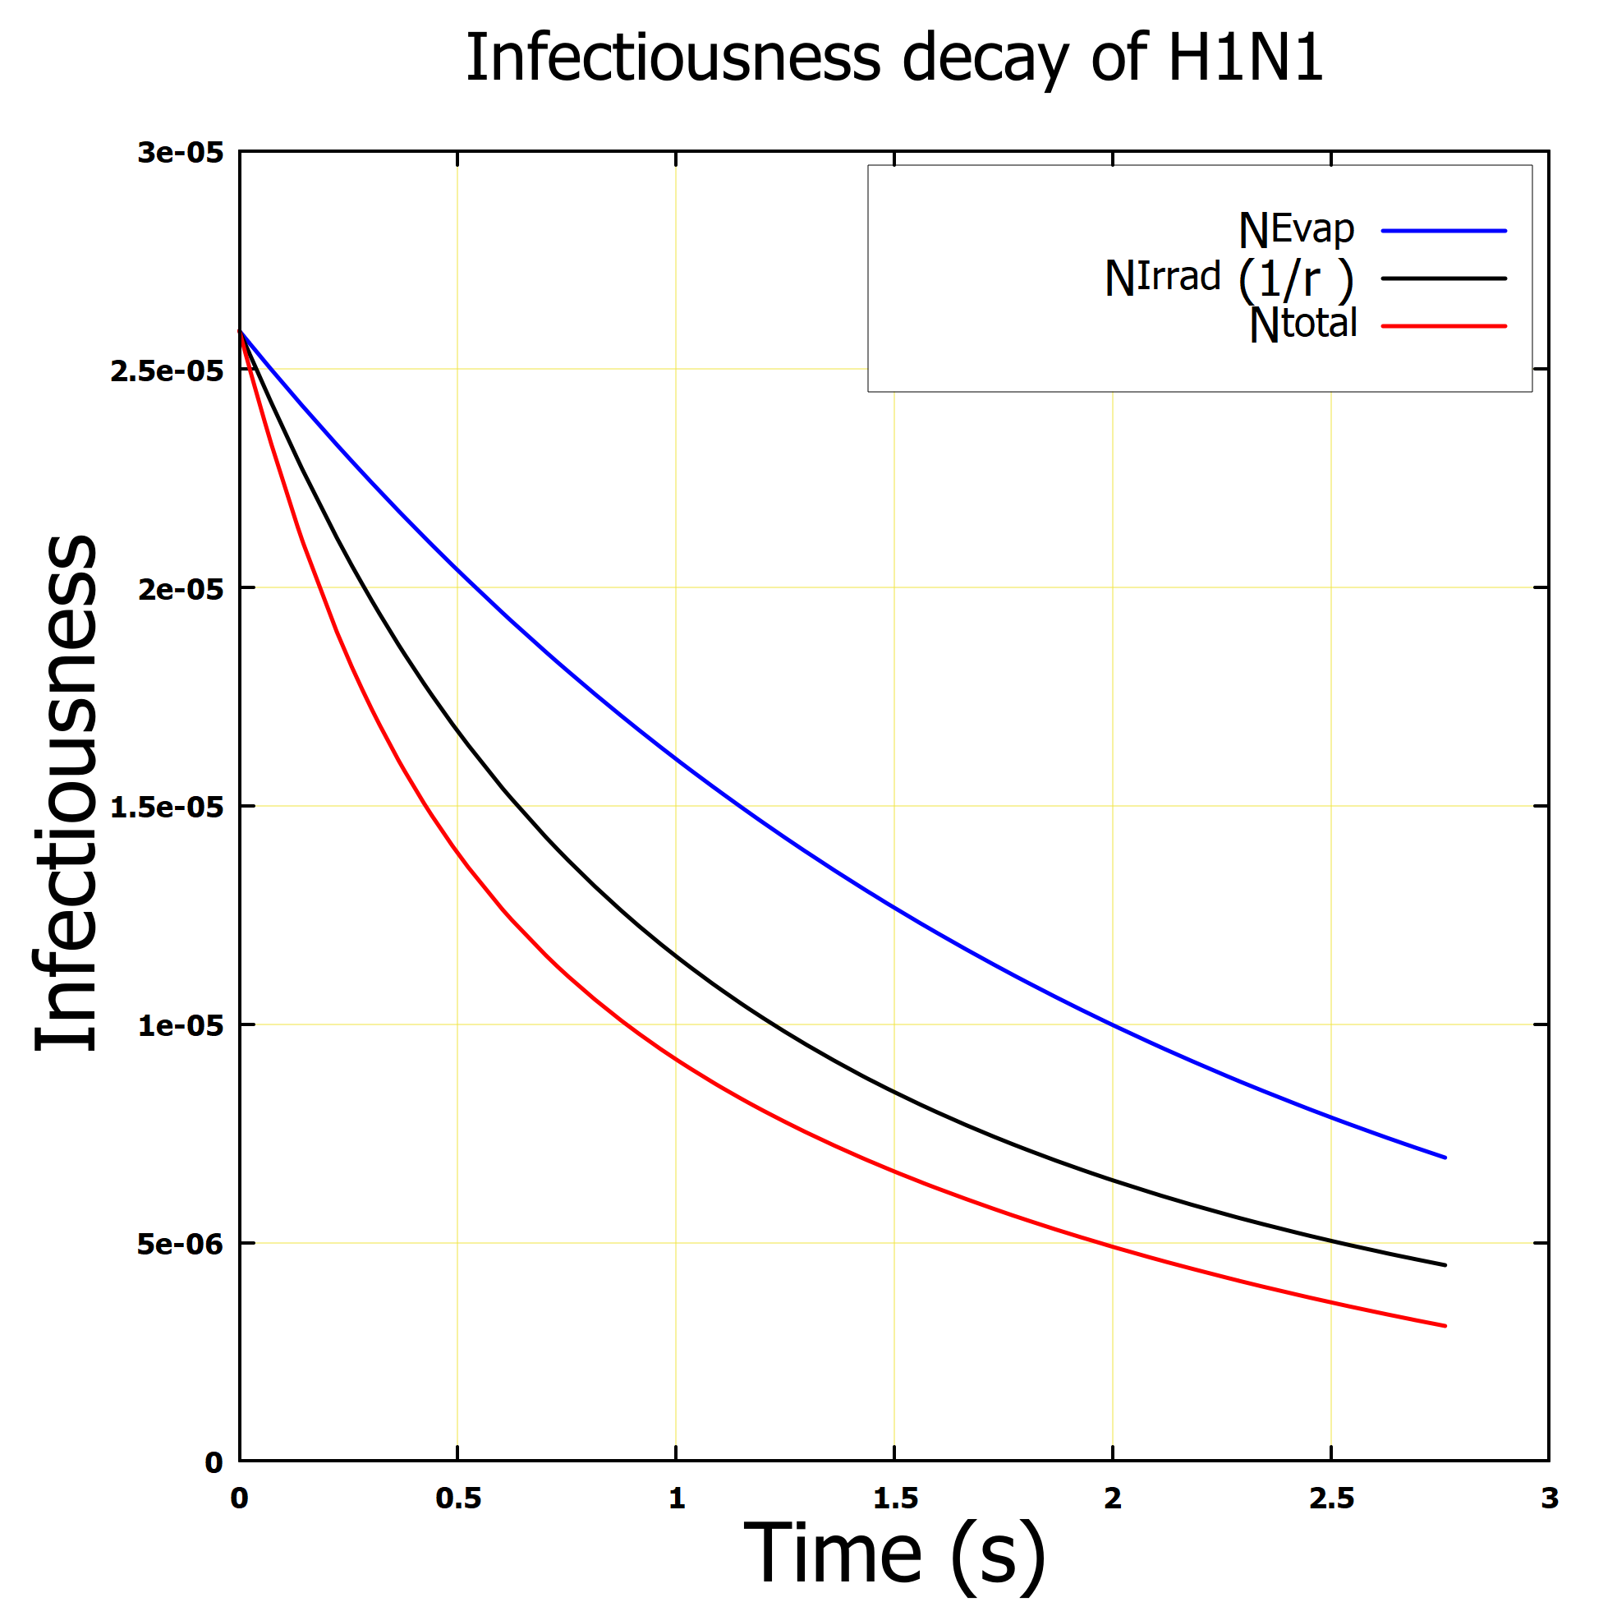
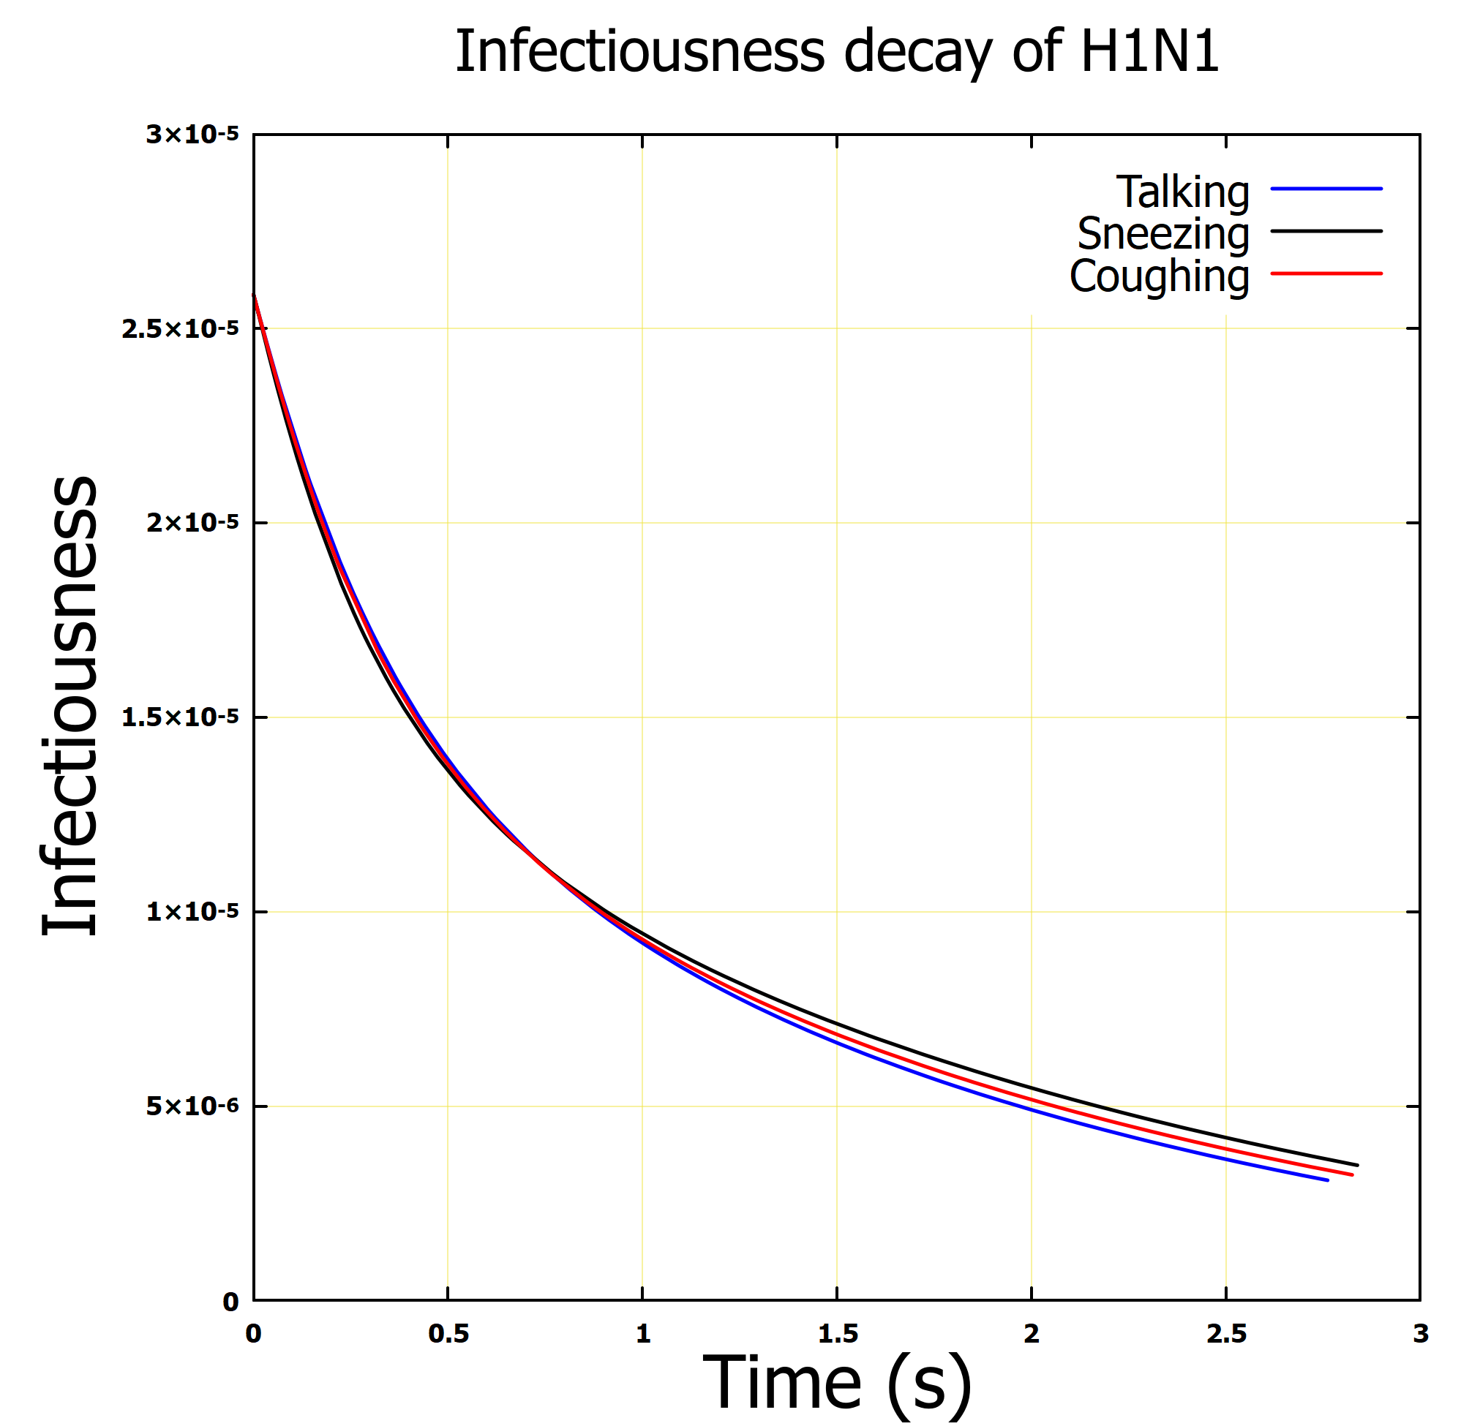
Results
Infectiousness decay of H1H1 Influenza virus as exposed to UV coupled evaporation
Fig (a): Uniform vs irradiance as a point source
Fig (b): Infectiousness due to evaporation, irradiance and irradiance coupled with evaporation
Fig (c): Total Infectiousness of H1N1 due to different methods of exhale
Point source irradiance yielded an improve result compared to the uniform irradiance
UV-C coupled with evaporation is more effective in reducing the infectiousness of the H1N1
Speaking shows higher total infectiousness decay; however, this is not too significant
The spread of the H1N1 influenzas virus in a confined environment can be mitigated using the proposed model

Slide 24
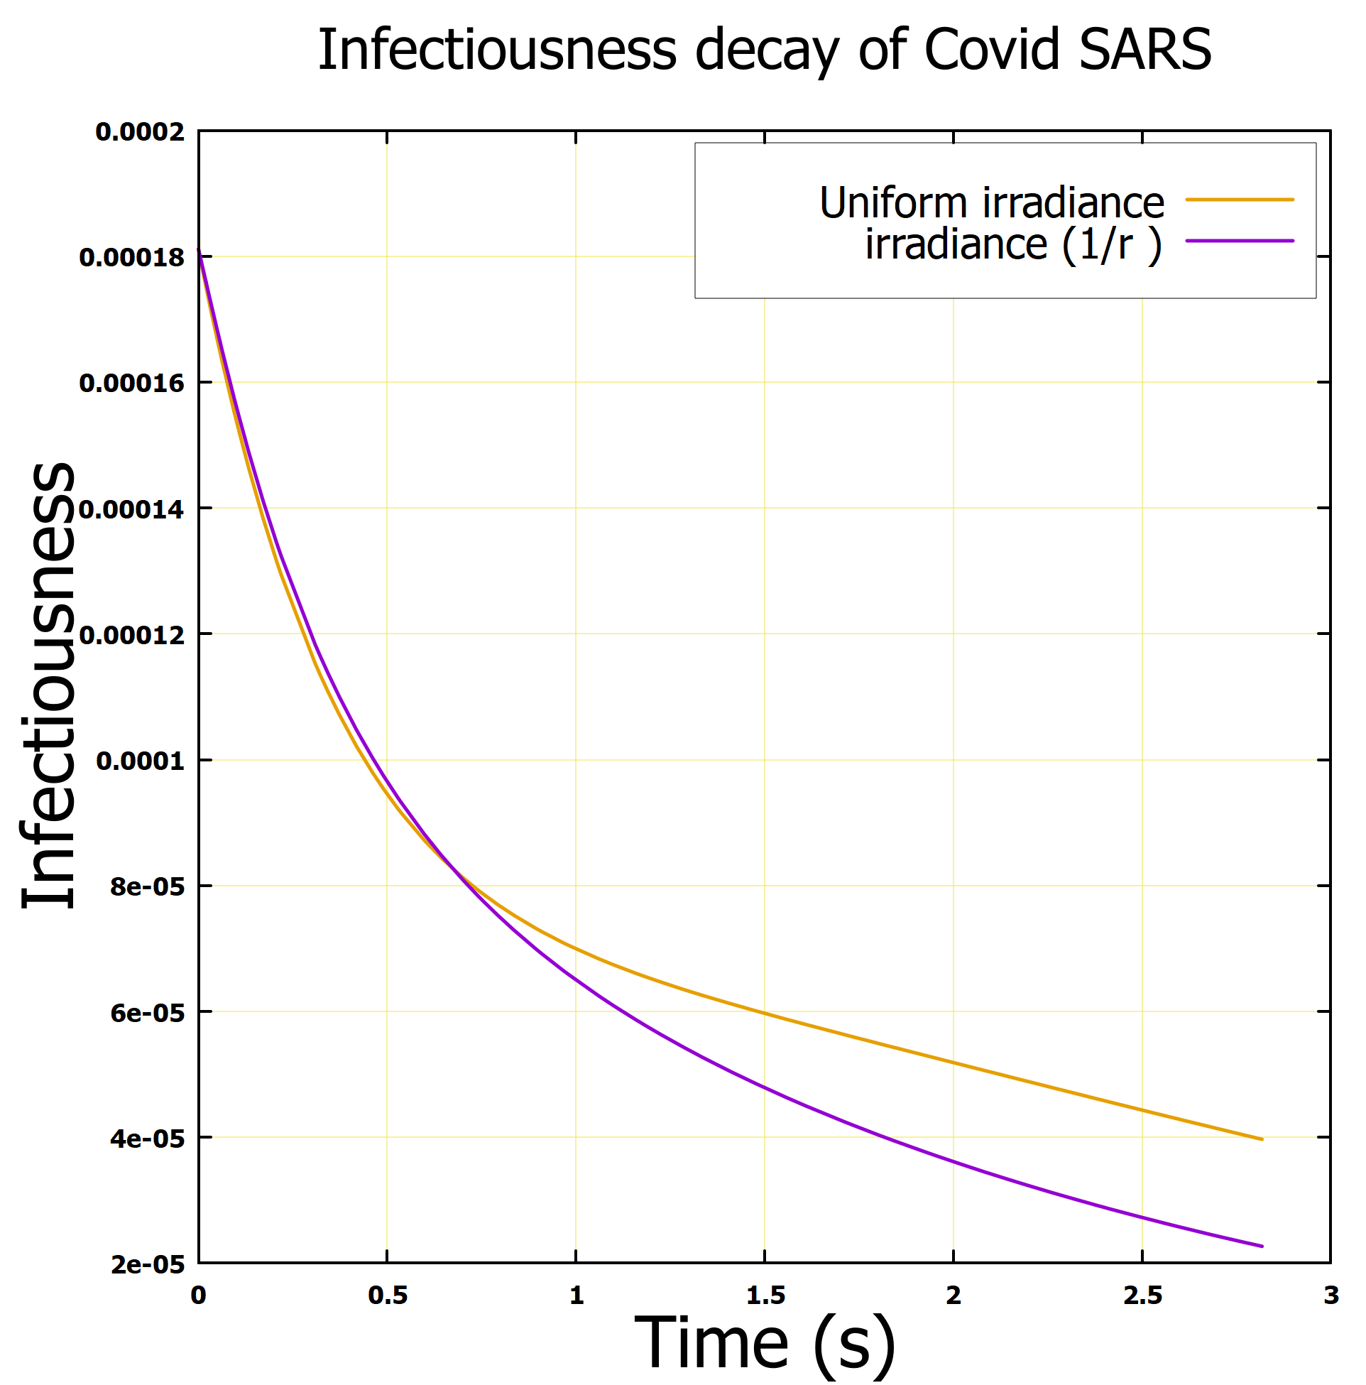
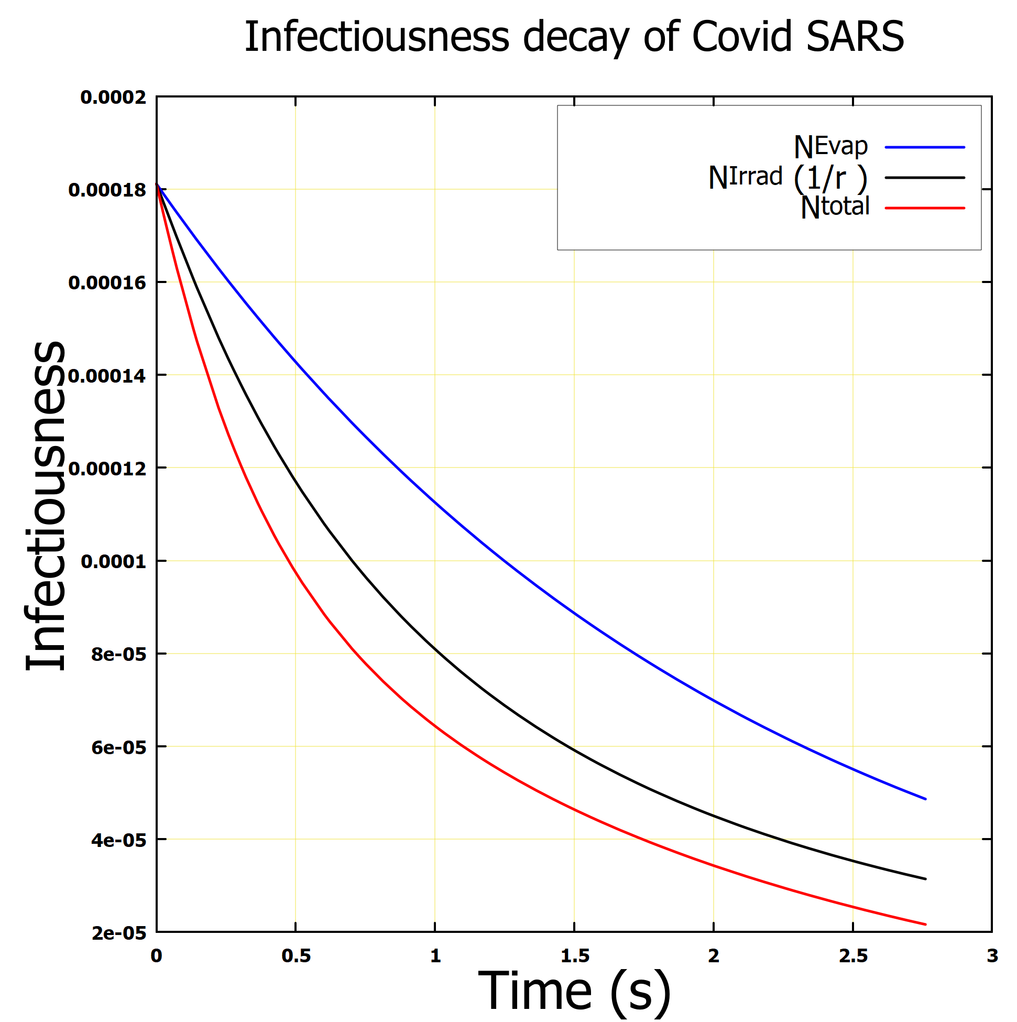
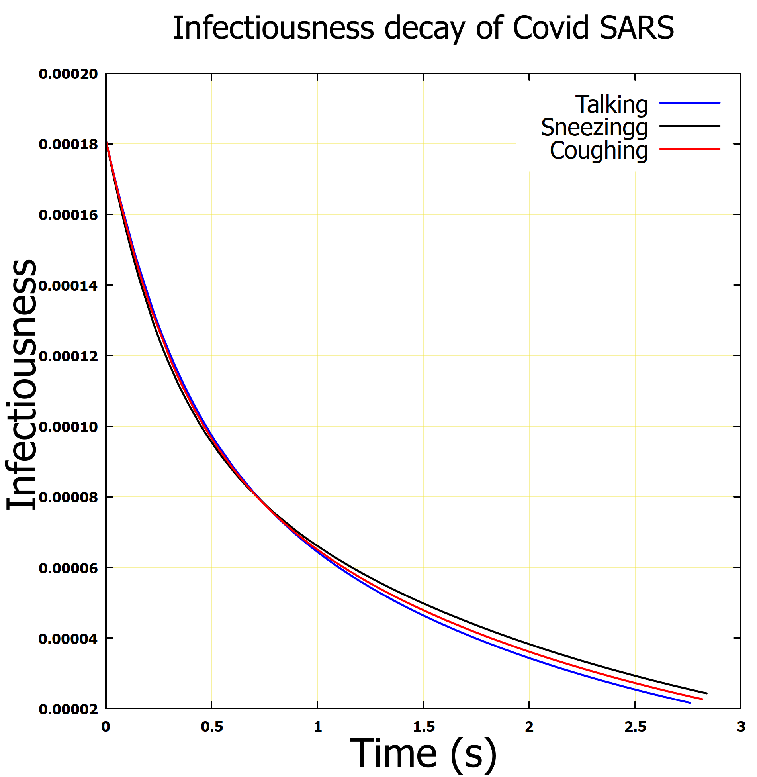
Results
Infectiousness decay of COVID-SARS virus as exposed to UV coupled evaporation
Fig (a): Uniform vs irradiance as a point source
Fig (b): Infectiousness due to evaporation, irradiance and irradiance coupled with evaporation
Fig (c): Total Infectiousness of COVID-SARS due to different dynamic of exhale
Point source irradiance yielded an improve result compared to the uniform irradiance
UV-C coupled with evaporation is more effective in reducing the infectiousness of the COVID-SARS
Speaking shows higher total infectiousness decay; however, this is not too significant
The spread of the COVID-SARS in a confined environment, can be mitigated using the proposed model

Slide 25
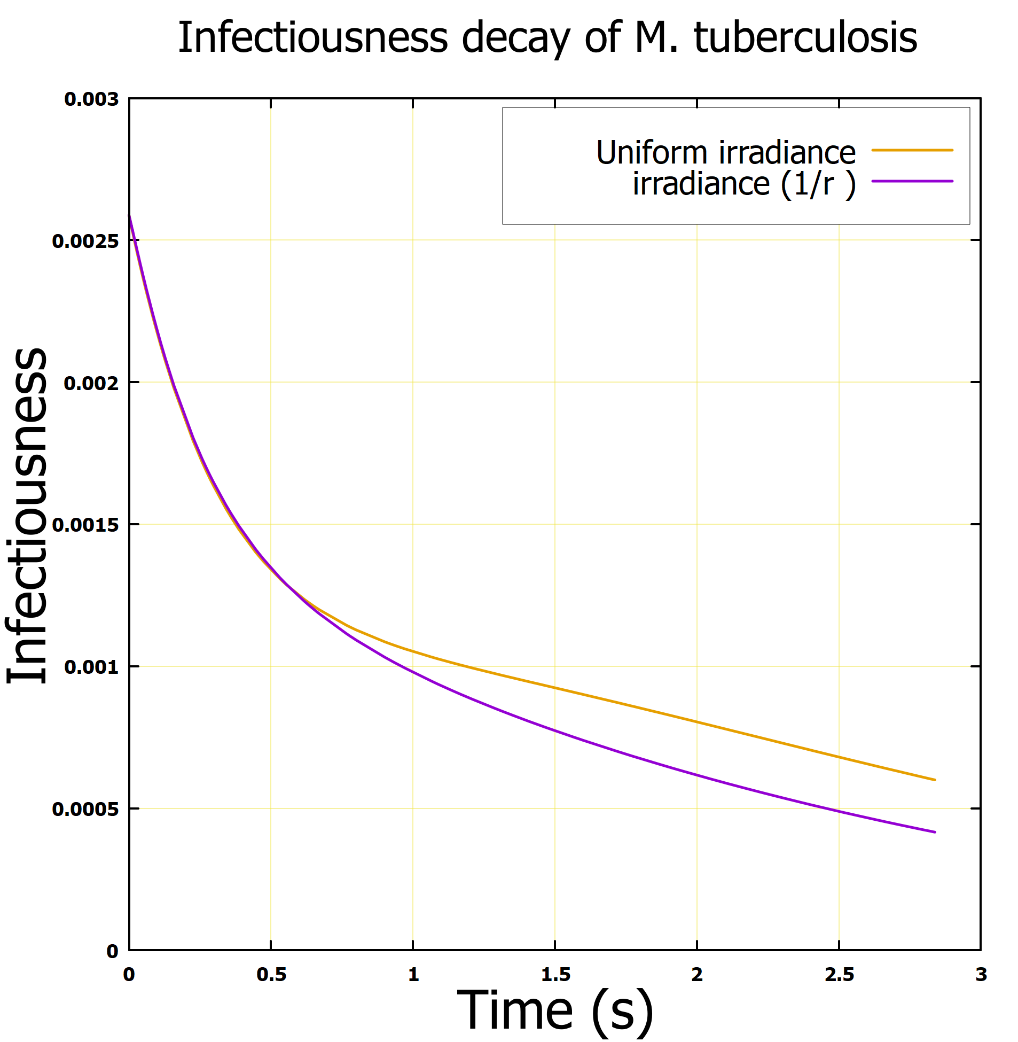
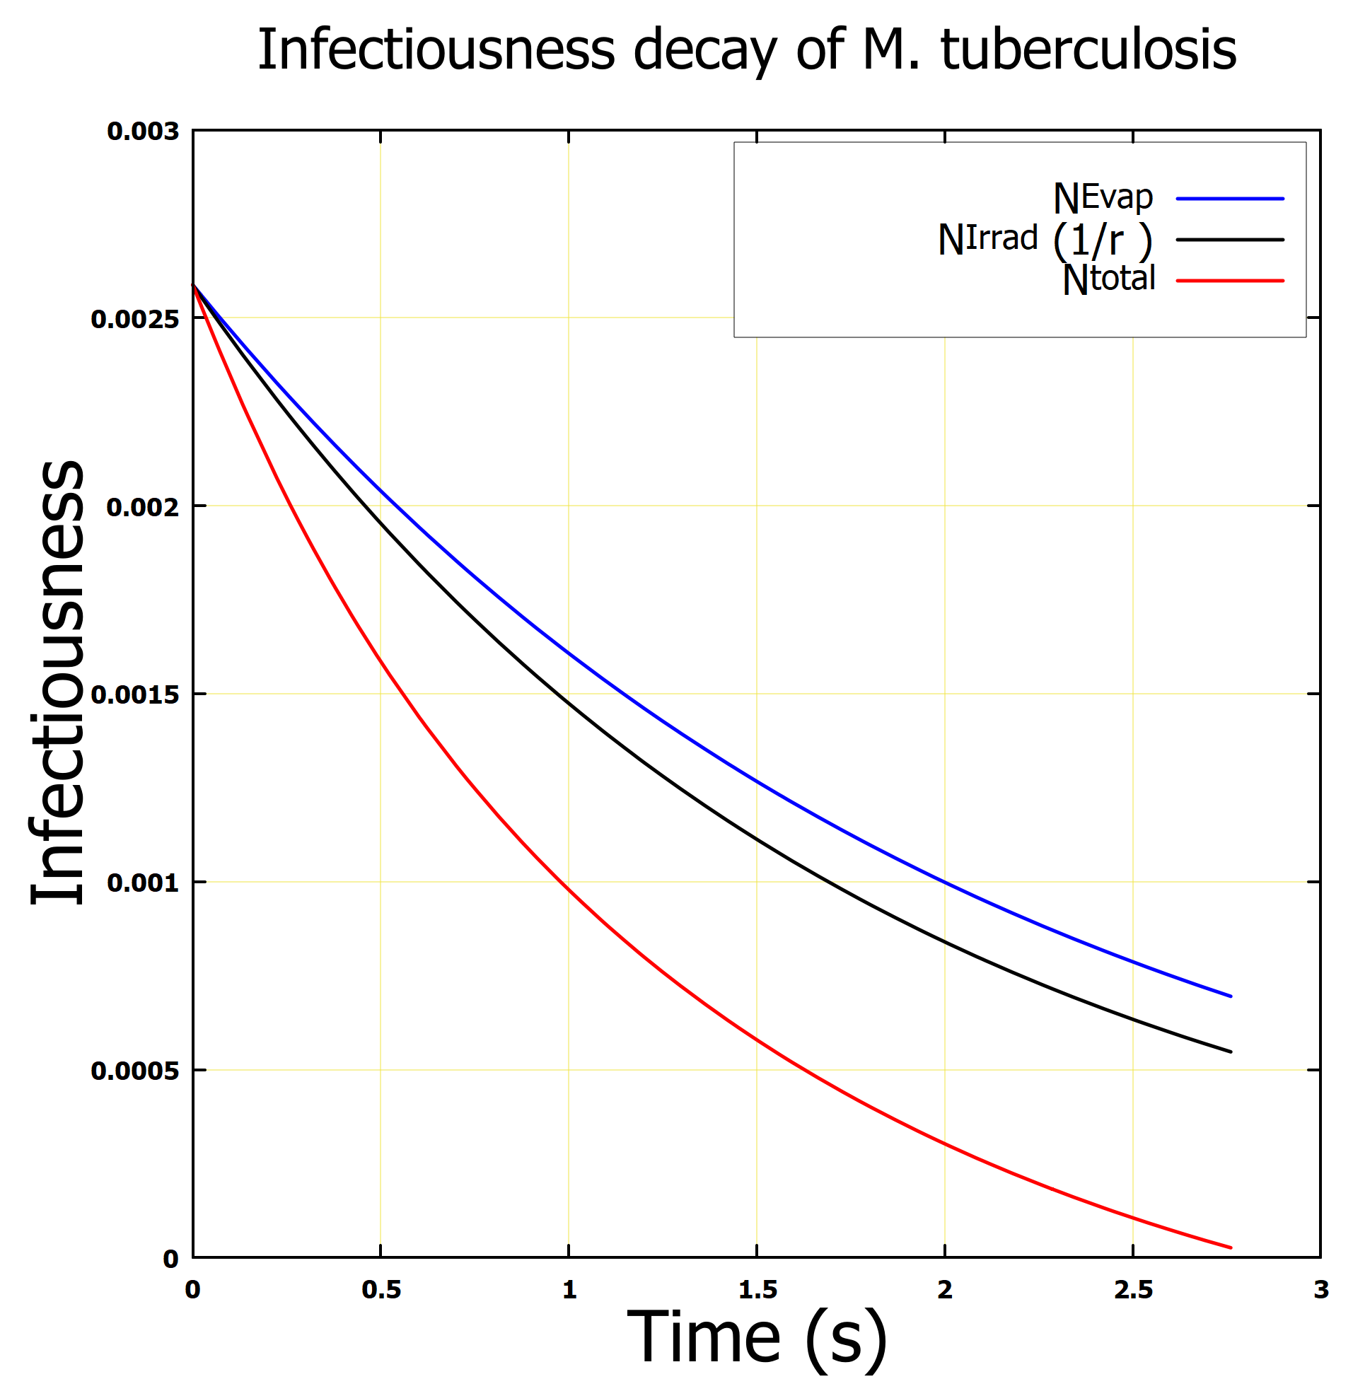
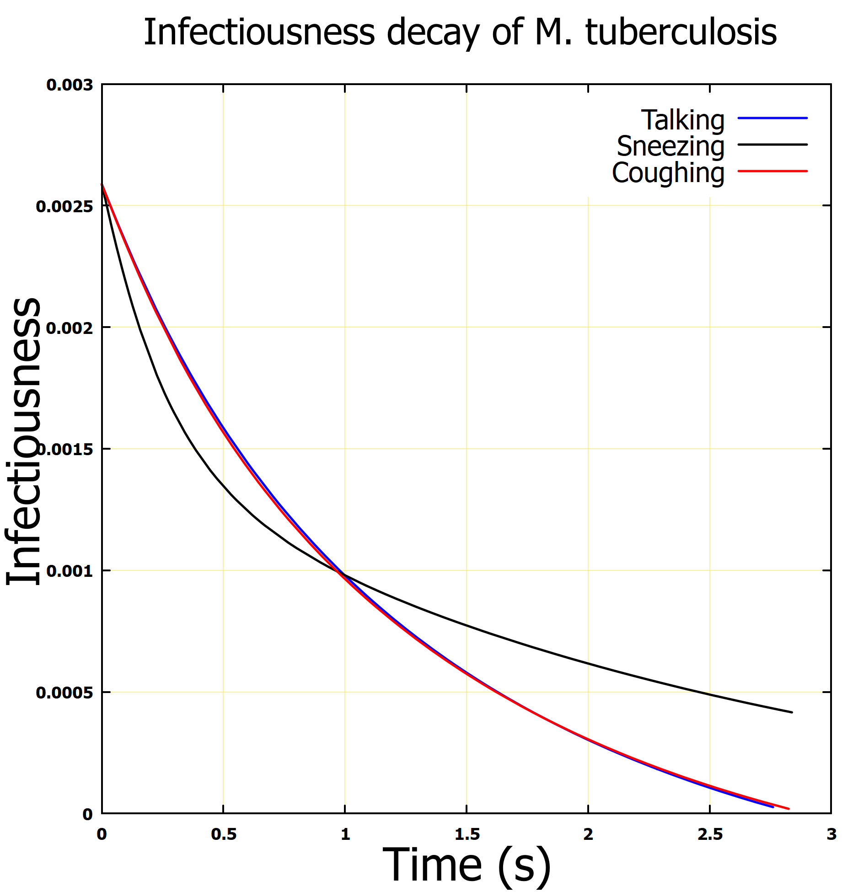
Results
Infectiousness decay of Mycobacteria Tuberculosis virus as exposed to UV coupled evaporation
Fig (a): Uniform vs irradiance as a point source
Fig (b): Infectiousness due to evaporation, irradiance and irradiance coupled with evaporation
Fig (c): Total Infectiousness of Mycobacteria Tuberculosis due to different dynamic of exhale
Point source irradiance yielded an improve result compared to the uniform irradiance
UV-C coupled with evaporation is more effective in reducing the infectiousness of the Mycobacteria Tuberculosis
Speaking and coughing show higher total infectiousness decay.
The spread of the Mycobacteria Tuberculosis in a confined environment, can be mitigated using the proposed model

Slide 26
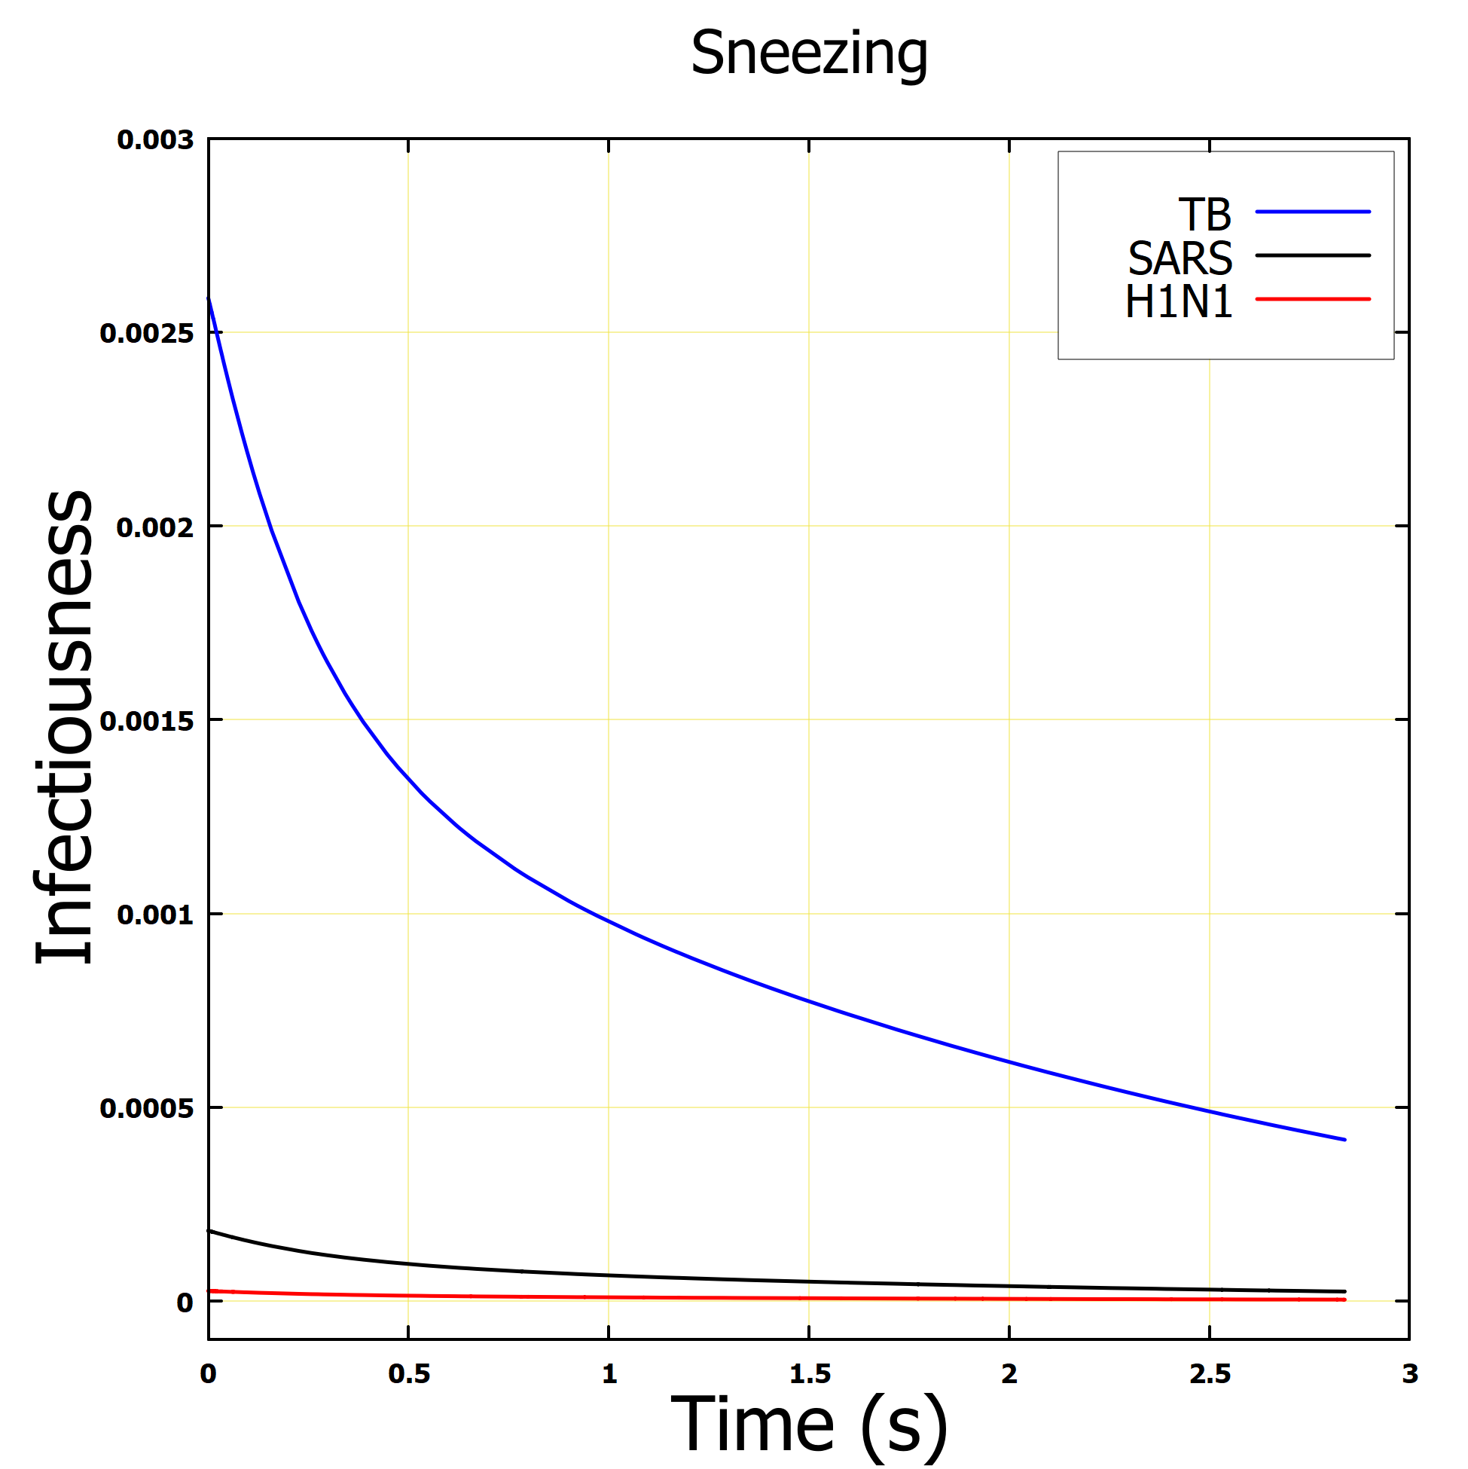
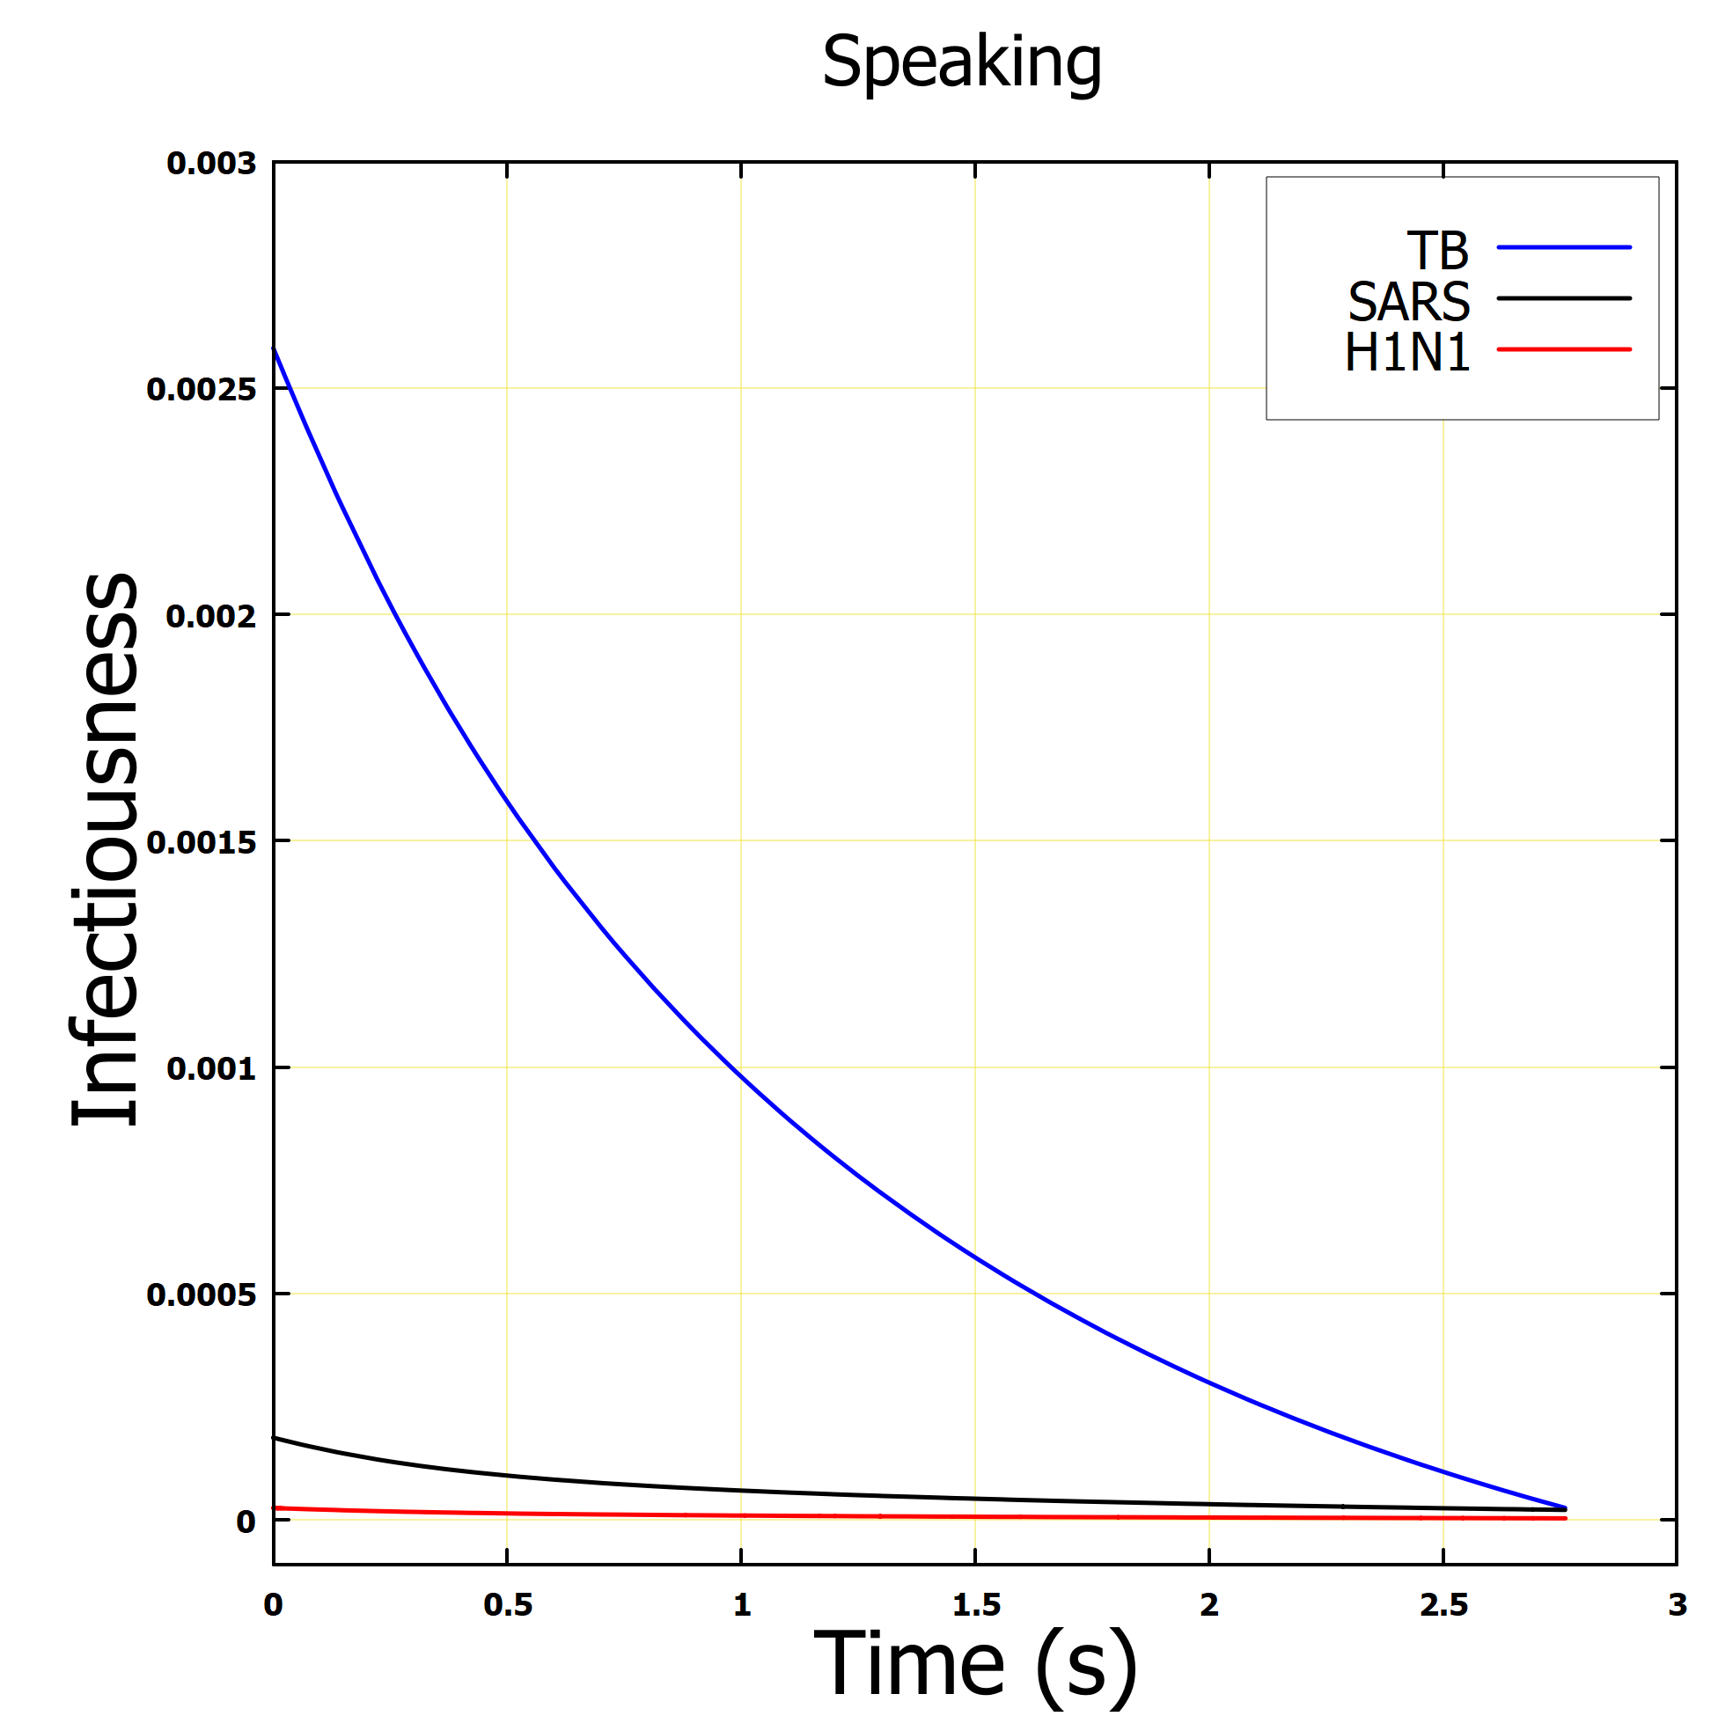

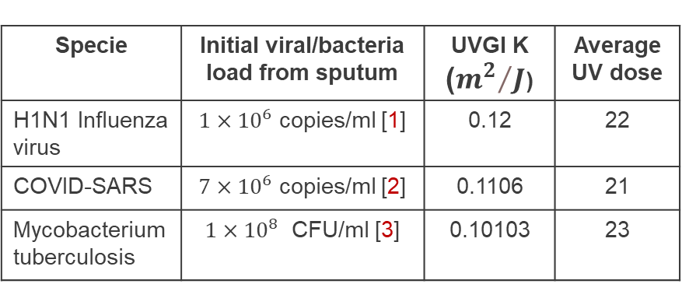

Results
Infectiousness decay of microorganisms: Speaking, coughing and sneezing
For different microorganisms, the infectiousness decay was reduced to almost zero
Dues to the initial concentration of the microorganism from the sputum, the infectiousness of the individual species varies.
Specie | Initial viral/bacteria load from sputum | UVGI K (${m^{2}}/J$) | Average UV dose
H1N1 Influenza virus | $1×{10}^{6}$ copies/ml [1] | 0.12 | 22
COVID-SARS | $7×{10}^{6}$ copies/ml [2] | 0.1106 | 21
Mycobacterium tuberculosis | $1×{10}^{8}$ CFU/ml [3] | 0.10103 | 23
$$CFU=colony forming unit$$
[1] Influenzas and rhinovirus viral load and disease severity in upper respiratory tract infections
[2] Virological assessment of hospitalised patients with covid-2019
[3] The detection of Mycobacterium tuberculosis in sputum sample based on a wireless magnetoelastic-sensing device

Slide 27
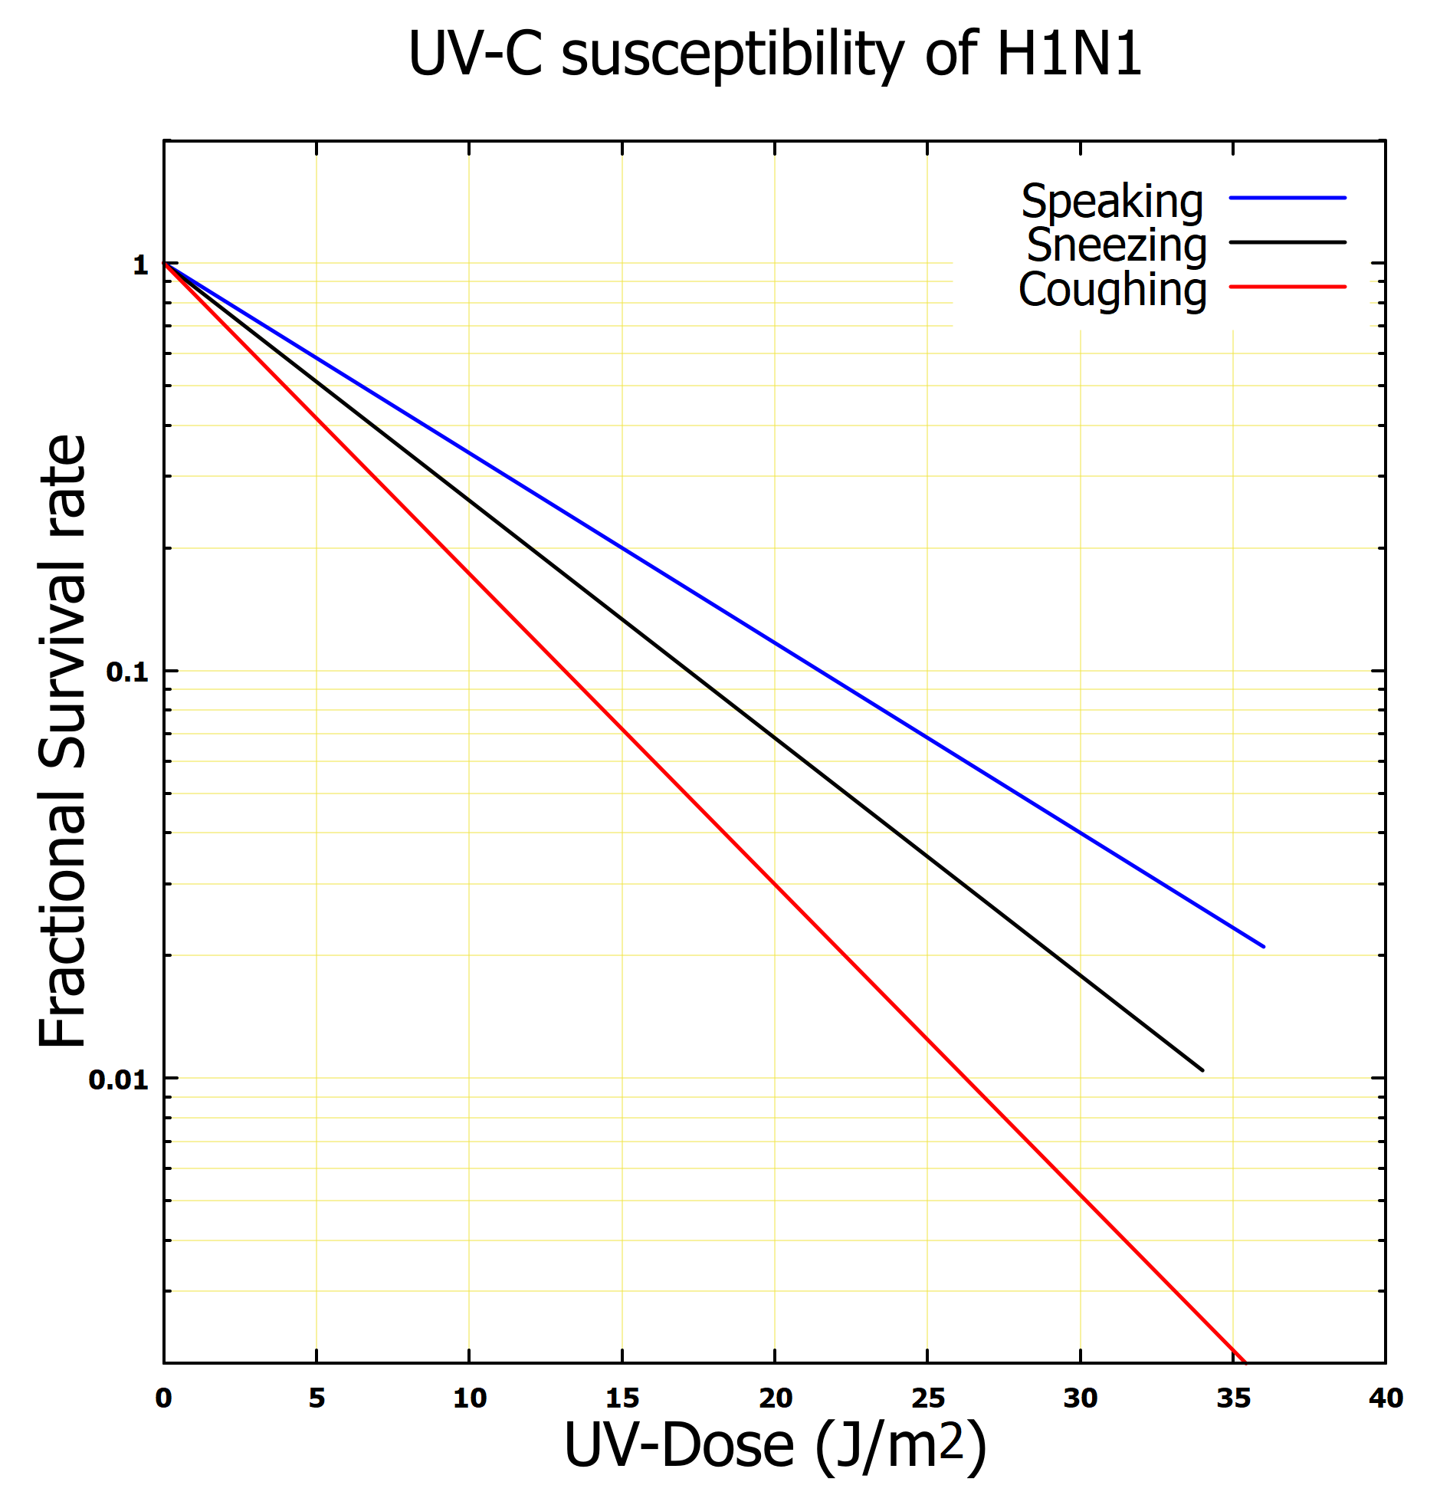
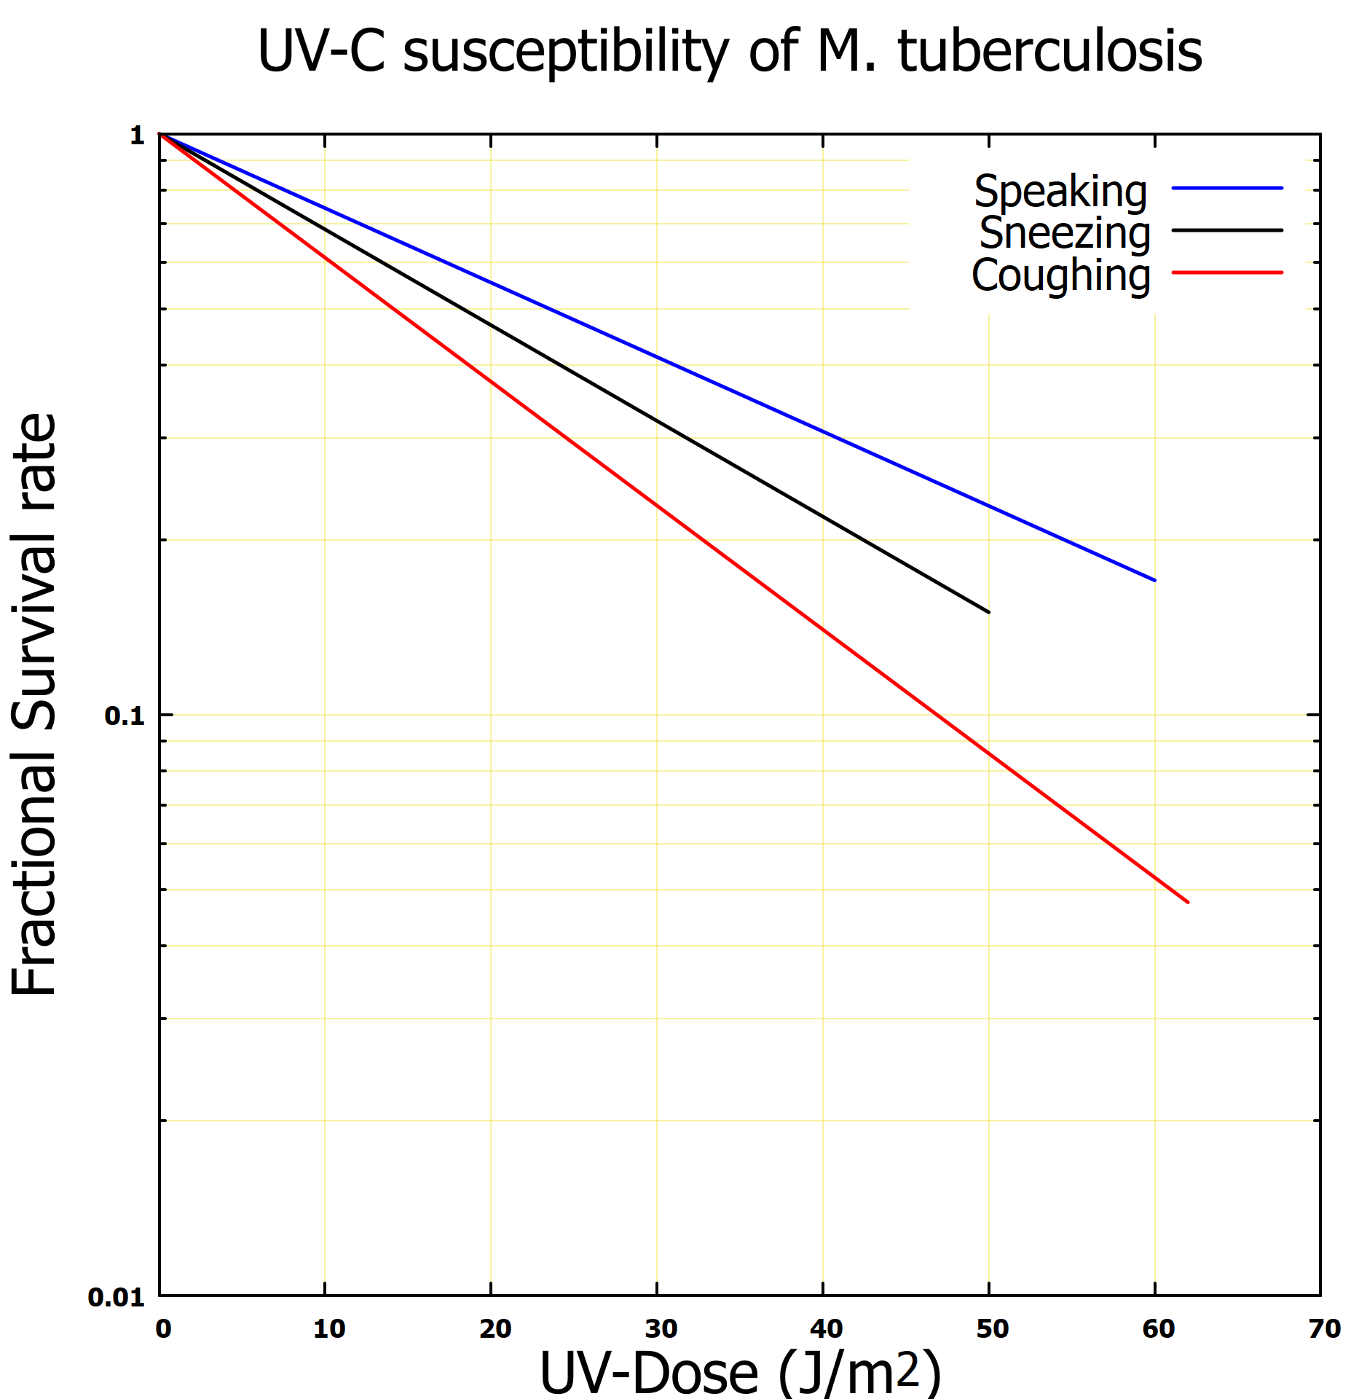
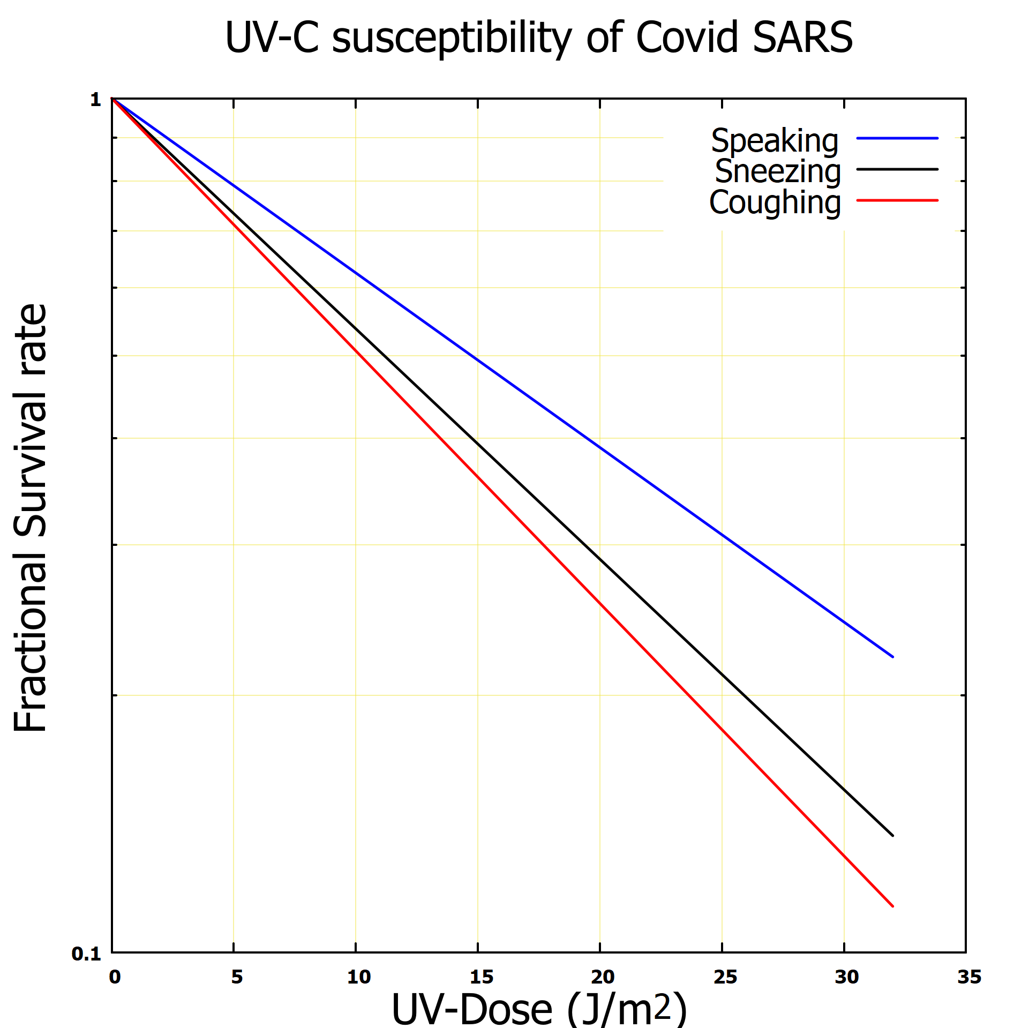
Results
UV-C susceptibility of microorganisms: speaking, coughing and sneezing
Fig a: H1N1 Influenza virus
Fig b: Mycobacterium tuberculosis
Fig c: SAR-CoV-2
The impact of the UV-dose coupled with evaporation at 20% relative humidity suggests
  Microorganism exhaled via coughing have a lower survival rate than those exhaled via speaking sneezing.
  Microorganisms exhaled via speaking have higher survival rate than those exhaled via sneezing or coughing.

Slide 28
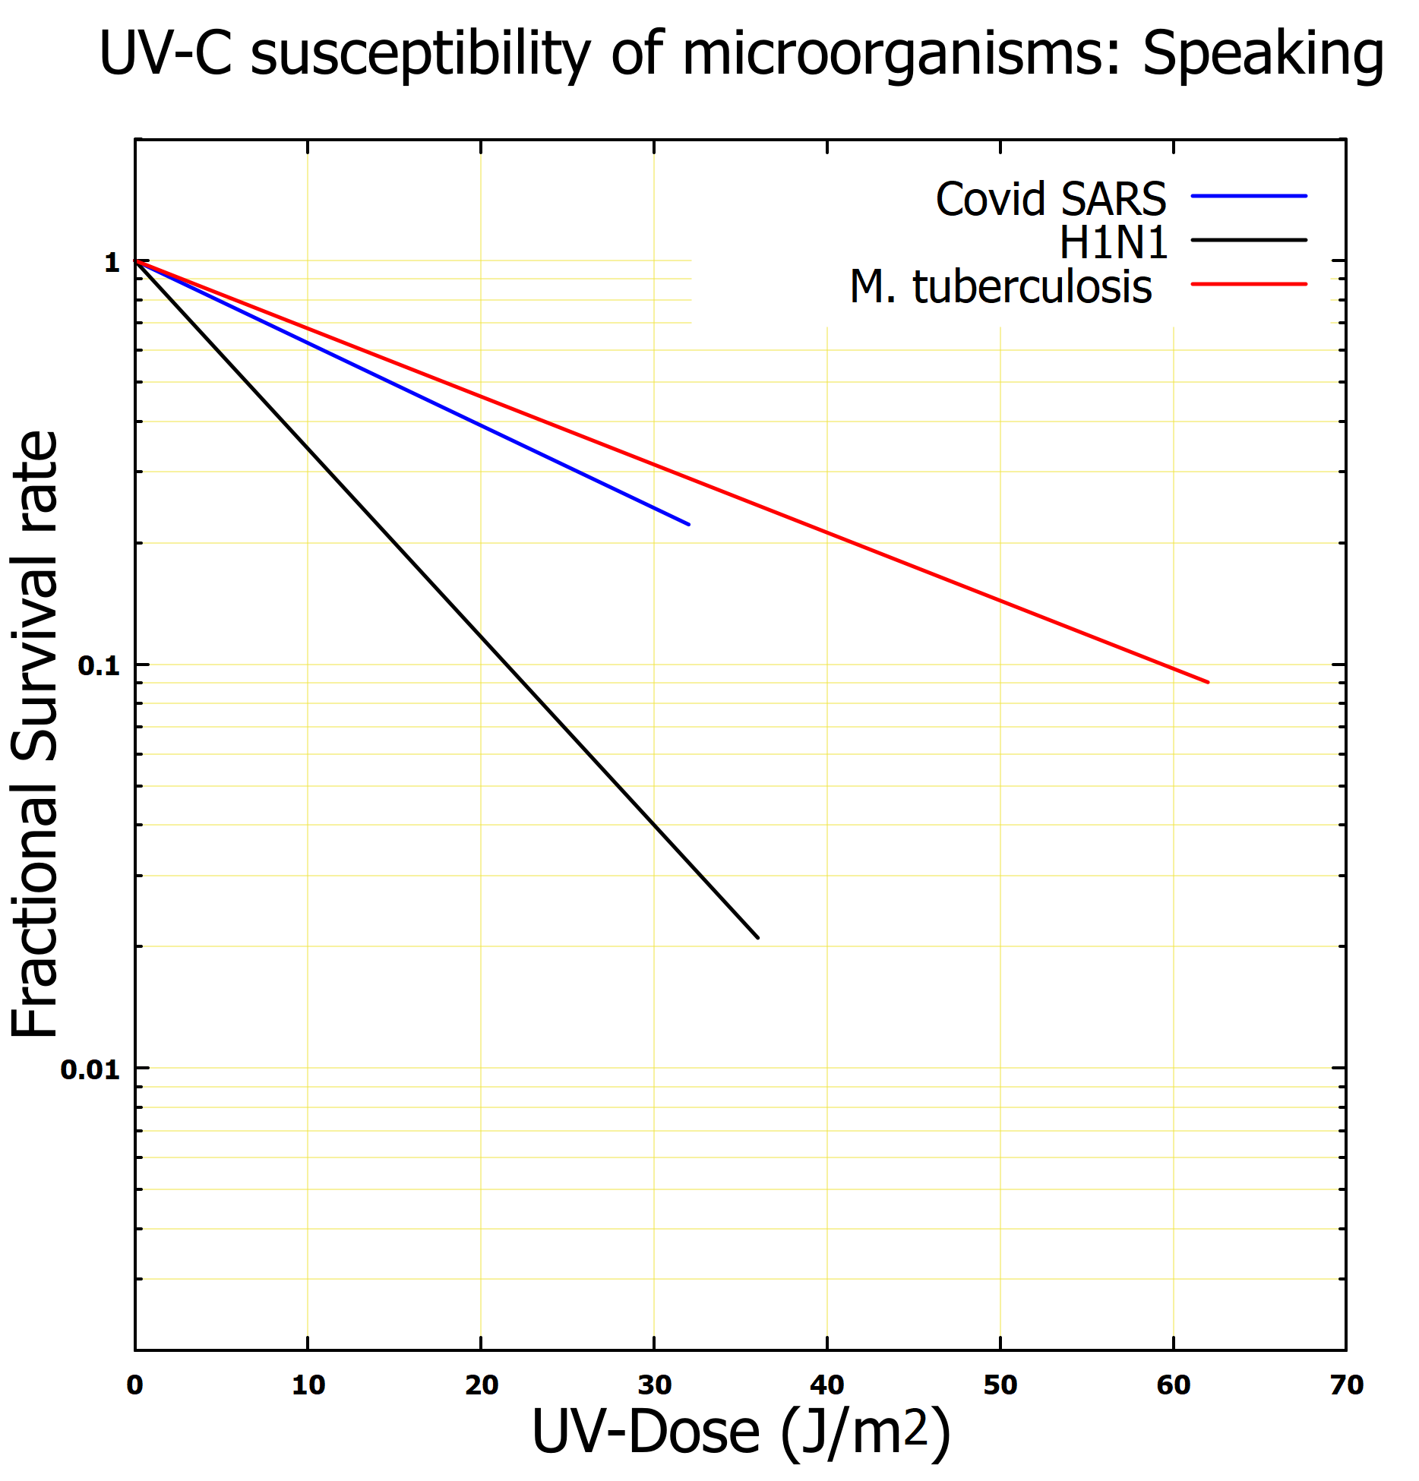
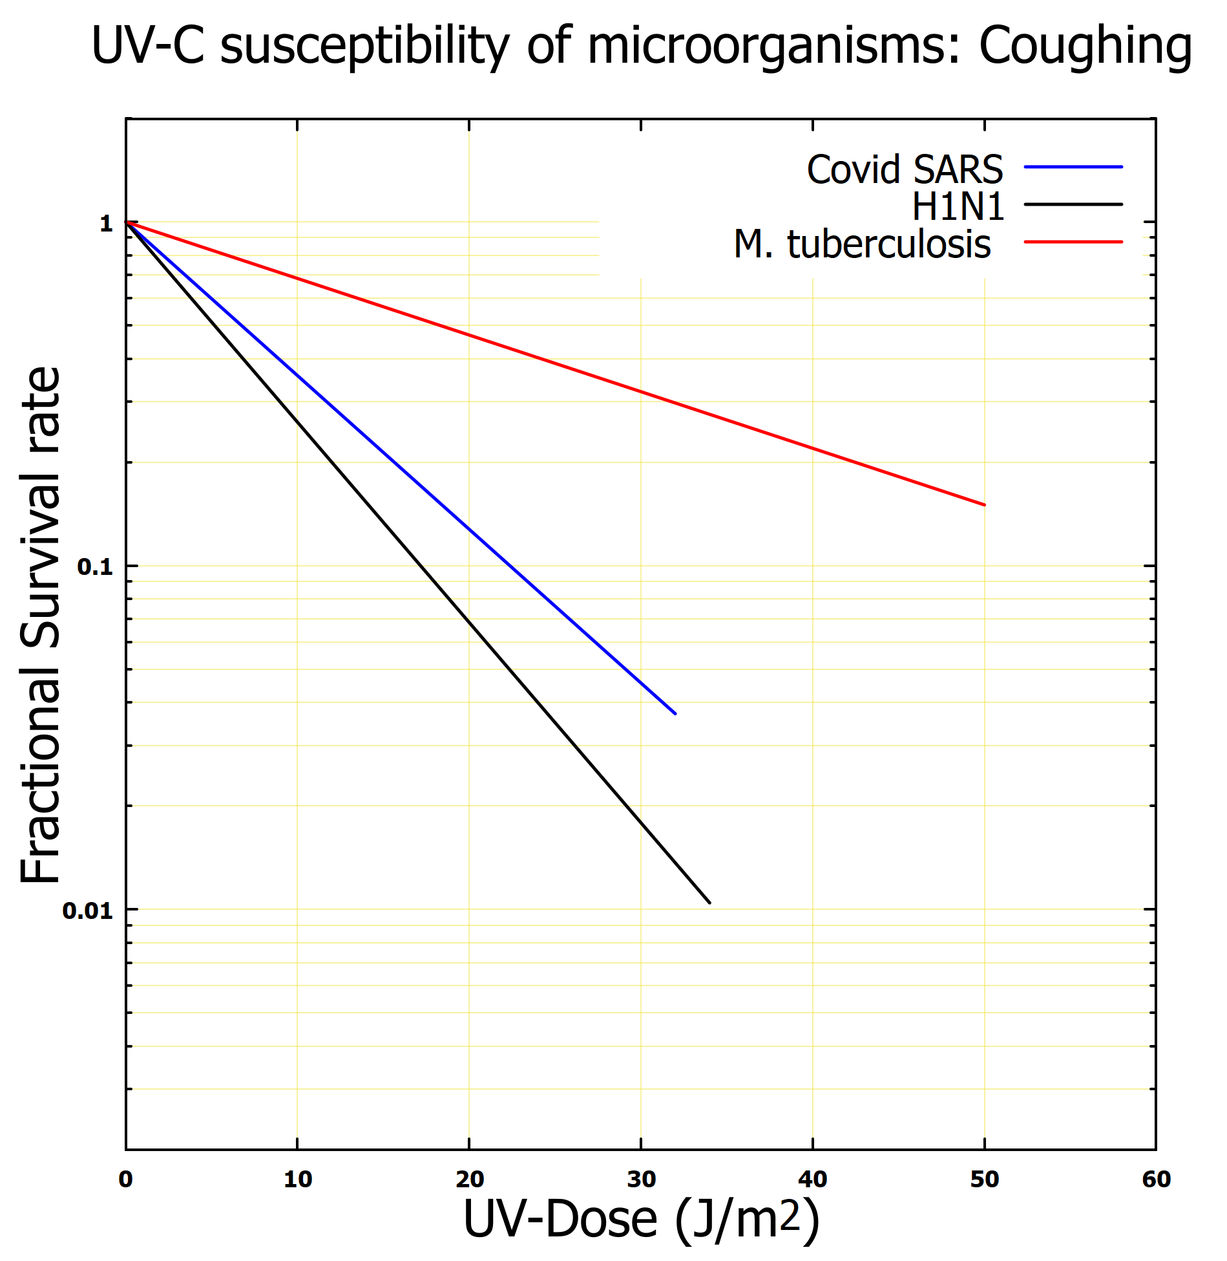
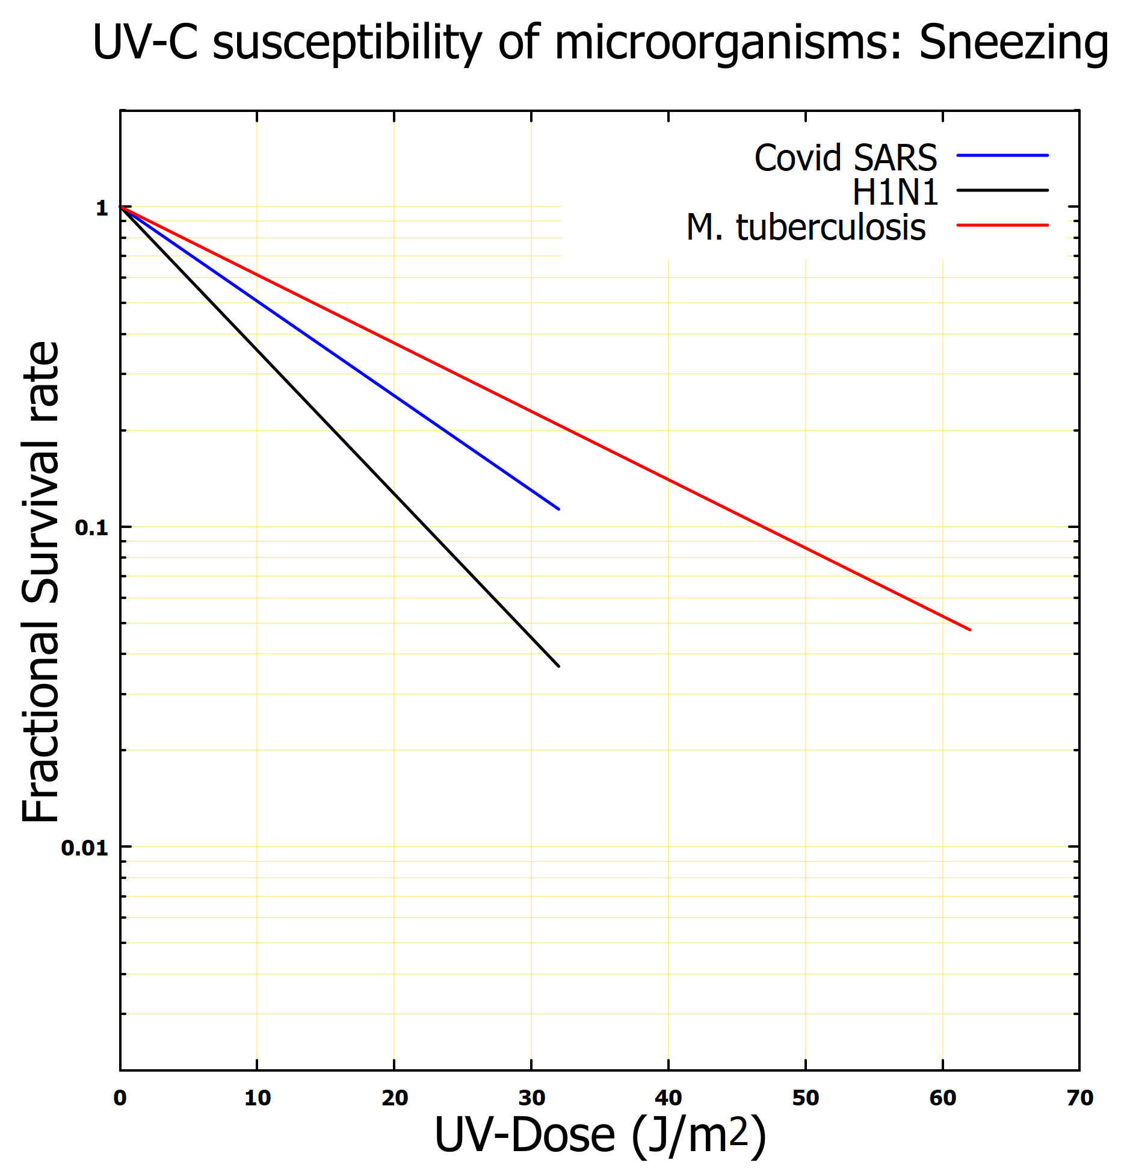
Results
UV-C susceptibility of microorganisms
Fig a: Speaking
Fig b: Coughing
Fig c: Sneezing
The impact of the UV-dose coupled with evaporation at 20% relative humidity suggests
  Irrespective of the method of ejection, the H1N1 influenza virus decreases faster that the SAR-CoV-2 and M tuberculosis.
  At equilibrium UV does of 32 J/m2, the survival rate of the H1N1 is significant reduced compared to SAR-CoV-2 and M tuberculosis.

Slide 29
Summary
The DPM implemented in the computational fluid dynamics in the Fluent v2022 was used to model the survival rate and the infectiousness of microganiams when exposed to UVGI coupled with evaporation in a confined environment .
The model results showed that microorganisms infectiousness reduced as the droplets pass through the UVC energy coupled with evaporation.
The infectiousness of microorganisms decrease faster with a fractional survival rate reduction > 93%.
The model proposed can be used to accurately interpret experimental results involving aerosolized microorganisms.
The results of this report provide insight of an improved method for mitigating the spread of infectious disease and directly improving health care systems
The models can be used to validate engineering interventions as well as form the basis of understanding the control of infectious microorganisms in a confined environment.

Slide 30





Research Outputs

Slide 31






CFD Research Team
Dr Emmanuel Igumbor
Dr Hasina Ralijaona
Katlego Pule
Prof Simon Connell
Matthew Connell
* Kondwani Mwale
*Potential member

Slide 32





Collaborators

