Slide 1
Defect levels induced by defect-complexes in Ge for enhanced Ge‑based device performance
by
Emmanuel Igumbor
Department of Mechanical Engineering Science, University of Johannesburg, Auckland Park, Johannesburg, South Africa
elgumuk@gmail.com

Slide 2
Content
Introduction and motivation
Computational details
Results and discussion
n/p-type impurities defect-complexes in Ge
Trivalent atom defect-complex induced defect levels in Ge
Conclusions

Slide 3
Introduction
Why germanium
Narrow band gap semiconductor (E_{g} = 0.67 eV (RT) 0.78 eV (0 K)).
Using hybrid function (0.78 eV) using local DFT(0 eV)
High (compare to silicon) electron hole mobility.
High level of purity compared with silicon.
low voltage operations.
Key material for next-generation microelectronics.
Applications
Promising material for complementary metal-oxide semiconductors (CMOS) technology [1].
Modern transistors: promising material for the development of metal-oxide semiconductor field effect transistors (MOSFETs) [2].
[2] M. Houssa, A. Satta, E. Simoen, B. De, M. Jaeger, M. Caymax, M. Heyns, Germanium-Based Technologies: From Materials to Devices (2011) 233.
[1] C. Chui, H. Kim, P. McIntyre, K. Saraswat, Technical Digest - International Electron Devices Meeting (2003) 437–440.

Slide 4
Introduction and motivation – Defects in semiconductors
Defects can be detrimental or beneficial,
e.g. they act as efficient recombination centres & affect carrier lifetime:
Fast switches: enhances the switching speed (introduce defect).
Defects can be introduced by:
Crystal growth, cutting and polishing
Processing, e.g.:
Sputter etching, plasma etching
Metallization (electron-beam, sputter deposition)
Unintentional radiation, e.g. in space, reactors, accelerators
Particle irradiation: alpha-particles, electrons, protons, neutrons

Slide 5
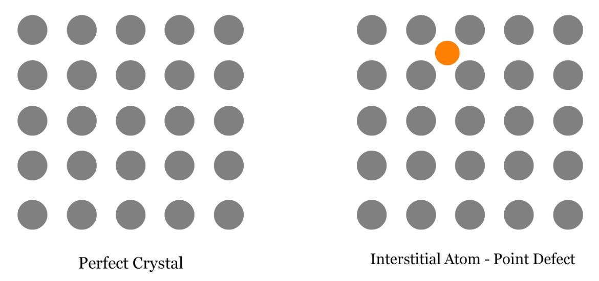
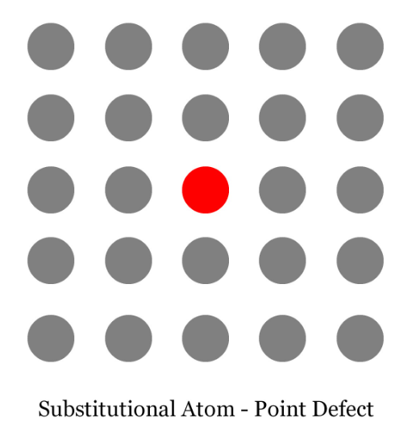
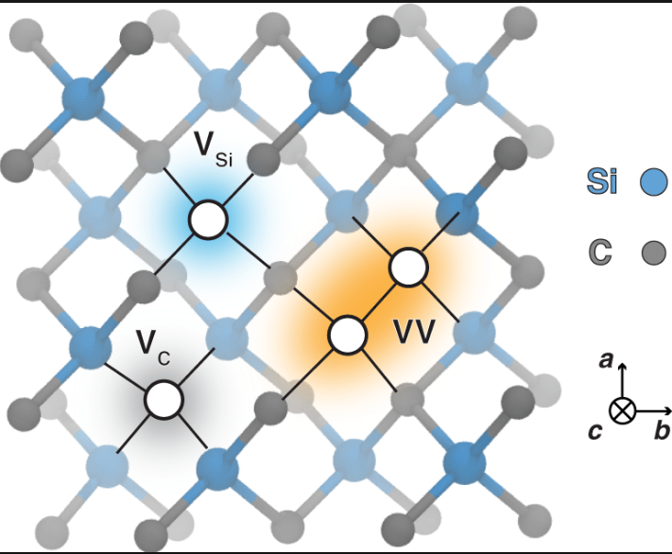
Introduction and motivation – Defects in semiconductors
Well know point defects in Ge are
Interstitial
Vacancy, di- vacancy and multi-vacancy
Doping, substitution and double substitution of external impurities

Slide 6
Computational background
Codes
VASP and Quantum Espresso
Pseudo potential
projector-augmented wave (PAW)
Supercell size
64 atoms
Brilloiun zone sampling
2x2x2 k-points were used centred at gamma position
Energy cut off of 400 eV
Defect-defect interactions
Freysoldt, Neugebauer, and Van de Walle scheme.
Extended Freysoldt correction scheme.

Slide 7
Computational background
HSE
All calculations were performed using the HSE06 hybrid functional with the PBE
The HSE06 approach is a combination of the PBE and the non-local Fock.
In all calculations, a mixing parameter of 25% (fraction of exact Hartree-Fock exchange) and 0.2 A^−1 screening parameter were used

Slide 8
Computational background
Formation energy calculation
$E^{F}$(d,q) = E(d,q) - E(pristine) + $∑{\left(∆n\right)}_{i}μ_{i}$ + $q$($E_{V}+ε_{F}$) +$E_{Cor}^{q}$
1
Where:
$E^{F}$(d,q) is the formation energy of a defect d in charge state q.
E(d,q) is the total energy of a defect d in charge state q.
E(pristine) is the total energy of pristine Ge.
$μ_{i}$ is the chemical potential of type ith atom.
$E_{V}$ is the valence band energy.
$ε_{F}$ is the Fermi energy.
$E_{Cor}^{q}$ is the correction term.

Slide 9
Computational background
Charge state transition levels calculation:
Binding energy calculation:
$ε(q/q^{′})$=$\frac{E^{F}\text{(}\text{d}\text{, }\text{q}\text{; }ε_{F}\text{=0) − }E^{F}\text{(}\text{d}\text{, }q^{′}\text{; }ε_{F}\text{=0) }}{q^{′}−q}$
2
$E_{binding}$= $\sum_{i}^{n}{E_{}^{F}\left(isolated defects\right)i}$-${ E}_{}^{F}$ $(defect−complex)$
3

Slide 10
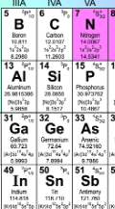
Introduction and motivation – Defects in semiconductors
Defect-complexes in Ge
Defect-complexes are point defects that significantly influence the geometric, optical, and electrical properties of materials.
Defect-complexes are known to improve the electronic and electrical properties of Ge.
Deep and shallow defect levels in Ge have been linked to defect-complexes formed by the double self-interstitials and rare earth atoms.
Despite this breakthrough, several defect-complexes in Ge are not well understood; hence may pose as a challenge to the optimal performance of Ge based devices
n/p-type defect-complexes in Ge

Slide 11
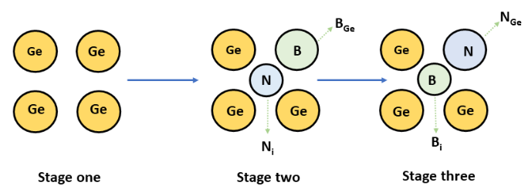
Results and discussion – Defect-complexes
n/p-type impurities defect-complexes in Ge: concept
Schematic representation of the n/p-type impurities (top panel), crystal Ge
(Stage one), substitution and interstitial defect-complexes, B_{Ge}N_{i} (Stage two) and N_{Ge}B_{i} (Stage three)
Al_{Ge}P_{i} and P_{Ge}Al_{i}
As_{Ge}Ga_{i}, and Ga_{Ge}As_{i},
Sb_{Ge}In_{i} and In_{Ge}Sb_{i}

Slide 12
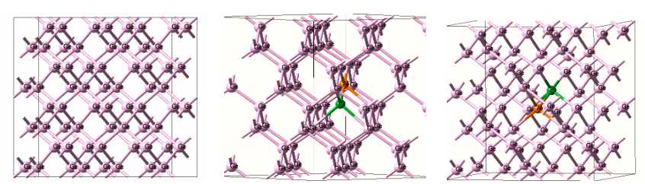
Results and discussion – Defect-complexes
Geometrical structures
(a) pristine Ge supercell (b) Al_{Ge}P_{i} and (c) P_{Ge}Al_{i}.
For the As_{Ge}Ga_{i}, Ga_{Ge}As_{i}, Sb_{Ge}In_{i} and In_{Ge}Sb_{i}, the relaxed bond lengths for the As-Ge, Ga-Ge, In-Ge and Sb-Ge are 2.48, 2.52, 2.59 and 2.70 ˚A, respectively. These relaxed bond lengths significantly increased by 0.02, 0.06, 0.13 and 0.24 ˚A, respectively,
The Al_{Ge}P_{i}, P_{Ge}Al_{i}, N_{Ge}B_{i} and B_{Ge}N_{i}, the relaxed bond lengths for Al-Ge, P-Ge, N-Ge and B-Ge atoms, respectively. reduced significantly by 0.07, 0.18, 0.42 and 0.35 ˚A, when compared with that of Ge-Ge bond length.
This suggests that the introduction of the impurity atoms Al, P, N and B on Ge atom lattice sites caused the surrounding host atoms to relaxed inward

Slide 13
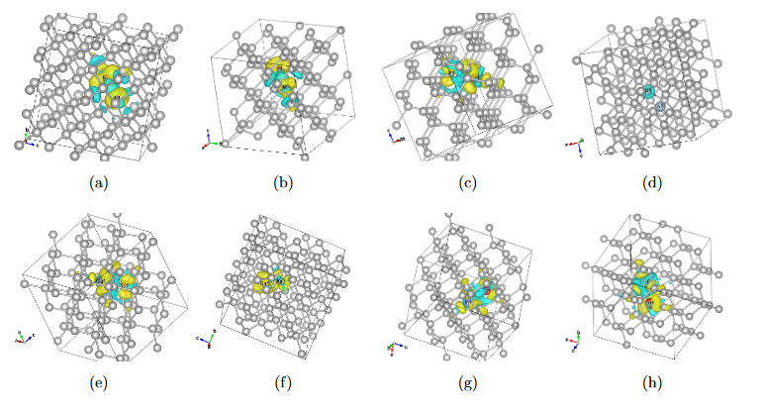
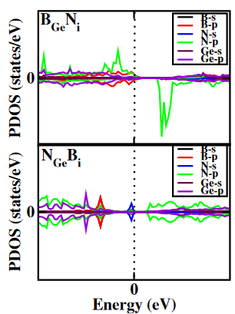
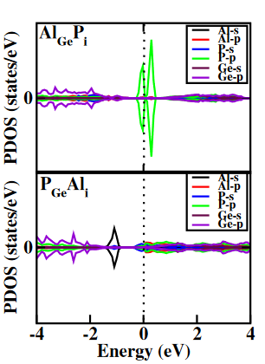
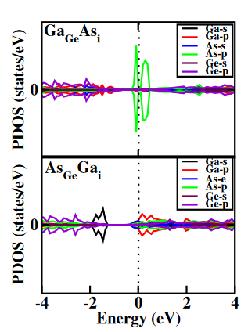
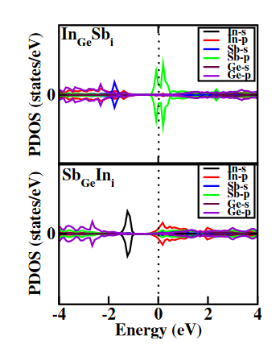
Results and discussion – Defect-complexes
Electron distribution and PDOS
Plots of isosurface of charge density difference (a) B_{Ge}N_{i}, (b) N_{Ge}B_{i}, (c) Al_{Ge}P_{i}, (d) P_{Ge}Al_{i}, (e) Ga_{Ge}As_{i}, (f) As_{Ge}Ga_{i}, (g) In_{Ge}Sb_{i} and (h) Sb_{Ge}In_{i}.
Partial density of states (PDOS) for the B_{Ge}Ni and N_{Ge}Bi, Al_{Ge}P_{i} and P_{Ge}Al_{i} , Ga_{Ge}As_{i} and As_{Ge}Ga_{i} and In_{Ge}Sb_{i} and Sb_{Ge}In_{i}
For the B_{Ge}N_{i}, the minority and majority spins are highly asymmetric, suggesting the possibility of spin polarisation
For the B_{Ge}N_{i}, N_{Ge}B_{i}, Al_{Ge}P_{i}, P_{Ge}Al_{i}, Ga_{Ge}As_{i} and As_{Ge}Ga_{i}, the charge (e−) on the interstitial(substitution) atoms are -1.75(1.00), -0.33(-1.19), -0.80(1.60), 1.30(-0.81), -0.18(0.27) and 0.35(-0.40), respectively
The introduction of defects, induced mid gap states in Ge
The In_{Ge}Sb_{i} and In_{i}Sb_{Ge}, amongst others are excellent n-type semiconductors.

Slide 14
Results and discussion – Defect-complexes
Formation and binding energy
There is a possibility of defect-complexes to decompose into non interacting defects B_{GeNi}
Other defect-complexes are stable with respect to their binding energies
The defect-complexes with B and N are usually with high formation energy
The combination of Al and P yielded the lowest formation energies

Slide 15
Results and discussion – Defect-complexes
Electrical defect levels
The (+1/0) for the In_{Ge}Sb_{i} is an important defect level, which could ionize at room temperature (300 K) and improved the donation of electrons to the conduction band
The (+1/0) defect level of the Al_{Ge}P_{i} is deep and acts as a recombination centre thereby reducing the carrier's lifetime.
Plots of formation energies as a function of the Fermi level. The slope of each plot corresponds to the charge state transition level.
The Ga_{Ge}As_{i} and As_{Ge}Ga_{i}, are charge state thermodynamically stable in their neutral charge state. No electrical active level induced

Slide 16
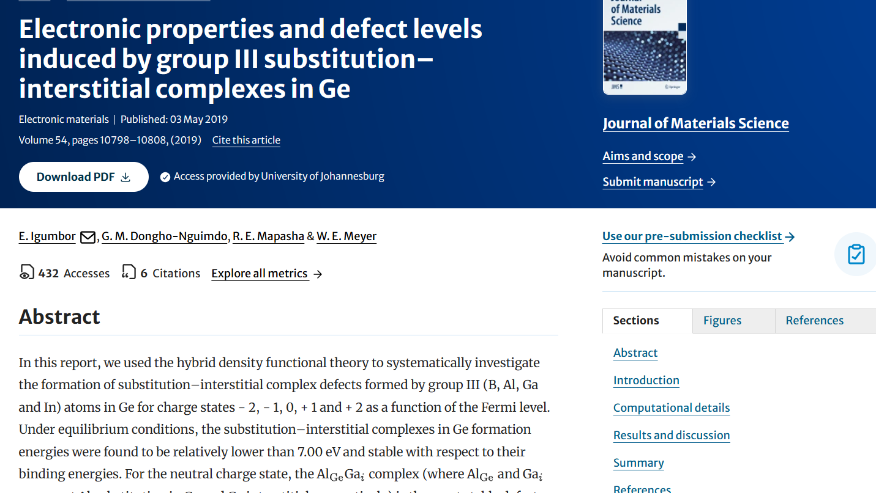
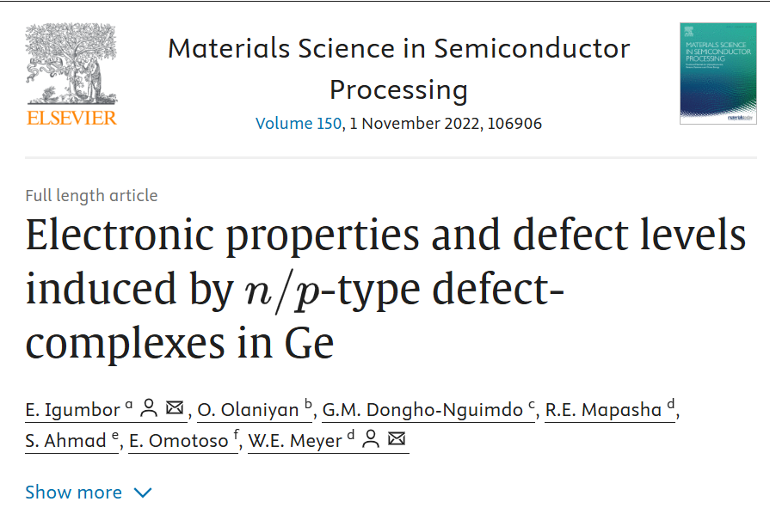
Results and discussion – Defect-complexes
Igumbor, E., et al. Journal of Materials Science 54.15 (2019): 10798-10808.
Igumbor, Emmanuel, et al. Materials Science in Semiconductor Processing 150 (2022): 106906.

Slide 17
Results and discussion – Defect-complexes
Trivalent atom defect-complex induced defect levels in germanium for enhanced Ge‑based device performance
High-energy particles, such as electrons, protons or ions, are used to irradiate germanium crystal, leading to the formation of defects. Such defects may migrate, annihilate or aggregate during annealing
Trivalent atoms have been used for doping of materials for the realization of p-type semiconductors.
The trivalent impurities introduced as interstitials significantly enhance diffusion activity in Si.
Research has revealed that the electron transport and recombination properties of SiC nanotubes are influenced by the presence of trivalent atoms.
Doping of group IV atoms (Si, Ge) with trivalent atoms boron (B), indium (In) and gallium (Ga) increases the number of holes in Si and Ge.
Furthermore, trivalent doping has been used to establish the energy and spatial distribution of intrinsic hole traps in dry thermal silicon dioxide as well as charge-compensating defects in Ge

Slide 18
Results and discussion – Defect-complexes
Trivalent atom defect-complex induced defect levels in germanium for enhanced Ge‑based device performance
To achieve a high-quality Ge-based electronic device, the influence of defect complexes in the host materials must be well understood and controlled
There is lack of information on the trivalent atom substitutional and interstitial defect complexes in Ge.
Considering the applicability of Ge in modern electronic devices, it is important that a detailed study of the trivalent atom substitutional and interstitial defect complexes be carried out:
To provide information of their induced defect levels and
How they may be controlled during device fabrication.

Slide 19
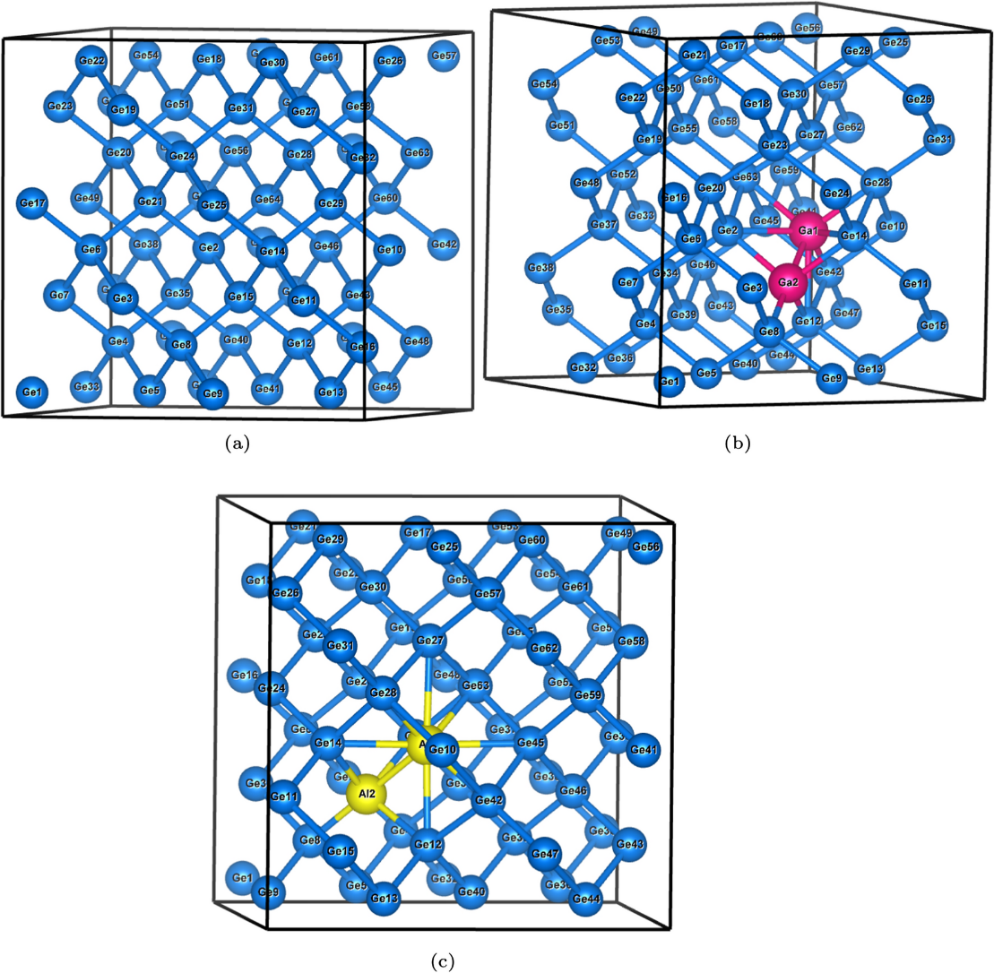
Results and discussion – Defect-complexes
Geometric representation
Relaxed geometric structure of (a) pristine Ge, (b) Ga_{Ge}Ga_{i}, and (c) Al_{Ge}Al_{i}.

Slide 20
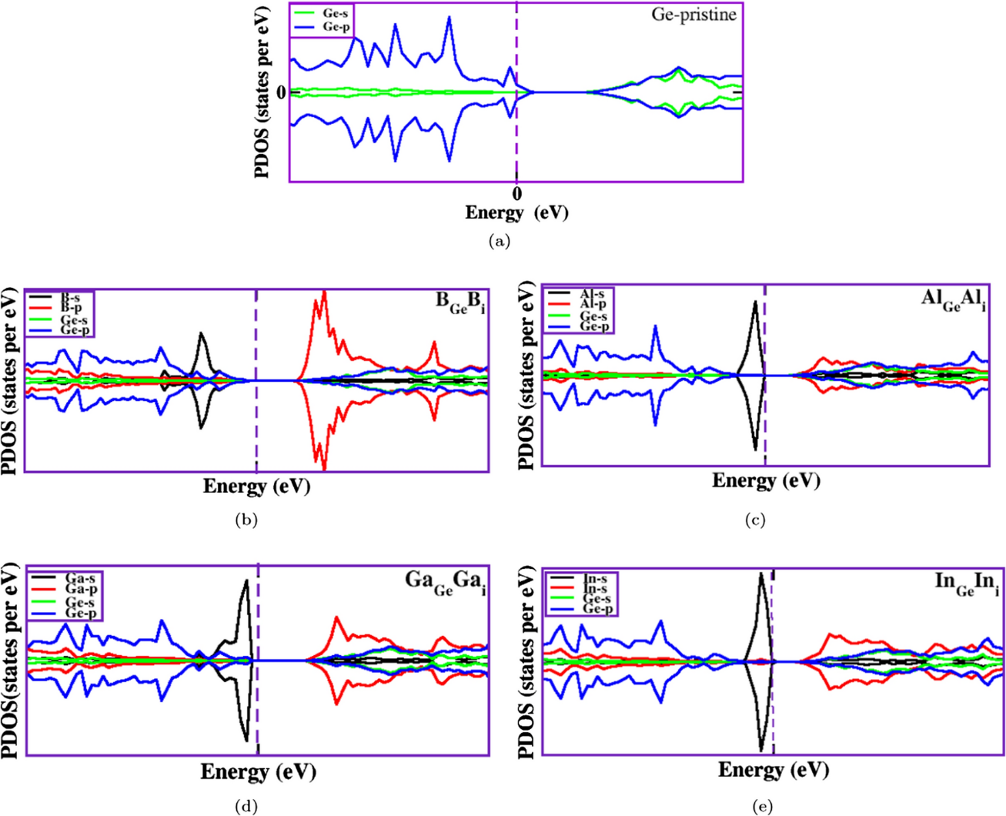
Results and discussion – Defect-complexes
Electronic properties: PDOS
All the defects considered exhibit a p−type semiconducting characteristic, and their Fermi levels are situated close to the valence band.
The majority of carriers are mainly holes.
The majority and minority spins are symmetrically aligned, suggesting a lack of spin polarization.
Such defects in Ge may not be courted for device applications where spin dependence is required.
Plots of partial density of states (PDOS) of the trivalent atom substitution-interstitial defect complexes in Ge: (a) pristine Ge; (b) B_{Ge}B_{i}; (c) Al_{Ge}Al_{i}; (d) Ga_{Ge}Ga_{i} and (e) In_{Ge}In_{i}. The Fermi level is set to zero and is represented by the dashed line.

Slide 21
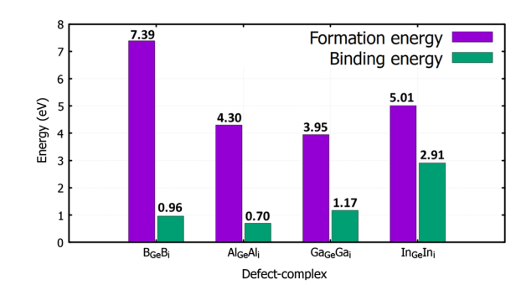
Results and discussion – Defect-complexes
Binding and formation energies
The energy of formation and the binding energy in eV of the trivalent atom substitution-interstitial defect complexes in Ge at e_{F}= 0.
The B_{Ge}B_{i} , Al_{Ge}Al_{i} , Ga_{Ge}Ga_{i} and In_{Ge}In_{i} , under equilibrium conditions, were energetically favourable.
This suggests that the substitutions and interstitials of the B, Al, Ga and In atoms bound with Ge atoms as complexes.
Igumbor, Emmanuel, et al. Journal of Electronic Materials (2024).

Slide 22
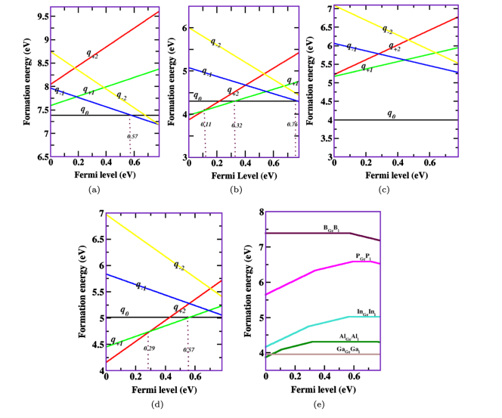
Results and discussion – Defect-complexes
Electrical active defect levels
For the (+1/0) of the Al_{Ge} Al_{i} , the (+1/0) and (+2/+1) of the In_{Ge}In_{i} increase in the concentration of electrons (holes) leads to an increase in the recombination rate.
Reduces the lifetime carriers
Under equilibrium conditions, the (0/−1) charge state transition energy level of the Al_{Ge}Al_{i} can ionize at relatively energy lower than 3 $kBT$ ($kB$ is the Boltzmann constant).
Plot of formation energy as a function of the Fermi energy for the substitution-interstitial defect complexes formed by the trivalent atoms in Ge: (a) B_{Ge}B_{i} ; (b) Al_{Ge}Al_{i} ; (c) Ga_{Ge}Ga_{i} ; (d) In_{Ge}In_{i} ; and (e) short representation of all the possible thermodynamic charge state. transition levels.
Igumbor, Emmanuel, et al. Journal of Electronic Materials (2024).

Slide 23
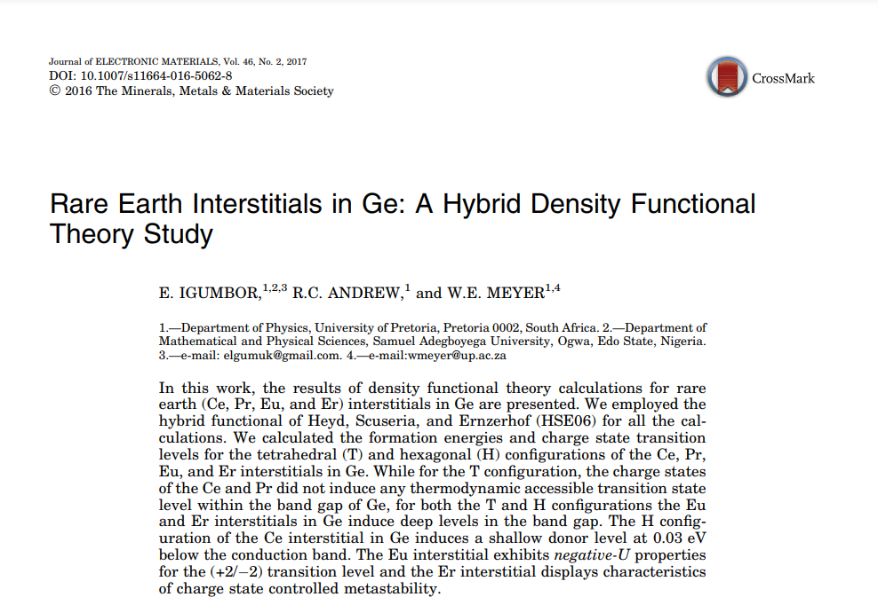
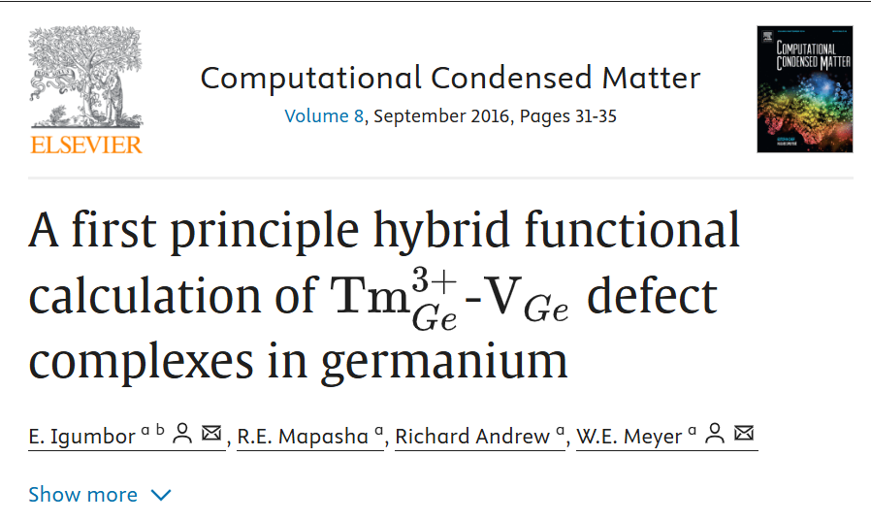
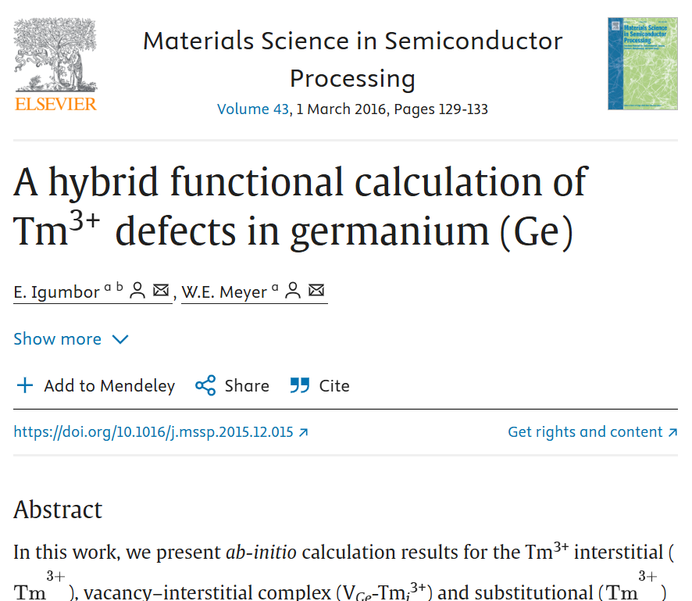
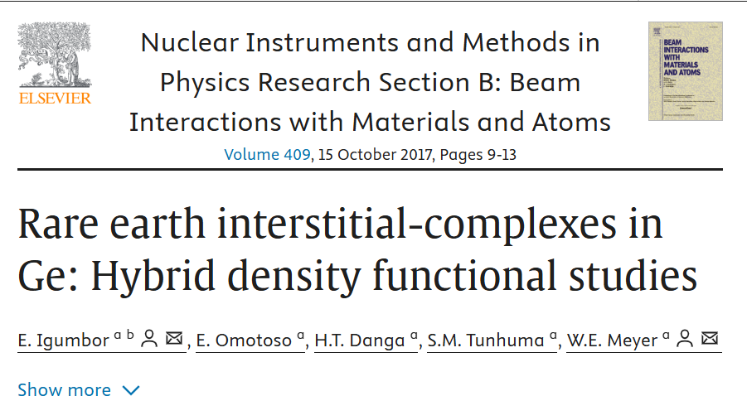
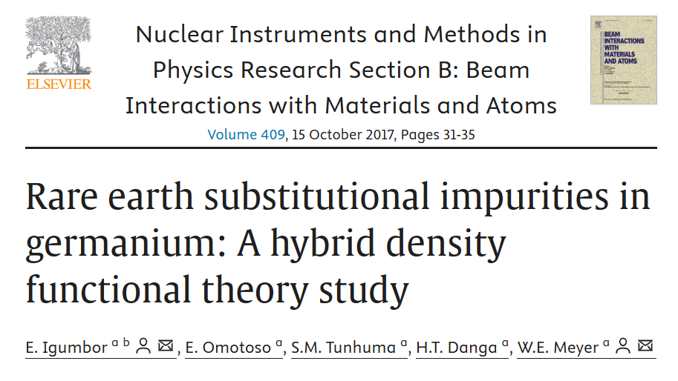
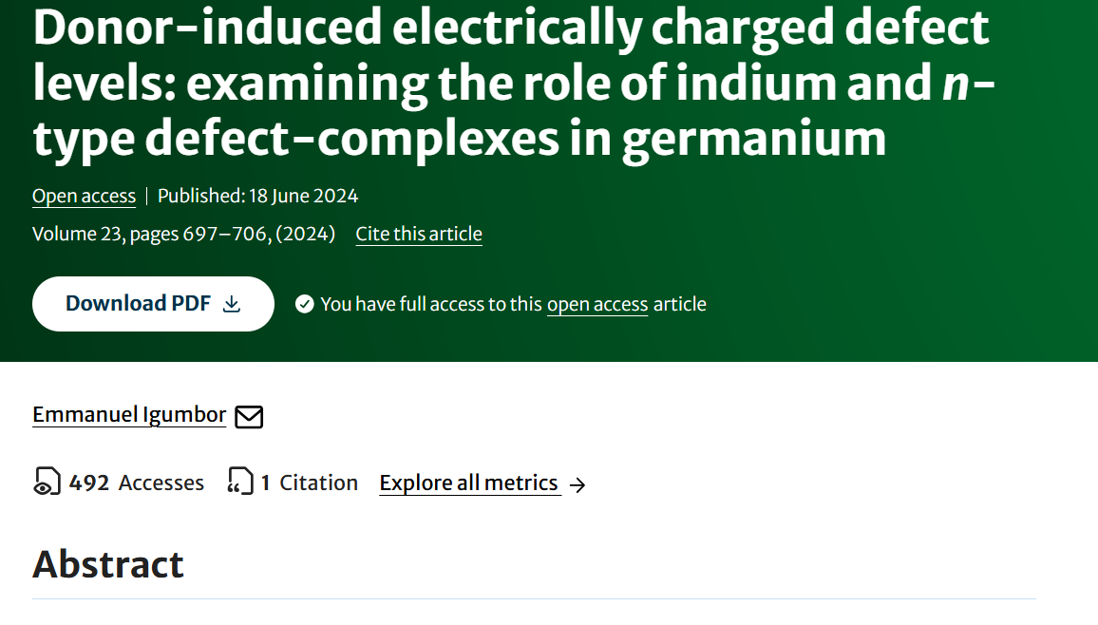
Results and discussion – Defect-complexes

Slide 24
Summary
Hybrid functional has been used to study the structural, electronic and charge state transition properties of defect-complexes in Ge.
The results provide new insights on the theoretical prediction defect-complexes in Ge.
The incorporation of n/p-type interstitial and substitutional defect-complexes critically influence the properties of Ge. Thus, providing essential information that are useful during the implantation processes as well as Ge-based device engineering.
It is expected that the data and information presented will be useful in the process modelling of Ge-based devices

Slide 25
Collaboration
Acknowledgement

